Slide 1
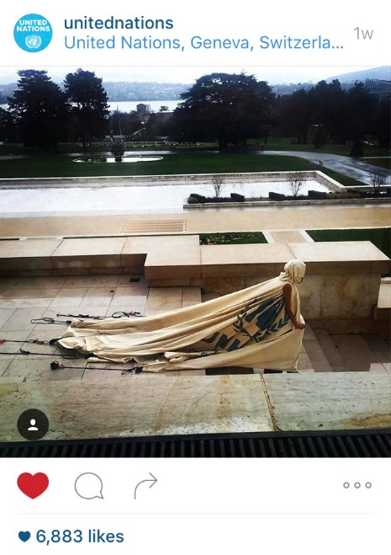
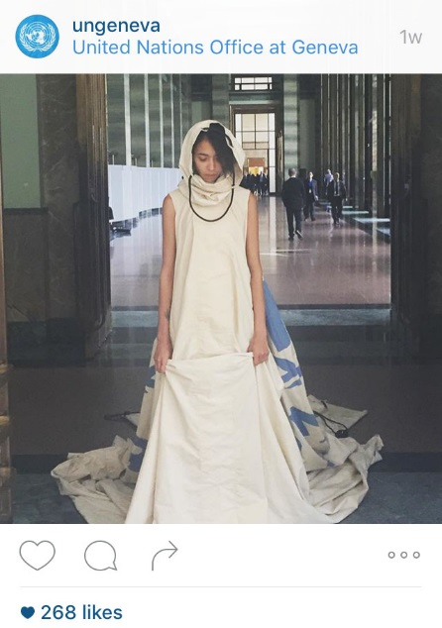
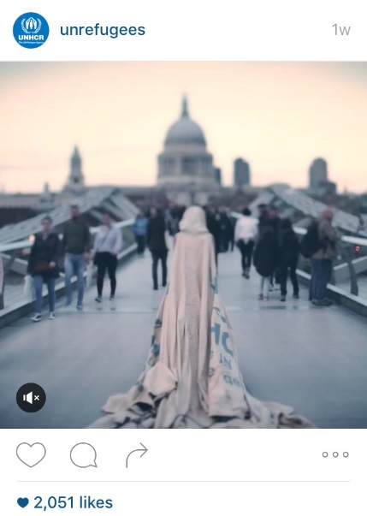
Social Media Impact in Geneva
TEDxPlacesDesNations Event: 1,000 people in the audience, 21 viewing parties worldwide 3,000+ people watching live
Instagram reach: over 731,000 users – an increase of around 600,000 since November
Total social media reach: estimated at over a million users
Twitter comments:
“Dear #dress4ourtime, In love with this masterpiece for #TEDxNations! It speaks volumes.”
“#dress4ourtime - a refugee tent from ZaatariCamp given a second life to send a powerful message… ”
“It's Beautiful & it's powerful what you've delivered through art! #Dress4OurTime #TEDxNations #UNHCR”

