Slide 1
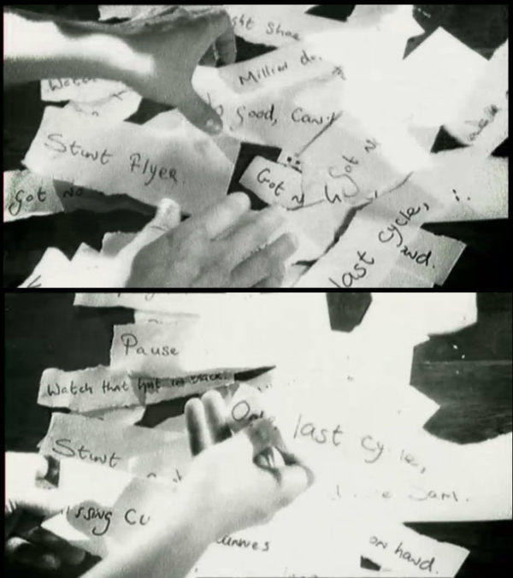
Breaking Into and Out of Academic Writing
THE CASE FOR DADA IN THE ACEDEMIC ESSAY
Location
Room D115
Central Saint Martins
Granary Building, 1 Granary Square
London N1C 4AA
‘The researcher is not ‘dependent on the categories of established theory and technique but constructs a new theory of the unique case’ (Schön 1983: 68).
Notes:
Hello and welcome then brief introduction and first task. Link to the writing café and the emergence of the idea.

Slide 2
AIMS
Empowerment & Agency by implementing a creative strategy in writing, allowing words/ideas to be manipulated physically by creatives in different ways from writing.
Originality; Innovation; To write about ones own creative practices; To create meaning; To avoid contrivance.
The method emphasizes editing after the act, rather than excessive planning and procrastination.
To force synthesis literally and brutally between texts.

Slide 3
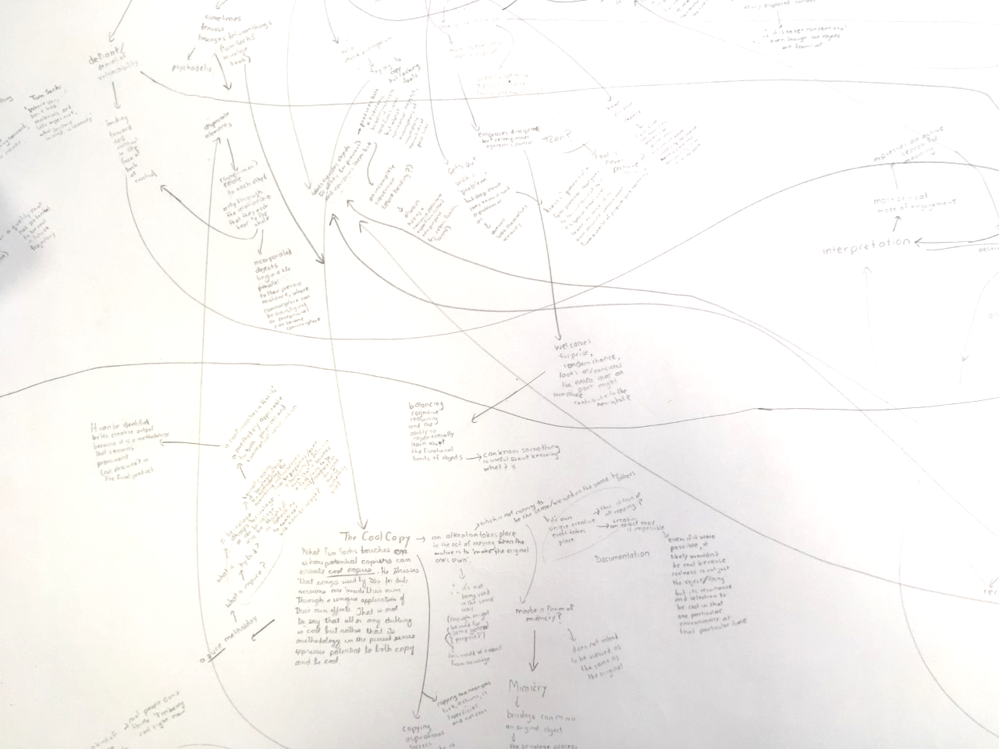
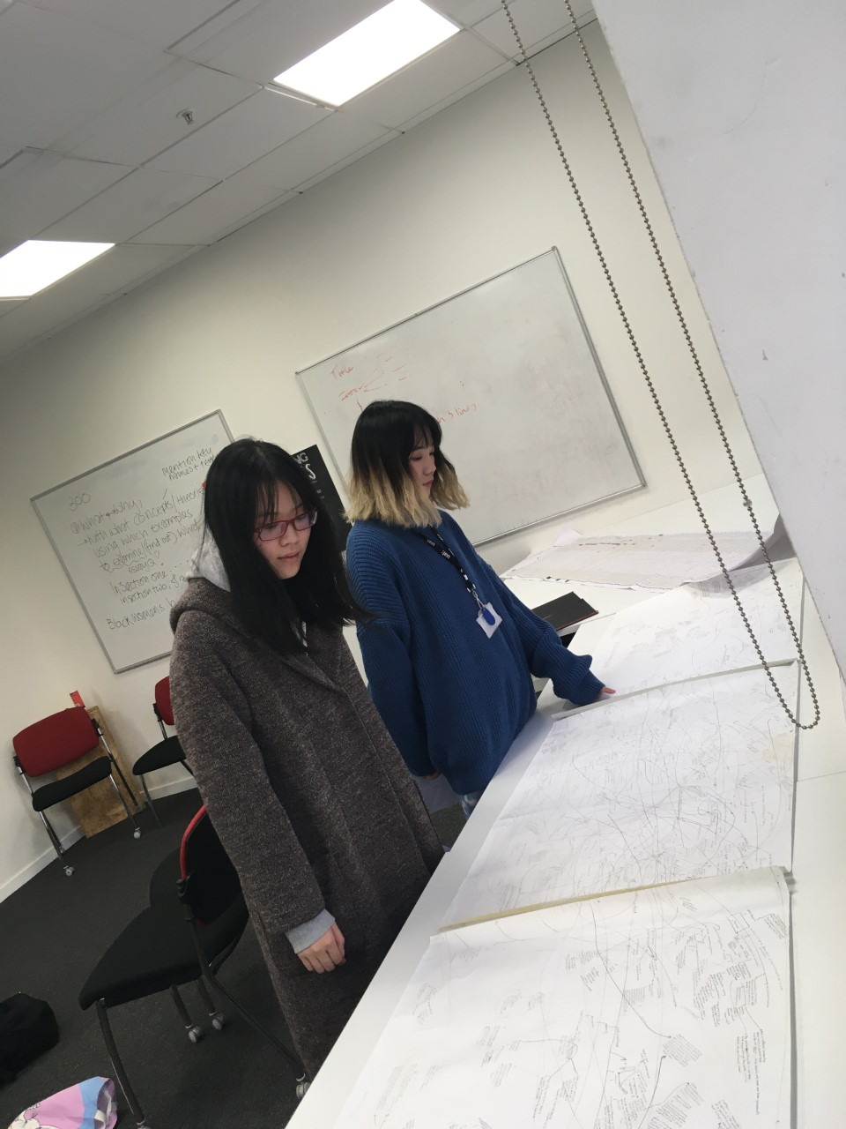
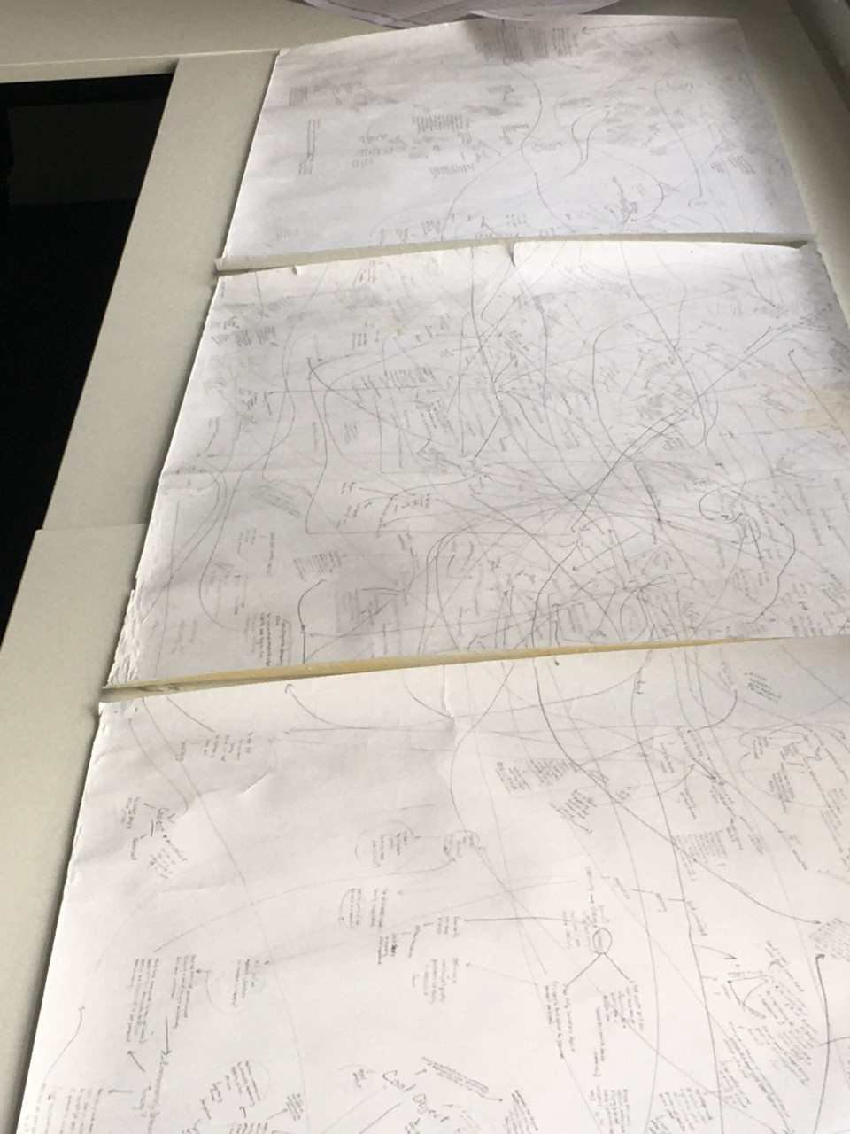
This method might be placed along with mind-mapping as a tool for the creative entering into an ‘oppositional and dialogic approach’ (Melles and Lockheart, 2012:350).
Students at UAL examine Dr Fortais’s complex mind-map at the November writing Café (2019).
Mind-mapping or Synaptic diagrams are an established creative method as developed and popularized by Buzan (1974); These are useful but are still highly conscious affairs and prone to contrivance. Dada methods force true randomness into the process of writing.

Slide 4
There are a range of academic and theoretical sources which underpin this session in particular Diaz (2011).
Creating unique and engaging design requires methodical research and experimentation. Quantitative and qualitative research methods borrowed from the humanities and social sciences, for example, have proven effective in yielding knowledge about behaviour throughout the design process.
However, they have yet to offer ways in which to bring forth and deliver new and creative results. Situations where there is a need to develop innovation and find new solutions require different methods. (Diaz, 2011: 21)
Key here are the artistic methodologies developed by Dada artists and further developed by Burroughs, W.S and Gysin, B (1978).

Slide 5
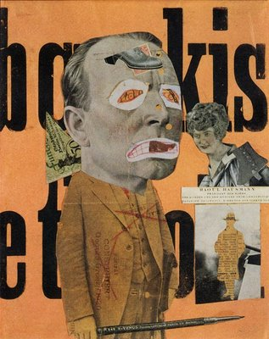
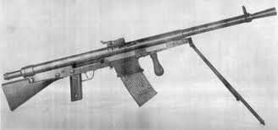
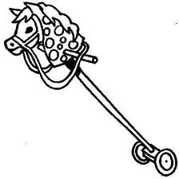
Dada 1916-1922
What's in a name?
Da da Da da Da da Da da Da da Da da ...
‘Dada which some say meant hobby horse in French’
Hausmann ‘The Art Critic’
Der Kunstreporter (Kunstkritiker), 1919
Although sources debate this it seems self evident that the word was chosen at random and kept for its ambiguous associations and plosive sound.

Slide 6
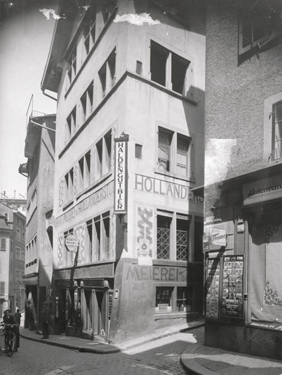
The Cabaret Voltaire
Dada had a strong identity it was a formed by friends at the Cabaret Voltaire a Nightclub in Zurich 1916, these artists and writers would put on performances for the public and share their Ideas.
(The Cabaret Voltaire served its purpose; to cement a movement, but it only lasted one year, then artists moved off to different locations around Europe such as Paris and Berlin.
The site of Hugo Ball's nightclub, ‘Cabaret Voltaire’

Slide 7
The Approximate Man I speak about who speaks who speaks I am alone I am not that a small noise I have several noises in me a ruffled noise frozen with the crossroads thrown on the wet pavement with the feet of the men in a hurry running with their dead around death which extends its arms on the dial of the hour only alive in the sun
ORIGINATOR
Tristan Tzara 1896-1963
Tzara is credited as the originator of the cut-up technique from his How To Make a Dadist Poem (1920) by in the Dada Manifesto.
short-lived journal Chemarea

Slide 8
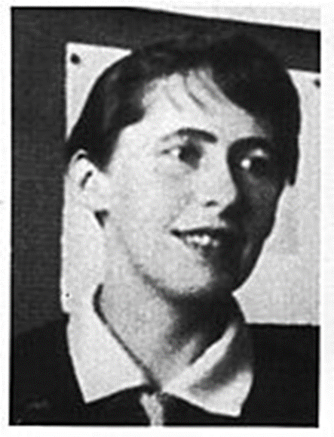
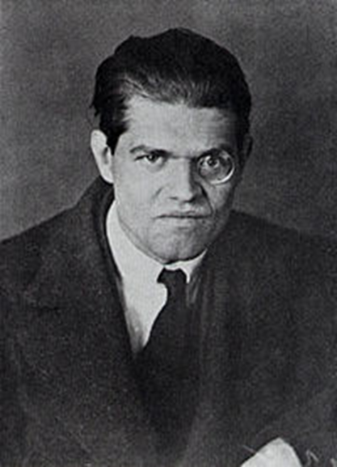
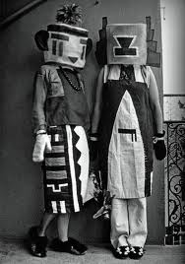
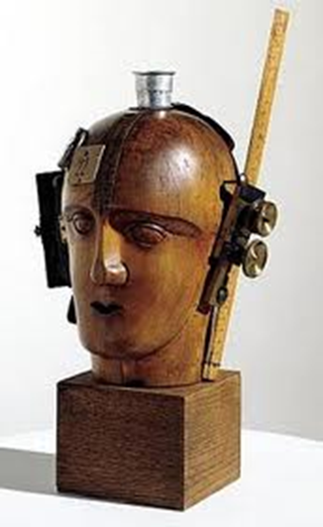
Sophie Taeuber-Arp 1889-1943
Sensibilities in the writing found expression in artworks and vice-versa.
Emmy Hennings 1885-1948
Raoul Hausmann, 1886-1971
Hugo Ball 1886-1927
Katzen und Pfauen (Cats & Peacocks)
baubo sbugi ninga gloffa
siwi faffa sbugi faffa olofa fafamo faufo halja finj
sirgi ninga banja sbugi halja hanja golja biddim
mâ mâ piaûpa mjâma
pawapa baungo sbugi ninga gloffalor
Dancer
To you it's as if I was already
Marked and waiting on Death's list.
It keeps me safe from many sins.
How slowly life drains out of me.
My steps are often steeped in gloom,
My heart beats in a sickly way
And it gets weaker every day.
A death angel stands in the middle of my room.
Yet I dance till I'm out of breath.
Soon lying in the grave I'll be
And no one will snuggle up to me.
Oh, give me kisses up till death.
Assemblage
Mechanical Head [The Spirit of Our Age], assemblage circa 1920
‘Kachina costumes’ made by Sophie, 1922
http://www.dailymotion.com/video/x1xd5l_hugo-ball-seahorses-and-flying-fish_music

Slide 9
Choices could be made about which texts to use, combine and order can be imposed at any point where convenient. Terms could be written out and then mixed up and selected.
Cut-Up Tzara
Fold-In technique
Gridding technique
Redacting technique
Chance, randomness and chaos is introduced to generate content. The process though offers control over objects/fragments in a physical way.
Control after the act.
Editing by moving, adding words or taking words away.
Making lists of implications or links searching for/creating meaning.
Combing the technique with mind-mapping.

Slide 10
1. Select a text
2. Use a cut-up technique
Cut-Up Tzara
Fold-In technique
Redacting technique
Gridding technique

Slide 11
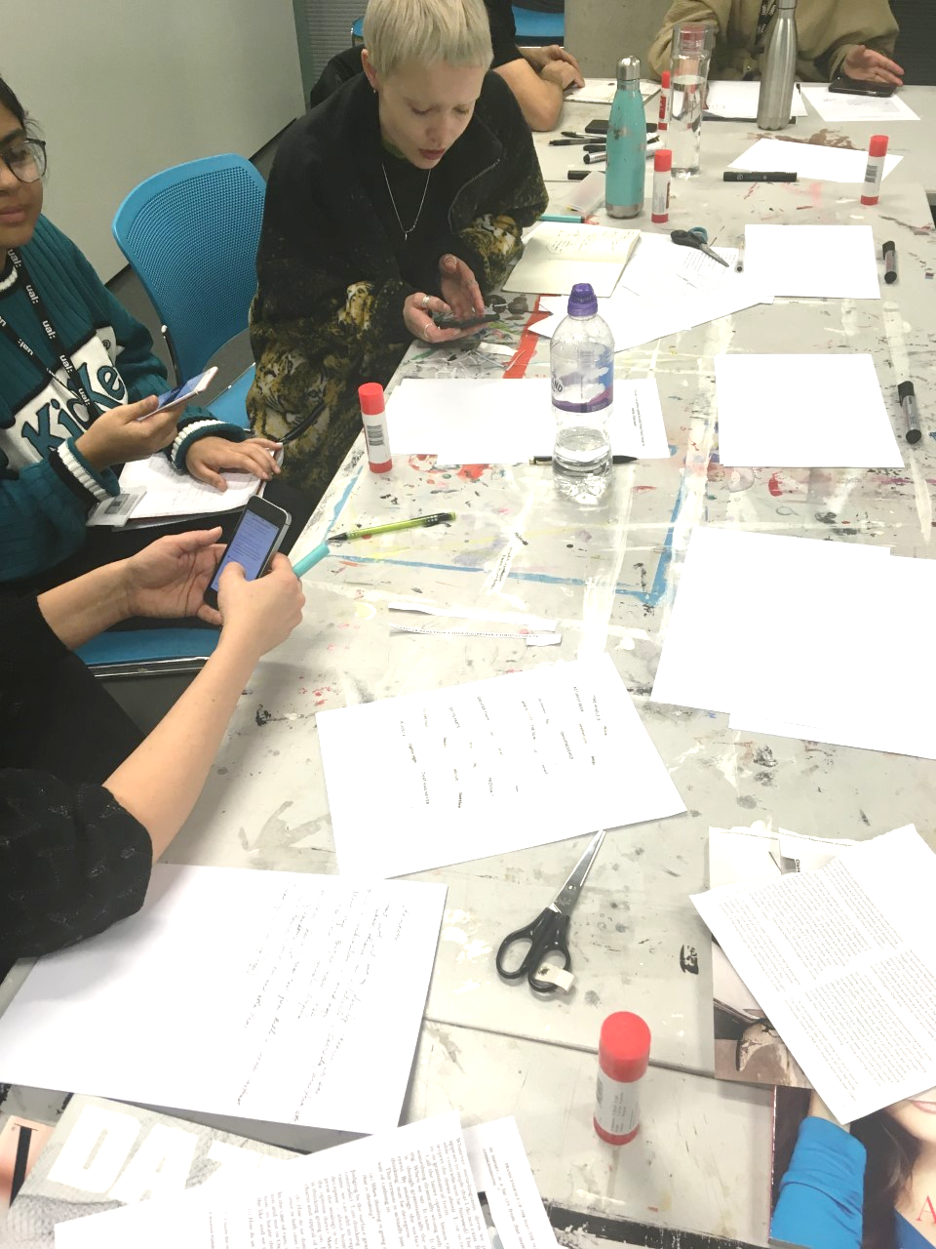
Cut-Ups William S. Burroughs
Nelson and Stolterman (2003: 16) have advocated a design culture and a first new tradition where design is seen as the ability to imagine ‘that-which-does-not-yet exist, and make it appear in concrete form as a new, purposeful addition to the real world’. (Diaz, 2011:22)
Participants research and apply Burroughs adaptations to the Cut-Up

Slide 12
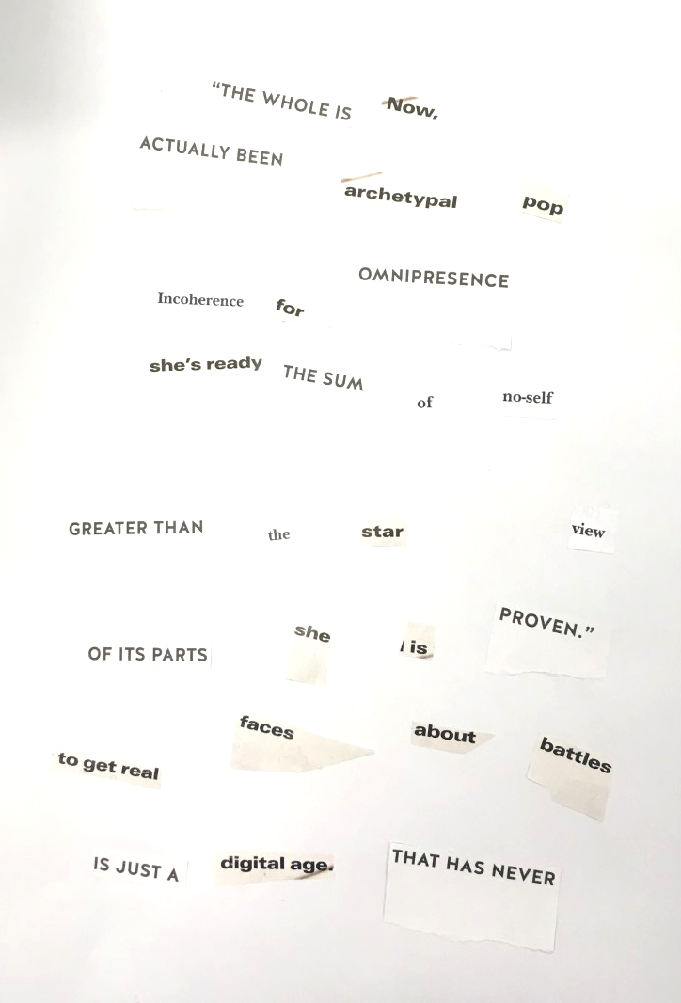
Unifying and Connecting Strategy
From experience of students in academic support there is a need to unify practice and theory and overcome the schism that often persists. This separation is a false dichotomy and here we propose a method to reconcile the two writing, and practice.
Text
Cut-up
Outcome
Feed in to practice
Feed in to writing
To see the text as:
Reducible.
Divisible.
In can be:
Refashioned.
Reformed.
These are all things you would teach in critical reading.
Example of participant cut-up (2019)

Slide 13
Looking for links
The use of chance is, in my opinion, compatible with the currently held notion of design as goal-oriented behaviour, enacted with the intention to produce a given result. Throughout the activity of design, the designer posits an objective and procures and utilizes the means to achieve it (Diaz, 2011:22).
Sharples (1999) appears to be stating a similar case for a design based, less constrained form of writing he speculates about the application of this in a contemporary context; while later being clear that even planned writing ‘also makes use of chance discovery’ (1999:10).
A writer need no longer be portrayed as a solitary thinker grappling with ideas, but as a member of a design team situated in a rich environment of colleagues, resources and design tools. Writing as design leads us towards new forms of authoring, such as multimedia design on computer, where text is woven into a rich interaction of form and function (Sharples, 1999:10)

Slide 14
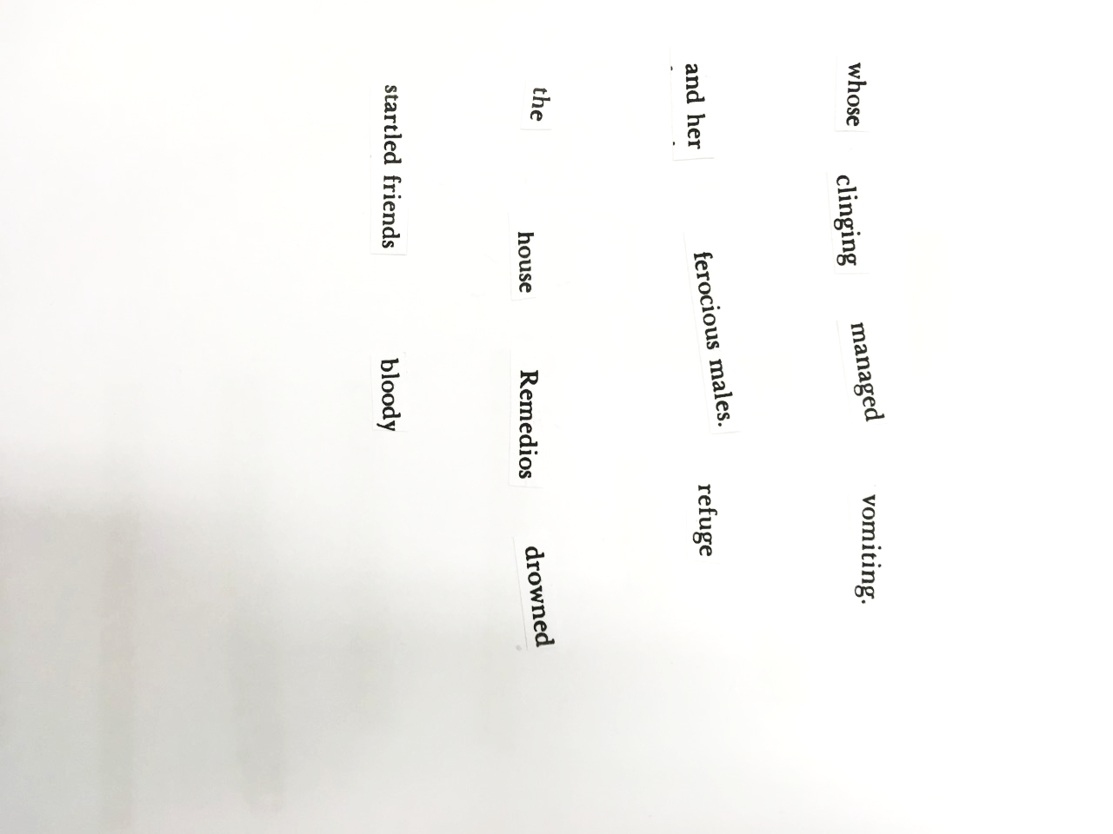
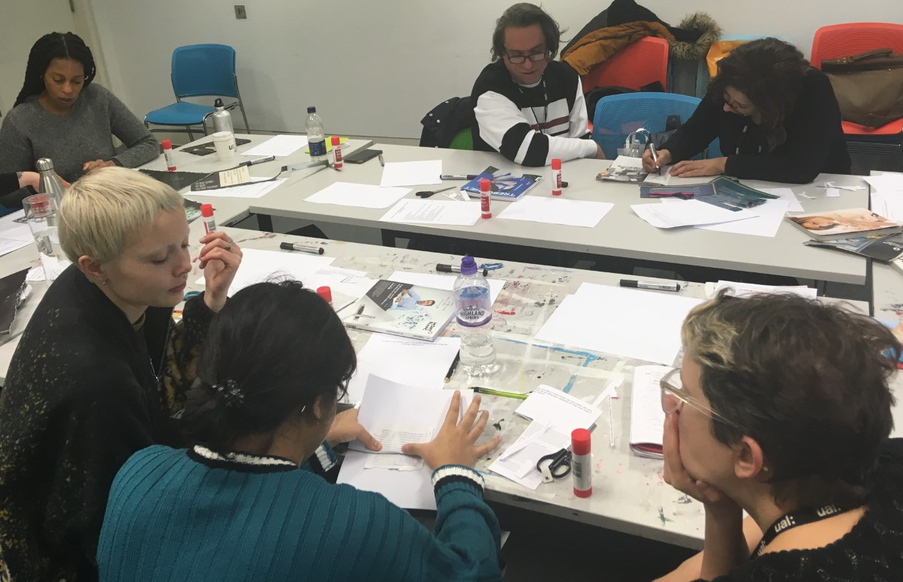
Co-creative Slides
Needless to say the topic touches on the territory of human agency. In the present text, however, I choose to focus on practical reasoning, or knowledge and understanding as approached from an experiential, tacit and embodied perspective. (Diaz, 2011:22).
Left: Participants working together to create texts. Above: Example of participant cut-up (2019)

Slide 15
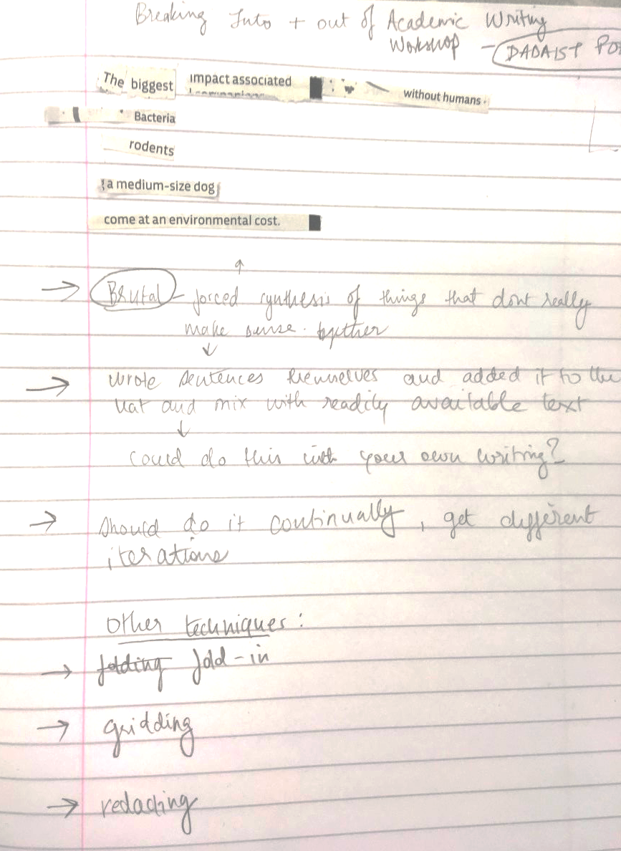
Co-creative Slides
Feedback from the session; how might these methods be used by students?
Generating titles, inventing categories and imposing categories; generating frameworks and subheadings to then connect.
Perhaps use ones own notes IE implement the strategy further down the line after some initial paraphrasing and notation has happened.
To formulate ideas/ include ideas; an initial process combined with mind mapping.
Contrast to formal aligning, more fun; offers a way to breakdown apprehension; encourages the editors mind of recognising quality when it occurs.
Randomness is a quality attributed to outcomes, such as things and events lacking predictable pattern(s), or purpose. According to Gregory Bateson, without a source of randomness, no system (mechanical or organic) could produce anything novel (Diaz, 2011:23).
Example of participant cut-up combined with notes (2019)

Slide 16
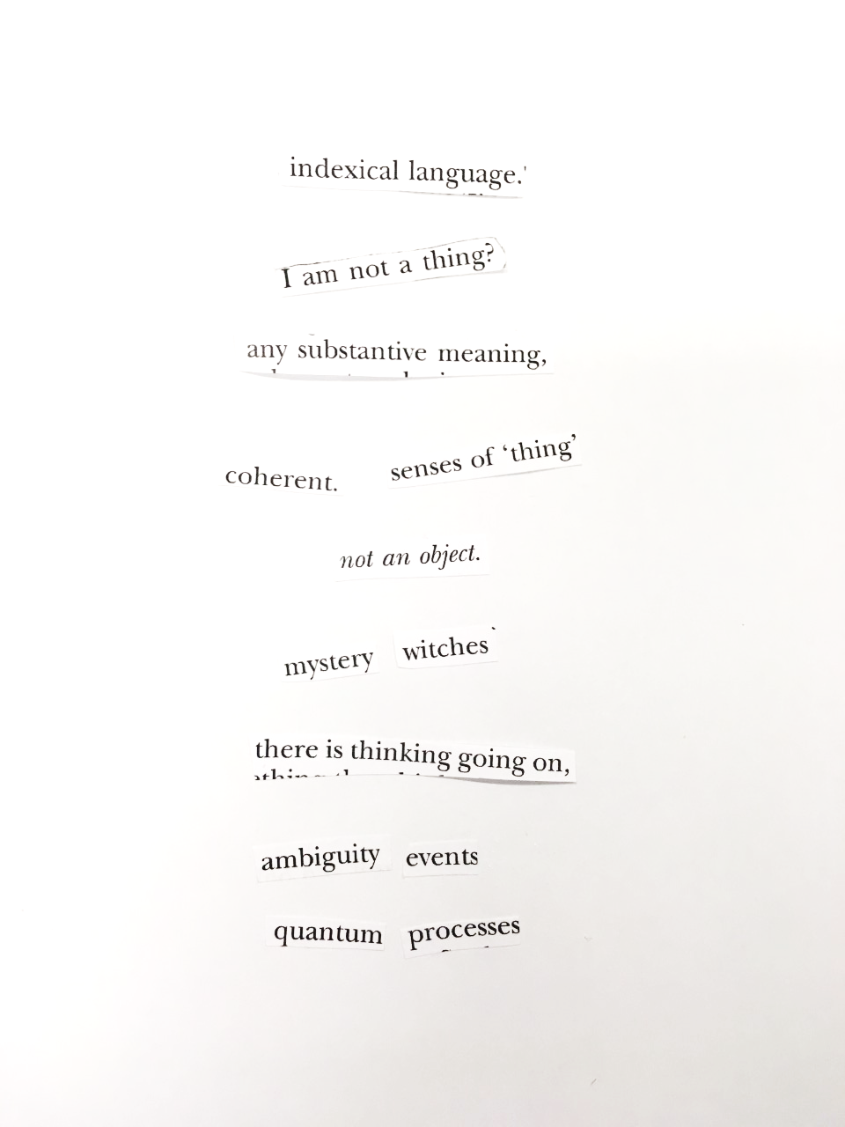
Meticulous planning vs random occurrence
Co-creative Slides
One noted case was in the early twentieth century when artists involved with Dadaism used chance and randomness to create art that
expressed their opposition to society and critiqued the traditional notions of artistic mastery and excellence (Diaz, 2011:23).
Most writing involves deliberate planning, but it also makes use of chance discovery. Engaged writing produces texts that become the source material to inspire contemplation and constrain deliberate planning (Sharples, 1999:10)

Slide 17
PADLET WALL
Select a sentence of text from anyone of your works and upload it to the Padlet wall where we can construct a collaborative text.
Upload your selection here
https://padlet.com/michaeleden123/nvb1zow7d36s

Slide 18
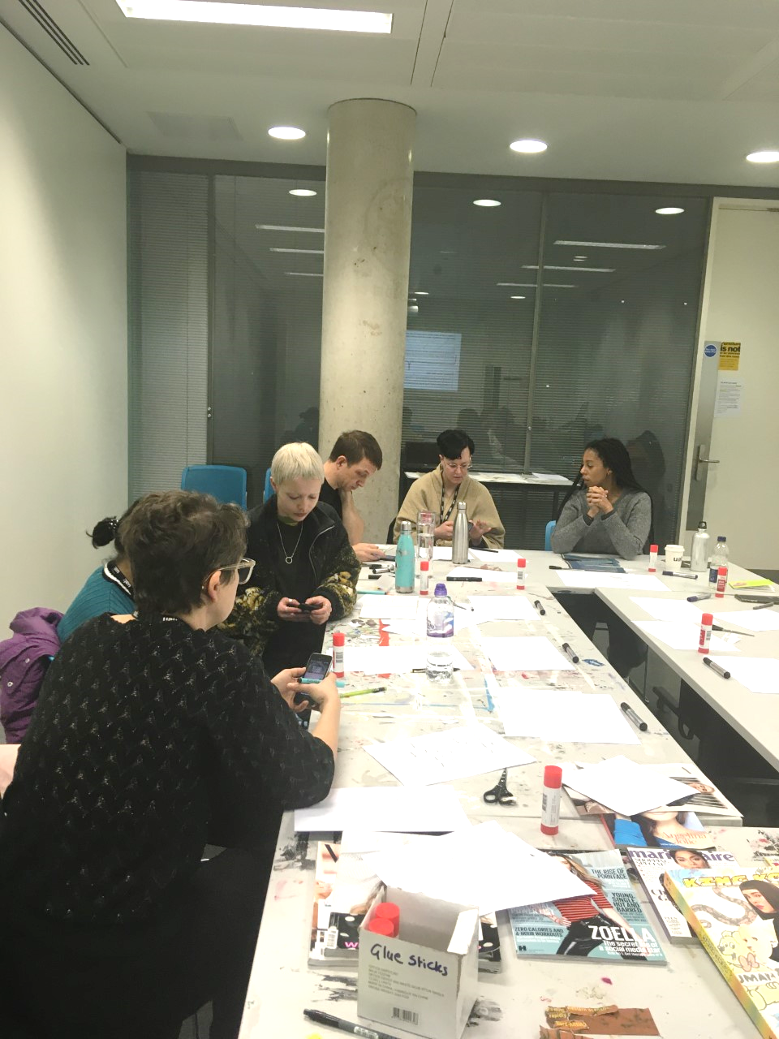
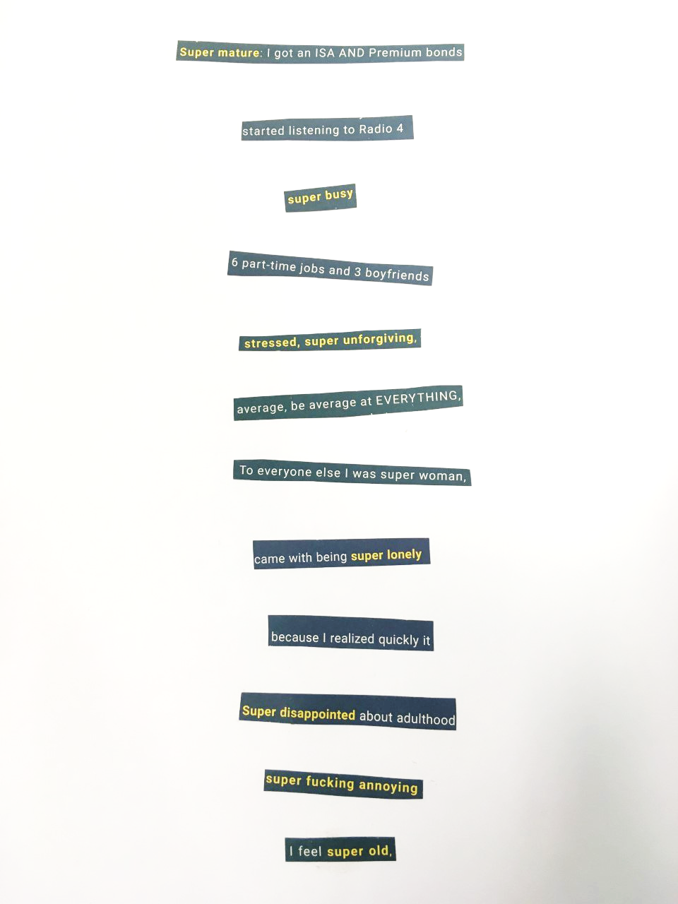
Participants working and discussing ideas (2019)

Slide 19
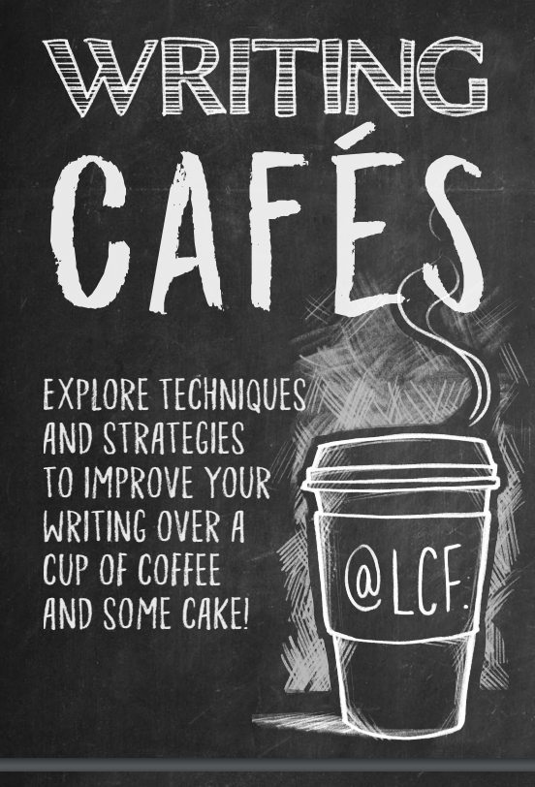
Relaxed, casual atmosphere Chat to other students about writing Speak to library and academic support staff about writing All of this, plus coffee and cake!

Slide 20
Feedback Link
https://forms.office.com/Pages/ResponsePage.aspx?id=xClkjH8We0e4y3fugnWNEYf_6dkO0DtGuYl9NiXRxHBUOUJVRU5RRjkxNlJCSDI3U1FDOFNVSjNEWCQlQCN0PWcu
Your thoughts and feedback is important; please do follow this link and add your comments which will be studied by the organisers and those delivering this session ☺

Slide 21
References
Bl.uk. (2019). P B Shelley, 'Ozymandias'. [online] Available at: https://www.bl.uk/learning/timeline/item126940.html [Accessed 2 Dec. 2019].
Burroughs, W.S and Gysin, B (1978) The Third Mind. Viking Press.
Buzan, T (1974) Use Your Head. London, BBC Books.
Derounian, J (2011) Academic writing: why does it have to be so dull and stilted, www.theguardian.com, accessed on: 26/11/19. Accessed at: https://www.theguardian.com/higher-education-network/blog/2011/nov/14/academic-writing-dull-stilted
Devlin, Kieron (2016) Is the academic essay becoming a fossil through lack of authorial voice? The case for more stylish and exploratory writing. Spark: UAL Creative Teaching and Learning Journal, 1 (1). pp. 34-40. ISSN ISSN 2397-6594
Díaz, L (2011) By chance, randomness and indeterminacy methods in art and design, Journal of Visual Art Practice, 10:1, 21-33.
Elderfield, J (1983) Publication excerpt from The Modern Drawing: 100 Works on Paper from The Museum of Modern Art, New York, The Museum of Modern Art.
Herbst, H (2014) The ABC’s of DADA. Cinegrafik, 1968. Youtube. 22 May 2007. Web. 20 Nov. 2014. Acessed on 26/11/19. Accessed at: https://www.youtube.com/watch?v=2LXxHiKxPwM
Lewis, P (2007) The Cambridge Introduction to Modernism. Cambridge University Press.
Lockheart, J. and Wood, J. (2019). Writing-PAD | Journal-Mission-and-Aims. [online] Writing-PAD. Available at: http://writing-pad.org/Journal-Mission-and-Aims [Accessed 29 Nov. 2019].
Motherwell, R. (1951). The Dada Painters and Poets: An anthology. Edited by R. Motherwell. New York, Wiltenborn, Schultz.
Rothman (2014) Why Is Academic Writing So Academic? The New Yorker.com Accessed on 26/11/19. Accessed at: https://www.newyorker.com/books/page-turner/why-is-academic-writing-so-academic
Schön, D. A. (1983), The Reflective Practitioner, How Professionals Think in Action, New York, NY: Basic Books.
Schwab, M and Borgdorff, H (2014) The Exposition of Artistic Research Publishing Art in Academia, Leiden University Press.
Sharples, M (1999) How We Write, London, Routledge.

Slide 22
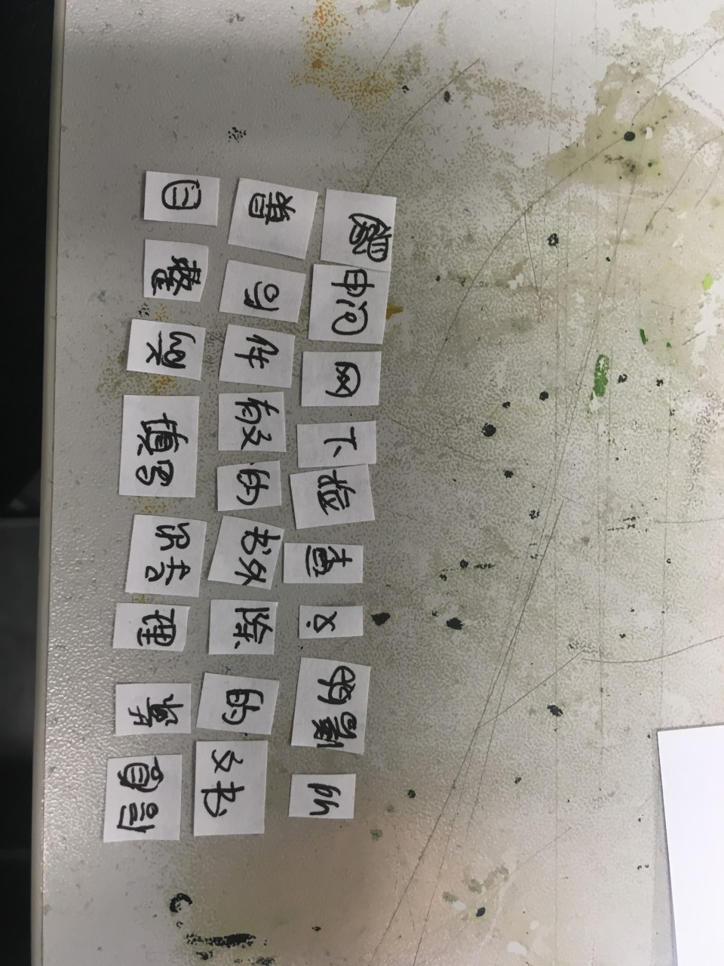
We will need a translator to discover what this cut-up means. ☺

