Slide 1
Other Voices Collaborative Learning and Publishing
DEL conference Toronto 2018
Frania Hall

Slide 2
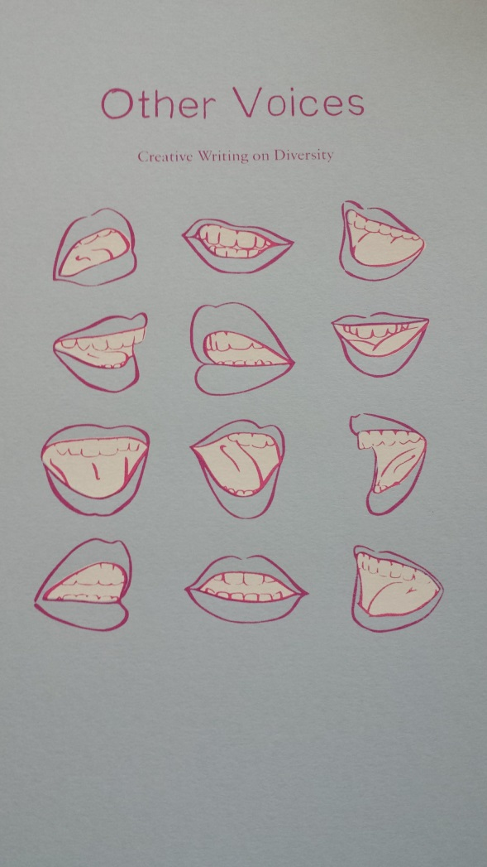

Slide 3
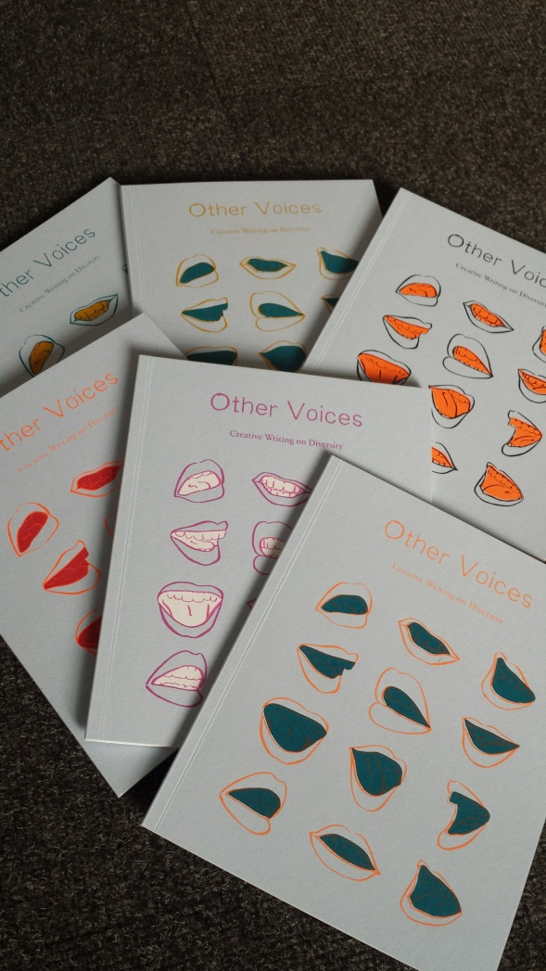

Slide 4
One project - many different student experiences
Cross-disciplinary
Co-creative

Slide 5
Teaching case study
Teaching and Learning funded project UAL teaching and learning exchange
Exploring pedagogy of learning through narrative and creative writing
Student-centred - Encourage students who see themselves as belonging to 'minorities' to express themselves
‘Equality of condition’ framework
Experiential approach to a critical intervention privileging unrepresented voices - diversity/inclusion and publishing house simluation
Combination of disciplines in this two stage project to support voices being heard

Slide 6
INCLUSIVITY - We’re interested in…
What students are experiencing
How they are learning
Seeing how, within this project, we can combine these two things.
Self-expression – what they are experiencing, how they can express it and how they can share it, recognise the relevance of their personal narratives
Learning from narrative – sense-making, how they learn from each other, how they can encourage empathy, problem solving, making connections
= resilience, self-belief, gaining voice, sharing/advocacy.
We as teachers learn from them about their lives in their words

Slide 7
Who we are
Dr. Susan Flynn –Susan lectures across the Communications and Media programme at LCC, merging her interest in egalitarian theory and practice with topics such as media theory, visual culture, globalization, media industry practice and creative writing.
Frania Hall – Frania is course leader MA Publishing, previously 20 years in publishing. Teaching and Learning Lead for Media School LCC. Currently undertaking PhD in creative digital collaborations in publishing.

Slide 8
What is ‘Other Voices’
A unique collection of short stories and poems from a diverse student community exploring creative writing as form of self-expression.
This is a collaborative student project based at LCC, UAL.
Creative writing from the BA Contemporary Media Cultures and BA Media Communications students is published in print and digital by the MA Publishing students.
The project took place during 2017-2018.

Slide 9
The project stages
Dr. Susan Flynn – centre of the project - ran creative writing workshops offering writing tuition and a supportive environment in which to explore alternative narratives, narrative as cognition, celebrating self identity, finding solutions in visualising and articulating their situations or problems they face with dominant ideologies
Frania Hall - extension for the project - once the pieces had been written we took on the role of a publishing house –simulating editorial meetings, production meetings, timescales and budgets. Refining through editorial processes, designing, making production choices with budgets
Both stages – students can set own learning agendas

Slide 10
Pedagogy
Role of narrative in cognition
Generation x and z – participation, digital connection and content creation
Constructivist –active role of learner, student centred
Inclusive pedagogy
Digital participation – digital and analogue flow
Aspects of attainment
Social process of learning: Situated learning (participating in a community): (Lave and Wenger 1991)
Experiential learning - concrete experience – reflection – conceptualisation - active experimentation, Kolb 1984

Slide 11
Freire 1996
‘the fruit of the lived experience of these students as individuals’
‘It is knowledge extracted from pure experience…’
‘respect and stimulus for the creative capacity of the learner’

Slide 12
Gerrig 1993
‘All readers are capable of performing the cognitive activities that enable them to be transported to narrative worlds’
Readers experience narrative and move to the author’s temporal and social situation

Slide 13
Bhaskar (M) 2013
‘Publishing isn’t a passive medium’
It is important to understand ‘The role of publishing as an act of mediation’
Framing, filtering, amplification
Act of curation
Digital publishing encompassed by this definition

Slide 14
Bickel & Jensen 2012
Many students ‘will experience cultural dissonance. Universities can be a guide to all these learners if they establish programs that help these learners to find their supporting values’

Slide 15
New generation and new styles of learning – content creators (Rosen)
Use of digital environments
Recording of own journeys/experience
Continuously making content
Consume user-generated content
Collective reflection and sharing
Important therefore to insert this sort of content into learning
New generation learners increasingly learn best from being actively involved in their learning and constructing their own learning around a project

Slide 16
Why does this resonate with edge effects
Through participants, agency and actions
Analogue and digital – working environments, disseminating voices, digital agnosticism
Narratives of different cultures– individual and shared
Bridging differences through different forms of expression
Sharing transitional experiences
Alternative lived experiences
Collaborative working – sharing, extending
Publishing is largely a digitally-enabled making process – even with print as outcome

Slide 17
From Susan’s introduction
‘Rich and complex experiences which shape our students’ lives’
‘The outlooks and ideologies of the texts and materials used to teach do not reflect the lived experiences of our students’
‘Privilege the voices of students and their complex and fascinating viewpoints’

Slide 18
What are the edges?
Gender
LGBT
BAME
Mixed race
UK/International
Single parent families
First to university
Mental illness

Slide 19
What are they facing?
Racism
Struggling to find mental well being
Alone in a city
Away from home
Finding place
Transition – child to adult
Absence
Escape

Slide 20
What have they overcome?
Accidents
Loss
Suicide attempts
Coming out
Looking for safety

Slide 21
What are their contexts?
Boxing
Hip hop (commentary)
Being on the tube
Migrant away from family (empathy)
Backpacking
Surfing

Slide 22
Creative writing
Students’ expressed feelings
Actions through the workshops
Exclusion
Fear
Hope
Belonging
Being outsiders
Volatility
Being Global citizens
Transition
Sense making
Experiencing narrative journeys
Celebrate their voices
Thought provoking
Constructivist learning
Sharing

Slide 23
To be heard through Publication
Tangible outcome in print, beautiful object, respectful of content, material value of their ideas
While also digital for wider dissemination – on a professional publishing platform – to reach diverse audiences, a spreadable media, content finds listeners, enagagement

Slide 24
PUBLISHING
Formal publishing vs self-publishing
An activity/process to learn – many skills
A way to share content and creations
Also forces a state of reflection, through editing, curation.

Slide 25
Process of Publishing
Refining, ensuring meaning is accurate through dialogue with authors = mediation
Engaging with the content and the authors’ aims as develop format, typographies, illustrations, cover design
Experiential learning – by doing it ‘for real’ and by empathising with authors as mediators of their work
Professionalising the experience for those participating in publishing but also for those who are the authors
Collaborative
Student-engaged working - freedom to make publishing choices, crafted project
Amplification of the voices

Slide 26
Digital – through process and outcome
Practicalities of fluid working - need digital to execute project, gain participants, to design and produce books, communication tool and then dissemination
Publishing processes a highly digital environment
Reaching, connecting and maintaining diverse audiences through digital publishing
New audiences - Connecting to audiences you might not reach with print – digital users

Slide 27
UAL Creative Attributes Framework
UAL’s framework for creative learning and reflection embedding skills and creativity
Provides guidance for embedding and enhancing enterprise and employability within the curriculum.
Making things happen - Proactive, agile and enterprising
Showcasing abilities and accomplishments - connects story telling with self-expression and explorations of identity Digitally literate
Life-wide learning – self-efficacy and resilience

Slide 28
Creative writing = spaces for
Honesty
Exploration
Expressing fear (fear of crossing the road)
Examining what makes you strong
Describing unsaid things
Take time to say things

Slide 29
Some of their quotes
‘a world in which there aren’t any static or stable places any more’
‘But I never shared that same clarity, same knowing, like they did’
Friends ‘remind me where I come from and where I am going’
‘do you know what you are doing to me?’
‘people have become see-through and the ground as white as the sky’

Slide 30
Becoming me
‘but this is a time of becoming’
‘I’m on the beginning of my way’
‘If I want to make that jump, then I have to make the hike too’

Slide 31
Where next?
A more integrated approach to the writing and publishing – more sharing the process of publishing more with the authors and the process of writing with the publishers
Focus on further dissemination – getting the voices heard – thinking how and where people engage with these stories – social media, events etc.
Feedback from the participants
Repeating with a wider range of students
Ensuring the stories speak for themselves – so not ‘labelled’

Slide 32
LINK TO ISSU
https://issuu.com/lccpublab/docs/othervoices_full__1_?utm_source=conversion_success&utm_campaign=Transactional&utm_medium=email

Slide 33
References
Paul Freire Pedagogy of Freedom
Michael Bhaskar – the content machine
Richard Gerrig –

