Slide 1
Combining industry guest events with live publishing projects
Learning through zine making
Frania Hall
Florence by the Book4 June 2017

Slide 2
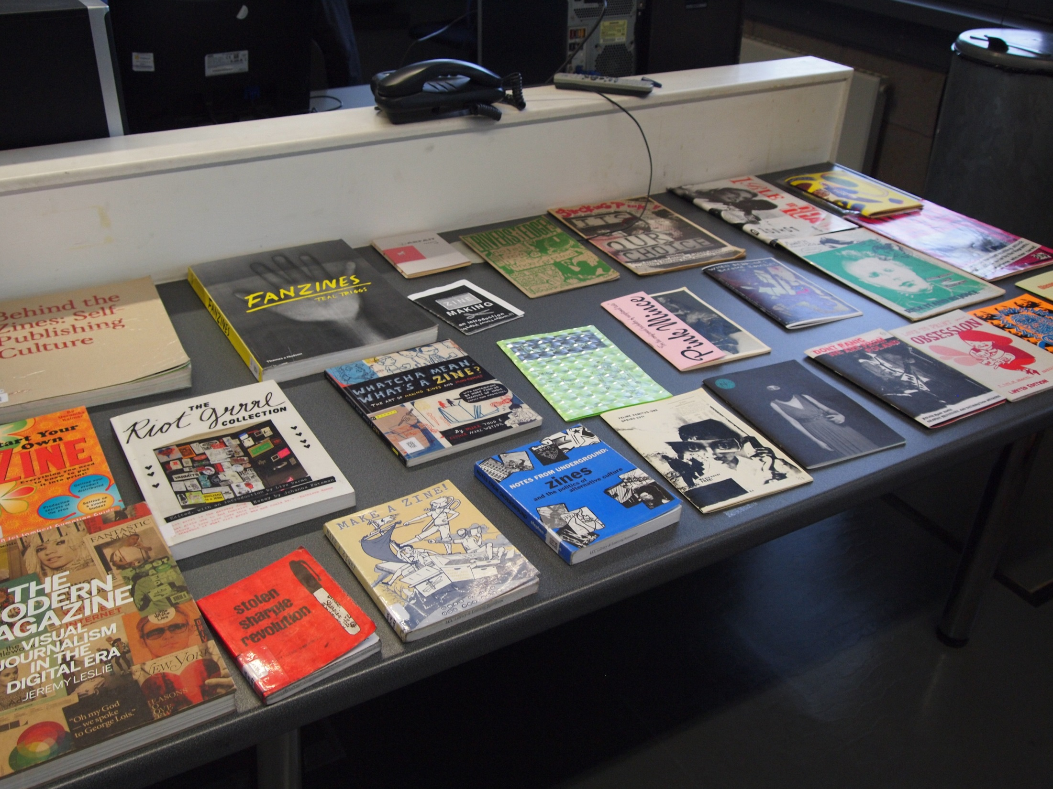
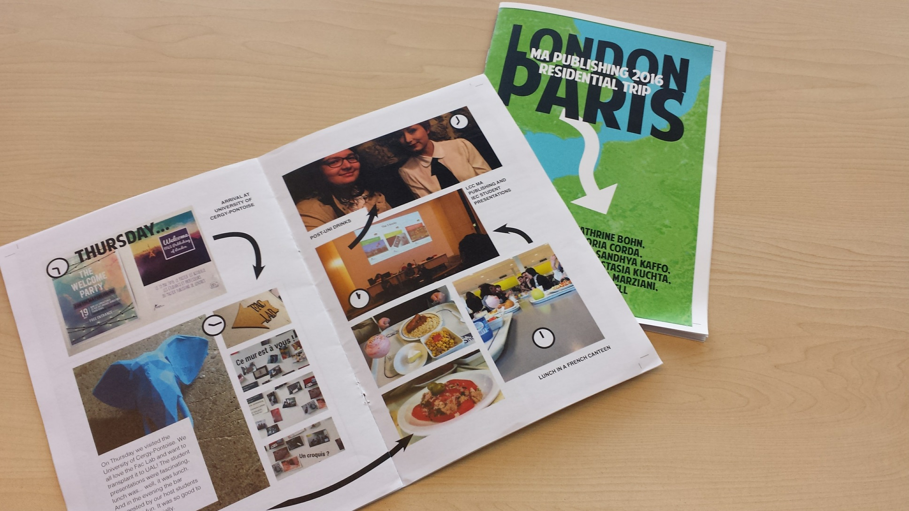
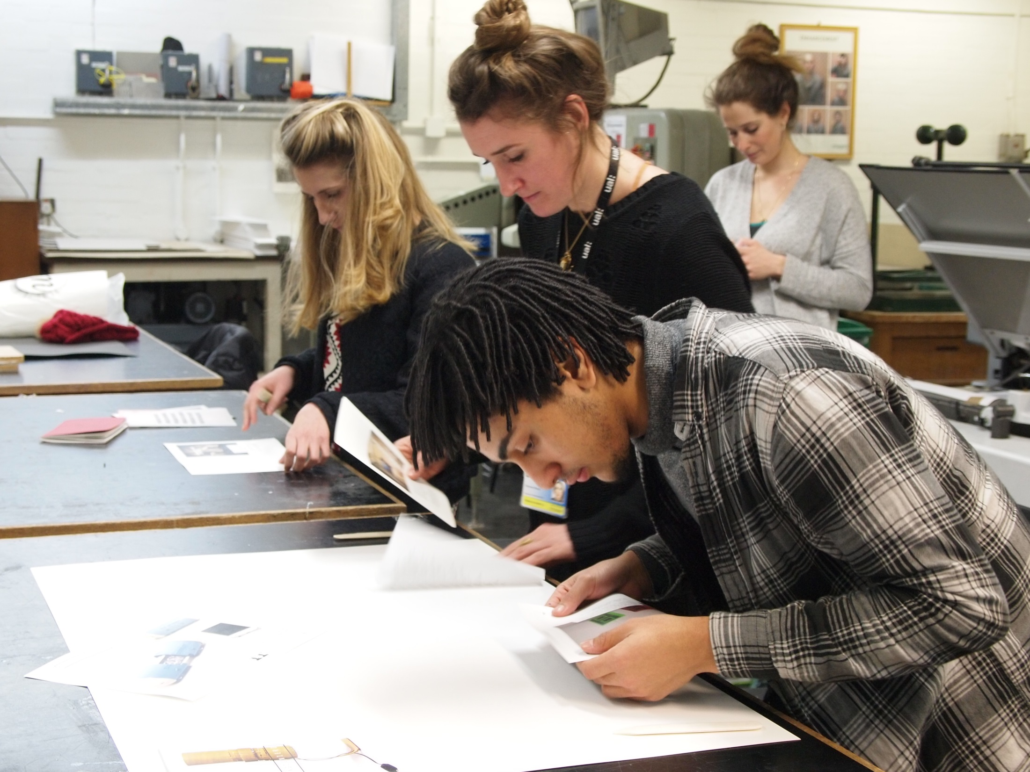
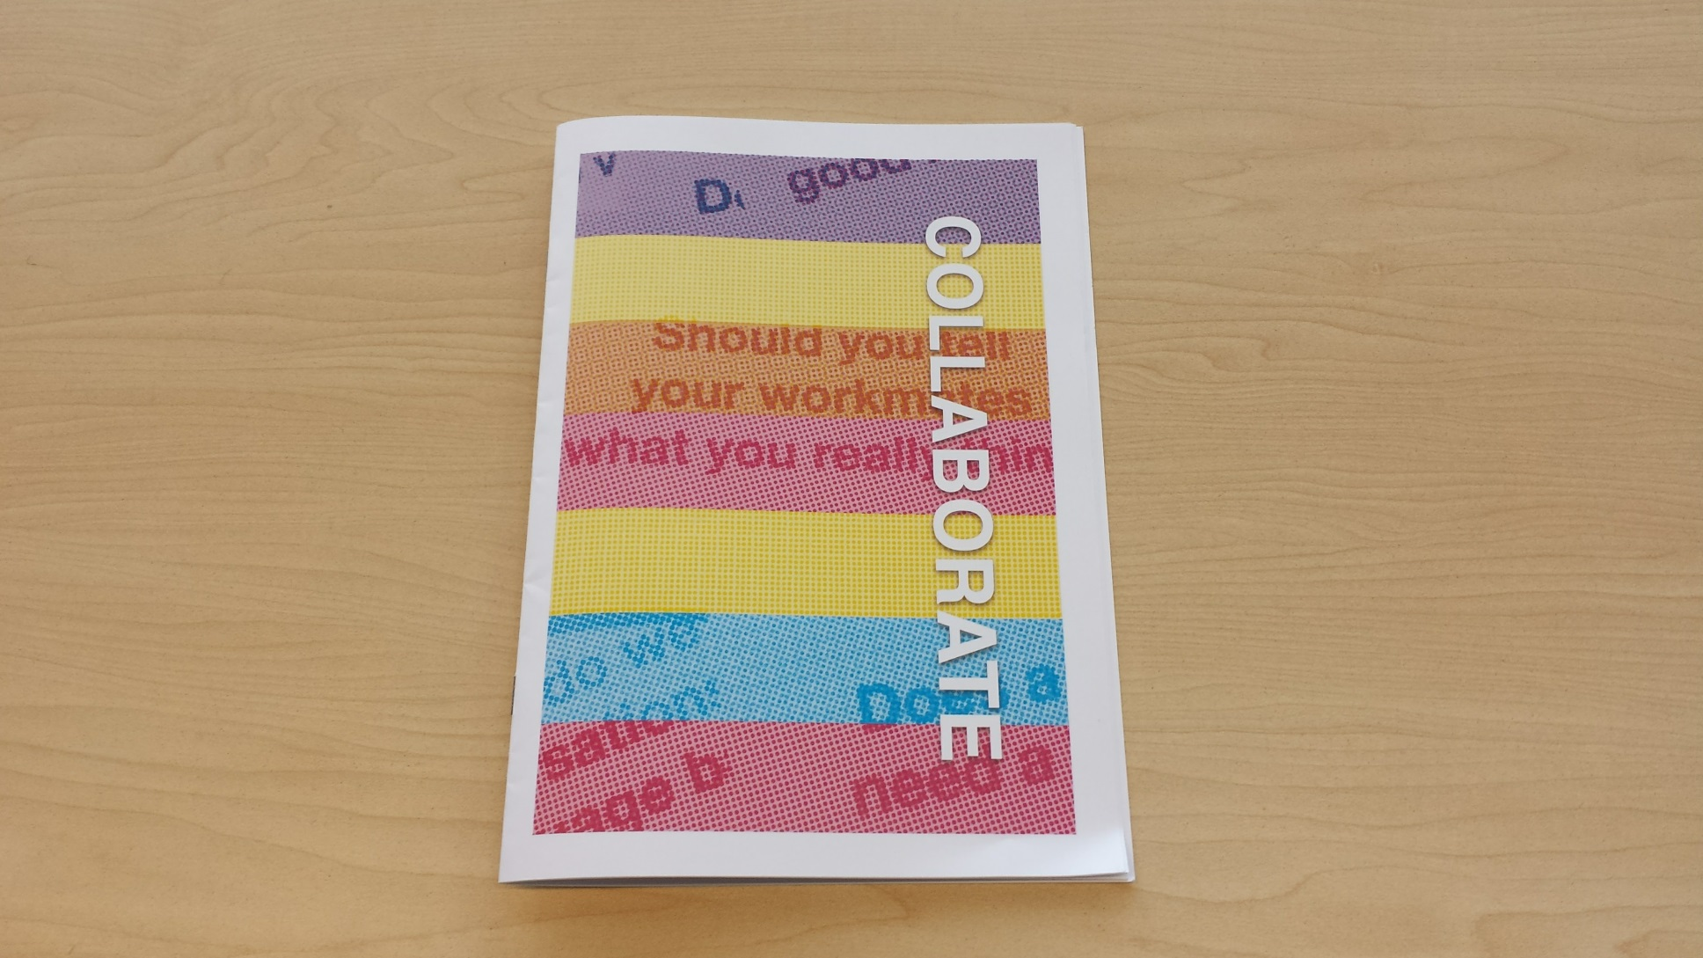
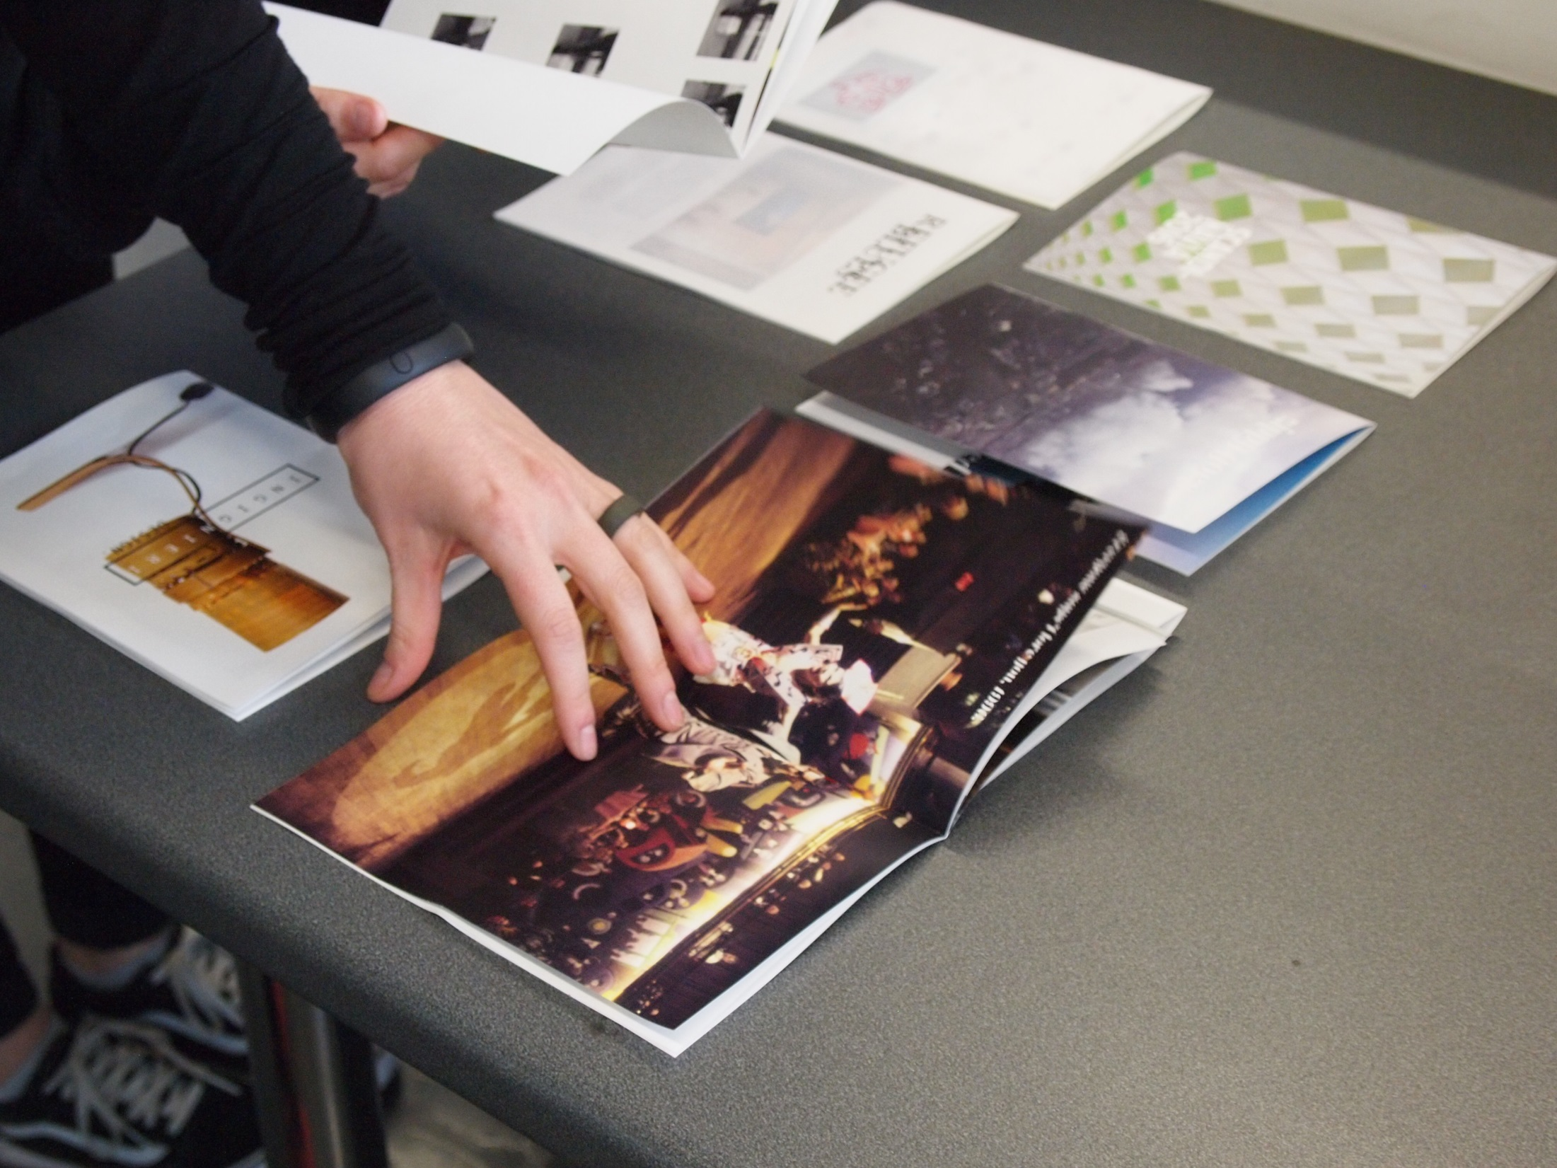
We make Zines

Slide 3
Zine
+
Industry event

Slide 4
Relevant zine themes
DIY
Capturing individual responses
UG content
Writer/Editor/photographer/designer/creator
Rough and ready production
Speed/energy
Individual expression
Tangible vs. ephemeral
Freedom
Non-professional
Currency

Slide 5
Industry events
Standard Pattern of panel events
Questions at the end
Networking at the end
Quieter students may not participate
Remember what you heard?
Think about what you have learnt?

Slide 6
Framing event with zine
Content curation
On-the-spot synthesis
Student participation
Active thinking
Co-creation

Slide 7
Pedagogy
Experiential learning through live projects
Not the making of the zine but the thinking about what you have heard, having to communicate it, selection/synthesis/curation
Documenting event, capturing responses

Slide 8
New generation – new styles of learning
Instant gratification
Tangible outcomes
Multi taskers (get them to use their multitasking to help you)
Insert user generated content into learning
Continuous/near instant activity/feedback
Continuous creation of content
Collective reflection
Help make own journeys

Slide 11


Slide 12
ENTREPRENEURS STUDENTS
Innovative spirit
Collaborative
Encouraging participation
Getting involvement in discussion/debates on equal footing
Leading discussion the way they want it to go
Getting close into their motivation
Thinking about markets
Responding creatively

Slide 13
Playing with format
Entrepreneurship theme
Networking
Participation
Ensure involvement from everyone
Engaging students from different courses to collaborate
By making the zine students have to think about what hearing, assimilate, synthesis = deeper learning?
Pilot event for 25 students.

Slide 14
SET UP
Ready made template – 16pp A5
Rough flat plan
Briefing on template and content
Groups pre-planned – small groups as pilot
Courses included: MA/BA publishing, MA Design Management, MA/BA Journalism BA creative enterprise – (inc illustrators, spatial designers etc.)
Organised areas to carry out close discussions

Slide 15
Event themes

Slide 16
Event plan
40 min Panel – starting up
20 min discussion with their group at a booth – ask questions
10 min plan spread ideas
30 min final panel – on-going management
Team leader to gather/deliver content
Zine making session was separate
Follow up questionnaire with students and guest feedback

Slide 17
5 entrepreneurs
B2B Publishing services
Maker community training app
Lifestyle & culture magazine site
Online international freelance photo library
Indie mag and creative agency
App developer and u/g content walking app

Slide 18
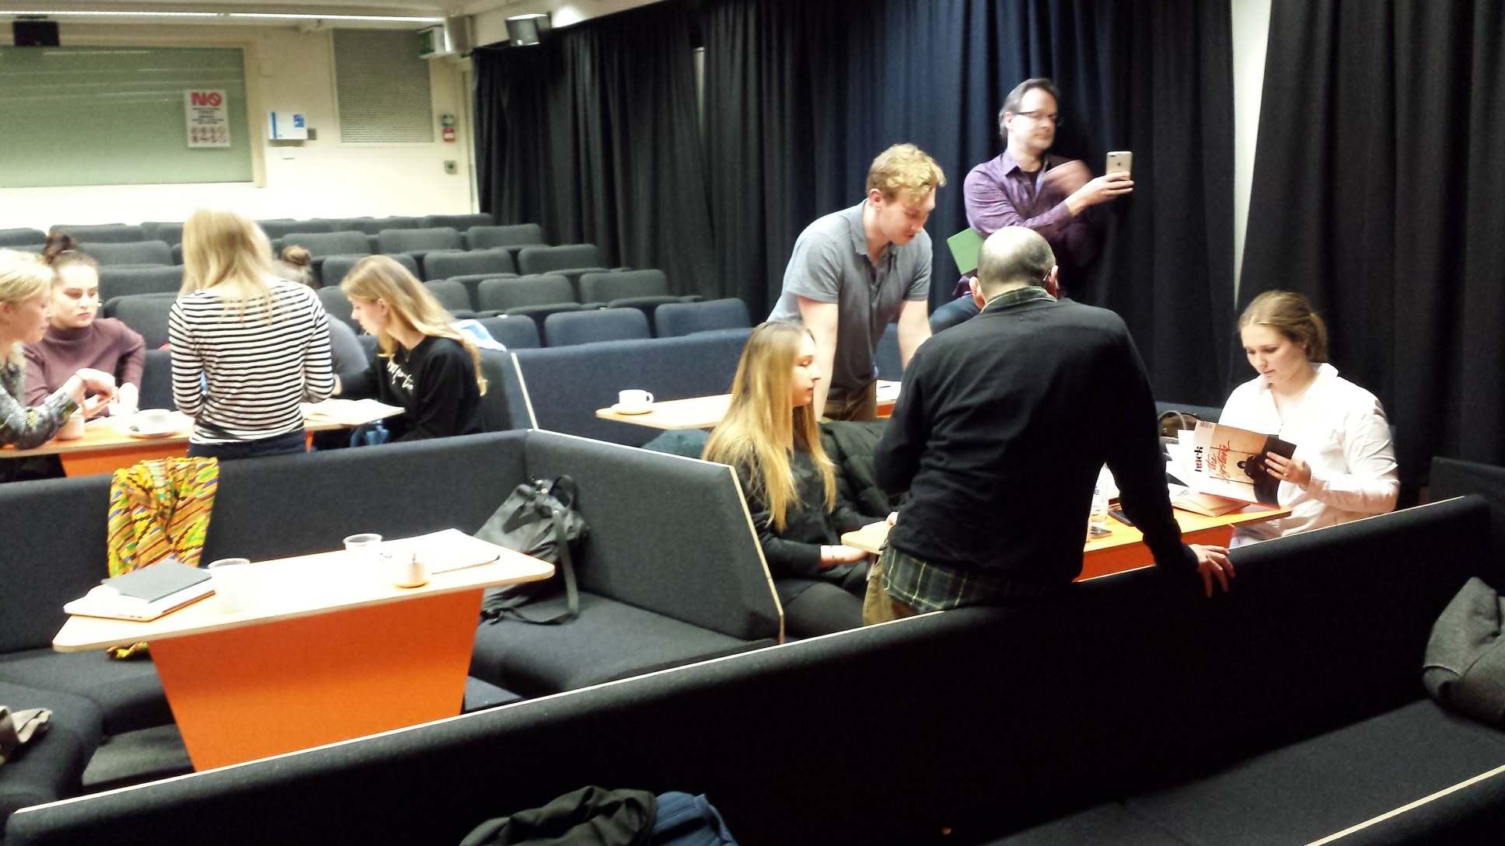

Slide 19
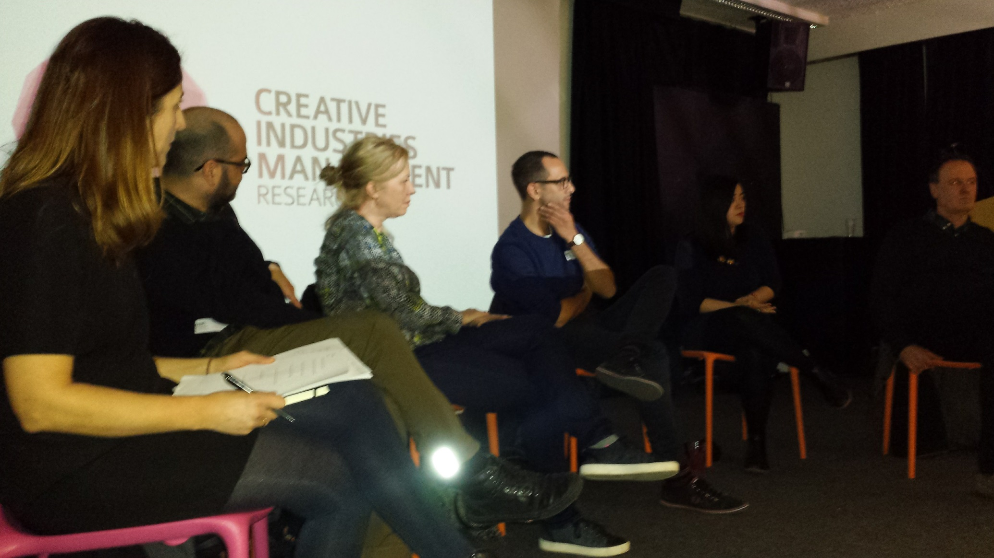

Slide 23
What worked from feedback
Event Format
Topics
Networking
Discussion - forced the students to engage in debates around specific topics, not only to ask a few CV-style questions
Personal – everyone felt involved in the stories, openness, energy in the room
Guests - really enjoyed the more intimate discussions and also their learning from each other – felt they got much more involved in discussions – sharing stories

Slide 24
Specific student learning
(from feedback)
Connecting across the courses
Talking directly to entrepreneurs, and doing so in more depth than just asking a question
Content creation focused attention
Engaged in debates around specific topics, not just asking a few CV-style questions
Thinking about content/asking questions made them think harder about what they learnt
Majority felt they participated more than they would usually and felt more confident

Slide 25
What to do differently
  Zine making had to be separate - timing
  Loosen up the students to be a bit more creative (ended up being designed consistently)
  Bring more materials to play with
  Allow students chances to talk to different entrepreneurs – and ask general questions – but see different responses to same entrepreneur
  Formalise content collection process further – tasks to keep students on track (and see more publishing)
  Facilitate editorial discussion
  Fixed wrap up session for the zine
  Some students were frustrated others didn’t commit fully

Slide 26
Developing pedagogy
Develop the reflection stage as critical practice – and collective reflection
Facilitate discussion with students to see what has emerged from their listening/observing/thinking about what they have seen
Considering different audiences/what differences they hear – writing as mediating
Embedding networking further - the students play a role as well as the panel

Slide 27
Developing an experiential cycle
participation
interpretation
reflection
critique
creation

