Slide 1
Don’t disrupt the day job: Para-organisations and innovation practices in UK publishing
By the Book 7 Paris 2022B
Dr. Frania Hall

Slide 2
Nosy Crow - 2018
Closes its App department
Kate Wilson: apps cost a lot to make and the market for them had not developed ‘in the way that we would have liked’
The day job – ‘It makes sense for us to focus our resources on the resilient children’s print market and on the area of the business where we are enjoying such success’
The bookseller – April 26th 2018 https://www.google.com/search?q=nosy+crow&rlz=1C5CHFA_enGB927GB927&source=lnms&tbm=isch&sa=X&ved=2ahUKEwjRkua4vKf4AhWhhIkEHbyXDQoQ_AUoA3oECAIQBQ&biw=1440&bih=655&dpr=2

Slide 3
Innovation around delivery
‘It has enabled us to better understand what print can do that the screen cannot, making us better print publishers in the process.
‘It has also encouraged us into areas of digital innovation – such as our successful Stories Aloud initiative, offering free audio readings accessed via a QR code printed on the inside of paperback editions of all of our picture books’
Audio growth 2021 UK – 14% growth - £151m audio downloads
Also innovations in discoverability etc.

Slide 4
What about content and format innovation?
Lots of content innovation:
Eg education sector – Hodder Education
Eg academic sector – Berg Fashion Library
Eg professional sector – Westlaw, BMJ
Each sector has very different business environments

Slide 5
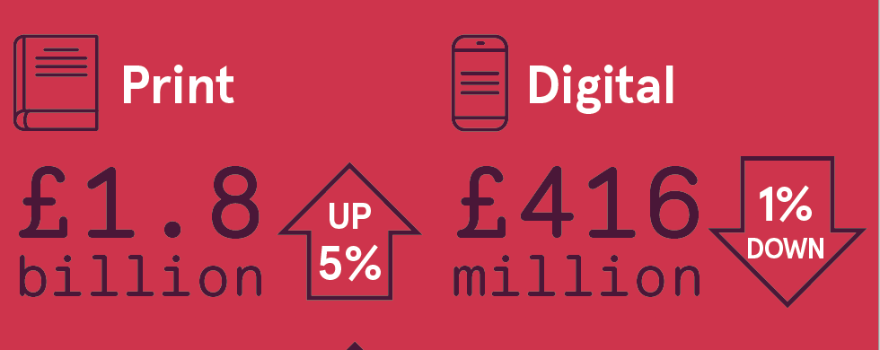
What is the day job?
Print sales in UK:
Total print up 5% in 2021 to £3.5 billion
Digital ebooks very successful but:
18% of consumer market
15% of education market
(75% of academic market – digital format)
So must not direct activity too far away from this
Yet complex digital projects need complex set up
Consumer books - 2021
https://www.publishers.org.uk/publications/publishing-in-2021/

Slide 6
Digital challenges
Success in audio, ebooks, ejournals – preserving the form of the book/article
Difficult and costly to experiment with new content-based projects particularly in consumer arena
Why?
Business models – pricing and digital sales models
Business development models – how digital projects are developed, iterative, ongoing support
Structural issues – streamlined workflows

Slide 7
Traditional development models
Consumer sector business models to support investment in new talent – HB first
Workflows well established, fine-tuned production lines, bureaucratic management processes
Traditional value chain - ‘The publishing value chain has remained relatively consistent since the invention of the printing press’ (Squires & Ray Murray, 2013)
Final product – rather than on-going iteration and changing relationships
Approaches to risk – how to manage demand uncertainty, a level of managed overproduction (Hirsch, Thompson)
Work patterns with suppliers – sit within industry boundaries
These remain successful for print – but also are legacy business models

Slide 8
Digital however is key
Gen Z and Millennials consumption patterns – immersive, interactive, personalized (Deloitte 2022)
Digital products central to some sectors
New author/reader economies aside from publishing
New discoverability and content formats –social media and social reading and writing sites
Compete (and collaborate) effectively in wider creative sector
https://www2.deloitte.com/content/dam/insights/articles/us175214_tmt-digital-media-trends-2022-report/figures/US175214_Infographic-final.pdf?icid=learn_more_content_click

Slide 9
Research
How to experiment with digital projects effectively
Recognition of importance of collaborative activity – outside of publishing sector
What are the processes new innovations require while in development?
Case studies (interviews, observations, content analysis) exploring formation, operation and outcomes
Consumer game book – with games developer and creatives
Education text – with arts organization
Academic database site – with competitors and developers
Features of success - themes around vision, autonomy, trust
Theories around collaboration and networks

Slide 10
Collaboration theory
Frameworks 1
They can be sites for creativity and innovation (group genius)
Certain conditions make collaborations effective and creative
Divergent and convergent thinking
Trust and shared attitudes to risk
Approaches to vision development
Centrality of network behaviour
Expectation of knowledge sharing – learning organisations
Project ecosystems can embody creativity and uniqueness

Slide 11
Network theory
Frameworks 2
Networks central to creative environments (Negus)
Allow for experimentation, innovation – structural holes (Burt, Kaats and Opheij)
Strong and weak ties both central – trust embedded in network (Granovetter, Heebels et al)
Entrepreneurial networks with role types – the Broker (Farrell, Levine and Moreland)
Creativity and value vested in the network and emerges in creative project ecologies (Grabher)

Slide 12
Case studies
15 in-depth semi-structured interviews (coded manually)
10 shorter structured interviews (coded with NVivo)
Content analysis across the materials available about the products pre-launch/launch/post launch
Talked to:
Publishing managers, digital developers, commissioning editors, digital consultants, composers, software developers, game producers, illustrators, storyboard writers, education experts, freelancers.

Slide 13
Note on the case studies
They were successful products, examining what characteristics they shared – across sectors
None quite knew what the product would be like that emerged - exploratory
Each required a huge amount of careful work and new ways of working
All talked about not disrupting, ‘derailing’, the day to day operations
Collaborating therefore externally requires certain behaviours to achieve successful outcomes
Once developed – ongoing work brought in house for two of them

Slide 14
Collaborations – a definition
‘Temporary mechanisms and long lasting relationships. They are cooperative and competitive weapons. Each is unique but the often share similar properties. They have an intended purpose yet their emergent benefits may be more important’ (Osborn and Hagedoorn, 1997)

Slide 15
A flavour of the collaborations
‘I would say almost every partnership is new… every one is made up as you go along’
‘You are all looking for new ways of thinking about something…and helping everybody to grow and think of new ways forward’
‘Our missions are different but goals have to be common enough’
‘Certain sorts of needs evolve in a project and then there are roles you don’t stipulate for that you need to have’
‘Both organisations had to take a big leap of faith’
‘We wanted to widen our reach and [they] were looking for more fine content—a match made in heaven!’
‘Every single aspect of the product is incredibly creative…this is saturated with creativity’

Slide 16
Ideal creative collaborations
Networks – entrepreneurial, value held in weak ties – FORMATION
Broker – central role to connect partners – FORMATION
Vision – clear, articulated shared vision – vision stakeholders – FORMATION
People – small team, wide range of different sorts of people, empowered - FORMATION
Autonomy – agency and seniority to take decisions quickly OPERATION
Project management – informal flexible nimble ecosystem - OPERATION
Content knowledge – need close understanding of the nature of the content - OPERATION
Expectations of varied outcomes – learning and creativity central – OUTCOMES
risk taking - experimental – disruptive – innovative - adaptable

Slide 17
How to make these work
Collaborating with external organisations is key – for knowledge, creativity and problem solving
Need methods to collaborate with them effectively
Need to recognize uniqueness of each innovation
Key, autonomous, networked people required
Need to put them into situations where collaborations can thrive
The way these operated it was clear they stood separately from the main organization
Not everything was resolved – but a way to experiment was established

Slide 18
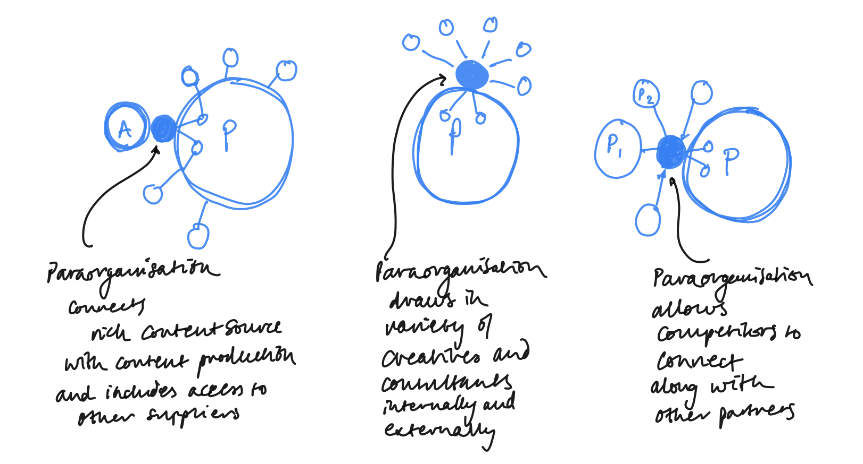
Models for Para-organisations

Slide 19
Para-organisations
My definition = ‘small, creative, autonomous organisations that step outside their parent companies to collaborate, develop and test new ideas. In this way the day to day business can continue but new modes of innovation can be introduced.’
The attributes noted above, that are required for ideal collaborations, are then embedded in these organisations
Though there are still limitations (eg around scale)

Slide 20
The para-organization facilitates innovation
So finally,
The para-organisation allows disruptive innovation to take place …
drawing on the expertise of the publishing house….
connecting with other individuals, organisations and competitors…
in flexible and unique ways…
Allowing for experimentation, knowledge sharing and creative risk taking.

Slide 21
Key theoretical frameworks
Grabher – project ecologies,
Granovetter/Burt/Uzzi - network theory
Levine & Moreland – disruptive thinking and collaboration strategies
Kaats and Opheij – successful conditions for collaboration
Negus – latent organisations
Sennet – communicaton
Bilton/Kung – managing creativity
f.hall@lcc.arts.ac.uk

Slide 22
Images
Front slide – author’s photo
get creativity flowing- tim-mossholder-unsplash.jpg
group working - marvin-meyer-SYTO3xs06fU-unsplash.jpg
network human - clarisse-croset--tikpxRBcsA-unsplash.jpg

Slide 23
Thank you f.hall@lcc.arts.ac.uk

