Slide 1
In book publishing
Digital Ecosystems
Dr Frania Hall
By the Book Porto 2023

Slide 2
3 themes emerging
Customer-centred, service-oriented
Getting closer to customers
Understand demand, use analytics
Specialist = service-oriented/consumer= flexible/creative
Hybridity
Combined print/digital offerings
Hybrid business models and business activities
Flexibility and bespoke
Ecosystems
Customer at centre
Connectivity between ecosystems
Collaborate and compete

Slide 3
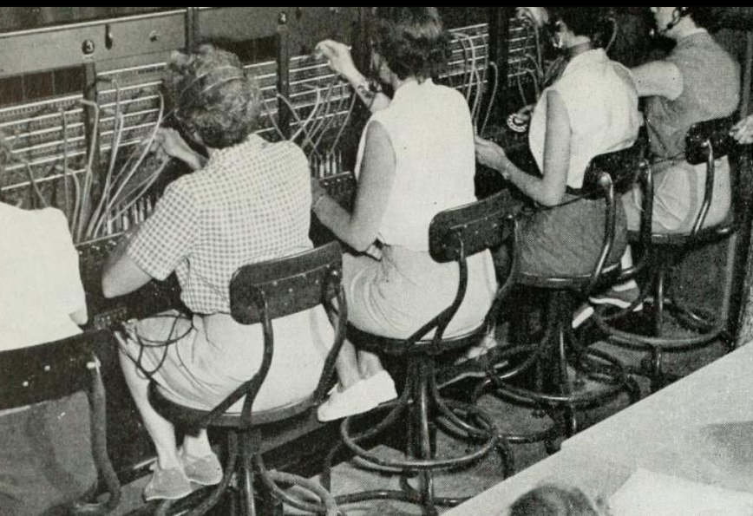
Old ecosystems
https://archive.org/stream/belltelephonevol3132mag00amerrich/belltelephonevol3132mag00amerrich#page/214/mode/1up

Slide 4
Converging telephone ecosystem
https://electronics.howstuffworks.com/telephone.htm

Slide 5
Mobile Ecosystems
https://assets.publishing.service.gov.uk/government/uploads/system/uploads/attachment_data/file/1048746/MobileEcosystems_InterimReport.pdf

Slide 6
What digital ecosystems you are in?
Mobile phone?
TV/Streaming services – how do you choose which?
Amazon – delivery + video?
Researchgate/orcid/university/open systems/publishers
Bundle deals for TV/Phone
Subscription packages for services (adobe)
Kindle sync to phone/tablet/computer

Slide 7
Ecosystems and media ecologies in publishing
‘a community of organisations, publishers, authors, end users and audiences along with their environment that function together as a unit’ (Naughton, 2012:114)
‘the future of the media ecology and the publishing sub-system lies in the new combinations generated by the different human and technological actors in the media ecology’ (Scolari: 143)

Slide 8
Digital transformations
New ecosystem configuration and alternative ecosystems
Self-publishers can buy in services, agents can publish their own works
Hybrids – authors, publishers, products
Tolino – digital reading from booksellers and publishers in collaboration – with CMS, DRM etc
Netgallery – providing PR services, aggregates influencers and advocates
Unbound explicitly reconstructing the publishing ecosystem
Amazon can develop a self-publishing arms and set up its own bookshops
Readers and writers – prosumers – can connect in dedicated social reading and writing platforms

Slide 9
Theoretical themes

Slide 10
Ecosystems of creativity
There is value vested in an ecosystem – eg ‘delicate ecology of networks’ which leads to creativity (Bilton, 2006:48);
‘creativity is dependent upon the relationships between individuals and organisations, not the competencies within individuals and organisations’ (Bilton, 2006:53)

Slide 11
Value chain as ecosystem and disruption
‘The publishing value chain has remained relatively consistent since the invention of the printing press’ (Ray Murray and Squires, 2013)
‘as [digital] is at the core of concerns of all actors in the book world, it disrupts the whole book ecosystem’ (Simon and De Prato, 2012:71)

Slide 12
Networks, value chains and symbolic value
‘communality and connectivity ties are at least as important in the publishing value chain.’ (Heebels et al, 2013:716).
‘On the one hand, personal and business strands of the [network] tie reinforce one another …creating relationships of trust, on the other hand, relational distance is managed and maintained…to be able to criticize and complement each other and realize creativity.’ (Heebels et al, 2013:715).

Slide 13
Information capital – data-centred ecosystems
‘The data generated by users are fed recursively into the algorithm, and the more data there are, the more effective this recursive process of refinement is. User data become the foundation of the organization’s success.’ Thompson (2021:172)

Slide 14
Evolution of complex ecosystems
‘new spheres of activity that would take on a life of their own’ Thompson 2021:479

Slide 15
4 examples

Slide 16
Amazon
‘The all-embracing online–offline ecosystem of Amazon’ (Thompson, 2021:193)
Built an e-reader ecosystem – with an established critical mass
Prime = complex consumer package - difficult to unpick
Extended interconnected ecosystem - kindle, GoodReads, Audible, kdp, Kindle Unlimited, PB POD etc - why go elsewhere outside of ecosystem
Distributed technologies – giving customers tools to create content

Slide 17
The consumer gets

Slide 18
Amazon’s walls

Slide 19
Complex interlinking
Kindle unlimited = uses books from KDP - with additional deals with publishers
Audible = links into your purchase of books, or buy the subscription to audible at different levels
And provide tools to do this yourself and analyses results – eg audio, analytics
Builds in discovery vehicles – audible narration by book, daily deals for kindle
And continues to do this through acquisition of other sites to connect to their ecosystem – goodreads – social reading platform

Slide 20
Ecosystem issues
Difficult to unbundle
Consumers making different sorts of choices/payoffs – difficult to compete
No need to go elsewhere as the Amazon universe has it all
But they can change business model – producer as consumer has less power than reader as consumer
Scale/commodification of content
Still no direct access to customers
However publishers have to understand what to give and not give access to within this ecosystem– how to value that content

Slide 21
Wattpad
Writer-reader ecosystems - read and write and interact
Explore stories within that universe
Develop close, symbiotic relationships between author and reader

Slide 22
The Wattpad ecosystem – what you get
Discoverability – utilising social reading approaches
Viability testing
AI Suggestions as you write about length etc.
Feedback from fans – and reading stats
Your work is in their system, develop it incrementally using analytics
Partnerships with publishers to produce diversity series (BLM)
Identifying and publishing their own Wattpad books in genre groups
Connectivity – screenwriter connected to authors
Patron funding – fans can pay for favourite authors with paid stories

Slide 23
Ecosystem issues
Like Amazon – grabs people and they can stay there
Consumers happy in that space
Alternative to mainstream publishing
Close reader/writer relationships
With dreams of bigger things, bigger data
A system of content creation that Wattpad can keep adding plug ins
Analytics at each stage
AI easy to embed

Slide 24
Academic ecosystem
Researchers have complex ecosystems
Publishers need to be everywhere in their ecosystem and plugging into all the things they are plugged into
But also helping them get even more plugged in
Publishers connect into seamless research workflow – offering that connectivity for researchers
It becomes part of the service publisher’s offer
So more embedded with the research process

Slide 25
Ecosystem and work

Slide 26
Researcher’s ecosystem – distributing their work
Orcid - digital record system - unique and persistent identifiers
Resesarchgate.net/academia.edu – social network-based discoverability platforms
Analytics – across these platforms – collated, citation
Own repositories – and versions of work, archives
Public repositories - PubMed
References and citation management (EndNote/Zotero)
Sites like Mendeley for note taking, annotation and sharing and collaboration
Managing rights/moral rights/creative commons
APIs allow further plugging in- future proofing for new system

Slide 27
Reader-end – researchers as consumers needing to discover research
Aggregators
Library systems
Proprietary platforms
Shibboleth/OpenAthens
Tools for easy discoverability, easy access – user-facing not content creating
Data analytics to support costings for purchasers
Access systems from OA to subscriptions
Patron driven, on-demand tokens systems
Transformative journals and pay to print mechanisms

Slide 28
Ecosystems issues
Need to keep abreast of everything/cover all bases of new technology
Need to be quick to make deals/arrangements
Have technology in adaptable formats to plug in
Need to work with people who potentially take on some of your roles – eg aggregators vs direct systems

Slide 29
Ed tech
Education publishing – re-orienting fit into institutional ecosystems
Edtech link into their VLE and LMS
Put student at centre of web of content and info –
Students can draw assessments and other tailored resources to them
Publishers need flexible systems to fit into any form of VLE they have

Slide 30
Publishing with Institutions at the centre
Textbooks integrated into weekly VLE
Features – P2P, notes, auto-help, students can make materials theirs
Centralised tools for assignments and assessment platforms
Moving to institutional solutions
Content is the same across publishers but the solutions change
Inclusive access initiatives - Pay for the materials built into units for the students – less drop out as they don’t have to pay extra
Education initiatives – covid-responses (US Education Stabilisation Fund)
Understanding pedagogy – eg formative assessments

Slide 31
Ecosystems issues
Similar ecosystems have existed but this is more seamless, service-based experience
Big spending at institutional level but also if lose contract big holes
Developing bespoke while making flexible
Student capacity for technology – only so many things they will use
Still need to appeal to students – keep close to them - to encourage institutions to invest
Need to keep an eye on edtech

Slide 32
Implications and challenges

Slide 33
Ecosystem centre of power for academic environment
Researching
Writing
Discoverability
Connecting
R

Slide 34
Position at centre - for Amazon Power of market creation- consumer and producer
Content making
Consuming
A

Slide 35
BUT
‘Networks are not a paradise of democracy and transparency’ (Scolari, in Phillips and Bhaskar, 2019:130)
‘Amazon was the pioneer of information capital in the world of the book and this was the source of the unprecedented power that it would eventually come to wield in the publishing industry. Thompson 2021:479

Slide 36
Problems with some ecosystems
Closed ecosystems - Never leave the ecosystem (longer term limits on creativity and innovation through lack of divergent thinking)
Self-fuelling – complexity of the ecosystem serves to strengthen the ecosystem
Track the real power – customers or companies?
How much control does the small player have – content providers, data providers
Embedded data power
Customer-centred or customer exploitative? (extend customer value for companies)
Changing business arrangements – KDP changing rules for self publishers
Publishers need build in flexibility, can’t claim the whole market
(producer, consumers, apex predator?)

Slide 37
Drama online – publisher-led ecosystem
4,200 playtexts from over 1,400 playwrights,
nearly 450 audio plays,
over 700 hours of video,
nearly 500 scholarly books from leading theatre publishers and companies,
offering a complete multimedia experience of theatre
Academic and performance related

Slide 38
Drama online at centre
CUSTOMERS AND PRODUCT
Bloomsbury
Faber
RSC and Globe
Nick Hern
LA theatre works audio
BBC
and more...
Bloomsbury infrastructure

Slide 39
Drama online - benefits
Collaboration between competitors
Value of content is key – good content curated by specialists
Ecosystem of deals and arrangements – to enrich the service with different organisations – continuous developments
Customer benefits: Value of user experience and navigation
Publisher benefits: distribution and connectivity with aggregators and library suppliers, and data/analytics - cooperative
Pressure to keep adding more content
A lot of relationships

Slide 40
Summary of considerations
Publishers need to understand the voracious ecosystems of tech-company competitors
Publishers must create their own digital ecosystems, to have own relationships
And be aware how to link theirs into others
Understand the different ecosystems their consumers are in and how to value them
Publishers can adopt more nuanced approaches to ecosystems of customers they know, in order to compete effectively

Slide 41
Final word - Your alternative ecosystem
Redistribute power?
Develop an ecosystem around you
Not sit within a corporation’s ecosystem
Eg
Use bookshop.org and Hive
Use open source reading app like readium
Connect your content from different sources into one app like glassboxx
Blockchain – de-centralised, distributed, transferrable systems
Keeping you connected and at the centre of your content

Slide 42
Questions
Identify further ecosystems – eg reading apps/software/hardware?
How do publishers engage with wider ecosystems?
What would a productive ecosystem look like?

Slide 43
Thank you
Dr Frania Hall
f.hall@lcc.arts.ac.uk

