Slide 1
CHANGING ZINE SCENES – Creativity, zine forms and new digital practices Frania Hall
SHARP Amsterdam 2022

Slide 2
The Zine
Reflective of an alternative, DIY media zines have given voice to those unrepresented in mainstream media.
The creativity, experimentation and problem solving that can be seen in zine making is also reflective of the diversity and individuality represented by the zines themselves.
A print culture impacted by digital tools

Slide 3
The Zine in production
Lowered costs of production with DTP and digital tools have made it much easier to make zines, changing the original aesthetic which is so integral to the zine ethos.
As a print culture, how do creators use digital tools to reflect their passion for the zine form?

Slide 4
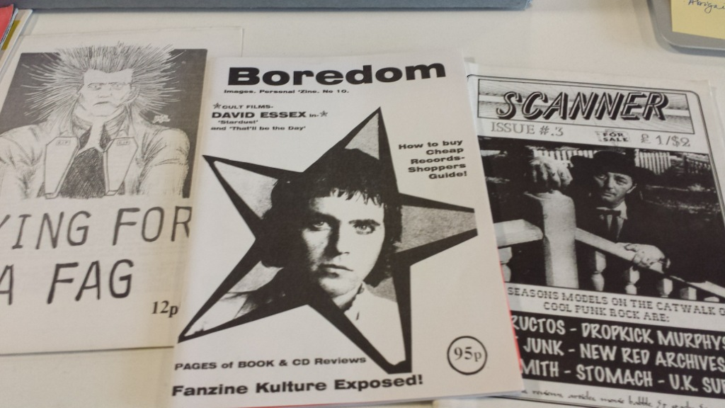
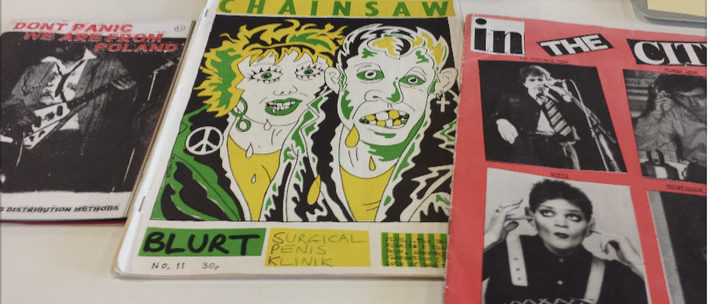
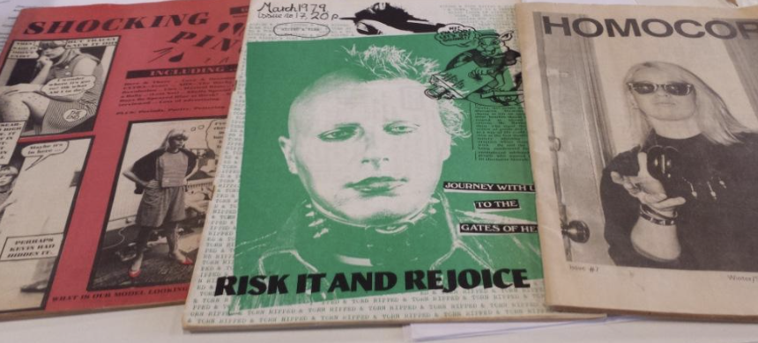
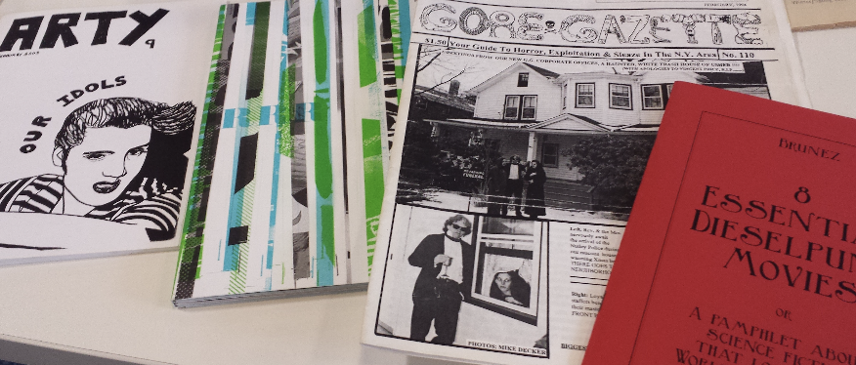
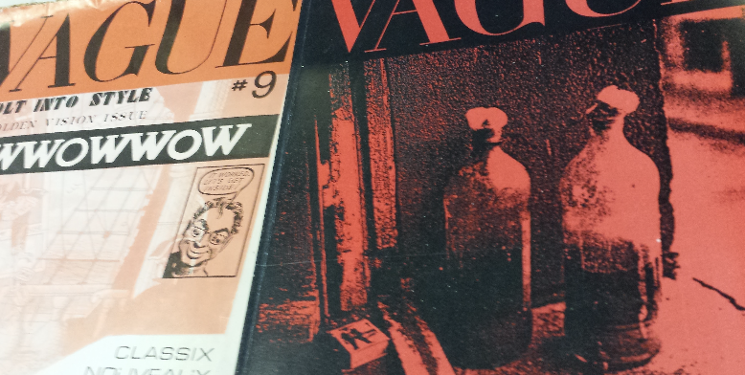
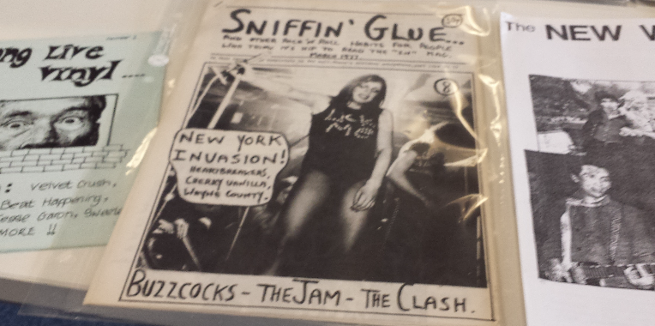
LCC zine collection

Slide 5
LCC zine collection
https://www.arts.ac.uk/students/library-services/special-collections-and-archives/lcc-collections-and-archives
https://lcczinecollection.myblog.arts.ac.uk/
The collection also has over 3000 punk, music and politics fanzines dating from the 1970s onwards
Collection continues to be added to

Slide 6
Using the special collection at LCC
As an archive loosely planned, has taken different directions at different times
Wide ranging
Personal and pragmatic approaches have made a mark on the collection as well as donations
A flexible taxonomy for it is developing as it is catalogued
Collecting copyright has an impact
Use by researchers for different disciplinary studies
Extensively use for teaching and learning and promoted diversity and self-expression

Slide 7
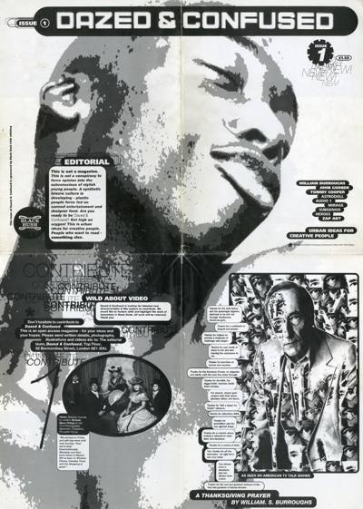
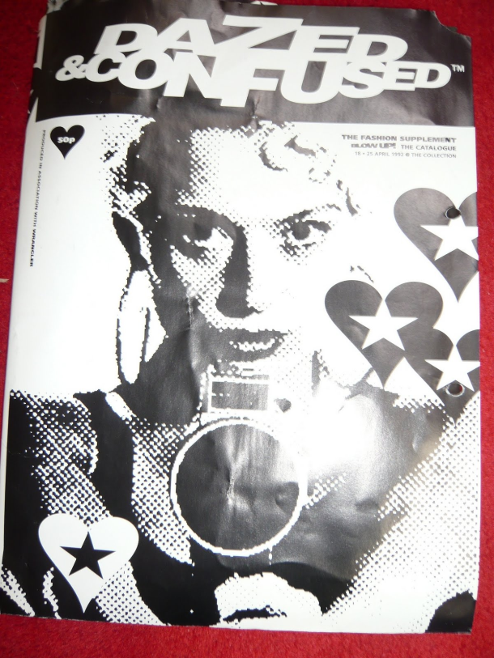
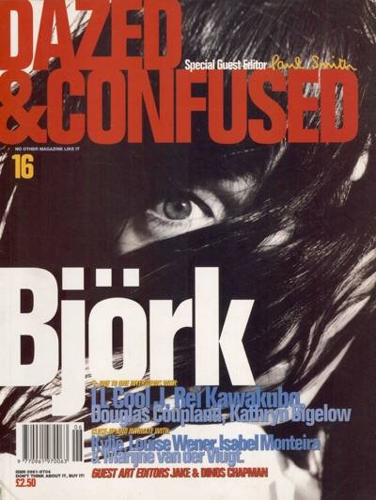
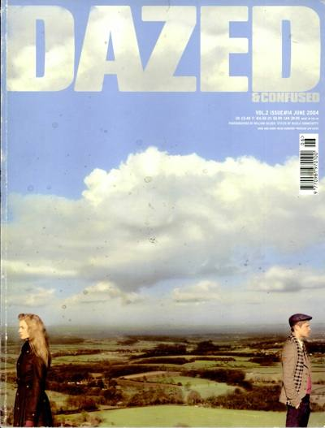
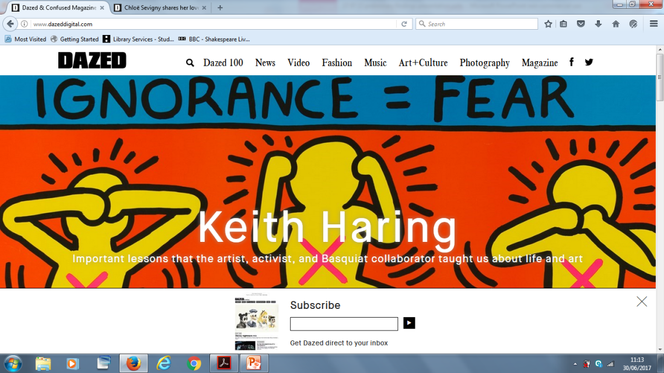
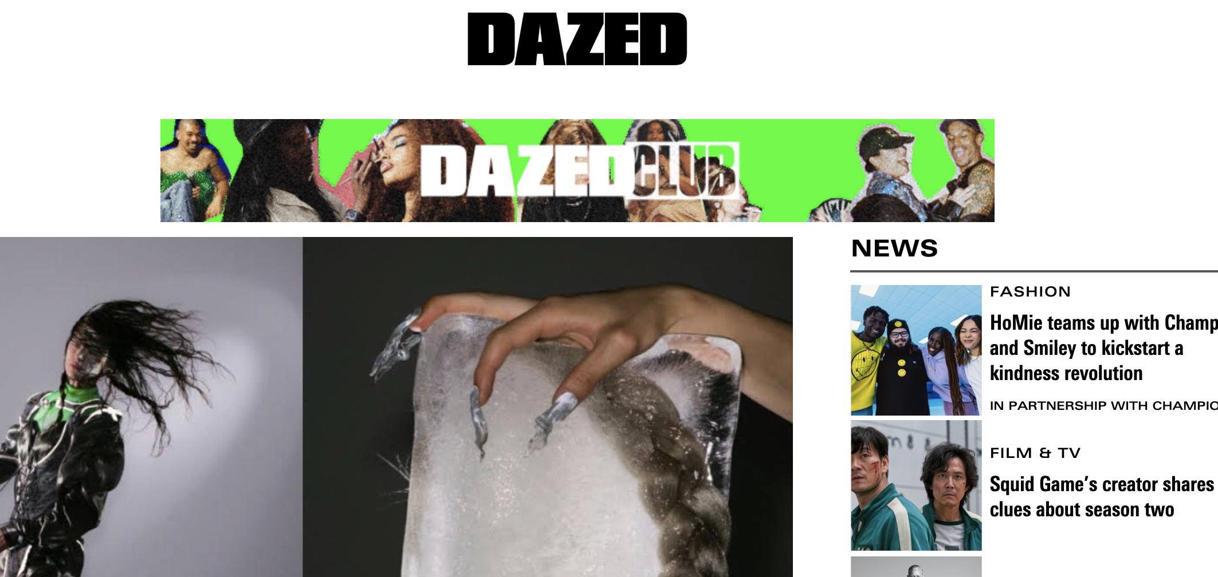
Zine or Magazine?
Dazed 1991-2022

Slide 8
The project
The Evolution of Zine Culture: Exploring social trends and digital impacts through the LCC archive
What is the impact of the digital environment on DIY production and distribution of zines?
Research into FORM rather than CONTENT – what story does it tell?

Slide 9
Zine-making: Many Motivations
Alternative approach to mainstream media
Response to inaccessibility of mainstream media
Activism
Sub-cultures/alternative cultures
Self-expression
Identity exploration
Fans
Personal crusades
Semi-professional indie mags
Portfolio – (growth of creative economy)
Place for experimentation/freedom/crafting
All to some extent DIY…ish

Slide 10
Some typologies of zines
Activist zines
Open
Alternative/underground
Immediate
Proactive – to get people thinking
Emotional
Provocative
Characteristics of New social movements (Lievrouw)

Slide 11
More typologies
Fanzines
Eg music, sports – sharing with like minded people
Alternative access to audiences
Can’t access professional markets/gatekeepers, nothing mainstream covers your multiple specific interests
Personal stories
Blogs in print
Entrepreneurial
Collective interests, subcultures, artistic, creative, longer term plan

Slide 12
Further zine themes today
Craftivism – creativity, inspiration and empowerment of craft, empowered by ‘looking at things and saying ‘I can do that’, Rise in ‘how to’ guides (Levine in Greer, Wrekk)
Art/thing of beauty (cf artists’ books) and agenda of creative portfolio & freedom to play/experiment (Zweig, McRobbie)
Conscious exposure of voices (diversity agendas) (Brouwer & Licona, Ramdarshan-Bold)
Conscious alternative to digital - new circulations, new community creation (Gamble)

Slide 13
Themes/ Characteristics of zine-making
Scissors and glue purposeful DIY energy – punk – take ownership of own culture (Triggs)
Conscious (mis)appropriation, bricolage etc. of alternative media (Lievrouw)
Crafters’ concern with materials and aesthetic
Designers’ concern with visual communication
Contingency – it is about content
More entrepreneurial aspirations after the professional
Fun – having a go – Lo-Fi culture advice
Ephemeral vs material (Brouwer & Licona)

Slide 15
The Digital Age

Slide 16
Early predictions about digital
What is the future of zines? One word: computers.”
Duncombe, Notes From Underground

Slide 17
Mainstream/alternative
“Internet technology has the capacity to erode the binarism of alternative and mainstream media and the polarities of powerful and powerless, dominance and resistance.”
Atton, Alternative Media

Slide 18
Self-publishing
‘While a paradigm shift is taking place in mainstream publishing…surely this brings good news for the self-publishing community’
Triggs, Fanzines.

Slide 19
New tools new motivations
‘Everyday creativity …brings together at least one active human mind, and the material or digital world, in the activity of making something which is novel in that context and is a process which invokes a feeling of joy’
Gauntlett, Making is Connecting

Slide 20
Zine culture evidenced in production methods
Production – huge challenges for early zine makers lead to exciting creative approaches to production; the look and feel was also part of their ‘alternative’ agenda;
as production becomes easier this has changed the way zines look/feel and enabled participants motivated in different ways

Slide 21
What are the digital impacts?
Production/layout – including publishing tools
Different ways to express creativity
Other methods of self—expression and exchange – more individualistic – Social media, alternative new media
Professionalisation vs DIY - rise of indie magazines
Increased connectivity to collaborate, find like-minded groups
Increased and easy distribution

Slide 22
The Research - themes

Slide 23
Research questions
How have production methods changed?
How far to they reflect new technologies?
Has that had an impact on how professional they look?
How far has that affected their creativity/experimentation?
How did the ‘print is dead’ rumour fuel zine culture?
How far do zine makers embrace or react to digital options? And what impact does that have on the zine scene?

Slide 24
Creativity
Zines = individual creativity, no boundaries, open to different styles of individual expression, also production problem solving
How does creativity manifest itself in modern zine making in comparison to early zines?
What does that say about zine culture as a creative alternative media?
How far is ‘energy’ in zine making reflected in their creativity?
Is there a perceived aesthetic for zines?

Slide 25
DIY
DIY is at the heart of zine making – desire to express identity
How does DIY manifest itself in modern zine making?
How far has connectivity led to a change in zine culture around collaborative working?

Slide 26
Further digital themes
Collaboration – zines can be collaborative, though not always
Does internet technology lead to more collaborative zine-making?
Distribution – early challenges in distribution are easier to overcome.
How far has technology led to more distribution options for zine-makers?
And do they take them up?

Slide 27
Research process

Slide 28
A word on content analysis methodology
‘Inferring features of a non-manifest context from features of a manifest text’
‘Abductive inferences’
Creating a ‘network of stable correlations - Krippendorf
‘Results need interpretation through an understanding of how the codes … connect to the wider context in which that (object) makes sense’ - Rose
Timeframes for digital development – titles grouped into 3 timeframes – reflecting Thompson’s stages of digital development in publishing (2005/2013) – eg developments in word processing

Slide 29
Sample
47 zines reviewed (print, UK and US)
Grouped into categories
Representative choices by Special Collections team
Title range – influenced by direction of special collection (ie early titles have been bought specifically, less comprehensive) – themes of: Music, Feminism, LGBTQ+, Art, and random.
Date range- based loosely on stages of digital development in publishing (Thompson 4 stages of 2005/2013) – eg developments in word processing
Variables – used a large number in order to test which was most useful – testing ways to apply content analysis approaches to zine collections

Slide 30
Zine topics and timeframes
 | 70s/80s | 90s/early 00 | Late 00 and 2010+
Feminism
Music
LGBT
Art
Other interests
Zines over time 1 Changing topics Random example
Zines over time 2 1 zine over time Random examples

Slide 31
Mapping questions to research tables

Slide 32
Data collection methods
Qualitative notes made on each zine with thematic headings
Then tallies made counting occurrences of features/variables (as table) for all the zines
Large number of variable to test which are most telling
5 Data tables - Numbers of variables per table:
Production | Creativity | DIY | Collaboration | Distribution
39 | 27 | 16 | 11 | 14

Slide 33
Example of variables
Indicators for production
type of binding (eg print shop stapled, hand stapled (top corner/two staples, etc.)
photo rendering (good, mixed, poor)
Typefaces – use of single typeface, some use of different type faces, lots of different typefaces etc.
Recognising that these are sometimes planned, sometimes expedient
Delineating experimentation/creativity vs efforts to be professional

Slide 34
Example of tallies

Slide 35
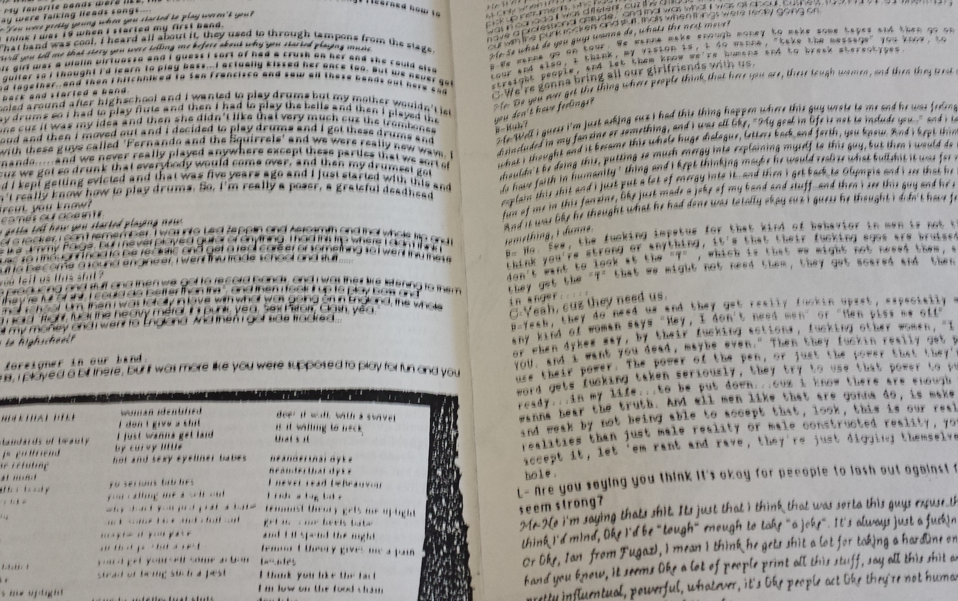
Bricolage, mixed typographies

Slide 36
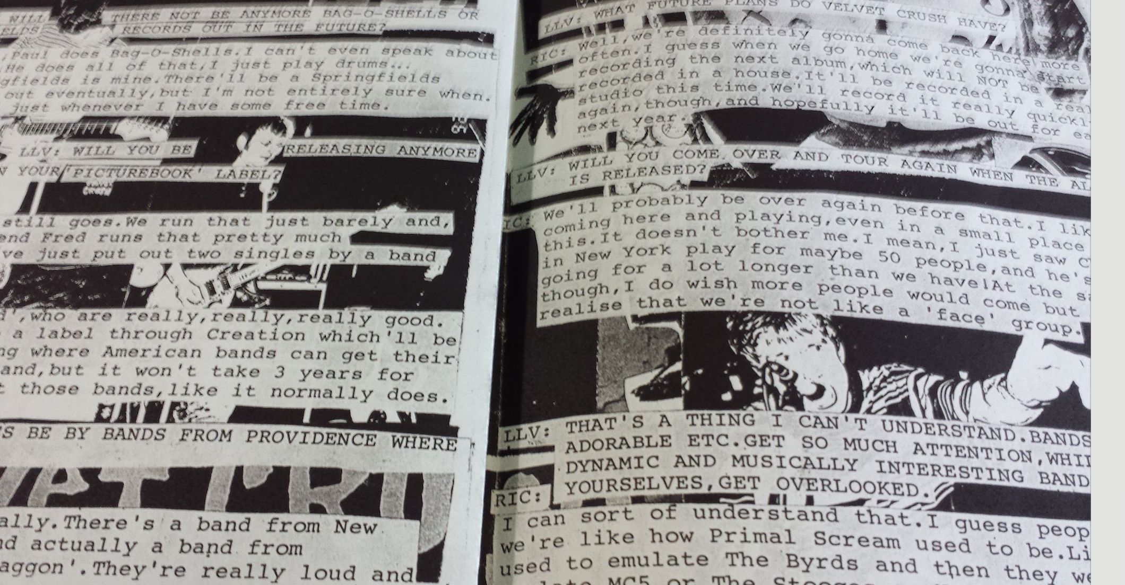
Cut and paste Xerox, formal styling

Slide 37
Findings

Slide 38
Changing to DTP
Phase one –examples are hand typed up and cut and pasted into copies (with differing degrees of care)
Phase two – word processing packages emerge – fewer examples of hand typed cut and paste, standard templates quickly adopted, slightly bland
Phase three – more planned design, professional page makeup, print shop printing – concerted effort to focus on using technology to professionalise work – even where use cut and paste effect
For later titles only – some highly designed –selling the design as integral

Slide 39
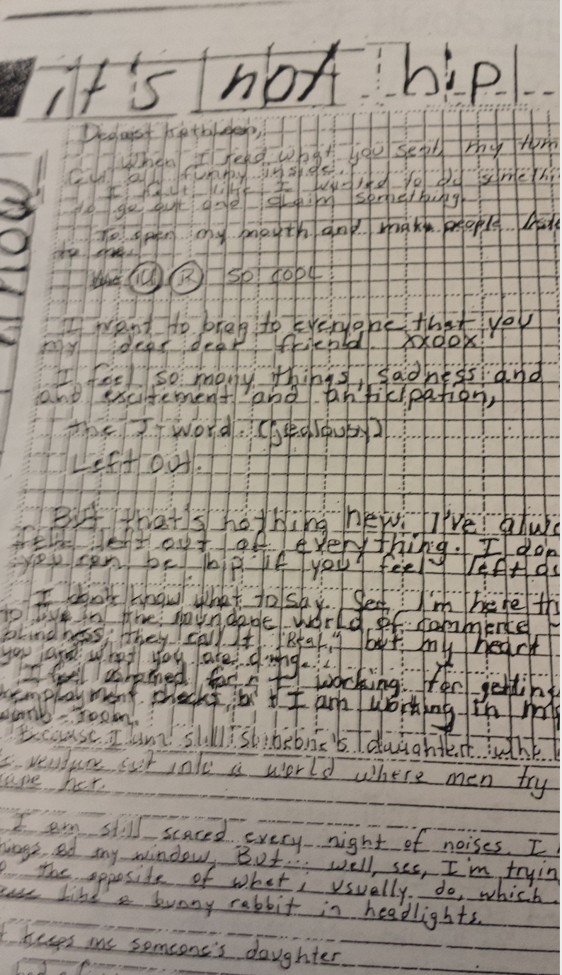
The progression to DTP

Slide 40
Cover designs

Slide 41
Word processing and images
Evidenced by increase in use of typefaces
Plus use of wider range of photos suggesting access to photos on internet
Better resolution of images, particularly photos – this improves quite quickly
Professional standard photos in the latest period
Increasing number and variety of images/types
Layout of images more carefully planned
Covers consistently become more designed

Slide 42
Early text wrap around – DTP experimentation

Slide 43
Aiming for mainstream – the paradox
Some early zines used typesetters, professional printers, professional binding and distribution – making use of mainstream approaches eg Shocking Pink
Consciously emulate mainstream – eg people working on them have different roles (editing, marketing)
Adopt protocols of mainstream eg captions, use of newsprint etc.
Only 1 later one used a professional typesetter – the most design-oriented zine
Later digital publishing by-passes the need for these roles, functions - can be more mainstream oneself
However, later examples not trying to mimic mainstream in the same way – instead more be professional within own DTP arena – Zine evolution to its own indie genre

Slide 44
Linking old and new
Early zines mimic mainstream in layout, image use, content structures
Recent zines mimic early zines in cut and paste, busy layouts within their word processing package
Some new zines explicitly use new technology to create old-style look (eg cut and pasted comments imposed on scans of an old zine)

Slide 45
Where creativity is manifest
Early creativity is reflected in layouts, trying different ways to fit everything in
Middle stage trying for more consistency – increasing professionalism
And more careful use of borders, placing of photos (more homogenous)
Later stage more creativity around images (mixing types, planning specifically to use one type of image)
Later creativity also around use of typefaces
Handwritten sections less about expediency but conscious styling
Experiments of different sorts all through – more technical experiments later
Colour options limited but used creatively
But less use of materials

Slide 46
DIY
Early DIY vested in binding, cut and paste solution
Middle DIY more in trying to get the templates to work
Later DIY text less busy/text heavy
Handwritten sections, starts off expedient, becomes more planned
Chaotic-feel remains but from being unplanned, becomes more planned
Later more adoption of specific ways to look DIY (eg hand stapling, rough folding, rough photocopying – more rare in early versions)

Slide 47
Professionalisation
Middle period ‘parish magazine’ style – less creative, more concentration on making it look like a professional, neat, well-produced magazine
Earlier = distribution is more considered – mimicking mainstream
Later = copyright, barcodes etc.
But an expectation later of what a zine should look like – divergence – highly professional approach, drawing on conscious mimicking of early zine rough and ready styles

Slide 48
Clear early distribution
Full options to subscribe, buy back issues etc. are clearly stated in earlier zines (no later zines mention subscriptions)
Formal outlets only featured for the 4 early professional zines
Later zines are much less preoccupied with explaining how to get hold of them
Print-focus - No later zines were also available as PDF/Online/e-zines
Addresses main distribution/ email addresses take over from postal addresses
Some websites for later zines suggesting marketing
No explicit marketing activity across any stages

Slide 49
Collaborative
Contributor zines feature earlier/middle
Collectives/cooperatives feature later
Personal zines become more prevalent later
Homogeneity across the music zines (content and style the same – the type of music is the differentiator /plus authorial voice)
No indication of technology/connecting up via social media to collaborate/create

Slide 50
Cross-period - Zine characteristics of form?
(not all zines do this but these are features frequently found across periods)
Cut and paste
Busy design
Text-heavy
Often no clear distribution of any sort
Black and white A5 most popular format
Creativity mostly in text/layout not in format
Print shop printing & standard paper use
Some sort of experimentation
Energetic layout, pride in uniqueness

Slide 51
Summary - The ’publishing story’
Paradox of seeking the mainstream – challenge of distributing alternative media, mimicking mainstream approaches
As mainstream methods become prevalent – drawing back from some of the mainstream methods and protocols, mimicking early zine approaches
Mid-term DTP - parish magazine style – consciously normalizing but the least creative
Divergence of zine types – the portfolio zine offshoot – individual showcase vs collective identity

Slide 52
Finally
There are still identifiable aspects of modern zines that reflect the ethos of alternative media and its power to engage audiences
While there is a changing relationship to craft in digital age, zine makers embrace digital options and often reflect characteristics of early zines within their digitally produced zines
Digital is not counter to zine culture but another tool for making
Collaborative working has become more prevalent enabled by digital connectivity– though at times porous boundary with indie magazine
Continuity despite significant change in production methods

Slide 53
Next steps - research
Go through qualitative data
Assess:
Genre
Emerging sense of curation
Change over time
Detail professionalisation
More specific exploration of bricolage
Unpick transition between zine to indie mag
And explore zine as self-publishing and self-promotion

Slide 54
Refs
Alternative Media, Atton
Notes from Underground, Duncombe
Making is Connecting – Gauntlett
Be Creative – McRobbie
Fanzines – Triggs
How internet revived zine scene – Gamble
Scissors and Glue – Triggs
Alternative and Activist Media - Lieuvrow
Stolen Sharpie Revolution – Wreek
Craftivism – Greer
Trans(affective)mediation – Brouwer & Licona
Artists, Books, Zines - Zweig

Slide 55
Thank you f.hall@lcc.arts.ac.uk

