Slide 1
From Outdated to Outstanding: The Piaggi Hat Collection's Journey to Figshare
Mark Hibbett and Anab Hussen, University of the Arts London

Slide 2
Europe's largest specialist university for art and design
World Top 2 university for art and design
Six colleges
Teaching-focused
Notes:
(QS World University Rankings)

Slide 3
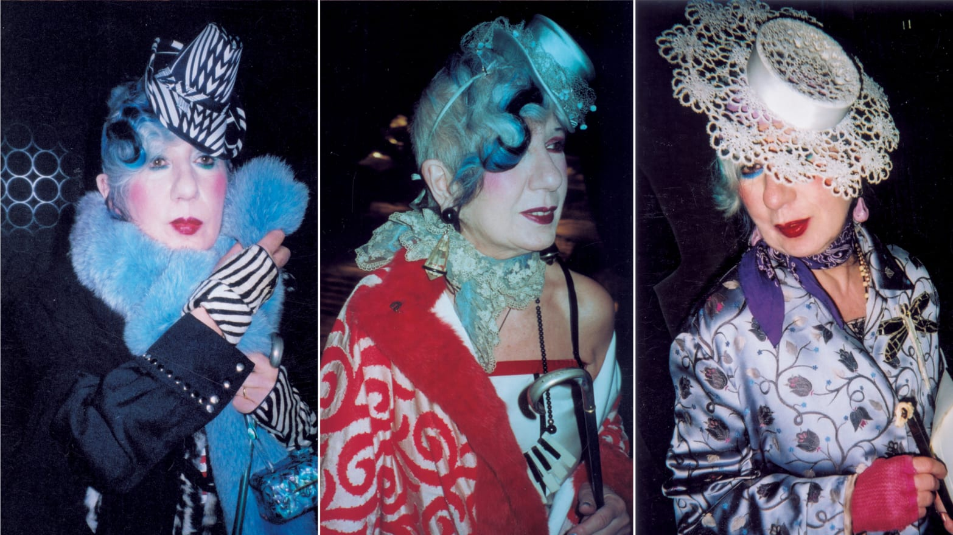
Anna Piaggi
Notes:
Italian fashion writer. Collected hats.
Exhibitions e.g. Milan 2011, V&A 2006
Died 2012. Stored in Milan, curated by experts at UAL (Judith Clark).

Slide 4
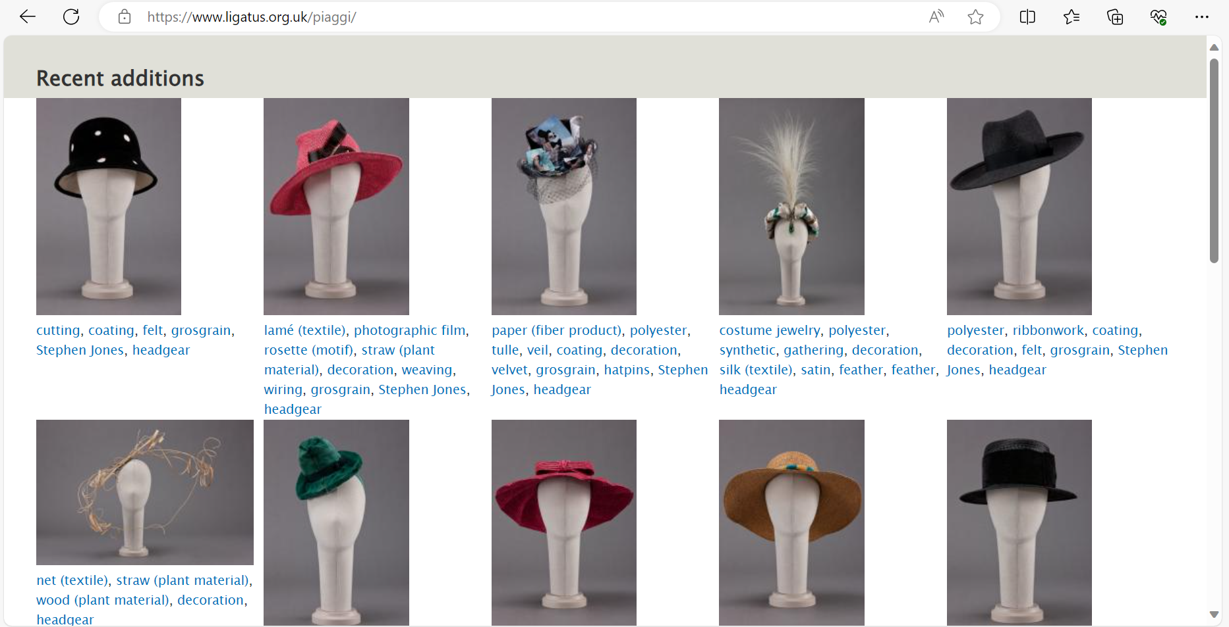
Old system
Notes:
Here’s archive system - set up in a weird way!

Slide 5
Existing data
Colours
Data
Dimensions
Notes:
Data had originally been set up in online database (SQLServer I think) in weird configuration, with dimensions separated out into their own table (just height breadth and depth).

Slide 6
Old system
Notes:
Ten years later - server upgrade needed Costs money that we didn't have, and set up in this weird way, so what to do?

Slide 7
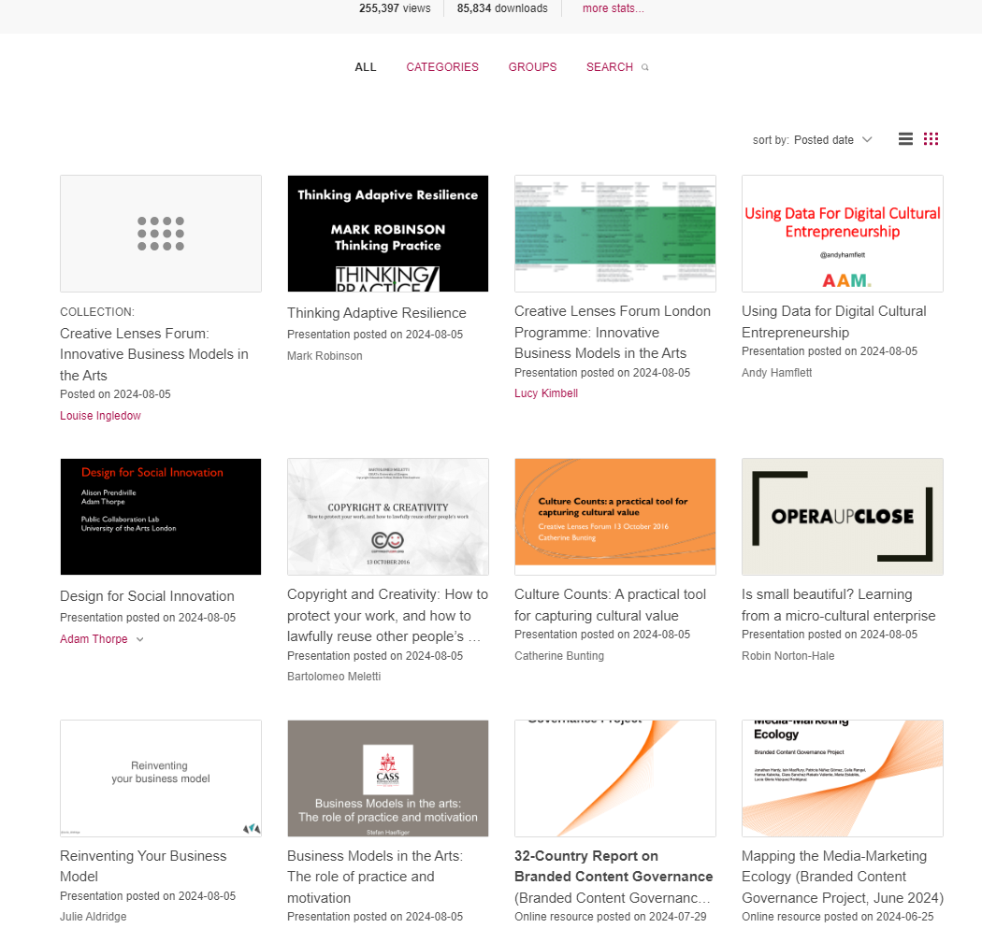
Figshare
Notes:
Figshare is the obvious candidate - data plus multiple images. But it's going to be a long job - 800 hats. Planned to do it manually. Then Anab: can we export it?

Slide 8
Exporting the data
Weird format
Reformatting in Access
Add custom fields
Trying in small batches
Figshare worked well for data…
Notes:
… but once we

Slide 9
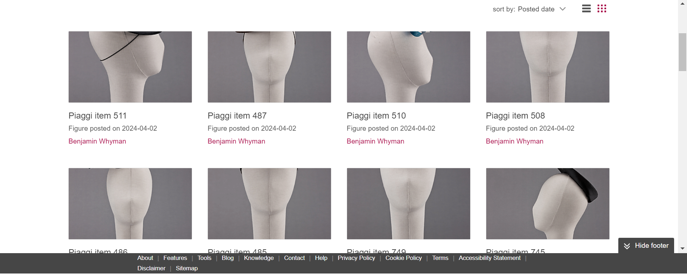
The Problem
Notes:
Hats done in portait style - they are literally portraits!

Slide 10
The Solution
FILL IN BACKGROUNDS
This will create a correctly sized thumbnail image for an item
Go into "My Data" in Figshare
Click on the title of the item to edit
Click on "Preview item" towards the bottom of the right-hand menu
There will be 2 or more images - click on the "Download file" button for one of the images - by default use the forward-facing one but you can choose a different one if it's more descriptive.
Save it on your laptop somewhere.
Go to photoshop (it takes a while to open, so if you're doing several of these leave it open).
Click "File", "Open" (and "On your computer" if it tries to get you to use the cloud) and open the image you've just saved.
Click "Image" and then "Canvas Size..."
It should say Width 667 and Height 1000. Change Width to 1500 - this will make the image wider, with white stripes on either side of the original picture.
Choose the Magic Wand icon.
Click the left hand side of the image where it's all white.
Press the Shift key on your keyboard - keep it pressed and then click the right hand side of the image. This should select both sides.
Click "Edit" and then "Content-Aware Fill..." (not "Content-Aware Scale"!)
Give photoshop a moment to work it out - the preview image should show a filled-in background. Click "OK"
Click "File", "Export", "Quick Export As PNG"
A new box will come up - click "Save" to save this new thumbnail in the same place as before.
Close the image - if it asks if you want to save changes, say "No" (it's already saved as a PNG)
A warning box will appear. Click "Submit for review" here too.
ADD THUMBNAIL
This will add the newly created thumbnail to the item you got it from
Go back to Figshare.
If the preview is open close it to go back to the edit screen for the item.
Click "Add custom thumbnail"
Click "Choose image"
Choose the version of the thumbnail that ends with .png
Click "Close"
You're now back at the edit item screen. Click "Save Changes".
Click "Submit for review"
A warning box will appear. Click "Submit for review" here too.

Slide 11
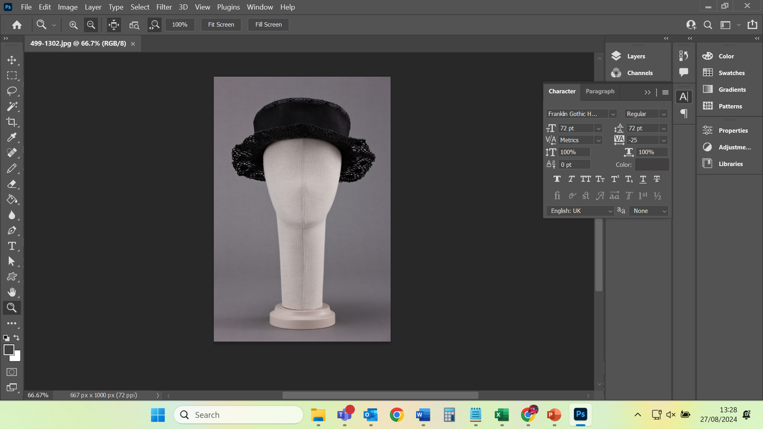
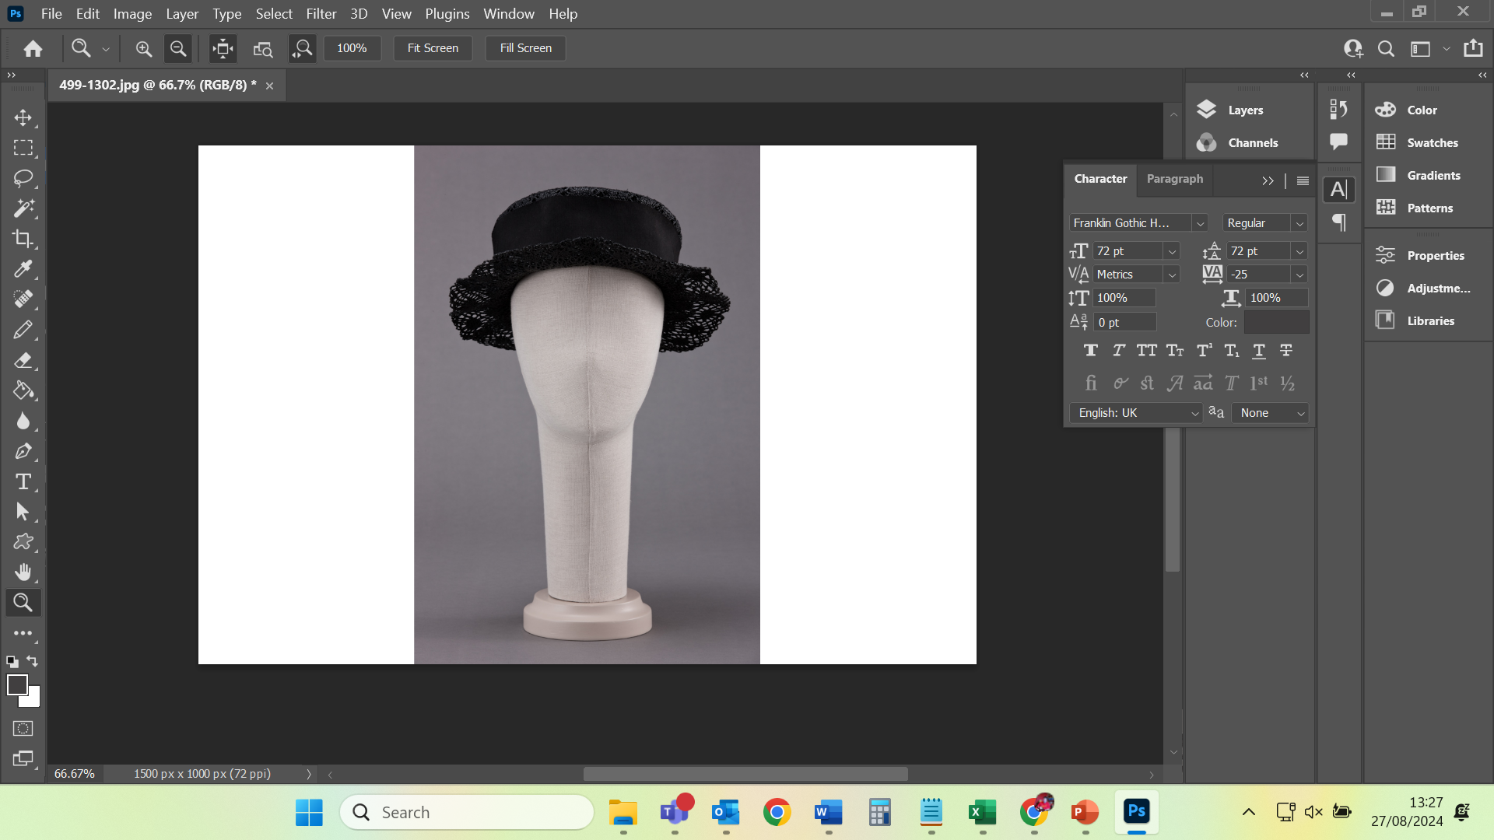
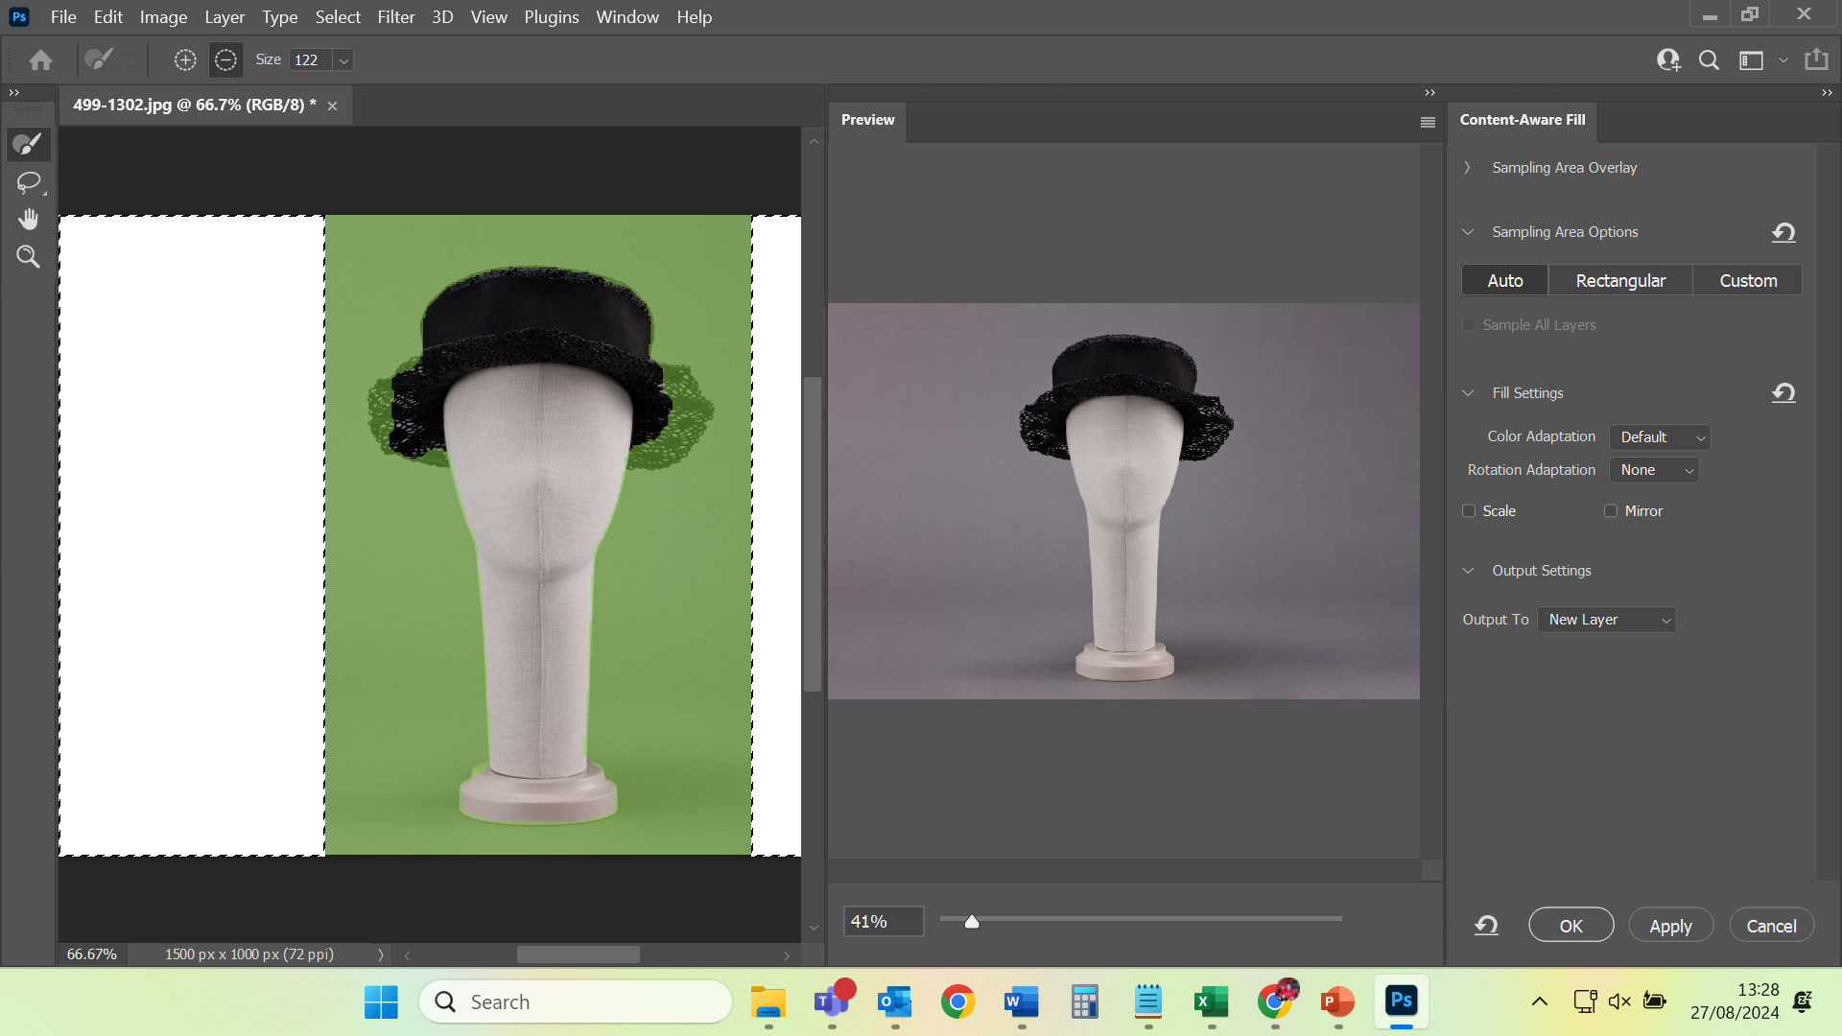
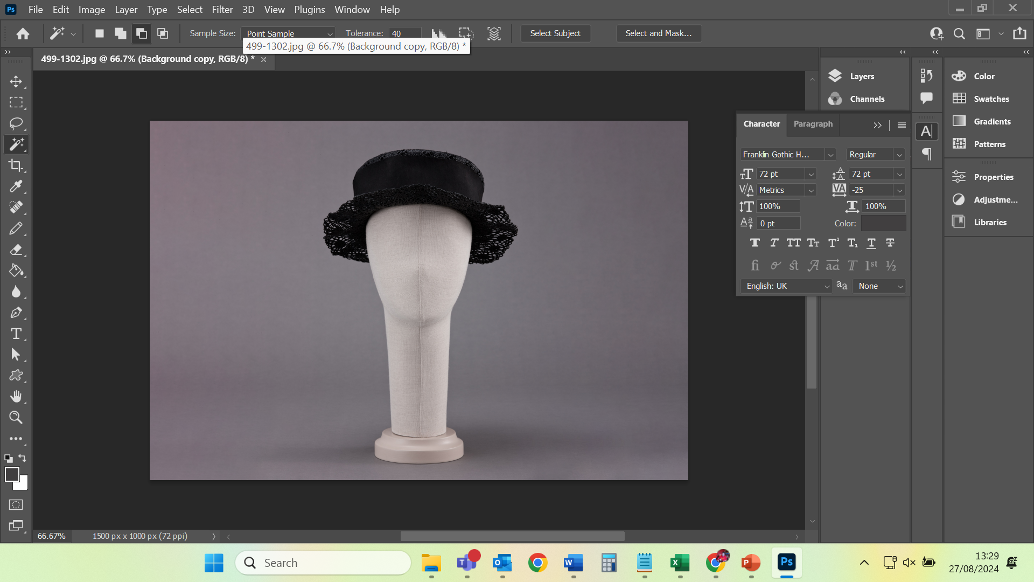
Notes:
Content-aware fill

Slide 12
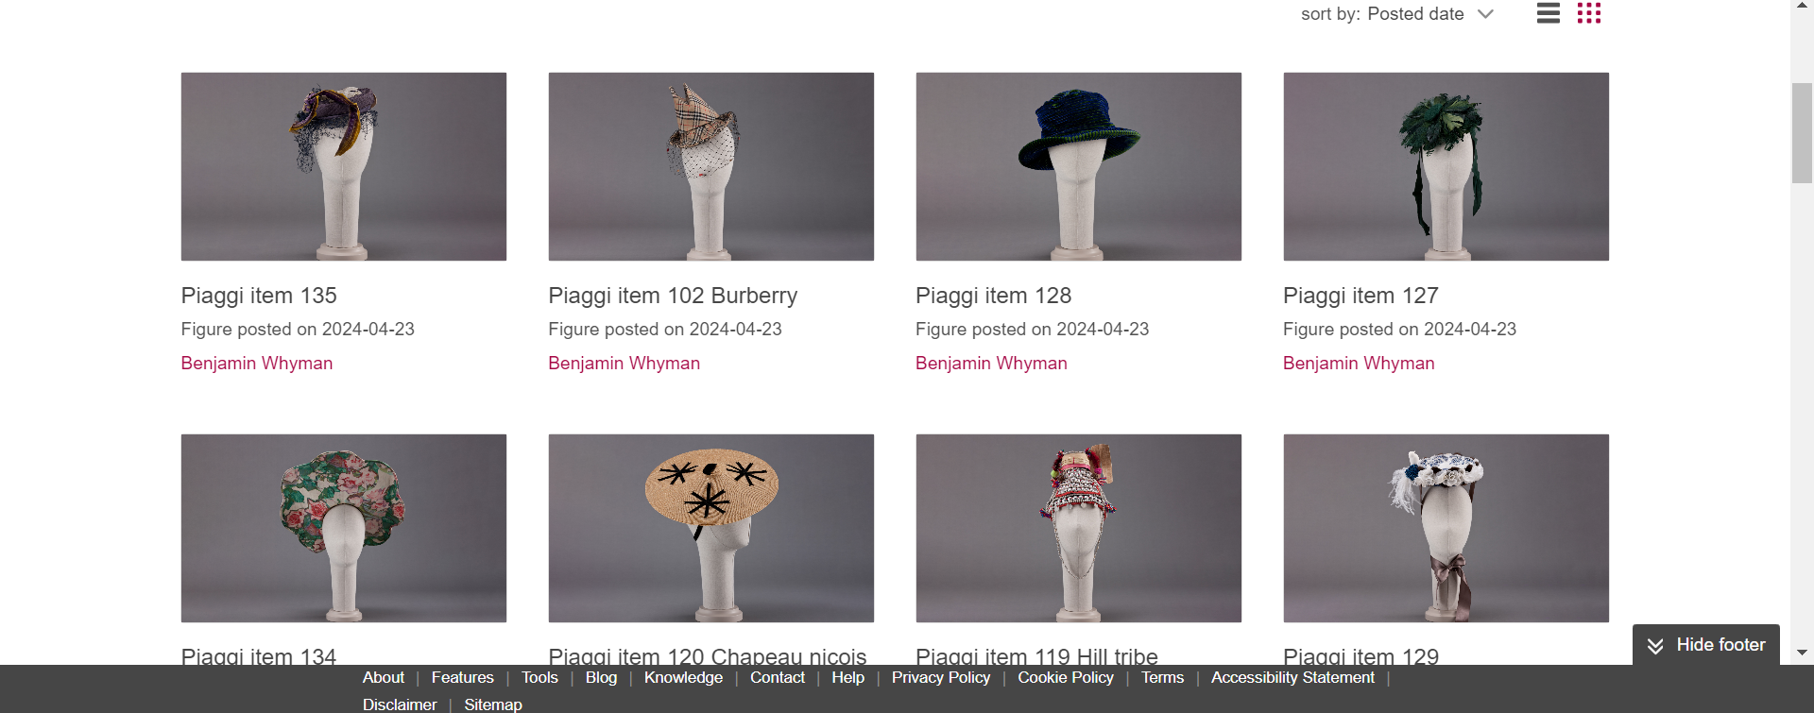
End result

Slide 13
Other benefits
Safely stored
Usage metrics
Tags
https://figshare.arts.ac.uk/piaggi

Slide 14
Conclusions
Imports worked really well
Great that it's discoverable
Assumptions made about screenshots are wrong

Slide 15
https://figshare.arts.ac.uk/Piaggi

