Slide 1
The Lost Paradise:
Photography and Desire
Dr Jennifer Good

Slide 2
Notes:
My area of expertise and teaching includes the history of photojournalism (see my book ‘Understanding Photojournalism’, and other published work).

Slide 3
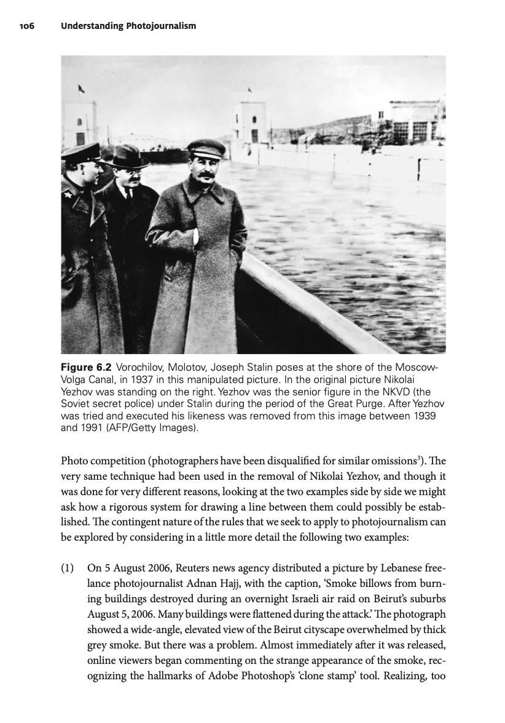
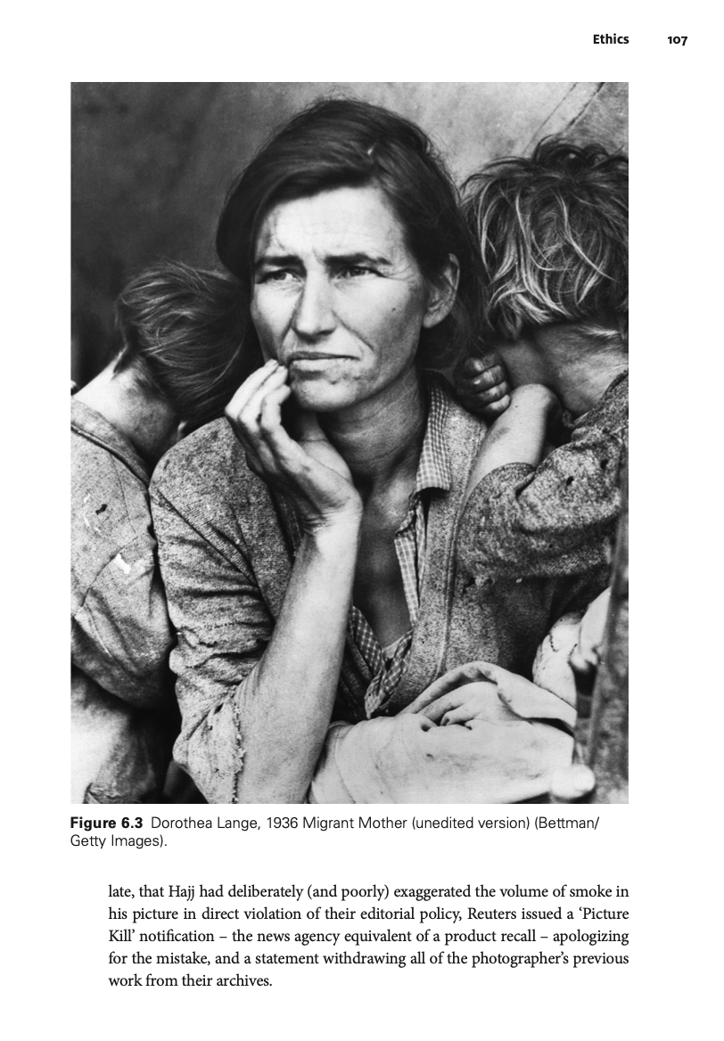
Notes:
Students always have a strong interest in discussing the history of image manipulation, and ongoing industry questions regarding digital manipulation and ‘truth’
Because of my strong interest in psychoanalysis, I am very interested in this desire.

Slide 4
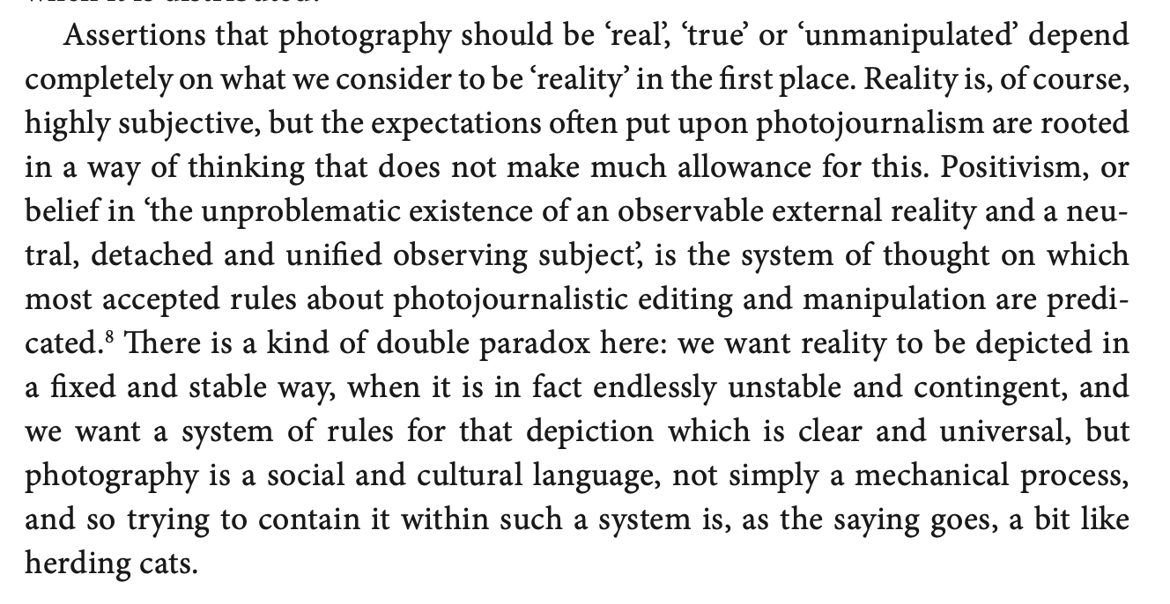
Notes:
I am interested in the fascination that these concepts hold on professional, social and even psychic levels. It’s this latter, deepest level that I want to discuss here.
What I’m interested in is not visual truth in photography, per se, so much as the desire for visual truth. The depth of this desire, and where it comes from.
It is what Sarah Kember calls our ‘investments’ in photographic realism, which, as I will discuss, operate at a deep psychic level.
Visual truth remains a deeply held social desire because it makes us feel ‘safe’.
The title of this panel is a fascinating provocation in this respect, because to me it refers to a ‘paradise’ of visual truth in photography – an idealised space of trustworthy visual representation and/or truth – that has never has existed, but is still endlessly pursued, not necessarily by photographers but by those of us who use, gather, collect and form attachments to images both vernacular and public.

Slide 5
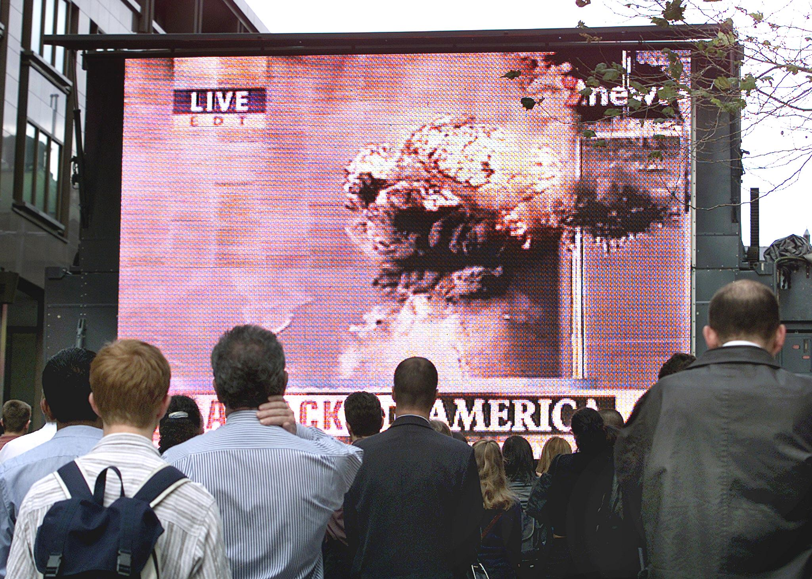
Notes:
This relates to my prior research on the psychoanalytic significance of the photographic and specifically photojournalistic representation of disaster (9/11 in particular – see my book and related publications).

Slide 6
Notes:
This work was, at base, not about images themselves, but about what people needed images to be in times of crisis.

Slide 7
Power:
Photography: ‘a certain relation to the world that feels like knowledge – and, therefore, like power’.
Susan Sontag

Slide 8
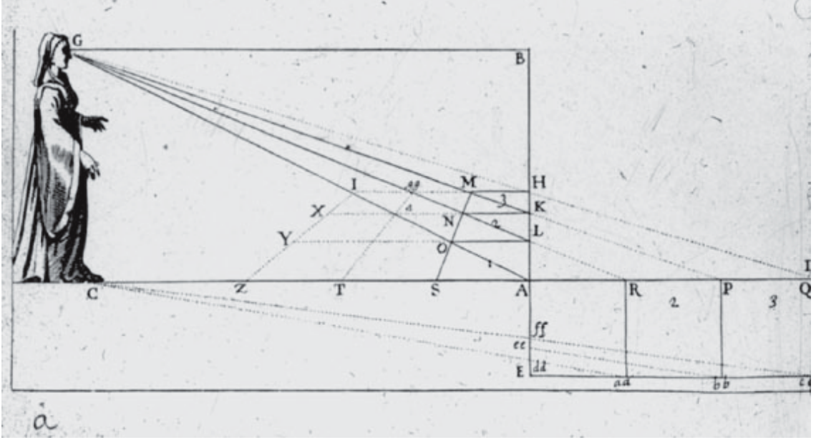
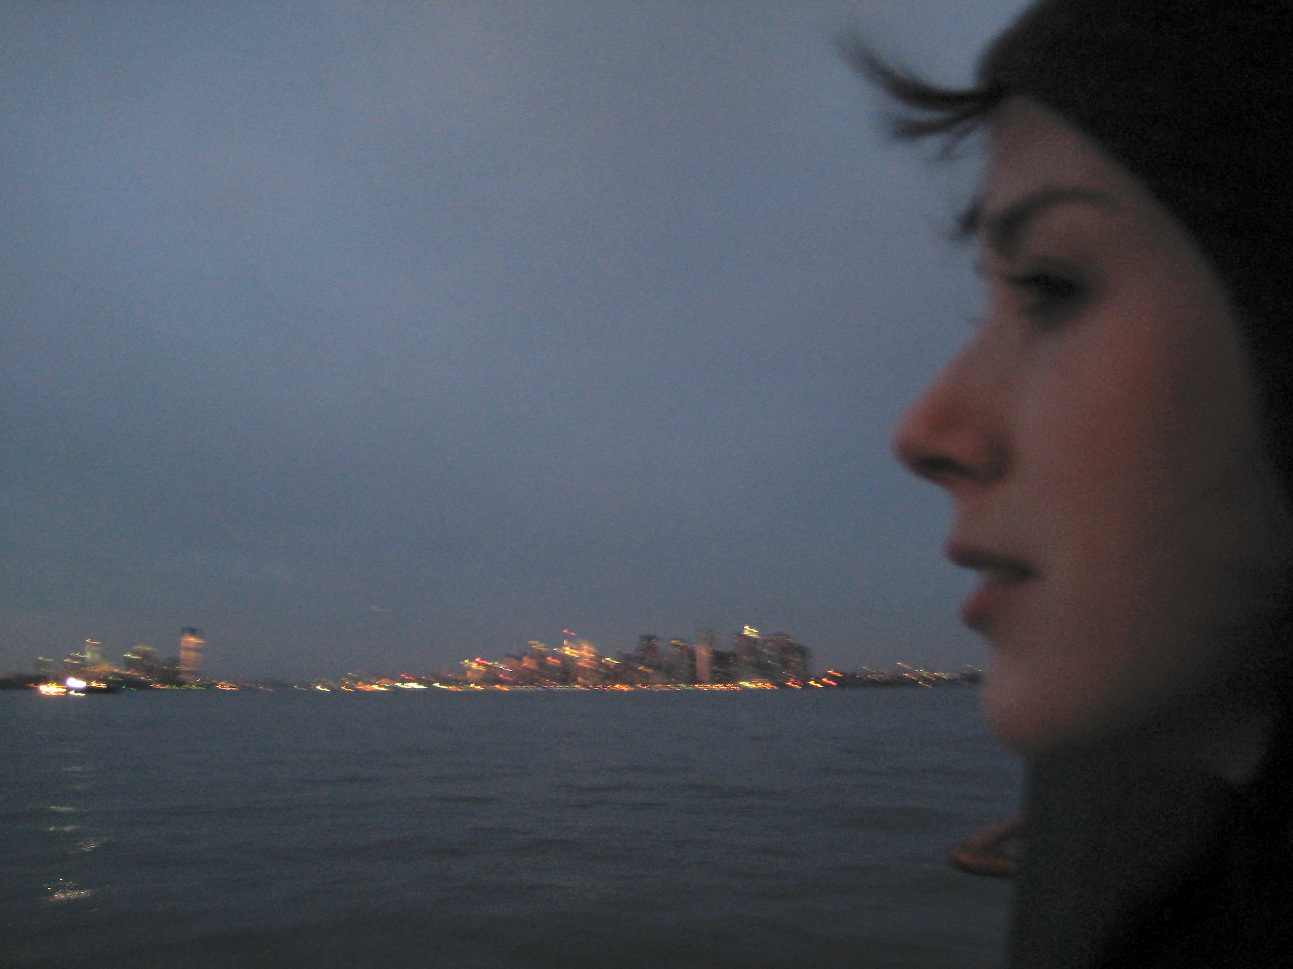
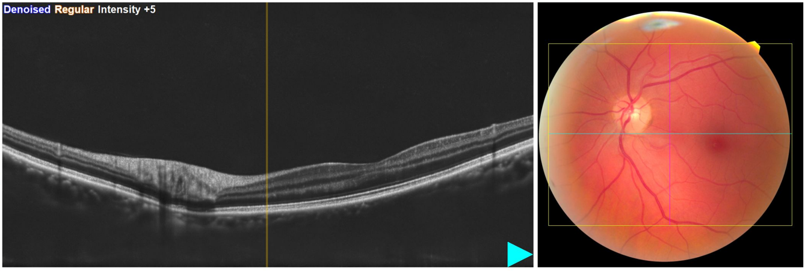
Notes:
This idea of a lost paradise - which cannot have been lost because it never existed - brings me to my current work in progress, in which I have begun to interrogate and experiment with letting go entirely of my claims to expertise as an academic authority on seeing. In my writing, I move away from the distanced perspective of a) the academic expert, and b) the ideal spectator of the image in general, and towards or even inside of my own body, my own lost paradise and my own fractured perspective.

Slide 9
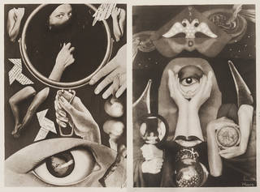
According to these photographs, sometimes I recognized a region of her face, a certain relation of nose and forehead, the movement of her arms, her hands. I never recognized her except in fragments, which is to say that I missed her being, and therefore I missed her altogether. It was not she, yet it was no one else. I would have recognized her among thousands of other women, yet I did not “find” her …
I was struggling among images partially true, and therefore totally false.
Roland Barthes
Claude Cahun & Marcel Moore, 1930
Notes:
about desire and loss (Cahun because of anti-photographic fragmentation)
The above quote connects these ideas firmly, for me, to love. My current work is about love, in a number of ways…

Slide 10
According to these photographs, sometimes I recognized a region of her face, a certain relation of nose and forehead, the movement of her arms, her hands. I never recognized her except in fragments, which is to say that I missed her being, and therefore I missed her altogether. It was not she, yet it was no one else. I would have recognized her among thousands of other women, yet I did not “find” her …
I was struggling among images partially true, and therefore totally false.
Roland Barthes
Claude Cahun & Marcel Moore, 1930
Notes:
about desire and loss (Cahun because of anti-photographic fragmentation)
The above quote connects these ideas firmly, for me, to love. My current work is about love, in a number of ways…

Slide 11
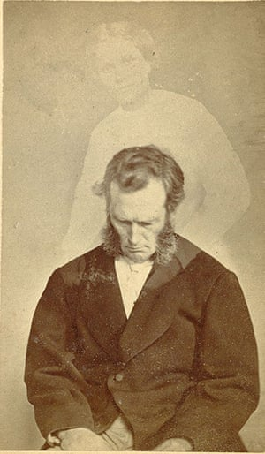
William H. Mumler, 1872
Notes:
Here, C19th spirit photography as typifying this desire – related to grief, and loss (of a kind of paradise in the form of the loved person).
Complex forms of desire have been woven into photographic practice from its earliest inception.

Slide 12
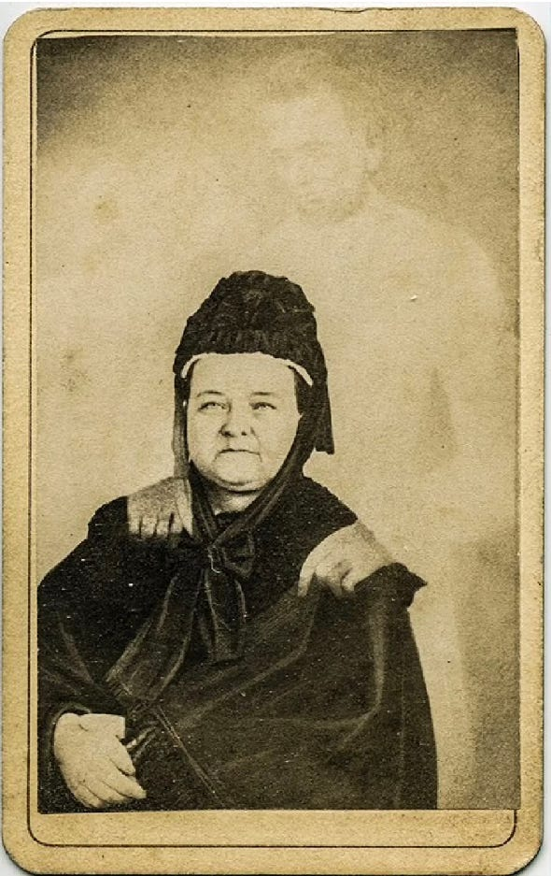
Mary Lincoln with the ghost of Abraham Lincoln by William H. Mumler ca. 1870
Notes:
Even after the practice was thoroughly debunked, people still lined up to have them made.
The desire was deeper and stronger than logic.
Stronger than truth.

Slide 13
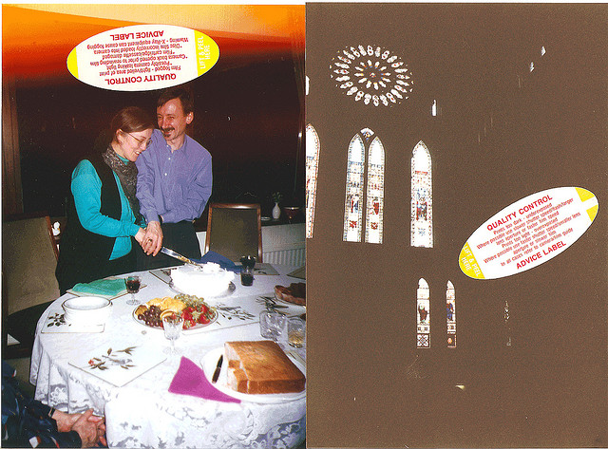
Notes:
Good and bad photography, + desire
The book is partly autobiographical, telling a story of the intertwining of my research on photography with my lived experience of violence. But I am not here to talk about that autobiographical thread, so much as another element of the work which has to do with the binary between conventional photographic epistemology and what might be called embodied seeing.

Slide 14
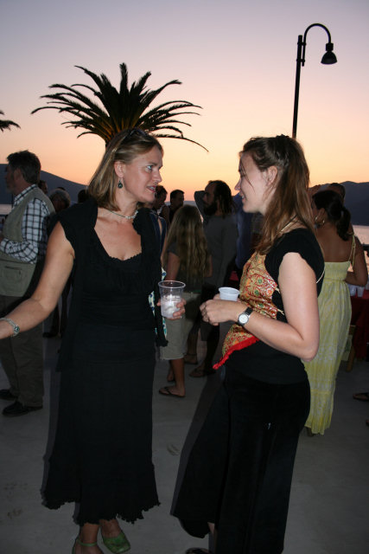
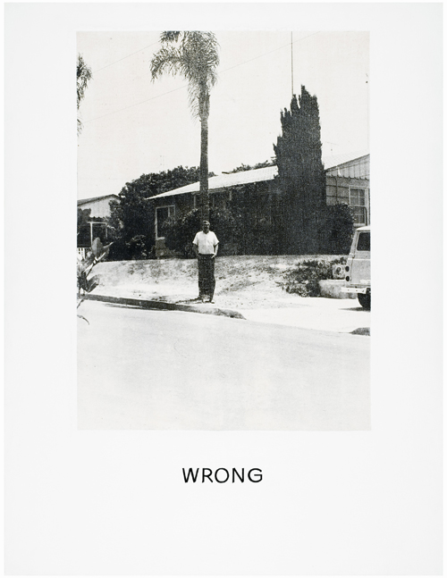
John Baldessari 1967
Notes:
and the uncanny
We need to be reassured

Slide 15
Desire:
…formal beauty in photography ‘helps us meet our worst fear, the suspicion that life may be chaos and that therefore our suffering is without meaning.’
Robert Adams

Slide 16
Panic:
…the panic over the loss of the real is actually a displacement or projection of a panic over the potential loss of our dominant and as yet unsuccessfully challenged investments in the photographic real.
- Sarah Kember, ‘The Shadow of the Object: Photography and Realism’, 1996

Slide 17
Panic:
…the panic over the loss of the real is actually a displacement or projection of a panic over the potential loss of our dominant and as yet unsuccessfully challenged investments in the photographic real.
These investments are social and psychological. They exist in the terms of power and knowledge and in the terms of desire and subjectivity.
- Sarah Kember, ‘The Shadow of the Object: Photography and Realism’, 1996

Slide 18
Panic:
…the panic over the loss of the real is actually a displacement or projection of a panic over the potential loss of our dominant and as yet unsuccessfully challenged investments in the photographic real.
These investments are social and psychological. They exist in the terms of power and knowledge and in the terms of desire and subjectivity.
…[this panic] masks a more fundamental fear about the status of of the self or the subject of photography, and about the way in which the subject uses photography to understand the world and intervene in it.
- Sarah Kember, ‘The Shadow of the Object: Photography and Realism’, 1996
Notes:
unpack to discuss psychoanalytical framing, along with concepts of both desire and panic
Kember takes this discussion of desire so far as to call the photograph – and especially the photojournalistic photograph – a fetish object in terms of the social attachment to truth value within it
For me, too, it functions specifically as a defence against the intolerable uncanny, or even just pure loss/grief.

Slide 19
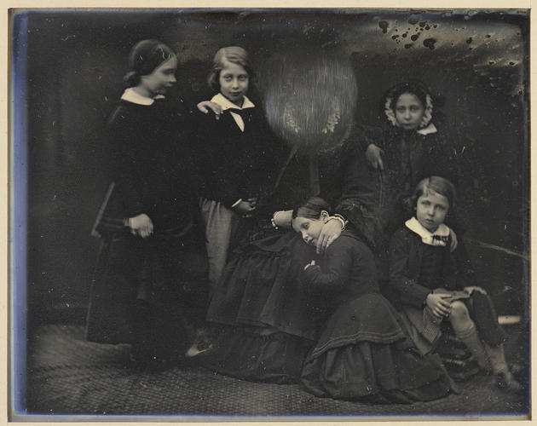
William Edward Kilburn, ‘Queen Victoria with the Princess Royal, the Prince of Wales, Princess Alice, Princess Helena and Prince Alfred’, 1852
Notes:
Describe the story (per Geoffrey Batchen)
anti-photographic again somehow. Embodied.
A kind of spirit photograph, because ghostly, but not. Also about an irrational, unfulfillable desire
And a kind of perverse faith in the power of the photographic image to ‘make it so’
(in the same way as seen with Stalin in the famous photographs edited to ‘disappear’ people.)

Slide 20
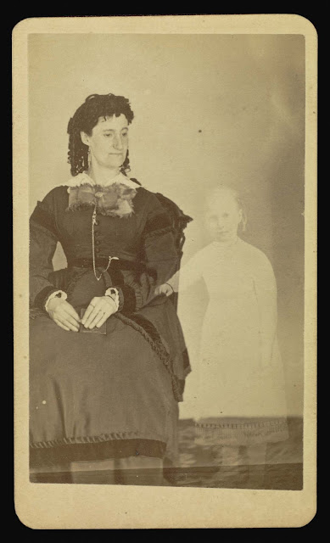
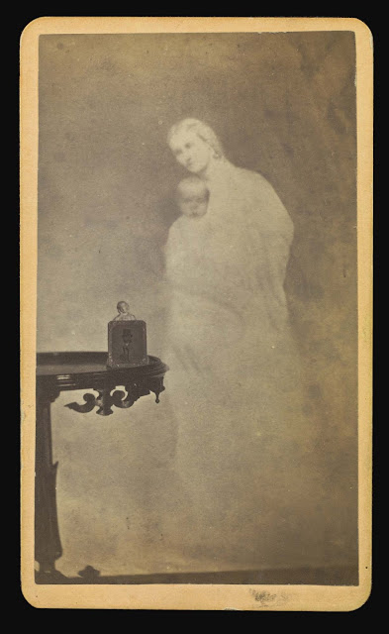
Sometimes, in the hallway, the light catches Nora’s portrait in such a way that I can see my own reflection in the glass, like a ghost. It is not so far from one of these composites. My own image, overlaid against hers, a transparent haunting. But that reflection is just a concrete metaphor for how much my own seeing of her there is already a projection of my self. The figures are simply reversed – she is whole, alive, the centre of the picture. I am the ghost that hovers – one of many in the house, I am sure – fleeting and barely there, gone when the light changes or I move down the hall towards her bedroom door.
Notes:
Describe the autobiographical nature of the work

Slide 21
Notes:
The book is unfolding… I haven’t had a chance to talk about any of the actual arguments is might be building towards, but these include:
the gendered contingency of photographic seeing and,
b) the photographic machine as an apparatus deployed primarily as a form of psychic resistance/defence against the uncanny, and against loss

