Slide 1
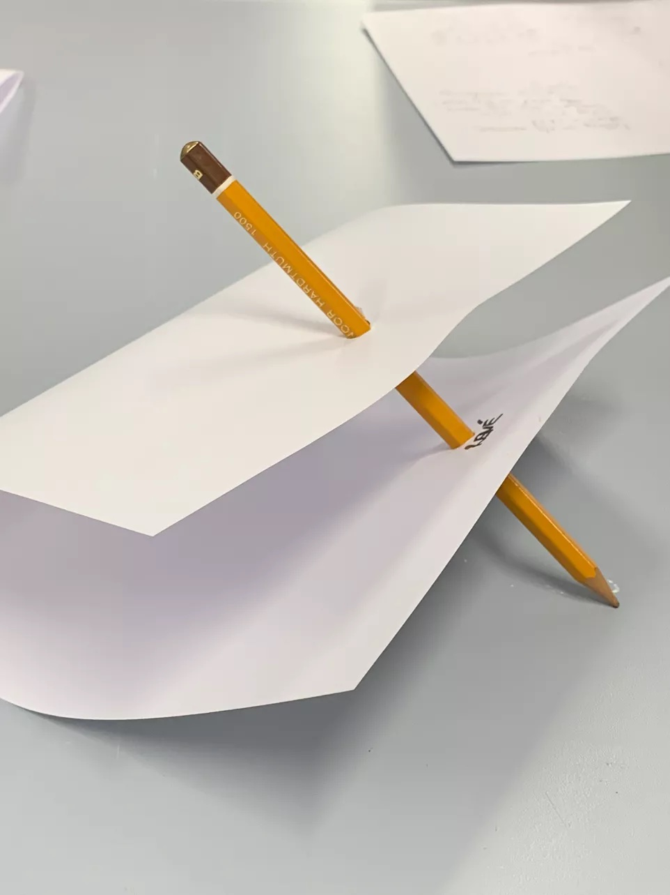
“Who’s in the Room?”
Crossing cultures, collaborating
Karen Amanda Harris
Intercultural Communications Trainer
Language Development Tutor
University of the Arts London
k.harris@arts.ac.uk

Slide 2
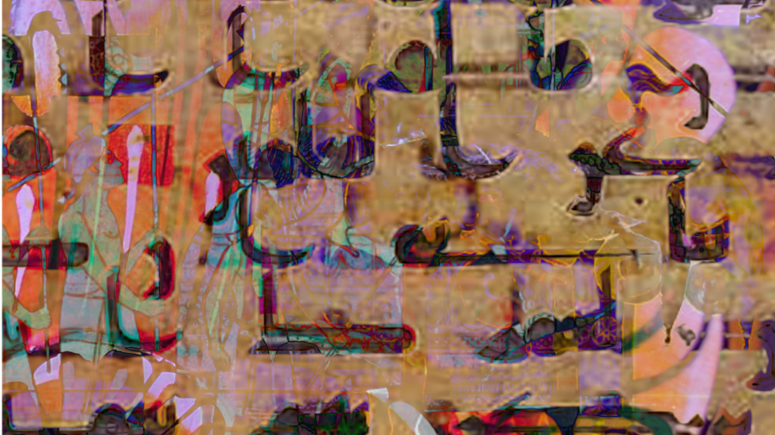
Inspiration: UAL Language-Art Project
This brings students together in a spirit of curiosity, friendship, and eagerness to learn from one another.
They discuss all things linguistic, and create language-themed art.
https://www.arts.ac.uk/study-at-ual/language-centre/language-art-project
The March of Letters by Nibras Al-Salman
(UAL Language-Art Project 2021)
Notes:
Language-Art Project is inclusive. All are welcome. Annual exhibition (online).
Why language? Satisfying intellectually, socially, creatively. People are often inherently interested and curious about language – we all have it, yet we all have a unique experience of it! So both a commonality and a point of difference/ interest. Unites!
Erika Tan, course leader for MA Fine Art – wanted something similar embedded in her course. To generate a sense of “who’s in the room.” This became our working title, then our definitive title.

Slide 3
What is it?
A pilot project at UAL: Intercultural Communications Training + MA Fine Art (Year One)
Format: 2.5 days of workshops in the Autumn term (spread through Sept/ Oct/ Nov). Timetabled into the course schedule.
Rationale:
To get a sense of “who’s in the room.”
Adventures in identity, culture, language, understanding and (mis-)interpretation.
Notes:
Bringing a Year One cohort together, at the very outset of their studies, for adventures in identity, culture, language and (mis-)understanding.

Slide 4
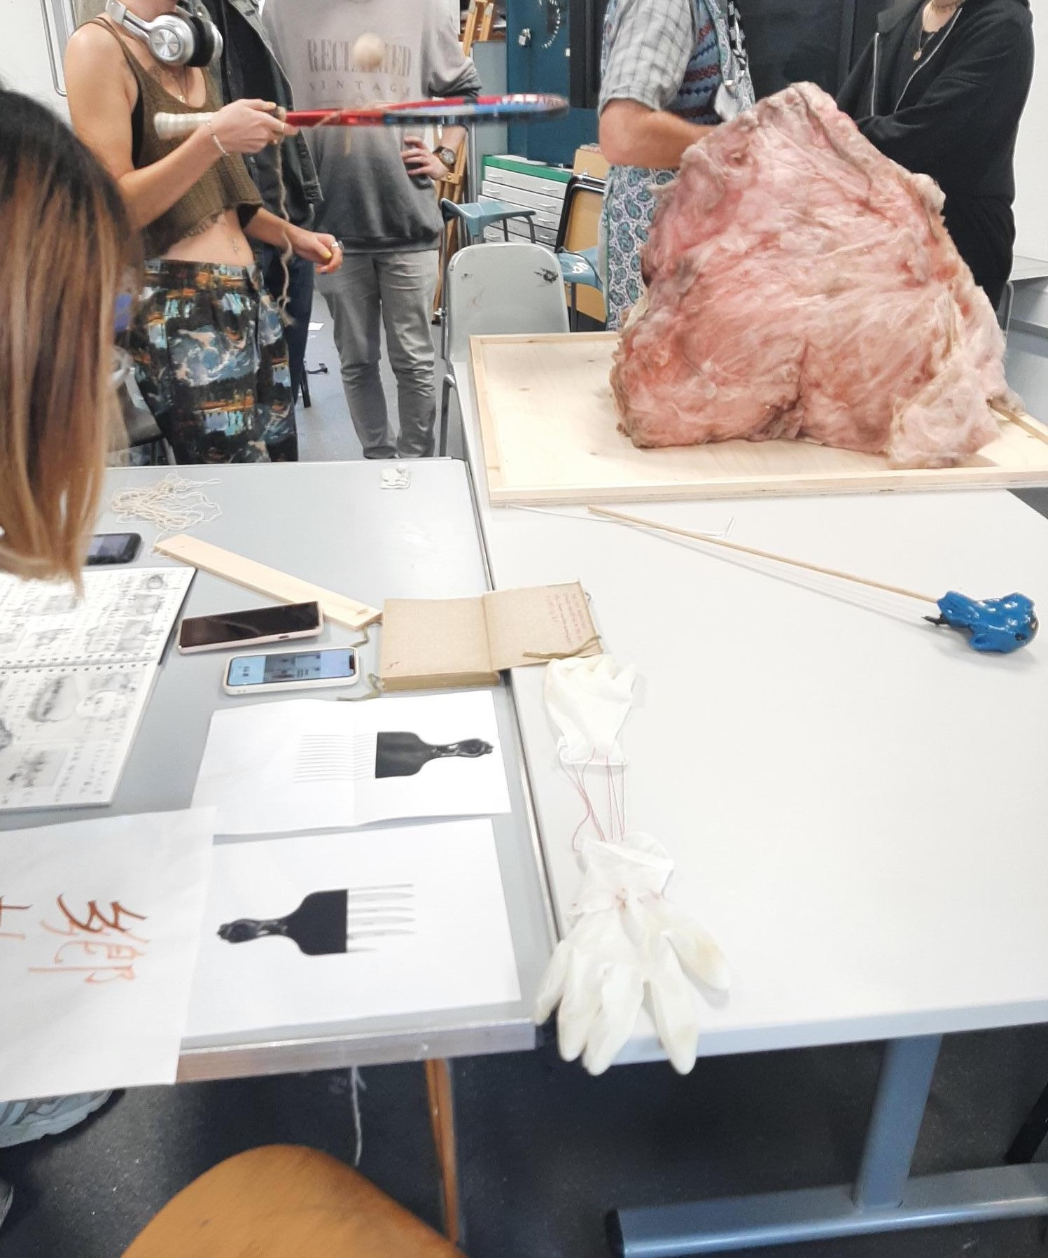
Who was actually in the room?
MA Fine Art (Year One). Over 30 students, mixed nationalities.
Facilitators: Intercultural Communications Trainer; MA Fine Art course leader; postgraduate ambassador.
(Also: a MAFA lecturer; two Year Two students.)
Notes:
Mixed nationalities, e.g. Chinese, Japanese, Polish, UK, US…

Slide 5
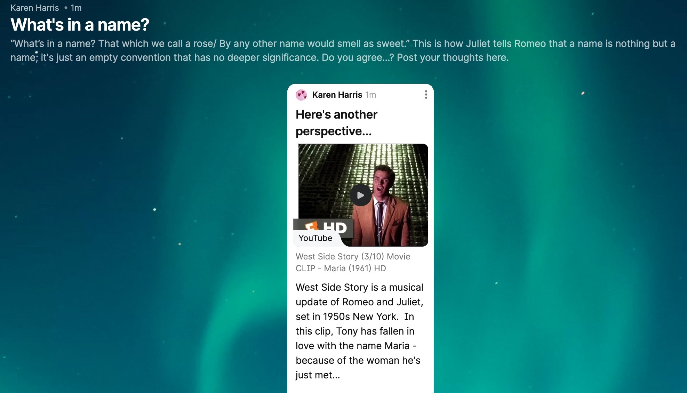
Session One: What’s in a name?
Padlet activity: Juliet versus Tony
Notes:
The morning activity.

Slide 6
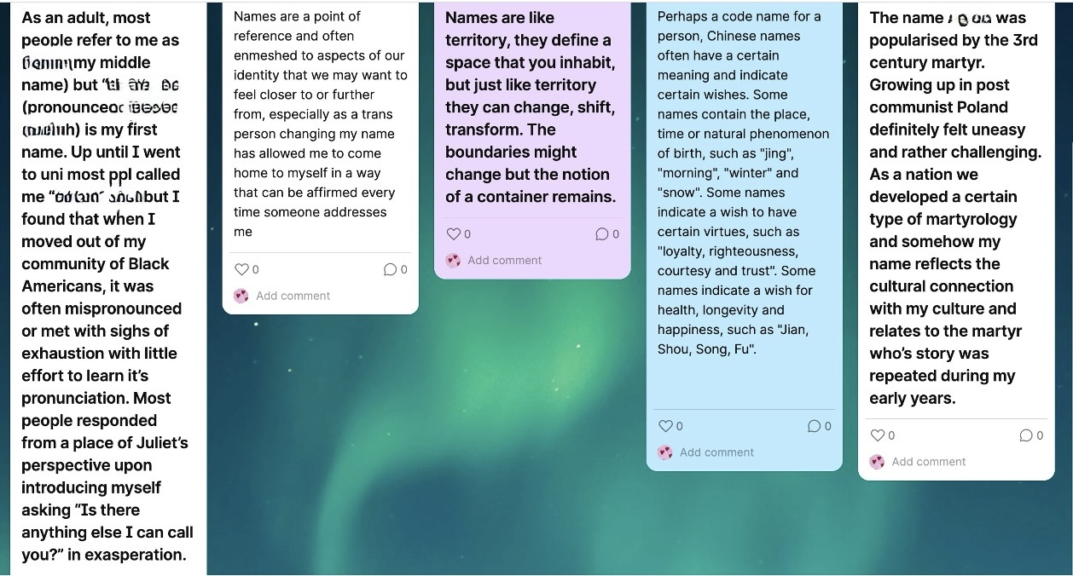
Sample responses...
(From Padlet activity, with names redacted.)
Notes:
A cross-section of reflections on name and cultural identity: black American, trans, Chinese (these names are multi-faceted!), Polish…
This was followed by discussion.
Erika Tan, MA Fine Art course leader: “The Padlet really worked well. I think the ability to put ideas up anonymously helps solicit such an interesting range of responses.”
And then they can get involved in the open discussion as and when they feel ready – less pressure?
Then onto the afternoon activity…

Slide 7
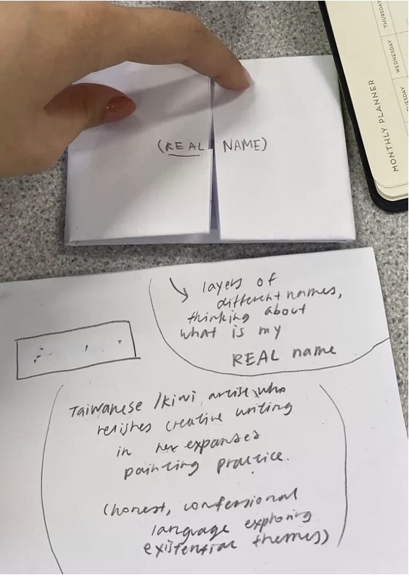
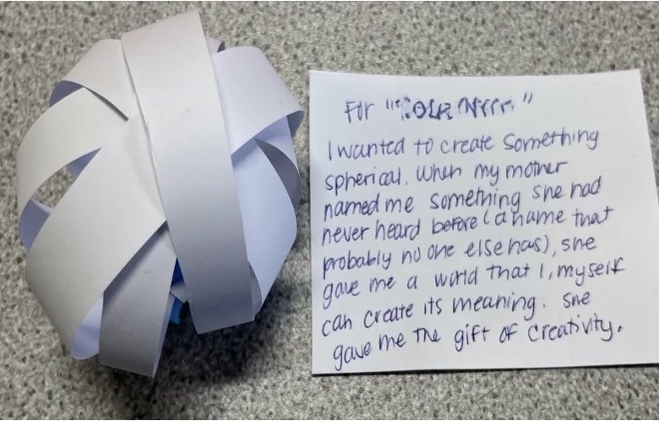
Name visualisations
Visualising one’s name; inviting responses
(names shown redacted)
Notes:
The afternoon activity.
Students created a visualization (some kind of artistic representation) of their name. These could be as straightforward or enigmatic, with as much or as little textual explanation, as they wished.
Students then wandered round the class and looked at each other’s pieces.
The whole-class discussion. “Any that particularly struck you, and why?” Students might respond e.g. ”I really liked Hannah’s one because...” And then I would invite the creator to add further comment, if they wished.

Slide 8
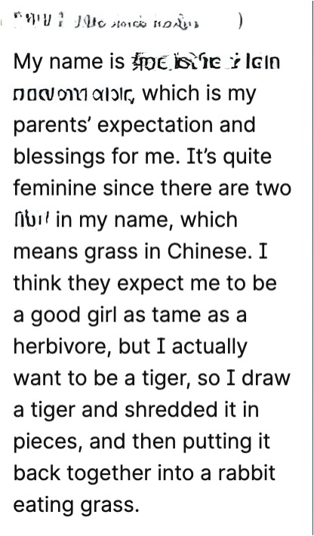
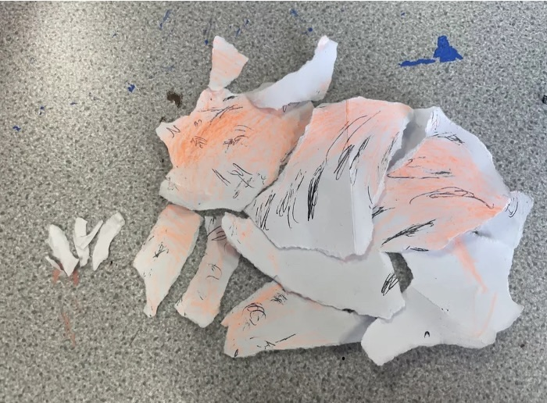
Another name visualisation
(name shown redacted)
Notes:
This student also put it on the Padlet.

Slide 9
Session One: Verdict
“Thanks so much for yesterday’s session. There was such good energy in the room!
I think Marc and I enjoyed very much being able to stand back a little and see the group working in this way and how you facilitated the discussions.”
Erika Tan, course leader.
Notes:
There was also some very happy feedback from students during the day, saying they liked the session.

Slide 10
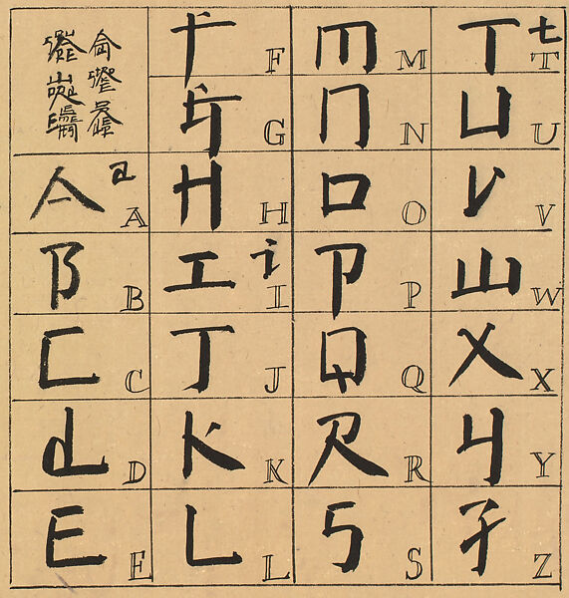
Session Two a) Language adventures
Discussing language and:
perception vs. reality
the liminal zone of understanding/not understanding
pleasures and challenges.
An Introduction to Square Word Calligraphy by Xu Bing (1994-6)
Notes:
Session Two has the theme “What do we mean by meaning?”
This slide shows the morning part. The discussion and prompts (including the Xu Bing exploration) were led by Erika Tan, MA Fine Art course leader.
Xu Bing’s work is deliberately designed to trick the viewer. At first glance, we are easily fooled into believing it is Chinese script – a closer look shows that it is actually English.
Students rarely get the chance to have these discussions surrounding language in class. Yet language is a great source of fascination, intellectual stimulation and creative possibility – and on a social barrier-breaking level, it provides a valuable way in which students can learn from and get to know one another.

Slide 11
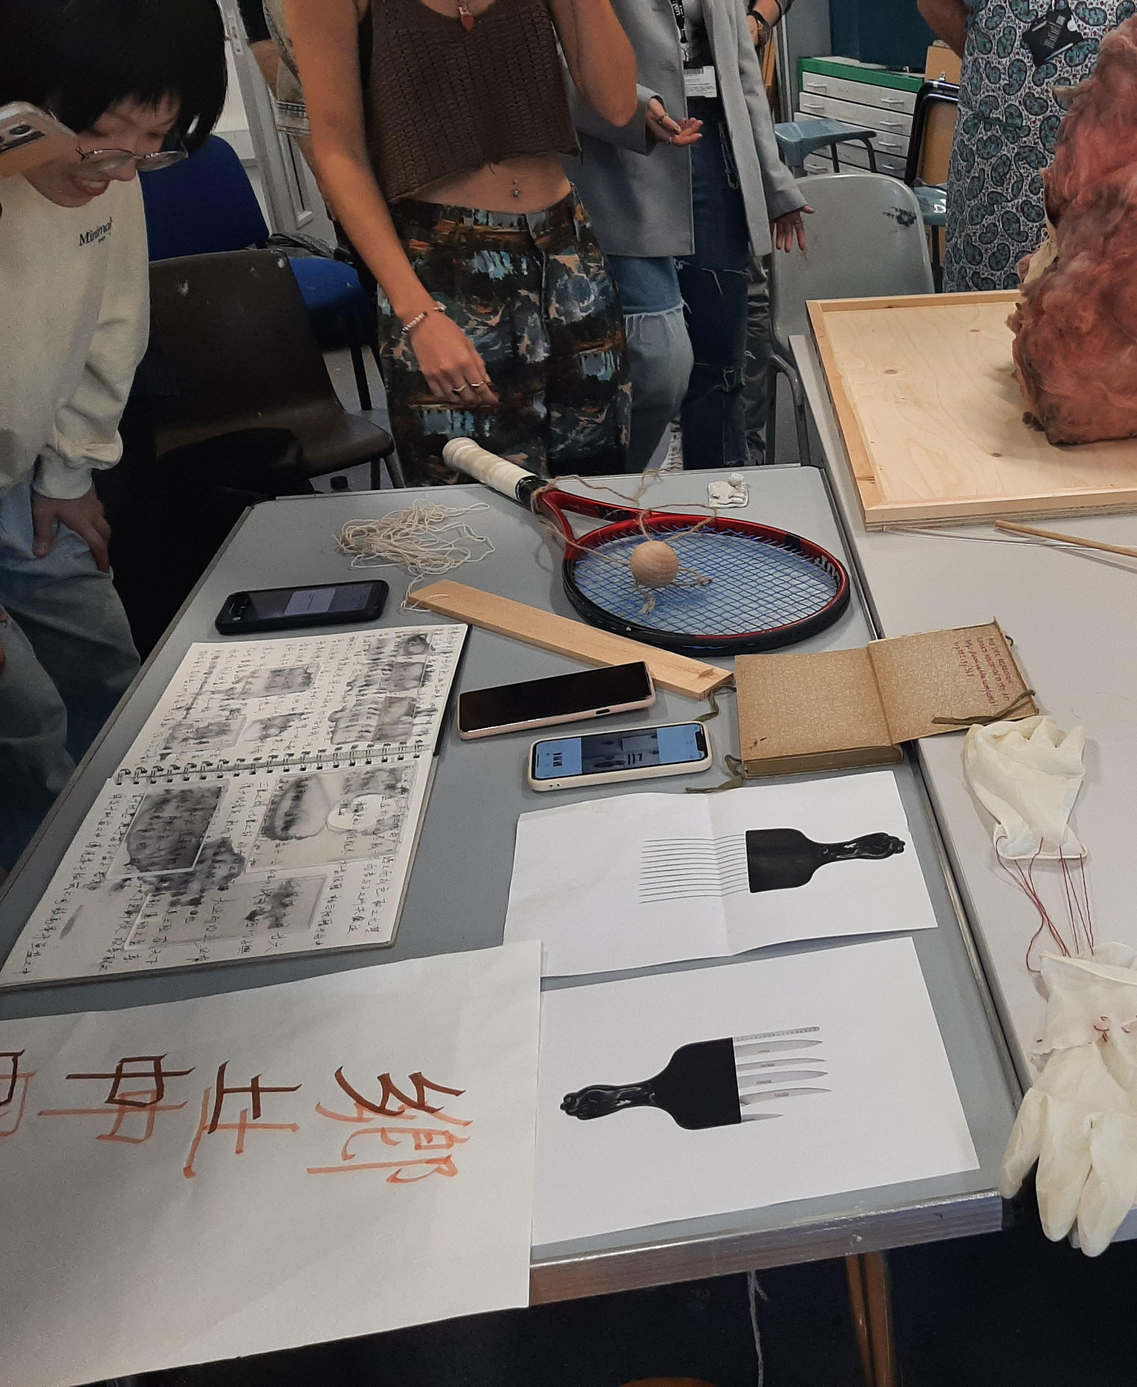
Session Two b) Object analysis
“There’s no such thing as a boring object!”
This experiment shows how different layers of meaning can co-exist.
Each individual brings a unique interpretation, creating a shimmering multidimensional richness.
Notes:
This was the afternoon part.
Students brought in an object that had some kind of personal/ cultural significance to them (e.g. jewellery), and pooled the objects on a table. Everyone would choose an object and consider their own interpretation of what it might mean (without knowing the context, and possibly not even who it belonged to). They then found the object’s “rightful owner” and would compare their interpretations. Followed by whole-class discussion.
One student offered himself(!) as his chosen object. He was a UK student, wearing a garment of his Ghanaian heritage – led to a thought-provoking conversation.
After this, students went to their studio space and created an artistic response to their own object. This could be partially informed by the discussions they had, and other students’ interpretations of their object. This was followed by a final whole-class discussion on what they had created, and why.
(Example: fibreglass piece – looks inviting and fluffy, but is not advisable to touch. This was an artistic interpretation of the student’s grandmother, who was kind but very “don’t mess with me” tough – hence the apparent paradox. The item he’d brought in was the grandmother’s apron – you can see part of it it in the top right of the picture. This led to a fascinating discussion. A lovely way of getting students to open up to each other.

Slide 12
Session Three: The best laid plans…
What should have happened:
-Playfulness with language: experimental poetry
Take a phrase/ sentence (just a few words).
Change the emotions by playing with its punctuation and creating the rest of the verse around it.
To sound joyful, sad, doubtful, reflective, etc.
Compare/ contrast/ combine.
But it didn’t happen. Unforeseen circumstances!
Notes:
In my email to the student beforehand: “This kind of linguistic experimentation might be very new to some, and possibly even overwhelming at first. Some might still feel wary of any kind of playfulness when it comes to language, after years of being told that there is a "right" and "wrong" way of handling lexis and grammar and syntax.” But also very liberating to explore the possibilities of language together.
The facilitator was a Year Two student, who couldn’t make it due to flooding. But it would have been great to try it!

Slide 13
So instead…
An alumna and a Year Two student gave talks on their own language-based artwork.
“I wander through passing conversations that are sitting in the atmosphere.” –Ellie Day, Yr 2 student.
Image removed.
Click here for image link.
Artwork by Ellie Day (2022)
Notes:
To inspire the students to take a similarly exploratory, playful approach to language – without fear of ”getting it wrong.”
Ellie Day’s work relates to psychogeography: her paintings are a visual representation of chatter/ small fragments of conversation as “urban noise.” This led to my observations about the pleasures of eavesdropping, e.g. on the bus. This is actually an effective way of tuning one’s ears into the language, and using one’s imagination to fill in the gaps.

Slide 14
Reflections and future considerations
Cohort? (Undergrad vs. postgrad/ subject discipline…?)
Timetabling constraints?
Temptation to overpack the session?
Spoken vs. non-spoken communication (e.g. Padlet)
Ultimately, “Who’s in the Room?” is about using language and storytelling to surmount barriers.
Notes:
Cohort? MA Fine Art are, by definition, mature (as Postgrads) and intense/ introspective. BA Journalism, by contrast, had less to say when I tried a Name Exploration Padlet with them.
It can work with students of less “arty” subject disciplines – can still be creative and curious! Regardless of subject, students often want to get to know one another – they just need a platform.
Timetabling pressures/ constraints? Need an enthusiastic course leader who’s on board with this – so scheduling this is seen as a benefit and not an imposition.
Temptation to overpack: tried to have a “reflecting on silence” component – but this was less successful. Too much?
Spoken vs. non-spoken communication – what counts as “active participation/ engagement”?

Slide 15
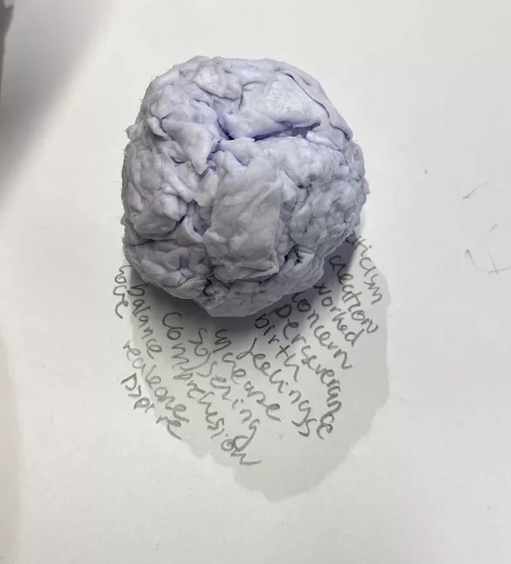
Thank you for listening!
k.harris@arts.ac.uk

