Slide 1
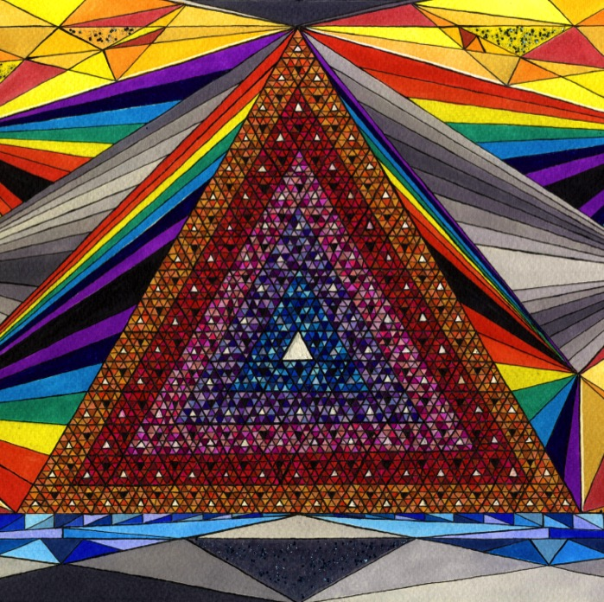
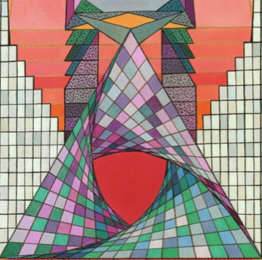
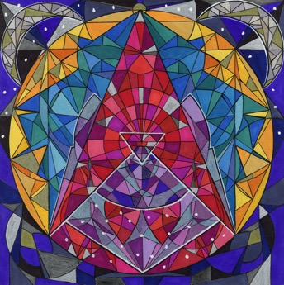
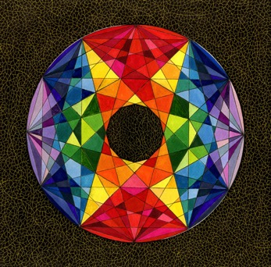
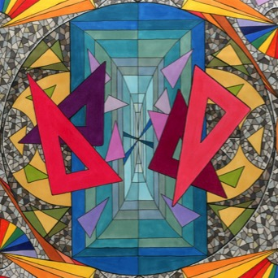
The Mathematical Art Statement: multidisciplinary magic
Karen Amanda Harris

Slide 2
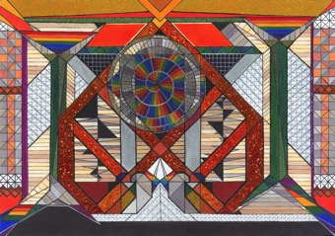
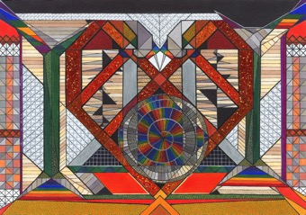
Background
MEd (Applied Linguistics)
Language Centre, University of the Arts London
Working at the intersection of language, art, culture and communication
Mathematical artist (non-digital)

Slide 3
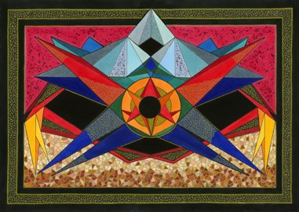
An artist statement to inspire non-mathematicians…
short (100-150 words) and balanced
non-technical description of the creative process, and the maths
emphasis on the mystical/ magical/ surreal splendour of the geometric world.

Slide 4
In this talk…
… I have colour-coded the key elements in my artist statements.
Green = sense of wonder, intrigue, magic
Blue = the technique
Red = the maths!

Slide 5
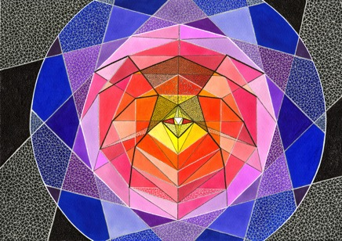
Spirit of the Silver Web (2020)
This is an A3 piece on watercolour paper: using Promarker, ink liner, gel pen and glitter nail varnish. It's one example of how I explore geometric possibilities -using ruler and compasses- to create vivid dreamscapes that are part abstract, part figurative. The division into colour sections, and the use of metallic gel pen to create a delicate net-like "webbing", add further sophistication, uniqueness and visual excitement.
At the centre is an equilateral triangle, surrounded by a square in a pentagon in a hexagon in an octagon (sorry, but no heptagon!) in a decagon in a dodecagon. The vertices of the inner and outer polygons are connected in a strict pattern to create the web's structure. At the heart of the web, outlined in black, is the red-eyed spider - its form emerging ghostlike from the lines of its silk.
The spider in this case did not create the web; the web created the spider.

Slide 6
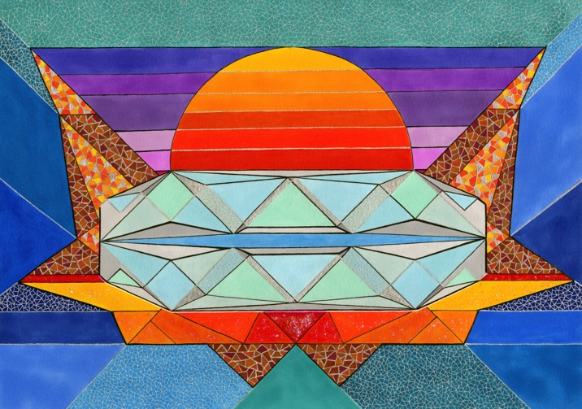
Sarcophagus (2018)
First paragraph only – just the mystical part!
Science fiction and mathematical exploration are profoundly connected. Especially intriguing is mathematical art which hints at a complex narrative beneath its surface. A 2D image, while technically motionless, might contain the tantalising promise of release from its static confines - with potential for backstory, movement and transformation.
(…)

Slide 7
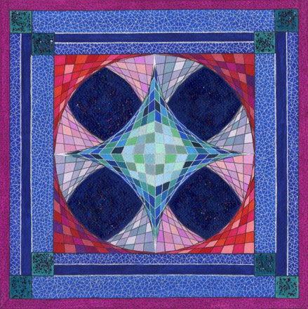
No Curve (2018)
First paragraph only
The apparent complexity of this design derives from a conceptually simple process: connecting points on the x and y axes at regular intervals (1,0 to 0,9; 2,0 to 0,8; 3,0 to 0,7...), applying and reflecting this throughout the image in a consistent pattern. The result is an illusion of three-dimensionality, with a central area that looms from its squeezed surroundings.
(…)

Slide 8
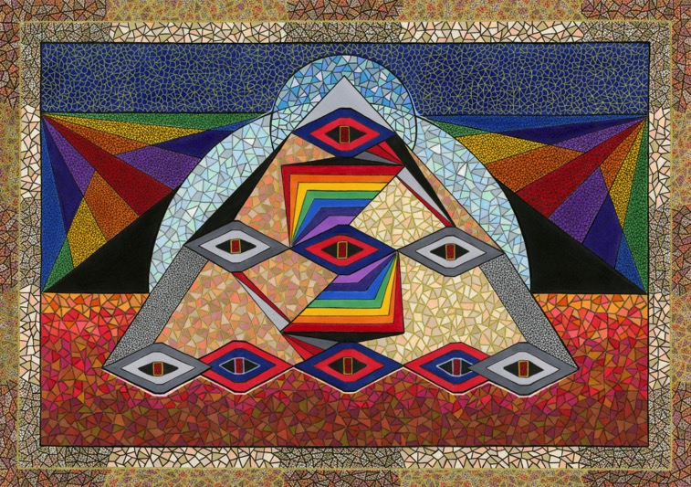
Nine-Eyed Pyramid (2019)
Final paragraph: combining the elements
(…)
The angled spectrum in the centre suggests an almost-staircase. Deliberately flouting the rules of spacing in perspective drawing, it teasingly flits between the 2- and 3- dimensional.

Slide 9
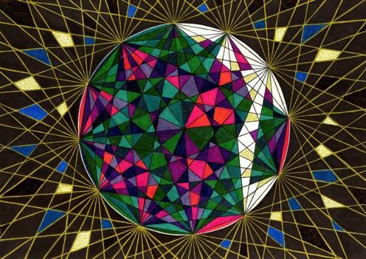
Broken Sphere (2016)
I started with a circle, and played with it. I was curious to know what would happen if I connected point to point to point to point to point ... and so on. This finally transformed into a sphere, containing multitudinous triangles, quadrilaterals and arrows. And then I wondered: what if I extend the lines further, and turn the sphere into a planet, caught in a network of golden threads, glittering in space?
The "brokenness" of the sphere, with the fragments flying outwards, brings movement to the image. If it had remained whole, with every section neatly coloured and no shards, it would have been static and lifeless.
The viewer is left to ponder what lies outside the boundaries. Where does the golden net finish - and how?

Slide 10
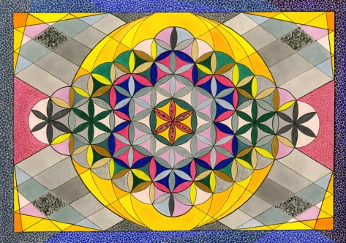
Ultimately, the purpose is…
…to intrigue non-mathematicians of all ages, so they might explore for themselves the infinite possibilities that come from a ruler, compasses, curiosity and imagination.
Karen Amanda Harris
k.harris@arts.ac.uk
karen@scarletfruit.com
https://scarletfruit.com/
All images and descriptions in these slides can be seen at https://scarletfruit.com/mathematical-gallery

