Slide 1
Comics and the Linearity of Time
Ian Hague
University of Chichester

Slide 2
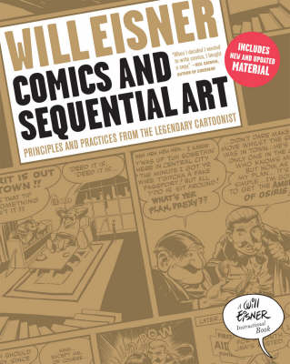
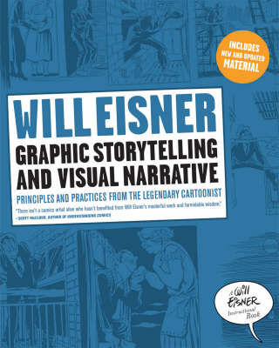
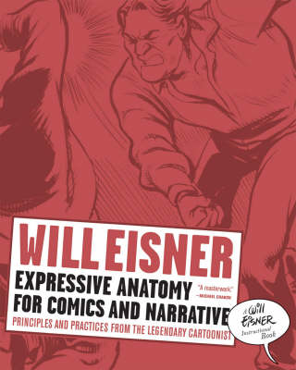
1985
1996
2008

Slide 3
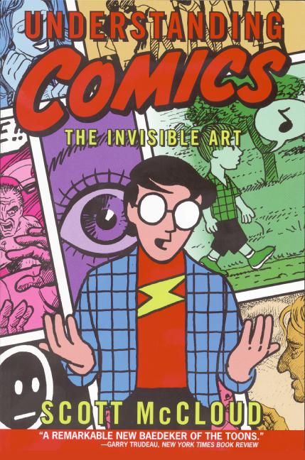
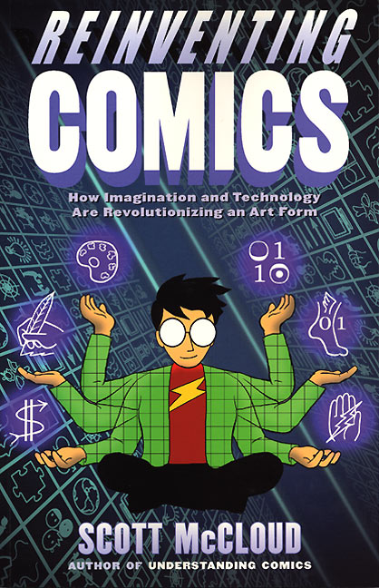
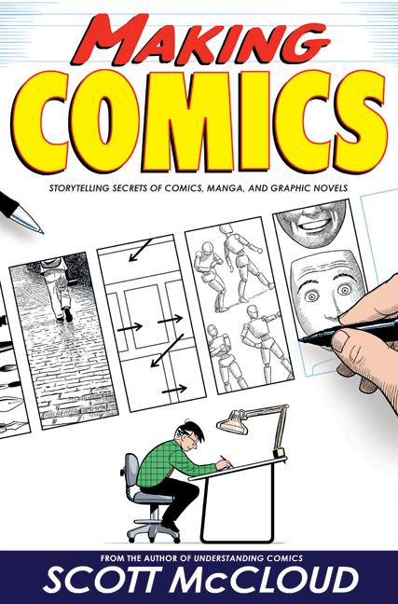
1993
2000
2006

Slide 4
Sequential Art: ‘A train of images deployed in sequence.’ (6)
‘The graphic novel, as we know it today, consists of a combination of text, either narrative or dialogue (balloons) integrated with sequentially deployed art.’ (136)
Comics: ‘The printed arrangement of art and balloons in sequence, particularly as in comic books.’ (6)
Eisner, Will, Graphic Storytelling and Visual Narrative (1996)

Slide 5
Iconic Solidarity: ‘the relational play of a plurality of interdependent images’ (17)
‘the unique ontological foundation of comics’ (17)
Groensteen, Thierry, The System of Comics (2007)

Slide 6
‘[Sequential Art] is studied here within the framework of its application to comic books and comic strips, where it is universally employed.’ (5)
Eisner, Will, Comics and Sequential Art (1985)

Slide 7
‘Juxtaposed pictorial and other images in deliberate sequence, intended to convey information and/or produce an aesthetic response in the viewer.’ (9)
McCloud, Scott, Understanding Comics: The Invisible Art (1993)

Slide 8
‘[. . .] editing is an operation that takes place after the filming, and it consists of an intervention on a material that has already been elaborated; the page layout, on the contrary, generally is invented at the same time that the drawings are realized on paper, or even before the scenario is drawn.’ (101)
Groensteen, Thierry, The System of Comics (2007)

Slide 9
‘In visual narration the task of the author/artist is to record a continued flow of experience and show it as it may be seen from the reader’s eyes. This is done by arbitrarily breaking up the flow of uninterrupted experience into segments of “frozen” scenes and enclosing them by a frame or panel.’ (39)
Eisner, Will, Comics and Sequential Art (1985)

Slide 10
Choice of Moment: ‘“Connecting the dots”, showing the moments that matter and cutting those that don’t.’ (37)
McCloud, Scott, Making Comics: Storytelling Secrets of Comics, Manga and Graphic Novels (2006)

Slide 11
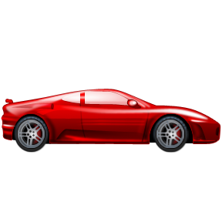

Slide 12

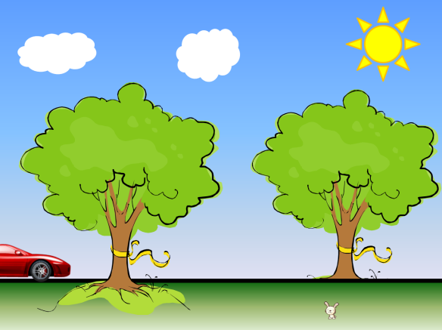
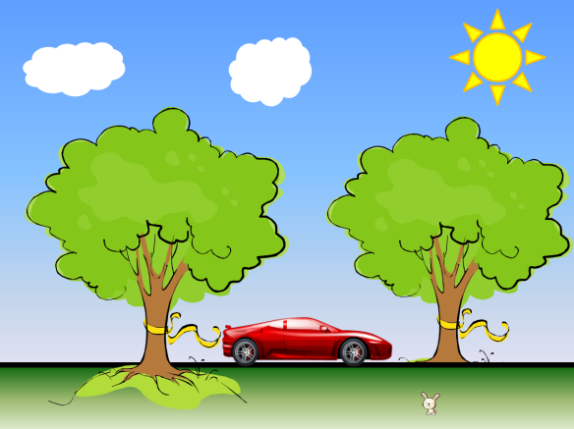
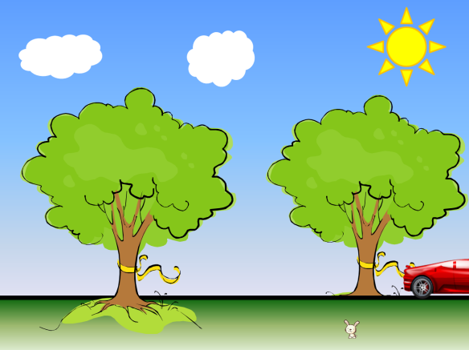
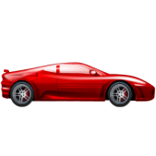

Slide 13
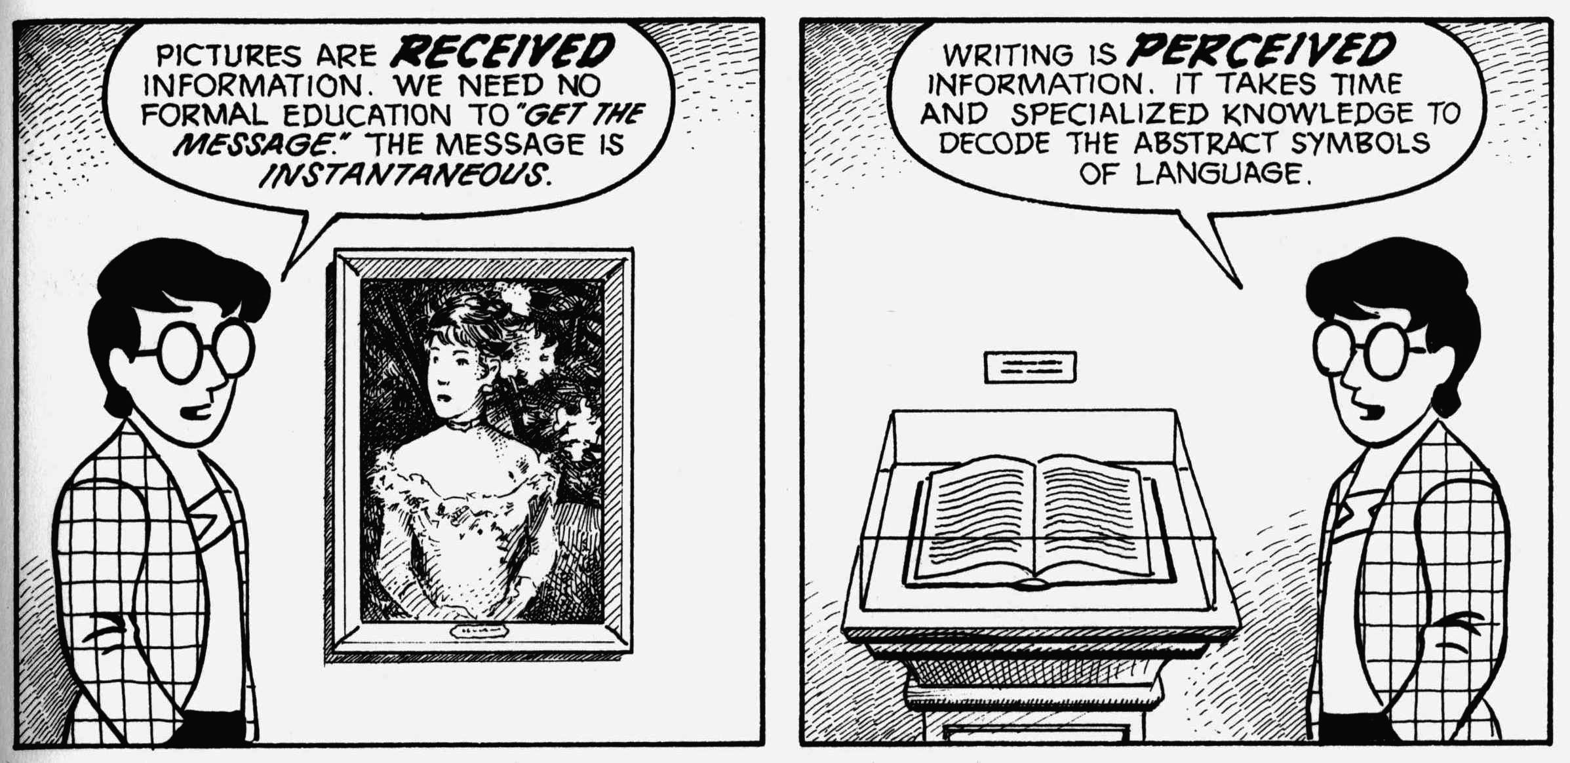
Closure: ‘...observing the parts but perceiving the whole...’ (63)
(49)
McCloud, Scott, Understanding Comics: The Invisible Art (1993)

Slide 14
‘[. . .] in comics word and image approach each other: words can be visually inflected, reading as pictures, while pictures can become as abstract and symbolic as words.’ (36)
‘[Comics] involve a tension between the experience of reading in sequence and the format or shape of the object being read’ (52)
‘[. . .] comic art is a form of writing.’ (33)
Hatfield, Charles, Alternative Comics: An Emerging Literature (2005)

Slide 16
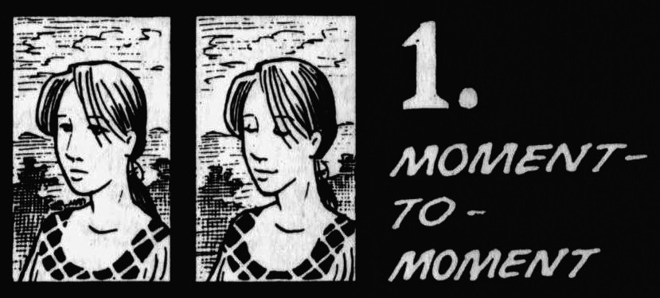
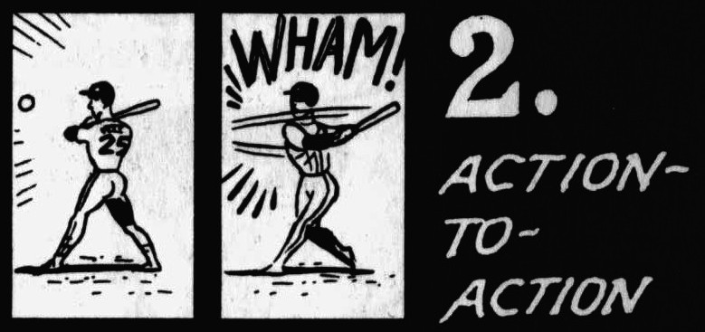
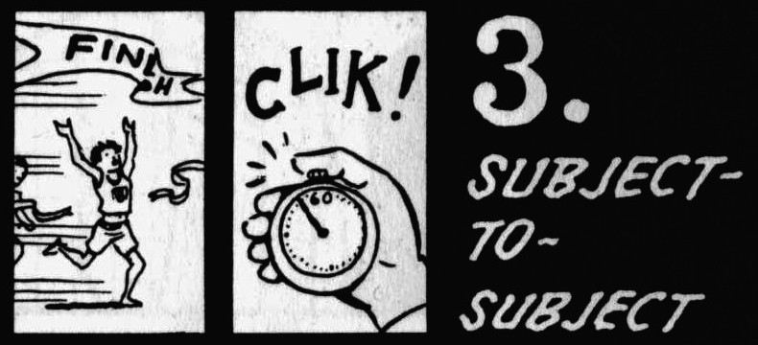
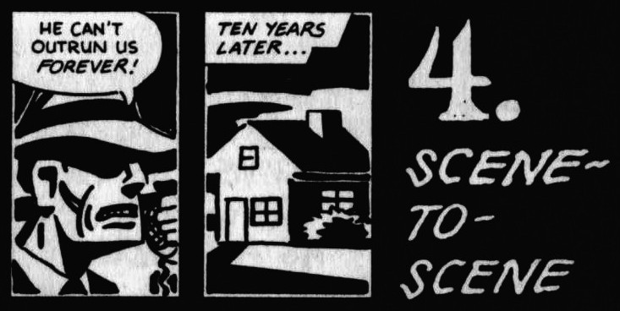
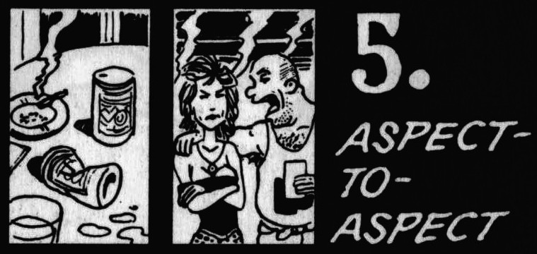
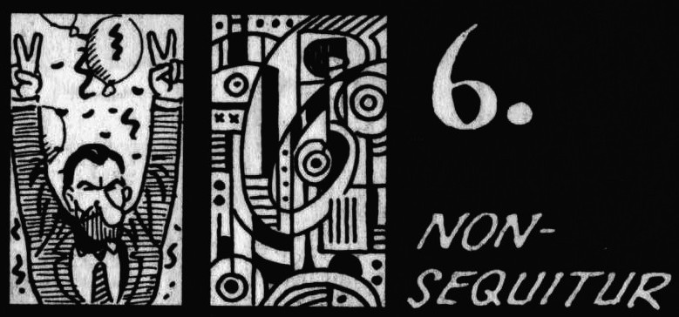

Slide 18
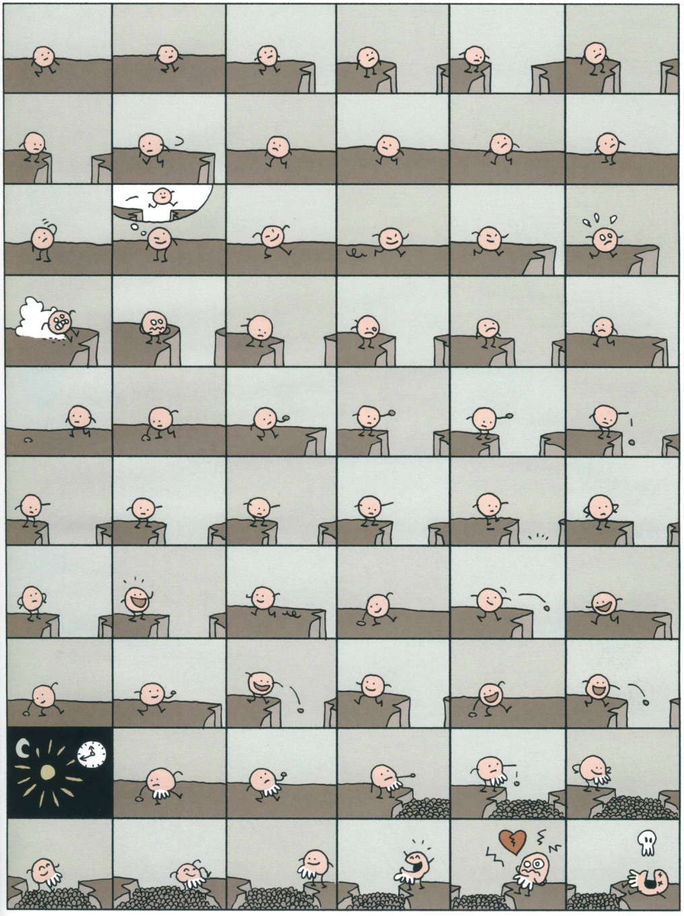
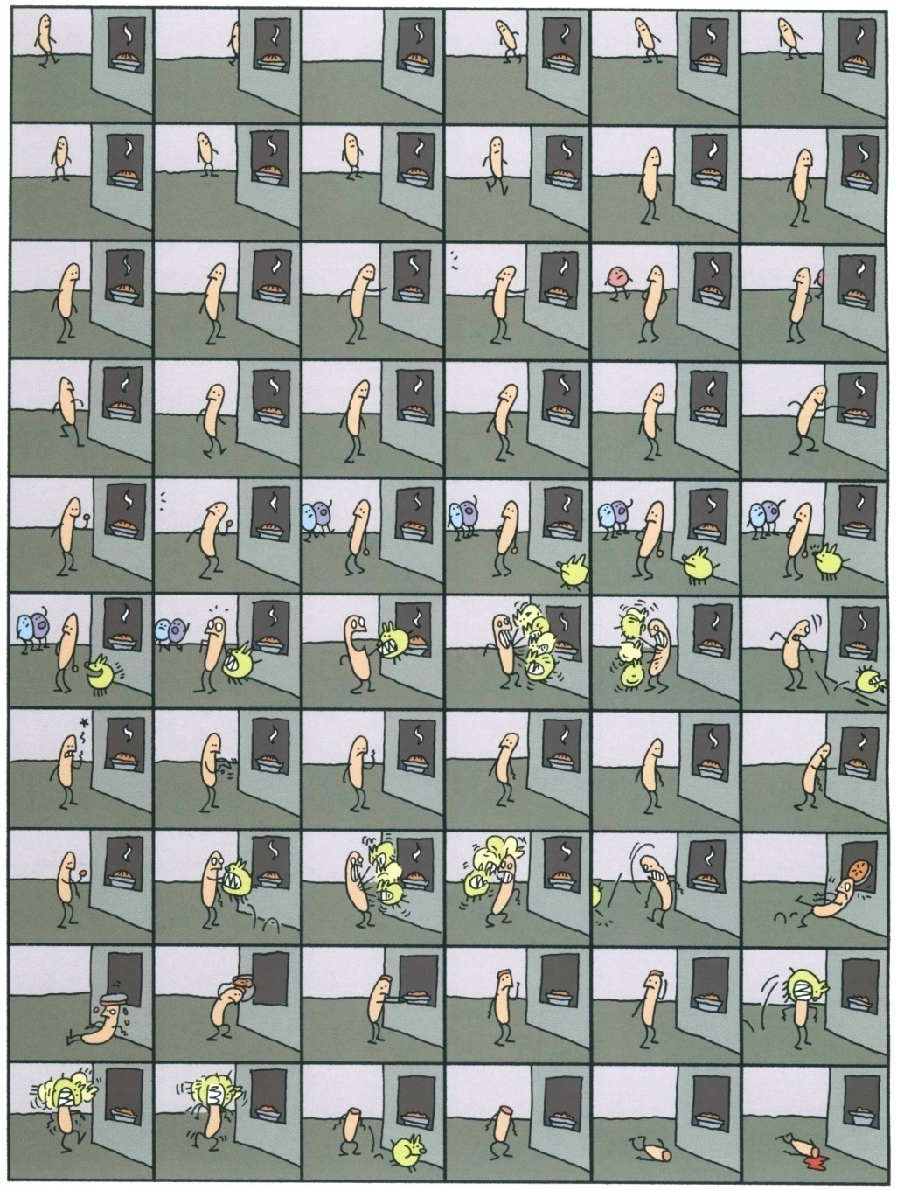
Mr. O (2004)
Mr. I (2007)

Slide 19
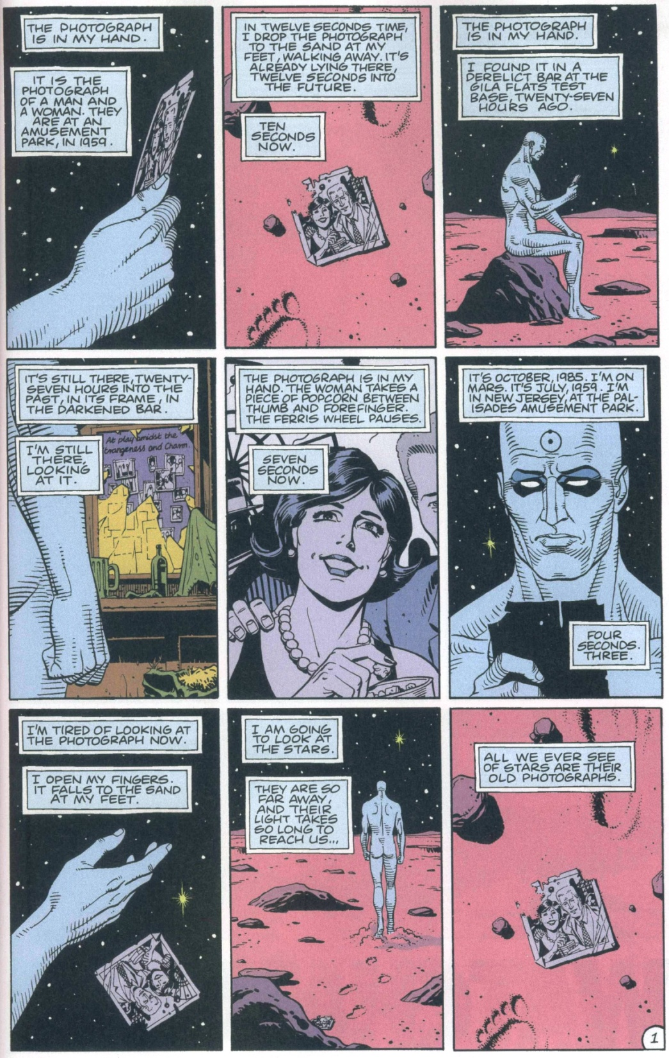
Watchmen (1986)

