Slide 1

Beyond the Visual: The Roles of the Senses in Contemporary Comics
Ian Hague
I.Hague@chi.ac.uk

Slide 2
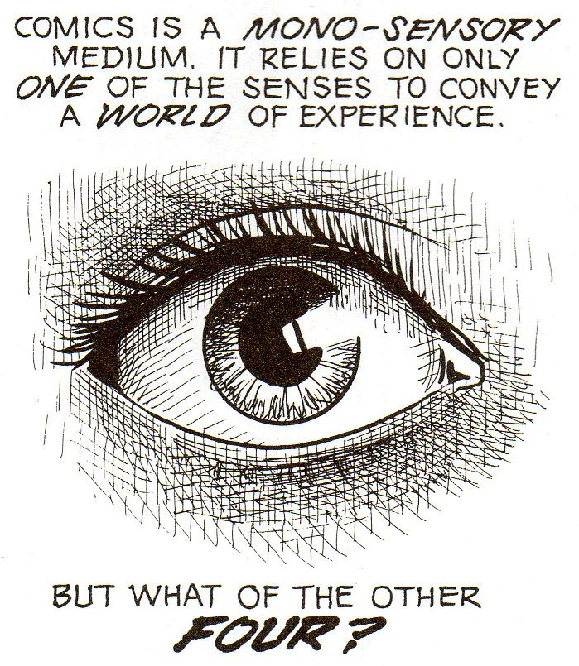
Scott McCloud, Understanding Comics: The Invisible Art, p.89.

Slide 3
‘It’s easy to forget that we read – or rather ‘use’ – comics in a very physical way (we tend to think of them as being two-dimensional, but in fact they exist in three dimensions).’
‘They can be bent, rolled-up, roughly opened or whatever. They can be held in different ways: cradled in your hand or gripped at the edges. We know how far into a comic we’ve read because we can feel how many pages are left. There are also smells: of dust, glue and paper.’
Roger Sabin, ‘The Crisis in Modern American and British Comics, and the Possibilities of the Internet as a Solution’ p.52.

Slide 4
‘Patterns emerged in interview regarding memories of comics [. . . .] readers often wanted to check details, testing memory against outside sources. Further discussion included titles and narratives alongside physical aspects of the texts, including paper quality, feel, scent and size.’
Mel Gibson, ‘What you read and where you read it, how you get it, how you keep it: Children, comics and historical cultural practice’, in Popular Narrative Media 1.2 (2008), pp. 151-152.

Slide 5
Touch
Smell
Hearing
Taste

Slide 6
‘[. . .] eyesight on its own does not always enable you to distinguish appearances from realities, and when in doubt it is wise to call on the sense of touch to settle the matter’.
Jonathan Rée, I See a Voice: Language, Deafness, and the Senses, p.20.

Slide 7
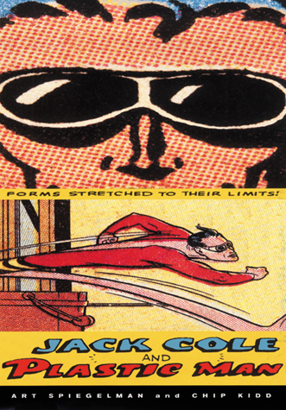
“The design approach to me was obvious: what if Plastic Man had turned himself into a book?”
Chip Kidd, quoted in Gary Spencer Millidge’s Comic Book Design, p.128

Slide 8

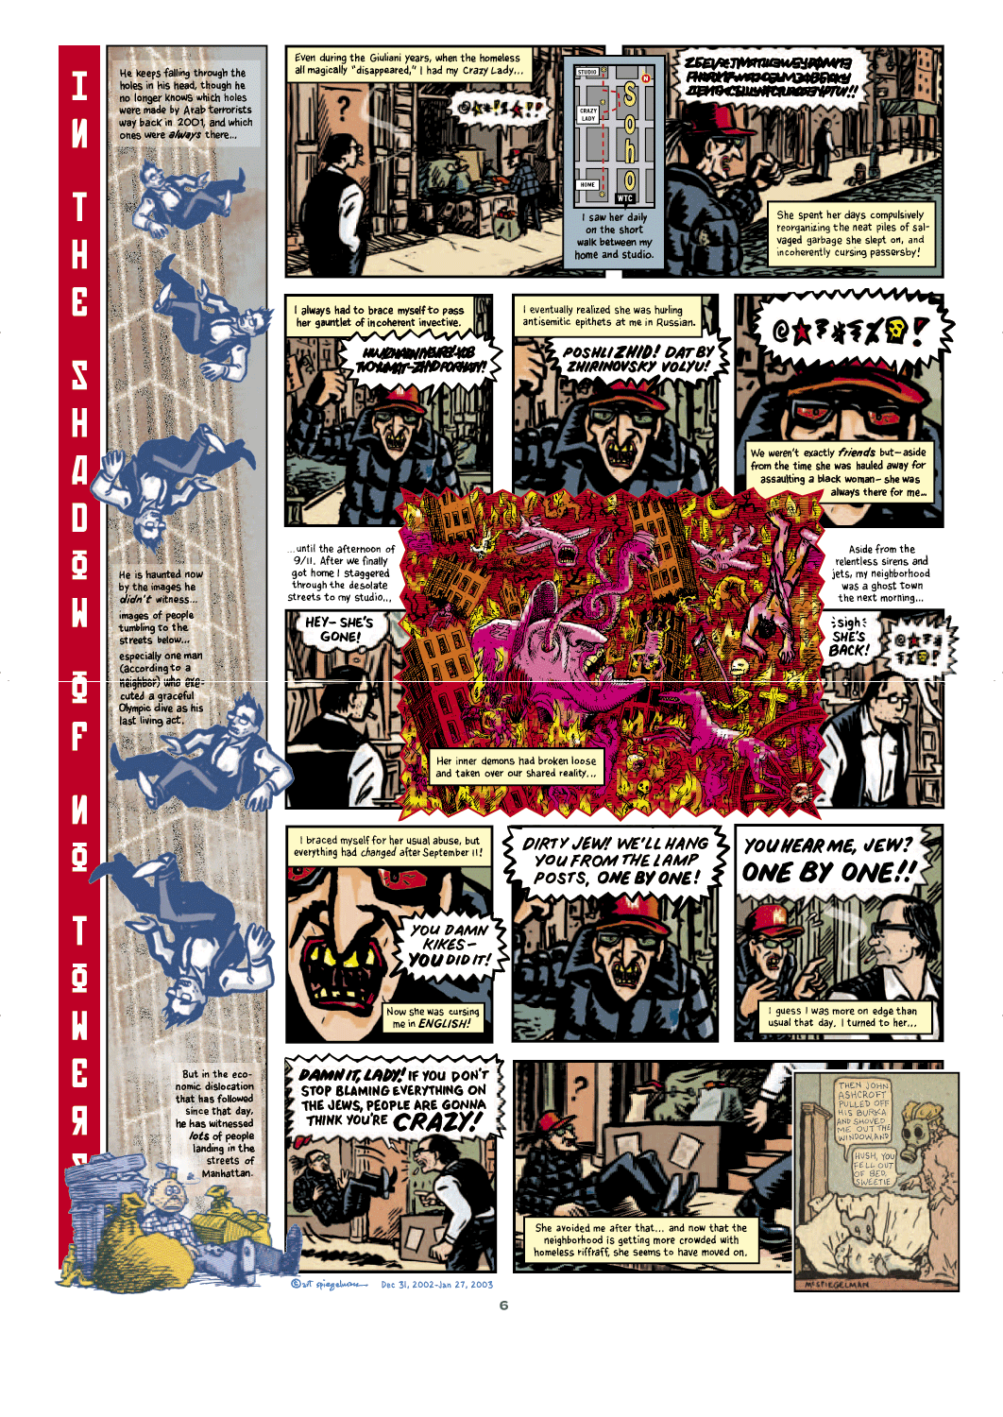

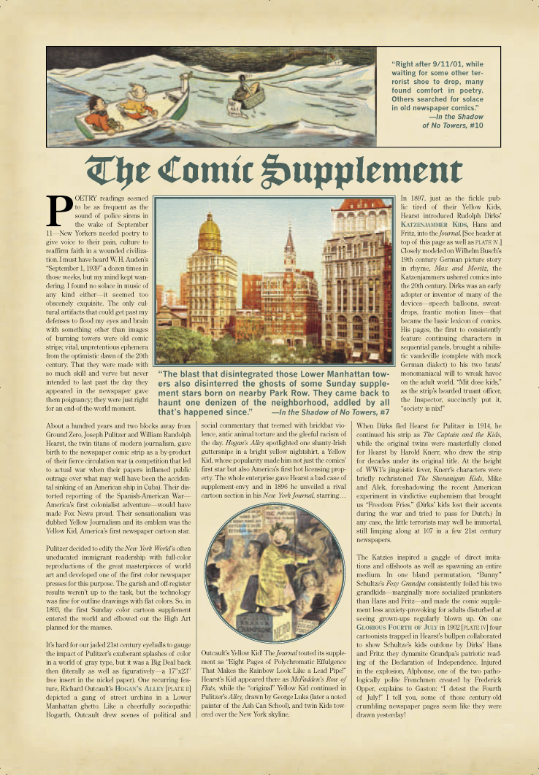
‘To appreciate the materiality of our media pulls us away from a symbolic understanding and toward a shared physical existence.’
Laura U. Marks,Touch: Sensuous Theory and Multisensory Media, p.xii.

Slide 9
Smell

Slide 10
‘A scent may drown entire years in the remembered odor it evokes.’
Walter Benjamin, ‘On Some Motifs in Baudelaire’ in Walter Benjamin: Selected Writings Volume 4: 1938-1940, p.20.

Slide 11
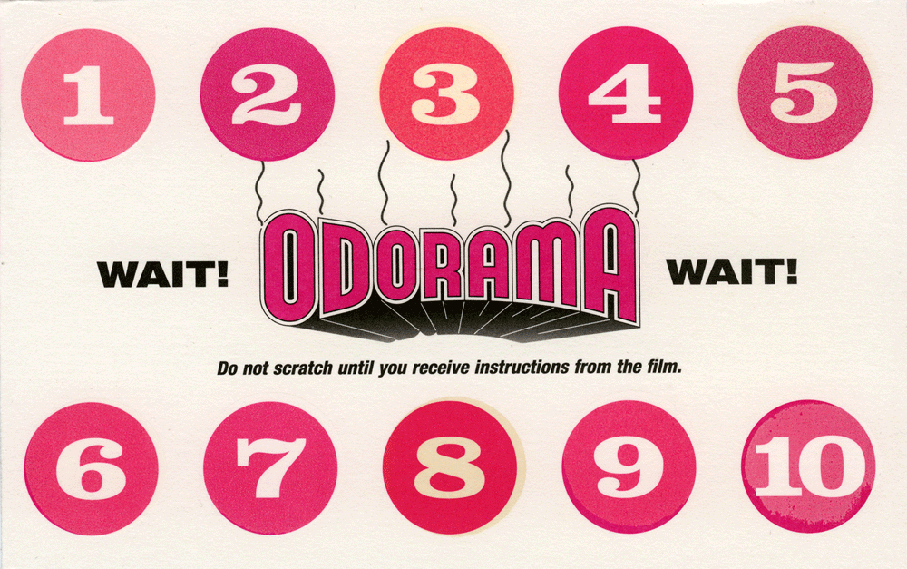
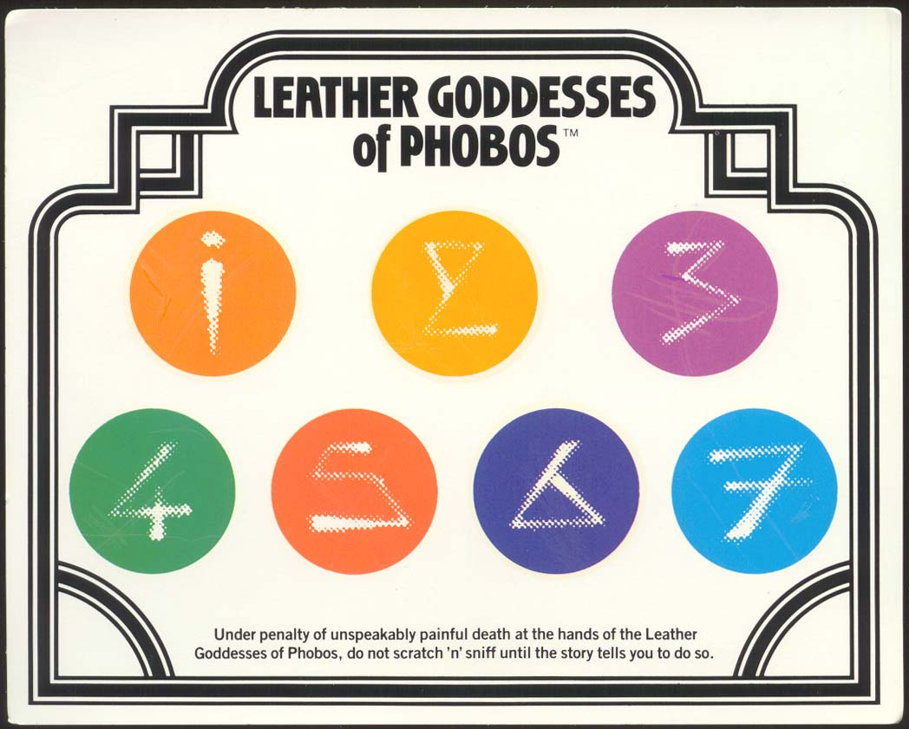

Slide 12


‘Each volume would have a new scratch-and-sniff, strawberries, chocolate, all meant to entice you into the baking world within. No manga publisher had done something that clever, to that point. It was pretty cool, and got people talking.’
Christopher Butcher, ‘Manga Milestones 2009-2010: 10 Manga That Changed Comics #7’ at http://comics212.net.

Slide 13
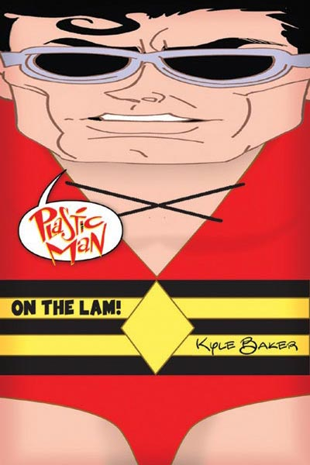

Slide 14


Slide 15
‘On the day Solipsistic Pop launched [. . .] people were walking up to offer their support and feedback for the book. The most popular phrase being:
“You got the smell right!”
This was heartening to hear. Believe it or not, I’d gone to a lot of trouble to make sure the book had that just printed aroma. It was part of the reason the anthology existed.’
Tom Humberstone, ‘Getting the Smell Right’ at http://solipsisticpop.com/page/2/

Slide 16
Hearing

Slide 17

‘A double reading of this book is essential for the reader who has the task of listening to Dominique Grange’s songs with their eyes focused on Tardi’s pictures.’
http://bd.casterman.com/albums_detail.cfm?id=11764

Slide 18
‘A double reading of this book is essential for the reader who has the task of listening to Dominique Grange’s songs with their eyes focused on Tardi’s pictures.’
http://bd.casterman.com/albums_detail.cfm?id=11764

Slide 19
‘The page functions both as sequence and object, to be seen and read in both linear and nonlinear, holistic fashion.’
Charles Hatfield, Alternative Comics: An Emerging Literature , p. 32.

Slide 20
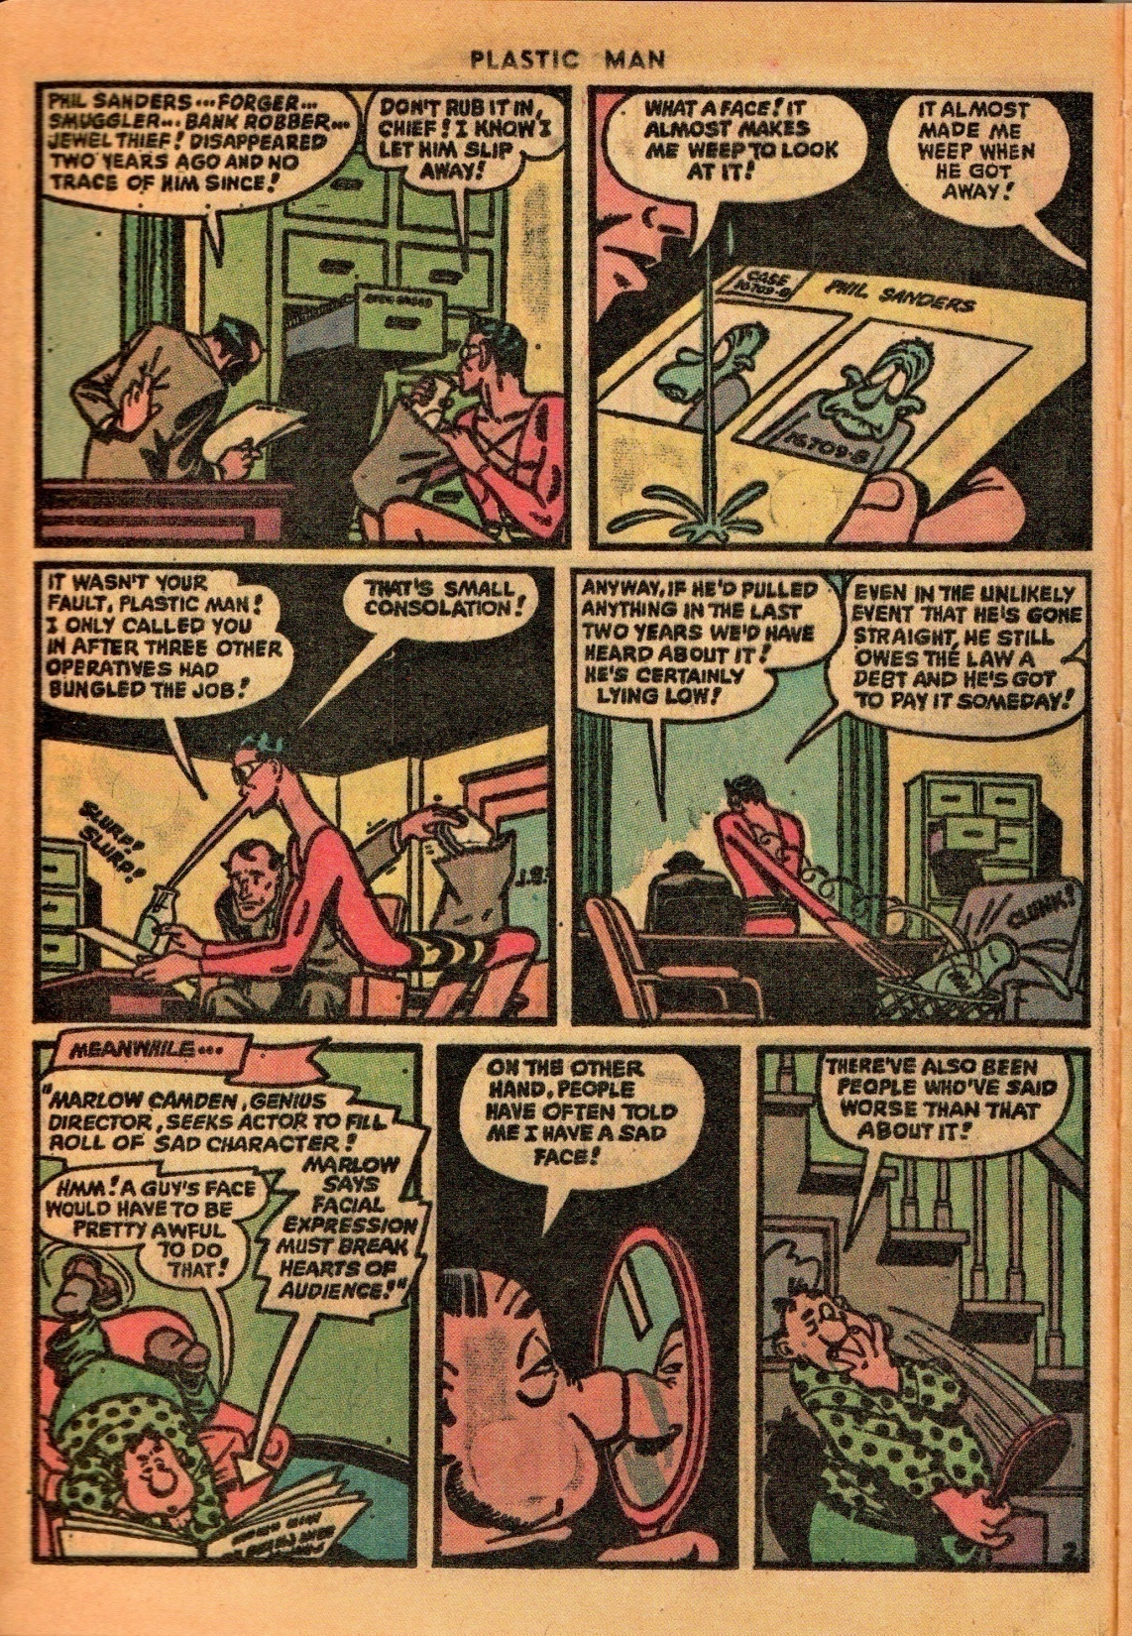
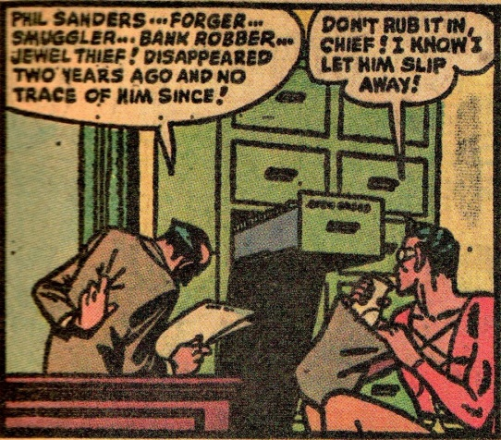
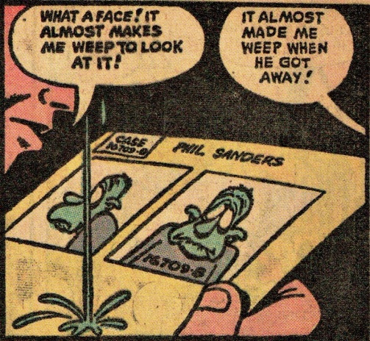
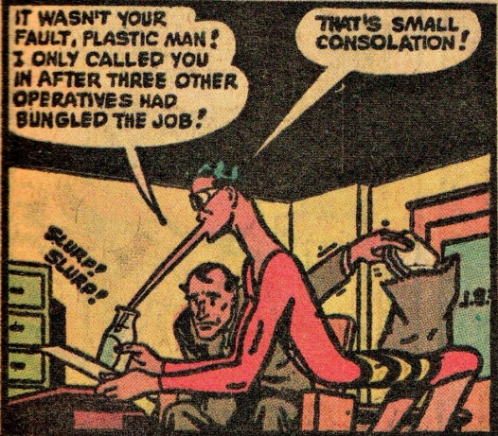
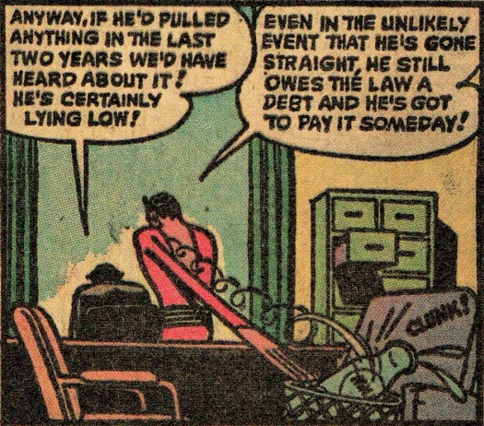
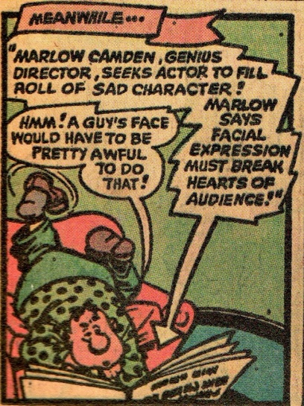
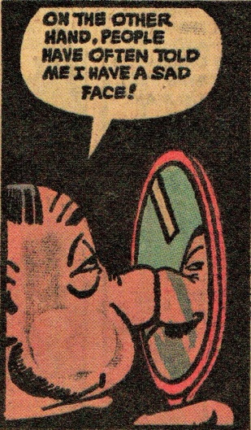
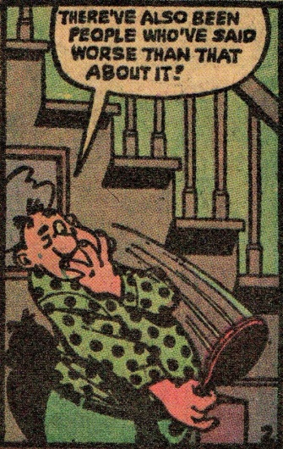

Slide 21
‘Unlike visual signals [. . .] which can exploit more than one dimension simultaneously, auditory signals have available to them only the linearity of time. The elements of such signals are presented one after another: they form a chain.’
Ferdinand de Saussure, Course in General Linguistics, p.70.

Slide 22
Taste

Slide 23
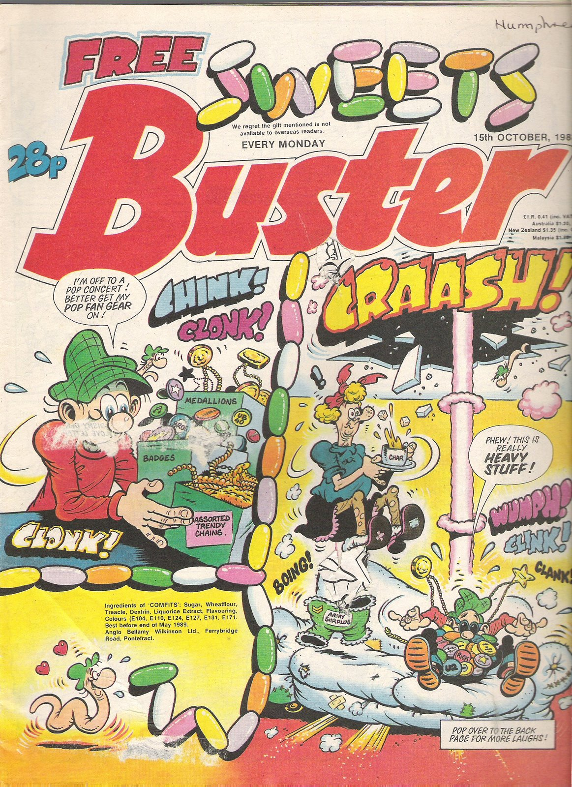
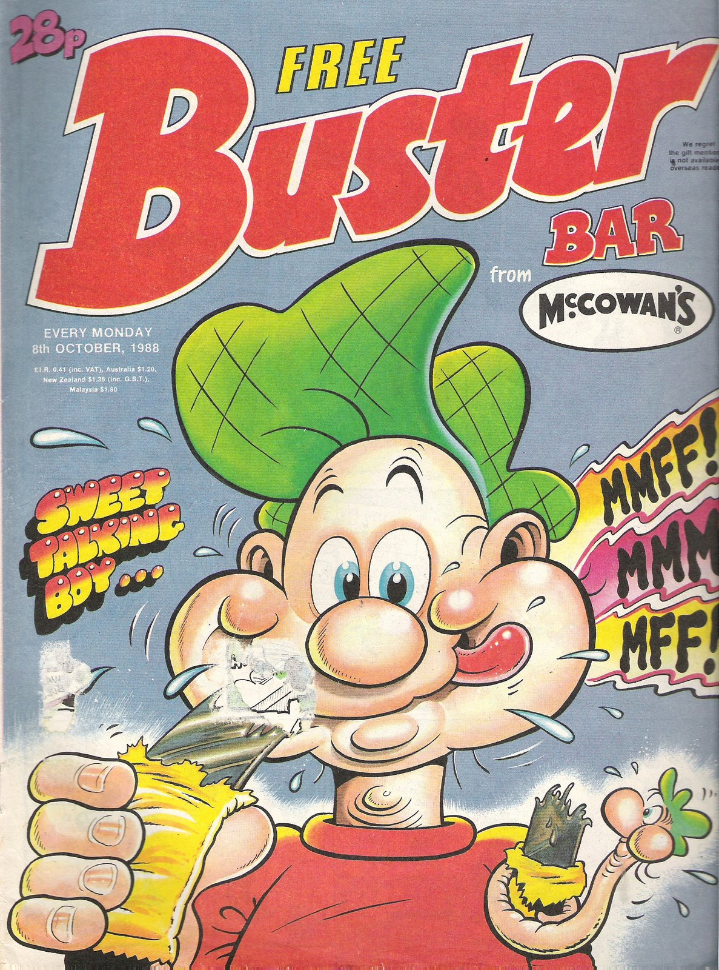

Slide 24

