Slide 1
Hearing Comics: Sound and Sequential Art
Ian Hague
University of Chichester
I.Hague@chi.ac.uk

Slide 2
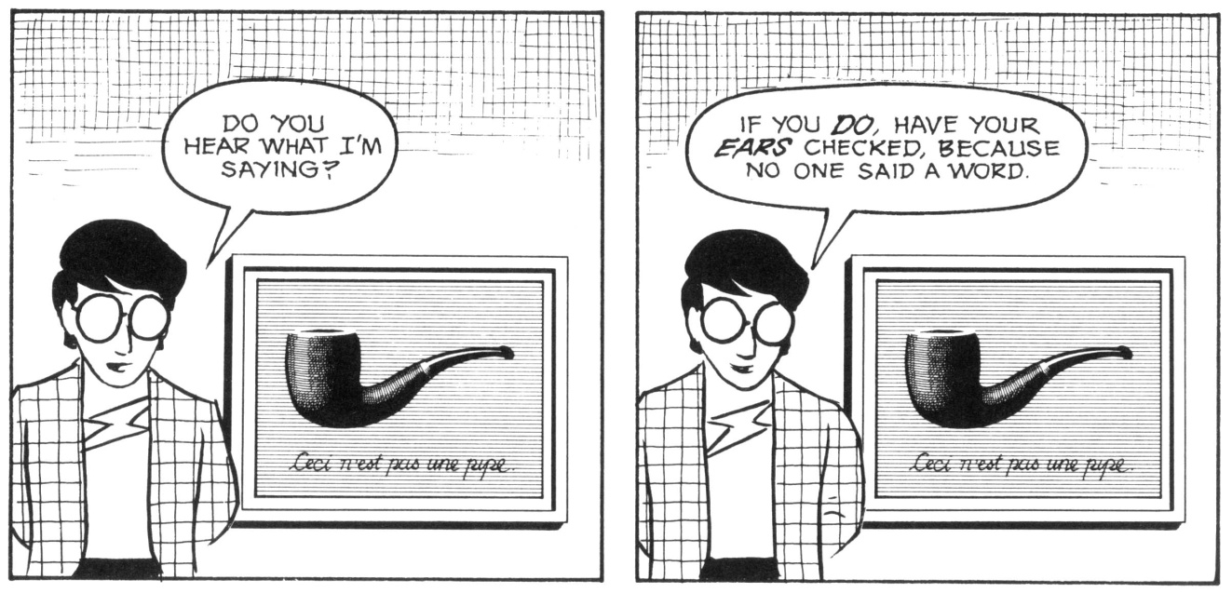
Scott McCloud, Understanding Comics: The Invisible Art, p.25

Slide 3
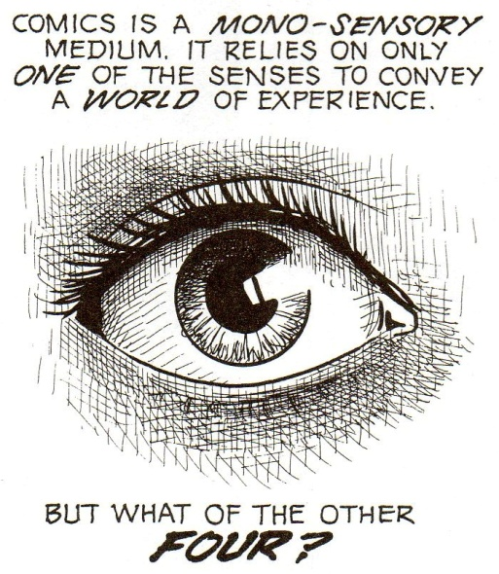
Scott McCloud, Understanding Comics: The Invisible Art, p.89

Slide 4
‘[. . .] most comics are silent; perhaps the turning of their pages produces a whispering, but that’s about it. In their own way, however, comics can be quite noisy.’
Joost Pollman ‘Shaping Sounds in Comics’, p.9
‘[. . .] you can listen with your eyes’
Ibid, p.15

Slide 5
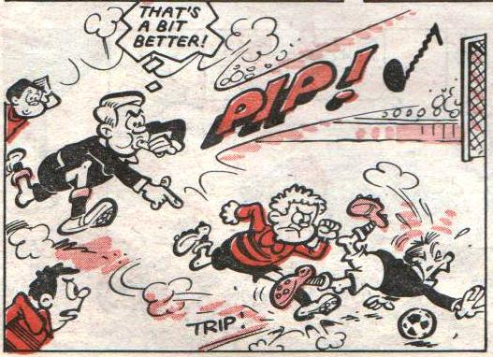
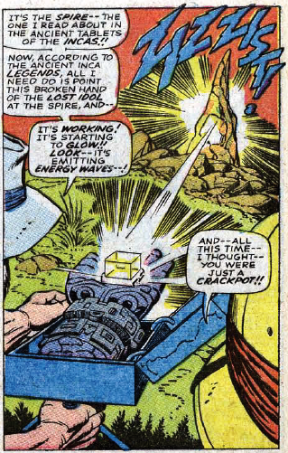
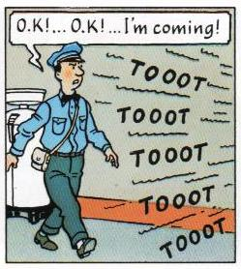
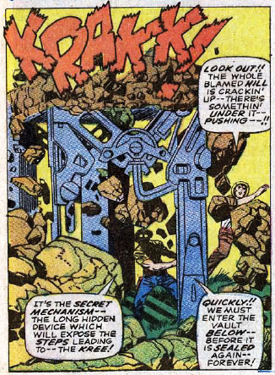
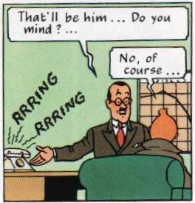
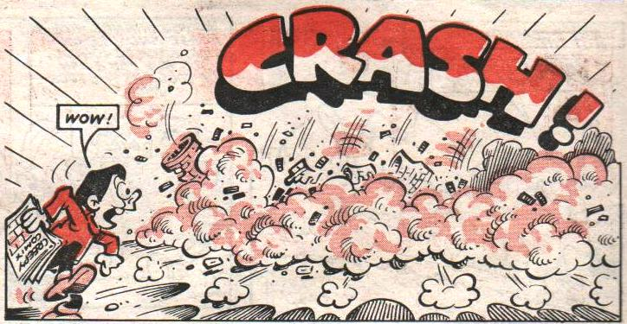
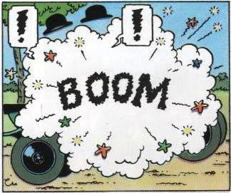
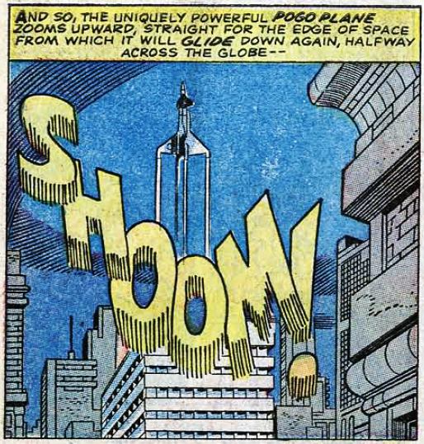
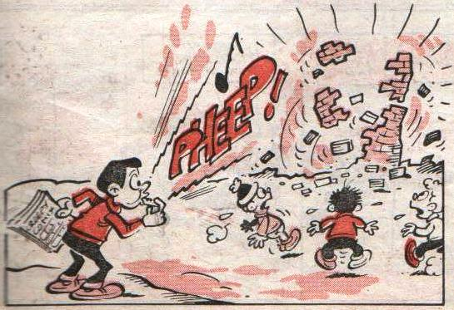
Visible sounds
Hergé, The Adventures of Tintin: Land of Black Gold, p.3 & p.7
Stan Lee and Jack Kirby et al, Fantastic Four #64, p.3 & p.6
Anon, Whoopee (and Wow!) 27/10/1984, unpaginated

Slide 6
‘[Sound effects] have become a kind of cliché; journalists find it irresistible to include "Pow! Blam!" and the like in headlines when writing about comics’
Suzanne Covey, ‘Beyond the Balloon: Sound Effects and Background Text in Lynn Johnson’s For Better or For Worse’ (website)

Slide 7
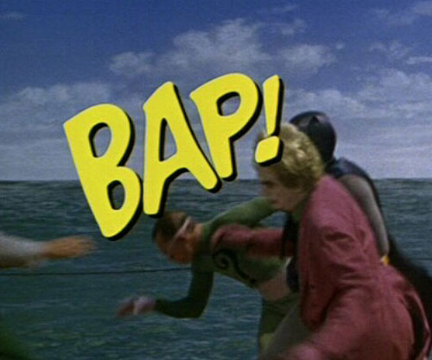

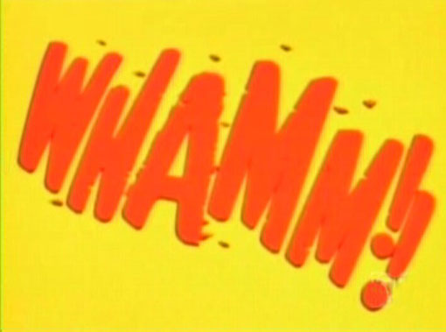
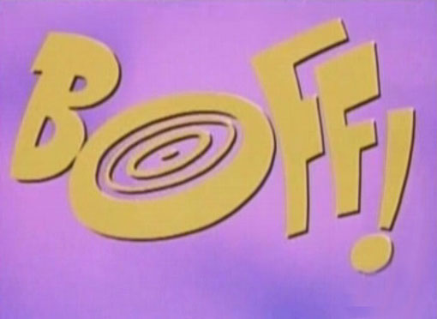
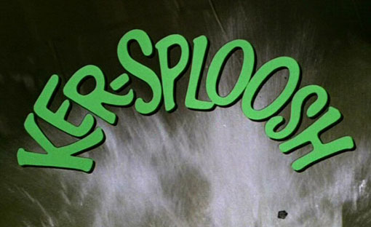
Batman (1966-1968)
Batman [The Movie] (1966)

Slide 8
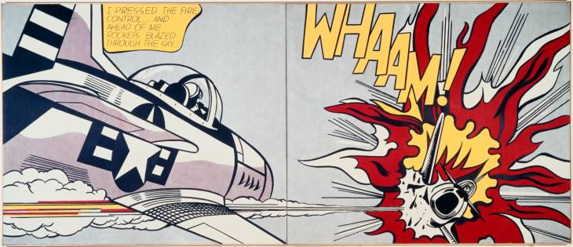
Roy Lichtenstein, Whaam!, 1963

Slide 9
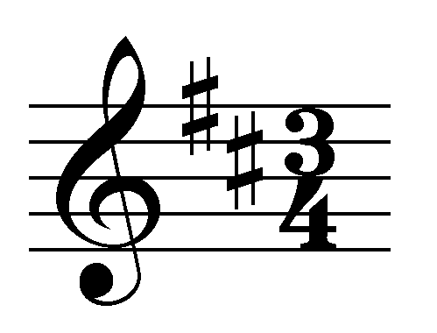
SPEECH BALLOONS
THOUGHT BUBBLES
NARRATION BOXES

Slide 10
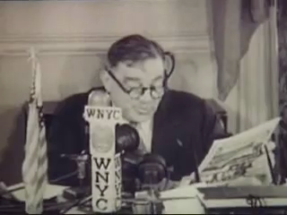
1945: New York City Mayor Fiorello La Guardia reads newspaper comics out over the radio during a newspaper deliverymen’s strike.

Slide 11
Comics and perceived sounds
Comics/Sound
Comic as sound source
Sounds as comics
Sounds around comics
Sounds of comics
Sounds in comics
Sounds with comics
Producible sounds

Slide 12
Sounds in comics

Slide 13
‘In 1995, Marvel published a “Golden Sound Story,” starring Spider-Man. It’s a book with a “Touch ‘n’ Listen” system that makes it possible to actually hear what you read. The so-called tingling of the Spider-Sense, that triggers Peter Parker into putting on his costume; the buzzing of the Neogenic Recombinator, a powerful and sophisticated weapon; the terrifying growl of the Lizard... all these sounds can be made audible by the mere push of a button. Thank God, most comics are silent [. . .]’
Joost Pollman ‘Shaping Sounds in Comics’, p.9

Slide 14
‘The basic truth about sounds, it would seem, is that they never last. You cannot collect and keep a beloved sound, as you can a letter or a flower or a lock of hair.’
Jonathan Rée, I See a Voice: Deafness, Language and the Senses - - A Philosophical History, p.23

Slide 15
‘[. . .] movies control pace; a cartoonist has to be really smart to slow you down, a filmmaker just has to leave the camera where it is for a long time.’
Frank Miller, ‘Men Without Fear: Creating Daredevil’ (DVD)

Slide 16
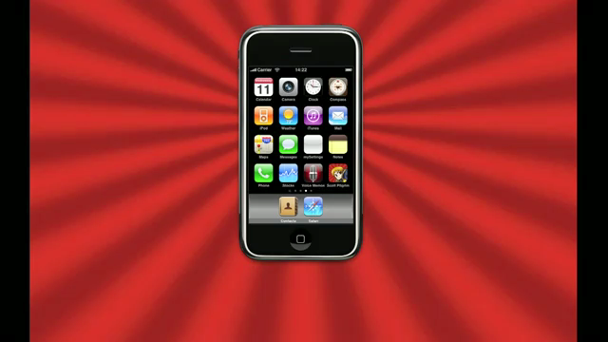

Scott pilgrim’s precious little app
‘Rogue electric strat clone through Zoom guitar effects’
‘Noise Collector’

Slide 17
Sounds with comics

Slide 18

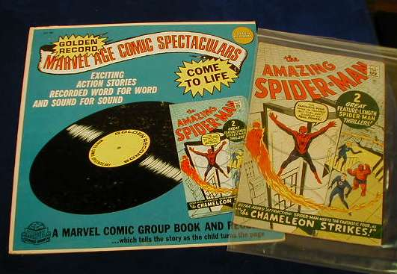
Sounds with comics
Audible content directly reproduces visual
Audible content does not directly reproduce visual

Slide 19
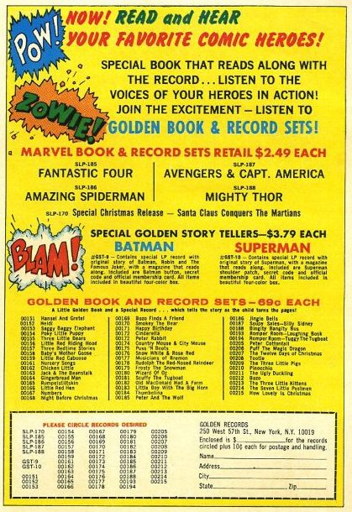

Slide 20
‘We propose that when specific representations are accessed, they contribute to a form of auditory imaginary for speech that includes properties of the vocal characteristics of the assumed author’.
Jessica D. Alexander and Lynne C. Nygaard, ‘Reading Voices and Hearing Text: Talker-Specific Auditory Imagery in Reading’, p.457

Slide 21
‘Ever wonder who is speaking in the panel that only shows Reed's lab and one word balloon reading, "We just keep enough money to pay our expenses. Every other cent goes into developing the most effective super-crime-fighting apparatus we can create!" and the other balloon reading, "Besides, aren't you wanted by the police? This isn't Outlaws Anonymous!" In other words, which of the Four rags on Spidey about being wanted? Well, in this version, Mr. Fantastic reads the first balloon (makes sense) and the second one comes from the Invisible Girl. Somehow I always visualized that ragging coming from the Human Torch. The disembodied "Wait! Come back!" in the next panel is also voiced by Mr. F.’
Al Sjoerdsma, ‘Audio: Golden Records: Amazing Spider-Man #1’ (website)

Slide 22
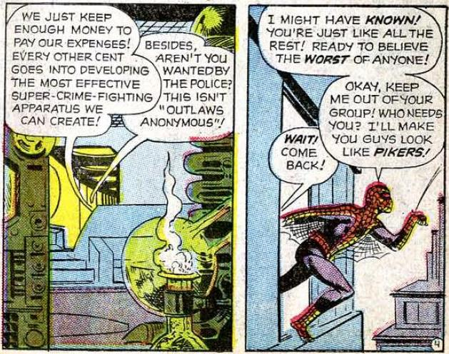
Stan Lee and Steve Ditko et al, Amazing Spider-Man #1, p.4

Slide 23
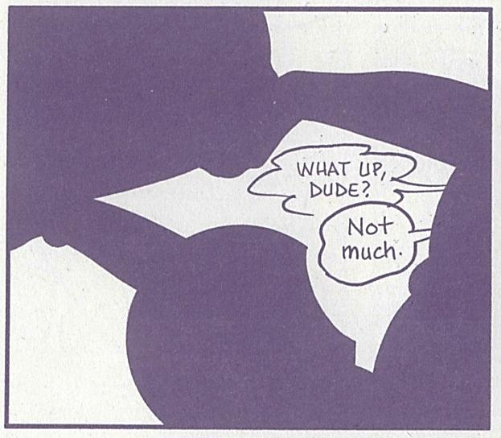
David Mazzucchelli, Asterios Polyp, unpaginated

Slide 24
‘A double reading of this book is essential for the reader who has the task of listening to Dominique Grange’s songs with their eyes focused on Tardi’s pictures.’
Casterman, ‘1968-2008...N’effacez pas nos traces !’ (website), translation by Hayleigh Nash (2010)

Slide 25
References (1 of 2)
Alexander, Jessica D. and Lynne C. Nygaard. "Reading Voices and Hearing Text: Talker Specific Auditory Imagination in Reading." Journal of Experimental Psychology: Human Perception and Performance 34.2 (2008): 446-459.
Batman: The Movie. Dir. Leslie H. Martinson. 20th Century Fox. 1966 (2002).
Bolinger, Dwight, ed. Intonation: Selected Readings. Harmondsworth: Penguin, 1972.
Casterman. 1968-2008...N'effacez pas nos traces ! n.d. 10 May 2010 <http://bd.casterman.com/albums_detail.cfm?id=11764>.
Chion, Michel. "Sound Film - Worthy of the Name." Visual Sense: A Cultural Reader. Ed. Elizabeth Edwards and Kaushik Bhaumik. Oxford & New York: Berg, 2008. 249-254.
Covey, Suzanne. "Beyond the Balloon: Sound Effects and Background Text in Lynn Johnson's For Better or For Worse." ImageText: Interdisciplinary Comics Studies 2.2 (2006): http://www.english.ufl.edu/imagetext/archives/v2_2/covey/.
EduComics. Edu Comics Project. n.d. 13 December 2010 <http://www.educomics.org/>>.
Golden Book & Record Sets Advert. n.d. 13 December 2010 <http://www.neatstuffsite.com/npics/300-1110-204b.jpg>.
Grange, Dominique and Tardi. 1968-2008...N'effacez pas nos traces ! Pantin: Casterman, 2008.
Groensteen, Thierry. The System of Comics. Trans. Bart Beaty and Nick Nguyen. Jackson: University Press of Mississippi, 2007.
Hergé. "The Adventures of Tintin: Land of Black Gold." Hergé. The Adventures of Tintin Volume 5. London: Egmont Books Limited, 1950 (2003). 3-64.
Ihde, Don. "Auditory Imagination." The Auditory Culture Reader. Ed. Michael Bull and Les Back. Oxford & New York: Berg, 2003 (2005). 61-66.
Khordoc, Catherine. "The Comic Book's Soundtrack: Visual Sound Effects in Asterix." The language of comics: word and image. Ed. Robin Varnum and Christina T. Gibbons. Jackson, Miss: University Press of Mississippi, 2001. 156-173.

Slide 26
References (2 of 2)
Kunzle, David. "The Voices of Silence: Willette, Steinlen and the Introduction of the Silent Strip in the Chat Noir, with a German Coda." The language of comics: word and image. Ed. Robin Varnum and Christina T. Gibbons. Jackson, Miss: University Press of Mississippi, 2001. 3-18.
Lichtenstein, Roy. Whaam! n.d. 15 December 2010 <http://www.tate.org.uk/collection/T/T00/T00897_9.jpg>.
Manilla, Ben. "The Sounds of American Culture: NYC Mayor LaGuardia's Legendary Radio Readings." NPR, 2008.
Mazzucchelli, David. Asterios Polyp. New York: Pantheon Books, 2009.
McCloud, Scott. Understanding Comics: The Invisible Art. New York: HarperPerennial, 1993 (1994).
Men Without Fear: Creating Daredevil. Prod. Eric Young. 2003.
Noise Collector. sample: guitarsolo1.wav. 8 July 2005. 26 November 2010 <http://www.freesound.org/samplesViewSingle.php?id=3649>.
O'Malley, Bryan Lee. "Scott Pilgrim's Precious Little App." Comp. Robot Media SL. HarperCollins Publishers Ltd., 2010.
Pollman, Joost. "An Art of the Real: About the Adulthood of Contemporary Comics." International Journal of Comic Art 1.2 (1999): 107-126.
—. "Shaping Sounds in Comics." International Journal of Comic Art 3.1 (2001): 9-21.
Rée, Jonathan. I See a Voice: Language, Deafness and the Senses - - A Philosophical History. London: Harper Collins, 1999.
Shepherd, John. Music as social text. Cambridge: Polity Press, 1991.
Sjoerdsma, Al. Audio: Golden Records: Amazing Spider-Man #1 [Review]. n.d. 13 December 2010 <http://www.spiderfan.org/audio/reviews/spiderman_record_comics/golden_records_asm1.html>.

Slide 27
Hearing Comics: Sound and Sequential Art
Ian Hague
University of Chichester
I.Hague@chi.ac.uk

