Slide 1
Comics as a tactile medium
FUNCTIONS OF TOUCH IN EXPERIENCES OF READING
IAN HAGUE
DEPARTMENT OF HISTORY, UNIVERSITY OF CHICHESTER
DIRECTOR, COMICS FORUM
I.HAGUE@CHI.AC.UK
HTTP://COMICSFORUM.ORG

Slide 2
‘[. . .] EYESIGHT ON ITS OWN DOES NOT ALWAYS ENABLE YOU TO DISTINGUISH APPEARANCES FROM REALITIES, AND WHEN IN DOUBT IT IS WISE TO CALL ON THE SENSE OF TOUCH TO SETTLE THE MATTER.’
JONATHAN RĖE, I SEE A VOICE: LANGUAGE, DEAFNESS AND THE SENSES, P.20.

Slide 3
TOUCH
PROPERTIES OF THE OBJECT
TOUCH AND PERFORMANCE
UNDIRECTED TOUCH
DIRECTED TOUCH
COMPOSITING MATERIALS
TEXTURE
HARDNESS
FLEXIBILITY
WEIGHT
TEMPERATURE
GENERIC DIRECTED TOUCH
SPECIFIC DIRECTED TOUCH
CONVENTIONALISED TOUCH
IMPLIED TOUCH

Slide 4
COMPOSITING MATERIALS
HARDNESS, STIFFNESS AND FLEXIBILITY
TOUCH IN READING

Slide 5
COMPOSITING MATERIALS

Slide 6
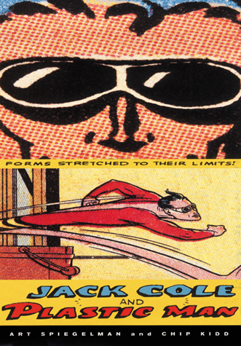
‘“THE DESIGN APPROACH TO ME WAS OBVIOUS: WHAT IF PLASTIC MAN HAD TURNED HIMSELF INTO A BOOK?”’
CHIP KIDD, QUOTED IN GARY SPENCER MILLIDGE’S COMIC BOOK DESIGN, P.128

Slide 7

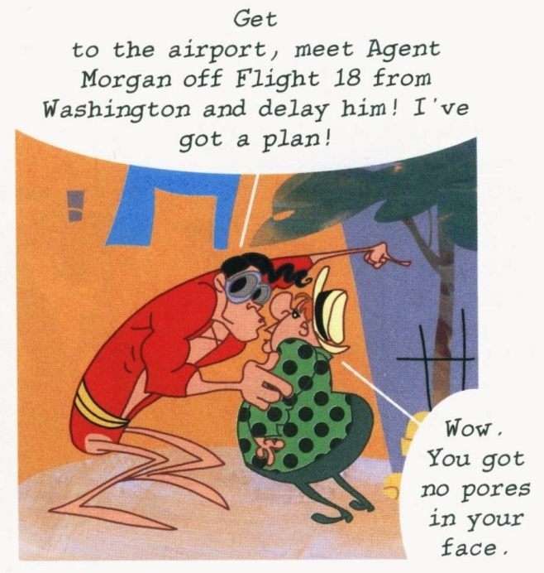

Slide 8
HARDNESS, STIFFNESS AND FLEXIBILITY

Slide 9

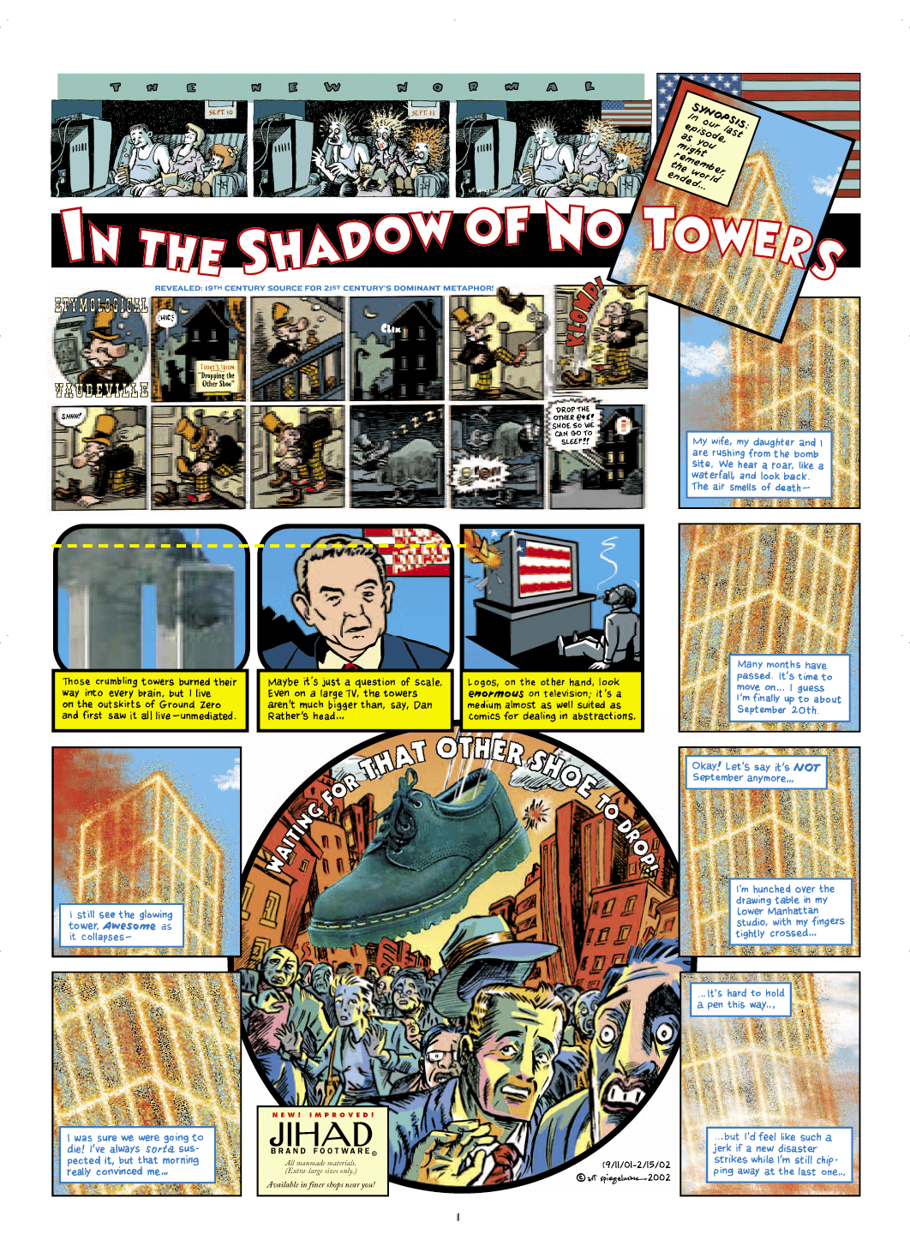
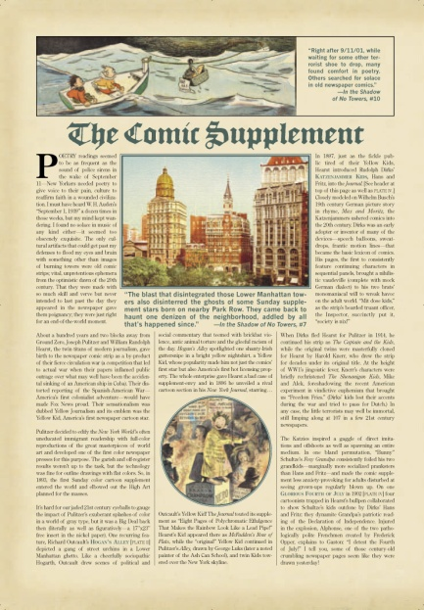
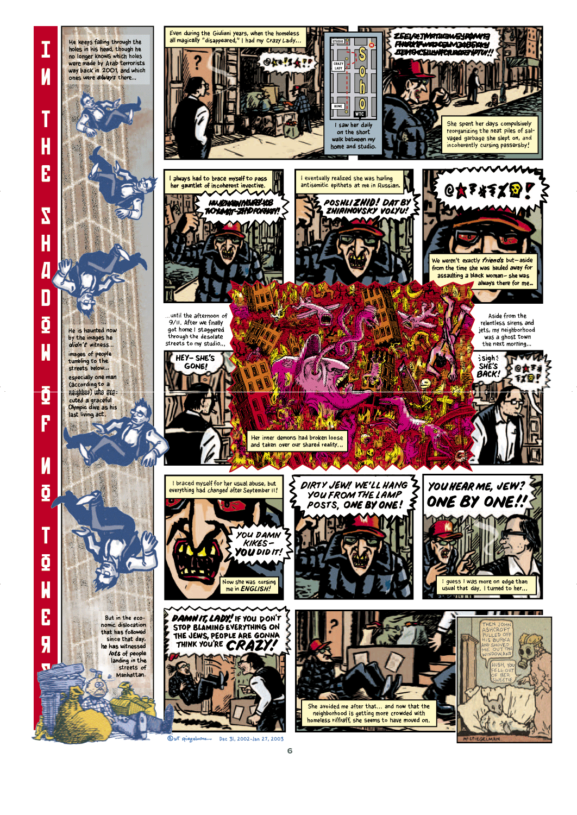

Slide 10
‘SPIEGELMAN’S TRAUMA TAKES THE FORM OF INNOVATIVE REPRESENTATION AND EXPRESSION IN SERIALIZED COMICS, AND YET THIS APPROACH IS CONTINGENT UPON AN ANTI-TRANSCENDENT RECOGNITION OF EPHEMERALITY—SOMETHING SPIEGELMAN TAKES PAINS TO UNDERLINE IN PRESENTING THE CORRESPONDENCE OF COMICS AND BUILDINGS THAT BOTH ARE ALL TOO DESTRUCTIBLE.’
HILARY CHUTE, ‘TEMPORALITY AND SERIALITY IN SPIEGELMAN'S IN THE SHADOW OF NO TOWERS’, P.242.

Slide 11
SPIEGELMAN CHALLENGES THE READER NOT ONLY TO ‘“READ BACK AND FORTH BETWEEN IMAGES AND WORDS . . . [REVEALING] THE VISUALITY AND THUS THE MATERIALITY OF WORDS AND THE DISCURSIVITY AND NARRATIVITY OF IMAGES”’
HIRSCH, QUOTED IN GILLIAN WHITLOCK’S ‘AUTOGRAPHICS: THE SEEING "I" OF THE COMICS’, P.966

Slide 12
‘TO APPRECIATE THE MATERIALITY OF OUR MEDIA PULLS US AWAY FROM A SYMBOLIC UNDERSTANDING AND TOWARD A SHARED PHYSICAL EXISTENCE’
LAURA U. MARKS, TOUCH: SENSUOUS THEORY AND MULTISENSORY MEDIA, P.XII

Slide 13
TOUCH IN READING

Slide 14
‘THE MEANINGFULNESS OF OBJECTS UNFOLDS THROUGH INTERACTION’
TIM DANT, ‘THE “PRAGMATICS” OF MATERIAL INTERACTION’, P.3

Slide 15
‘[. . .] MOST GESTURES LEAD TO REPETITIONS OR FURTHER GESTURES TO ACHIEVE AN ACCUMULATING EFFECT IN TRANSFORMING THE OBJECT’
TIM DANT, ‘THE “PRAGMATICS” OF MATERIAL INTERACTION’, P.13

Slide 16
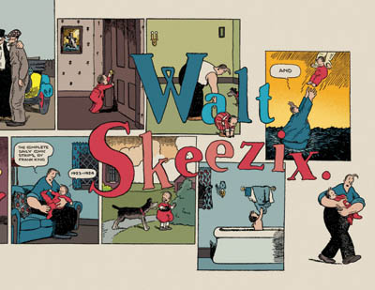
‘THE INEFFABLE GRACE AND INFINITE GENTLENESS OF KING'S ART TAKES ON AN INCREASING POIGNANCY AS YOU MAKE YOUR WAY THROUGH [WALT AND SKEEZIX 1923 -1924]. IT'S LIFE PRESENTED AS A GIFT, SLIPPING AWAY BIT BY BIT EACH TIME YOU TURN THE PAGE.’
FRANK O. KING, WALT AND SKEEZIX: 1923 - 1924, BAND.

Slide 17
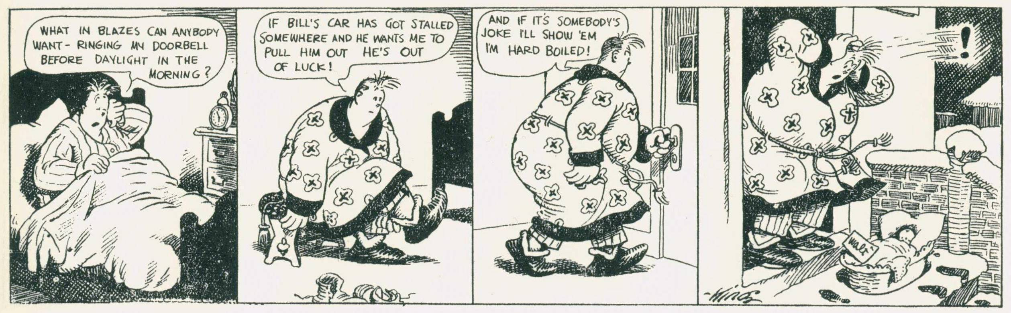
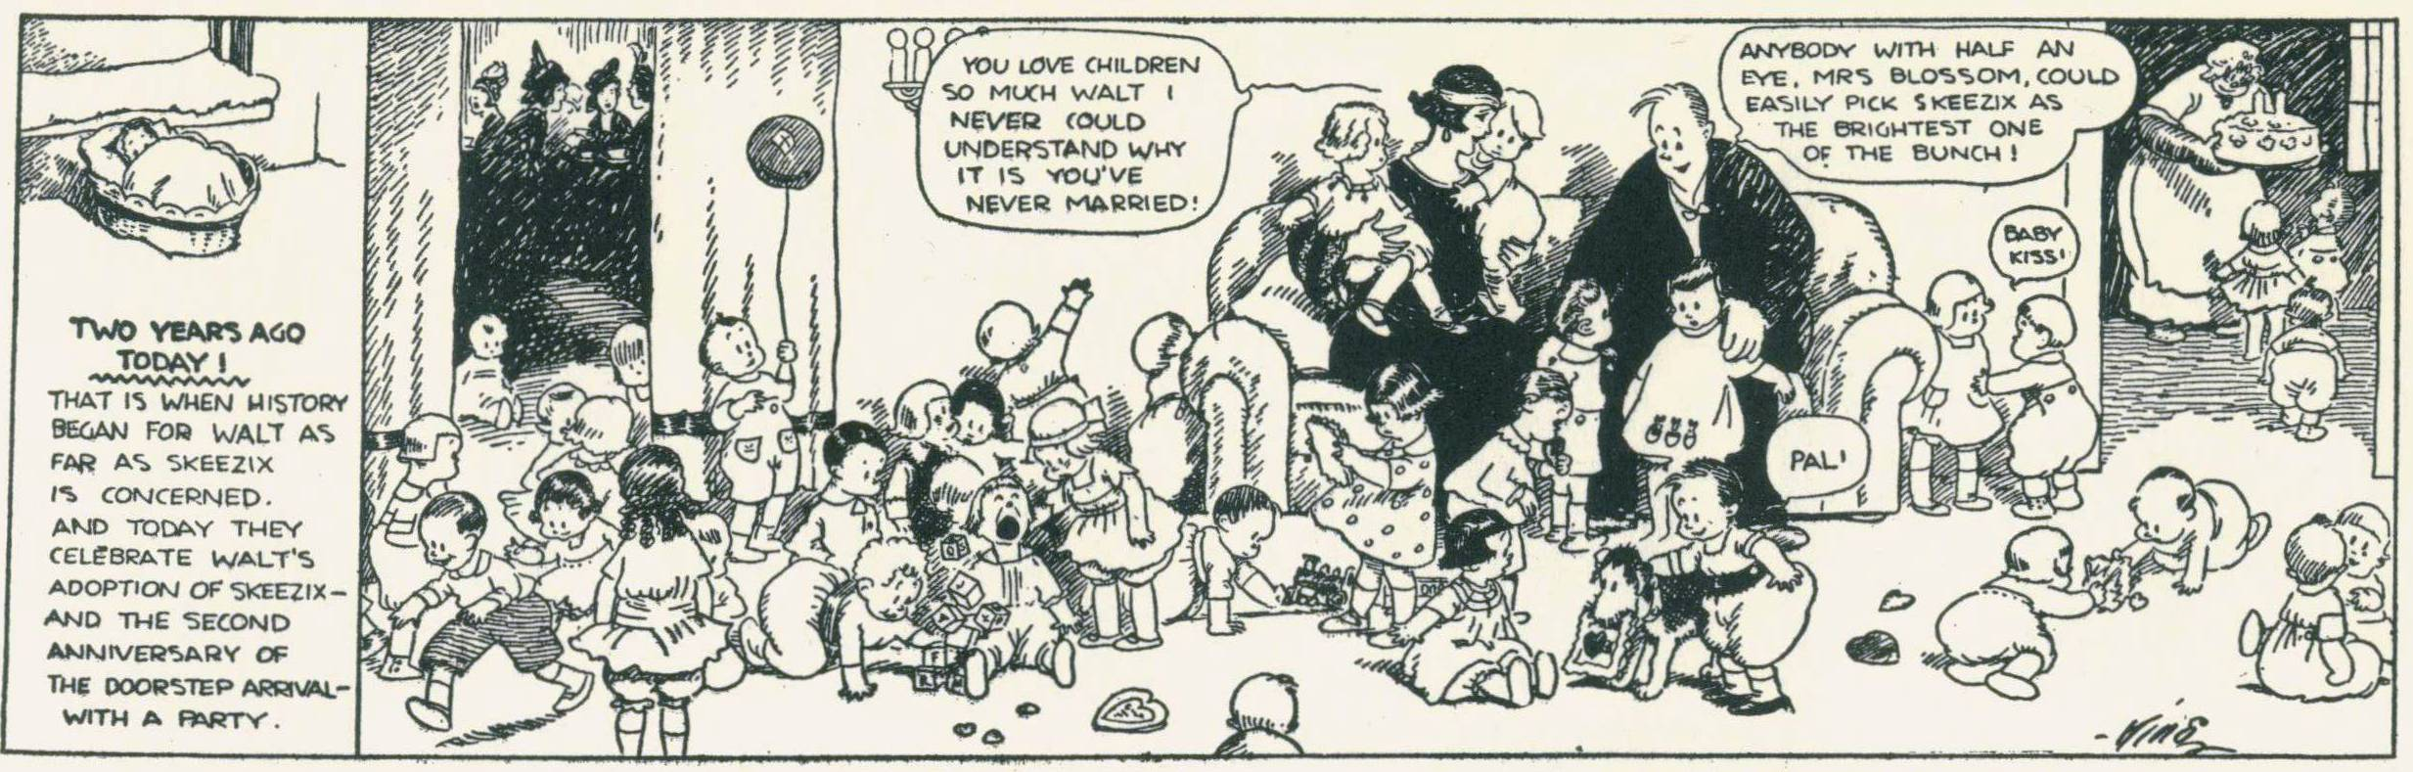
FRANK O. KING, GASOLINE ALLEY, 14/02/1921
FRANK O. KING, GASOLINE ALLEY, 14/02/1923

Slide 18
‘WE KNOW HOW FAR INTO A COMIC WE’VE READ BECAUSE WE CAN FEEL HOW MANY PAGES ARE LEFT.’
ROGER SABIN, ‘THE CRISIS IN MODERN AMERICAN AND BRITISH COMICS, AND THE POSSIBILITIES OF THE INTERNET AS A SOLUTION’, P.52.

Slide 19
(A) BASIC FORCE FEEDBACK DEVICES, SUCH AS VIDEOGAME CONTROLLERS AND TACTILE MICE, THAT OPERATE IN TWO DIMENSIONS; (B) MORE SOPHISTICATED HAPTIC “DISPLAYS” THAT SIMULATE SHAPE AND TEXTURE IN THREE DIMENSIONS; (C) INCREASINGLY POPULAR EXOSKELETAL OR EXTERNAL DEVICES FOR EXERTING TACTILE PRESSURE ON THE SKIN, OPERATING WITHIN A LARGER, FREE-FLOWING SPACE FOR THE USER.
MARK W. D. PATERSON, ‘DIGITAL TOUCH’, P. 432

Slide 20
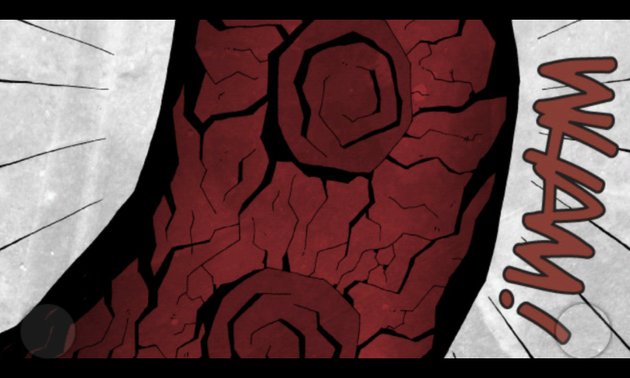

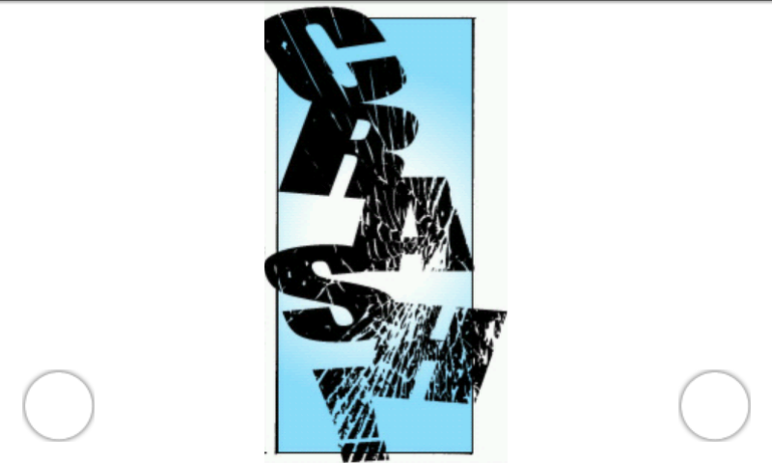
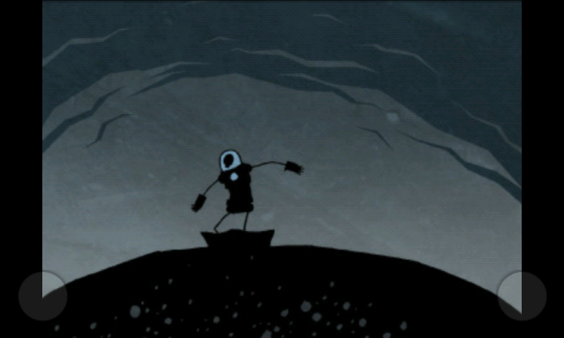
P.10
P.15
P.19
P.22
THOMAS HALL AND DANIEL BRADFORD, ROBOT 13 #1 (RUNNING ON ANDROID, HTC DESIRE).

Slide 21
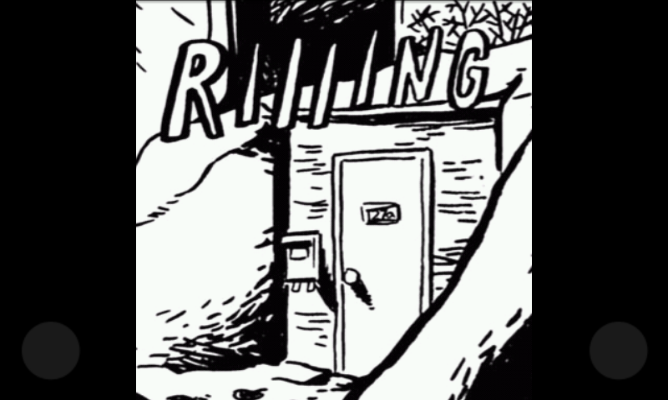
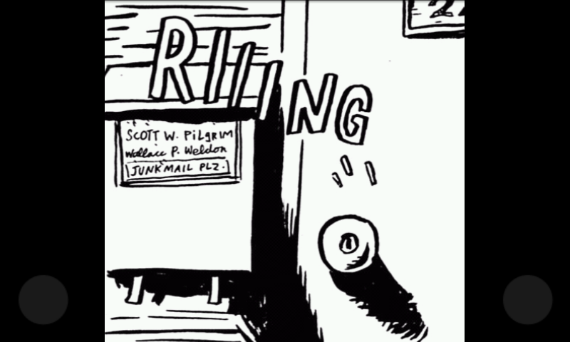
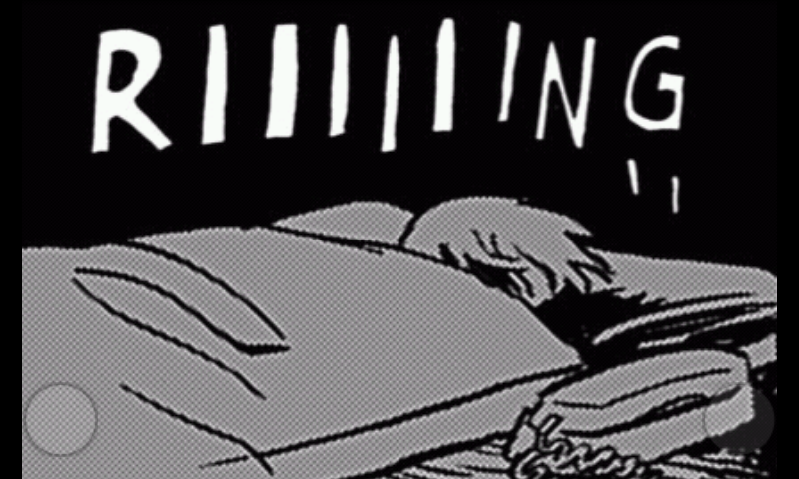

BRYAN LEE O’MALLEY, SCOTT PILGRIM’S PRECIOUS LITTLE APP, VOL.1, P.21 (RUNNING ON ANDROID, HTC DESIRE).

Slide 22





Slide 23
Comics as a tactile medium
FUNCTIONS OF TOUCH IN EXPERIENCES OF READING
IAN HAGUE
DEPARTMENT OF HISTORY, UNIVERSITY OF CHICHESTER
DIRECTOR, COMICS FORUM
I.HAGUE@CHI.AC.UK
HTTP://COMICSFORUM.ORG

