Slide 1

Comics Forum: The Plan
Ian Hague
University of Chichester
I.Hague@chi.ac.uk

Slide 2
Journals
Comics Forum
Comics Grid
International Bande Dessinée Society Conference
European Comic Art
Annual Conferences
International Comics Conference
Image [&] Narrative
Scottish Word and Image Group
ImageText
Transitions
Journal of Graphic Novels and Comics
University of Dundee
International Journal of Comic Art
Glyndŵr University
Sequential Art Narrative in Education
Degree Courses
University for the Creative Arts, Epsom
Mechademia
University of Staffordshire
Scandinavian Journal of Comic Art
Swindon College School of Art
Studies in Comics

Slide 3
Comics Forum
2009-
Conference Series
2011-
Website
2011-
Social Networking

Slide 4



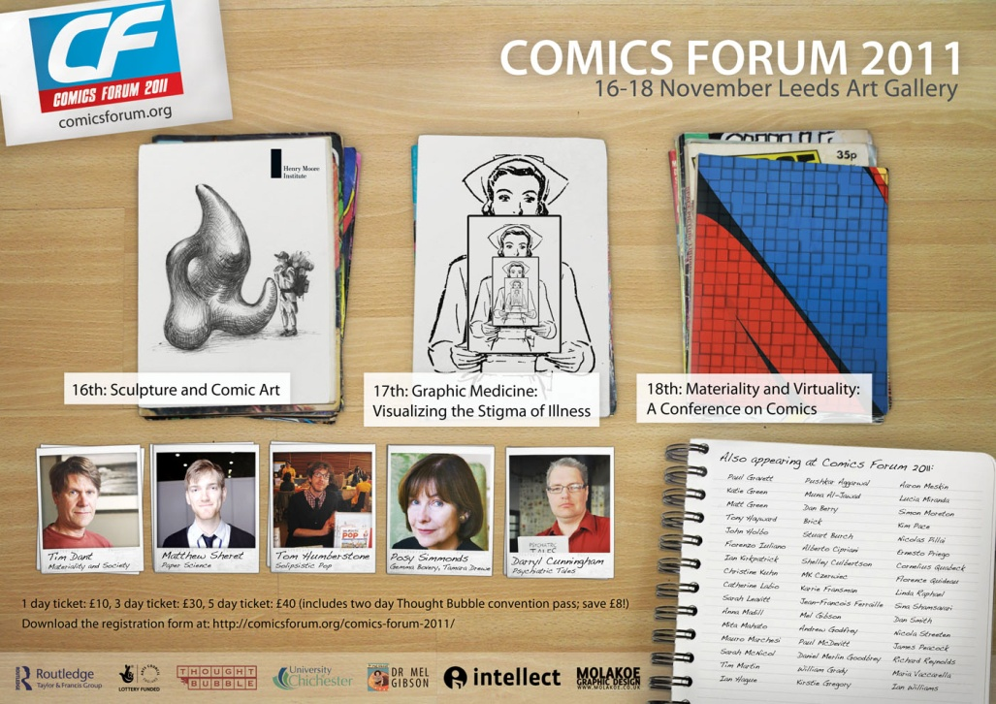
Conference Series

Slide 5
Comics Forum
2009-
Conference Series
2011-
Website
2011-
Social Networking

Slide 6
Comics Forum News
Guest Articles
Blog
Affiliate Conferences
Columns
Scholarly Resources
Digital Texts
Scholar Directory
Website
Link Directory
Mapping Project
Comics Forum 2012
Comics Forum Archives
News
Comics Forum 2009
Comics Forum 2010
Comics Forum 2011
Website Archive

Slide 7
Business
Culture
Education
Jobs
News
Law & Politics
Obituaries
CFPs
Research
Publications
Technology

Slide 8
Comics Forum News
Guest Articles
Blog
Affiliate Conferences
Columns
Scholarly Resources
Digital Texts
Scholar Directory
Website
Link Directory
Mapping Project
Comics Forum 2012
Comics Forum Archives
News
Comics Forum 2009
Comics Forum 2010
Comics Forum 2011
Website Archive

Slide 9
Comics Forum
2009-
Conference Series
2011-
Website
2011-
Social Networking
2012-
Awareness Events
?
Professional Body

Slide 10
Awareness Events
Convention & festival based
Public awareness
Various academic levels
Membership benefits
Flyers, sample texts etc.
Coordinated funding bids
Social Networking
Organised development
Formally delineated body
Twitter
Facebook
Others?
Professional Body

Slide 11
What’s next?
News Editor
Social Networker
Recruitment
Resource Developer
Awareness Events
Professional Body Developer
Research Activity
?

Slide 12
Get Involved
Comics Forum Website
http://comicsforum.org
Ian Hague
I.Hague@chi.ac.uk

