Slide 1
COMICS AND THE SENSES
IAN HAGUE
DEPARTMENT OF HISTORY, UNIVERSITY OF CHICHESTER
I.HAGUE@CHI.AC.UK

Slide 2
TWO QUESTIONS
WHAT ARE COMICS?
HOW DO COMICS WORK?

Slide 3
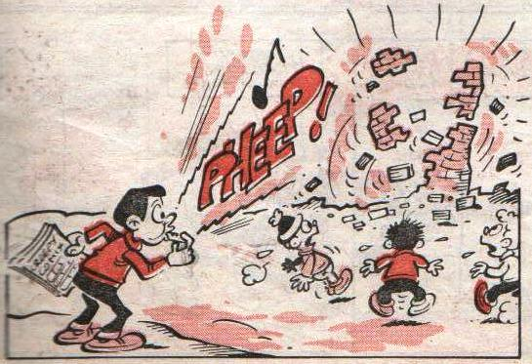
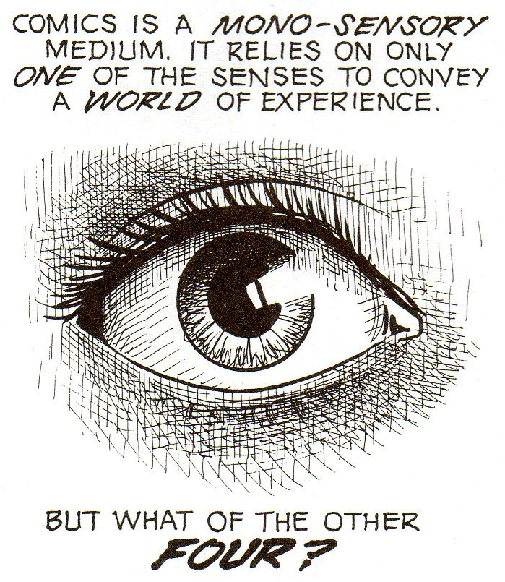
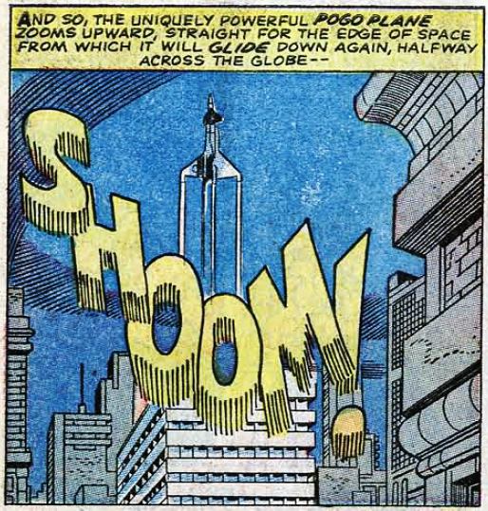
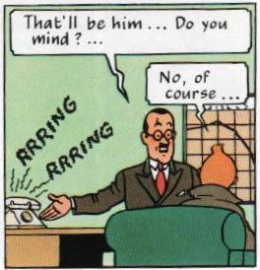
A VISUAL MEDIUM?
McCloud 1993, 89

Slide 4
MULTISENSORY COMICS
IT’S EASY TO FORGET THAT WE READ – OR RATHER ‘USE’ – COMICS IN A VERY PHYSICAL WAY (WE TEND TO THINK OF THEM AS BEING TWO-DIMENSIONAL, BUT IN FACT THEY EXIST IN THREE DIMENSIONS). THEY CAN BE BENT, ROLLED-UP, ROUGHLY OPENED OR WHATEVER. THEY CAN BE HELD IN DIFFERENT WAYS: CRADLED IN YOUR HAND OR GRIPPED AT THE EDGES. WE KNOW HOW FAR INTO A COMIC WE’VE READ BECAUSE WE CAN FEEL HOW MANY PAGES ARE LEFT. THERE ARE ALSO SMELLS: OF DUST, GLUE AND PAPER. COMPARED TO THIS VERY SENSUAL EXPERIENCE, CLICKING A MOUSE JUST ISN’T THE SAME.
(SABIN 2000, 52)
PATTERNS EMERGED IN INTERVIEW REGARDING MEMORIES OF COMICS [. . . .] READERS OFTEN WANTED TO CHECK DETAILS, TESTING MEMORY AGAINST OUTSIDE SOURCES. FURTHER DISCUSSION INCLUDED TITLES AND NARRATIVES ALONGSIDE PHYSICAL ASPECTS OF THE TEXTS, INCLUDING PAPER QUALITY, FEEL, SCENT AND SIZE.
(GIBSON 2008, 151-152)

Slide 5
A NEW APPROACH
SIGHT
HEARING
TOUCH
SMELL
TASTE
CASE STUDY: ALAN MOORE

Slide 6


HEARING
1968-2008… N’EFFACEZ PAS NOS TRACES!
DOMINIQUE GRANGE/TARDI
CASTERMAN
JOHNNY CASH: I SEE A DARKNESS
REINHARD KLEIST
ADAPTED BY AVE COMICS

Slide 7
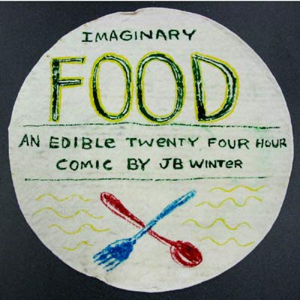
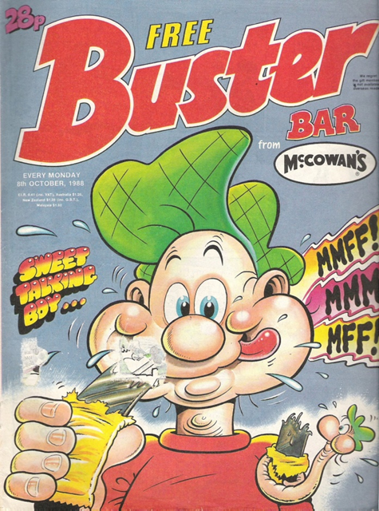
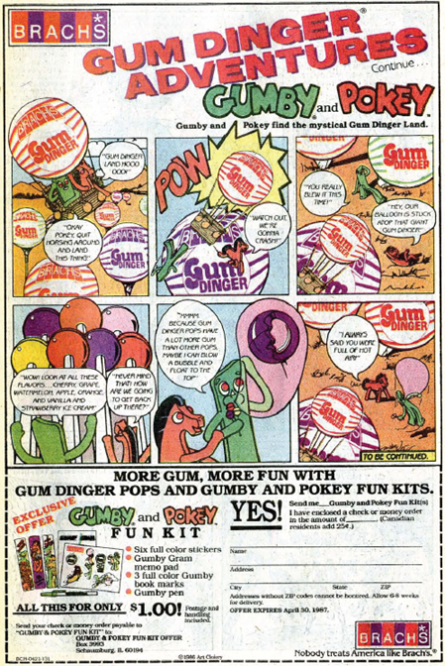
TASTE

Slide 8
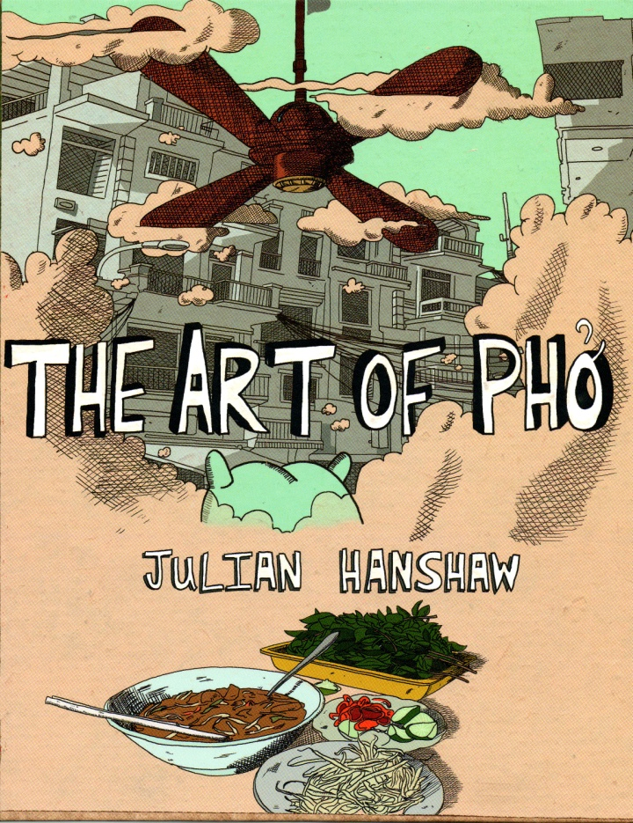
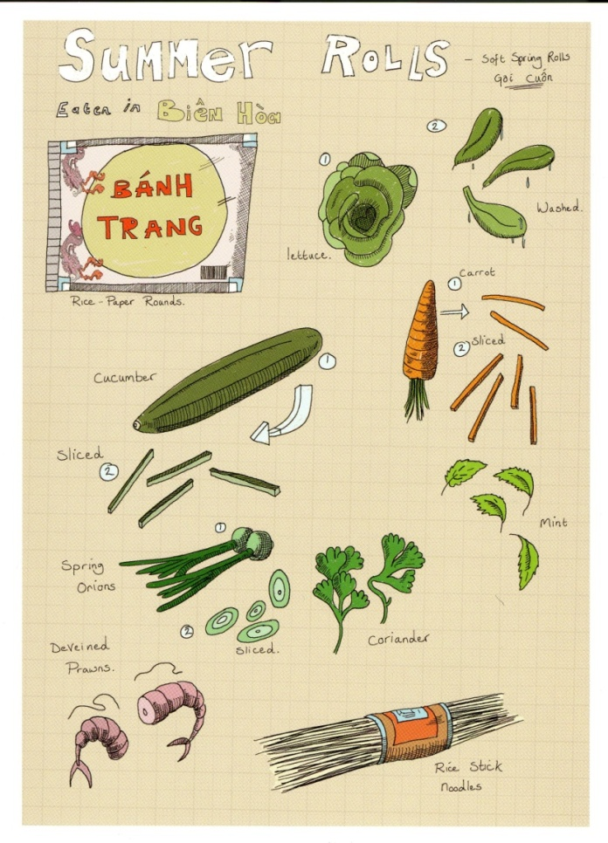
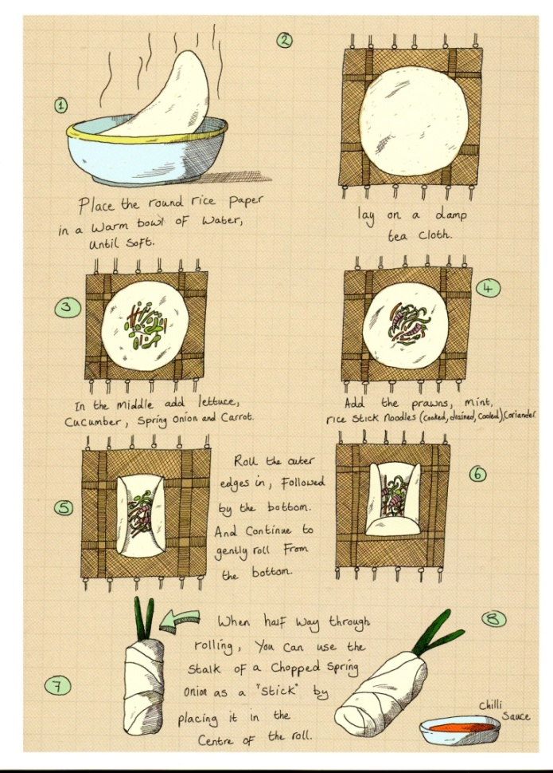
TASTE

Slide 9
GOING FORWARDS
BETTER UNDERSTANDING OF EXISTING COMICS
TRACKING DEVELOPMENT OF PUBLISHING IN DIGITAL ERA
DEVELOPING COMICS AND OTHER IMAGE FORMS IN WAYS THAT ARE MORE ACCESSIBLE TO VISUALLY IMPAIRED USERS

Slide 10
REFERENCES
GIBSON, MEL. “WHAT YOU READ AND WHERE YOU READ IT, HOW YOU GET IT, HOW YOU KEEP IT: CHILDREN, COMICS AND HISTORICAL CULTURAL PRACTICE.” POPULAR NARRATIVE MEDIA 1.2 (2008): 151-167.
McCLOUD, SCOTT. UNDERSTANDING COMICS: THE INVISIBLE ART. NEW YORK: HARPERPERENNIAL, 1993 (1994).
SABIN, ROGER. “THE CRISIS IN MODERN AMERICAN AND BRITISH COMICS, AND THE POSSIBILITIES OF THE INTERNET AS A SOLUTION.” COMICS AND CULTURE: ANALYTICAL AND THEORETICAL APPROACHES TO READING COMICS. COPENHAGEN: MUSEUM TUSCULANUM PRESS & UNIVERSITY OF COPENHAGEN, 2000. 43-57.

Slide 11
COMICS AND THE SENSES
IAN HAGUE
DEPARTMENT OF HISTORY, UNIVERSITY OF CHICHESTER
I.HAGUE@CHI.AC.UK

