Slide 1
Eye Like Comics: Ocularcentrism and the Ideal Perspective in Comics
Ian Hague
Department of History, University of Chichester
Director, Comics Forum
I.Hague@chi.ac.uk
comicsforum.org

Slide 2
Approaches to comics
art & aesthetics
Business and economics
Art historian
Cultural historian
historiographer
historical
Health-medical
philosophical
Contains material adapted from :A Framework for Studying Comic Art, Matthew Lombard et al; in the International Journal of Comic Art, 1.1 , 1999, pp.17-32.
psychological
sociological

Slide 3
Formalist approaches to comics
The definitional project
What are comics?
The mechanical project
How do comics work?

Slide 4
‘[As well as] internal characteristics that define what a comic is, something else is involved in their definition. It is hard to state without sounding tautological: a comic is what has been produced under the definition of a ‘comic’. There has been a historical process whereby public arguments about comics, and what is acceptable under that name, have become in their turn powerful determinants of what is produced.’
Martin Barker, Comics: power, ideology and the critics (1989), p.8.
Defining comics
‘[j]uxtaposed pictorial and other images in deliberate sequence, intended to convey information and/or produce an aesthetic response in the viewer’
Scott McCloud, Understanding Comics: The Invisible Art (1993), p.9.
‘[. . .] “comicness” might usefully be reconceptualized from being an immutable attribute of texts to being considered as a historically contingent and evolving set of reading protocols that are applied to texts, that to be a comic means to be read as a comic.’
Joseph Witek ‘The Arrow and the Grid’ in A Comics Studies Reader (2009), p.149.
‘For our present work, I would propose a definition in which a “comic strip” of any period, in any country, fulfills [sic] the following conditions: 1) There must be a sequence of separate images; 2) There must be a preponderance of image over text; 3) The medium in which the strip appears and for which it was originally intended must be reproductive, that is, in printed form, a mass medium; 4) The sequence must tell a story which is both moral and topical.’
David Kunzle, The Early Comic Strip: Narrative Strips and Picture Stories in the European Broadsheet from c.1450 to 1825 (1973), p.2.
Knowingly incomplete definitions
Social definitions
‘This work is intended to consider and examine the unique aesthetics of Sequential Art as a means of creative expression, a distinct discipline, an art and literary form that deals with the arrangement of pictures or images and words to narrate a story or dramatise an idea. It is studied here within the framework of its application to comic books and comic strips, where it is universally employed.’
Will Eisner, Comics and Sequential Art (1985), p.5.
‘Comic Strip: A serially published, episodic, open-ended dramatic narrative or series of linked anecdotes about recurrent identified characters, told in successive drawings regularly enclosing ballooned dialogue or its equivalent and generally minimal narrative text.’
Bill Blackbeard, ‘Mislabeled Books’ in Funnyworld #16 (1974), p.41.
‘If one wishes to provide the basis of a reasonable definition for the totality of the historical manifestations of the medium, and also for all other productions unrealized at this time but theoretically conceivable, one must recognise the relational play of a plurality of interdependent images as the unique ontological foundation of comics.’
Thierry Groensteen, The System of Comics (2007), p.17.
Elemental definitions

Slide 5
Formalist approaches to comics
ELEMENTAL DEFINITIONS
The definitional project
KNOWINGLY INCOMPLETE DEFINITIONS
What are comics?
SOCIAL DEFINITIONS
The mechanical project
How do comics work?

Slide 6
‘[. . .] the more intricate a modern science becomes and the better it understands itself methodologically, the more resolutely it will turn its back on the ontological problems of its own sphere of influence and eliminate them from the realm where it has achieved some insight. The more highly developed it becomes and the more scientific, the more it will become a formally closed system of partial laws. It will then find that the world lying beyond its confines, and in particular the material base which it is its task to understand, its own concrete underlying reality lies, methodologically and in principle, beyond its grasp.’
Georg Lukács, History and Class Consciousness: Studies in Marxist Dialectics (1968 [1971]), p.104.
‘What the speakers of a language think it worthwhile to say depends on their opportunities for expression, what modes of discourse are generally available to them.’
Walter Benjamin, ‘A State Monopoly on Pornography’ in Walter Benjamin: Selected Writings Volume 2, part 1, 1927-1930, 2005, pp.72-73

Slide 7
Formalist approaches to comics
The definitional project
What are comics?
SOCIAL DEFINITIONS
ELEMENTAL DEFINITIONS
The mechanical project
KNOWINGLY INCOMPLETE DEFINITIONS
How do comics work?

Slide 8
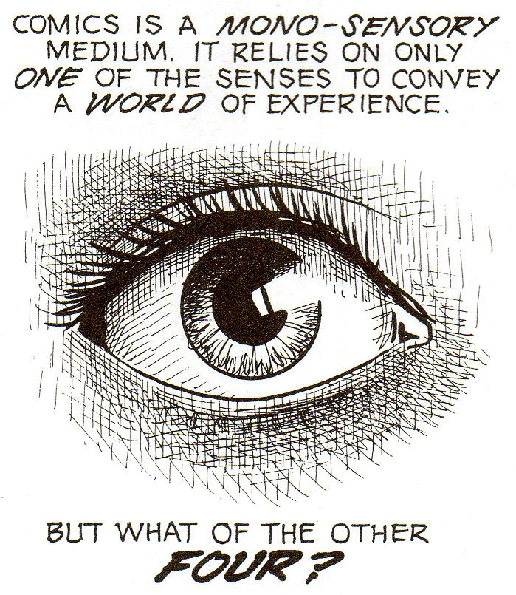
Scott McCloud, Understanding Comics: The Invisible Art , 1993, p.89.

Slide 9
‘It’s easy to forget that we read - or rather ‘use’ – comics in a very physical way (we tend to think of them as being two-dimensional, but in fact they exist in three dimensions). They can be bent, rolled-up, roughly opened or whatever. They can be held in different ways: cradled in your hand or gripped at the edges. We know how far into a comic we’ve read because we can feel how many pages are left. There are also smells: of dust, glue and paper. Compared to this very sensual experience, clicking a mouse just isn’t the same.’
Roger Sabin, ‘The Crisis in Modern American and British Comics, and the Possibilities of the Internet as a Solution’ in Comics and Culture: Analytical and Theoretical Approaches to Reading Comics (2000), p.52.

Slide 10
‘Patterns emerged in interview regarding memories of comics [. . . .] readers often wanted to check details, testing memory against outside sources. Further discussion included titles and narratives alongside physical aspects of the texts, including paper quality, feel, scent and size.’
‘What you read and where you read it, how you get it, how you keep it: Children, comics and historical cultural practice’ in Popular Narrative Media 1.2 (2008), p.151-152.
‘What sort of music should I listen to when I’m reading comics?’
Adam Fisher, untitled letter, The Mighty World of Marvel v.4 #12 (2010), p.75.
‘I did lose interest [in Marvel Comics] in the early ‘80’s as the print quality went downhill (anyone remember The Mighty Thor Weekly? The colours were all over the place!, or The Hulk comic or Spider-Man comic on poor quality newsprint?)’
Mark Williams, untitled letter, Astonishing Spider-Man v.2 #9 (2007), p.75.
‘I love the sweet, delicious scent of comic books […]’
Bill Reed, ‘365 Reasons to Love Comics #342’, Comic Book Resources website (2007).
‘Just finished RASL Volume 2 graphic novel and I love the way you put a story together. Stupid question... Do you ever think of a soundtrack to your work? I had trouble with this volume of material.’
Jason Warzecha, untitled letter, RASL #8 (2010), n.p.

Slide 11

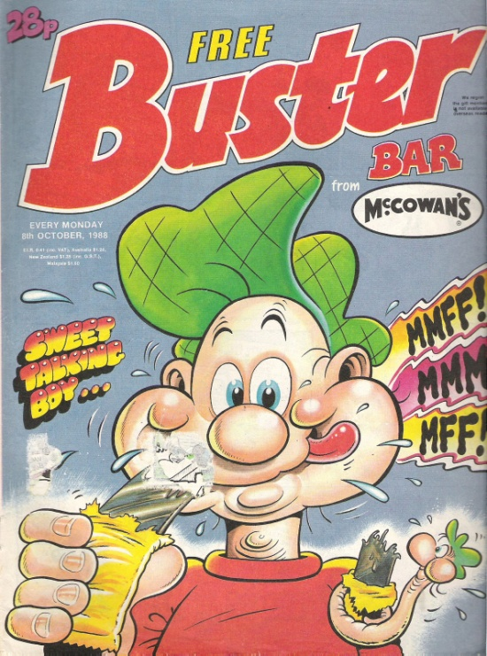
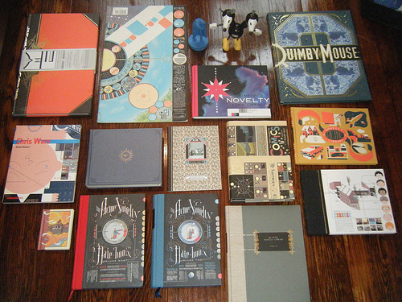
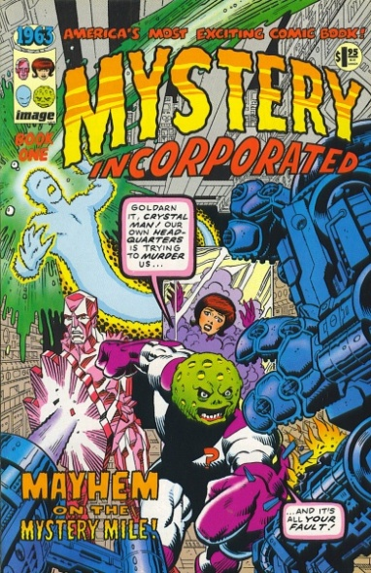
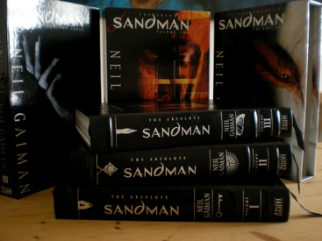

‘We reject the notion print is dead.
True, the screen promises endless possibilities but we vow to create beautiful work you can hold, and beautiful work you cannot. We are committed to producing gorgeous, tactile Comics [sic] that readers will cherish.’
Tom Humberstone, Solipsistic Pop #1 (2009), n.p.

Slide 12
Eye Like Comics: Ocularcentrism and the Ideal Perspective in Comics
Ian Hague
Department of History, University of Chichester
Director, Comics Forum
I.Hague@chi.ac.uk
comicsforum.org

