Slide 1
IAN
Hague
I.HAGUE@CHI.AC.UK
‘I DO LOVE THE SMELL OF THAT OLD NEWSPRINT’: SMELL AND NOSTALGIA IN COMICS

Slide 2
‘It’s easy to forget that we read – or rather ‘use’ – comics in a very physical way (we tend to think of them as being two-dimensional, but in fact they exist in three dimensions). They can be bent, rolled-up, roughly opened or whatever. They can be held in different ways: cradled in your hand or gripped at the edges. We know how far into a comic we’ve read because we can feel how many pages are left. There are also smells: of dust, glue and paper. Compared to this very sensual experience, clicking a mouse just isn’t the same.’
Roger Sabin, ‘The Crisis in Modern American and British Comics, and the Possibilities of the Internet as a Solution’ in Comics and Culture: Analytical and Theoretical Approaches to Reading Comics (2000), p.52.

Slide 3
‘I miss the smell of the old comics [. . .]. The new ones, what with their slick pages and fancy printing, have become too artificial for me’
Bill Reed, ‘365 Reasons to Love Comics #342 [The Smell]. 8 December 2007. Comic Book Resources. 25 July 2011. <http://goodcomics.comicbookresources.com/2007/12/08/365-reasons-to-love-comics-342/>
‘Patterns emerged in interview regarding memories of comics [. . . .] readers often wanted to check details, testing memory against outside sources. Further discussion included titles and narratives alongside physical aspects of the texts, including paper quality, feel, scent and size.’
Mel Gibson, ‘What you read and where you read it, how you get it, how you keep it: Children, comics and historical cultural practice’ in Popular Narrative Media 1.2 (2008), p.151-152.

Slide 4
‘Only three synapses are needed to connect to the hippocampus, which is necessary for associative learning and various forms of memory.’
Rachel S. Herz, ‘I Know What I Like: Understanding Odor Preferences’ in The Smell Culture Reader, p.191.
‘Only two synapses separate the olfactory bulb from the amygdala, which is critical for the expression and experience of emotion.’

Slide 5
‘[. . .] when from a long-distant past nothing subsists, after the people are dead, after the things are broken and scattered, still, alone, more fragile, but with more vitality, more unsubstantial, more persistent, more faithful, the smell and taste of things remain poised a long time, like souls, ready to remind us, waiting and hoping for their moment, amid the ruins of all the rest; and bear unfalteringly, in the tiny and almost impalpable drop of their essence, the vast structure of recollection.’
Marcel Proust, Remembrance of Things Past: Volume 1, Wordsworth Editions, Hertfordshire, 2006. p.63.

Slide 6
‘Comics have a privileged relationship with childhood because it is in childhood that each of us discovered them and learnt to love them.’
Thierry Groensteen. "Why Are Comics Still in Search of Cultural Legitimization?" A Comics Studies Reader. Ed. Jeet Heer and Kent Worcester. Jackson: University Press of Mississippi, 2009. 3-11.

Slide 7

‘DELVING INTO THE FACSIMILE PAGES OF [THE BEST OF JACKIE], IS LIKE BEING GIVEN A TICKET TO TRAVEL BACK IN TIME’
All quotations from www.carltonbooks .co.uk (accessed July 2011)

Slide 8

‘“ALL YOUR FAVOURITES” IS ANOTHER TREASURE TROVE OF HILARIOUS NOSTALGIC GEMS, REPRODUCED IN FACSIMILE FORM TRUE TO THE ORIGINAL, TO PORE OVER AND ENJOY’
All quotations from www.carltonbooks .co.uk (accessed July 2011)

Slide 9

‘AFTER THE HUGE SUCCESS OF “THE BEST OF JACKIE”, THIS IS THE FOLLOW-UP TITLE, “THE BEST OF JACKIE ANNUAL” - MORE GREAT MATERIAL, REPRODUCED IN FACSIMILE FORM TRUE TO THE ORIGINAL’
All quotations from www.carltonbooks .co.uk (accessed July 2011)

Slide 10

‘REPRODUCED 25 PER CENT BIGGER THAN THE ORIGINALS SO YOU CAN FEEL EVERY BULLET HIT, EVERY CRASHING WAVE AND EVERY NERVE-SHATTERING EXPLOSION’
All quotations from www.carltonbooks .co.uk (accessed July 2011)

Slide 11
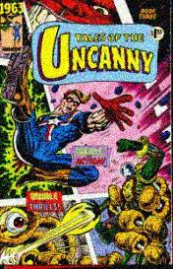
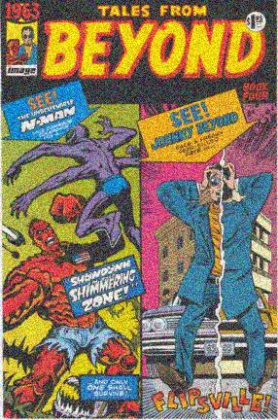
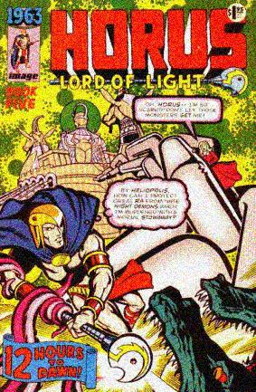
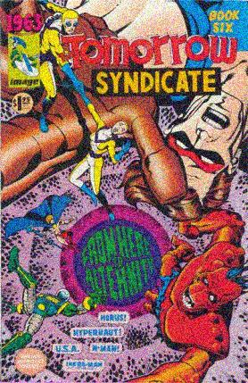
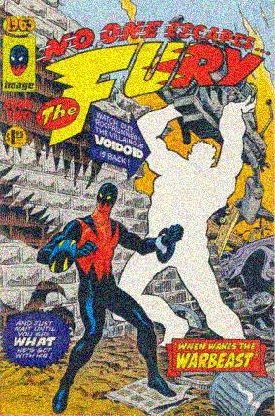
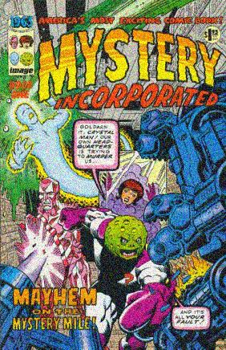
If you hold the comic book you are reading up to your nose and inhale slowly, you will discern the most distinctive difference of all between RETRO and ANY OTHER FORMAT!! That’s RIGHT, revellers! With the miracle of our professionally patented AROMARAMA process, contemporary comic collectors can at last enjoy the laser-accurate HOLOGRAPHICALLY REPRODUCED odor of yesteryear!!
Alan Moore et al, 1963 #3, p.14

Slide 12
‘I was recently reading Alan Moore’s 1963 for the first time and I saw in one issue a blurb boasting about the cheap paper used to print it, including the authentic comic book smell. I went ahead and sniffed the comic and it was true! The scent brought back fond memories of my pre-adolescence and biking to the comic book store to spend my allowance.’
‘I do love the smell of that old newsprint. Alan Moore mentioned it, in a 1963 lettercol, I believe, and ever since I’ve been acutely tuned into that particular sweet vapor that comes from old comics.’
Reader comments on Bill Reed’s ‘365 Reasons to Love Comics #342 [The Smell]’ accessed at Comic Book Resources website.

Slide 13
Instead of a text-based experience aimed at finding and connecting bits of information, the goals of the immersed user will include the visual and sensory pleasures of spatial exploration.
Lister, Martin, et al. New Media: A Critical Introduction. Abingdon: Routledge, 2003. p.21
‘A SCENT MAY DROWN ENTIRE YEARS IN THE REMEMBERED ODOR IT EVOKES’
Walter Benjamin. ‘On Some Motifs in Baudelaire’ in Walter Benjamin: Selected Writings Volume 4: 1938-1940. Ed. Howard Eiland and Michael W. Jennings. Trans. Edmund Jephcott. Cambridge MA & London: Harvard University Press, 2003. 313-355. p.335

Slide 14

‘[THE BEST OF “JACKIE” ANNUAL FEATURES] EVERYTHING A YOUNG GIRL GROWING UP IN THE SEVENTIES WOULD WANT IN AN ANNUAL, AND EVERYTHING A WOMAN IN HER THIRTIES AND FORTIES WOULD WANT TO LAUGH AT NOW.’
‘NOW IS YOUR CHANGE [SIC] TO RELIVE ALL OF THOSE GOLDEN JACKIE MOMENTS AND SHOW THE YOUNGSTERS IN YOUR LIFE WHAT LIFE WAS LIKE WHEN YOU WERE GROWING UP.’
‘[THE BIGGEST “JACKIE” ANNUAL EVER! FEATURES] EVERYTHING A YOUNG GIRL GROWING UP IN THE SEVENTIES WOULD WANT IN AN ANNUAL, AND EVERYTHING THAT WILL BRING BACK FOND MEMORIES FOR A WOMAN IN HER THIRTIES AND FORTIES.’
All quotations from www.carltonbooks .co.uk (accessed July 2011)

Slide 15
Dear Al and the Gang,
I am a great fan of all your comic books, and since I one day hope to be a comic artist worthy to sit at the feet of the great Roarin’ Rick Veitch, I sent away for a duplicated amateur magazine about comics that I saw advertised. The magazine was called The Comics Gazette, and since it featured an interview with the Roarin’ One himself, how could I pass it up? Well, I read the interview, and I have to admit that I’m kind of troubled by some of the things that Rick said, especially about everybody in the Sixty Three sweatshop having to sign contracts that make Affable Al the sole owner of any characters they create, or that their descendants create. I admit that there was a lot of stuff in the interview that I maybe didn’t understand, like for example what does “Work For Hire” mean? All the same, this thing about contracts doesn’t seem fair, although I know that The Affable One would never do anything mean, and I wondered if you could maybe explain it to me. But don’t worry…whatever the explanation, you can bet that I’ll Be Sure To See It’s Sixty-Three!!
Ralph J. Hutty, 58 Genesee St.
Englewood, N.J.
Alan Moore et al, 1963 #1, p.26

Slide 16
Ralph, we’d bet our bottom dollar on it…especially when we reveal that Roarin’ Rick’s rib-tickling rant was just another example of the screwy, scatter-brained sense of silliness that’s all a part of slaving in the sensational Sixty-Three sweatshop! The Roarin’ One was indulging in some good-natured joshing by ribbing Affable Al about the perennial pesky pranks that our lovable leader persistently pulls around the office, like handing out wacky gag contracts for everyone to sign! As for the magnificently mysterious motto “Work For Hire”, let the serried ranks of Sixty Three-dom hereby receive notice that “hire” is the nickname of Handsome HIRAM GLICK, our swingin’ septuagenarian Voucher Clerk! Y’See, whenever one of our prodigious pencillers or inimitable inkers finishes a job, he has to fill out a voucher for Hiram to process, which is, of course, making additional “Work for Hire”, even though the cheery old codger never utters a word of complaint. Anyway, Ralph, much as we’d love to delve even further into this tantalizing topic, there are even more pressing issues that we have to find room for, such as the ones mentioned in our next letter:
Dear Al and Rick,
In MYSTERY INC. #17, on page 5 in the last panel, King Zero’s leg is blue instead of white. Also, on page eighteen you have Crystalman saying “We have to stop him reaching the the Devolvo Ray”, with the word “the” repeated twice. Is there a reason for this or did you just make a mistake?
Owen Bevels, 139 Bridge St.
Daly City, Calif.
Alan Moore et al, 1963 #1, p.26

Slide 17
Benjamin, Walter. "On Some Motifs in Baudelaire." Benjamin, Walter. Walter Benjamin: Selected Writings Volume 4: 1938-1940. Ed. Howard Eiland and Michael W. Jennings. Trans. Edmund Jephcott. Cambridge MA & London: Harvard University Press, 2003. 313-355.
Burgas, Greg. "Comics You Should Own Flashback - 1963." 26 August 2007. Comic Book Resources. 25 July 2011. <http://goodcomics.comicbookresources.com/2007/08/26/comics-you-should-own-flashback-1963/>.
Carlton Publishing Group. "Against All Odds 12 of the Best "War Picture Library" Comic Books Ever!" n.d. Carlton Publishing Group Website. 25 July 2011. <http://www.carltonbooks.co.uk/display.asp?ISB=9781853756610&>.
—. "The Best of "Jackie" Annual." n.d. Carlton Publishing Group Website. 25 July 2011. <http://www.carltonbooks.co.uk/display.asp?K=9781853756085&sf1=title%5Findex&st1=jackie&y=0&sort=sort%5Fdate%2Fd&x=0&m=5&dc=6>.
—. "The Biggest "Jackie" Annual Ever! The Best Thing for Girls - Next to Boys." n.d. Carlton Publishing Group Website. 26 July 2011. <http://www.carltonbooks.co.uk/display.asp?K=9781853756672&sf1=title%5Findex&st1=jackie&sort=sort%5Fdate%2Fd&m=2&dc=6>.
Conroy, Mike. 500 Great Comicbook Action Heroes. London: Chrysalis Impact, 2002.
Deleuze, Gilles. Proust and Signs: The Complete Text. Trans. Richard Howard. London & New York: Continuum, 2008.
Gibson, Mel. ""You Can't Read Them, They're For Boys!" British Girls, American Superhero Comics and Identity." International Journal of Comic Art 5.1 (2003): 305-324.
—. "“I do have the annuals but somehow they are just not the same as the weeklies printed on that dreadfully poor quality paper”: British girls’ comics, publication formats and perceptions of class." Materiality and Virtuality: A Conference on Comics. Leeds, 2011.
Groensteen, Thierry. "Why Are Comics Still in Search of Cultural Legitimization?" A Comics Studies Reader. Ed. Jeet Heer and Kent Worcester. Jackson: University Press of Mississippi, 2009. 3-11.
Herz, Rachel S. "I Know What I Like: Understanding Odor Preferences." The Smell Culture Reader. Ed. Jim Drobnick. Oxford & New York: Berg, 2006. 190-203.
Lee, Stan and George Mair. Excelsior! The Amazing Life of Stan Lee. London: Boxtree, 2002.
Lister, Martin, et al. New Media: A Critical Introduction. Abingdon: Routledge, 2003.
Looby, Christopher. ""The Roots of the Orchis, the Iuli of Chesnuts": The Odor of Male Solitude." The Smell Culture Reader. Ed. Jim Drobnick. Oxford & New York: Berg, 2006. 289-304.
Moore, Alan, Rick Veitch and Steve Bissette. 1963. 6 vols. Fullerton, CA: Image Comics, 1993.
Proust, Marcel. Remembrance of Things Past. Trans. C.K. Scott Moncrieff and Stephen Hudson. 2 vols. Ware: Wordsworth Editions Limited, 2006.
Reed, Bill. "365 Reasons to Love Comics #342 [The Smell]." 8 December 2007. Comic Book Resources. 25 July 2011. <http://goodcomics.comicbookresources.com/2007/12/08/365-reasons-to-love-comics-342/>.

