Slide 1
Drawing ‘the apprenticeship of a man of letters’: Adapting Remembrance of Things Past for bande dessinée
Dr Ian Hague
@drianhague
www.ianhague.com

Slide 2
ADAPTATIONS

Slide 3



ADAPTATIONS
SEQUENCE
BRAIDING
THE INSET
PERSPECTIVE

Slide 4






ADAPTATIONS
SEQUENCE
BRAIDING
THE INSET
PERSPECTIVE

Slide 5
SEQUENCE

Slide 6



ADAPTATIONS
SEQUENCE
BRAIDING
THE INSET
PERSPECTIVE

Slide 7
ADAPTATIONS
SEQUENCE
BRAIDING
THE INSET
PERSPECTIVE

Slide 8

ADAPTATIONS
SEQUENCE
BRAIDING
THE INSET
PERSPECTIVE

Slide 9
ADAPTATIONS
SEQUENCE
BRAIDING
THE INSET
PERSPECTIVE

Slide 10
BRAIDING

Slide 11
ADAPTATIONS
SEQUENCE
BRAIDING
THE INSET
PERSPECTIVE

Slide 12
ADAPTATIONS
SEQUENCE
BRAIDING
THE INSET
PERSPECTIVE

Slide 13
ADAPTATIONS
SEQUENCE
BRAIDING
THE INSET
PERSPECTIVE

Slide 14
ADAPTATIONS
SEQUENCE
BRAIDING
PERSPECTIVE
THE INSET

Slide 15
ADAPTATIONS
SEQUENCE
BRAIDING
THE INSET
PERSPECTIVE

Slide 16
THE INSET

Slide 17
ADAPTATIONS
SEQUENCE
BRAIDING
THE INSET
PERSPECTIVE

Slide 18
PERSPECTIVE

Slide 19
ADAPTATIONS
SEQUENCE
BRAIDING
THE INSET
PERSPECTIVE

Slide 20
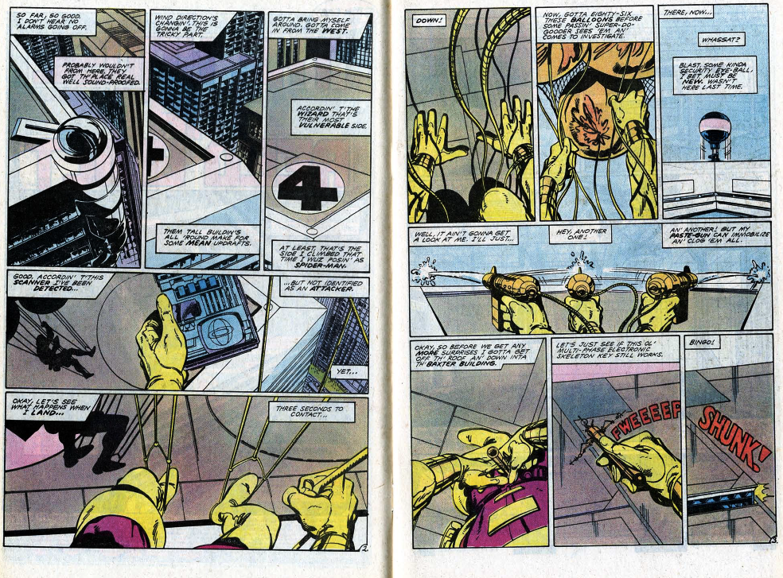
ADAPTATIONS
SEQUENCE
BRAIDING
THE INSET
PERSPECTIVE

Slide 21
ADAPTATIONS
SEQUENCE
BRAIDING
THE INSET
PERSPECTIVE

Slide 22
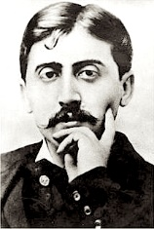
ADAPTATIONS
SEQUENCE
BRAIDING
THE INSET
PERSPECTIVE

Slide 23
ADAPTATIONS
SEQUENCE
BRAIDING
THE INSET
PERSPECTIVE

Slide 24
Drawing ‘the apprenticeship of a man of letters’: Adapting Remembrance of Things Past for bande dessinée
Dr Ian Hague
@drianhague
www.ianhague.com

