Slide 1
It’s a book! It’s a game! It’s Building Stories! Play, Plot and Narration in Graphic Narratives
Simon Grennan and Ian Hague
www.kartoonkings.com www.ianhague.com
@drianhague

Slide 2
I: Building Stories

Slide 3
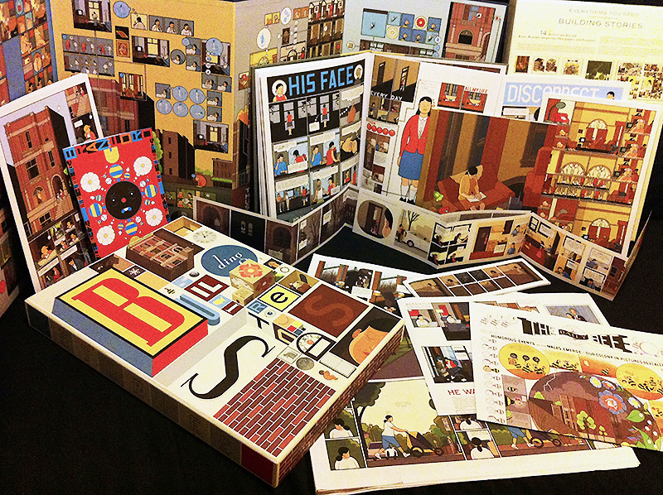

Slide 4
II: Chatman on Narrative

Slide 5
A salient property of narrative is double time structuring. That is, all narratives, in whatever medium, combine the time sequence of plot events, the time of the histoire (“story-time”) with the time of the presentation of those events in the text, which we call “discourse-time”. What is fundamental to narrative, regardless of medium, is that these two time orders are independent.
Chatman, Seymour, ‘What Novels Can Do That Films Can’t (and Vice Versa),’ Critical Enquiry 7:1 (1980), 121-140. 122.

Slide 6
‘[There is a] disparity between the story order and discourse order: story order is A, B, C, D; discourse order is A, C, B, D’
Chatman, Seymour, ‘What Novels Can Do That Films Can’t (and Vice Versa),’ Critical Enquiry 7:1 (1980), 121-140. 124.

Slide 7
III: Expanding on Chatman

Slide 8
Story Time

Slide 9
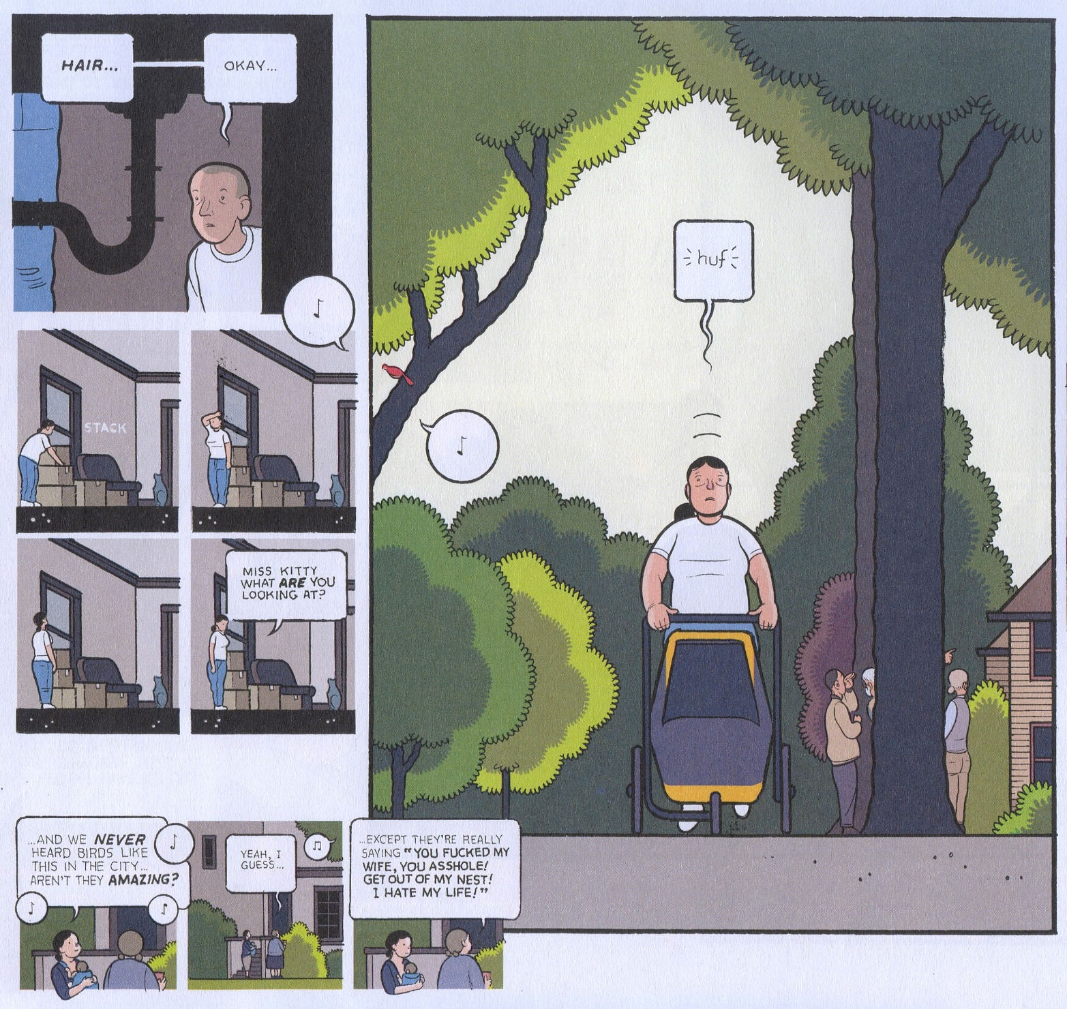
Discourse Time

Slide 10
User Time

Slide 11
Story Time
Discourse Time
User Time

Slide 12
IV: Plot in Games

Slide 13
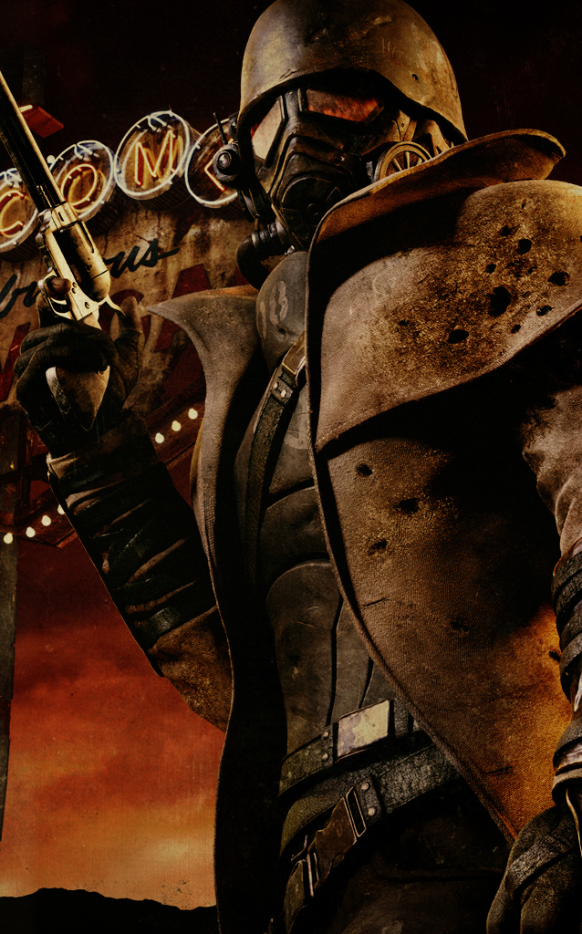
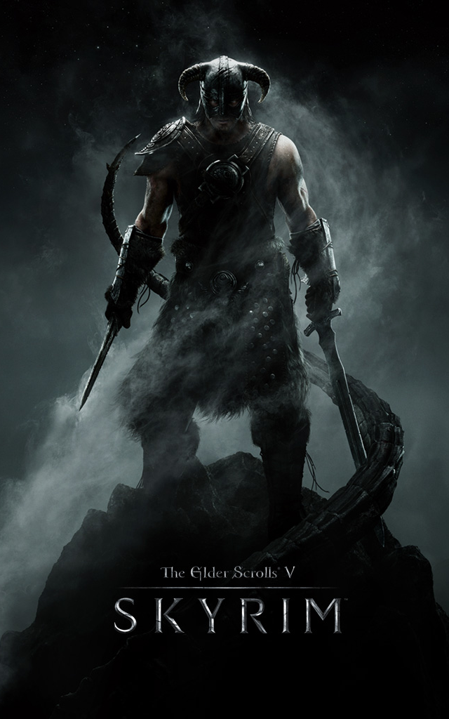
The Elder Scrolls V: Skyrim (2011)
Fallout: New Vegas (2010)

Slide 14
V: Is Building Stories a game?

Slide 15
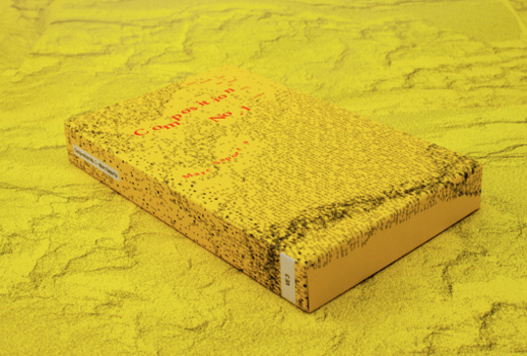
Composition No. 1
Marc Saporta (1962)

Slide 16
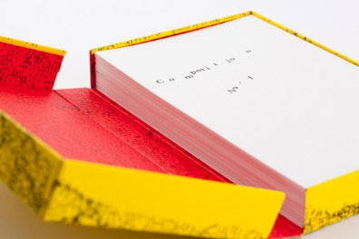

Slide 17
VI: What does this tell us?

Slide 18
Comparison of narratives across media.
Understanding the nature of choice.
Means for dealing with existing choice-based narratives.

Slide 19
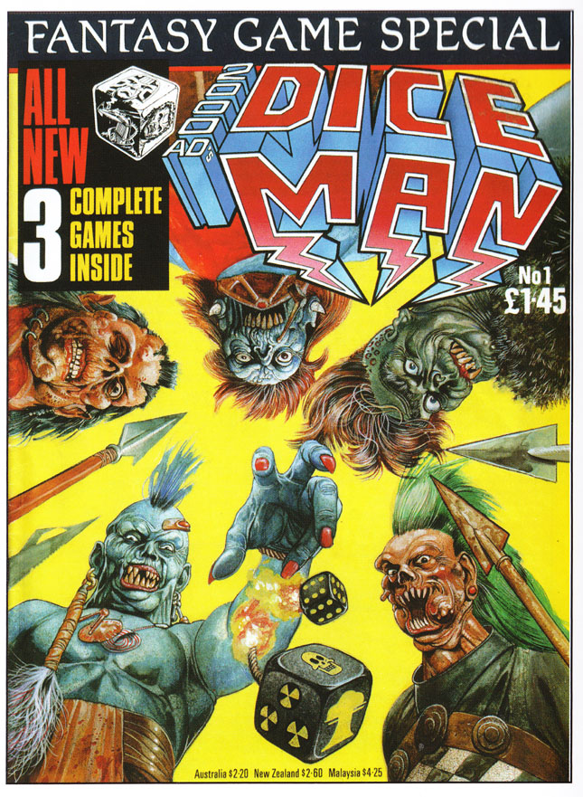
Dice Man
Various
(1986)

Slide 20
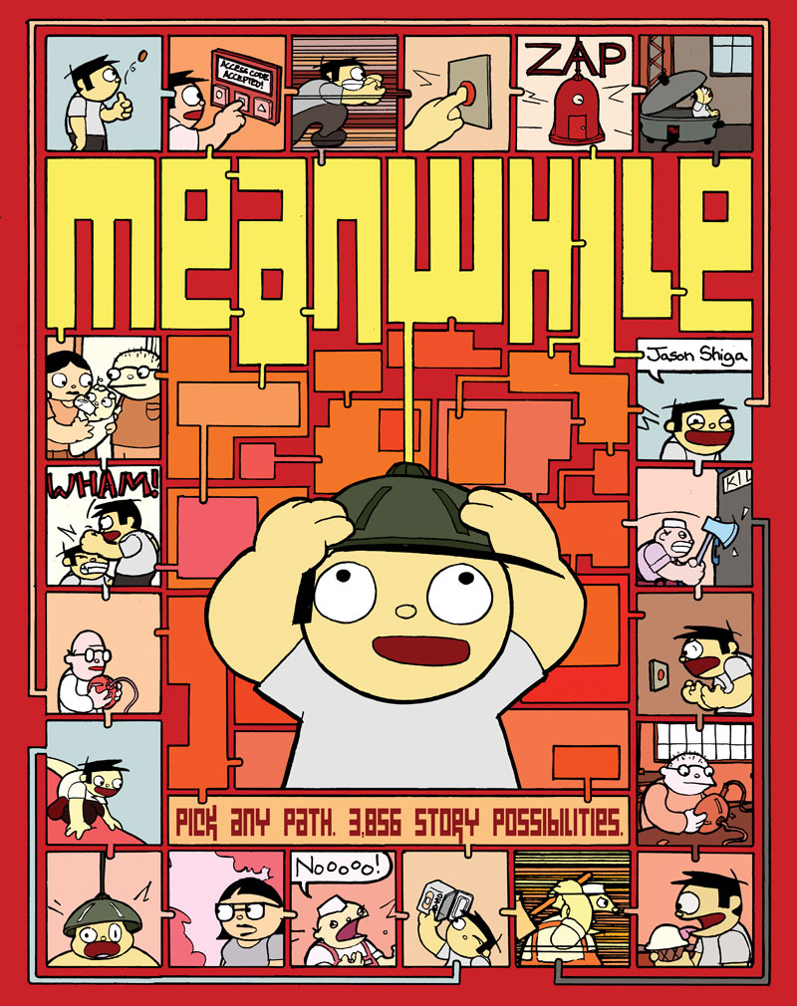
Meanwhile
Jason Shiga
(2010)

Slide 21
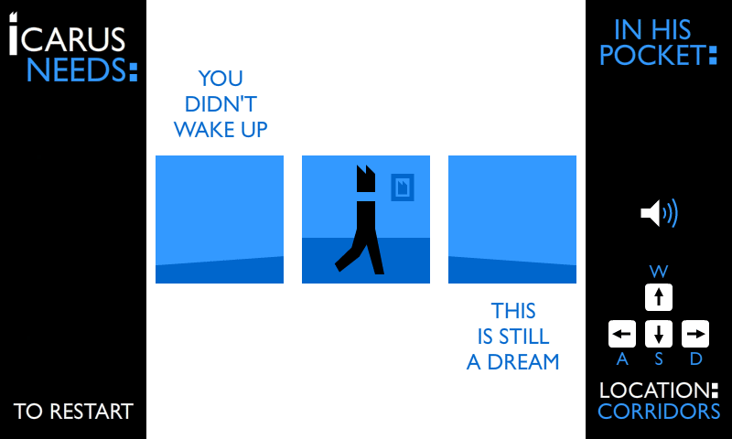
Icarus Needs, Daniel Merlin Goodbrey (2013)

Slide 22
It’s a book! It’s a game! It’s Building Stories! Play, Plot and Narration in Graphic Narratives
Simon Grennan and Ian Hague
www.kartoonkings.com www.ianhague.com
@drianhague

