Slide 1
‘Image’, ‘Cultural Form’, the Politics of Aesthetics
Dr Yi Chen

Slide 2
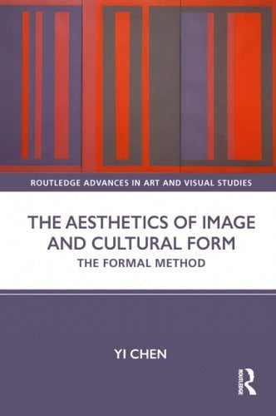

Slide 3
The concept of ‘Image’, ‘cultural form’
Examples of ‘Image’: The avant-garde impulse in paintings (late 1950s/early 1960s); how this cultural moment exemplifies an orientation toward visual culture analysis
The formalist disposition in visual culture analysis (methodology)
Politics of Aesthetic Forms (Jacques Rancière’s notion of ‘sensible’)
Notes:
In this presentation, I will talk about the main ideas featured in my book in relation to the concepts of Image and ‘cultural form’, as well as the images that inspired my conceptual development. I see them as ways of thinking about visual material forms, with particular focus and accents. And this is where I am developing a methodology that could be adopted broadly in the exploration of contexts, visual material forms, cultural historical analysis.

Slide 4
The sensuous form of ‘Image’
‘Image’- a genre of things characterised by its ontological intensity (presence, display, exhibitionistic character)
Fashioning of surface and structures, tactile qualities
Material modes of presentation (medium, material context), perceptual qualities (scale, texture of perceptual experience)
Capacity and agency
Image = the sensuous material forms of things
Notes:
‘Image’ as a concept accentuates the sensuous form of its being
How my discovery of these abstract paintings and their aesthetic concerns, which culturally orientated, coincided with my theoretical interest- that Image are forms.

Slide 5
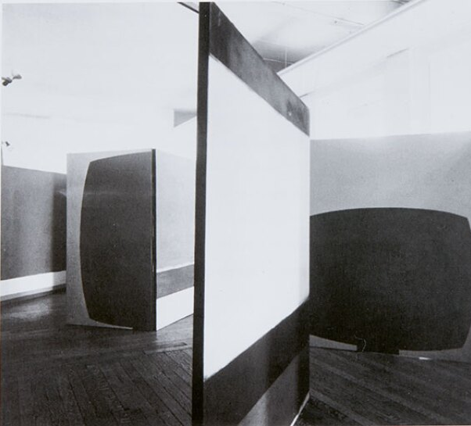
Place (exhibition)
Ralph Rumney, Richard Smith, Robin Denny
Larger than the body size (7ft x 6ft )
Red, green, black, white
Paintings are arranged diagonally across the gallery to give four main vistas
Installation view of Place (1959), Institute of Contemporary Arts, London
Notes:
As mentioned earlier, I am looking at a specific orientation toward painting that had taken place in the late 1950s early 1960s’ London. There was a group exhibition called Place and it’s an early manifestation of their attitude toward painting, image making and bringing cultural experiences into the forms of painting.
The exhibition comes about through some self-inititated parameters that all three painters agreed to. They are preoccupied with the formal elements of painting- colour, scale, composition etc. and are often claimed as formalist painters

Slide 6
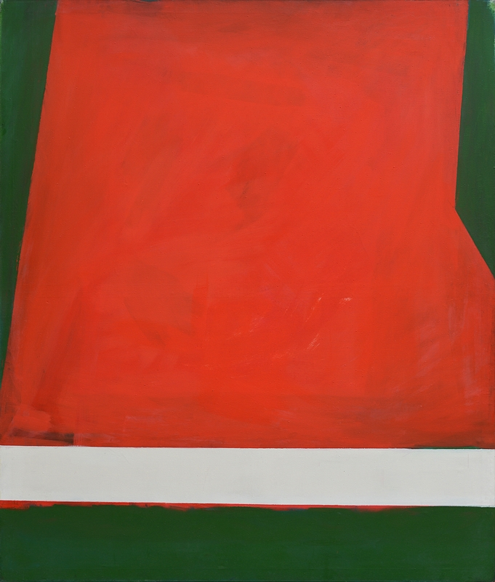
‘The body should see pictures on the margins of his perception all the time without ever being forced to look directly at them unless he so desires’ (Ralph Rumney, 1959).
Re-enacting modes of perception in the urban environment
Important to the painters were the recognition of the perceptual characteristics of the participant- the sensuous faculties of urban inhabitant, the ambience of mass media
Robyn Denny Place 3 (1959)
Notes:
Urban context of their painting, they are very much attuned to forms of experience, and the relationship between painterly forms- scale, colour, and the characteristic form of experience in the urban setting.
Instead of isolating forms of painting as an autonomous practice, they are keen to show aesthetic contiguity..

Slide 7
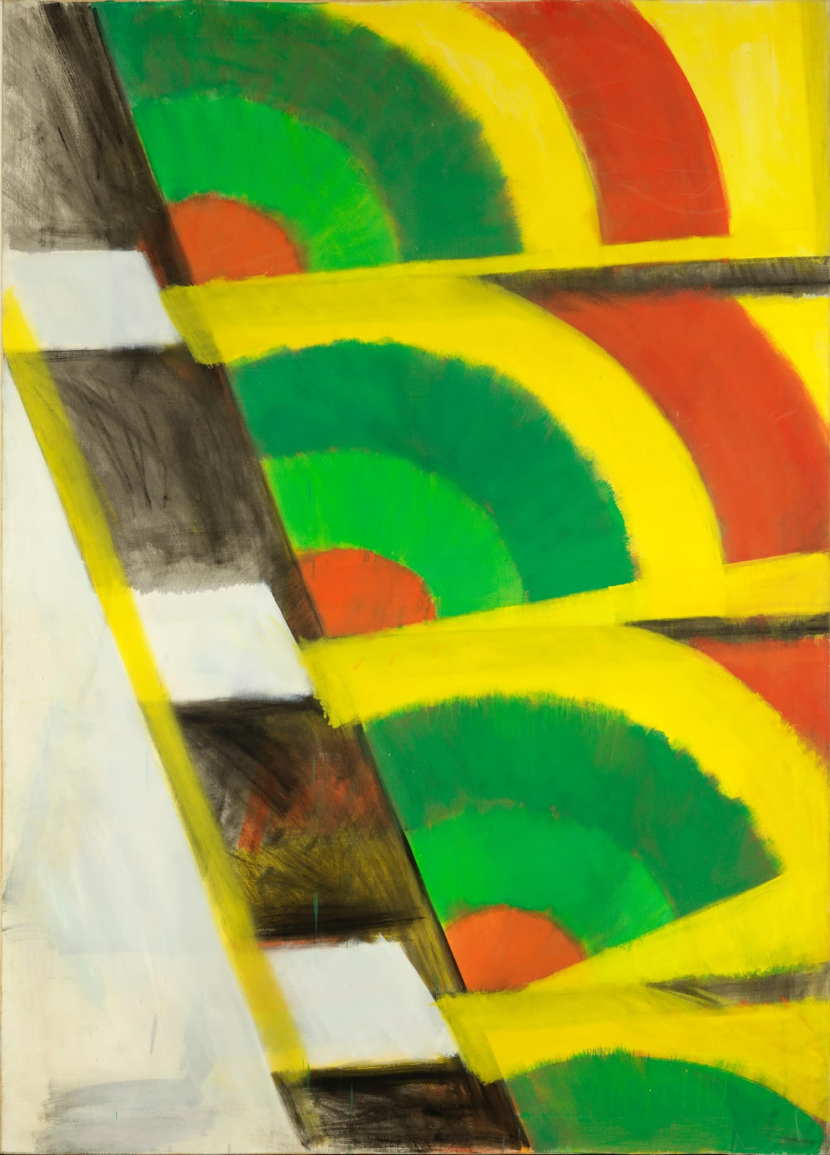
The formal resemblance between Smith’s paintings and ads is shown at the level of a visual ambience that suffuses mass culture, where paintings represent ‘an audio-visual impression of the atmosphere one works in’ (Lucy Lippards, 1964).
Trailer, 1962
Oil on Canvas
84 x 60 inches; 213.5 x 152.4 cm
Notes:
In 1962, Richard Smith made a ten-minute colour film Trailer with the photographer
Robert Freeman. In conversation with the American art critic Lucy Lippard, Smith
enumerates the iconography featured in the film—‘cigarette packages, watches, petals,
three types of cake, a blue soda siphon, a tire rolling across, then out of the screen; flashing
images with shadows going in different ways and finally a crumpled Phillip Morris packet
which is one of the saddest images I’ve ever seen’ (Lippard, 1964: 33). The film consists of
shots of colour advertisements (e.g. ads of cigarettes and cake mix ads) made with stylised
visual techniques. For instance, it includes segments of ads in great close-ups, constantly
switching and occasionally allowing its whole to be seen. These shots are intercut with
images of Smith’s paintings. Upon watching the film, the art historian Richard Morphet
recounts what he perceives as ‘close affinities between these lush garish colour ads, and
the textures, and the flicking techniques of mass communication with the image in the
pictures …’ (Morphet, 1962: n.p.).

Slide 8
Towards a Formalist Method: Image in relation to Cultural Form
The form of Image: bringing forth ‘Image’ through dense descriptions of its form (the aesthetic tradition of Formalism)
‘Cultural form’- sensuous, affective qualities that structure social relations (rhythm, ambience, mood); style of living; shared sensibilities

Slide 9
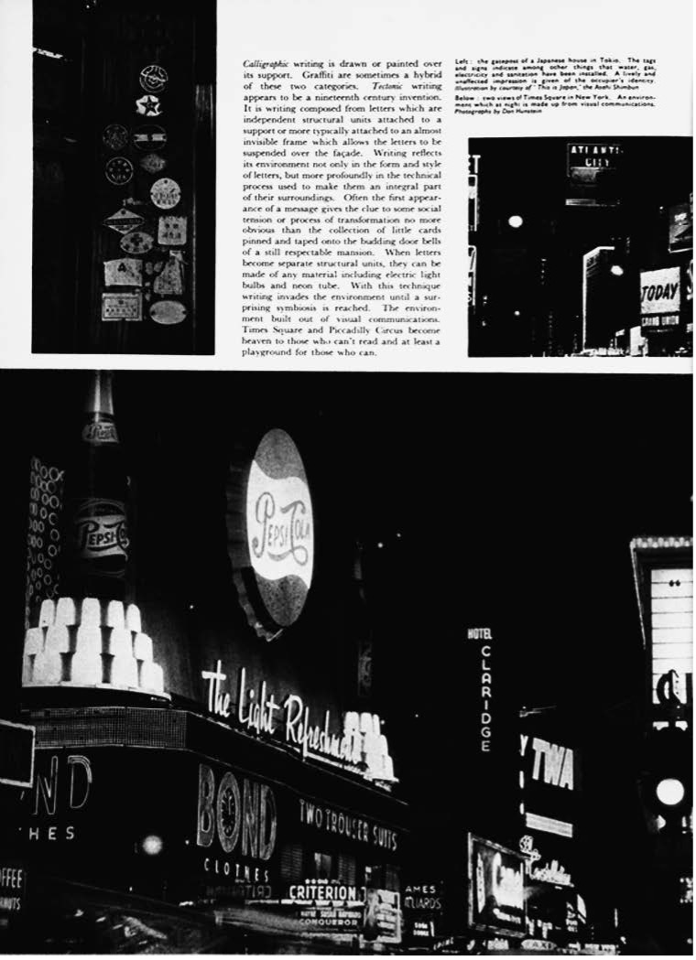
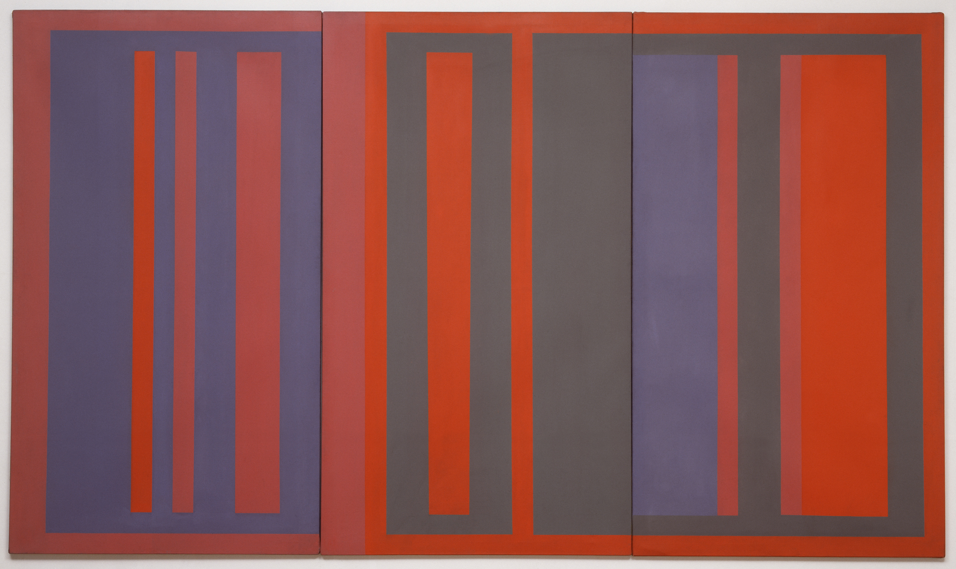
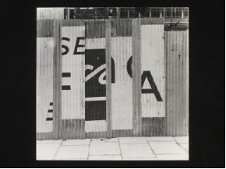
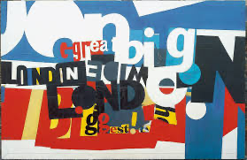
Methodology: The Aesthetics of Image and Cultural Form
Contextualising the singular form within cultural form and vice versa
‘making intelligible’ through Image— making visible the sensuous and perceptual patterns of shared experience
Robyn Denny, Baby is Three (1960)
Edward Wright. Page from Architectural Design, December 1956
Robyn Denny, Austin Reed Mural (1959)
Robert Brownjohn, Street Level (1961)
Notes:
TAKE SOME ARGUMENTS FROM CHAPTER 2 ENVIRONMENTAL IMAGE
Creating images that present and enact perceptual structures, in some cases it’s conscious, in other cases, one could make analysis that foregrounds the relationship
Robert Brownjohn- how he was drawn to a particular kind of aesthetics, found in the readymade visual forms in the popular environment
How public scaled signs and visual elements give form to urban environment, inducing a particular pattern of response
Note: I’ve also explored images that configure cultural forms. The active role of Image in creating cultural form, and the politics of this!!

Slide 10
Politics of Image
Politics of aesthetics- doing away with preconceived categories and the antagonistic logic of politicising matters
Jacques Rancière: aesthetic suspension is first and foremost suspension of any hierarchical regime (The Method of Equality, 2016: p75).
Notes:
Democracy may not have anything to do with reaching a consensus, it could be configured through the lens of something completely different
The sensual condition of social life (i.e. ‘aesthetics’) is emphatically addressed by the Rancierian idea of the ‘sensible’. In his book Politics of Aesthetics, the ‘sensible’ is endowed with a distinct set of analytical orientations. It doesn’t refer to felt senses; instead, it points to the sensual forms or conditions upon which sense perceptions take place, or the affective conditions upon which something may be felt and recognised in certain ways (Rancière, 2006). To extend this line of thinking, theory of ‘sensible’ also prescribes a relationship in which singular entities (e.g. social subjects) are made intelligible through sensual structures (i.e. ‘singularities’ are discerned through sensual logic). The singular-structure relation accentuates ‘forms of partaking’ that makes the singular coincide with structure— for instance, in ‘modes of perceptions’ that inscribe them in a commonality. Rancière’s notion of the distribution of the sensible elucidates this: ‘…a generally implicit law that defines the forms of partaking by first defining the modes of perception in which they are inscribed’ [Rancière, 2010: 44]).
At the heart of redeeming politics in aesthetics is the recognition that aesthetic forces and structures are a priori forms that determine the intelligibility of singular forms by way of how something presents itself as quality of experience. And the process of distinguishing a ‘singularity’, to make it intelligible, or conversely in the case of it being obscured within structures of experience, engenders ‘politics of aesthetics’. Here, we have a conception of politics premised on sensual forms and logic of senses that enable us to recognise actors and assemblages which may not fall into specific categories of identification.

Slide 11
Politicising ‘forms’ (‘Sensible’)
‘Sensible’ (Jacques Rancière)- sensual forms or conditions upon which sense perceptions take place; affective conditions upon which something may be felt and recognised. ‘Cultural form’ is analogous to ‘sensible’.
How does Image(s) render ‘sensible’, or unveil ‘sensible’?
‘Politics revolve around what is seen and what can be said about it, around who has the ability to see and the talent to speak, around the properties of space and the possibilities of time’ (Rancière, Politics of Aesthetics, 2004: 13).
Notes:
‘sensible or perceptual shock’ in Image — ‘disrupting the relationship between the visible, the sayable, and the thinkable without having to use the terms of a message as a vehicle’ (Rancière, 2006: 63).

