Slide 1
Notes:
Bonjour et merci pour l’invitation
Je vais presenter le travail develope durant les premieres phases du projet herewear, le focus sera sur notre approcvhe par le design a la comprension et communications des problematiques pertinentes aux

Slide 2
HEREWEAR
Materials-First and Product-First Approaches to Creating Local, Circular & Bio-based Textiles
Principal Author: Rebecca Earley
Co-Authors: Laetitia Forst*, Guy Buyle, Lien Van der Schueren, Nona Dokuzova, Denitsa Nika
Notes:
Bonjour et merci pour l’invitation
Je vais presenter le travail develope durant les premieres phases du projet herewear, le focus sera sur notre approcvhe par le design a la comprension et communications des problematiques pertinentes aux

Slide 3
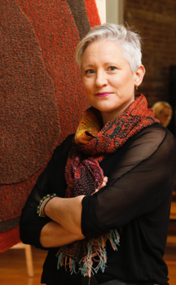
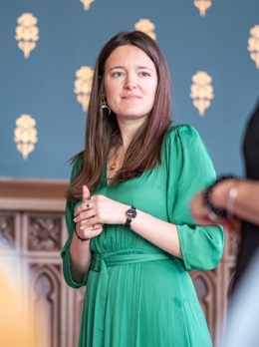
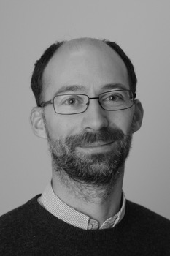
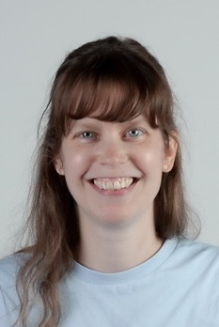
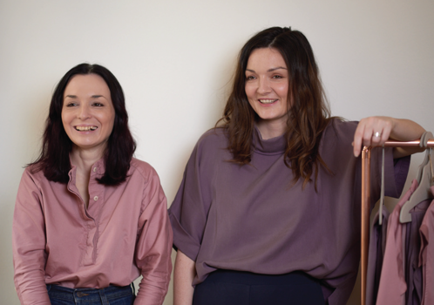
Introduction
Professor Rebecca Earley
& Dr Laetitia Forst
University of the Arts London
Dr Guy Buyle
& Dr Lien Van der Schueren
Centexbel
Nona Dokuzova
& Denitsa Nika
Vretena

Slide 4
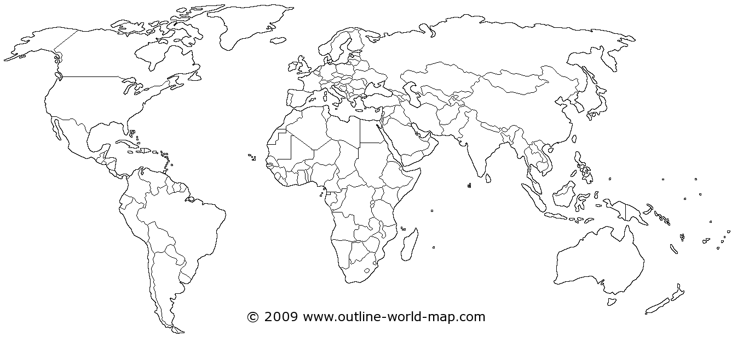
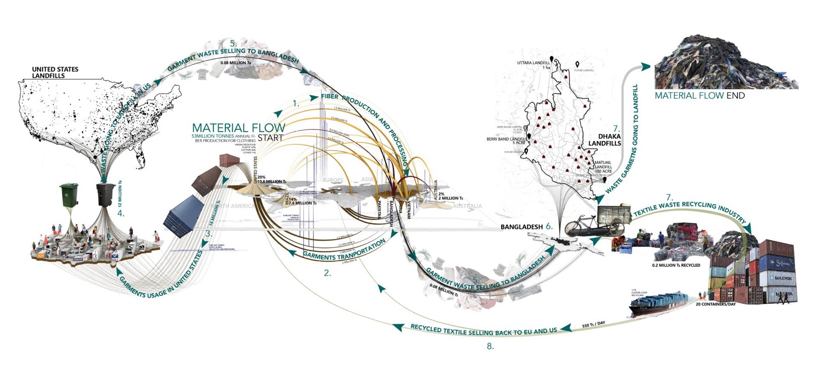
The HEREWEAR context
Image credit: Fengjiao Ge

Slide 5
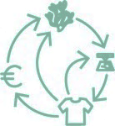
The HEREWEAR context

Slide 6




What is HEREWEAR?
https://herewear.eu/

Slide 7
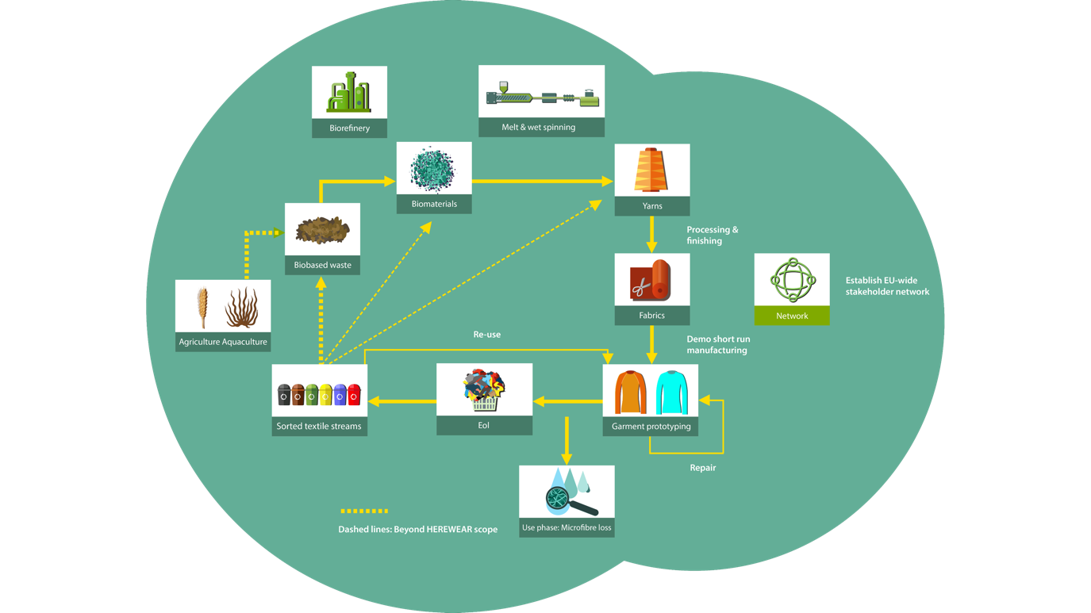



What is HEREWEAR?

Slide 8
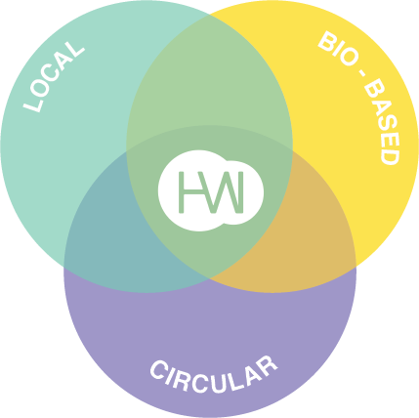

Slide 9
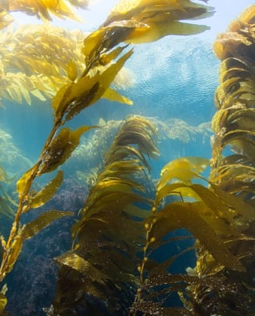
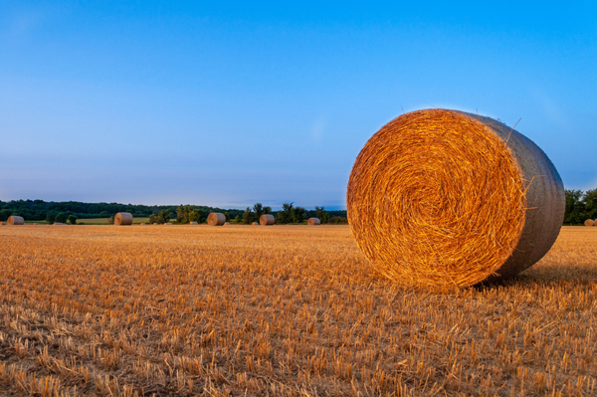
BIO-BASED

Slide 10
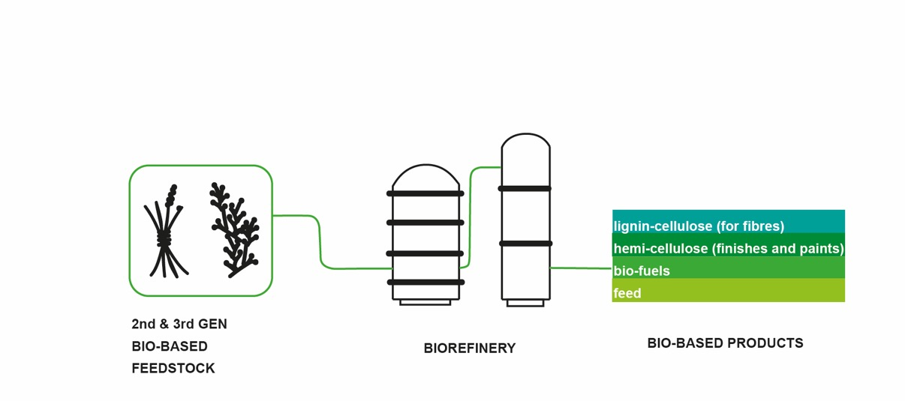
How HW is exploring ‘bio-based’:
Cellulose from biowaste sources (such as straw and seaweed)​
Bio-polyester to replace currently used fossil-based polyester​
Bio-based coating, printing and dyeing

Slide 11
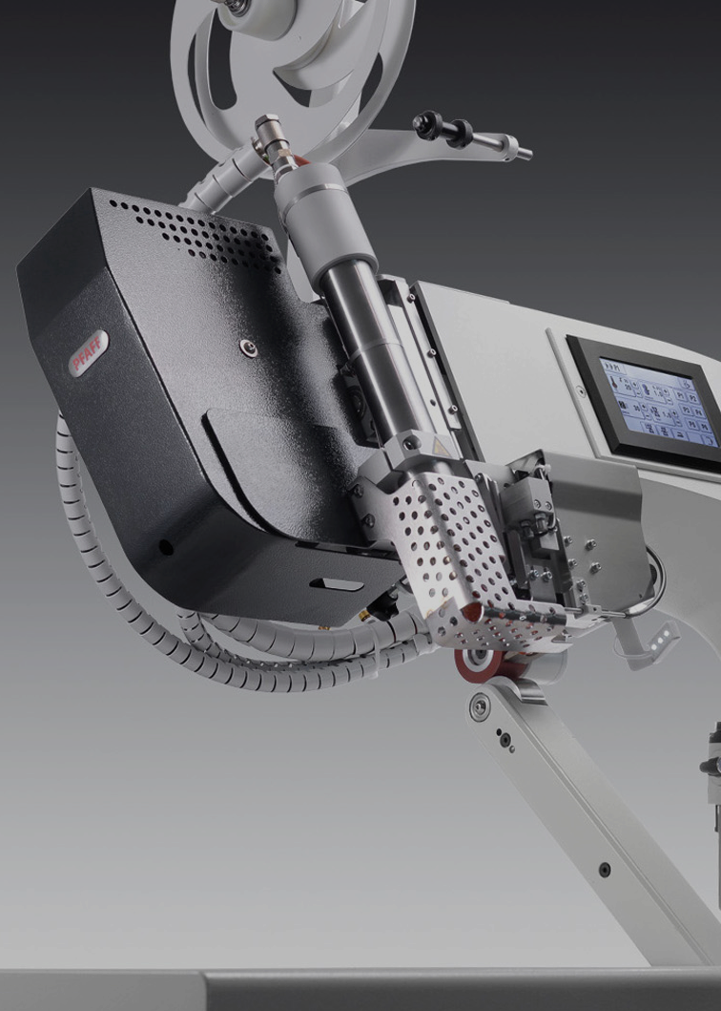
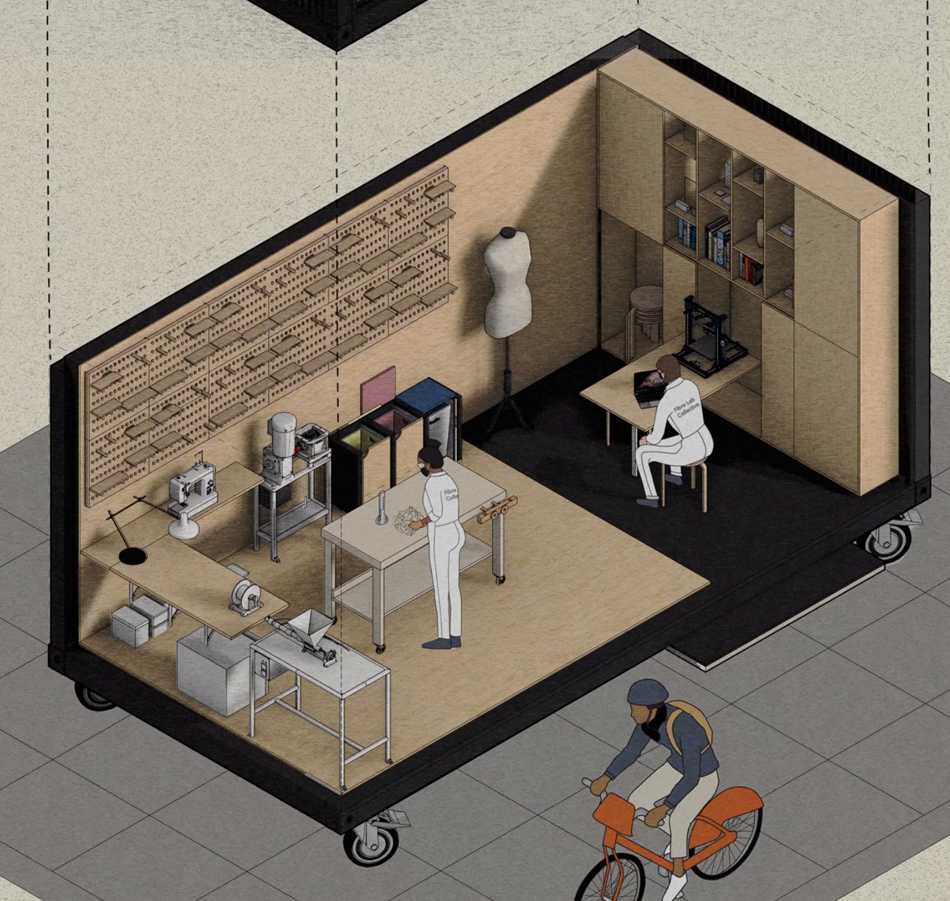
LOCAL

Slide 12
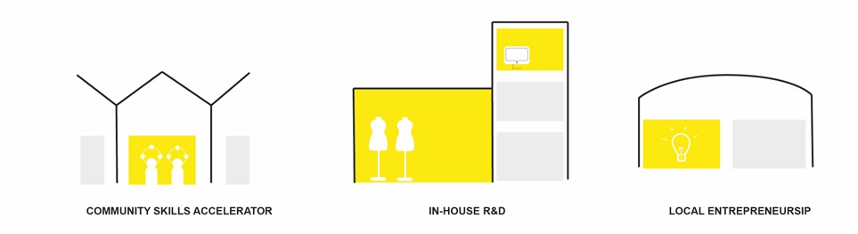
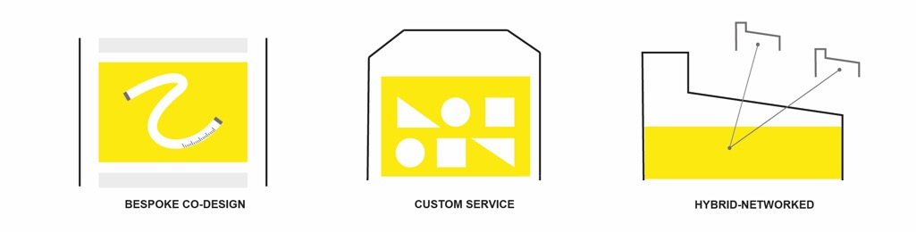
How HW is exploring ‘local’:
Networked manufacturing (from fibre to garment)​
Small-scale automated production via microfactories (from fabric to garment)​
Building EU-wide community of like-minded actors along value chain

Slide 13
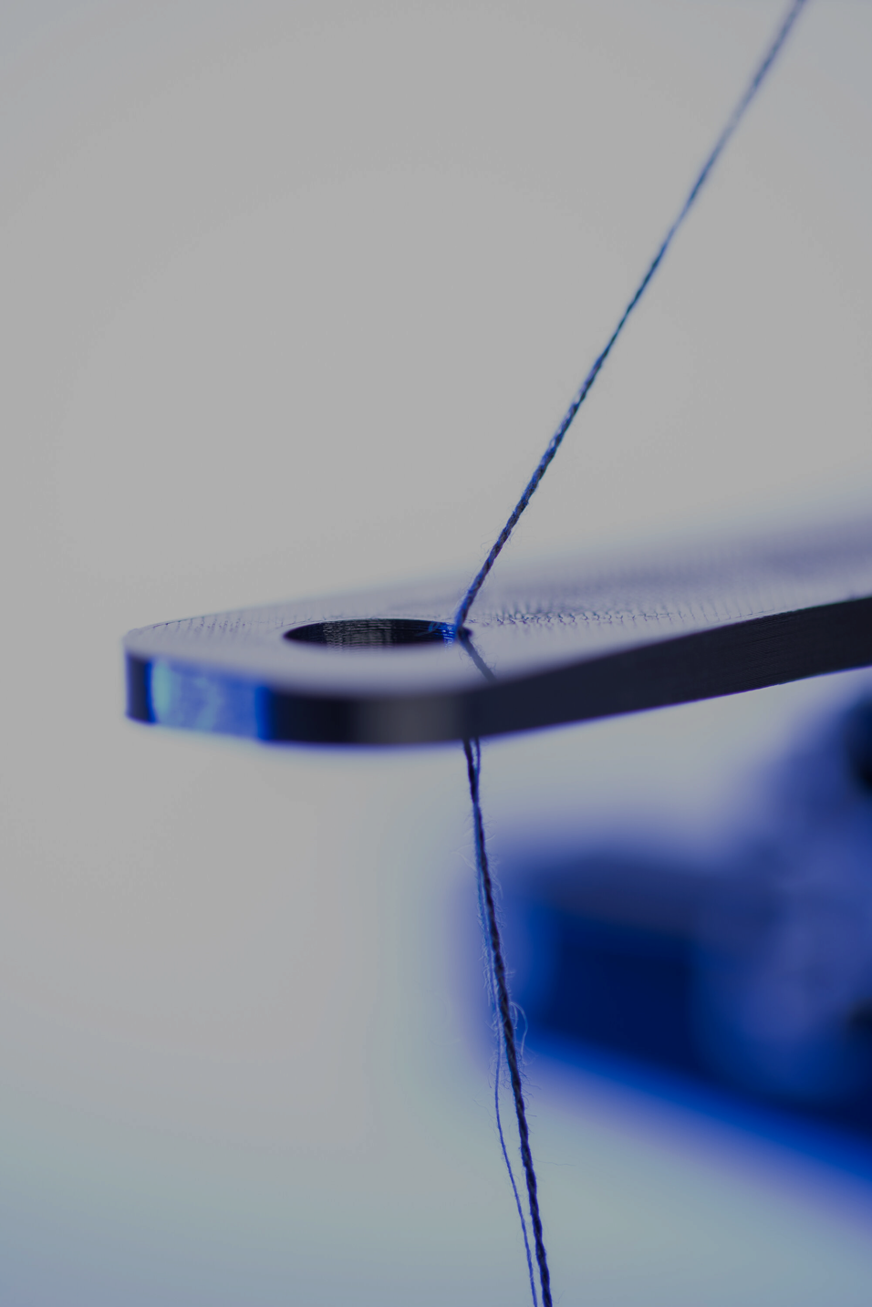
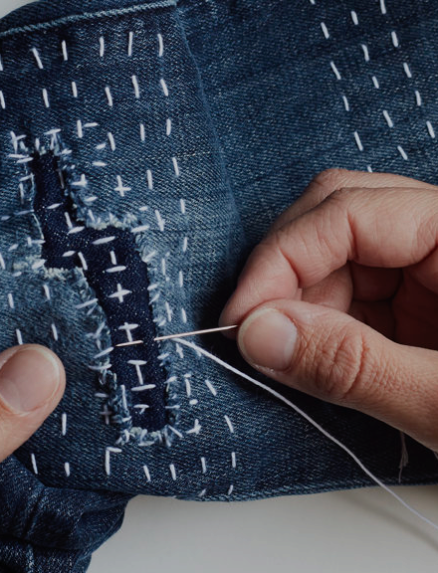
LOCAL
CIRCULAR

Slide 14
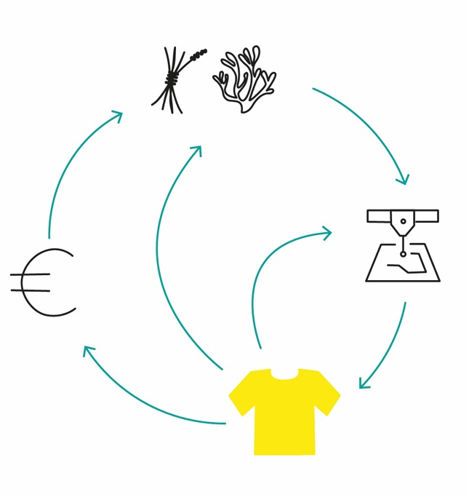
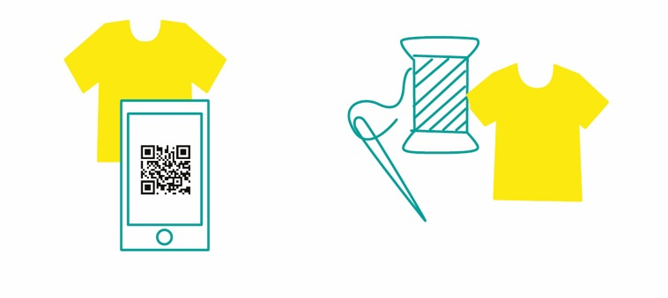
How HW is exploring ‘circular’:
Creation of circular design guidelines​
Optimised use, upcycling, re-use and repair ​
Supporting software tools for brands and designers
​
Circularity labelling​
Minimizing microfibre release

Slide 15
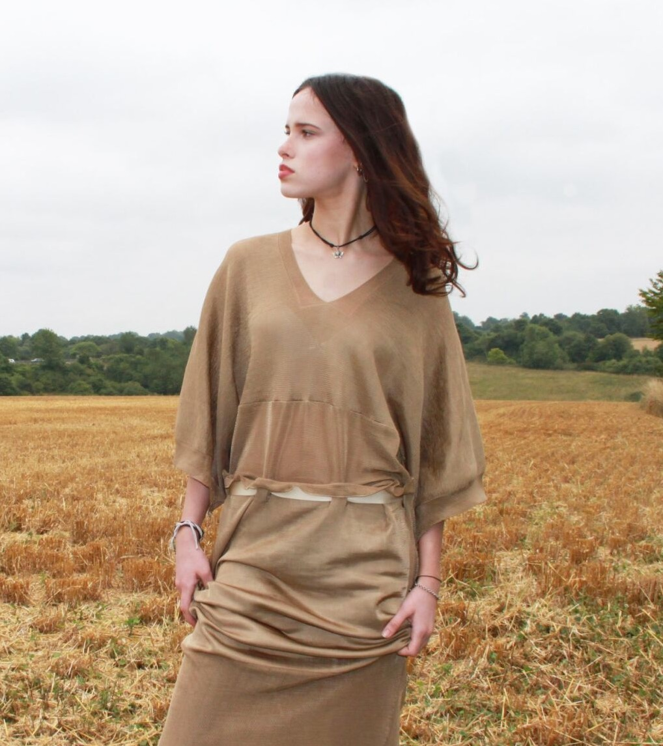
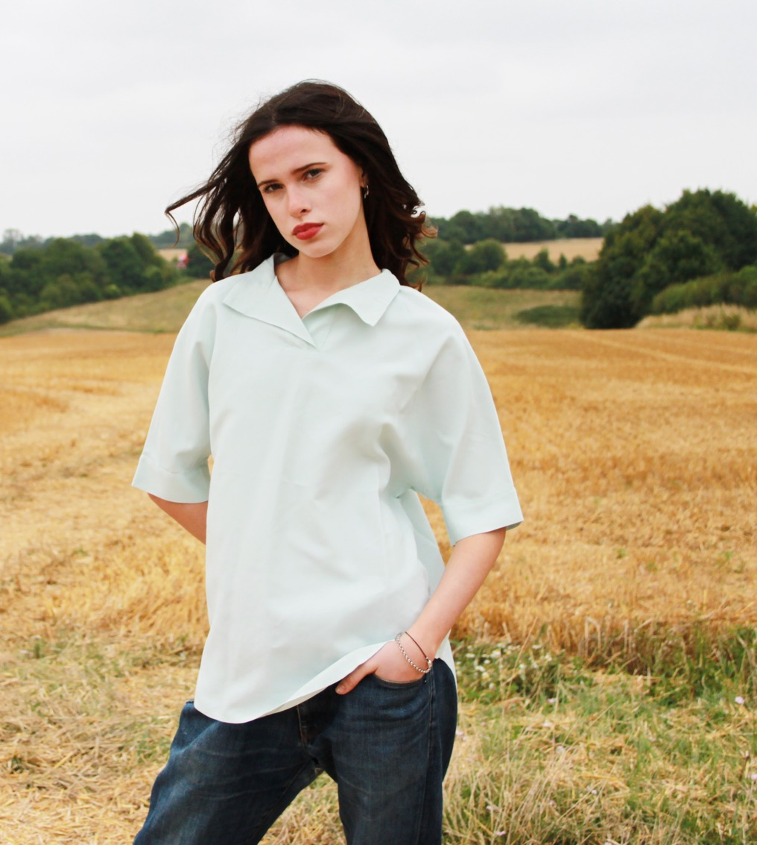
MATERIAL FIRST
PRODUCT FIRST

Slide 16
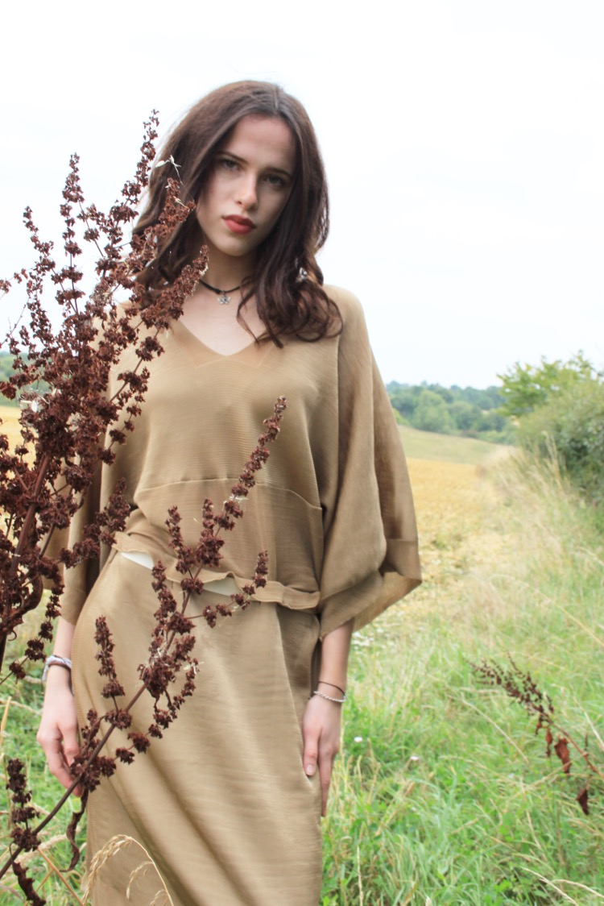
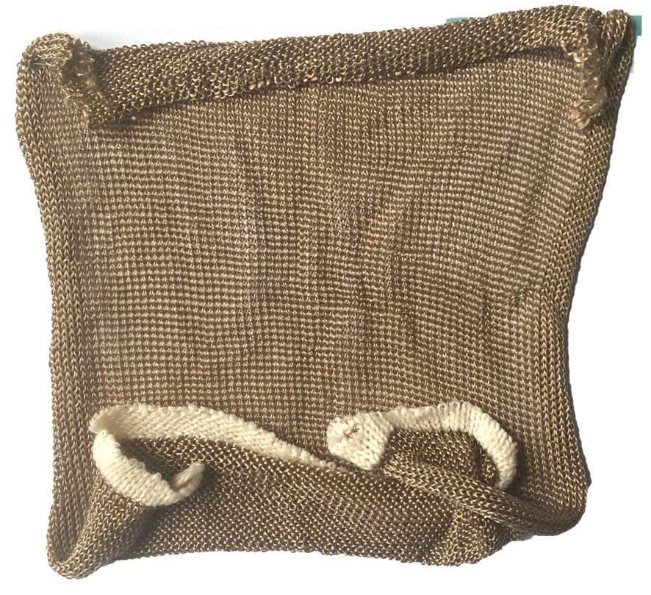
Material first

Slide 17
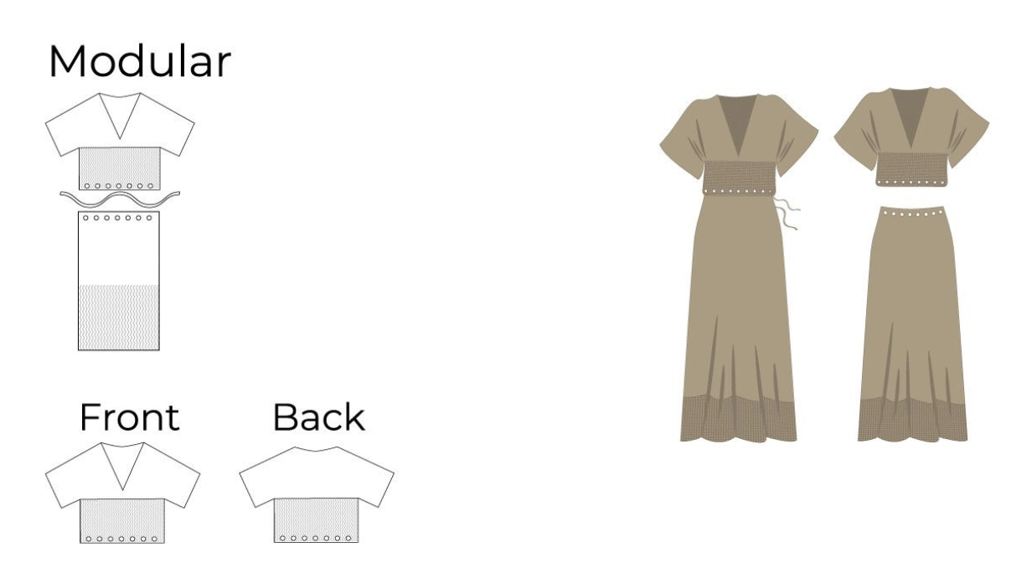
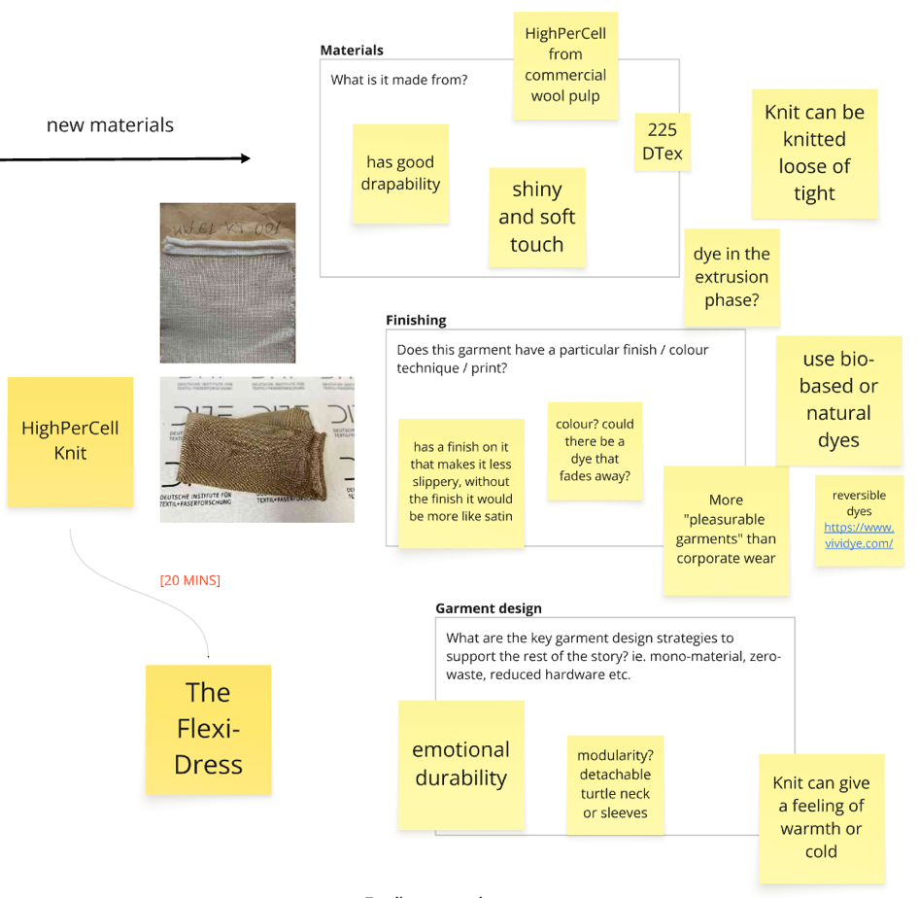
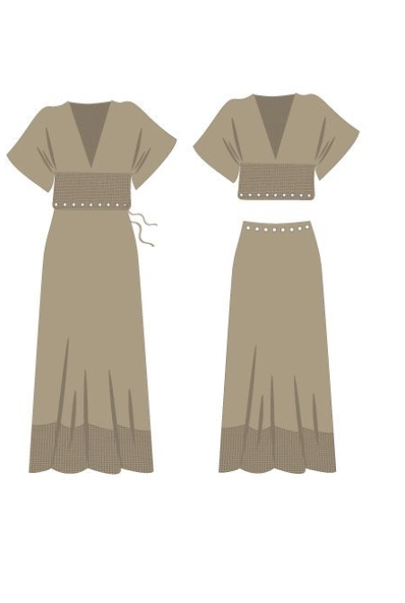
Material first

Slide 18
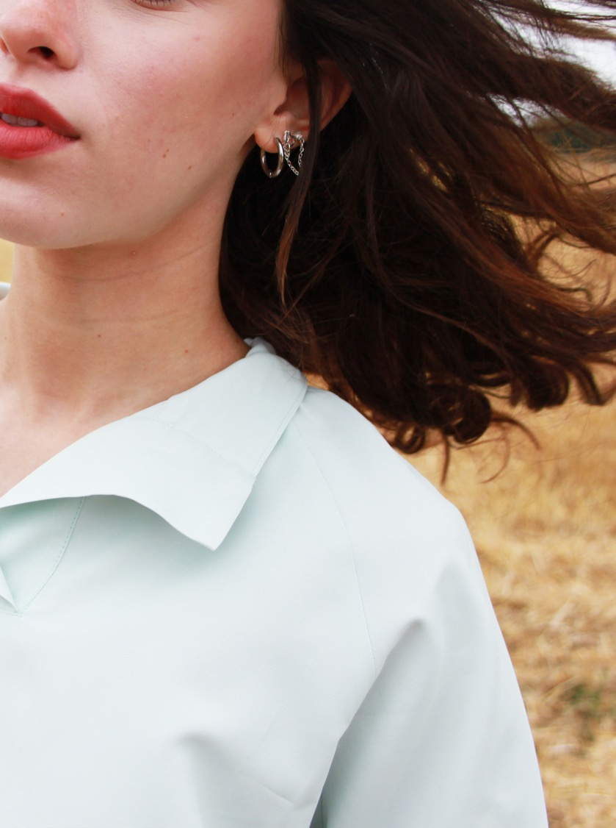
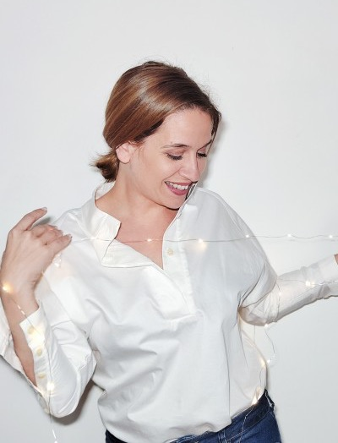
Product first

Slide 19
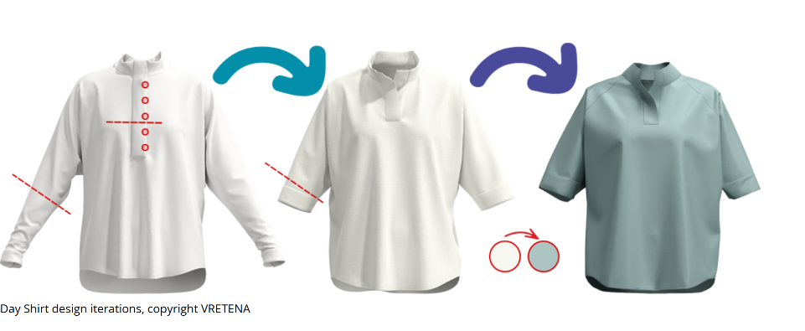
Product first

Slide 20
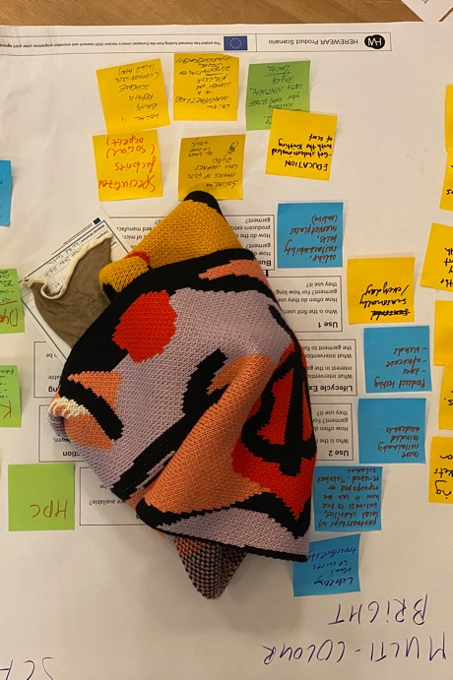
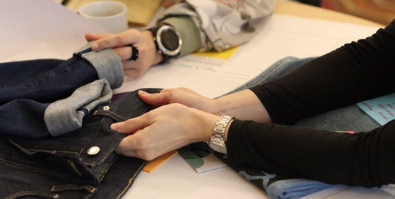
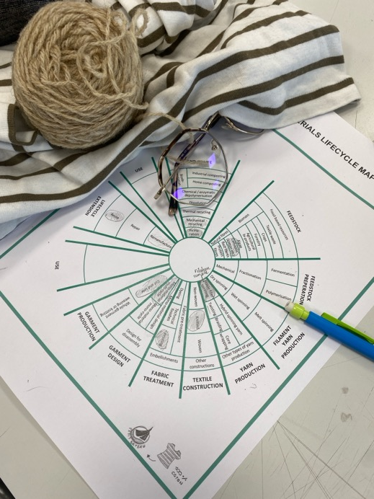
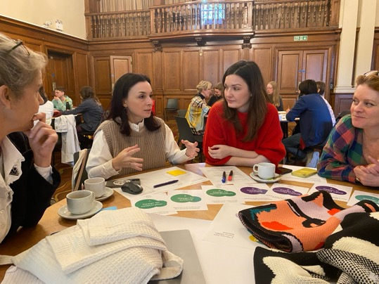
Tools for change

Slide 21
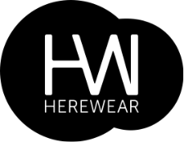

Design tools:
• The Material Lifecycle Map
• The BIO TEN
• Garment Scenarios

Slide 22
Design tools:
• The Material Lifecycle Map
• The BIO TEN
• Garment Scenarios

Slide 23
Design tools:
• The Material Lifecycle Map
• The BIO TEN
• Garment Scenarios

Slide 24
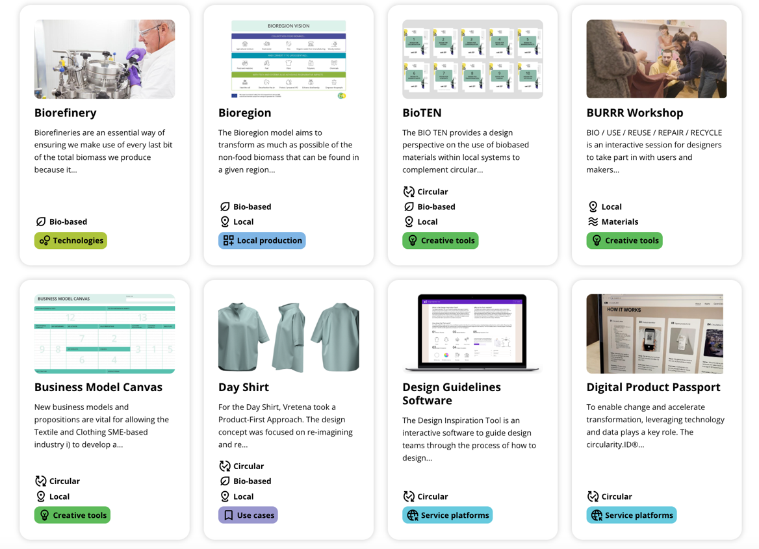
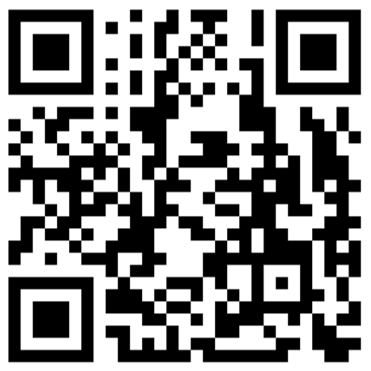
Explore the HERWEAR HUB

Slide 25
Thank you
r.l.earley@chelsea.arts.ac.uk
l.forst@arts.ac.uk
Notes:
Bonjour et merci pour l’invitation
Je vais presenter le travail develope durant les premieres phases du projet herewear, le focus sera sur notre approcvhe par le design a la comprension et communications des problematiques pertinentes aux

