Slide 1


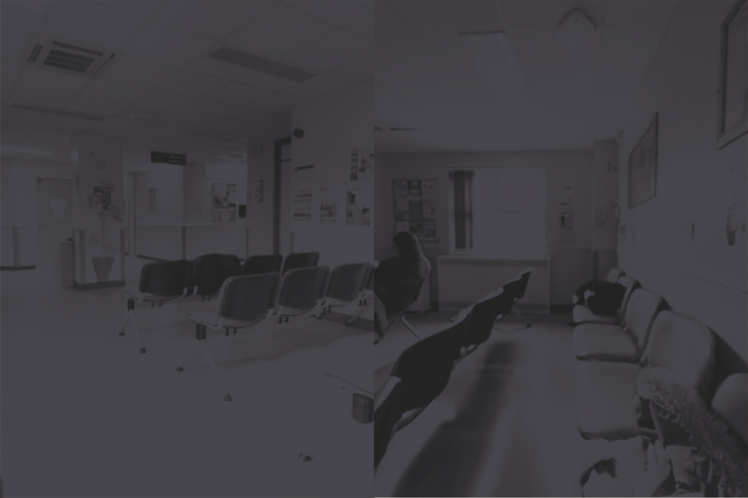

Dr Sarah Green, DBA, MA, FHEA
Senior Lecturer in Media and Communications
University of the Arts London
June 2025
………………………………………………..

Slide 2
Or:
Do we really know how patients think and feel?
Dr Sarah Green, DBA, MA, FHEA
Senior Lecturer in Media and Communications
University of the Arts London
June 2025
………………………………………………..

Slide 3
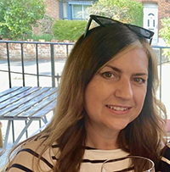
Context
Why me?
………………………………………………..
No previous experience in Healthcare
Unfamiliar with NHS ethics process
Limited hospital exposure
Skilled and experienced user-centred designer and researcher, keen spatial interest
Outcomes
Sarah Green, DBA, MA, FHEA
Notes:
It is well known that the NHS operate under complex pressures including budgetary and resourcing. In response, the previous 2019 ‘Health Infrastructure Plan’ states the intention is to address ‘what matters to someone’ and not just ‘what’s the matter with someone’. There is a need to ensure such developments meet the goals of world-class facilities to speed up recovery.
Outside of these pockets of innovation however, a sizeable legacy remains of outdated facilities that will continue to impact patients and the microlevel facets of the patient experience still need to be fully understood.
This study took place in conjunction with the Hampshire Hospitals Foundation trust and employed a novel, interdisciplinary research methodology.As a significant managerial contribution, a practical guide has been developed to help healthcare and design practitioners enhance the creation of patient spaces.

Slide 4
Overview
………………………………………………..
Context
Project Aims
Research Methodology
Findings
Outcomes
Sarah Green, DBA, MA, FHEA
Notes:
So I will briefly outline what I am going to discuss, starting with some contextual background to the project, a summary of the aims and objectives of the study, the novel approach I formed for the research methodology, a very high level summary of findings before explaining the contribution of this work.

Slide 5
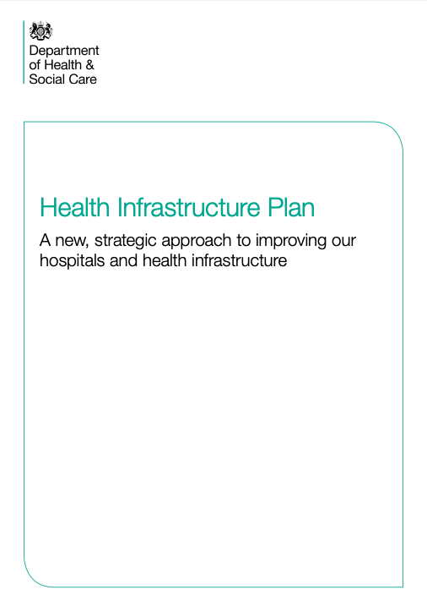
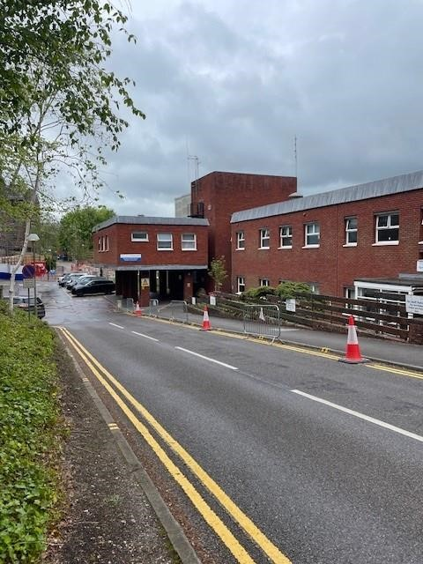
Context
………………………………………………..
’Patient hospital experiences are diverse and subject to many influences such as lighting, noise, décor and aesthetics ‘
(Cassol et. al., 2011; Green, 2024; Nielsen et. al., 2017; Pattison, 1996),
“What matters to someone is not just what’s the matter with someone”
(NHS, 2019, p.24).
Photo: Sarah Green, 2024
Outcomes
Sarah Green, DBA, MA, FHEA
Notes:
It is well known that the NHS operate under complex pressures including budgetary and resourcing. In response, the previous 2019 ‘Health Infrastructure Plan’ states the intention is to address ‘what matters to someone’ and not just ‘what’s the matter with someone’. There is a need to ensure such developments meet the goals of world-class facilities to speed up recovery.
Outside of these pockets of innovation however, a sizeable legacy remains of outdated facilities that will continue to impact patients and the microlevel facets of the patient experience still need to be fully understood.
This study took place in conjunction with the Hampshire Hospitals Foundation trust and employed a novel, interdisciplinary research methodology.As a significant managerial contribution, a practical guide has been developed to help healthcare and design practitioners enhance the creation of patient spaces.

Slide 6
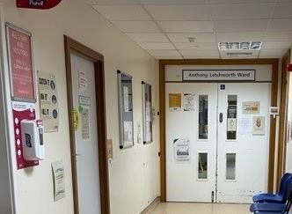

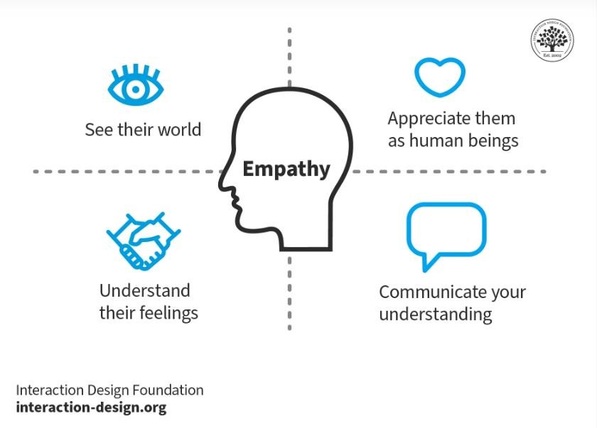
Project Aims
………………………………………………..
Design Thinking
Empathy based approach
Understand feelings and emotions
Patient perceptions of spaces
Barriers and enablers
Photo: Sarah Green, 2024
Sarah Green, DBA, MA, FHEA
Notes:
The overall research aim was to understand how patients feel about their time in hospital waiting rooms and what really matters to them concerning the design of spaces, in order to identify potential new conceptualisations of waiting room design. The focus is on determining and conveying emotions and the particular causal effects of diverse spatial elements.
The key research questions that this study addresses are:
What are patients’ perceptions of hospital waiting room spaces?
What are the barriers and enablers of a positive patient experience in the spaces?
The research objectives are:
To create a conceptual framework bringing together health and design thinking domains to identify opportunities to contribute to new knowledge on the topic of patient lived experience and the role of spaces;
To understand patient perspectives on healthcare spaces, including how aspects of the ‘conceived space’ and the ‘perceived space’ impact their ‘lived space’;
To advance the understanding of ‘lived experience’ by testing the appropriateness of the framework that employs Design Thinking and Third Space principles;
To leverage these research insights to devise recommendations and considerations for practitioners for patient-centred and ‘lived space’ design projects.

Slide 7
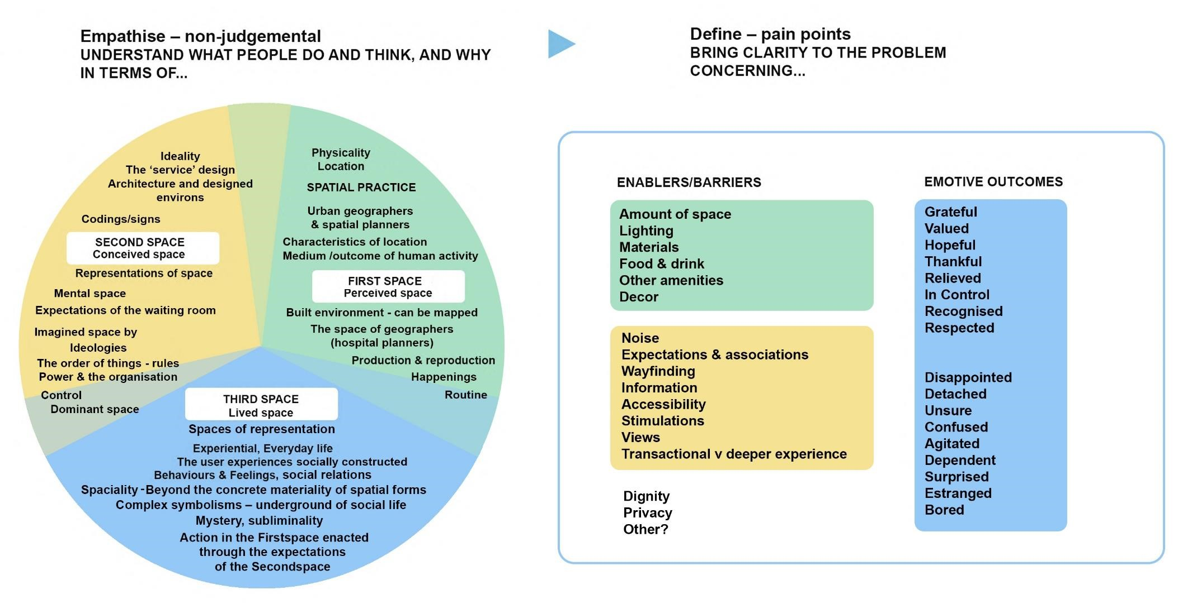
Initial Research Methodology – what did the literature say?
………………………………………………..
Outcomes
Diagram: Sarah Green, 2024
Notes:
This research aimed to explore patient perceptions of health spaces and experiences in the patients’ third space through a design, as opposed to clinical lens.
Through the reading of both clinical and non-clinical academic papers, business reports and books, it was determined that there are many opportunities for validating spatial concerns and emotive experiences since they touch many aspects of patients’ lives.
it was argued that the majority of health studies of patient spaces have missed an opportunity to prioritise the voice of the patient and that more qualitative methods, adopting empathetic approaches typified by design methodologies and broader measurement frameworks, should be explored.
Data collection took place through a series of site visits and ethnographic obvservations in the form of note-taking, sketching and photography, before twenty in-depth interviews with patients who had visited the same spaces.
By integrating two data analysis methods—Voice-Centered Relational Method and Emotion Coding—this study uncovered deeply insightful and powerful narratives of patient experiences for the first time.

Slide 8
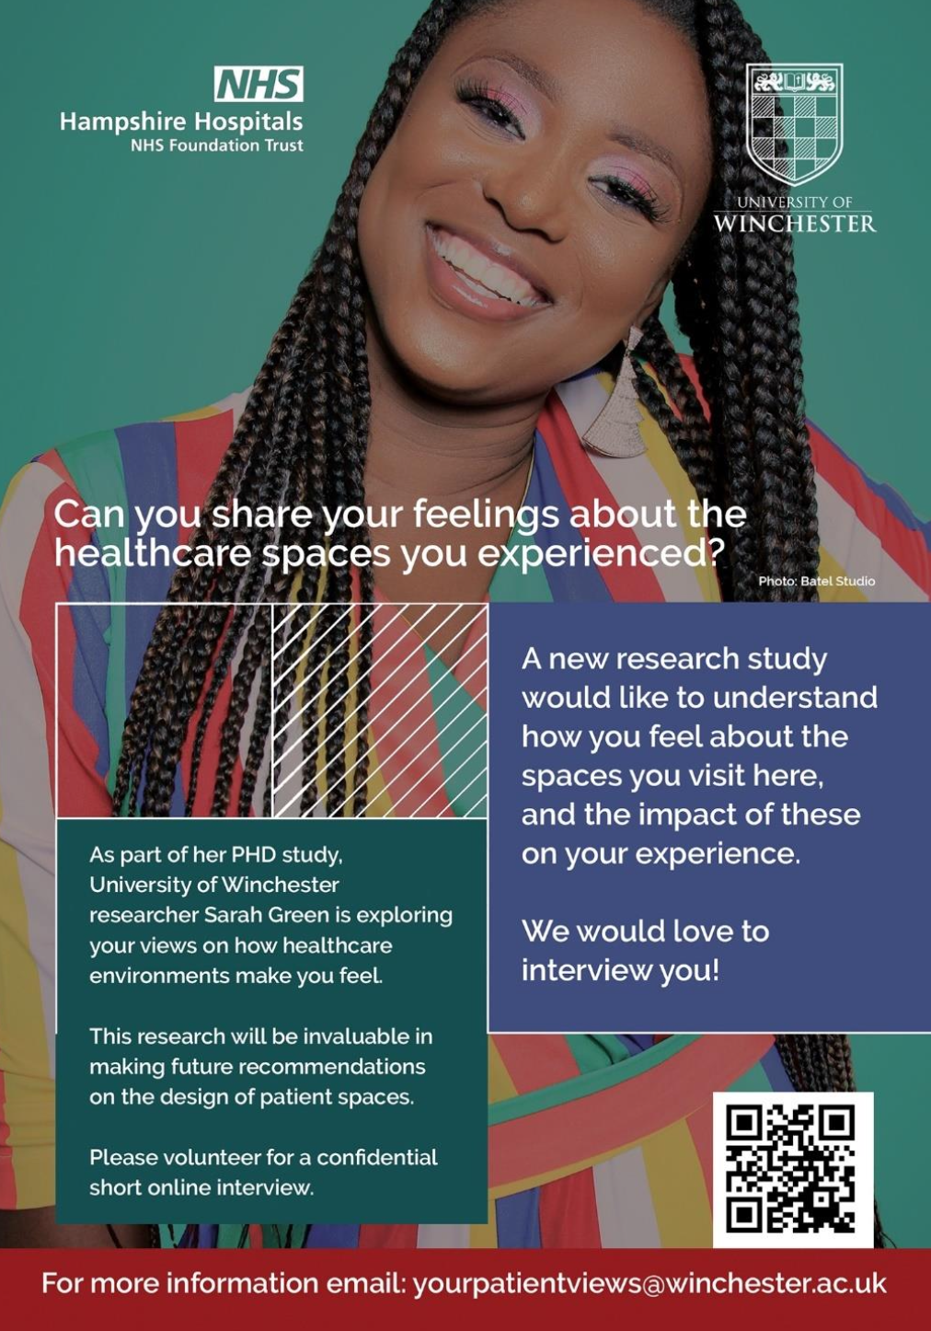
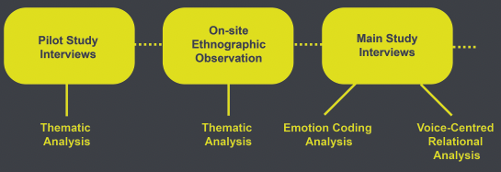

Research Methodology
………………………………………………..
Outcomes
Sarah Green, DBA, MA, FHEA
Notes:
This research aimed to explore patient perceptions of health spaces and experiences in the patients’ third space through a design, as opposed to clinical lens.
Through the reading of both clinical and non-clinical academic papers, business reports and books, it was determined that there are many opportunities for validating spatial concerns and emotive experiences since they touch many aspects of patients’ lives.
it was argued that the majority of health studies of patient spaces have missed an opportunity to prioritise the voice of the patient and that more qualitative methods, adopting empathetic approaches typified by design methodologies and broader measurement frameworks, should be explored.
Data collection took place through a series of site visits and ethnographic obvservations in the form of note-taking, sketching and photography, before twenty in-depth interviews with patients who had visited the same spaces.
By integrating two data analysis methods—Voice-Centered Relational Method and Emotion Coding—this study uncovered deeply insightful and powerful narratives of patient experiences for the first time.

Slide 9
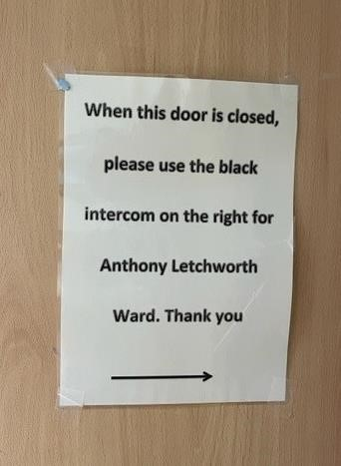
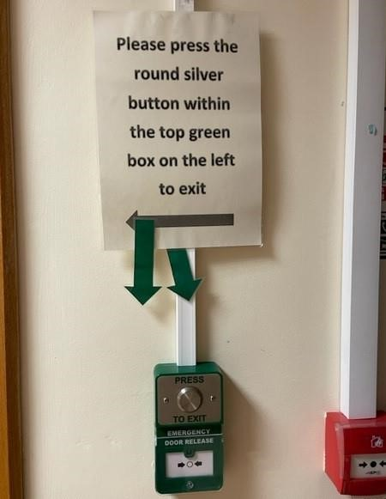
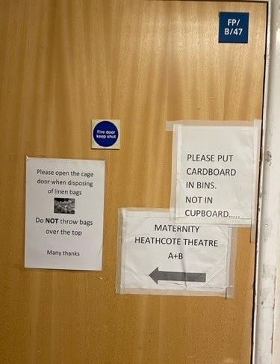
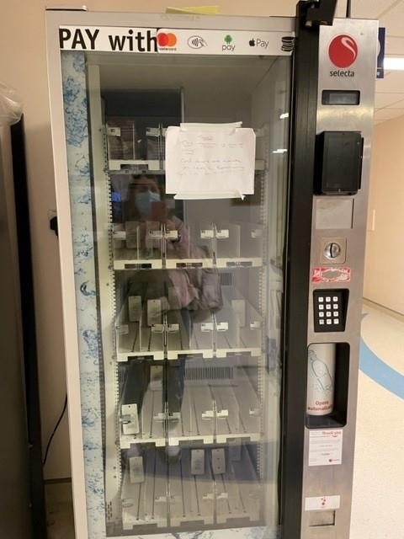
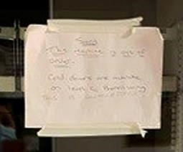
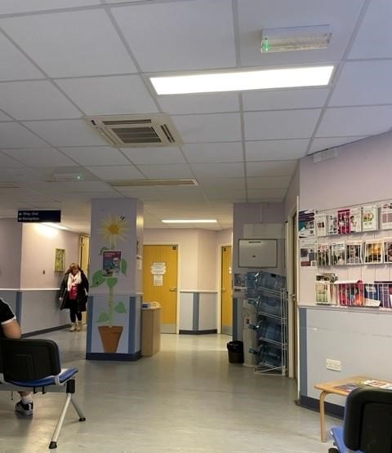
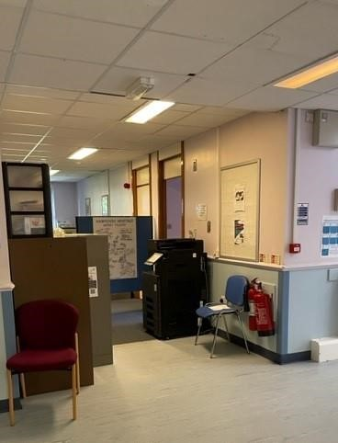
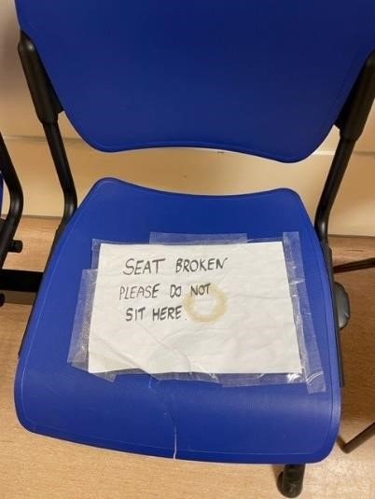
Findings
………………………………………………..
Sketches, notes, photographs extensive interview transcripts
Outcomes
Photos: Sarah Green, 2024
Sarah Green, DBA, MA, FHEA
Notes:
After initially gathering the various photographs, notes and sketches from the eight separate site observation visits, these were first grouped according to the spaces they represented
The photographs were assigned emotion codes . These interpretations by the researcher of both the notes and photographs resulted in themes as an outcome of the observation stage. Overall, the categories resulting from the observation were divided into two contexts: enablers of positive patient experiences and barriers to positive patient experiences.

Slide 10
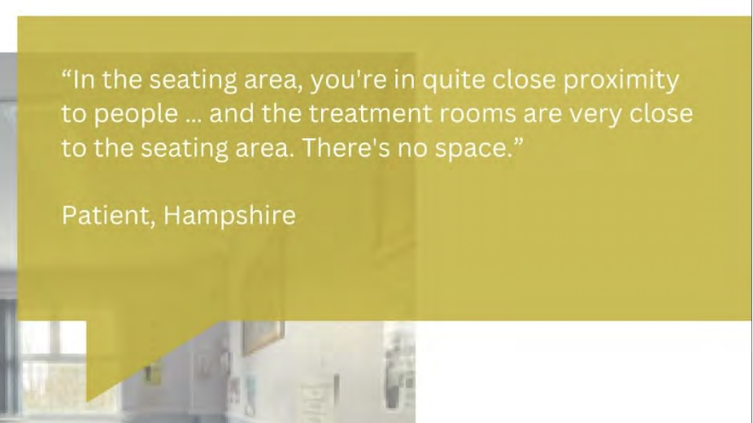
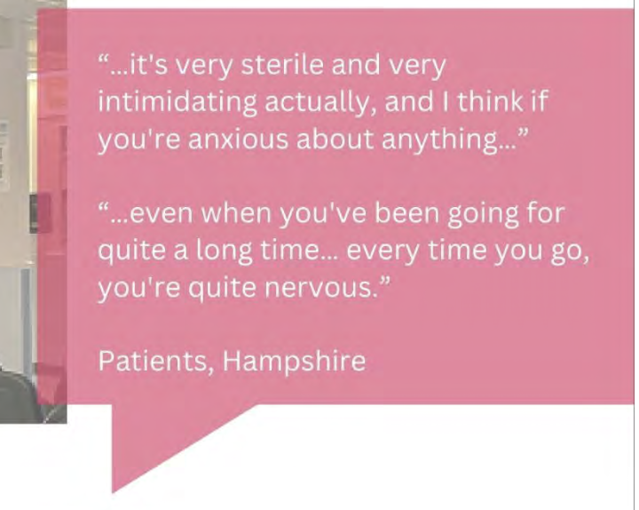
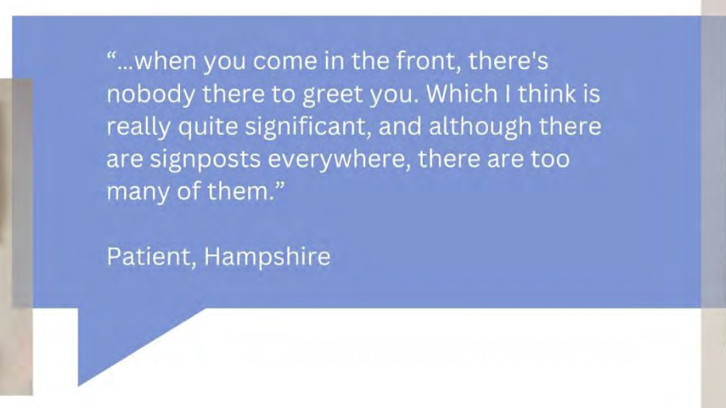

Findings
………………………………………………..
Some real quotes:
Outcomes
Notes:
After initially gathering the various photographs, notes and sketches from the eight separate site observation visits, these were first grouped according to the spaces they represented
The photographs were assigned emotion codes . These interpretations by the researcher of both the notes and photographs resulted in themes as an outcome of the observation stage. Overall, the categories resulting from the observation were divided into two contexts: enablers of positive patient experiences and barriers to positive patient experiences.

Slide 11
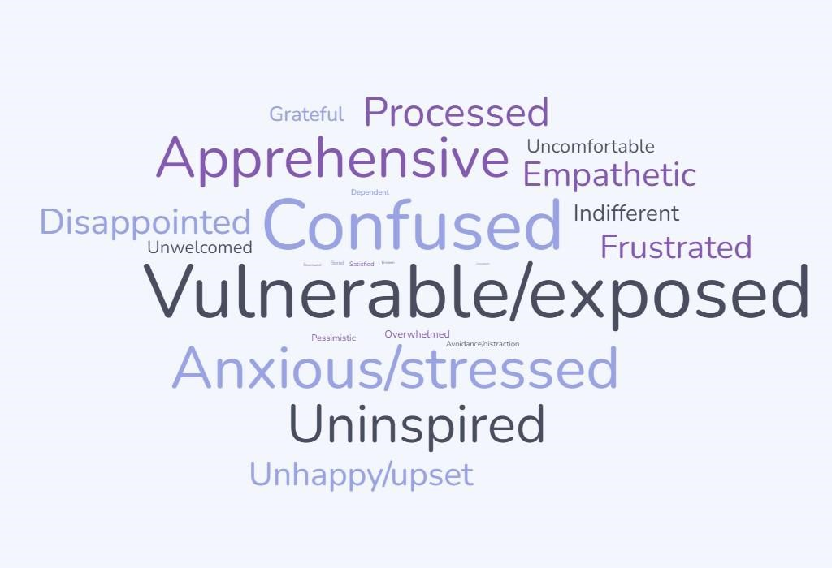
Findings - thematic
………………………………………………..
Outcomes
Wordcloud: Sarah Green, 2024
Sarah Green, DBA, MA, FHEA
Notes:
After initially gathering the various photographs, notes and sketches from the eight separate site observation visits, these were first grouped according to the spaces they represented
The photographs were also assigned emotion codes . These interpretations by the researcher of both the notes and photographs resulted in themes as an outcome of the observation stage and these were then compared and categoraised alongside the interview transcripts.
The image here and on the poster shows a summary of the emotions experienced by patients as found within the interview narratives.
The quotes used on the poster are just a few of the many many statements patients made about their time visiting.

Slide 12
Findings – about Voice-Centred Relational Analysis (ipoems)
………………………………………………..
Listening for the plot: (and generating a researcher’s emotional response to this)
2. Listening for the voice of “I” (focusing on the individual’s sense of self)
3. Listening for contrapuntal voices (multiple lenses on the stories told)
4. Listening for broader political, social and cultural structures (listening for clues)
”Importance is placed on attending to the broader social and cultural issues that shape and constrain participants' narratives” (Hutton and Lystor, 2020,
p.16)
Unveils individual narratives in terms of relationships to others, but also here in terms of relationships to the space, whilst additionally including the researcher’s own interpretations of the narratives (Mauthner and Doucet, 1998).
Outcomes
Sarah Green, DBA, MA, FHEA
Notes:
After initially gathering the various photographs, notes and sketches from the eight separate site observation visits, these were first grouped according to the spaces they represented
The photographs were assigned emotion codes . These interpretations by the researcher of both the notes and photographs resulted in themes as an outcome of the observation stage. Overall, the categories resulting from the observation were divided into two contexts: enablers of positive patient experiences and barriers to positive patient experiences.

Slide 13
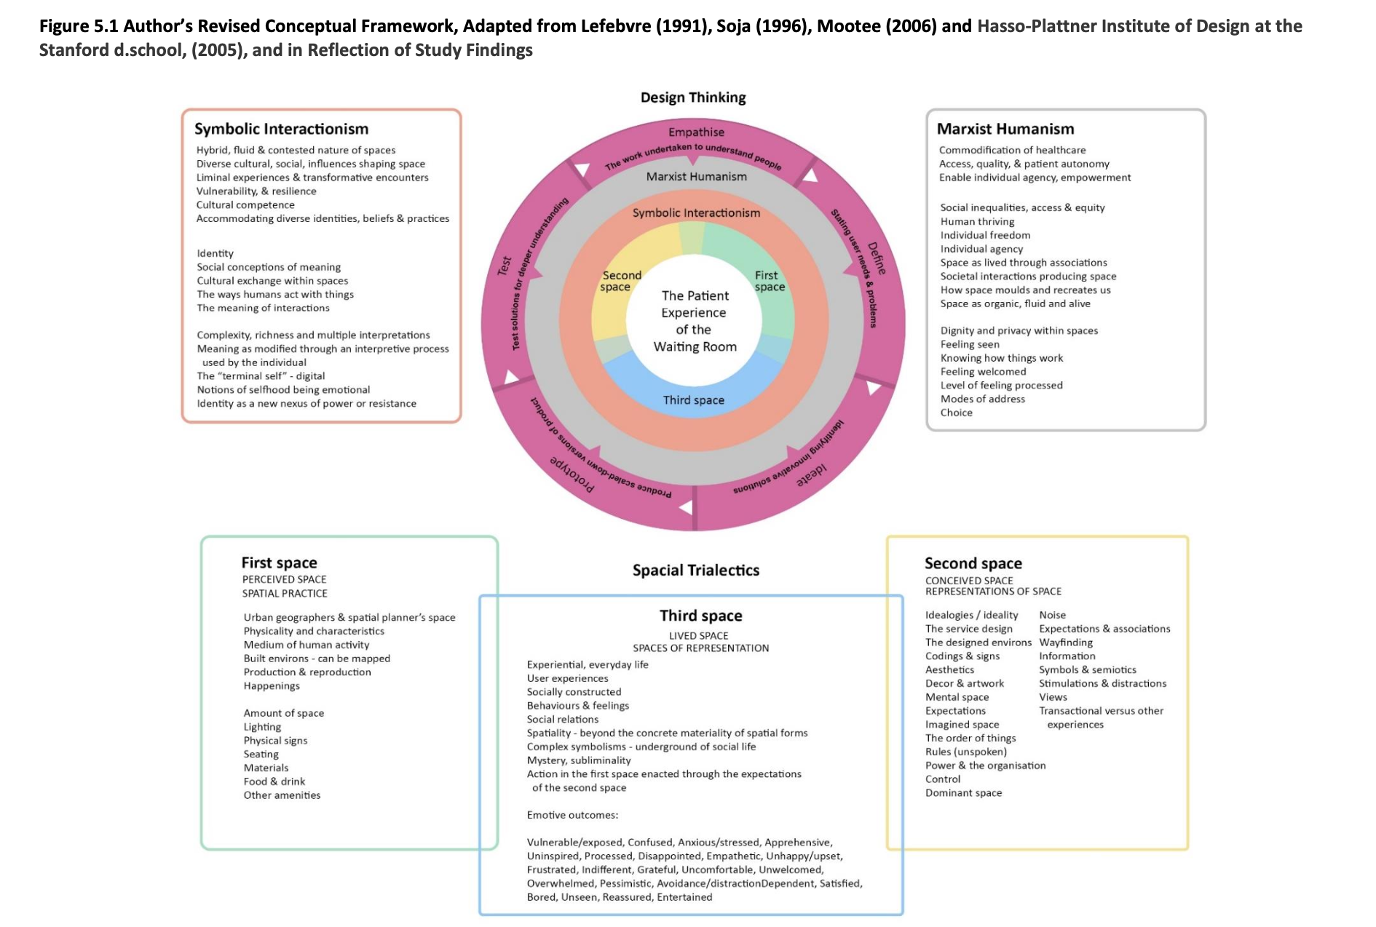
Outcomes – research framework
………………………………………………..
Sarah Green, DBA, MA, FHEA
Notes:
On the poster a revised conceptual framework is shown that proposes that any further research concerning patient experience of health spaces should consider the lenses of design thinking, but also the notion of spatial trialectics - specifically a focus on understanding the ‘thirdspace’ of behaviours and social experience, above simply noting the way the spaces were orignially planned or used. Finally – a tangible outcome from this study is the Health Space Design Playbook. This document proposes discussion points, based in this research, for anyone designing or improving positive patient spaces. You can request a copy by using the QR code on the poster.
Thaks for your attention and I hope to see you at the conference.

Slide 14
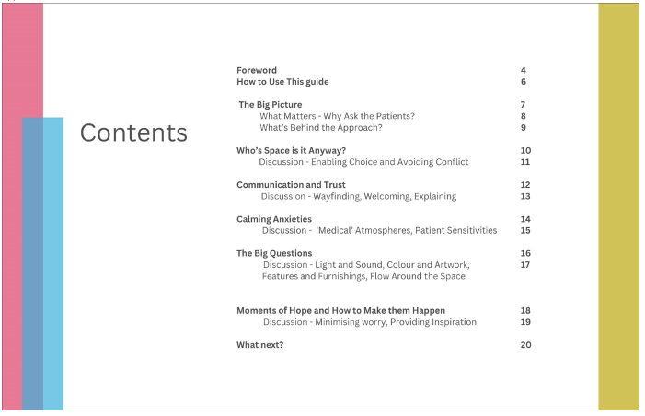
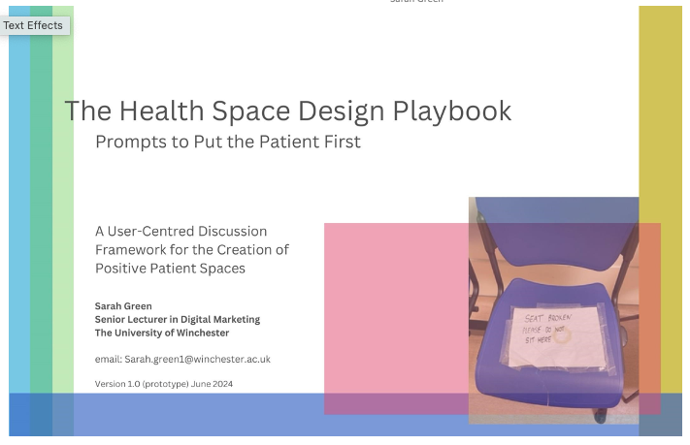
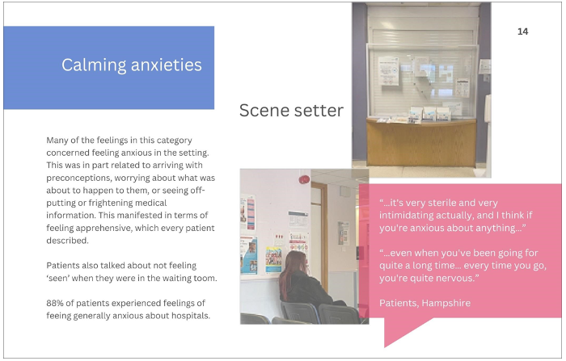
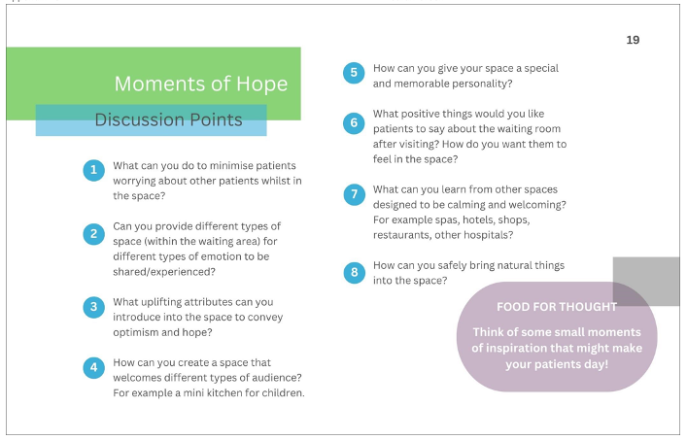
Outcomes - playbook
………………………………………………..
C Sarah Green, 2024
Sarah Green, DBA, MA, FHEA
Notes:
On the poster a revised conceptual framework is shown that proposes that any further research concerning patient experience of health spaces should consider the lenses of design thinking, but also the notion of spatial trialectics - specifically a focus on understanding the ‘thirdspace’ of behaviours and social experience, above simply noting the way the spaces were orignially planned or used. Finally – a tangible outcome from this study is the Health Space Design Playbook. This document proposes discussion points, based in this research, for anyone designing or improving positive patient spaces. You can request a copy by using the QR code on the poster.
Thaks for your attention and I hope to see you at the conference.

Slide 15

Thank you
………………………………………………..
iPoem…
Sarah Green, DBA, MA, FHEA
Notes:
On the poster a revised conceptual framework is shown that proposes that any further research concerning patient experience of health spaces should consider the lenses of design thinking, but also the notion of spatial trialectics - specifically a focus on understanding the ‘thirdspace’ of behaviours and social experience, above simply noting the way the spaces were orignially planned or used. Finally – a tangible outcome from this study is the Health Space Design Playbook. This document proposes discussion points, based in this research, for anyone designing or improving positive patient spaces. You can request a copy by using the QR code on the poster.
Thaks for your attention and I hope to see you at the conference.

