Slide 1


Slide 2


Slide 3
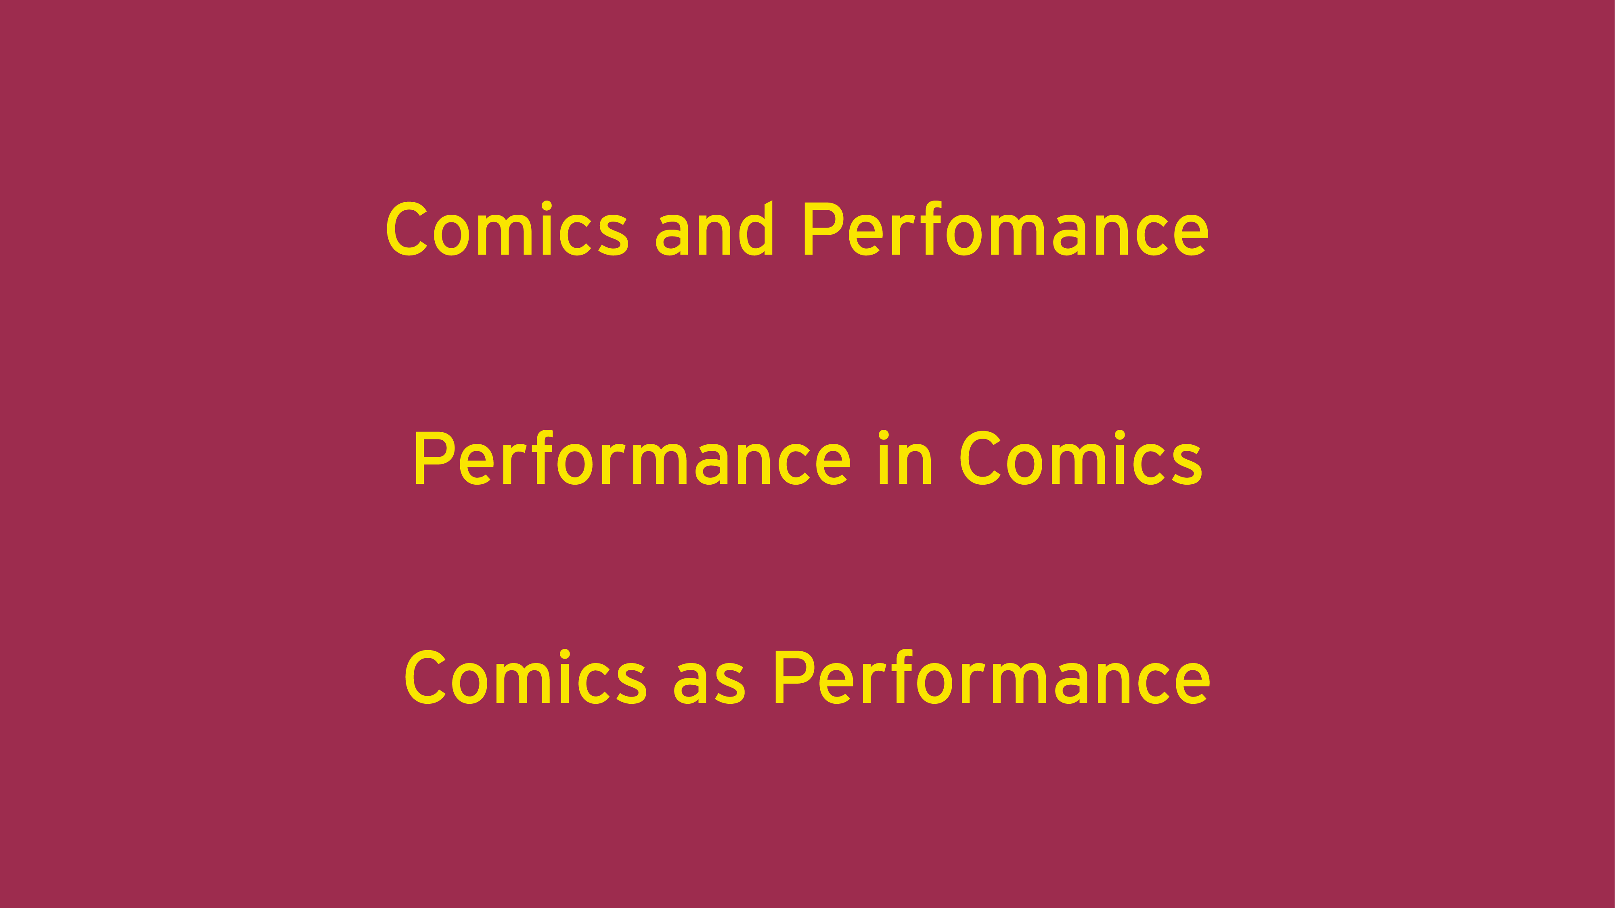

Slide 4


Slide 5


Slide 6
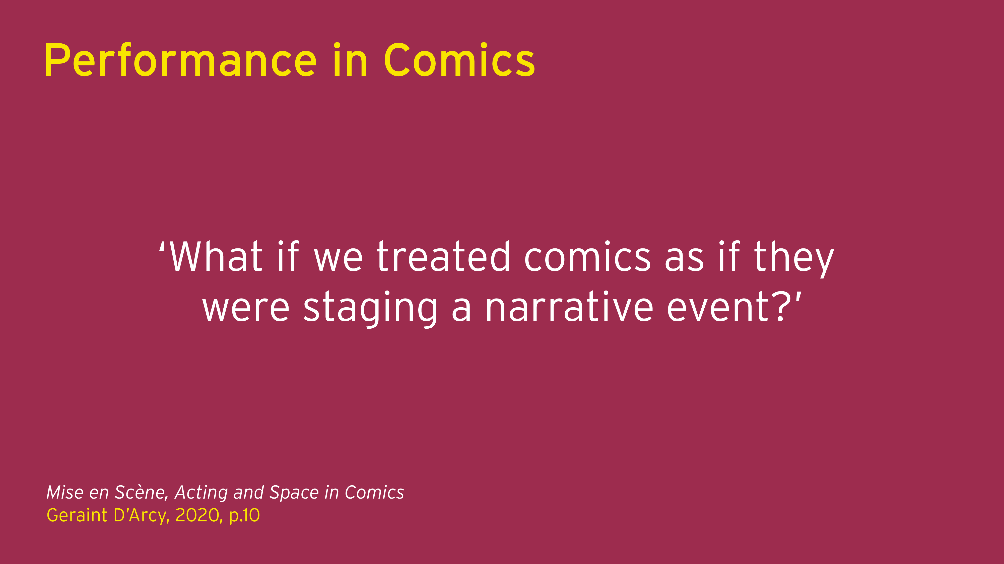

Slide 7
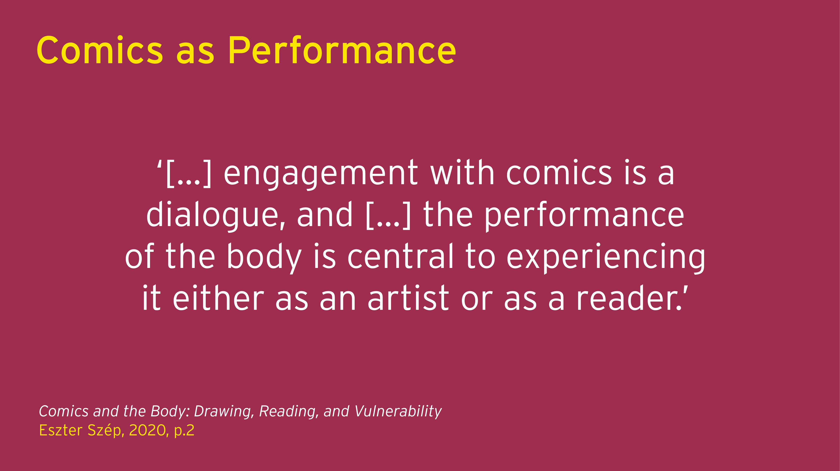

Slide 8
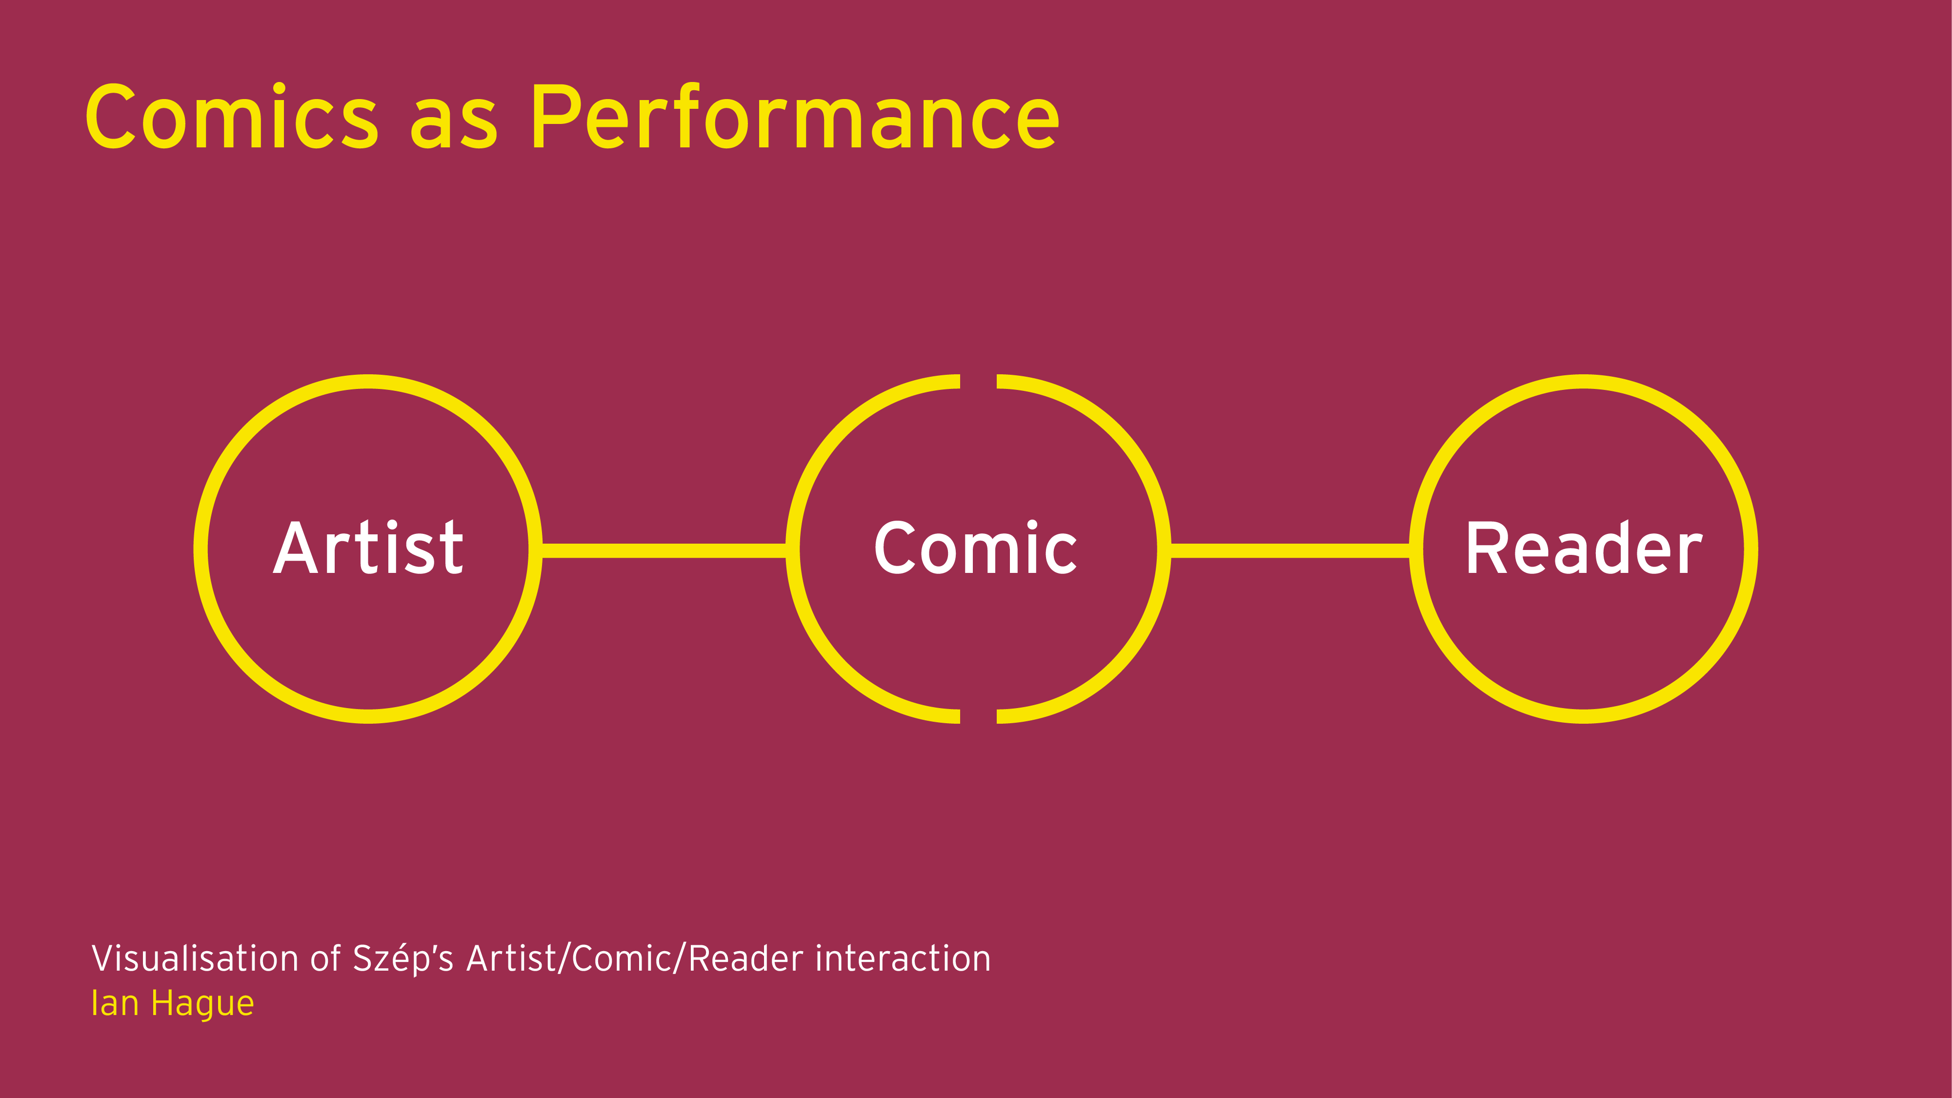

Slide 9


Slide 10
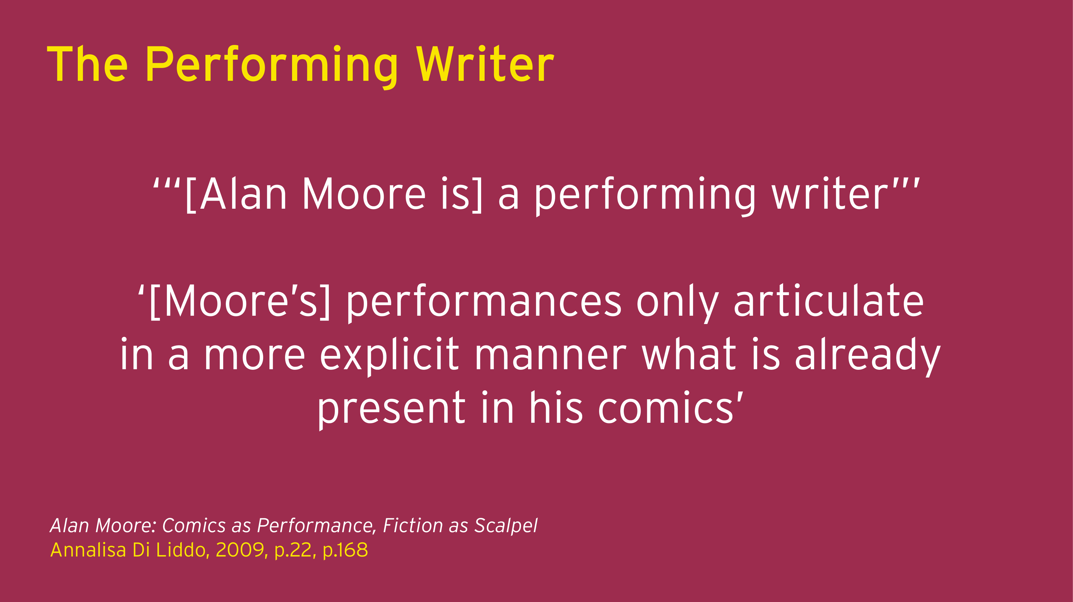

Slide 11
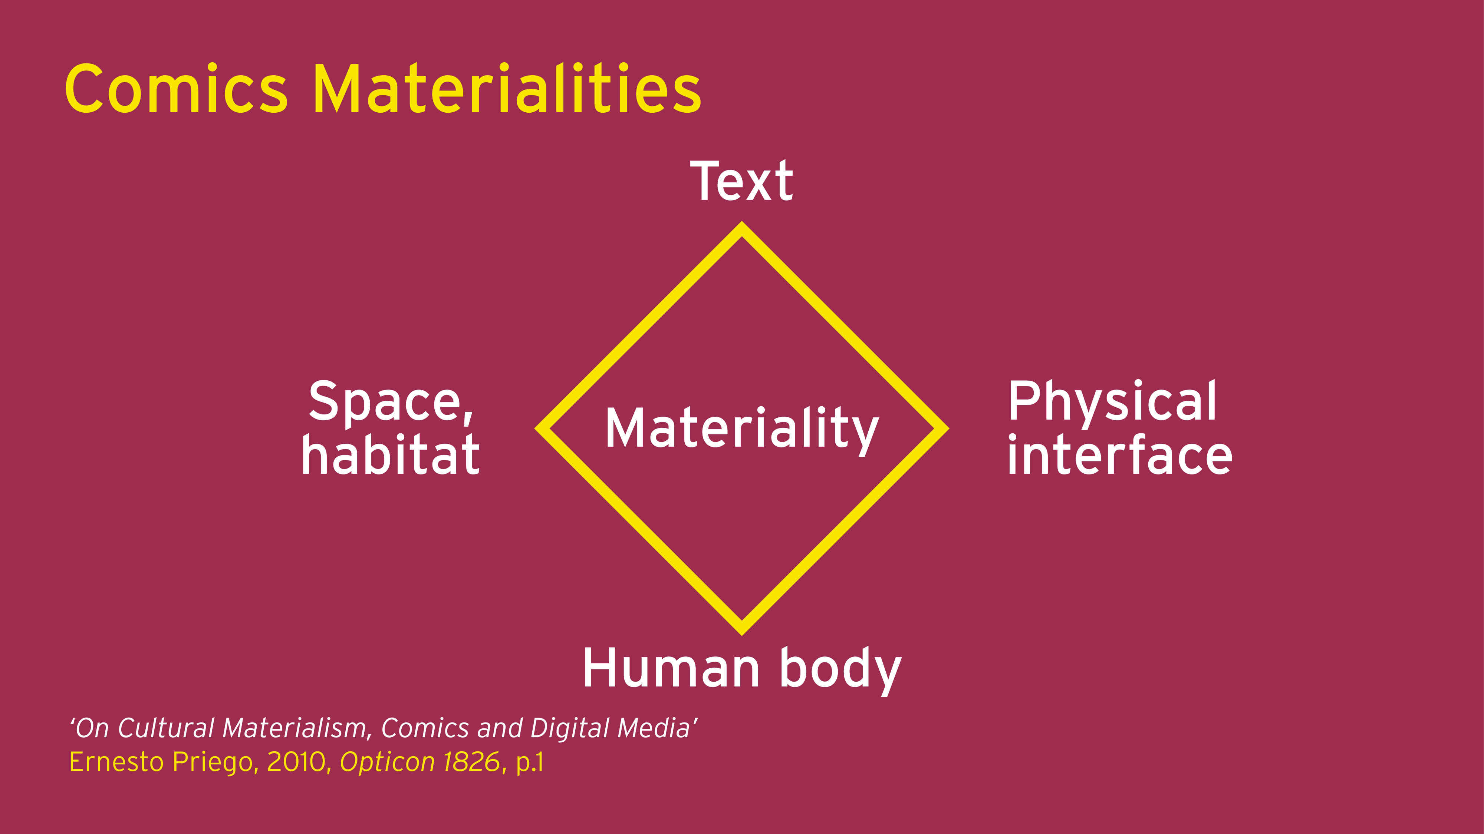

Slide 12
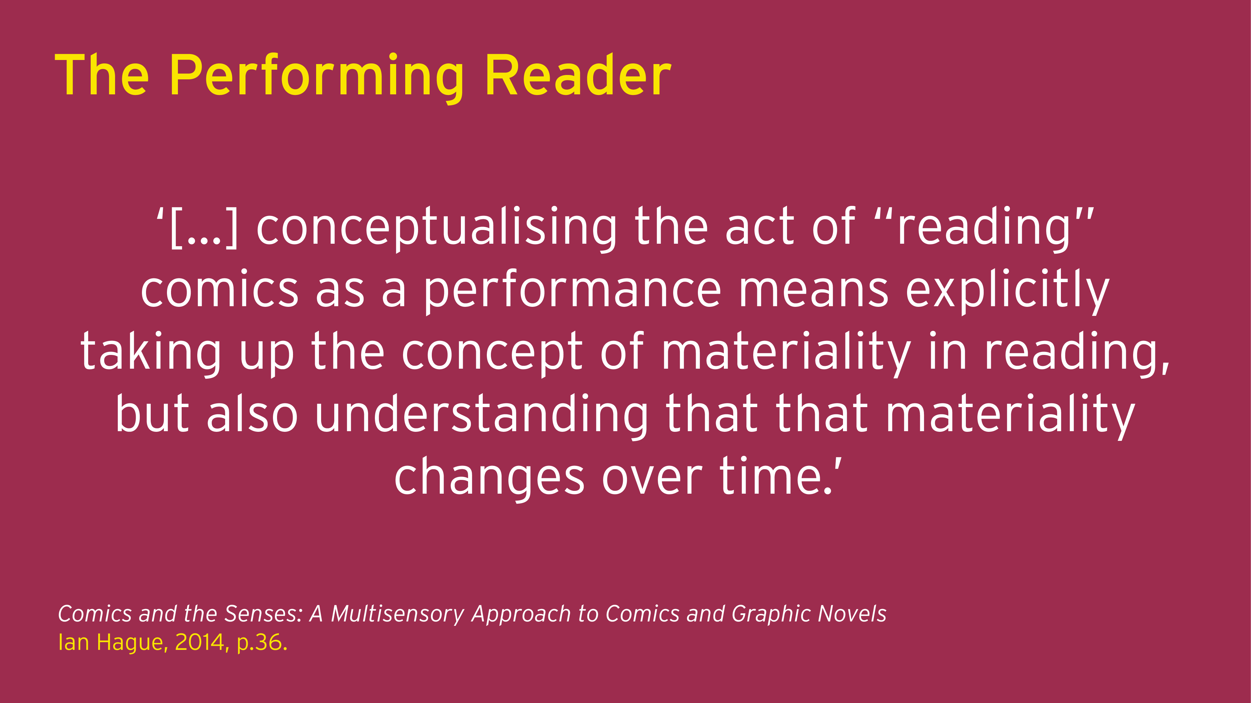

Slide 13
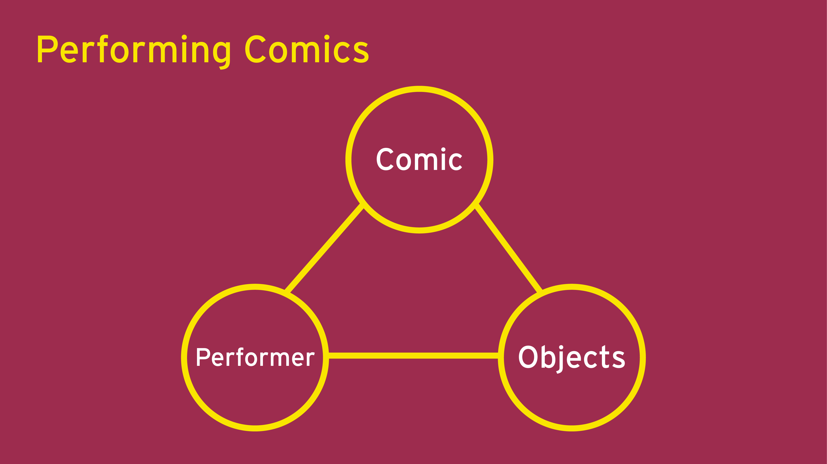

Slide 14
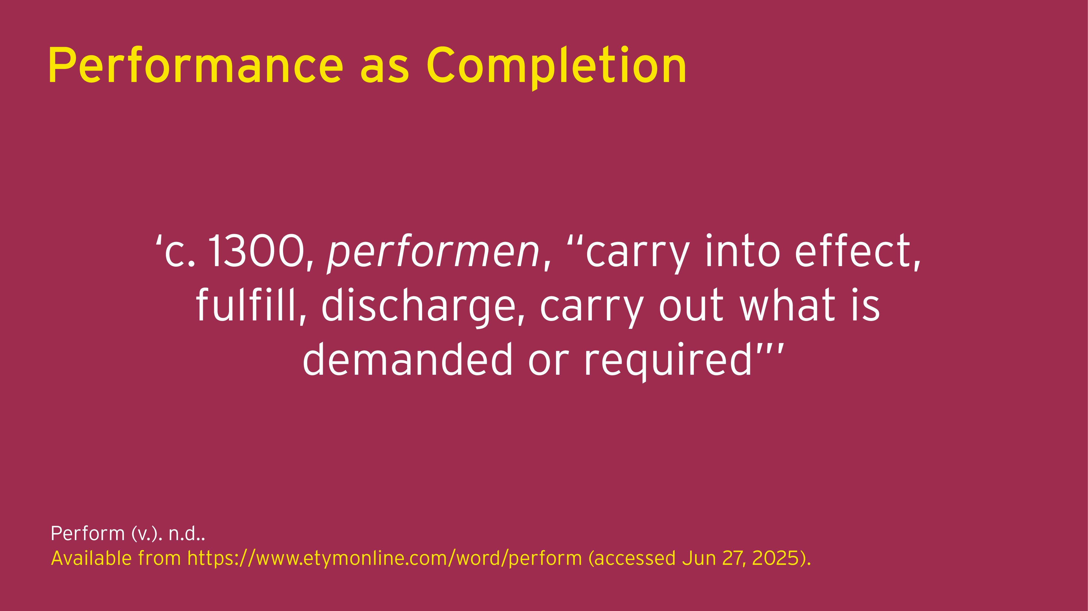

Slide 15


Slide 16


Slide 17
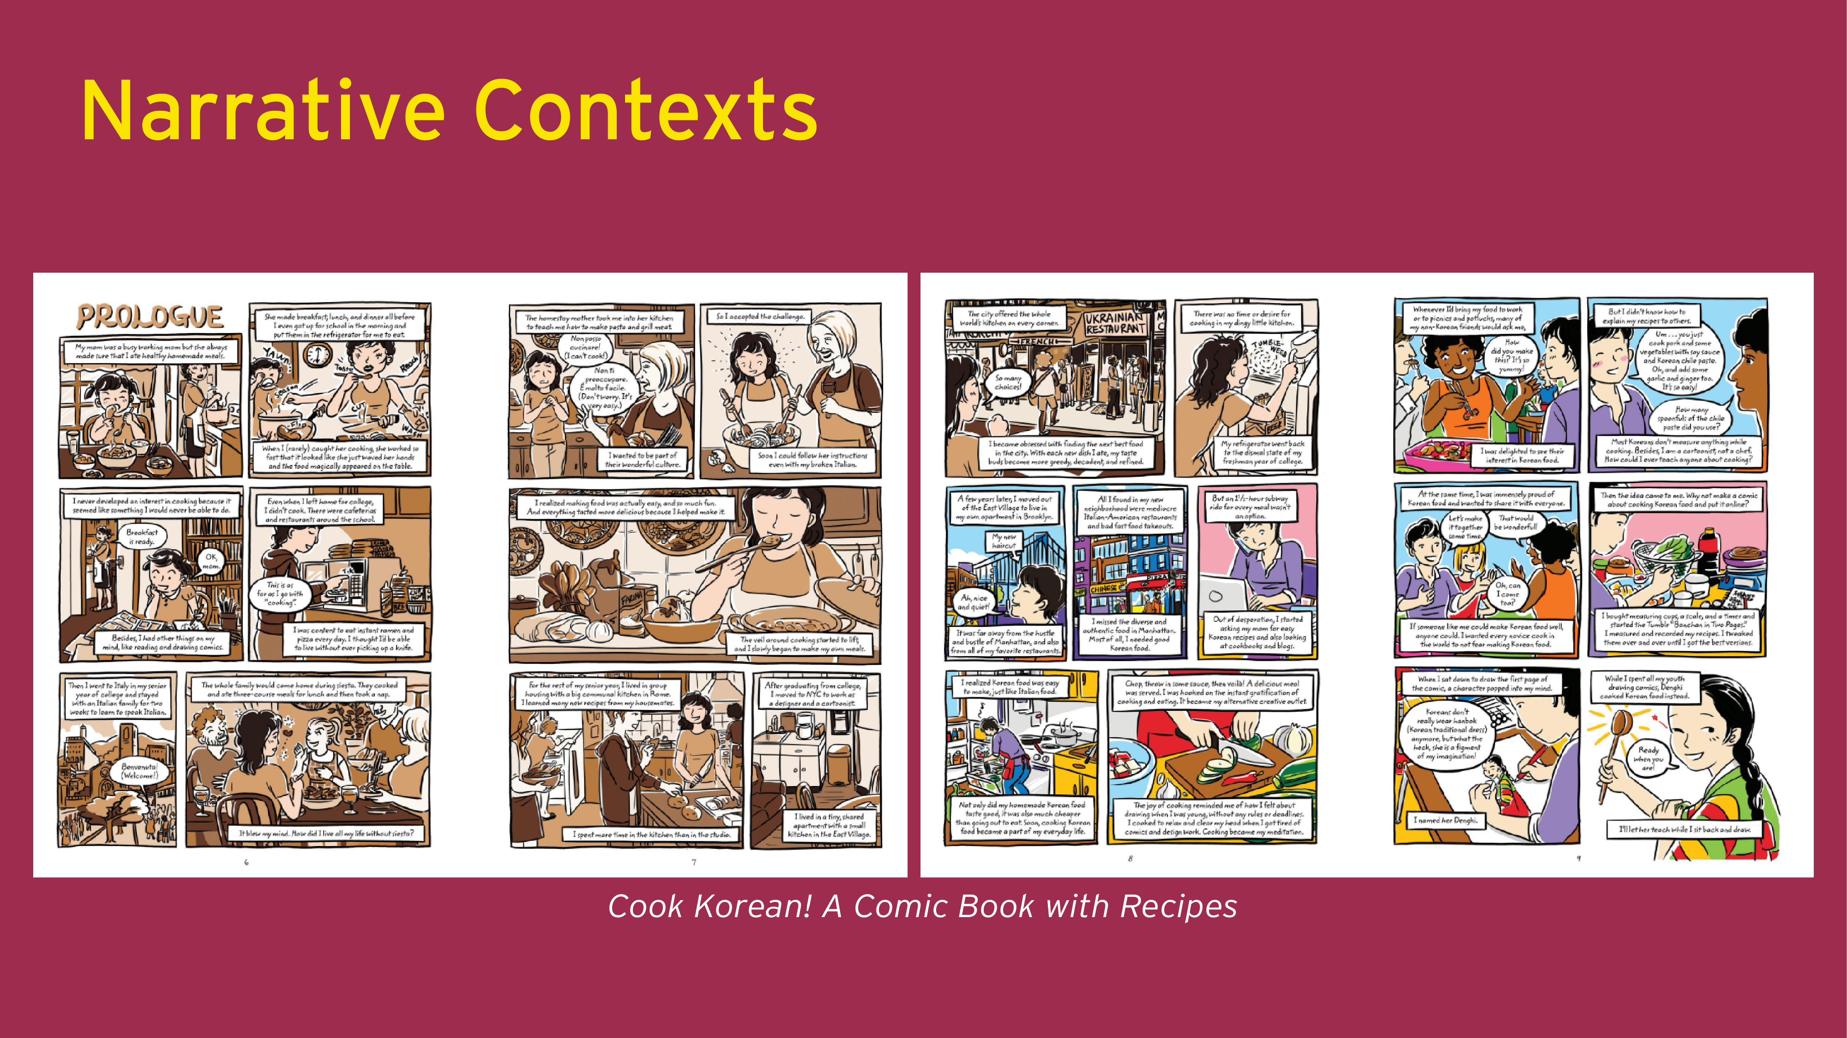
Notes:
Why respond to the comic’s demands?

Slide 18
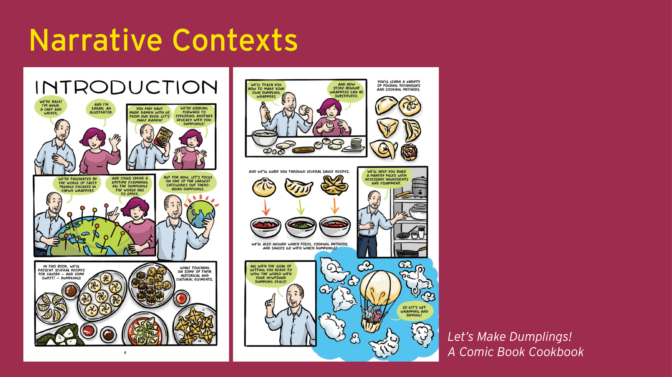

Slide 19

Notes:
Purpose of performance

Slide 20

Notes:
Engaging in cultures

Slide 21
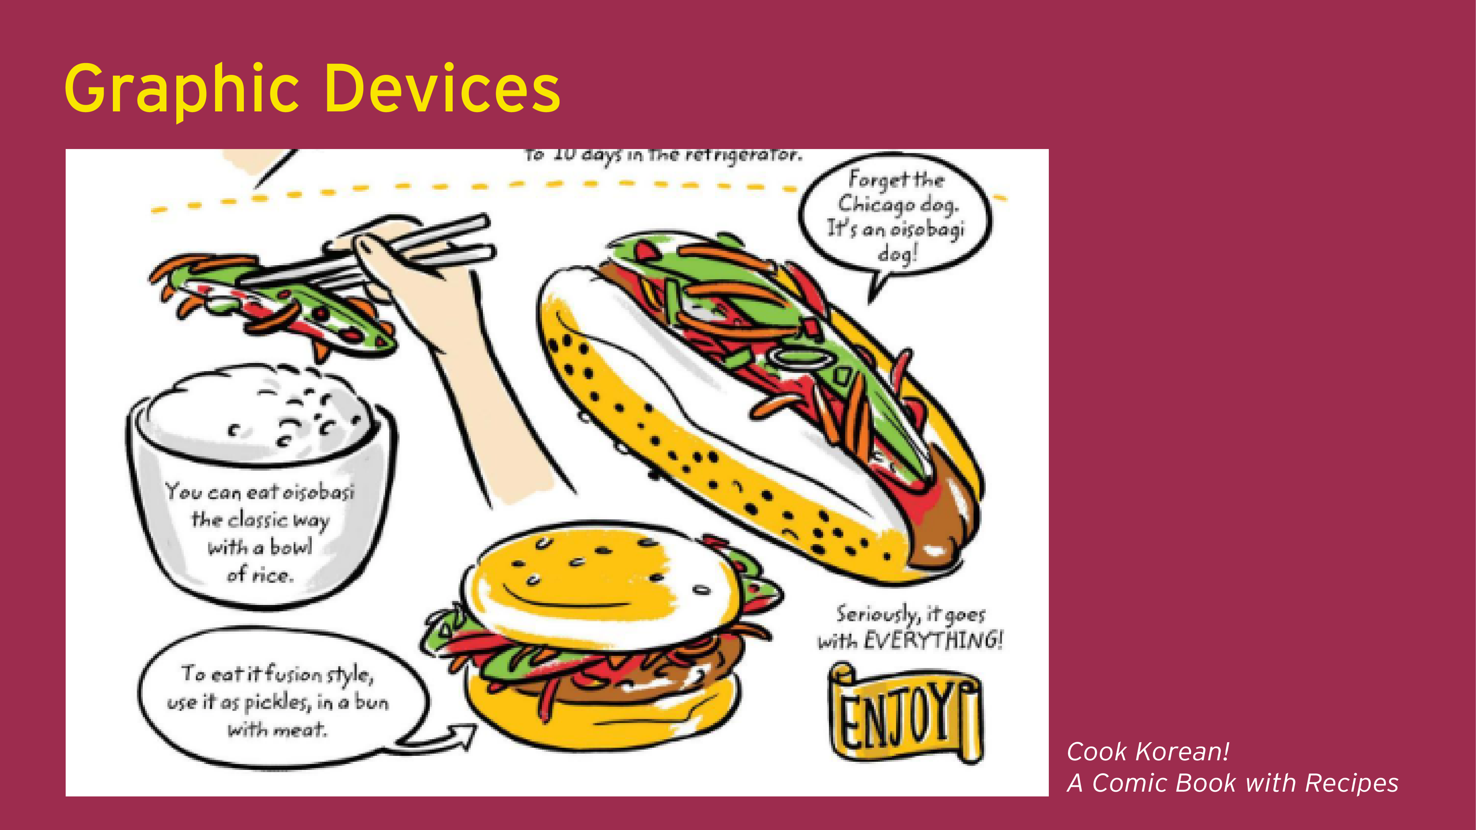
Notes:
How to meet the comics’ demands

Slide 22
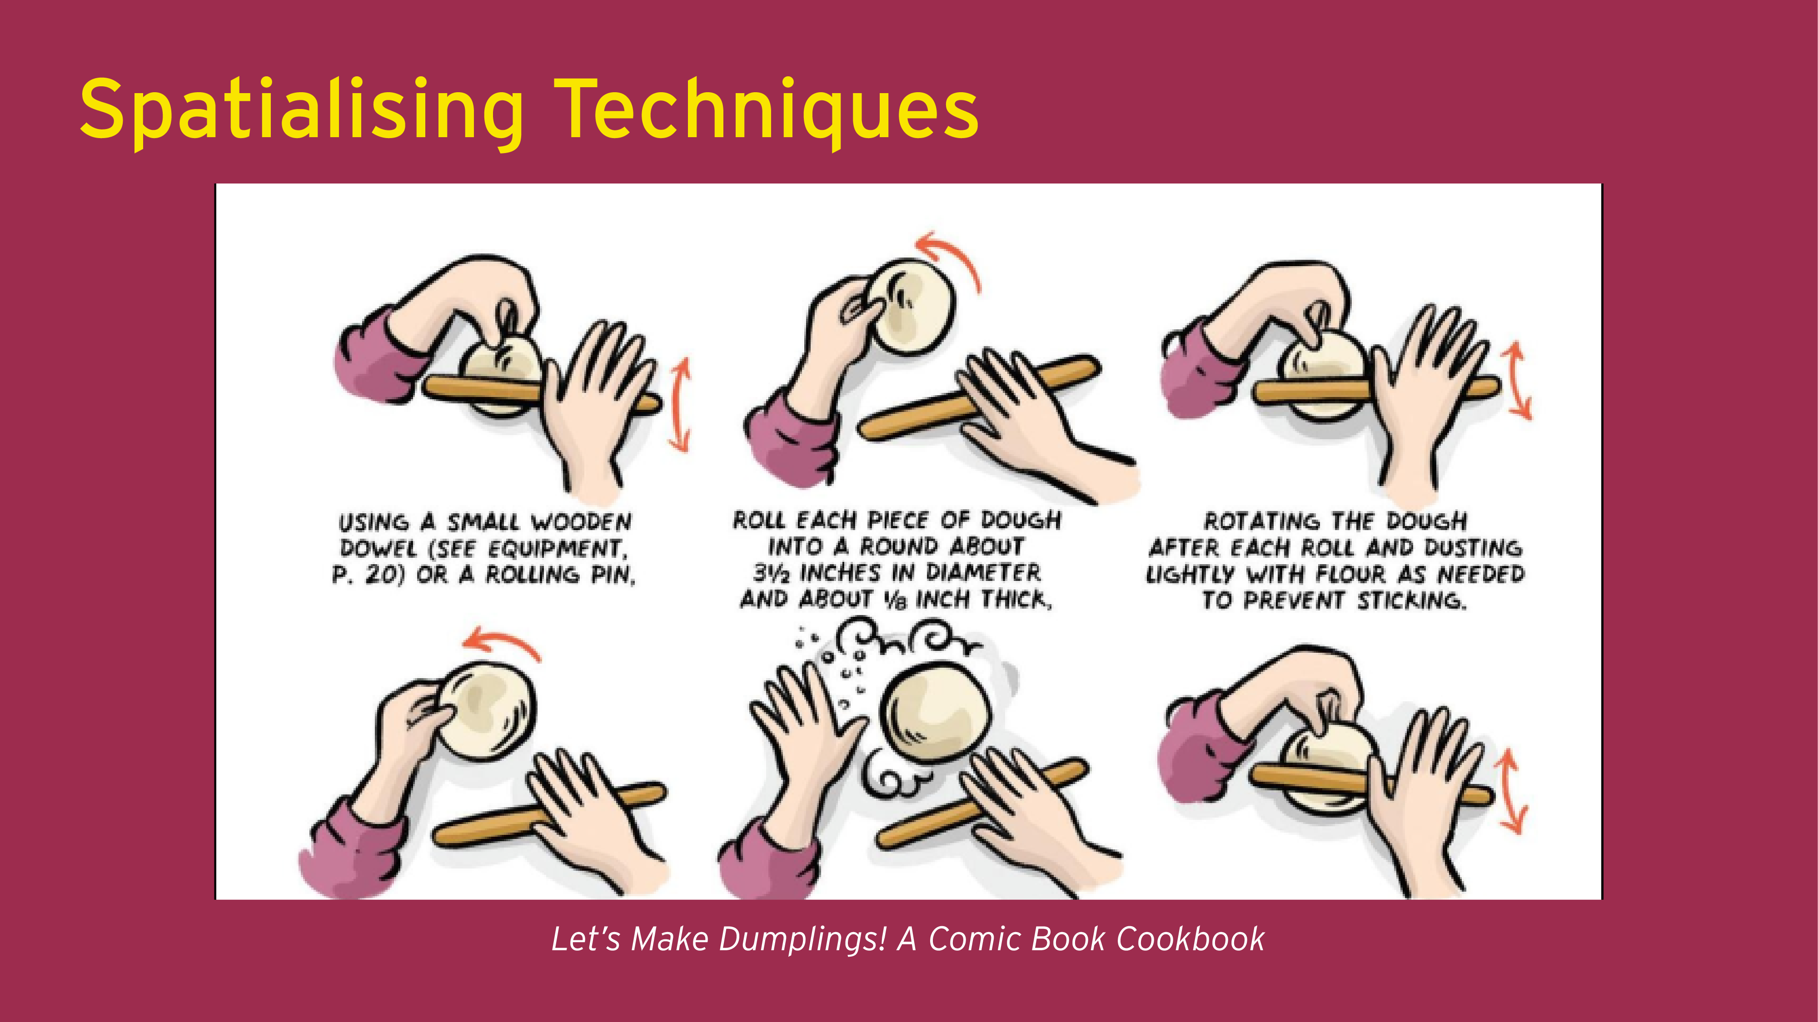
Notes:
Seeing past, present and future (cf. video, time based media)

Slide 23
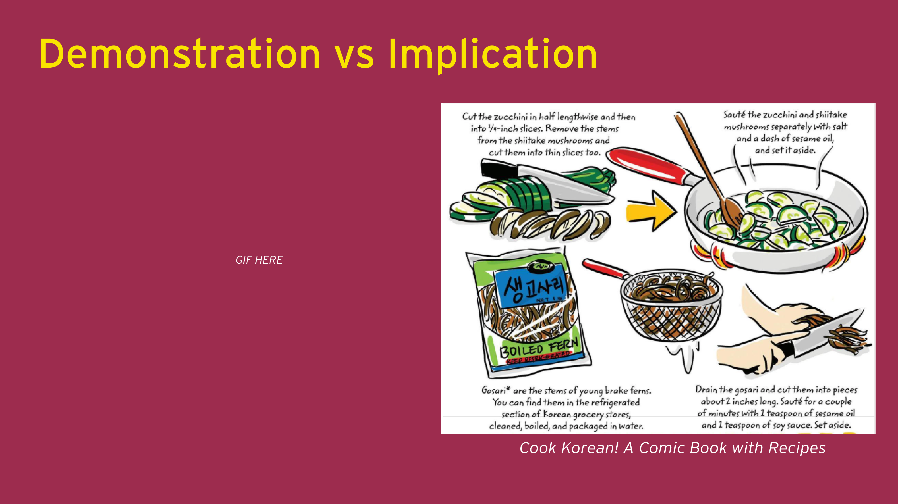


Slide 24


Slide 25


Slide 26


Slide 27


Slide 28


Slide 29
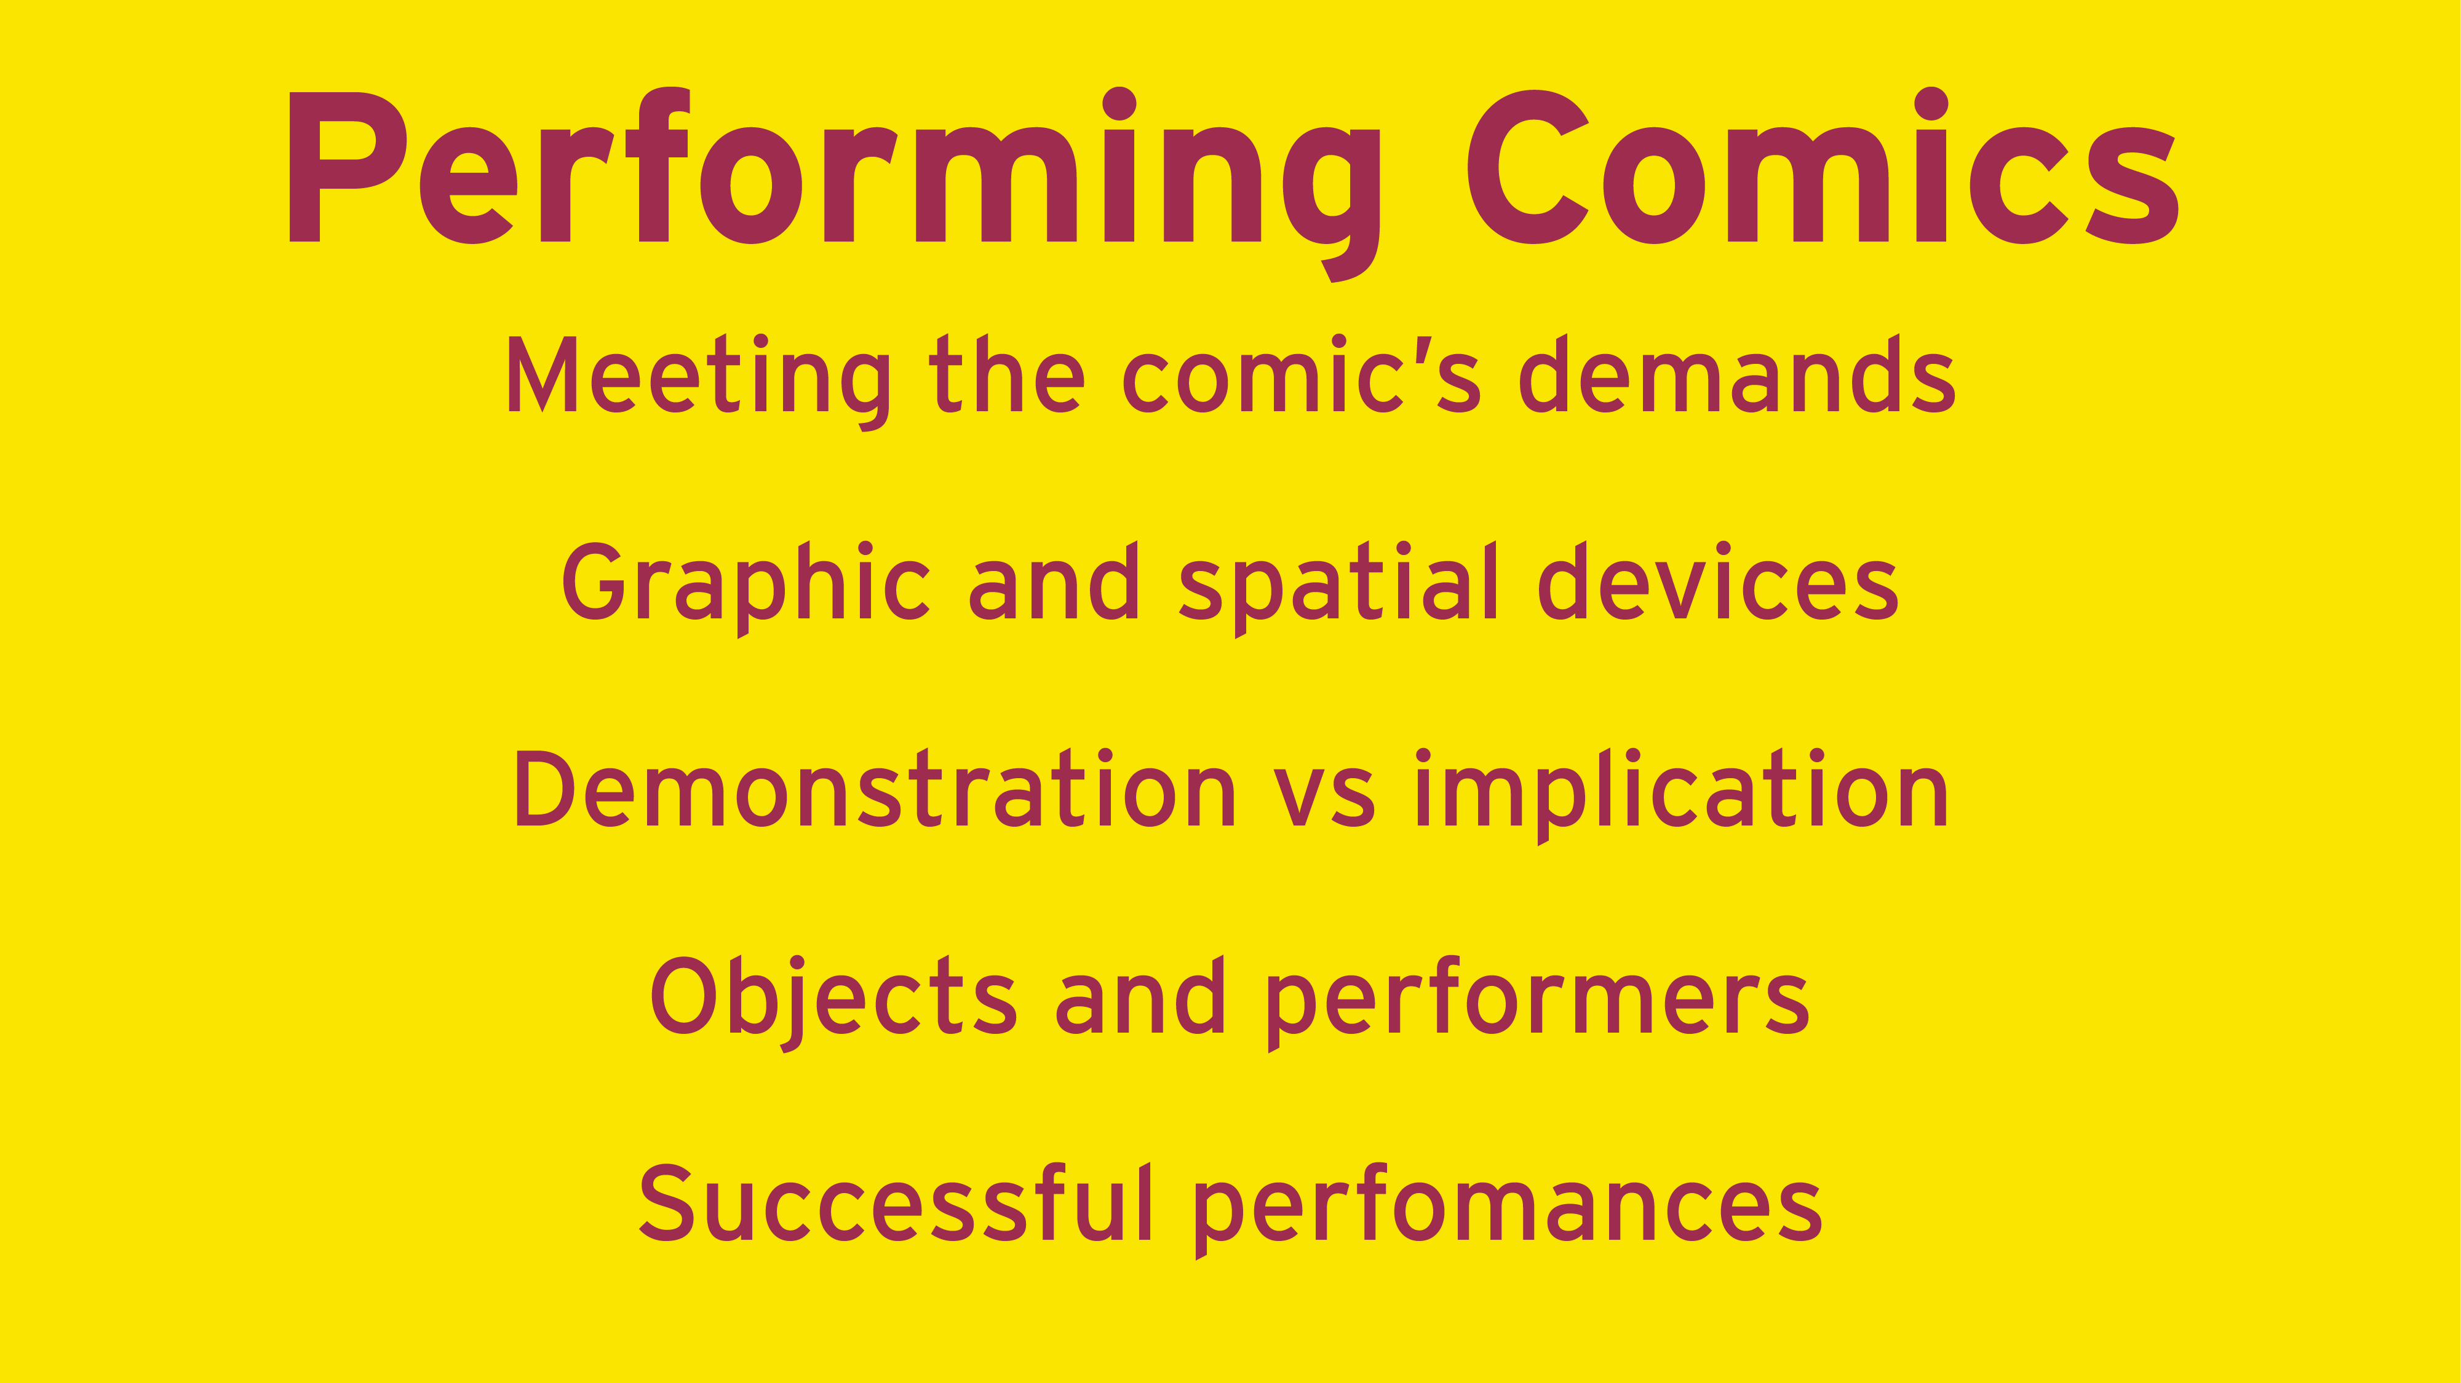

Slide 30


