Slide 1
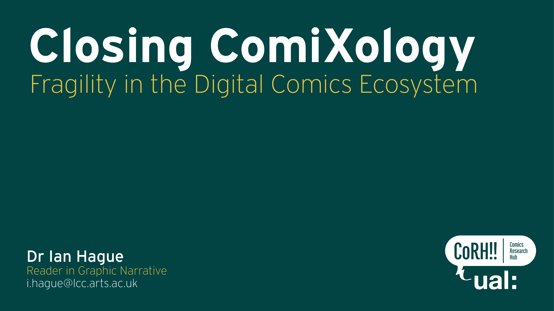
Notes:
In this presentation I would like to use the digital comics retailer Comixology as a case study to explore the concepts of fragility and risk as they relate to the digital comic as an economic object.

Slide 2
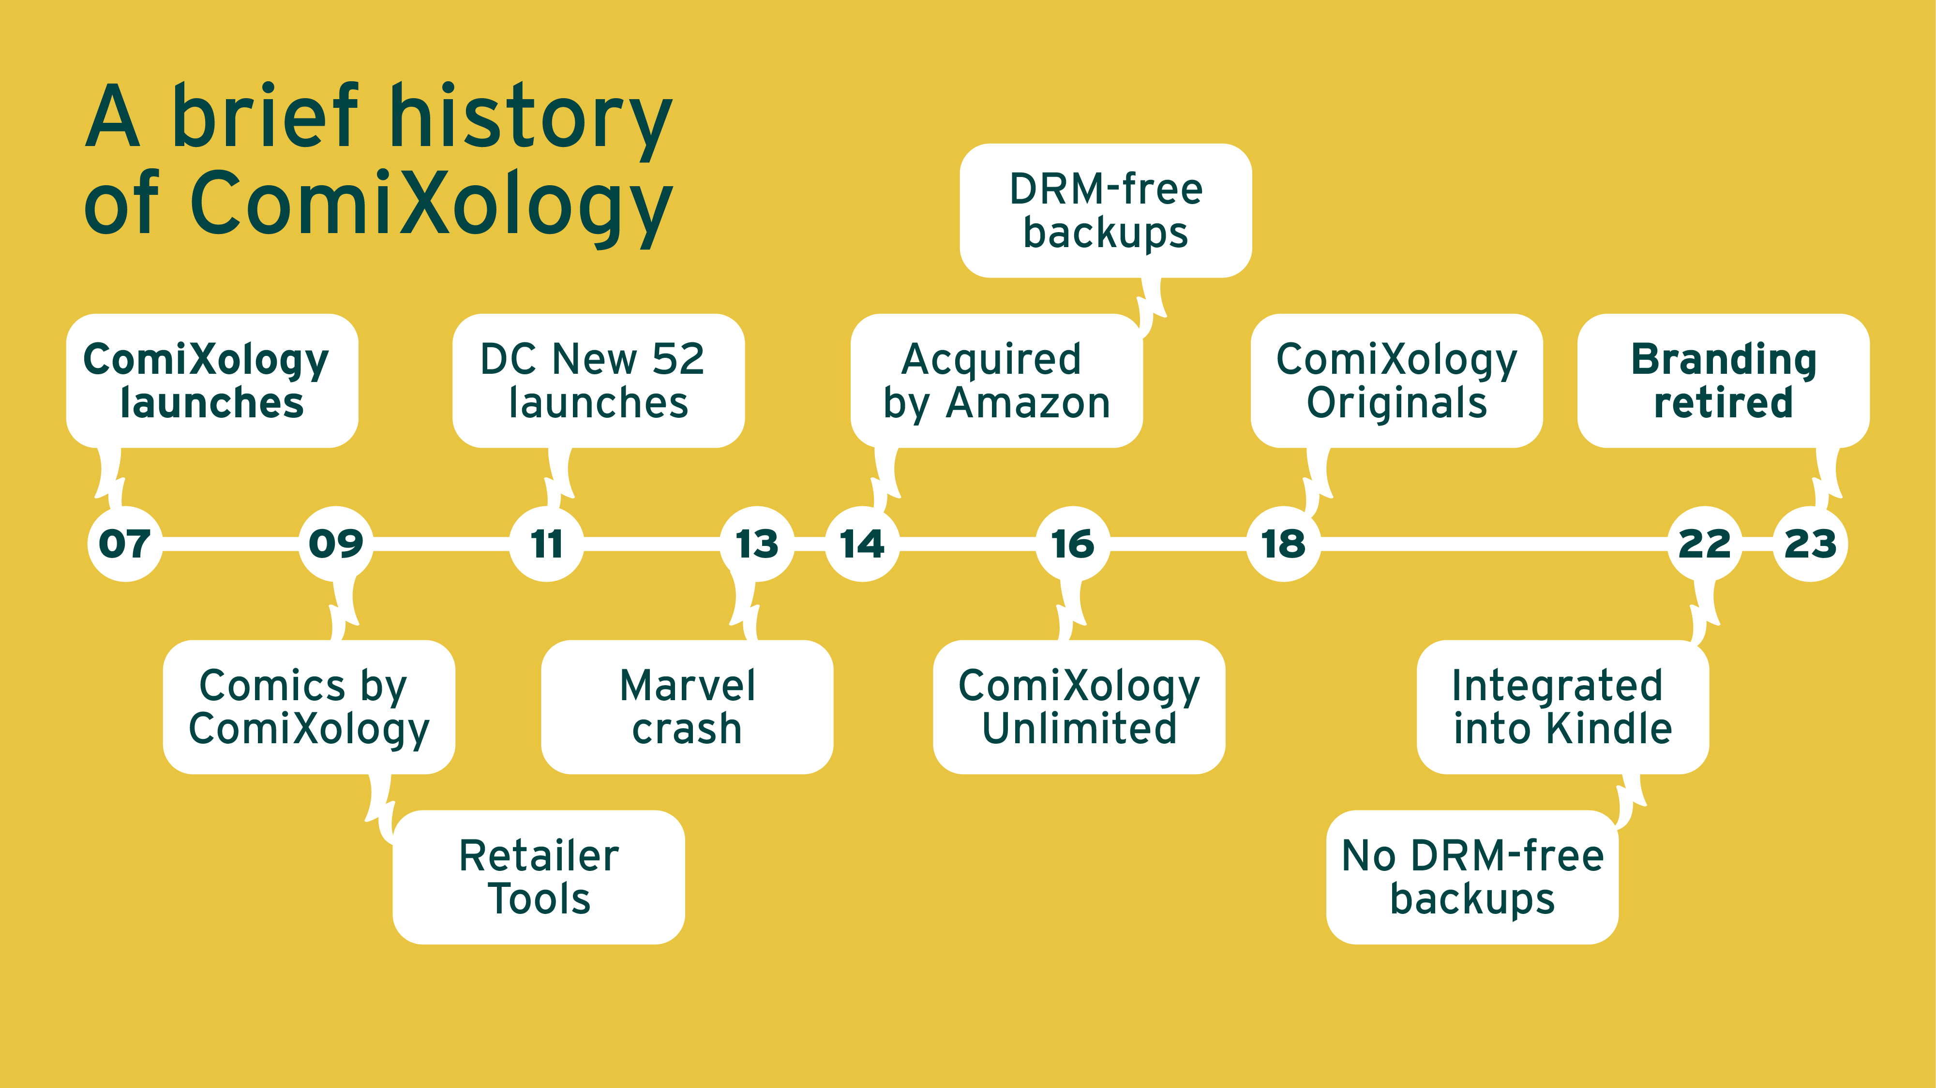

Slide 4
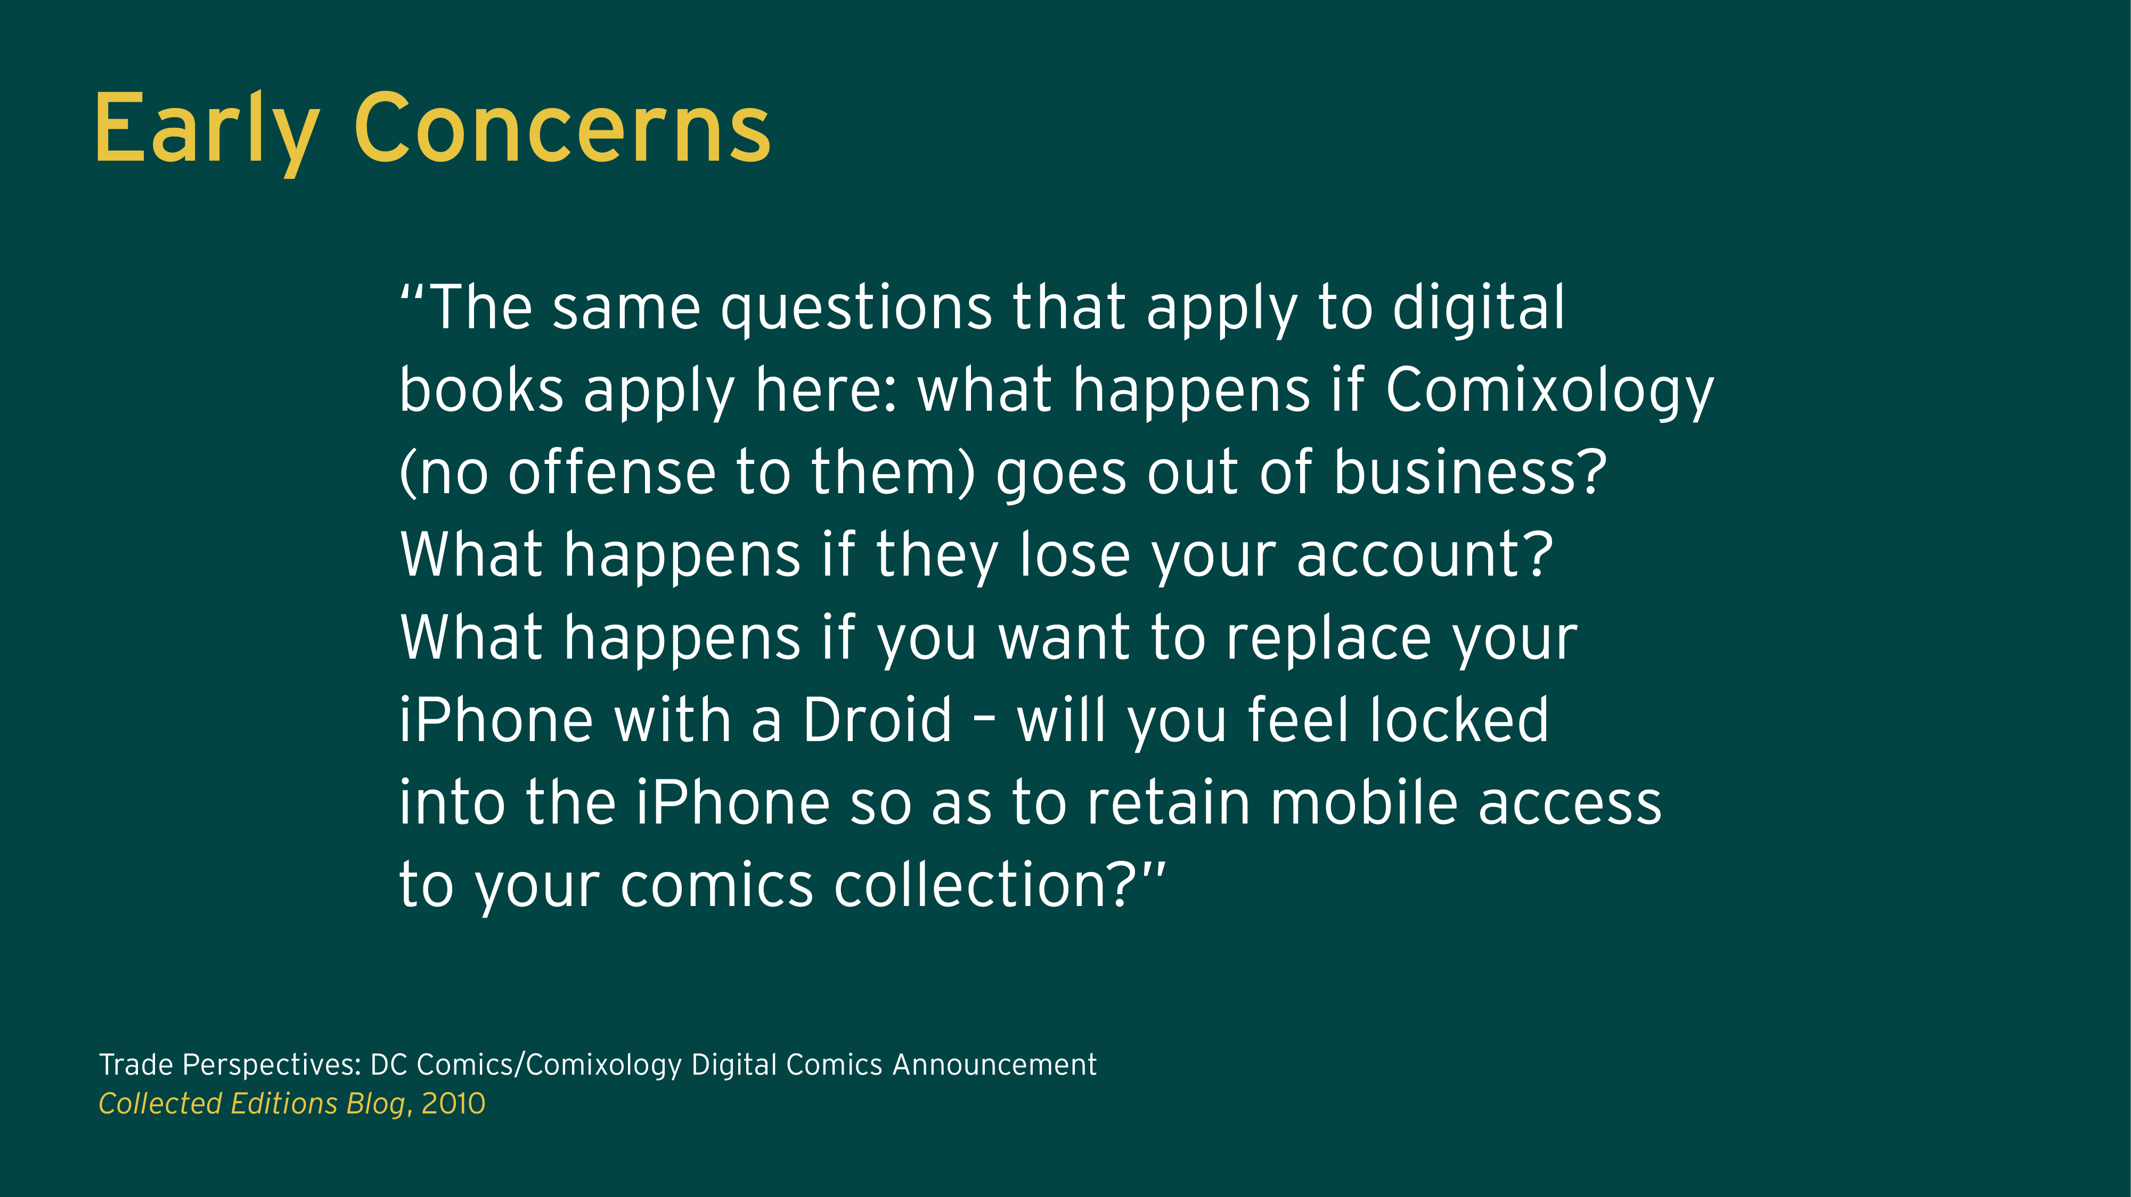

Slide 5
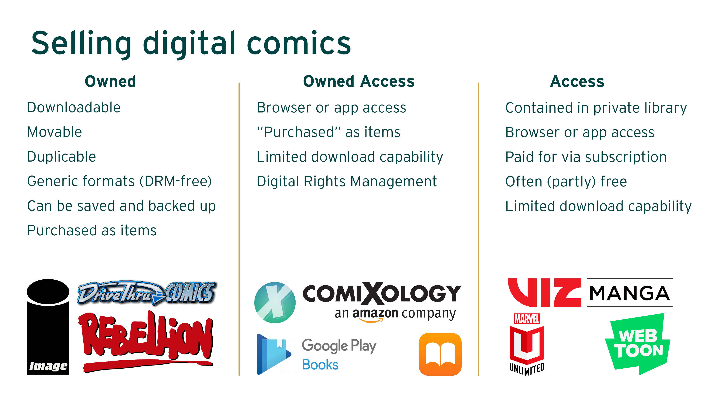

Slide 10
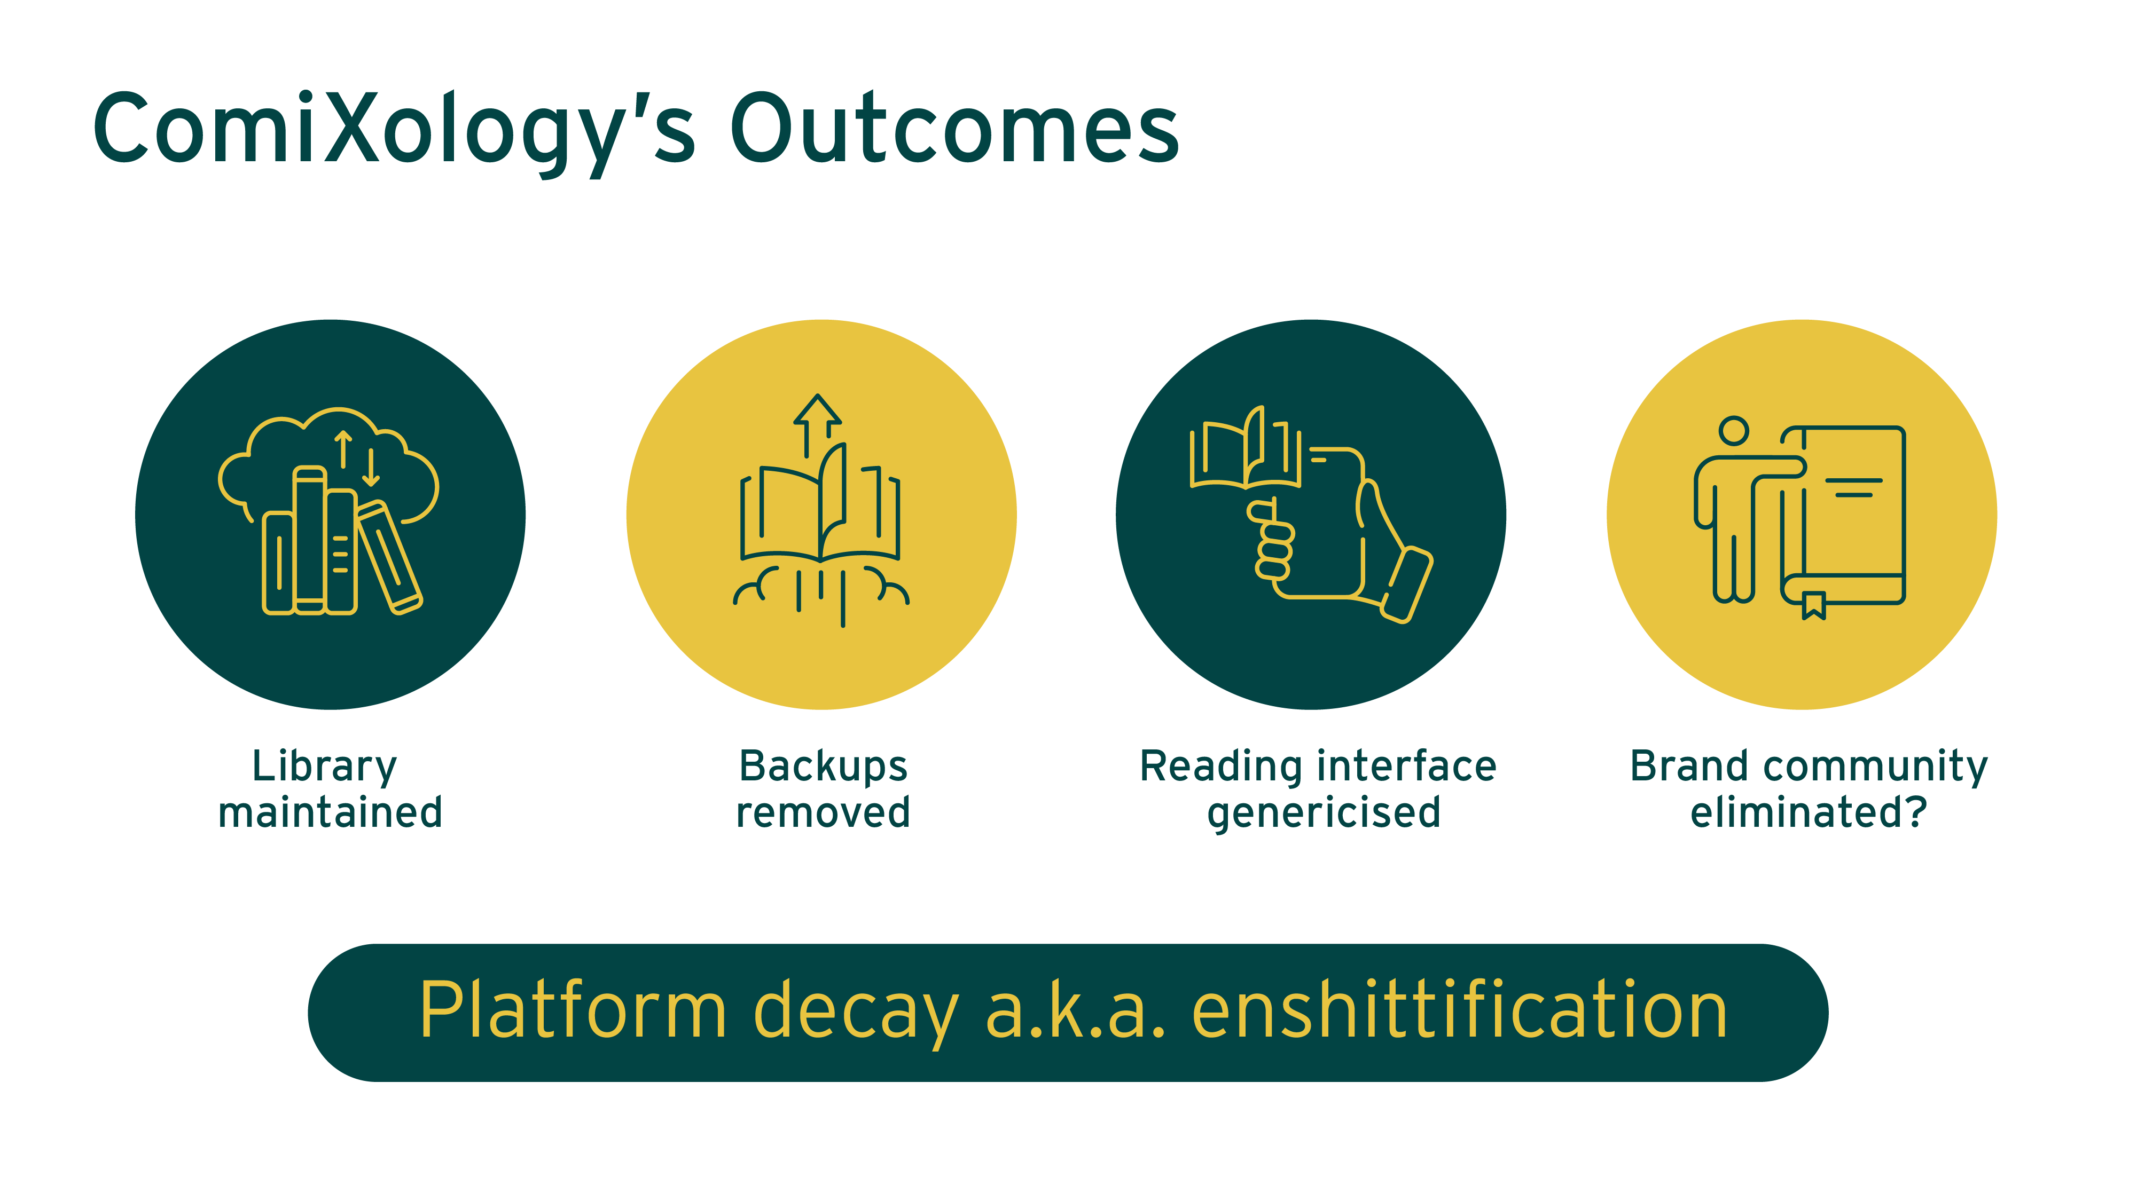
Notes:
Cory Doctorow - enshittification

Slide 11
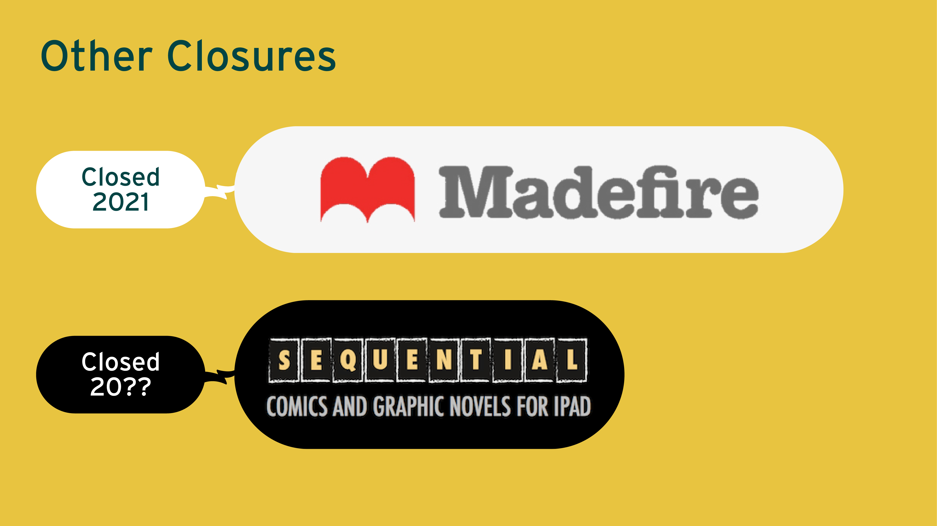
Notes:
– All new purchases of books have been suspended indefinitely. – All publication of new books has been suspended indefinitely. – Support of and future updates to the Madefire App have been suspended indefinitely. – Access to purchased content stored in the cloud may be limited and therefore customers are encouraged to download all previously purchased content from the cloud onto the Madefire App before the end of April 2021.

Slide 12
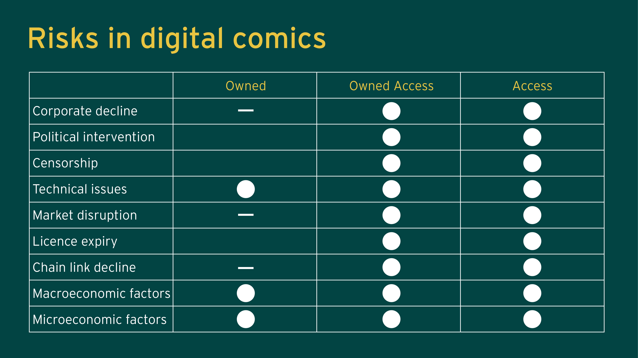

Slide 13
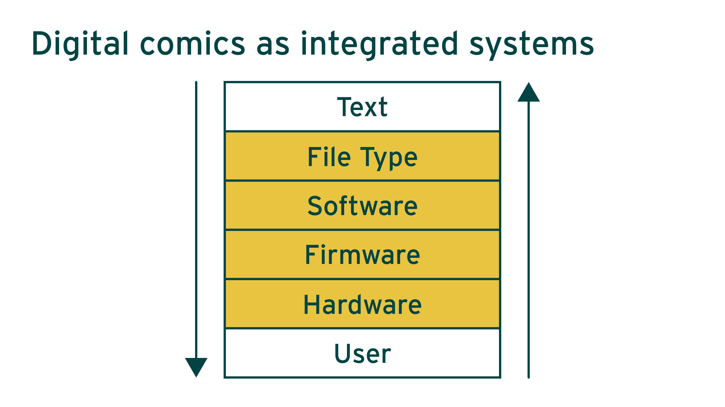

Slide 14
