Slide 1
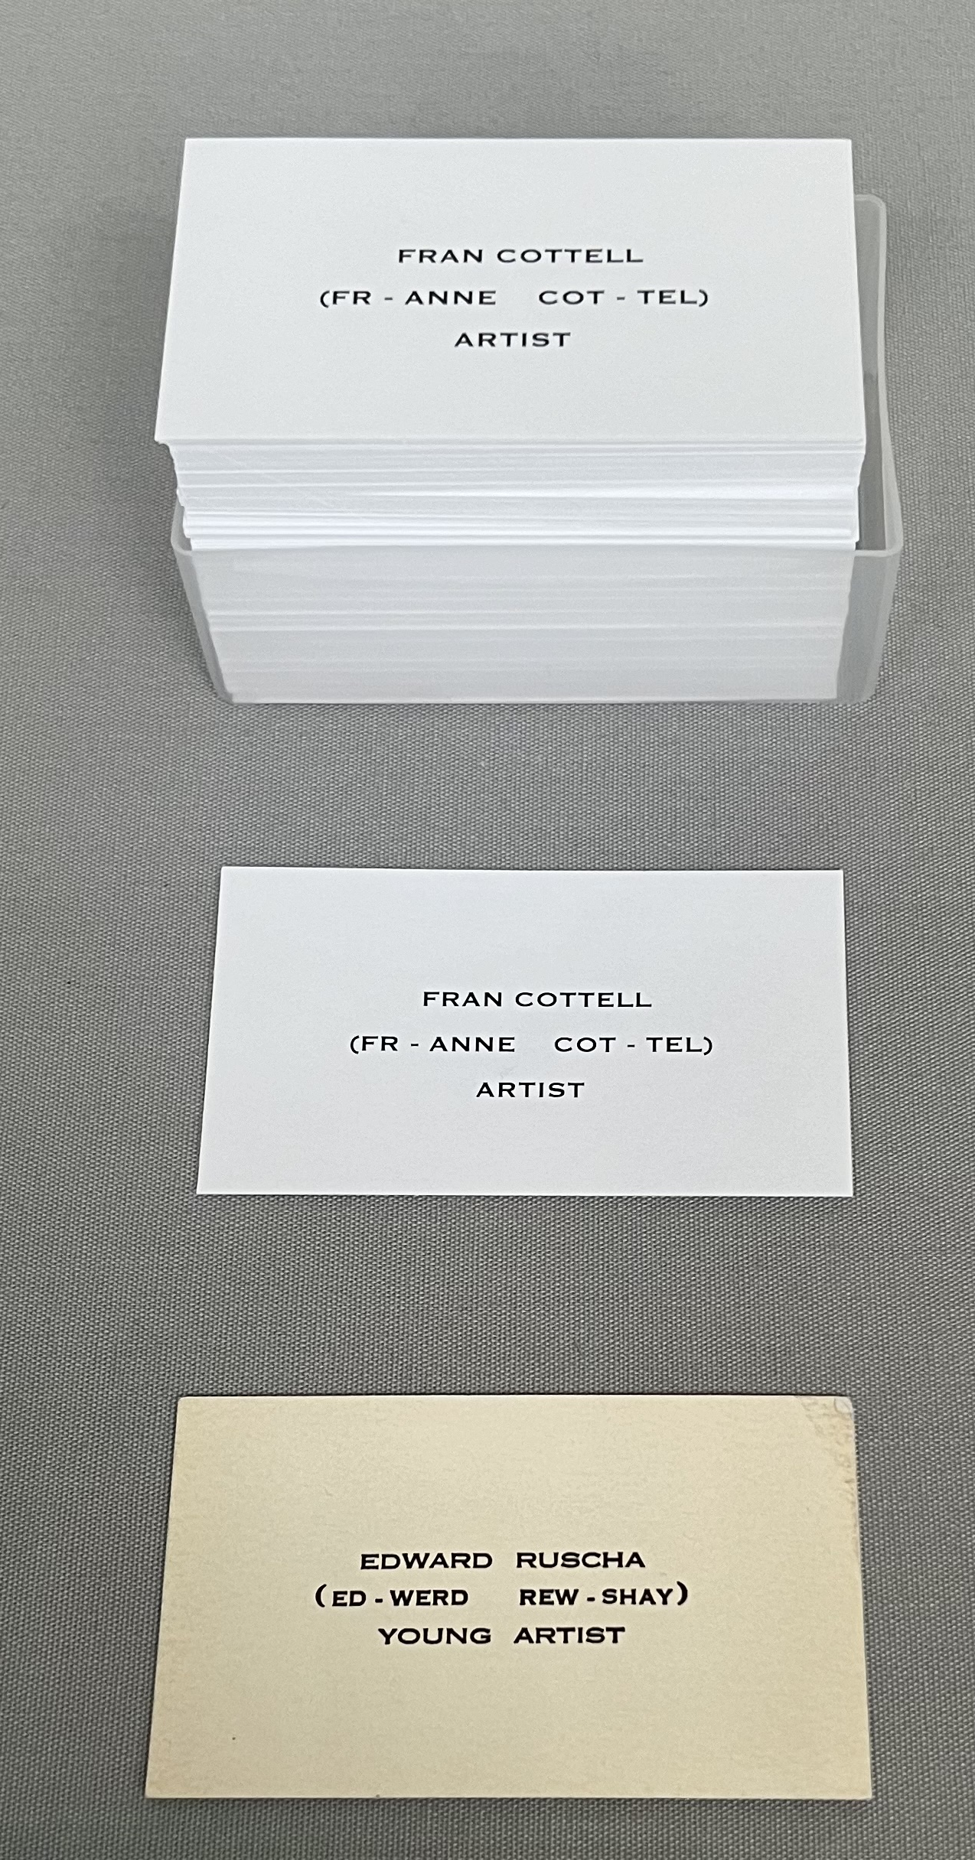
COLLABORATING, CONNECTING AND CREATING: A FEMINIST RESPONSE TO THE CHELSEA COLLEGE OF ARTS LIBRARY SPECIAL COLLECTIONS THROUGH EXHIBITION MAKING.
SIOBHÁN BRITTON
ACADEMIC SUPPORT LIBRARIAN
CHELSEA COLLEGE OF ARTS, UNIVERSITY OF THE ARTS LONDON

Slide 2
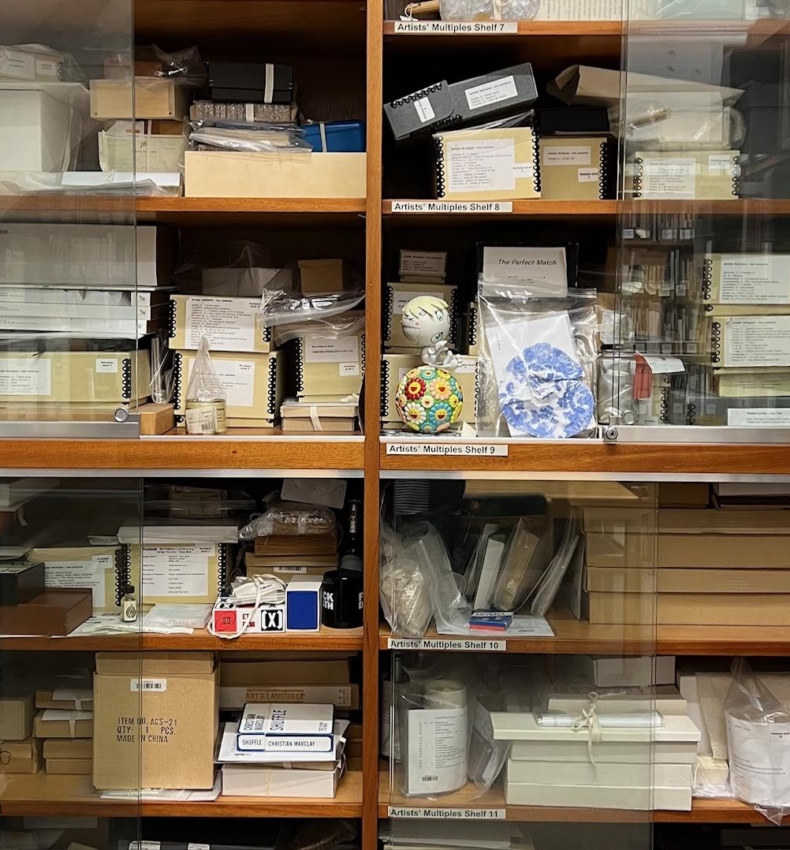
THE COLLABORATION
The Library contains display cases. They’re often used to showcase special collections material, and students and staff can submit proposals to display their work.
I was contacted by a member of staff I knew, who was part of a UAL research group called Subjectivities and Feminisms. They wanted to put together an exhibition for International Women’s Day in March 2024 and asked if they could use the Library cases.
I made a proposal to the group: for the show would they consider making work as a reaction to material in our special collections and display the original works and special collections items side by side?
Notes:
A group of staff working across research, teaching and student support services, founded 21 years ago. In their words: “S&F embraces a legacy of feminist thinking and performance, and questions whether and how subjectivity is a transitive process, and whether and how it is attached to identity”.

Slide 3
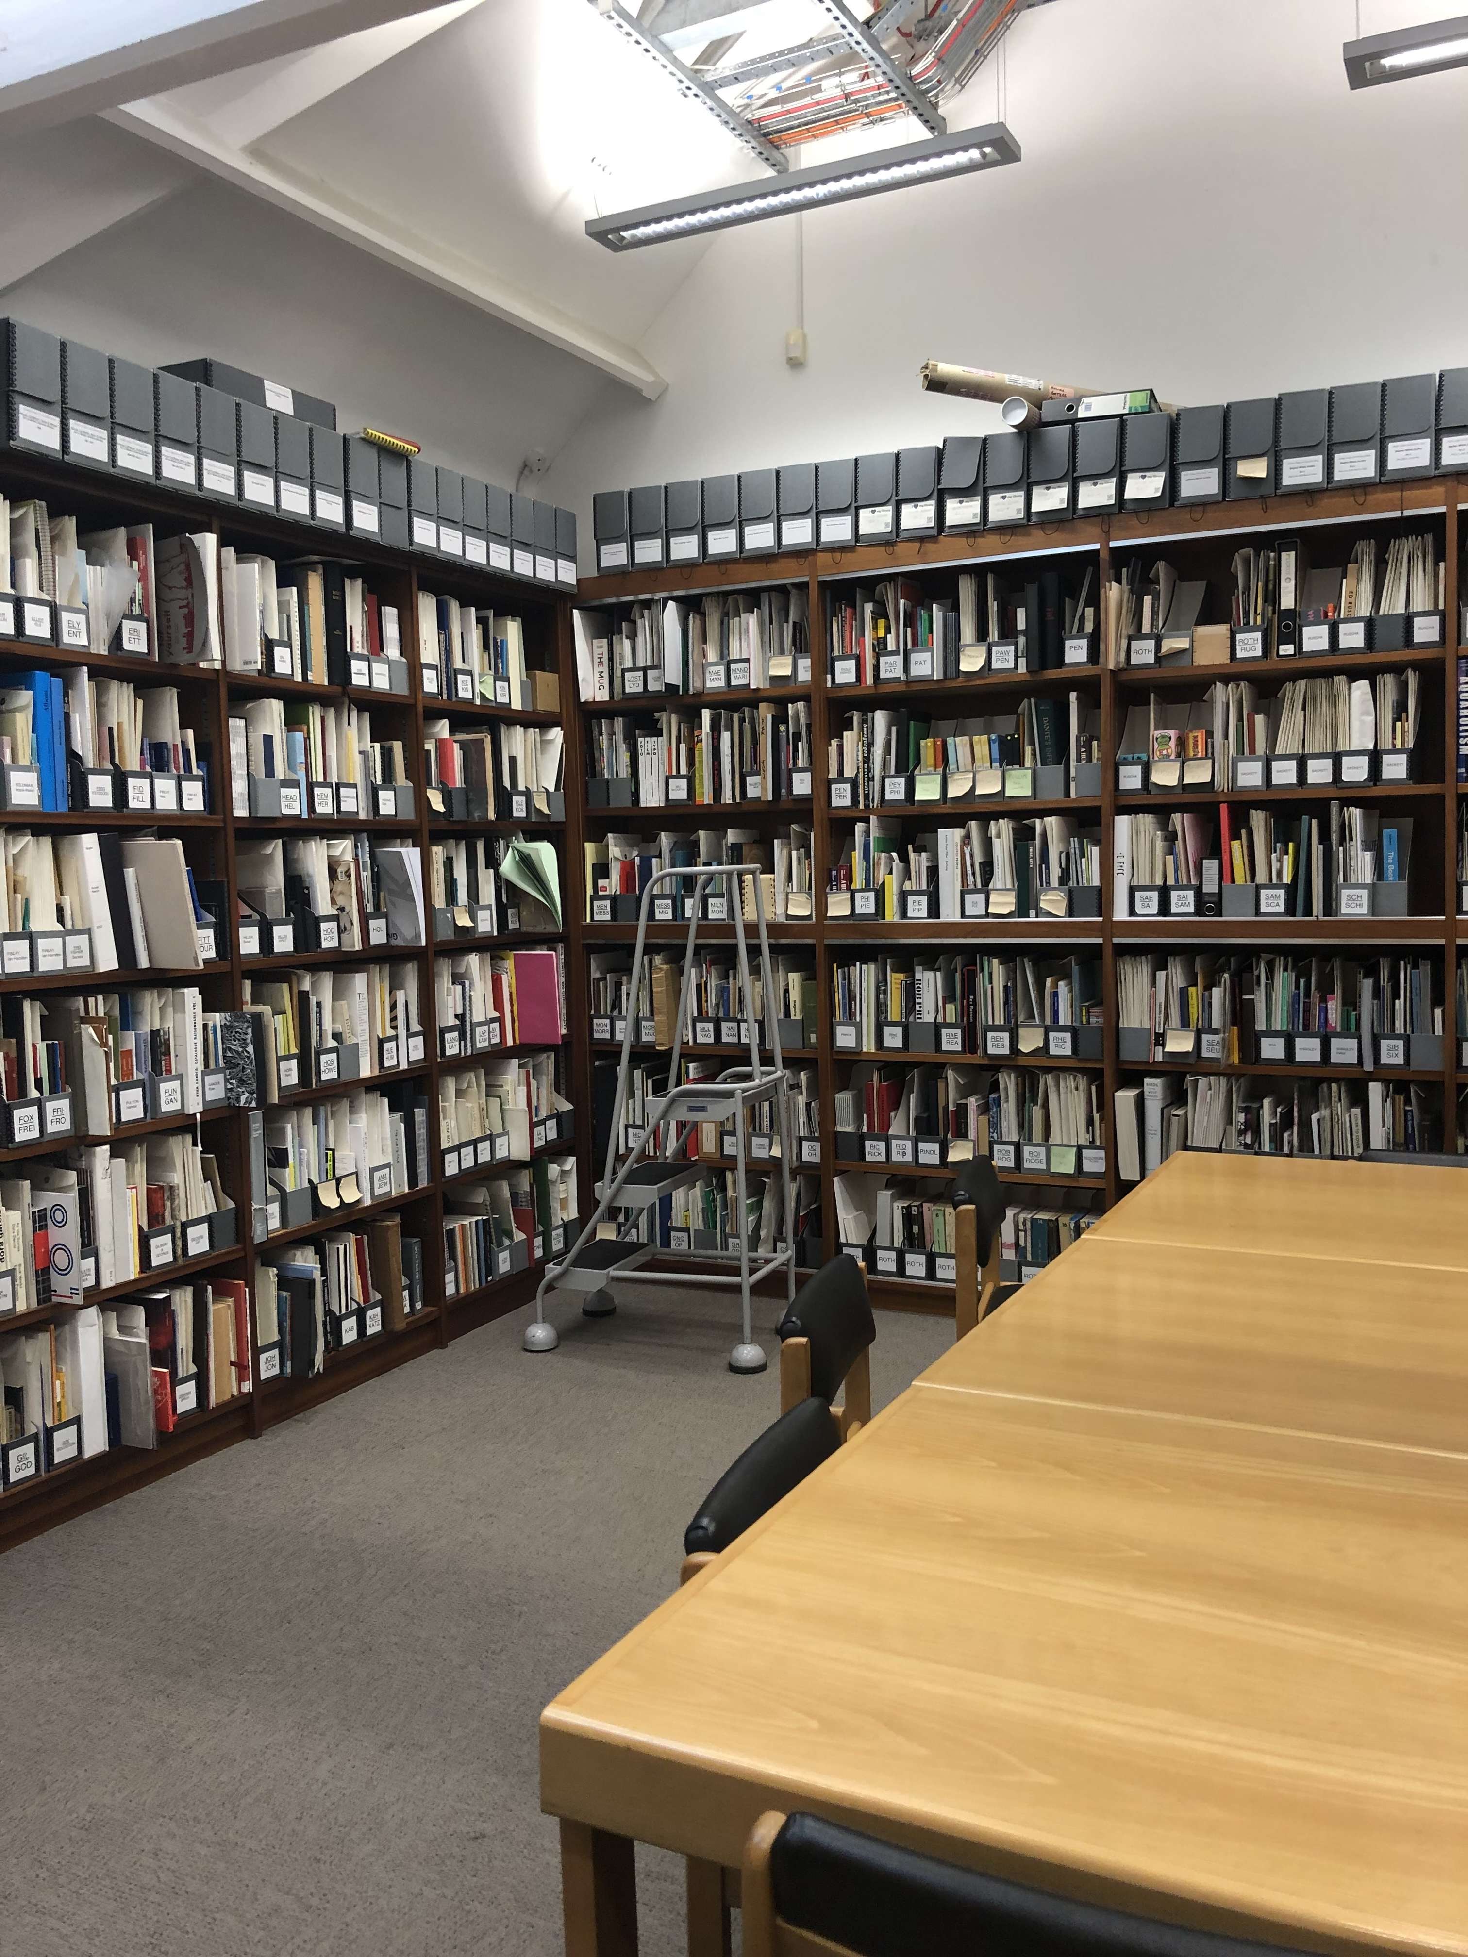
SPECIAL COLLECTIONS AT CHELSEA
Artists’ books: Collection began in the 1970s and continues to grow. Approximately 5500 items.
Artists’ multiples: Around 550 items. Strong representation of material from 1970s and 1990s.
Rare Journals.
Ephemera.
Archives.

Slide 4
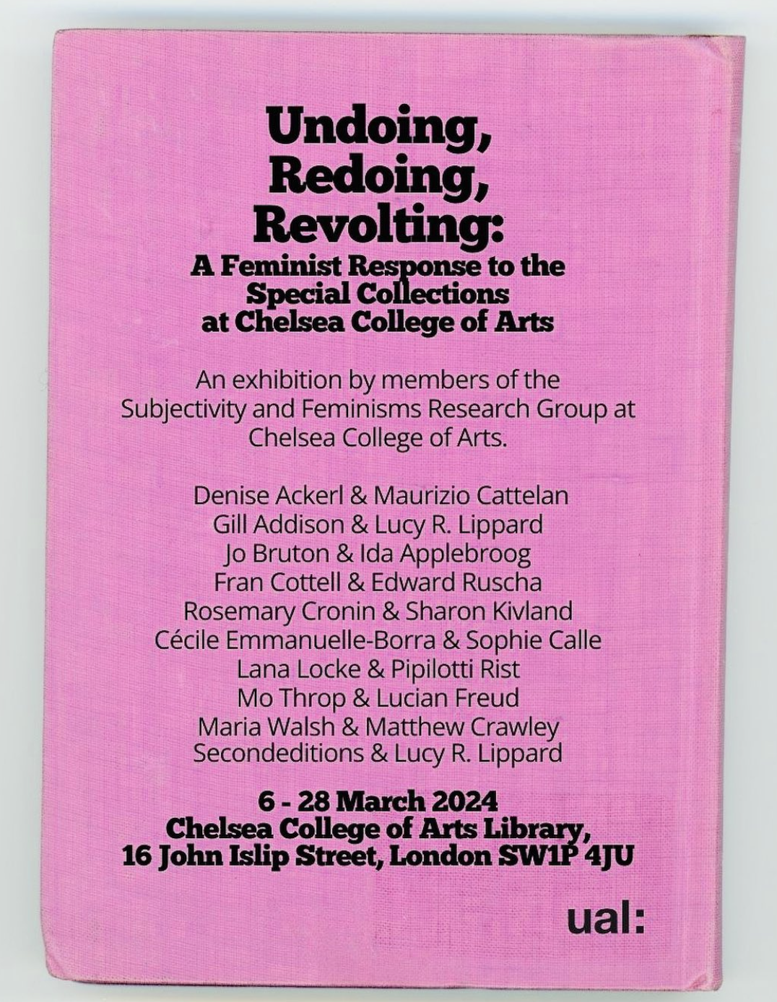
DEVELOPING THE EXHIBITION
The group visited the special collections twice to identify the material they wanted to work with. Some of them already had specific items in mind, others decided in these sessions.
There were some challenges:
The initial theme changed a few months into the process.
Work created came in a range of formats but had to be mindful of limited space in cases.
Some formats for original work were not possible e.g. wall drawings or any moving image work.
Time commitments: Much of the process occurred at a busy time of the year, and co-ordinating visits/requests for material could sometimes be challenging.
The exhibition was installed over 2 days in March 2024.
It was titled Undoing, Redoing, Revolting: A Feminist Response to the Special Collections at Chelsea College of Arts.

Slide 5
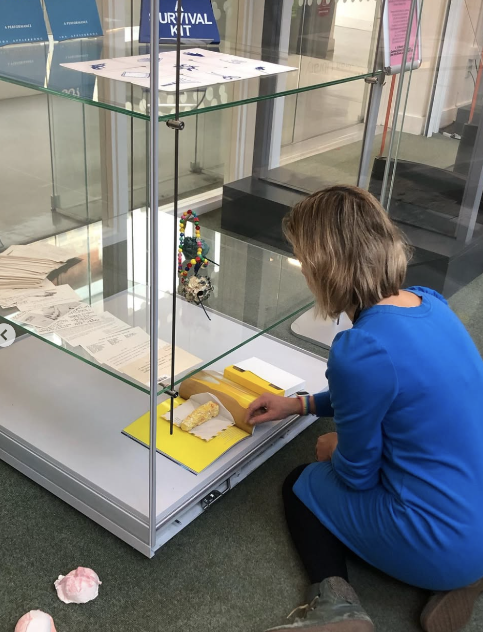
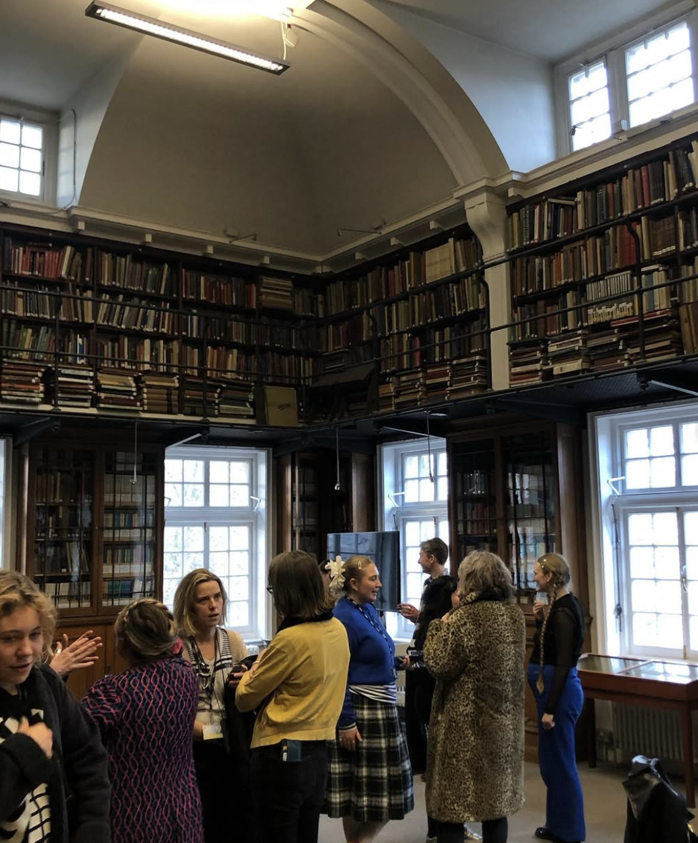
Images from the show

Slide 6
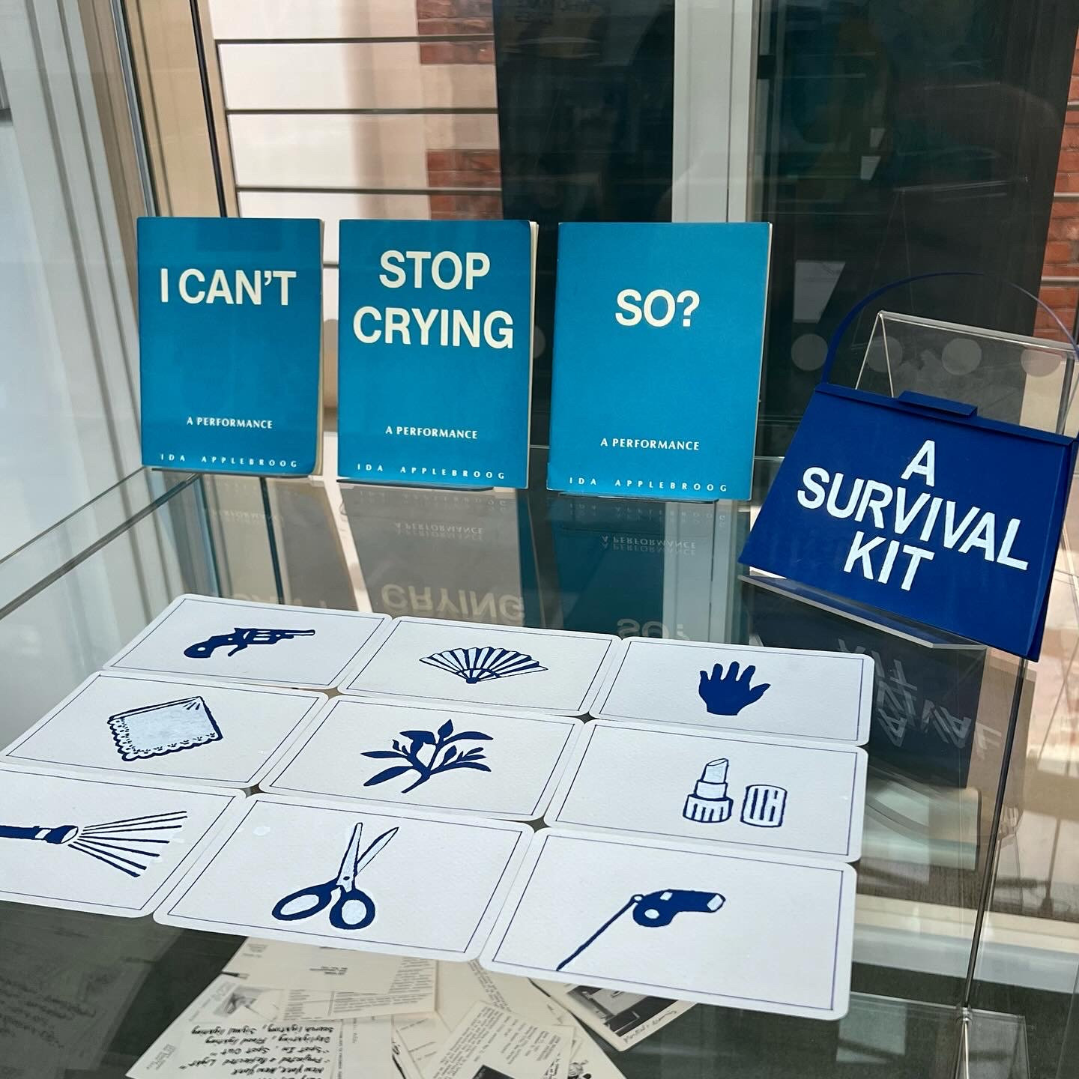
Images from the show

Slide 7
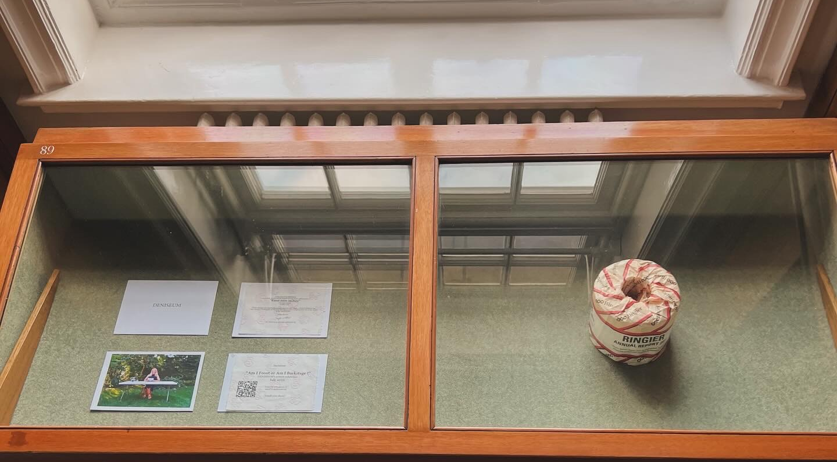
Images from the show

Slide 8
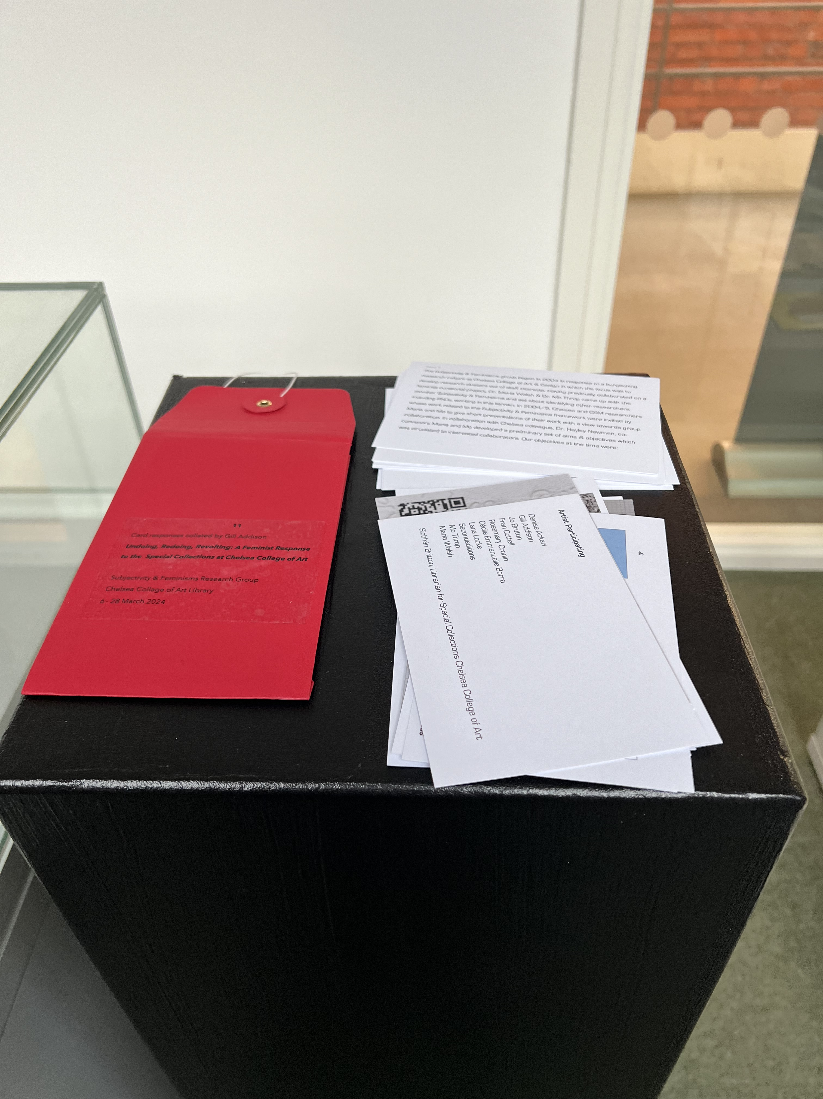
POST-PROJECT
The project allowed me to build on existing relationships with staff I already knew and develop new ones with staff I didn’t. Some staff in the group have brought students in for special collections sessions since the exhibition.
It was great way to showcase the creative potential of special collections material.
It helped me to see familiar special collections items in new ways.
Two publications created for the show were donated to the special collections.
It has inspired similar projects using special collections.

Slide 9

Thank you!
s.britton@arts.ac.uk
Bluesky: @sluginkpress

