Slide 1
Evaluation Partnerships – Embedding evaluation into teaching practice for educational enhancement Dr Frania Hall, Media School, LCC, UAL.
Advance HE – Educational Excellence Symposium 9 December 2025

Slide 2
Contextualised Evaluation
‘Encourage teachers to claim the right to valid, rigorous and creative approaches to the evaluation of their courses and teaching’ Nygaard and Belluigi, 2011:690
‘At its heart effective evaluation is about the quality of choices made in balancing realistic expectations and needs of it with judgements about focus, scope and methods.’ Parsons 2017:1
Evaluation for education enhancement

Slide 3
OUTLINE OF SESSION
Context – UAL Media School
Development of an evaluative framework
Application and materials
The partnership approach

Slide 4
MEDIA SCHOOL
Course leader and Teaching And Learning Lead Media School
1470 students
8 undergraduate 9 postgraduate courses
Evaluation project funded for 3 years so far – for staff participation and student engagement

Slide 5
Development of Research-based Framework
Educational Enhancement Sabbatical
Primary research - 4 case studies around other institutions, research with staff and students
Literature review and research report
Establishing criteria for robust, consistent evaluative data collection
Exploring aspects of evaluative culture, establishing evaluative mindsets and approaches to evaluation to enhance teaching excellence.

Slide 6
Evaluation Project
Year 1 22-23 | Research project (sabbatical) - including research report, detailed literature review, case studies, research with students and staff​ Devising framework, preparing materials​, enlisting projects
Year 2 23-24 | 23 24 6 projects Blog developed Results disseminated via UAL T&L days and blog Materials revamped once first year run with student designer
Year 3 24 25 | 24 25 8 projects Results disseminated via UAL T&L days and blog and PD meetings
Year 4 25 26 | 25 26 projects being set up – 1 project in its third year, 1 in its second year and new projects being added Sessions to present findings from 24 25 being planned

Slide 7
Underlying principles

Slide 8
Evaluation Relationships - School & Institution
Institutional- level evaluation
For formal reporting and stakeholders
Eg APP, TEF
School-level teaching and learning evaluation
Enhancing T&L practices through evaluation

Slide 9
Evaluation for teaching and learning
A process for student engagement
A process that takes account of student journey
A process for acknowledging context
A process for learning
A process for identifying what works and what doesn’t work
A process for experimenting
A process for connecting – staff/students; staff/staff
A process all are responsible for

Slide 10
Staff/Student Evaluation Alignment
Students:
Reflect on learning as they progress through unit, identify areas to focus on, develop learning literacies
Staff:
See how learning happens, assess effectiveness, identify what works/doesn’t work based on evidence, adapt ongoing

Slide 11
Evaluative Mindset
Thinks about evidence-based, context-relevant practices, chronicling and mapping how things work, collecting and utilising robust data for knowledge building for evolving pedagogies
Notes:
Building this in the Media School through:
Developing consistent approaches to evaluation
Developing flexible toolkit, adaptable for variety of situations
Sharing best practice and pinpointing about what does/doesn’t work
Aligned to themes – attainment, student experience, journey, learning, community building etc.

Slide 12
Evaluative Culture
Supportive culture where everyone shares responsibility for understanding and implementing evaluation for the development of effective teaching and learning practices
Notes:
Building this in the Media School through:
Projects, interventions, co-creation initiatives for reapprovals
Iterating learning – not reinventing wheel
Collaborative cross-school culture and funding
Organisational learning through best practice - database of evidence
Large and small projects – covering 28 staff and teaching of about 700 students
Takes evaluation seriously
Allows time it needs
Embeds evaluative practices
Instils evaluative mindsets
Flexible/adaptable but consistency in elements
Target-setting
transparent
Part of a learning organisation

Slide 13
Application
Adaptable process for big and small interventions
Empowering staff to undertake effective evaluations themselves, appropriate to their context

Slide 14

Blog development – tools and database
BLOG
https://positiveevaluation.myblog.arts.ac.uk/
BLOG DESIGN BY EMMA VUKMAN MA Publishing 24/25

Slide 15


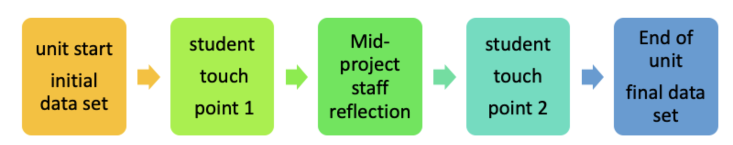
HOW IT WORKS: 1 Design

Slide 16
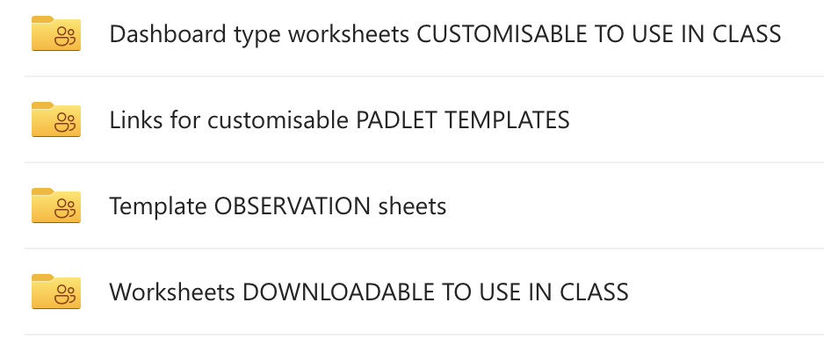
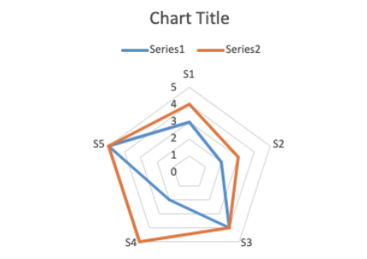
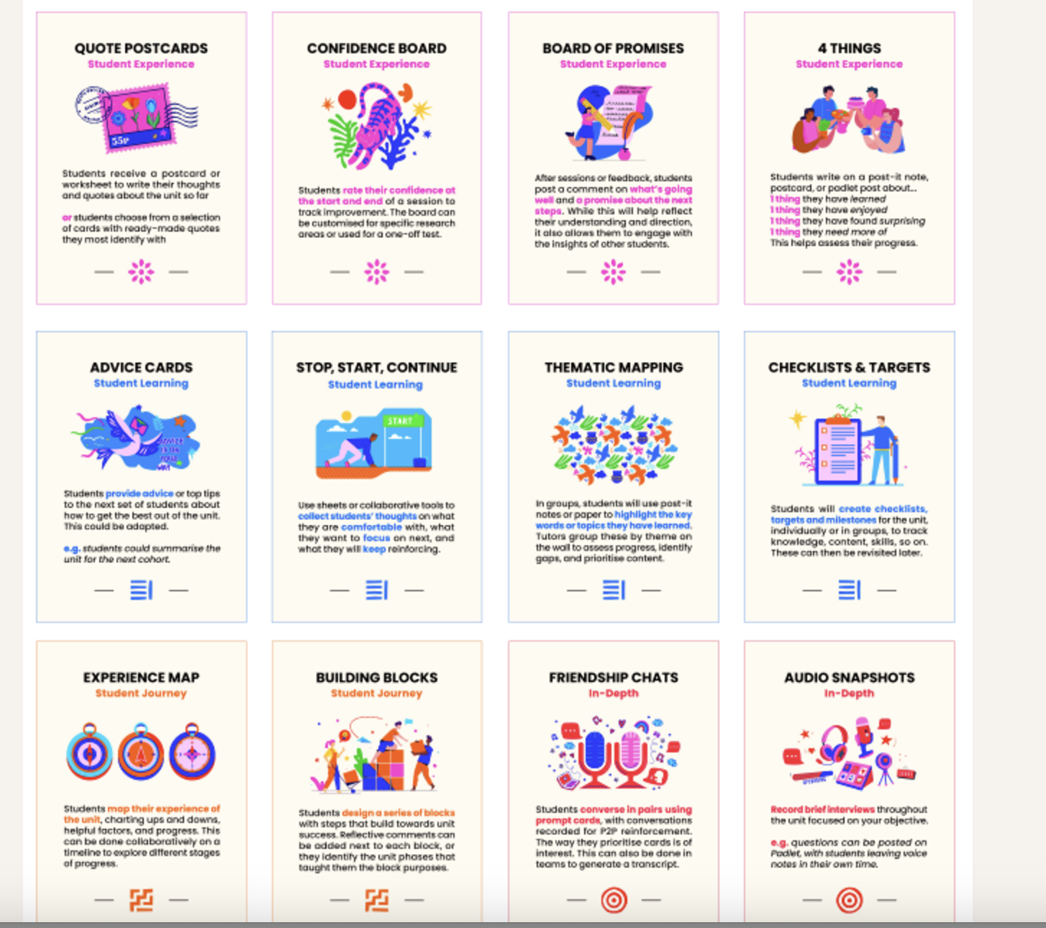
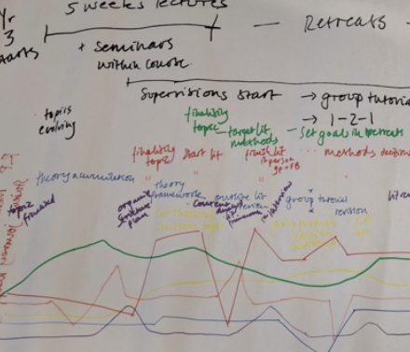
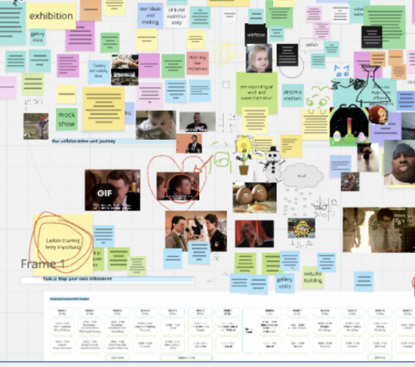

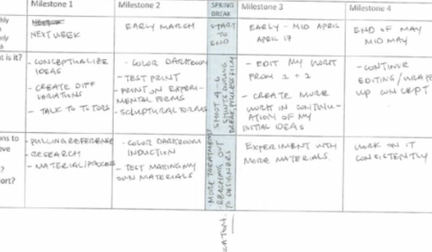
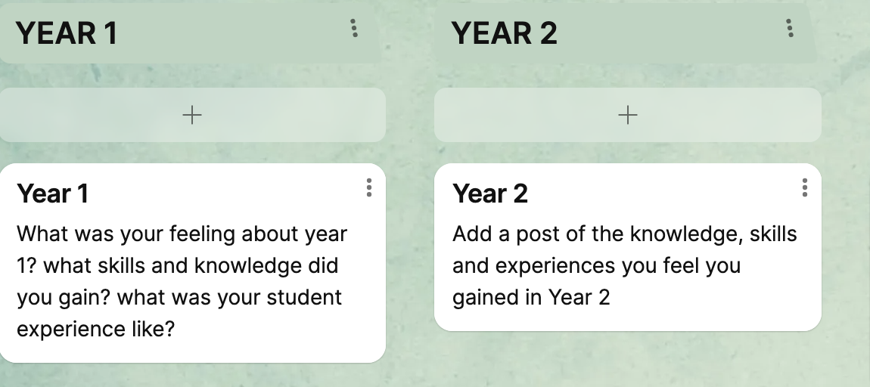
HOW IT WORKS: 2 Qualitative Touchpoints
Notes:
We also use additional data like tutorial records, attainment data, course- level statistics etc.

Slide 17
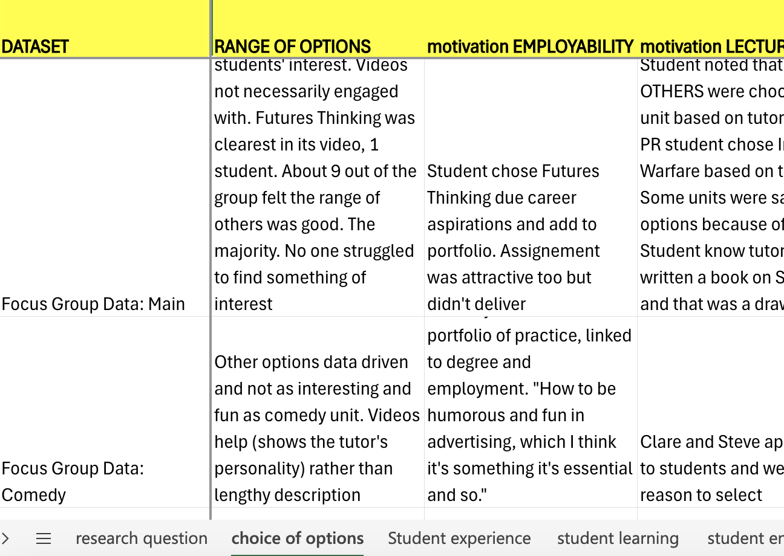

HOW IT WORKS: 3 Analysis

Slide 18
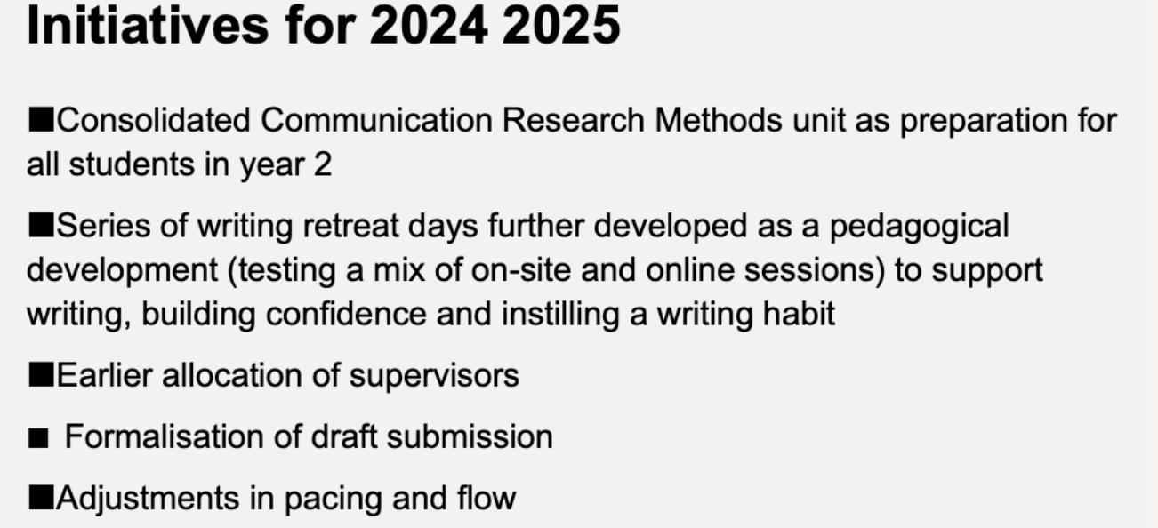
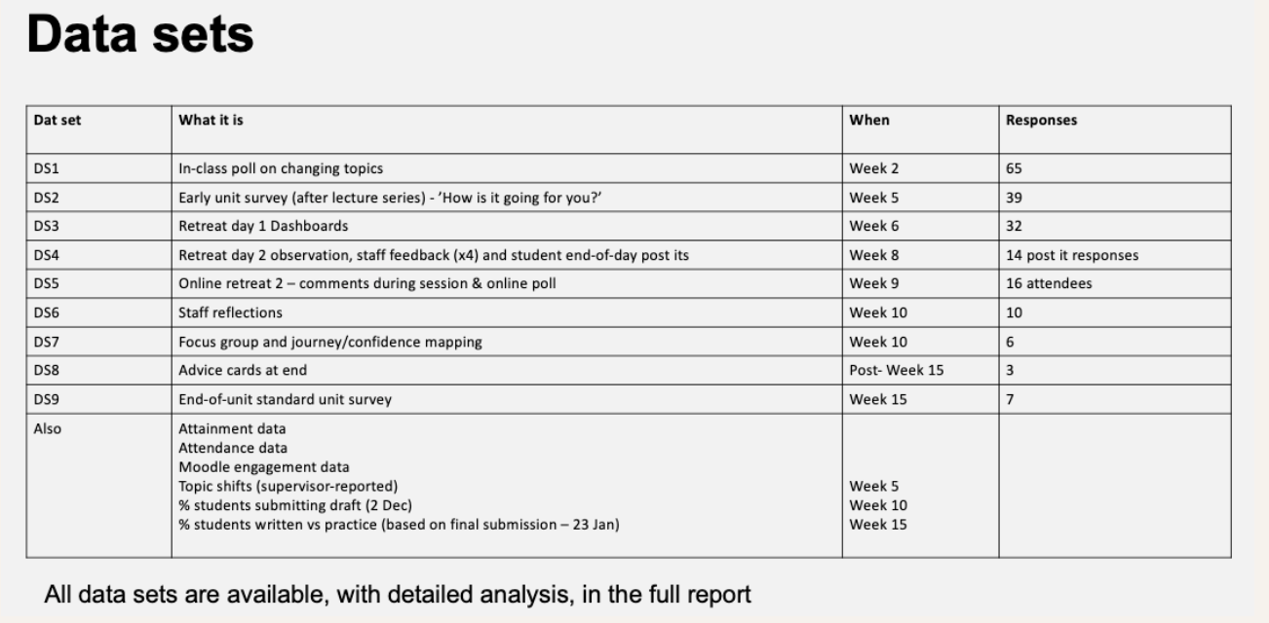
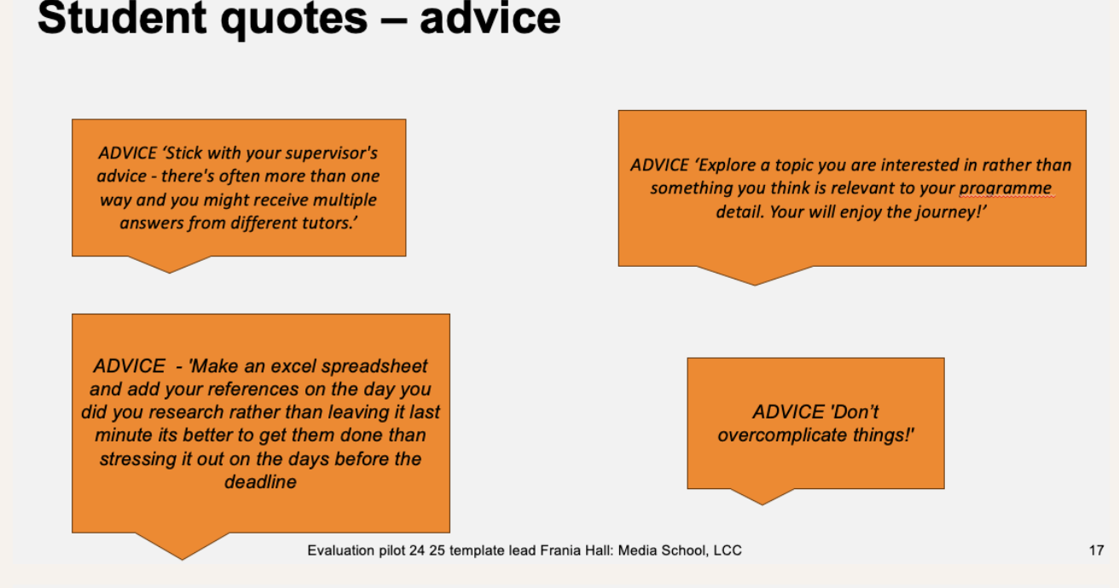
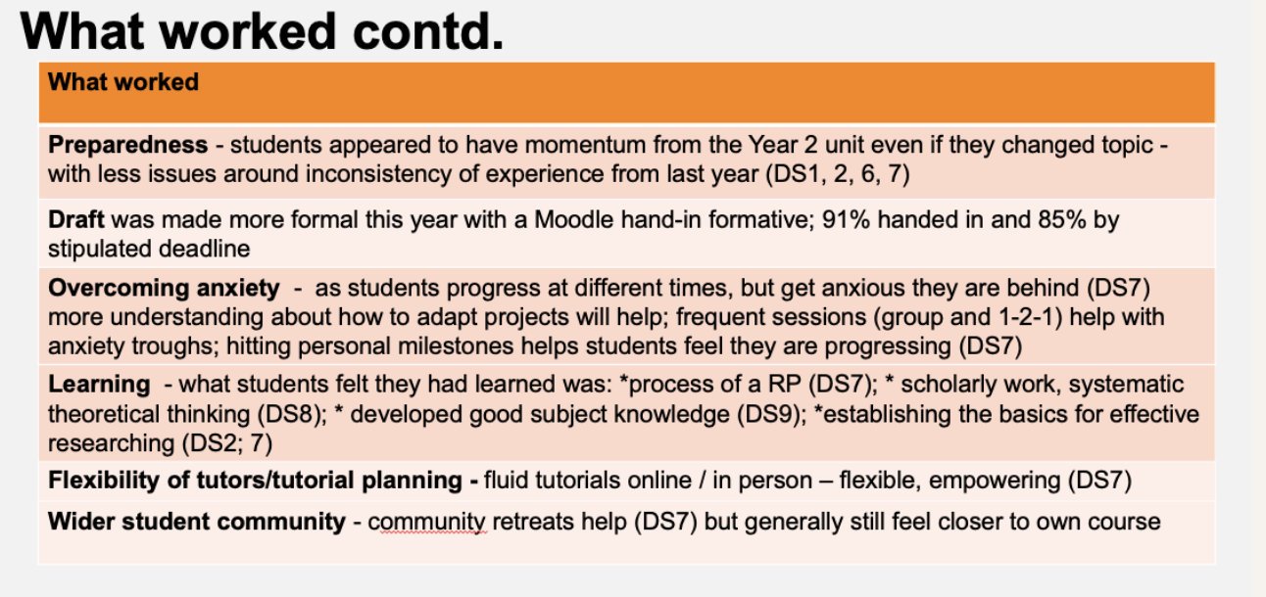
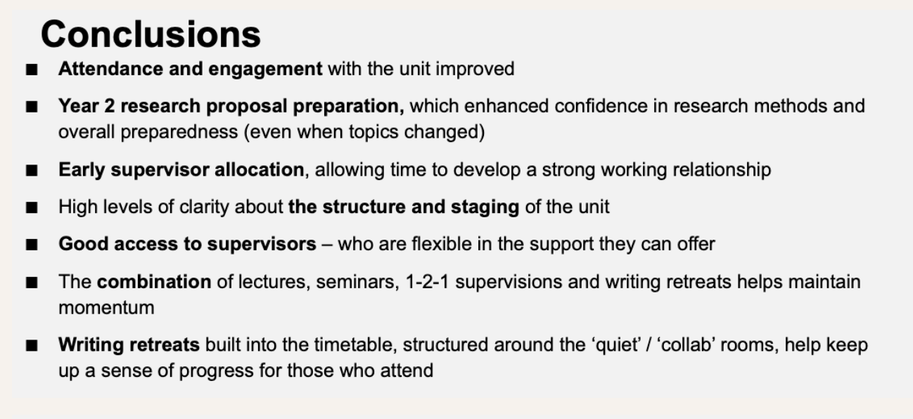
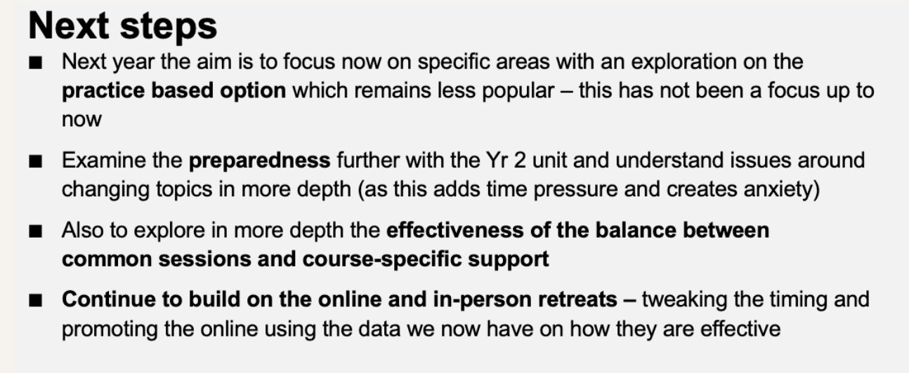
Evidenced best practice

Slide 19
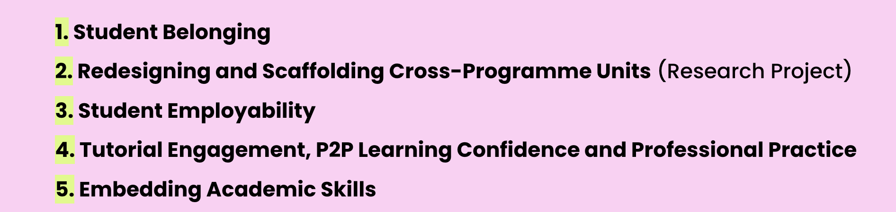
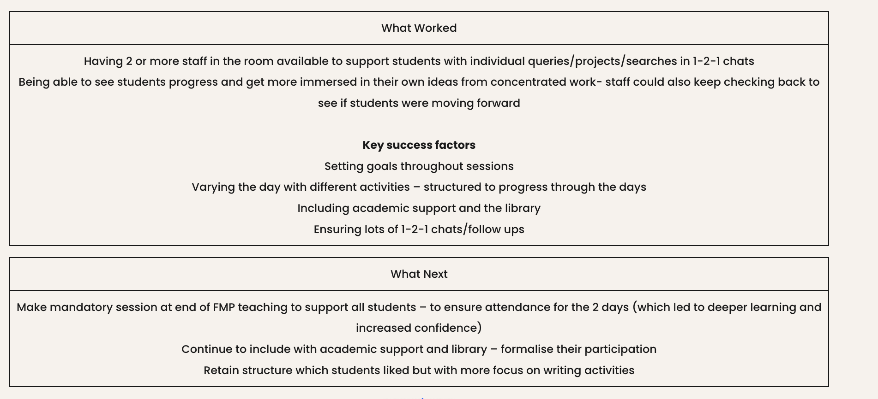
Summaries - Finding new ideas
THEMATIC
SUMMARIES

Slide 20
Example projects
New Option units Media Comms (200 students yr 3) – understanding intellectual challenge and student satisfaction
Creative Foundations unit (200 students yr 1)– student learning around creativity & cross-course working
Situated Practices– BA Photography (80 students yr 2) - co-creation mapping student journey
Photofictions BA Photography (80 students yr 1) - growth mindsets/personal efficacy, sustained working and confidence
Research project (200 students yr)– assessing iterative developments, student journey and experience, and writing retreat model
Photography Zine Project (15 students) – community building and student engagement

Slide 21
Example: Advice Cards and Learning
Students reflect on what they have learned
Advice for next student can be used with new cohort – in their own voice
ADVICE ‘Stick with your supervisor's advice - there's often more than one way and you might receive multiple answers from different tutors.’
DO NOT LEAVE EVERYTHING TO THE LAST MINUTE. Give urself a deadline a week before actual deadline and GET IT DONE LITTLE SLACKER. Go to the darkroom bar after to celebrate (everyday). Borrow as much equipment as u can from the kit room and do all ur inductions asap. ALSO GET EQUIPMENT FUND IF U CAN!!!!!

Slide 22
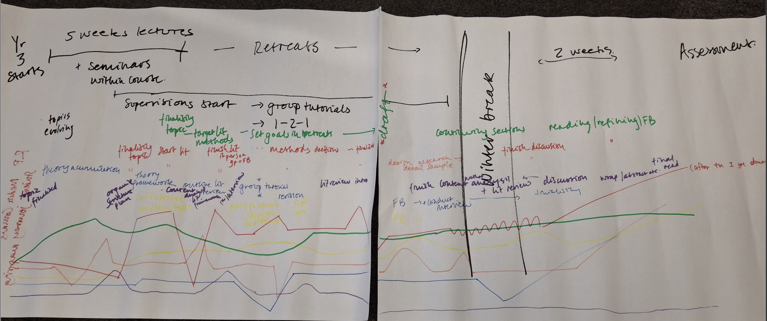
Example: Pain points on the journey
This helps chart bottlenecks, moments of anxiety etc, and students reflect on their own processes of learning, discuss improvements as they map

Slide 23
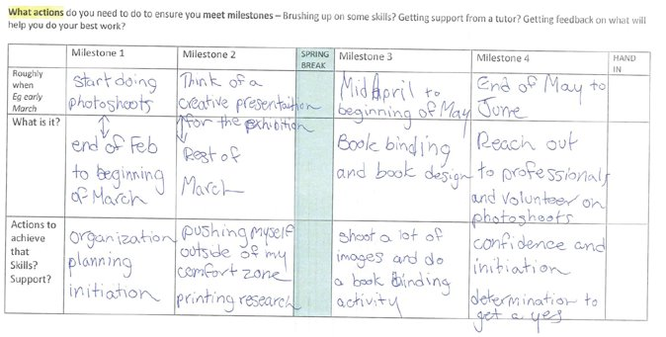
Example: Road map to assessment
Collaborative planning exercise in Miro leads to personal milestones chart
Seeing how students break down and sustain a long project

Slide 24
Partnership approach
Co-creating progress of units with students
Engaging students in reflection and conversation
Making evaluation helpful now
Embedded into student journey of unit/session
More inclusive data gathering
Developing learning literacies
Above all avoiding surveys

Slide 25
Impacts
Enhancing units that encompass around 700 students – sustained improvements
Attainment and engagement indicators improved
Reach and inclusivity – eg 182 points of feedback from students across the various touch points
Building detailed evidence-base of what works via blog to share best practice
Recognising the innovative work staff do

Slide 26
Wider picture
Local-level evaluation dovetails institutional evaluation
OfS focus on developing self-evaluation processes
Dynamic evaluative processes (Mazzucato, 2025)

Slide 27
References
Nygaard, C., Belluigi, D.Z., 2011. A proposed methodology for contextualised evaluation in higher education. Assessment & Evaluation in Higher Education 36, 657–671. https://doi.org/10.1080/02602931003650037
Mazzucato, M., 2025. The Public Value of Arts and Culture. UCL Institute for Innovation and Public Purpose.
Parsons, D., 2017. Demystifying evaluation: Practical approaches for researchers and users, 1st ed. Bristol University Press. https://doi.org/10.2307/j.ctt1t89h20

Slide 28
THANK YOU
Questions?
Blog - https://positiveevaluation.myblog.arts.ac.uk/
COLLABORATIONS?
I would love to hear from you
F.hall@lcc.arts.ac.uk

