Slide 1
Engaging feeling: the ‘tactile imagination’ and the landscape image
Henrietta Simson Colour and Poetry
March 2024

Slide 2
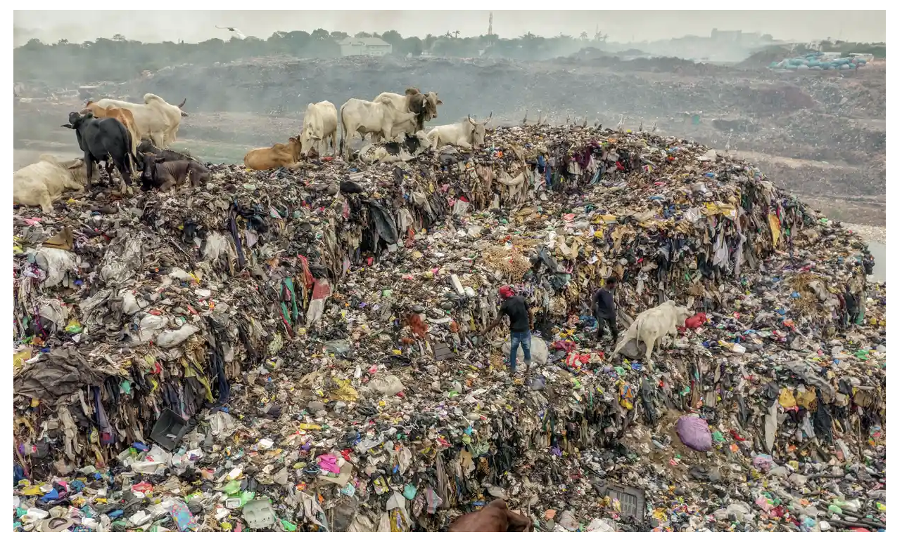
Welcome to the Anthropocene!
Clothing in landfill, Accra, Ghana, Photo: Muntaka Chasant/REX/Shutterstock

Slide 3
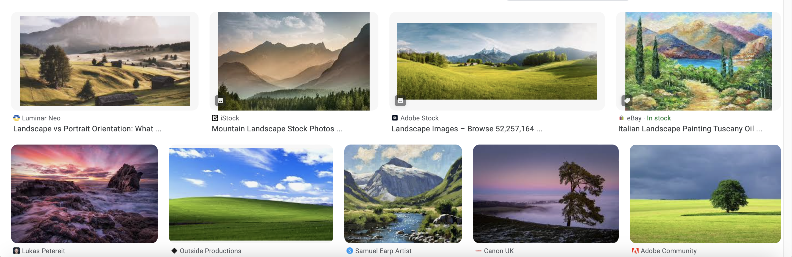

Slide 4
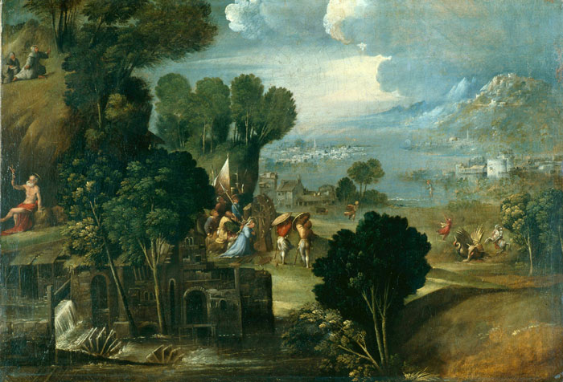
Landscape with Saints, Dosso Dossi, 1530c., Pushkin Museum Moscow, oil on canvas

Slide 5
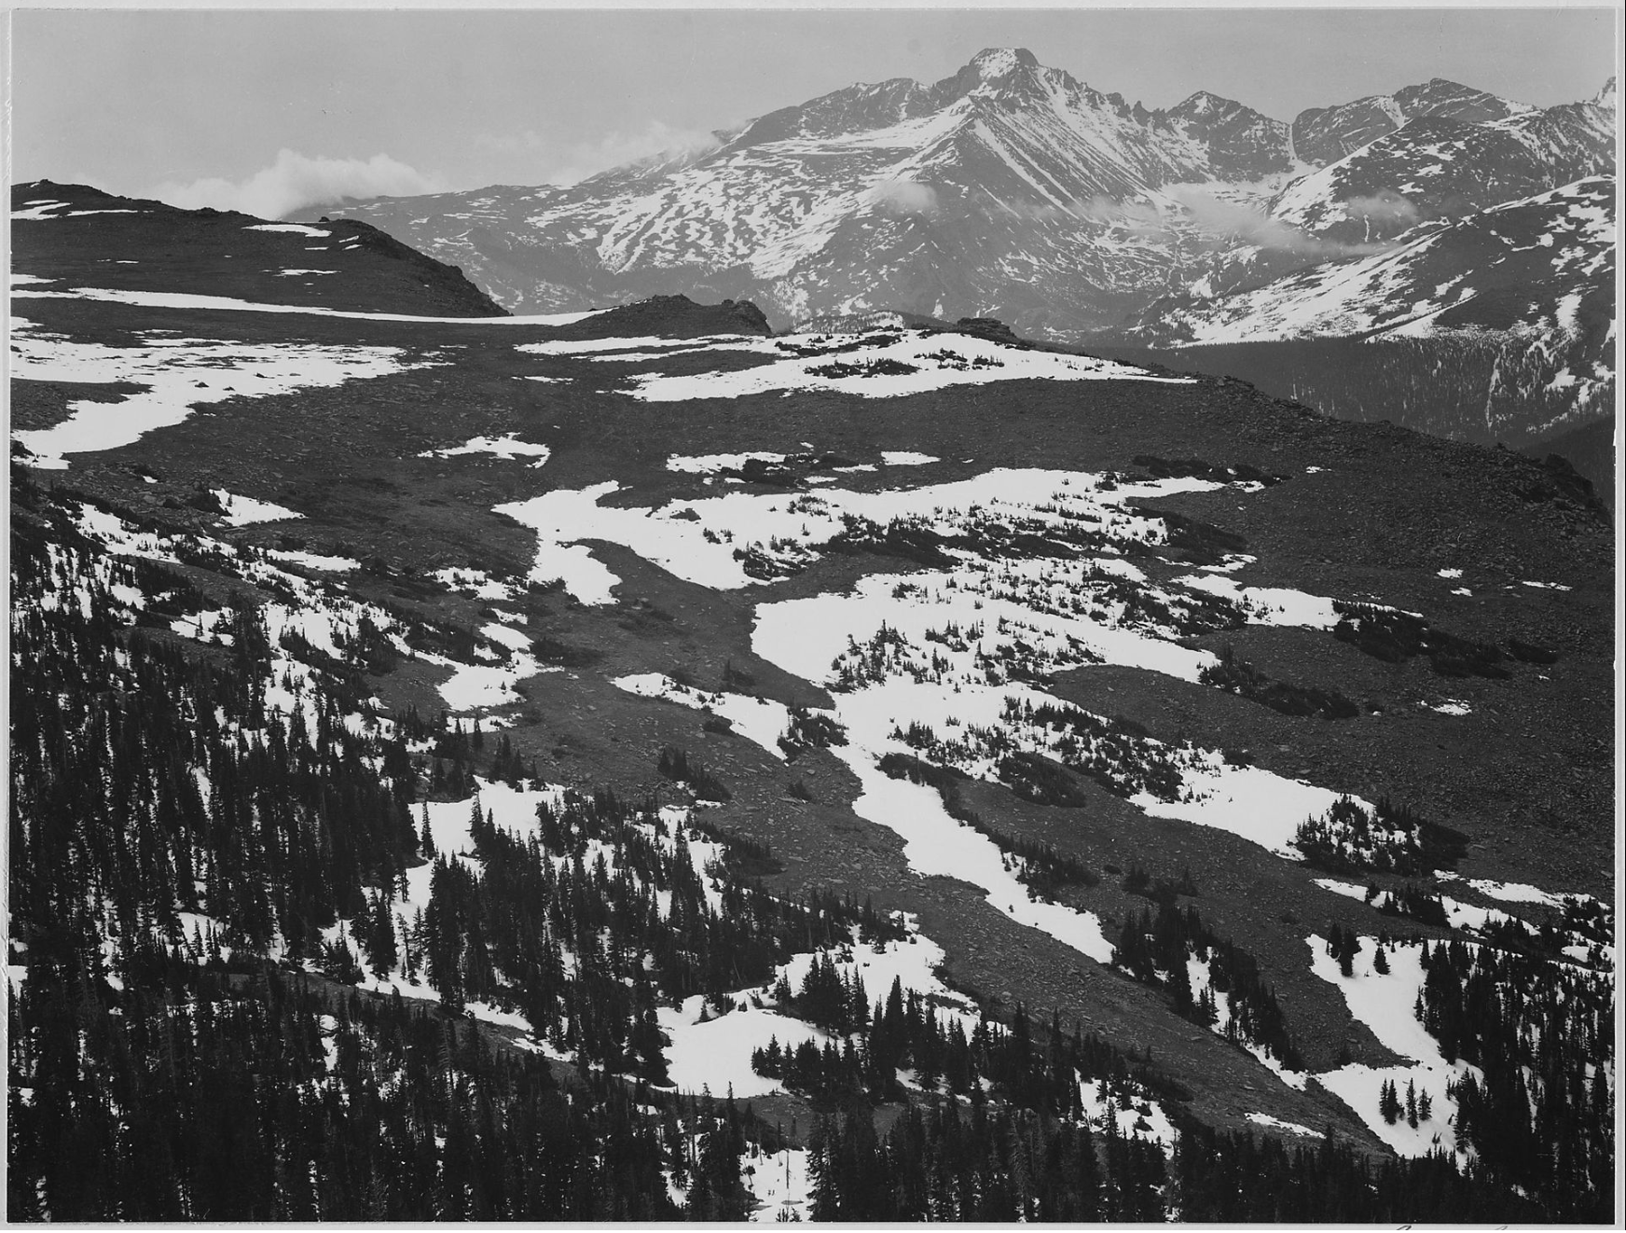
Ansel Adams, View of plateau, snow covered mountain in background, “Long Peak, Rocky Mountain National Park,” Colorado, 1941-42

Slide 6
“We know the representation is not reality; and yet to a point we react to it as if it were real.”
Christopher Wood, The Art Bulletin 77, no. 4 (December 1995), 678.

Slide 7
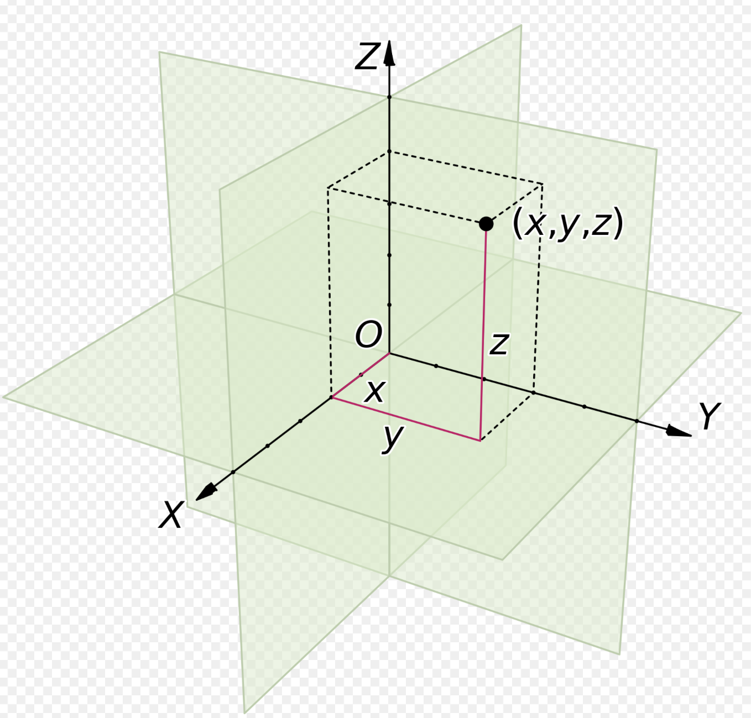
Descartes’s three-dimensional system of coordinates, res extensa

Slide 8
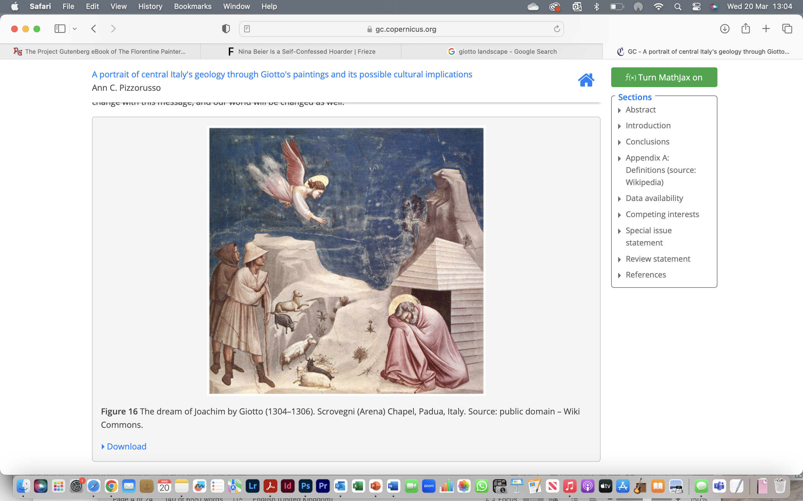
Giotto, Joachim’s Dream, (1304-06) Arena Chapel, Padua

Slide 10
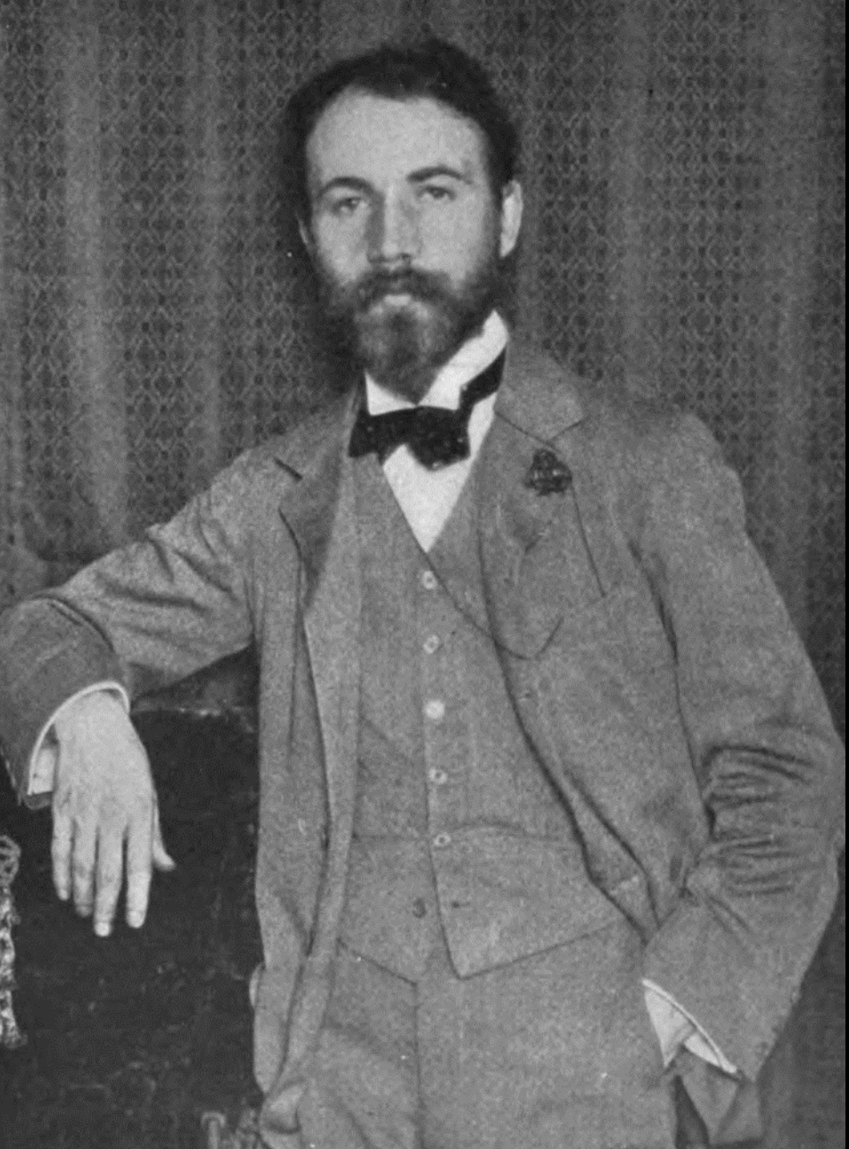

Slide 11
“[To] stimulate our consciousness of tactile values, so that the picture shall have at least as much power as the object represented, to appeal to our tactile imagination.”
Giotto, Joachim’s Dream, (1304-06) Arena Chapel, Padua

Slide 12
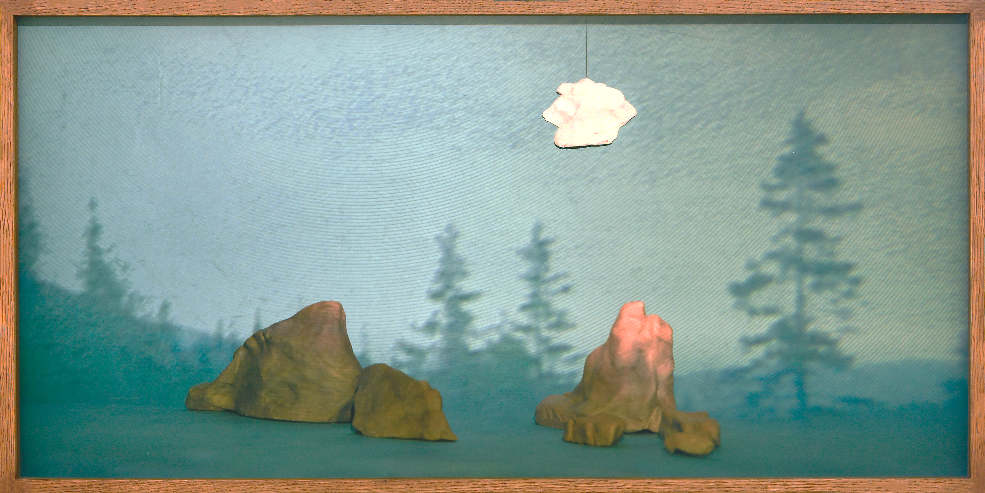
Henrietta Simson, The Artificial and the Real, 2018-22, 48 x 94.5cm, archival digital print on paper and wooden frame

Slide 13
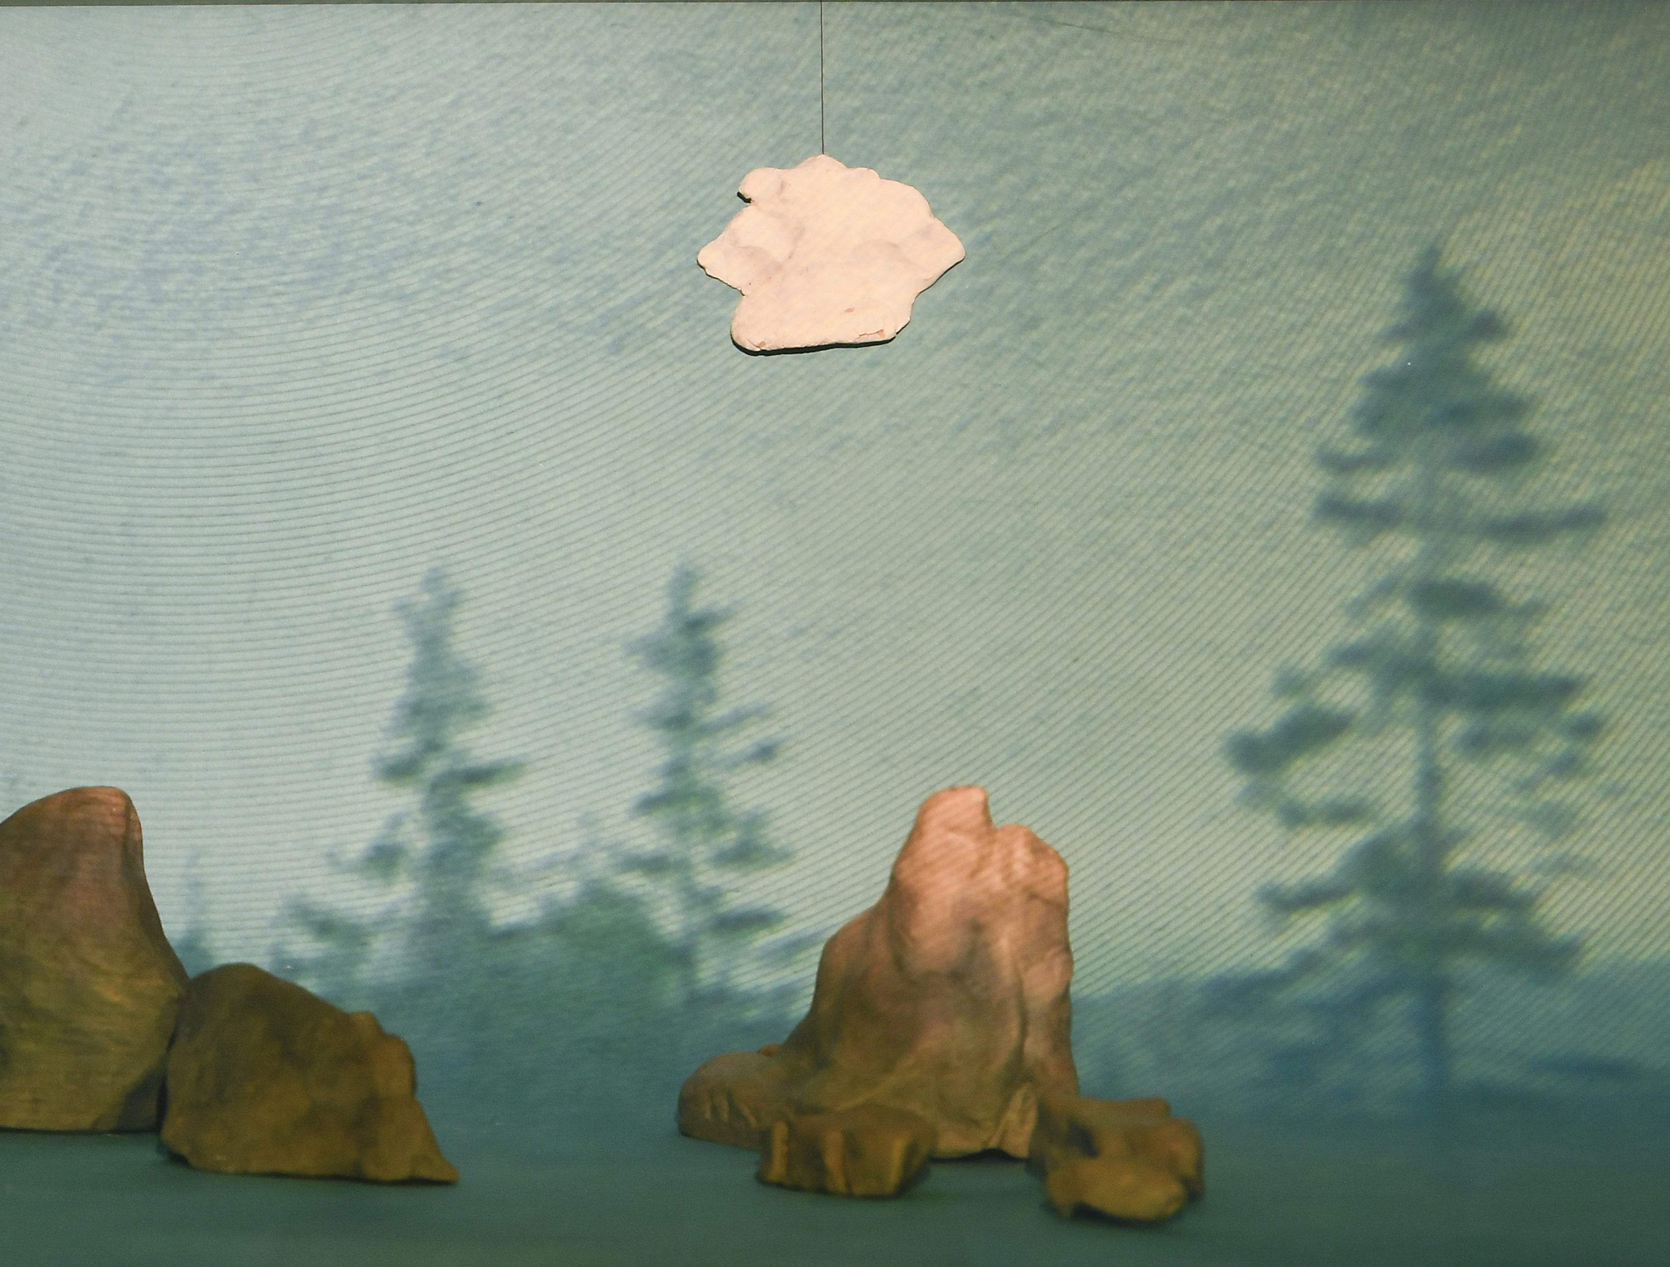
“tactile values to retinal impressions”

Slide 14
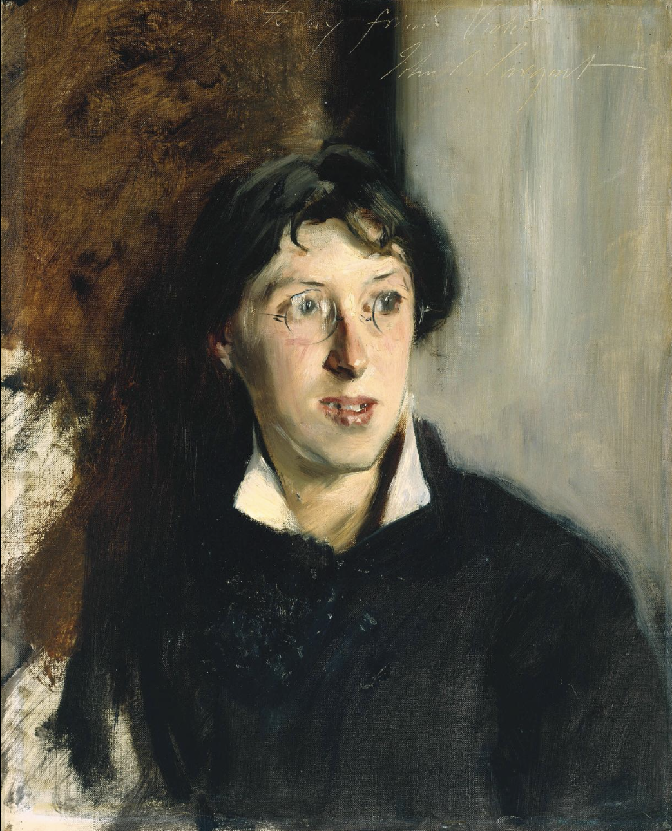

Slide 15
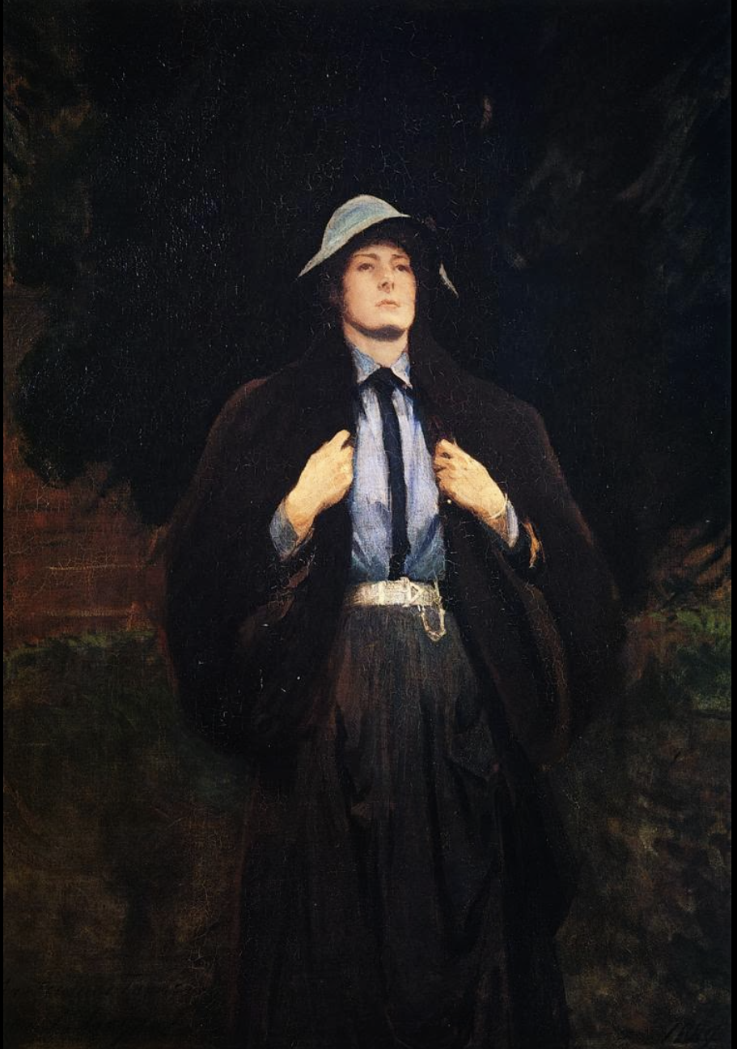

Slide 16
“[F]irst, all vivid perception is due to the conversion of ocular impressions into feelings of bodily activity; second, such bodily activity produces a sense of living in those who experience it; and third, painting having the means of producing such a condition by processes more direct, more efficacious and more economical than those of reality, possesses the power of enhancing the sense of our own vitality.”
Vernon Lee, quoted in Joseph Bristow, “Vernon Lee’s Art of Feeling,” 127.

Slide 17
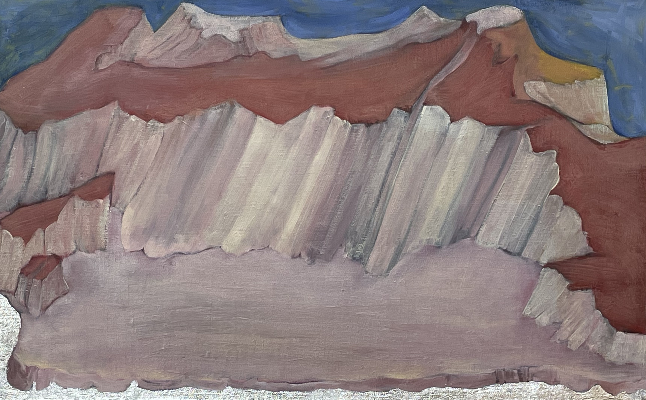
Henrietta Simson, Red Wilderness, 2021, 73x46cm, oil and metal leaf on linen

Slide 18
“Attending to paintings [from the past] is the product of naming rather than looking. This is the most primal, unavoidable, and irrevocable loss. What does not fall within the purview of established schemes stays in the remainder, always on the outside of the framing propensity of language. That absence is then deepened by time’s distancing. Language makes vanish what it first sought to preserve: the compelling visuality of the work of art.”
Michael Ann Holly, “Patterns in the Shadows,” in InVisible Culture: An Electronic Journal for Visual Studies 1 (Winter 1998)

Slide 19
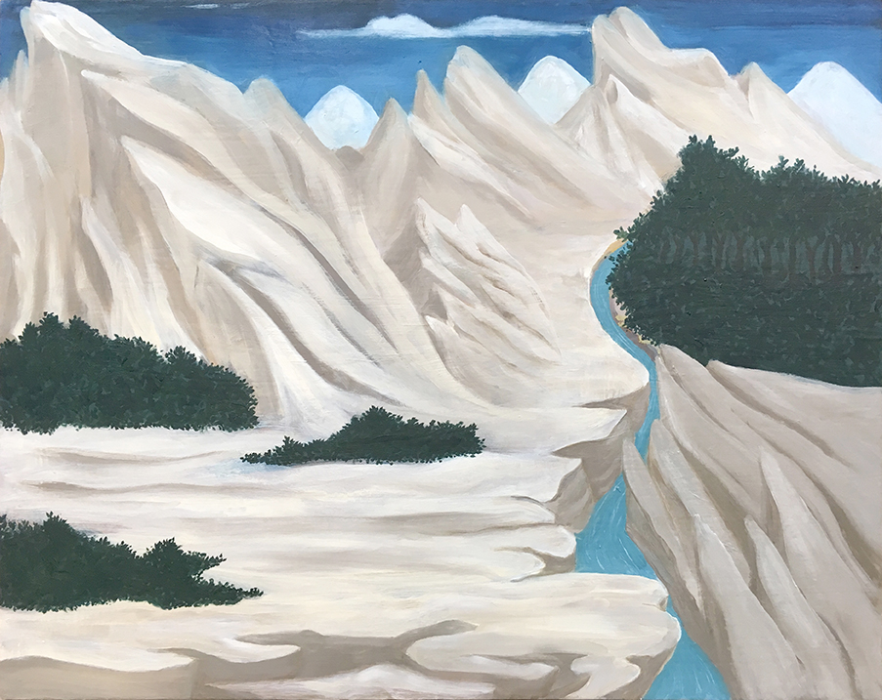
Henrietta Simson, Wilderness Landscape
(Weight of the World), 2018, 30 x 45cm, oil on gesso panel

