Slide 1
Lightbot Origins: From Comenius to the Post‑Flash Era
Thom Kaczmarek – Senior Lecturer in Games Design at London College of Communication, University of the Arts London
Notes:
My name is Thom Kaczmarek, Senior Lecturer in Games Design here at LCC, and my MA project was titled Lightbot’s Origin and Legacy

Slide 2
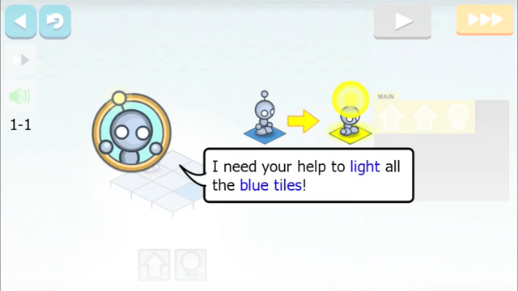
What is Lightbot?
Lightbot is a “shared” title for a series of four programming games developed by Danny Yaroslavski using Adobe Flash technology. We used the 2013 version to teach programming concepts, such as functions and sequential logic.
light-bot (2008)
Lightbot 2.0 (2010)
LightBot (2013)
LightBot Jr (2014)
LightBot (2013) Trailer Lightbot Inc | Screenshot

Slide 3
But why?
Notes:
You may ask, but why should designers program?

Slide 4
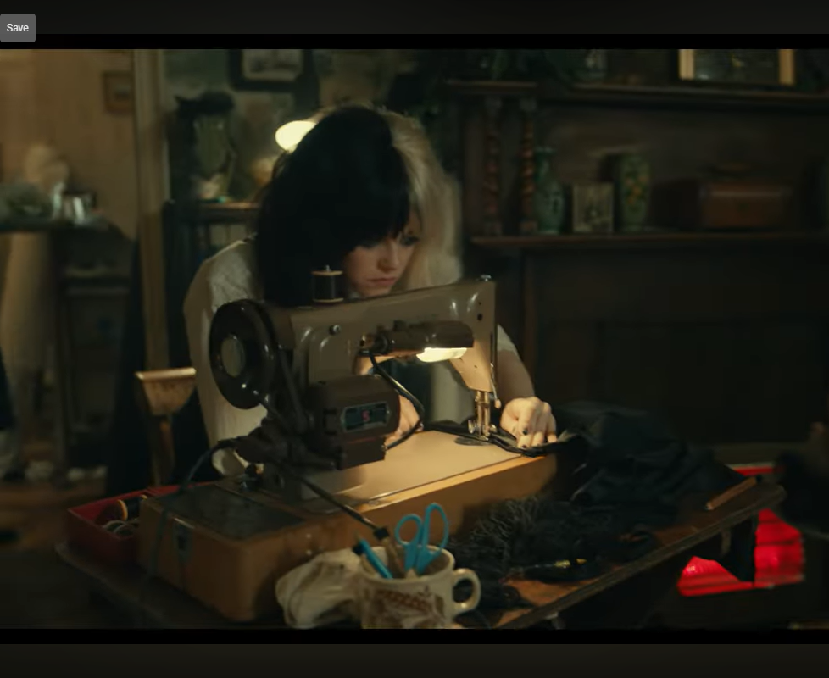
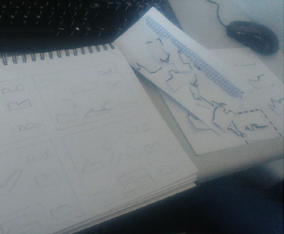
Should designers program?
Should Fashion Designers tailor their garments? Should writers edit their books?
Being able to do it gives you more creative control.
And in a digital society, a paper prototype alone may not be sufficient to prove your idea, so we also teach our students how to program.
Cruella (2021) Disney | YouTube
Notes:
Let me rephrase it.

Slide 5
Inspiration
Notes:
1

Slide 6
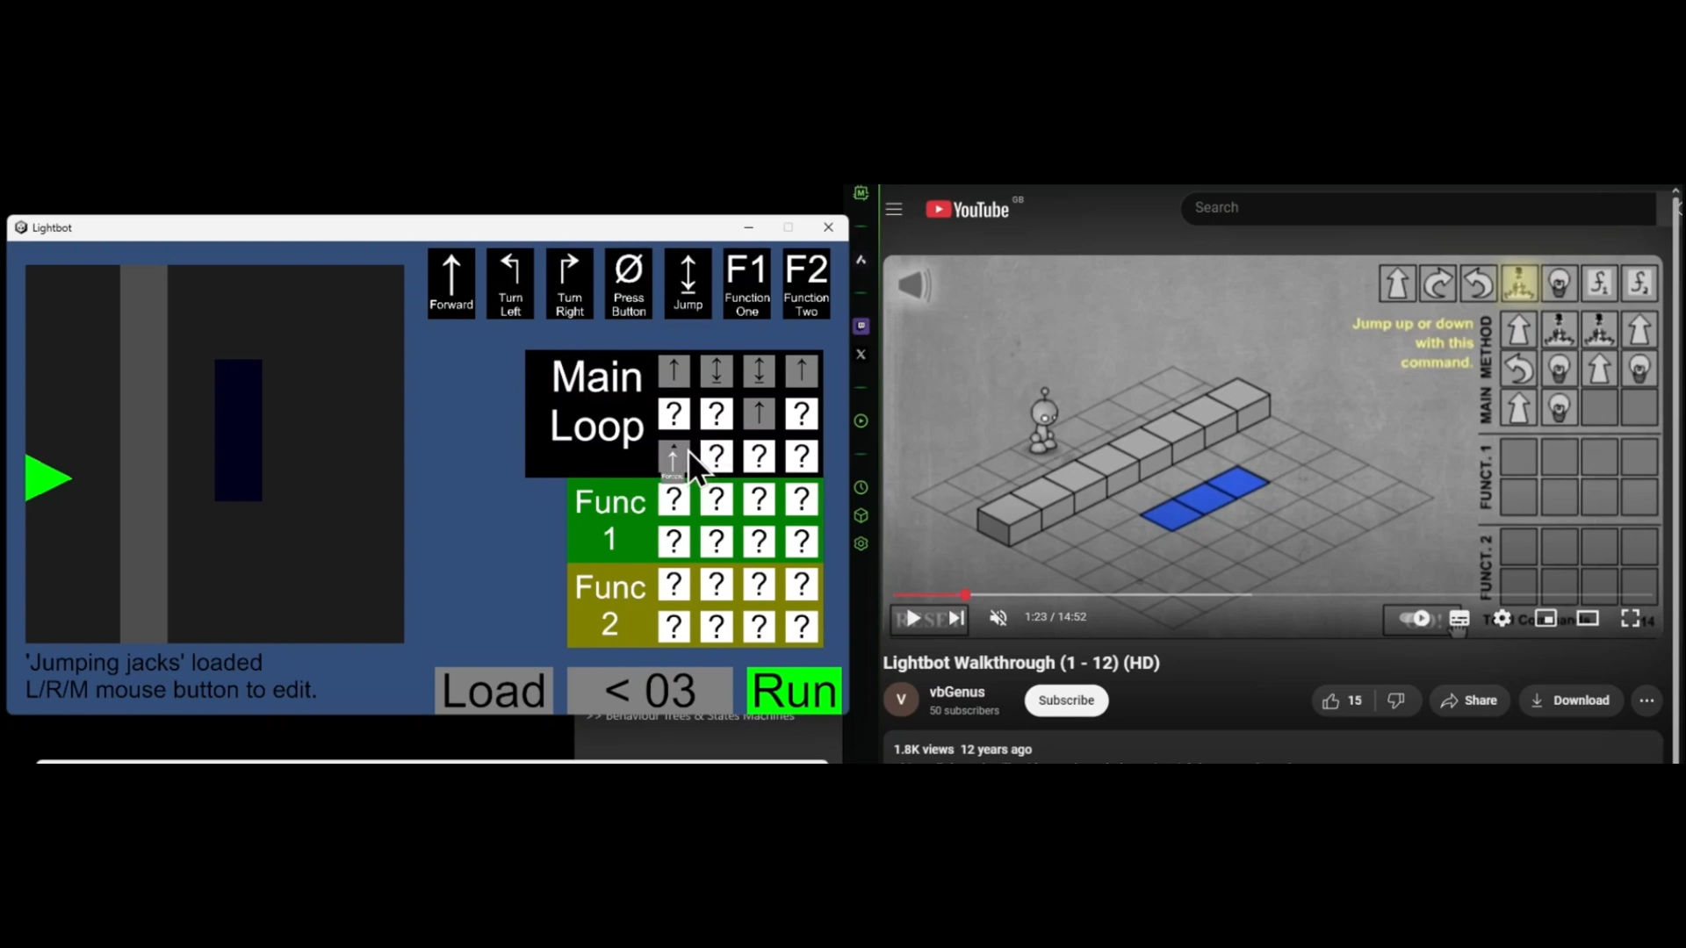
Notes:
A significant amount of game design practice is researched and disseminated through playable artefacts, authored by individuals from conflicting schools of thought, with diverse goals:
Game Development (making games)
Gamification (applying game mechanics to a non-game context)
Game-Based Learning (utilising a game to teach a concept)
Game Studies and Archaeogaming (researching games as cultural artefacts)
This MA explored all four perspectives, ultimately focusing on the game studies/archaeogaming angle.
https://ual.cloud.panopto.eu/Panopto/Pages/Viewer.aspx?id=0b44e70c-6b2c-4126-adc9-b27f011ddfb8

Slide 7
Origins
Notes:
1.30
By looking at the origins and legacy of the Lightbot series I wanted to utilise archaeogaming, a subset of media archaeology as "a way of studying recurring cyclical phenomena [of gamification and game based learning to teach programming] that (re)appear and disappear over and over again in media history, somehow seeming to transcend specific historical contexts" (Huhtamo, 1997, p.222)

Slide 8
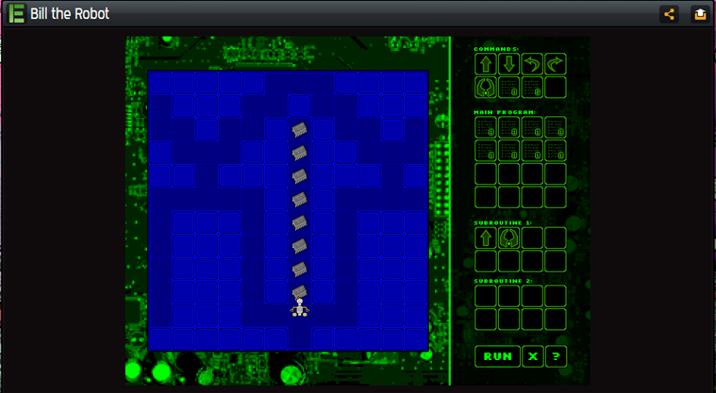
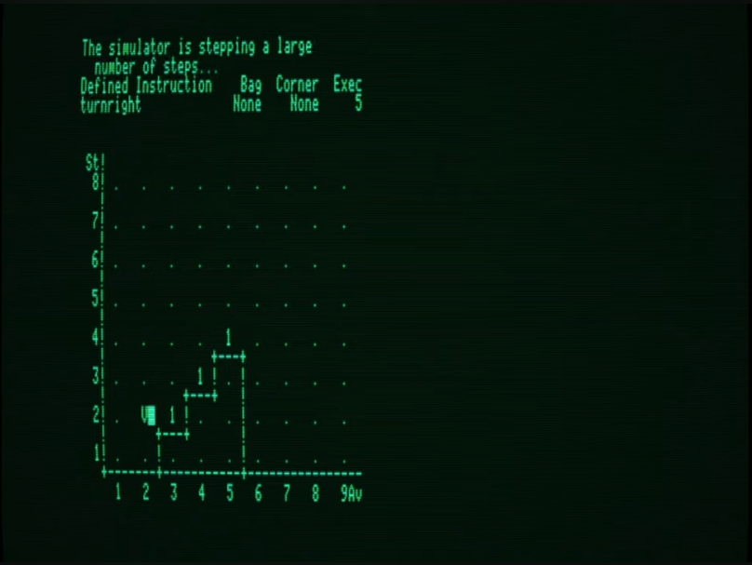
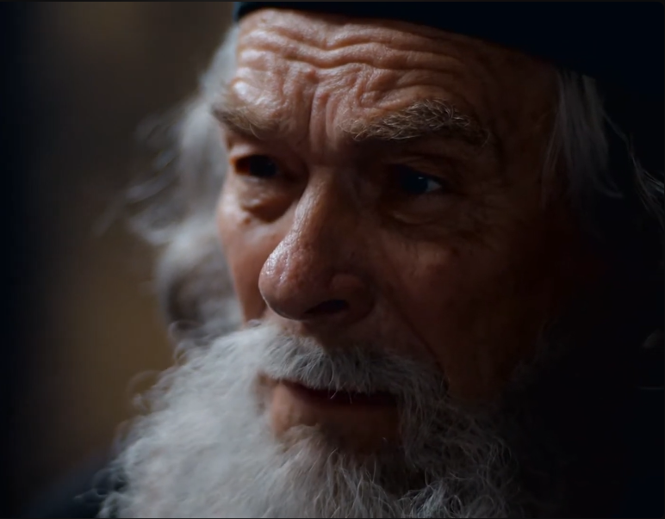
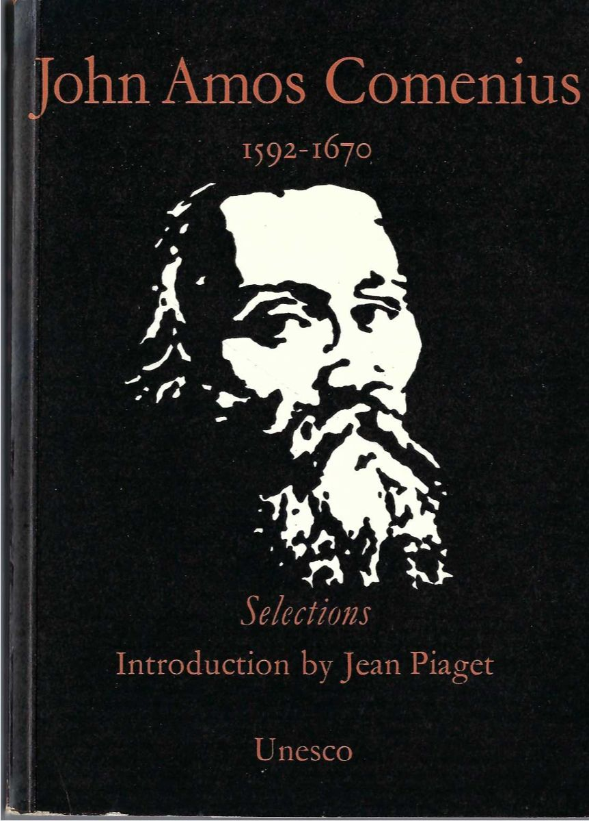
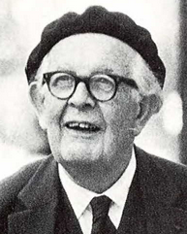
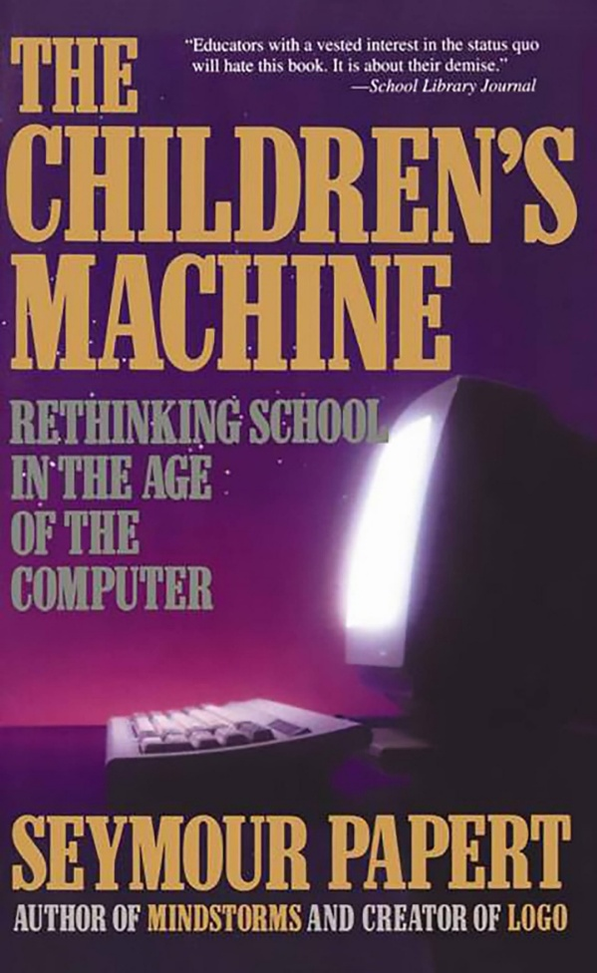
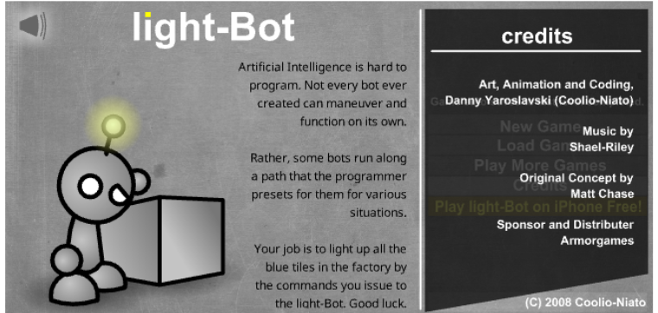
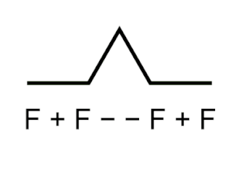
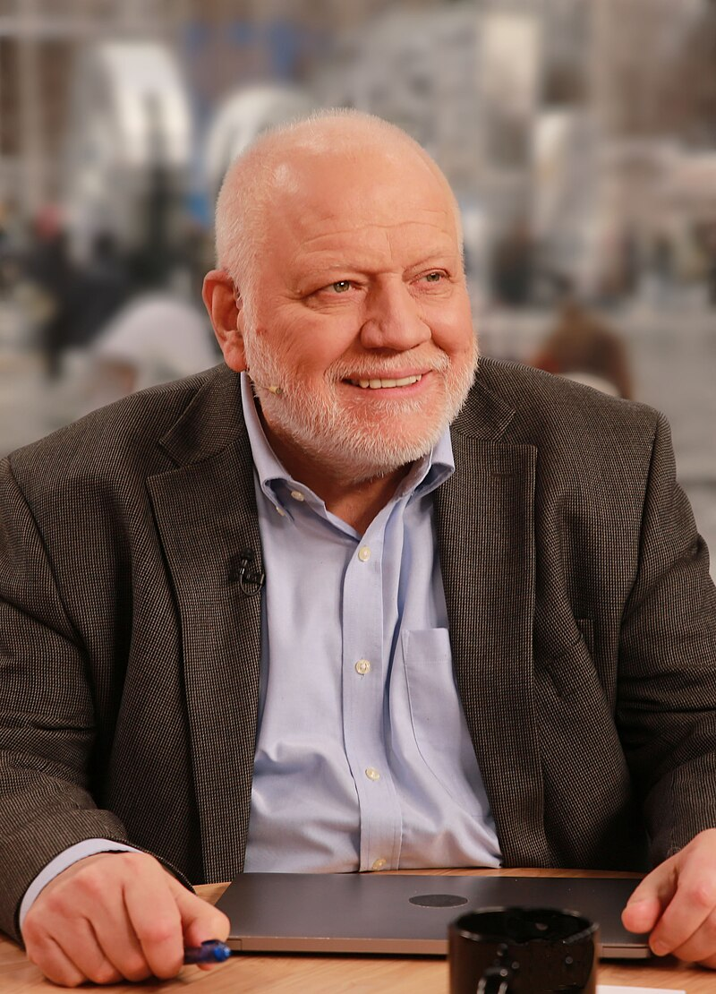
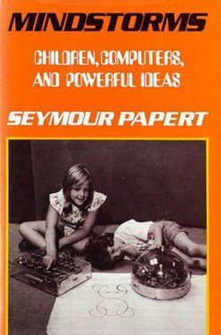
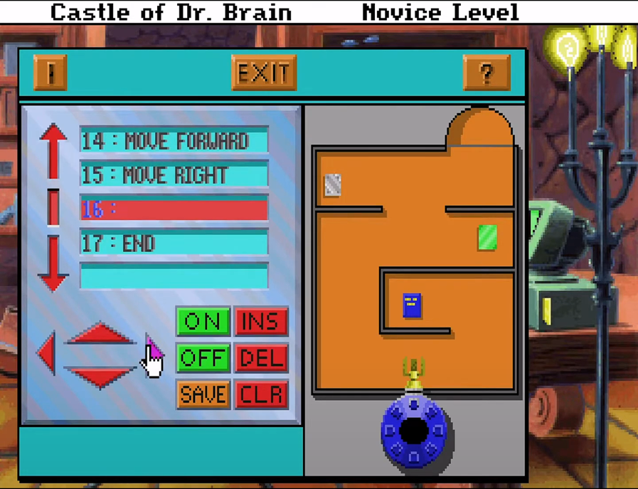
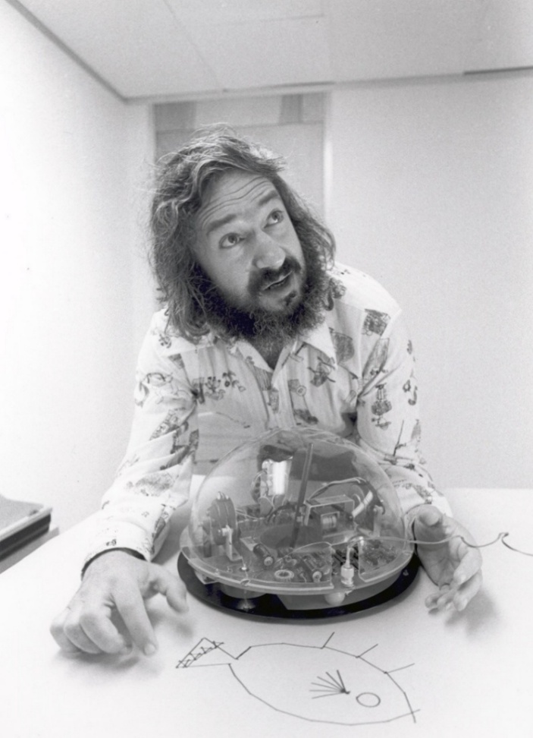
Comenius (1630-1680)
Piaget and Papert (1958-1962)
Karel the Robot (1970s-1980s)
Bill the Robot (2004)
Seymour Papert and Us (2017)
UNESCO (1957)
Logo Programming (1960s)
Dr Brain Series (1990s)
Light-bot (2008)
8
Notes:
Comenius was a 17th-century Czech Academician, contemporary of Bacon and Descartes. He is considered the godfather of the modern educational system and Gamification. His post mortem Spilegium didacticum (1680) introduces mathetics (art of learning).
Further reading led me to Piaget's introduction to selections of works of John Amos Comenius written for UNESCO in 1957. John Piaget, was a pioneering Swiss psychologist, who inspired passion for educating the youth in others – this include Seymour Papert with whom he worked between 1958 and 1962 at University of Geneva.
Alexei L. Semenov, in his 2017 memoir of Seymour Papert, stated that Papert was the one who not only introduced him to the works of Comenius, but also revived the Comenian concept of Mathethics (the art of learning) as an alternative to Didactics in his works such as Mindstorms (1980) and The Children Machine (1983)
Furthermore Logo programming was developed at MIT by Seymour Papert, a South African mathematician and computer scientist, as a way to transition from traditional instructionist lecturing to a more constructionist approach, where students co-create their knowledge with computers as objects to think with.
As I was doing deeper research I discovered Karel the Robot, a student-developed software from the 1970s, published in 80s (Pattis, 1981), designed to help students learn Pascal programming as an alternative to LOGO.
In 2004 Matt Chase developed game Bill the Robot (2004). The game was inspired by programming Robot puzzles from Dr Brain series. And it was developed as a teaching tool to help high school students differentiate between rotation and directional movement in Logo Programming.
This is a missing link between the modern GBL research into Lightbot series and educational theory.
The 2008 light-Bot lists Matt Chase as the creator of the original concept, however later entries in the series, do not mention him at all.

Slide 9
Findings
Notes:
5

Slide 10
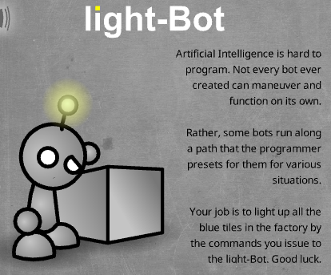
Misnomers
Examining the Lightbot Series was challenging due to the presence of misnomers related to the games title, as discussed in the materials being researched, for example:
“Light Bot 2.0”, "LightBot”, and "Light Bot” are used in three consecutive sentences by Christian and Mathrani (2014, p.3)
If you just look at names, they refer to 2010, 2013 and 2008 entries – but only one of those was the sole focus of their research.
light-Bot (2008) Menu Danny Yaroslavski | Screenshot

Slide 11
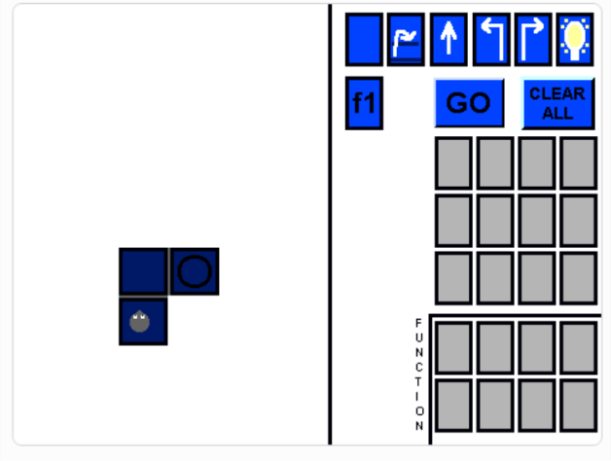
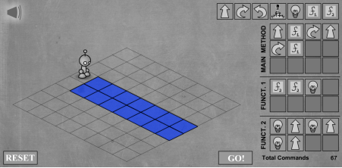
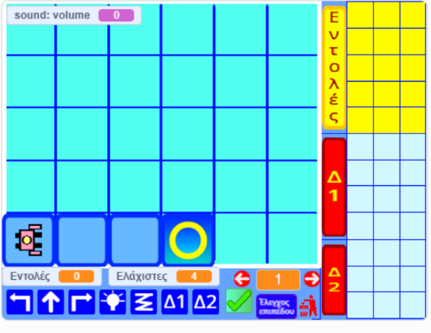
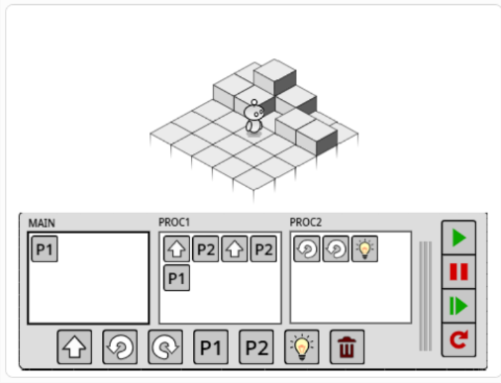
Fallacy of Lightbot Scratch Duality
The Lightbot series is often compared against Scratch (a rightful heir of LOGO). However, this is a fallacy, as Scratch is a game engine.
Despite being targeted at children, it is advanced enough to enable the recreation of the light-Bot game in full, with various examples already existing, as pictured.
Top Left light-bot (2008) right LDNG (2014); bottom left raf-pan (2021) right ikarienator (2020) Thom Kaczmarek | Screenshots

Slide 12
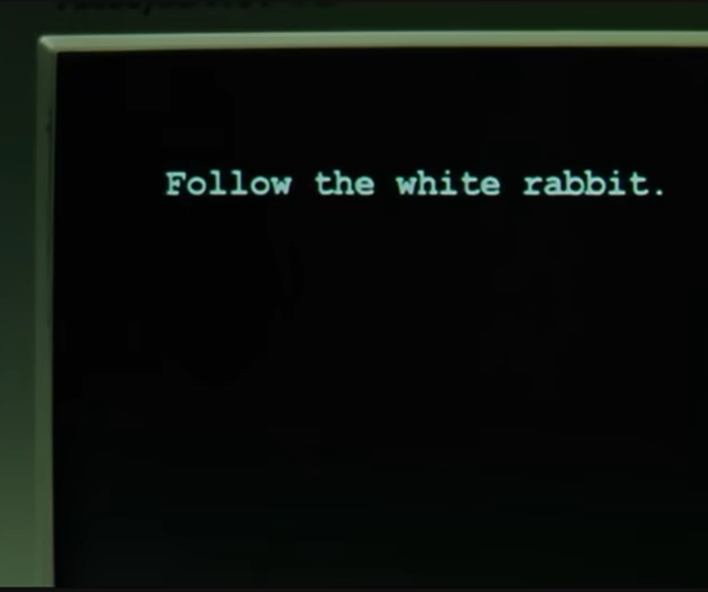
Constructionist Origins
The unexpected direct historical link between the origins of the Lightbot series and constructionist theory is the most significant finding.
It illuminates why using this educational approach to teaching programming leads to such positive learning outcomes.
Follow the white rabbit. Warner Bros | Matrix (1999)

Slide 13
Dissemination & Impact
Notes:
6.30

Slide 14
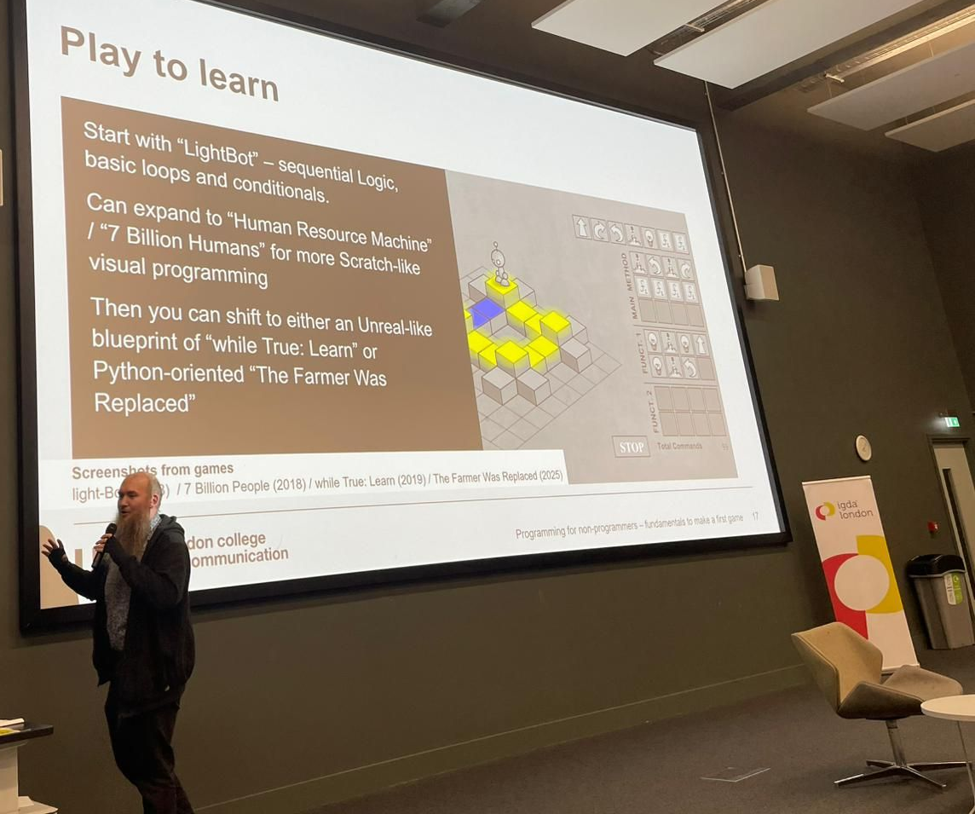

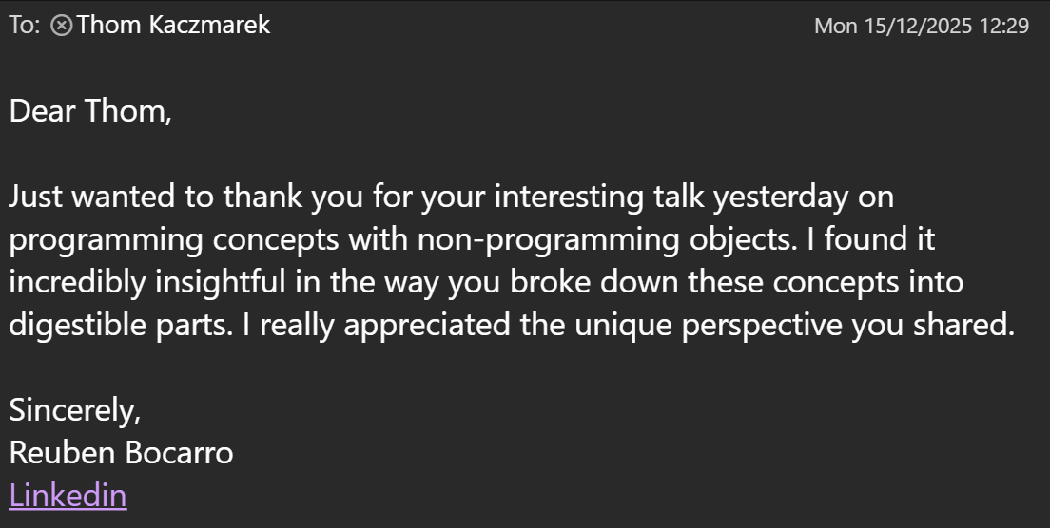
Home Students, Academics and Industry
In December, I had the opportunity to speak at the London Chapter of the International Game Development Association (IGDA London), held at London South Bank University.
The lighting talk was inspired by my MA research and focused on teaching programming, receiving positive feedback on the day due to its inclusive and unique nature.
Demonstrating programming concepts with non-programming objects IGDA London | Photo: Andrew Lemon

Slide 15
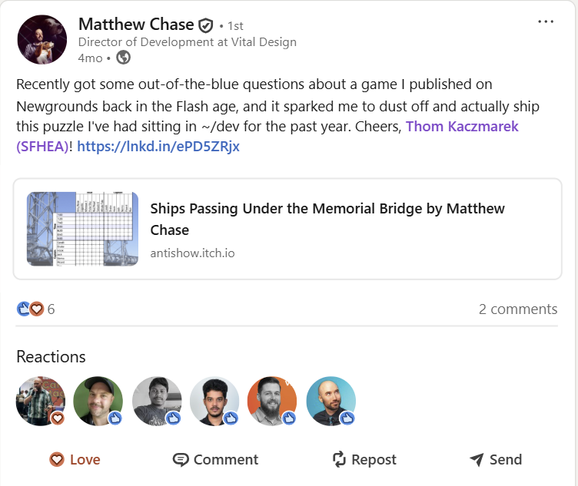
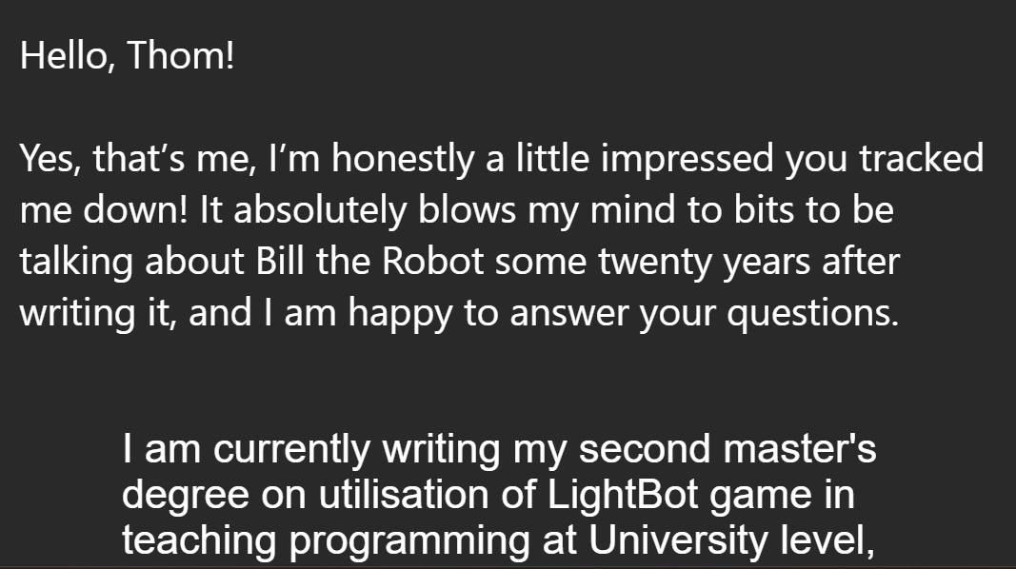
Inspiration is also Impact
As I mentioned earlier, I managed to reach out to Matthew Chase (to his surprise), author of Bill the Robot (2004), on which light-Bot (2008) is based.
This inspired him to complete and share some of his works publicly (and others privately with me, to aid in the research), which had a positive impact.
LinkedIn Chat LinkedIn | Screenshot: Thom Kaczmarek

Slide 16
What went wrong? (Desk Rejected ☹)
Notes:
6.30

Slide 17
Thank you Thom Kaczmarek – Senior Lecturer in Games Design at London College of Communication, University of the Arts London t.kaczmarek@lcc.arts.ac.uk
Notes:
Thank you for listening.

