Slide 1
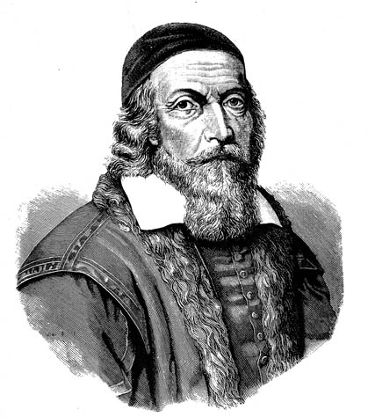
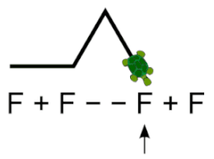


Lightbot Origins: From Comenius to the Post‑Flash Era
Thom Kaczmarek, University of the Arts London, t.kaczmarek@lcc.arts.ac.uk
Keywords: LightBot, Archaeogaming, Game‑Based Learning, Gamification, Constructionism, Mathetics
INTRODUCTION
As digital technologies have become increasingly seamless, they have also become invisible, encouraging users to overestimate their own technical competence. This gap between perceived and actual skill is particularly visible in computing, where a new divide has emerged between creators and consumers. Game development illustrates this tension clearly: players experience polished results, while developers navigate messy, iterative processes that remain largely hidden. The rise of online tutorials has further blurred the line, giving many the illusion of expertise without the depth to understand the complexities involved. These issues form the backdrop for examining LightBot, a game whose simplicity masks a rich pedagogical lineage.
CONSTRUCTIONISM AS TRANSITIONAL THEORY
Papert’s constructionism provides a conceptual bridge between passive technology use and active creation. Although technology‑neutral in principle, constructionism grew alongside the early digital age, recognising computers as uniquely powerful environments for thinking, experimenting, and building. Papert’s revival of Comenius’s term mathetics reframed learning as an active, self‑directed process, positioning teachers as guides rather than instructors. This lineage, from Comenius’s experiential philosophy to Papert’s digital constructionism, provides the intellectual foundation for many modern educational tools, including LOGO and its formal and informal descendants.
FLASH MEMOIR
The early 2000s saw the rise of Flash‑based creative communities such as Newgrounds and Kongregate, where young developers experimented freely with animation and game design. This ecosystem embodied Papert’s prediction that game creation would become part of youth culture. When Flash declined, much of this creative output risked disappearing, prompting preservation efforts like Ruffle. LightBot emerged directly from this homebrew Flash culture, and its current status, partially abandoned, partially preserved, reflects the broader challenges of maintaining digital artefacts from this era.
GAMES AS MOTIVATIONAL TOOLS IN EDUCATION
Educators and parents have long debated whether games trivialise learning, yet research consistently shows that well‑designed digital games can enhance engagement and improve learning outcomes. Early edutainment often failed because it prioritised assessment over play, but later work emphasised the importance of meaningful gameplay, feedback, and exploration. When aligned with pedagogical goals, games can support reflection, hypothesis testing, and knowledge construction. This makes them particularly valuable in domains like programming, where abstract concepts benefit from tangible, interactive representations.
PROGRAMMING EDUCATION AND COMPUTATIONAL THINKING
Programming is difficult to teach because it demands abstraction, logical reasoning, and algorithmic thinking. Game‑based approaches have been used to introduce these concepts across all educational levels, though not always with uniformly positive results; some students develop more realistic, and therefore less enthusiastic, views of their own abilities after attempting to make games. Computational Thinking has become a foundational literacy, encompassing abstraction, decomposition, pattern recognition, and algorithm design. These skills are increasingly essential in a world shaped by software, echoing early claims that programming represents a “second literacy.”
ROLE OF LIGHTBOT IN TEACHING PROGRAMMING
LightBot succeeds because it transforms abstract programming ideas into concrete, visual actions. Its robot, tiles, and icons provide a tangible environment where students can experiment with sequencing, functions, debugging, and recursion without the barrier of syntax. The game has been adopted globally, from primary schools to universities, and is recommended by organisations such as the BCS. Although LightBot cannot replace traditional instruction, it offers an accessible entry point into computational thinking and algorithmic reasoning.
LIGHTBOT IS NOT ‘REAL PROGRAMMING’, BUT IT IS MORE COMPLEX THAN ASSUMED
While LightBot is often described as limited, this research shows that it contains more computational depth than previously recognised. Its mechanics implicitly introduce Boolean logic, integer operations, conditional behaviour, and even data‑structure‑like relationships through teleports and dynamic references in the level editor. These features reveal a richer conceptual landscape than many studies acknowledge, suggesting that LightBot’s educational value extends beyond its surface simplicity.
RESEARCH METHODS
This study uses archaeogaming to reconstruct LightBot’s origins, treating digital games as cultural artefacts that can be excavated, contextualised, and interpreted. By examining legacy versions, abandoned websites, community discussions, and historical documentation, the research pieces together a lineage that spans decades of educational theory and digital practice. Although some sources are incomplete or inaccessible, this approach allows LightBot to be understood not only as a teaching tool but as part of a broader cultural and technological continuum.
FINDINGS
The historical analysis reveals a recurring cycle of ideas that reappear across generations of educational technology. LOGO established the foundation for visual, exploratory programming; Karel the Robot and later puzzle‑logic games extended these ideas; and Bill the Robot, created in 2004 to help children struggling with LOGO, provided the direct conceptual template for light-Bot (2008). The first LightBot (and interviews from its release) explicitly credited Bill the Robot author Matt Chase as its inspiration, though this acknowledgement was removed in later versions. Despite refinements, the core mechanics introduced in 2004 remain central to the series, underscoring the enduring influence of earlier educational philosophies. Earlier works discussed titles from the LightBot series and constructionism, some even grouped them together with games that form direct heritage, without ever explicitly making the connection.
CONCLUSION
By tracing LightBot’s lineage from Comenius to Papert to the Flash era, this research offers the first comprehensive account of the game’s intellectual and cultural origins. Understanding this heritage clarifies why LightBot series resonates so strongly in educational contexts and highlights the importance of preserving digital artefacts that have shaped programming education worldwide. The series stands as a testament to the longevity of constructionist ideas and their capacity to re‑emerge in new technological forms.
ACKNOWLEDGEMENT
This research was performed as part of my MA Academic Practice in Art, Design and Communication at the University of the Arts London (2024-2026), which was fully funded by my employer. Looking for PhD opportunities.
Spilegium didacticum by Comenius (1680) introduces mathetics
Comenius Selections by UNESCO (1957) with an introduction by Jean Piaget
Piaget and Papert collaborated at the University of Geneva (1958-1962)
Seymour Papert co-creation of Logo Programming (1960s)
Bill the Robot (2004)
Karel the Robot (1970s-1980s), made by a University student, was inspired by LOGO.
LightBot series (2008-2016)
Matt Chase is credited for the original concept of the first light-Bot (2008), developed in high school by Danny Yaroslavski
Matt Chase used Flash technology to develop Bill the Robot, as a tool to help teach LOGO to high schoolers
Semenov, in ‘Seymour Papert and Us’ (2017), mentions that Papert introduced him to Comenius.
Papert revived concepts of mathetics (art of learning) in Mindstorms (1980) and The Children’s Machine (1993)
Partially inspired by Dr Brain Series (1990s) programming robot puzzles
Its sequel, LightBot 2.0 (2010), adds more features but removes Chase’s credit.
The third instalment, Lightbot (2013), was developed at the University with an education-first redesign, reaching millions of students.
This is a missing link between the LightBot series and educational theory.
Danny Yaroslavski received Forbes 30 under 30 recognition in education for LightBot series.

