Slide 1
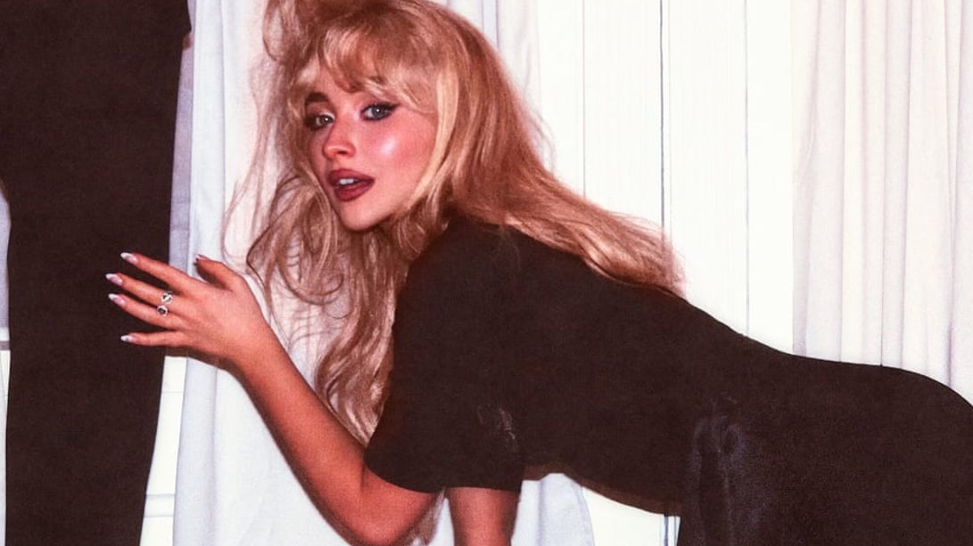
‘One is not born but rather becomes a misandrist’:
Negotiating contemporary feminist encounters from Gisèle Pelicot to Sabrina Carpenter
Dr Liza Betts l.betts@fashion.arts.ac.uk

Slide 2
An estimated 736 million women—almost one in three—have been subjected to physical and/or sexual intimate partner violence, non-partner sexual violence, or both at least once in their life (30 per cent of women aged 15 and older).
More than 640 million women aged 15 and older (26 per cent) have been subjected to intimate partner violence.
140 women or girls are killed every day by someone in their own family.
By the time they are 19 years old, almost 1 in 4 adolescent girls (24 per cent) who have been in a relationship have already been physically, sexually, or psychologically abused by a partner.
Less than 40 per cent of the women who experience violence seek help of any sort. In the majority of countries with available data on this issue, women who do seek help look to family and friends and very few seek support from formal institutions, such as police and health services.
Dr Liza Betts l.betts@fashion.arts.ac.uk
UN Women Facts & Figures

Slide 3
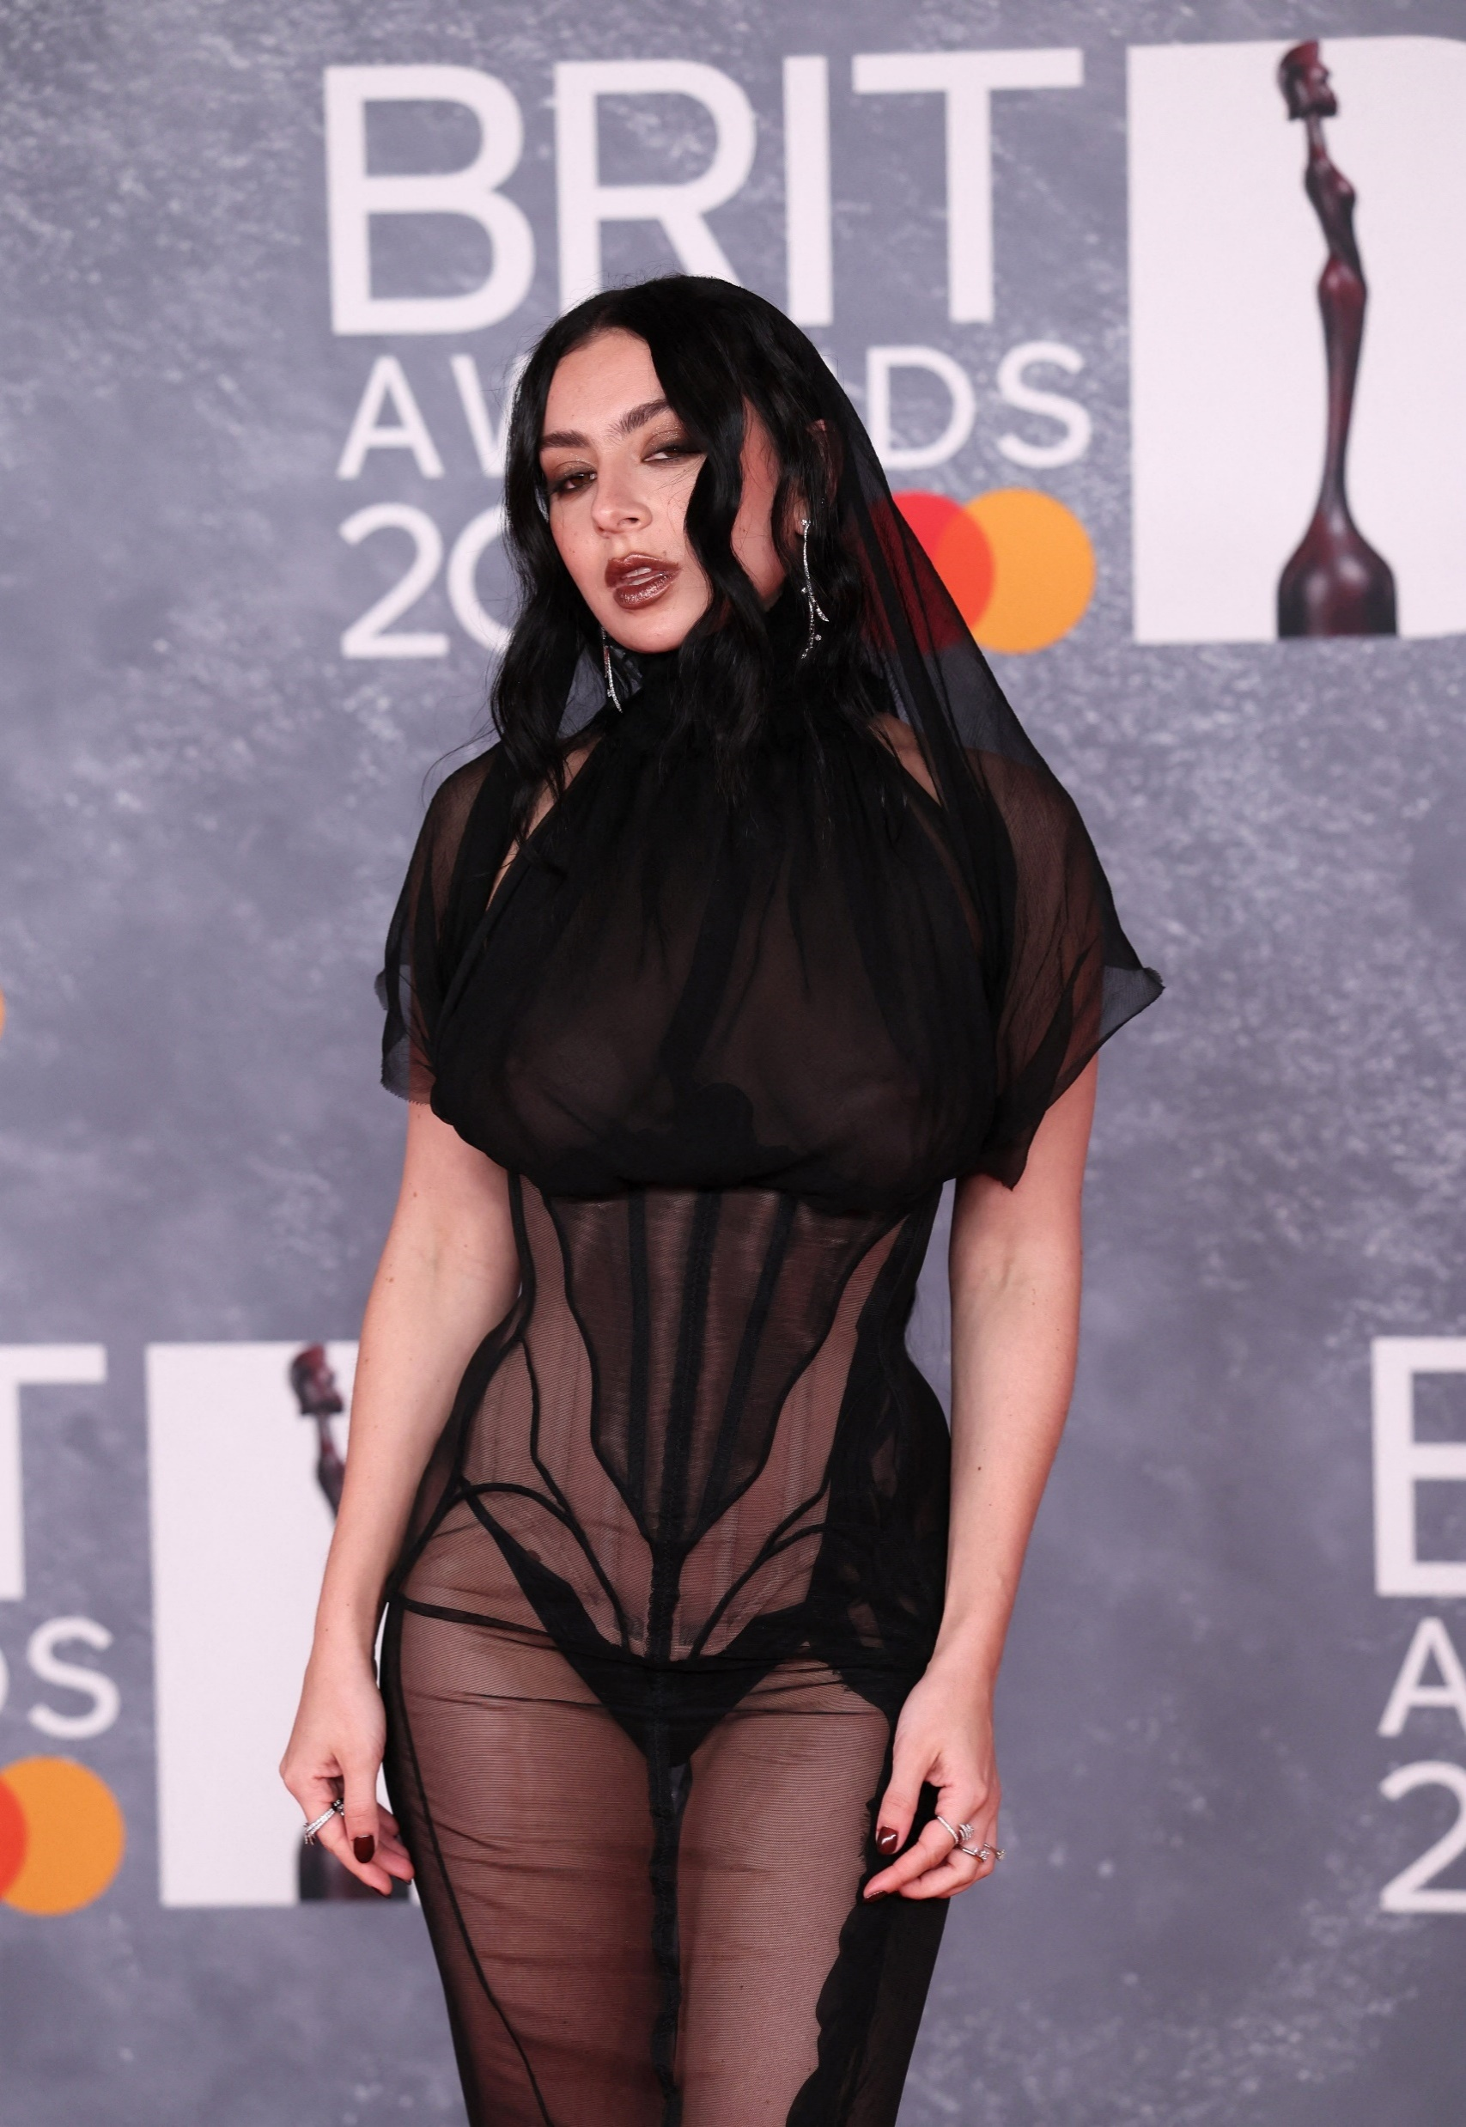

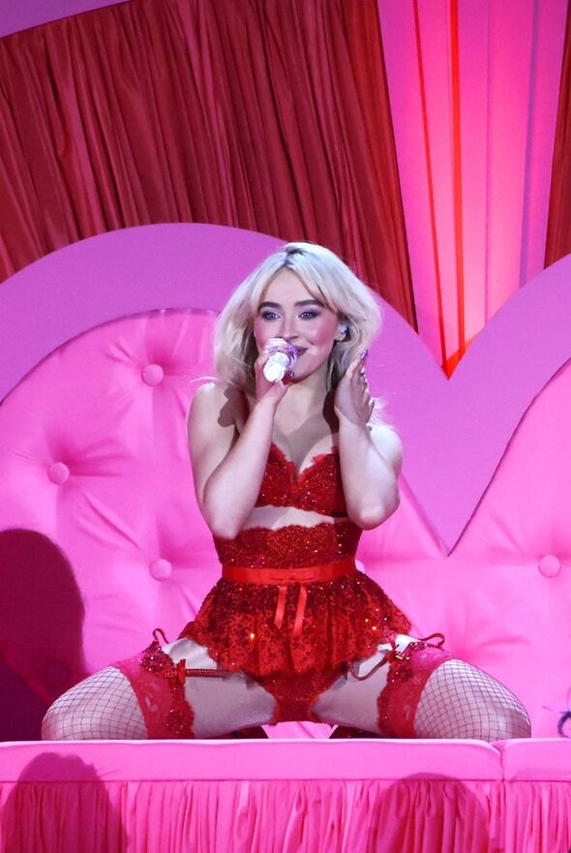


Slide 4
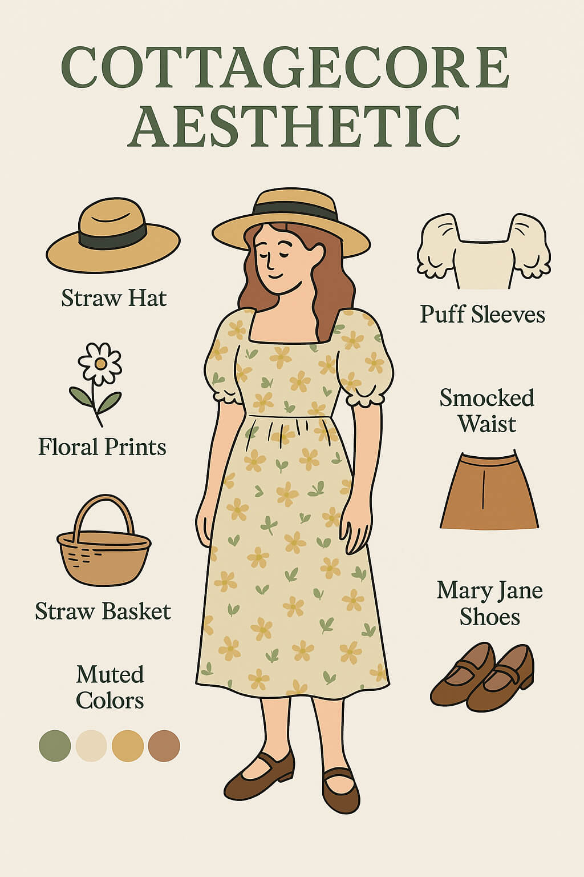
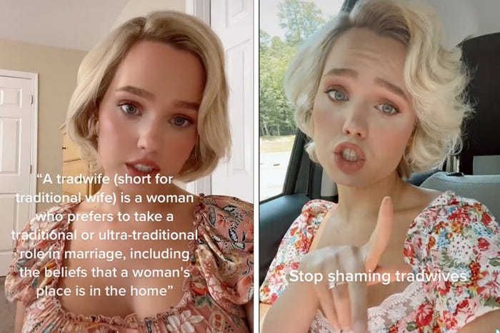

Slide 5
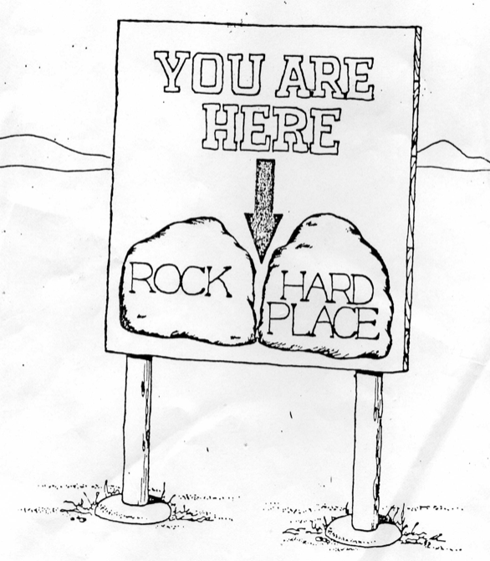
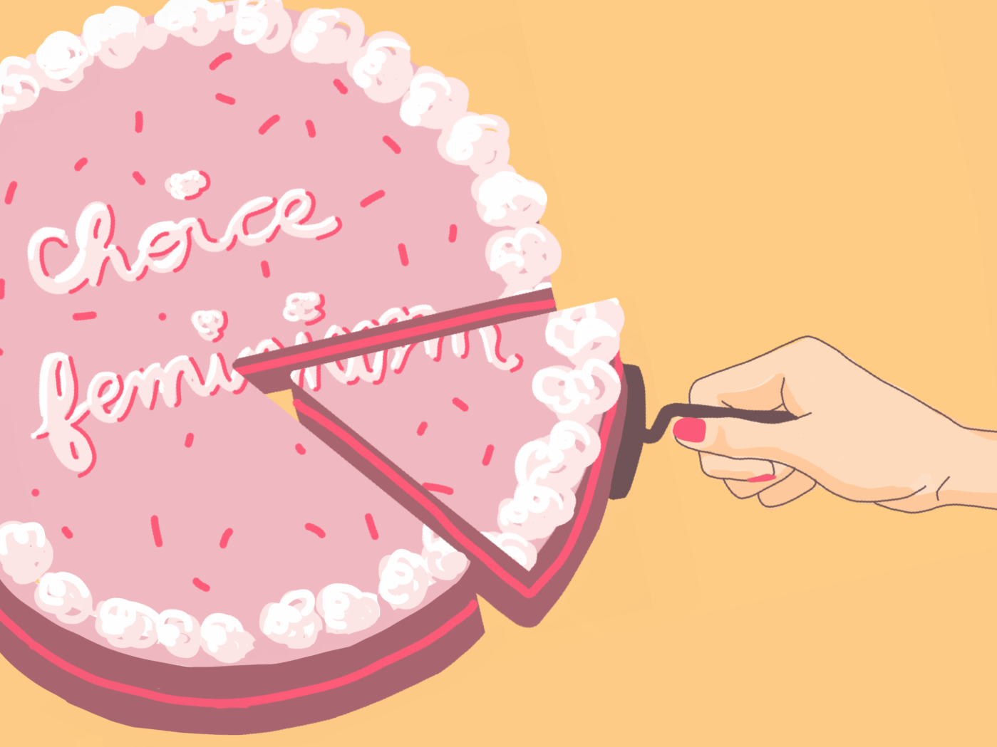

Slide 6
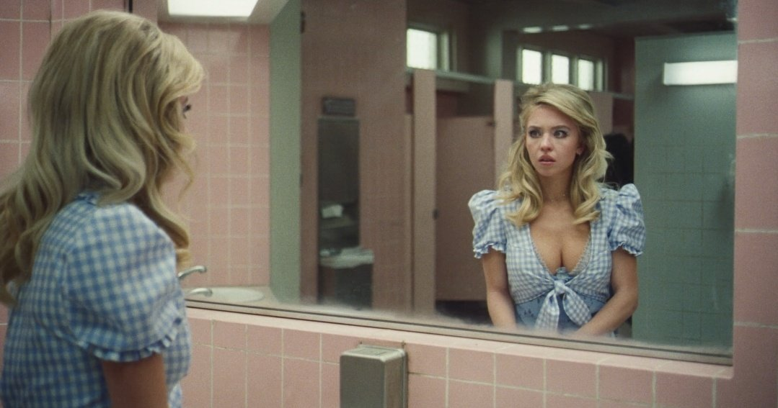
‘Self/other relations are active and productive, something is produced (rather than being revealed) and the construction is an aesthetic one’ (Hirschkop & Shepherd, 2001:155)

Slide 7

“Caring for myself is not self-indulgence. It is self-preservation, and that is an act of political warfare.” (Lorde, [1988], 2017:130)
“For the master’s tool will never dismantle the master’s house. They may allow us temporarily to beat him at his own game, but they will never enable us to bring about genuine change. And this fact is only threatening to those women who still define the master’s house as their only source of support.” (Lorde, 1984:112)

Slide 8
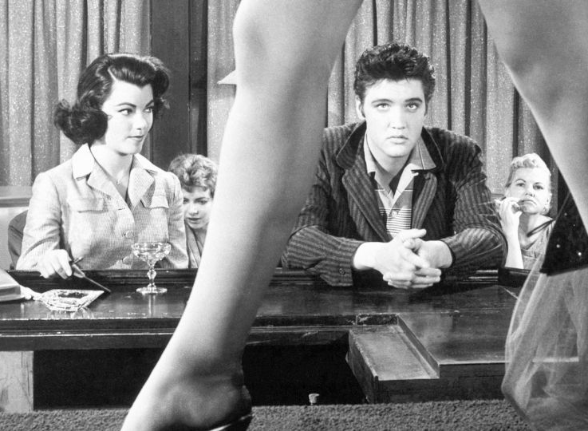
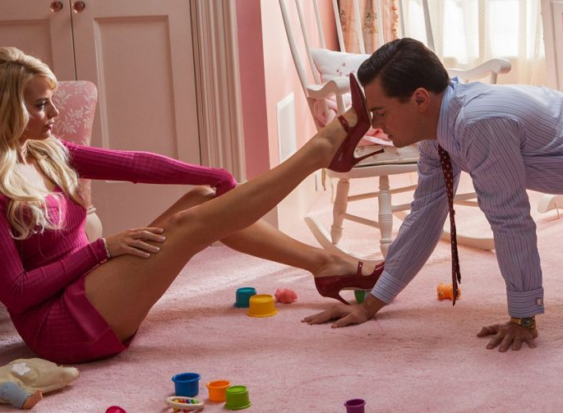
‘In a world ordered by sexual imbalance, pleasure in looking has been split between active/male and passive/female. The determining male gaze projects its phantasy on to the female form which is styled accordingly. In their traditional exhibitionist role women are simultaneously looked at and displayed, with their appearance coded for strong visual and erotic impact so that they can be said to connote to-be-looked-at-ness.’ (Mulvey, 1975: 809)
“You are a woman with a man inside watching a woman. You are your own voyeur.”
(Margaret Atwood ‘The Robber Bride’, [1993], 2009)

Slide 9
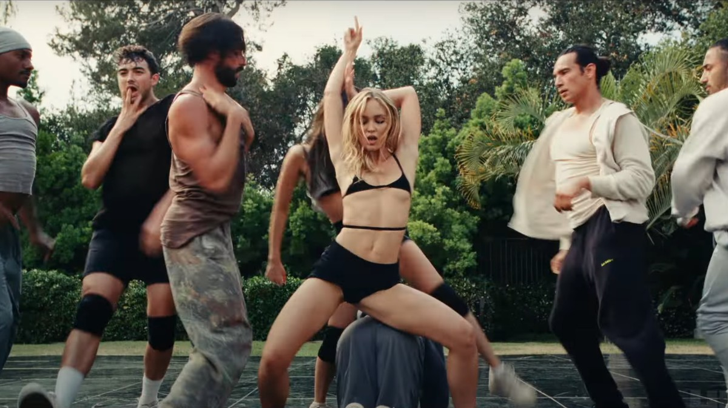
‘negative discourses executed and popularised by the media begin to be seen as an objective reality, eventually becoming regimes of truth’ (Walkerdine, Lucey, Melody. 2001: 212)
‘The eyes of others our prisons: their thoughts our cages’ (Wolf, 1920: 12)

Slide 10
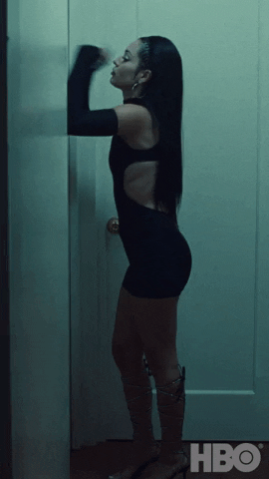
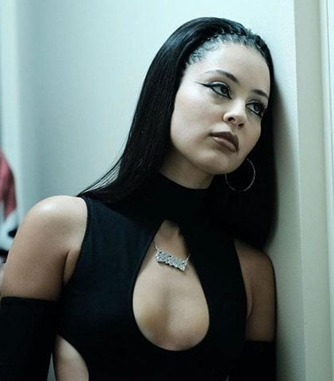
‘It’s crucial to unpack what’s true and what’s not true about female advancement’
Traister quoted by Wiegel, 2016: n.p.)

Slide 11
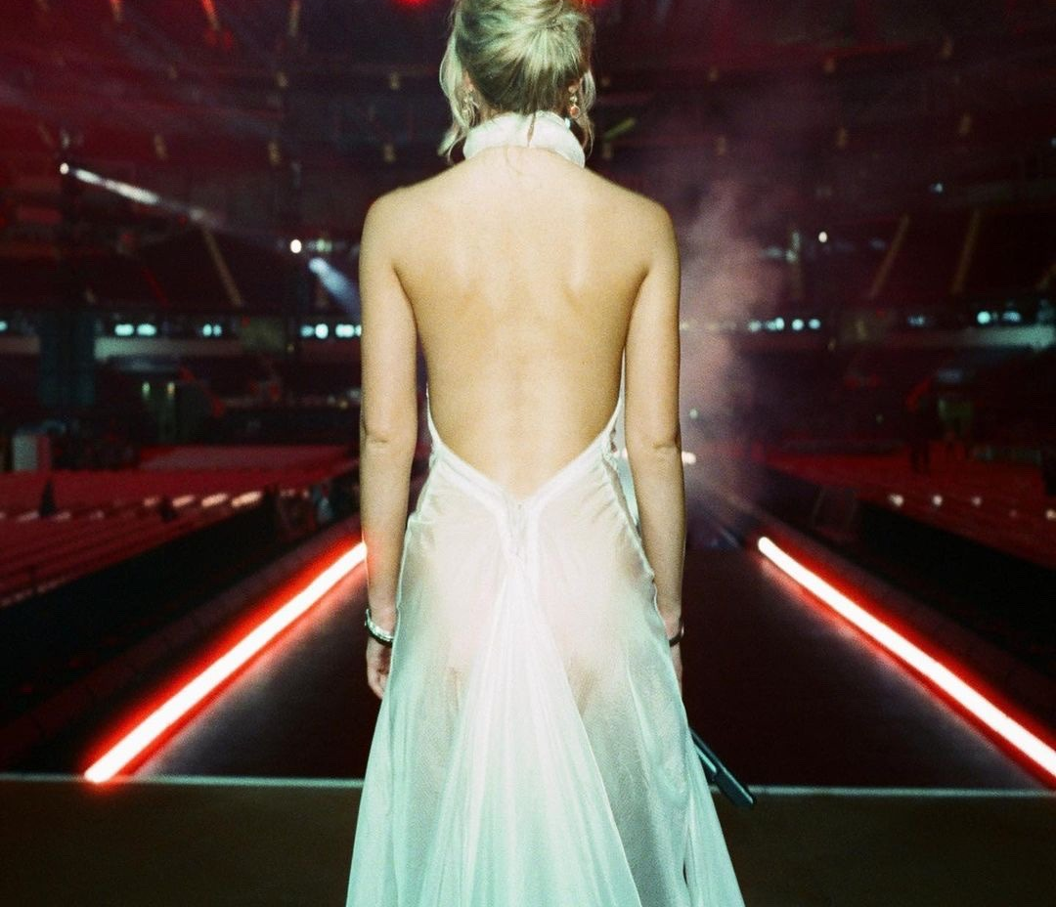
‘Women are deprived of the possibility of defining themselves, that is, their living state deviates from their consciousness and nature, which is a state of female alienation’ (Li, 2022: 3616)
‘Can we be authors of ourselves if we cannot speak or are only heard through the words of others?’ (Skeggs, 2004:130)

Slide 12
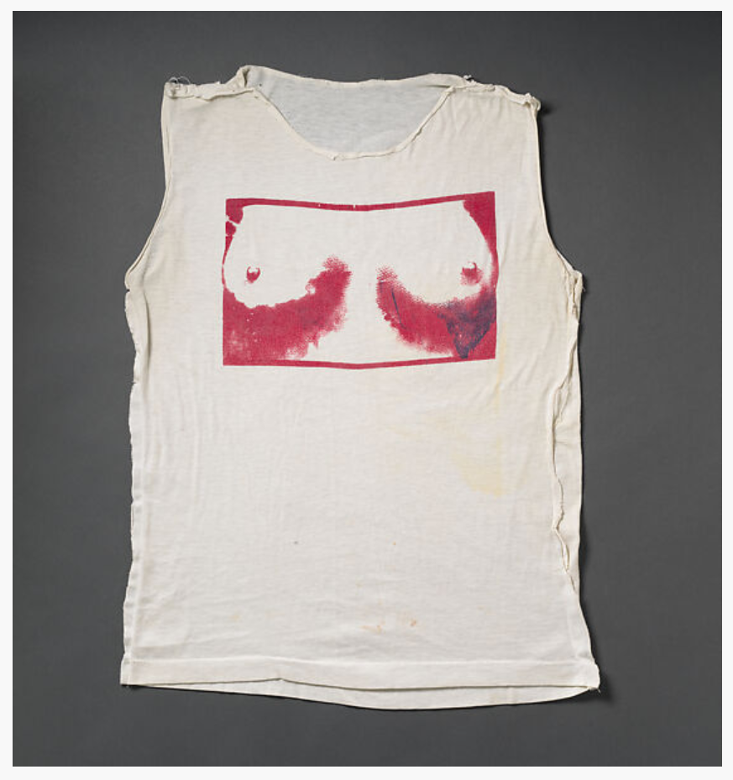
Women’s bodies (are) policed in terms of acceptable dress and self presentation…rebellion against modestry and expression of sexuality are important signified meanings of Westwood’s pieces…the ‘tits’ shirt is an act of defiance against the norm of modesty and respect’ (Rosato, 2022:24)
‘her function is such that to make her interchangeable with every other female (Solanis, 1971: 48)
‘(the) surpression of all ideas or knowledge that might expose him or threaten his dominant position in society’ (Solanis, 1971: 64)
Westwood/McLaren ‘tits’ t-shirt 1975
Vivienne Westwood | "Tits" T-shirt | British | The Metropolitan Museum of Art

Slide 13
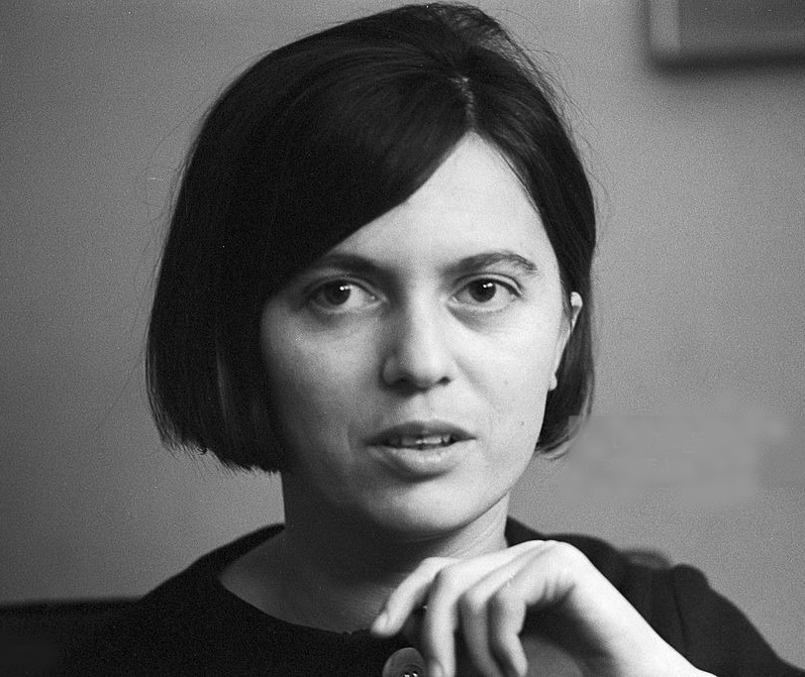
Heterosexual Contract
‘the ideology of sexual difference functions as censorship in our culture by masking, on the ground of nature, the social opposition between men and women. Masculine/feminine, male/female are the categories which serve to conceal the fact that social differences always belong to an economic, political, ideological order.’ (Wittig, 1992:2)

Slide 14
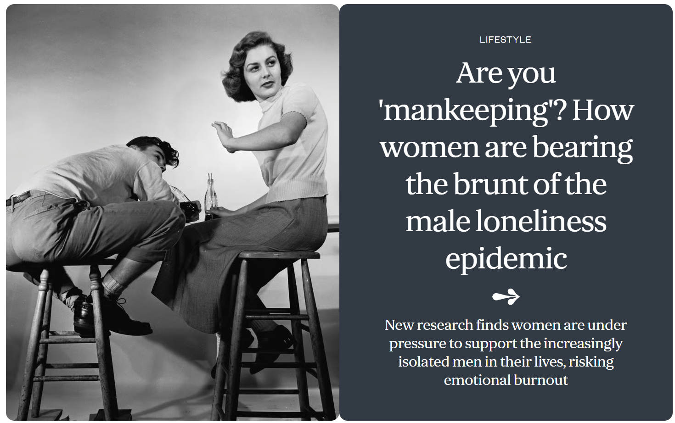

Slide 15
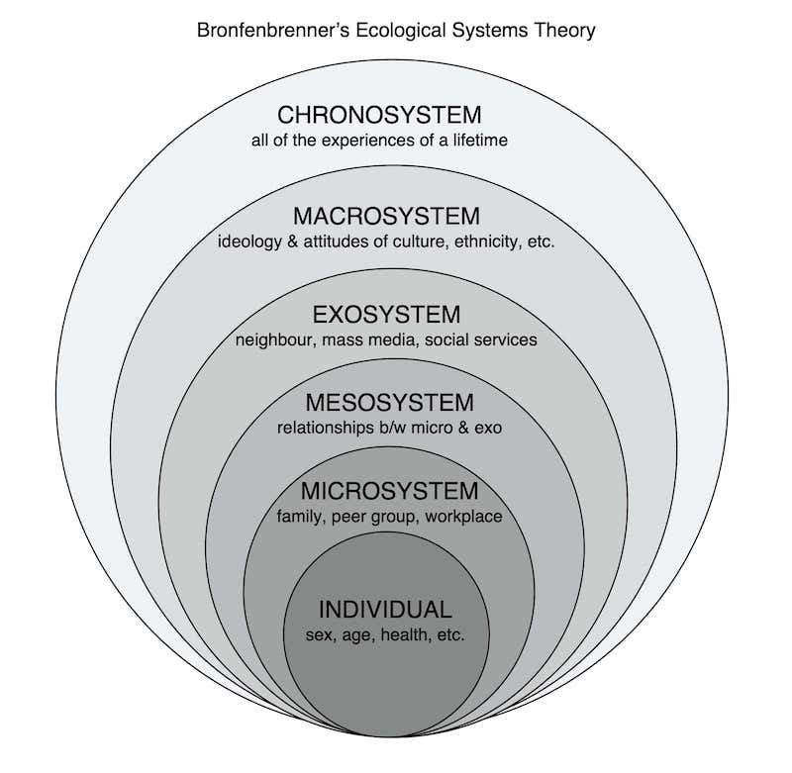
System’s Theory
We all have a part to play

Slide 16
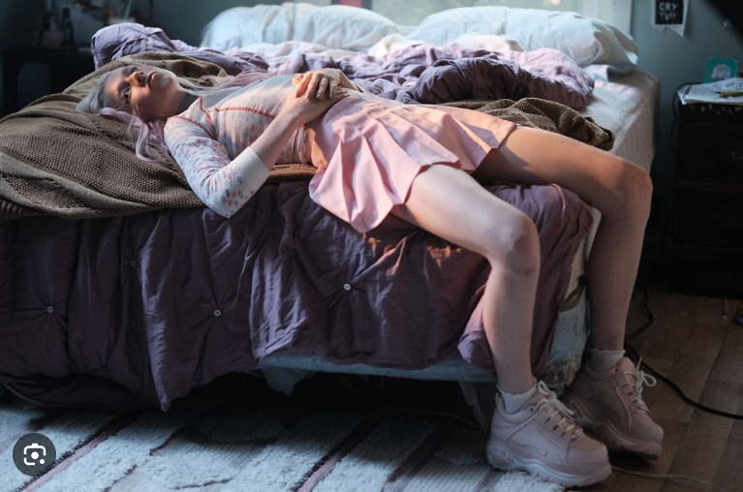
‘even if younger women have not completely rejected feminism, they are extremely ambivalent about it’
(Ortner, 2017:118)

