Slide 1
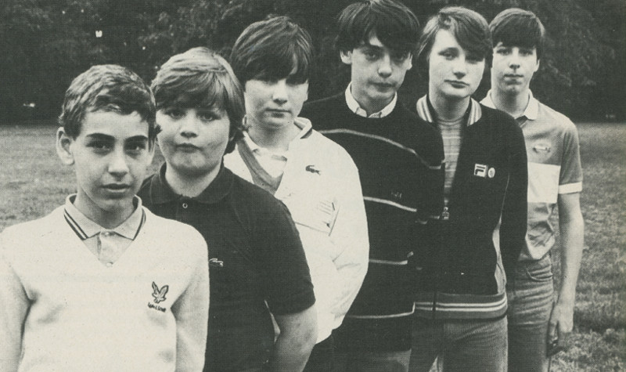
Casual Class Resistance
l.betts@fashion.arts.ac.uk

Slide 2
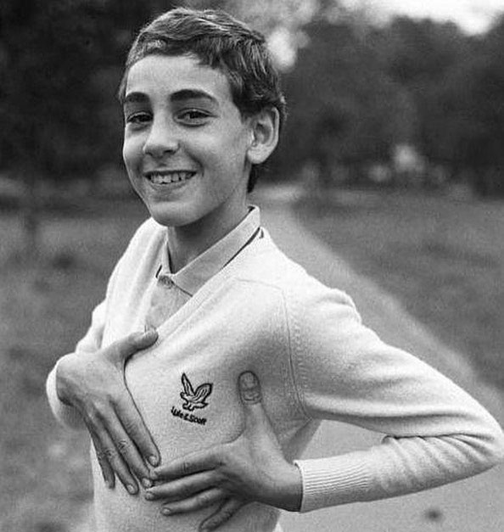
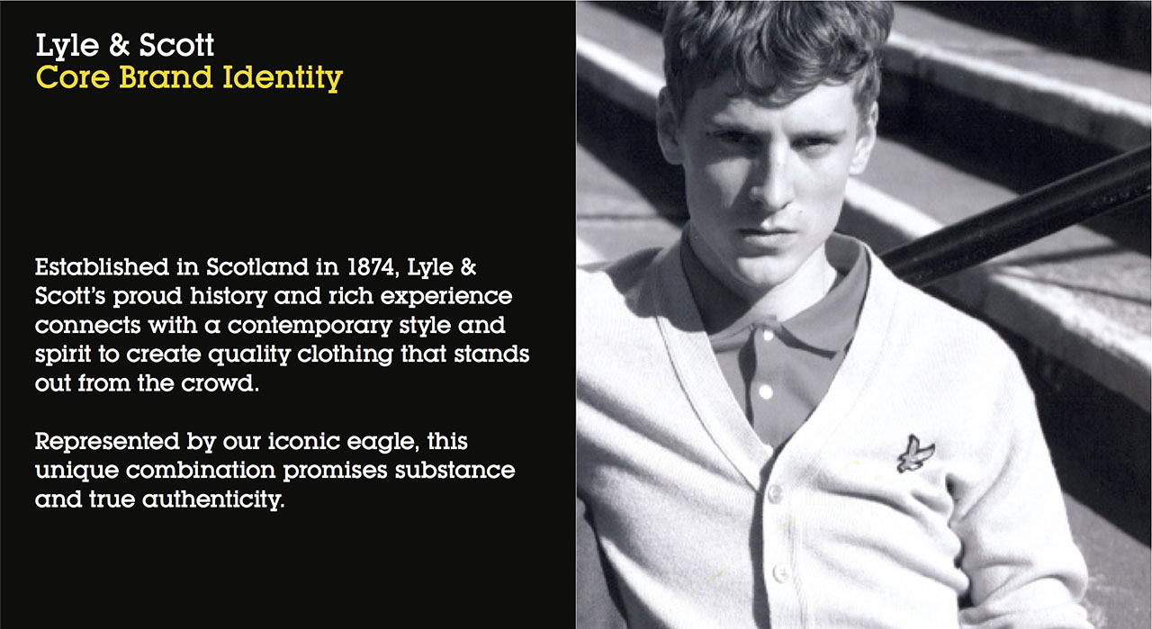


Slide 3
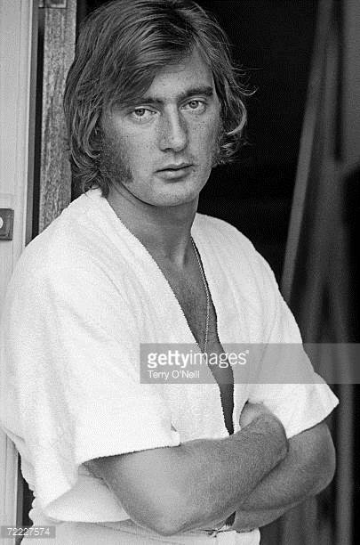
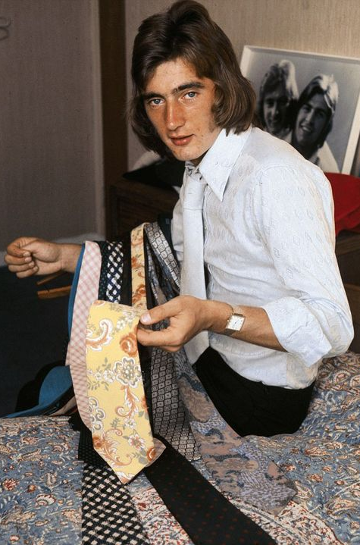
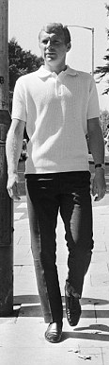
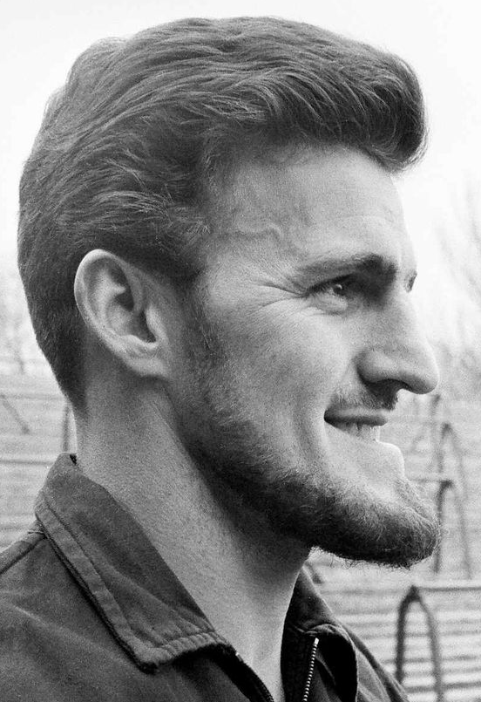
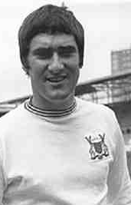
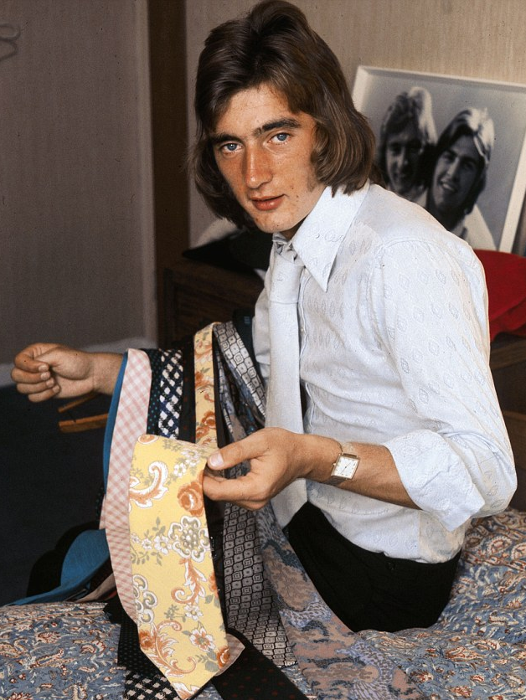


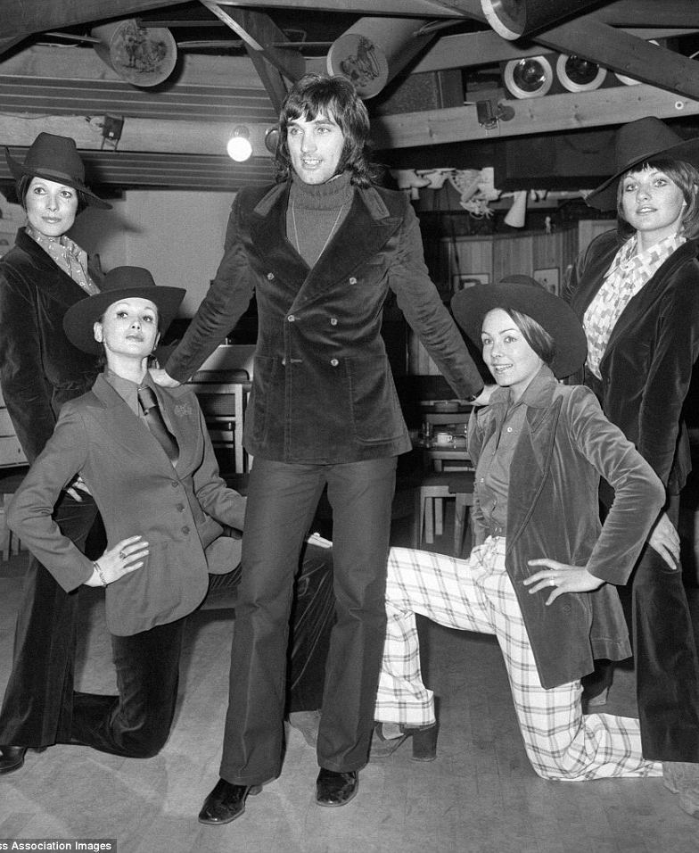
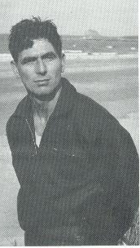
‘Self-invention is a tricky process, fraught with nuances through which class location is read off the body’ (Walkerdine, Lucey, Melody, 2001:45)
George Best, Alan Hudson, David Beckham, Aaron Ramsey, Gordon Smith, Jim Baxter, Bobby Moore

Slide 4
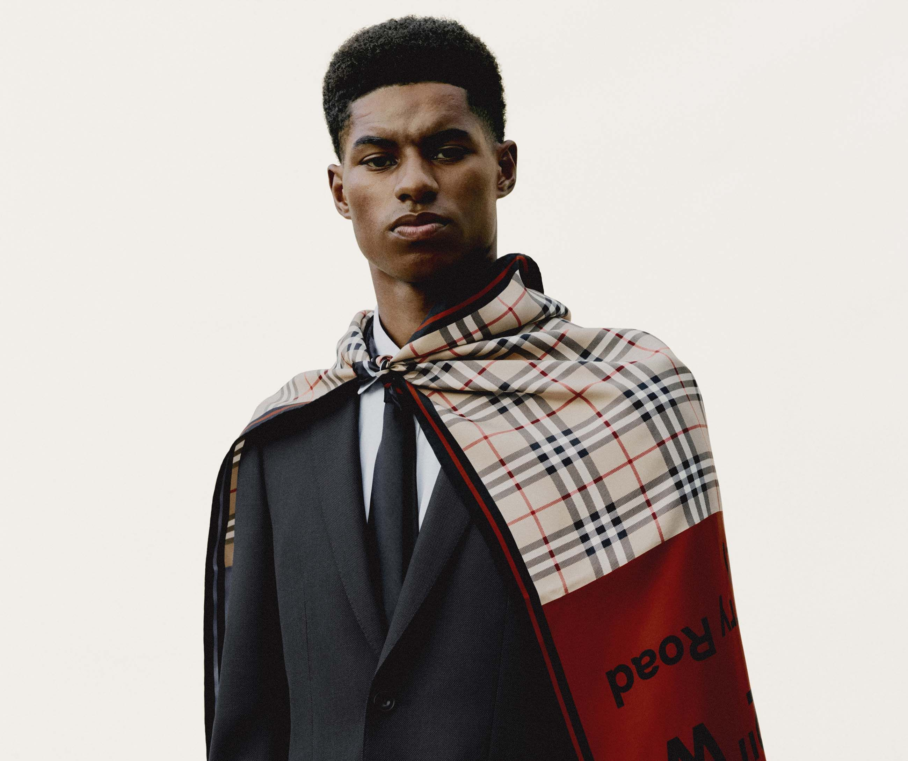

Maintaining Boundaries
‘The ability to properties aspects of culture in making the self is central to how class is made in a contemporary setting’ (Skeggs, 2004: 178)

Slide 5
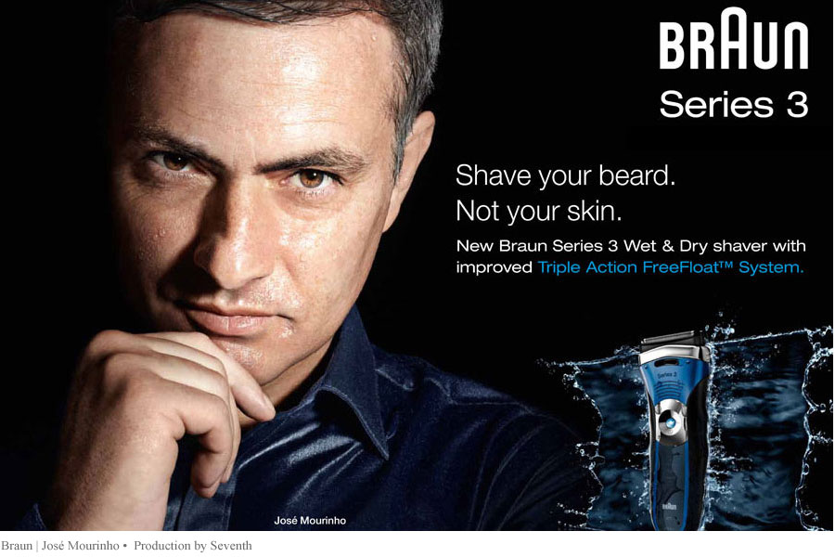
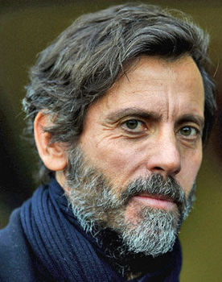
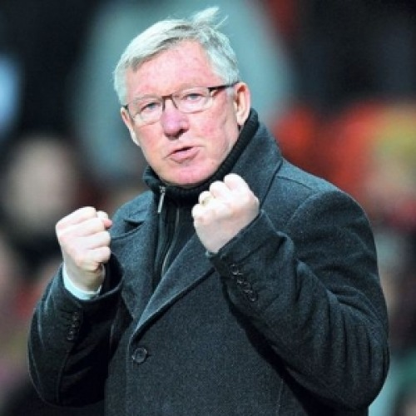
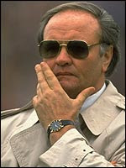
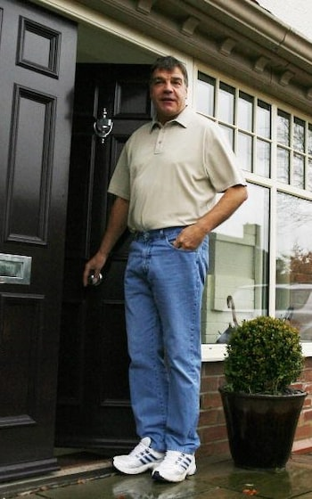
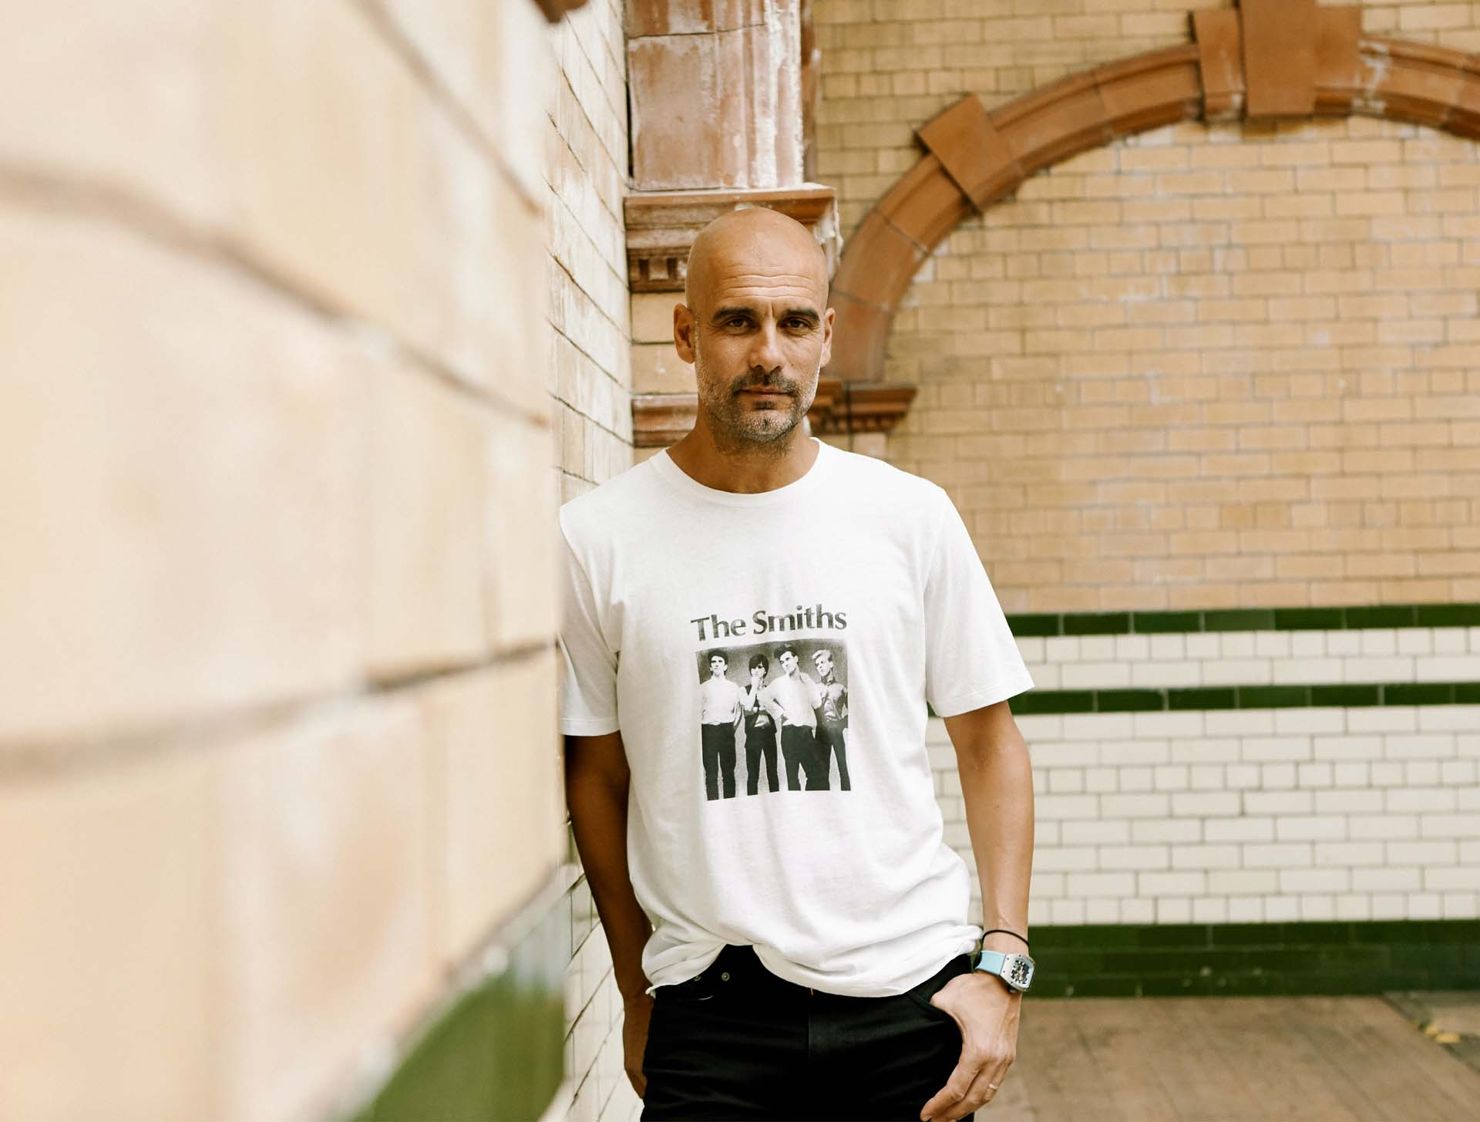

‘the process of reading is where an intertextually organised reader meets an intertextually organised text within a historically and culturally specific context’ (Gledhill & Williams, 2000:166)

Slide 6
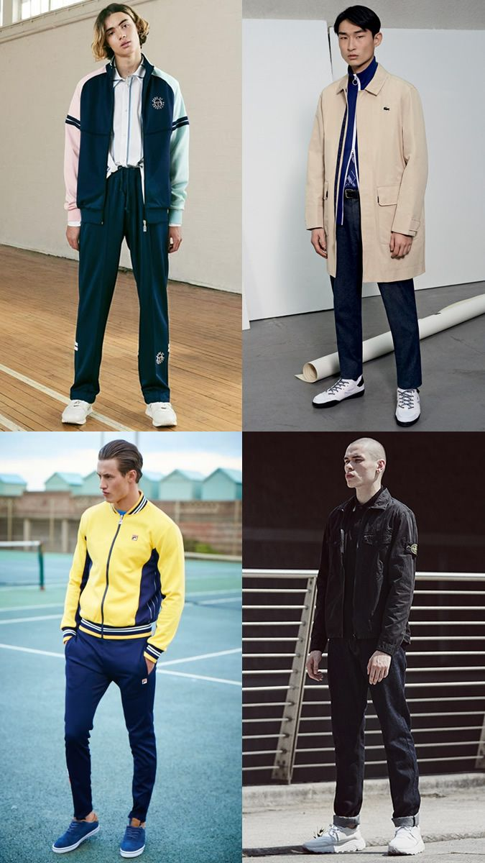
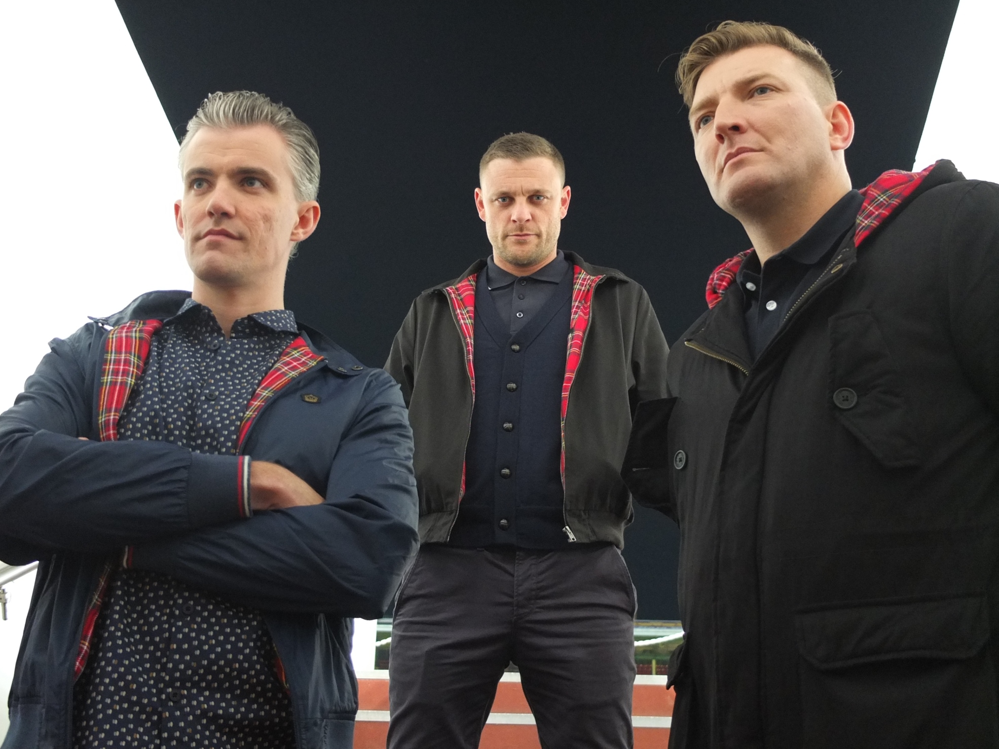
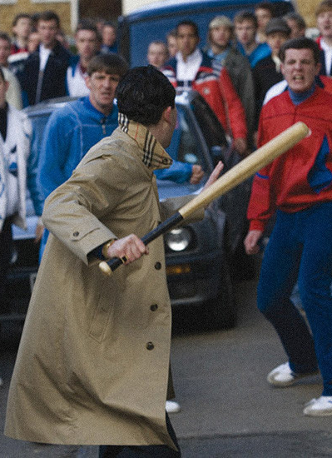
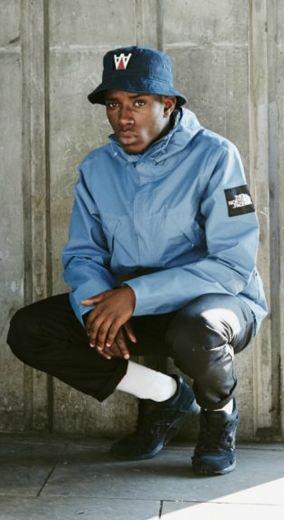
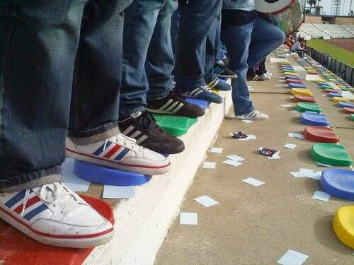

‘Pure aesthetic not for working class’
(Bourdieu [1979] 1996)​
(Sub) Cultures of consumption

Slide 7
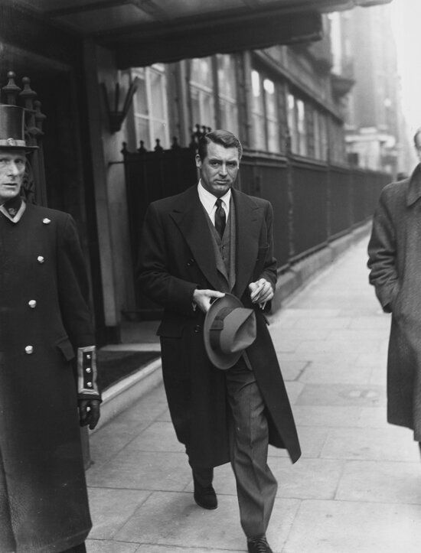
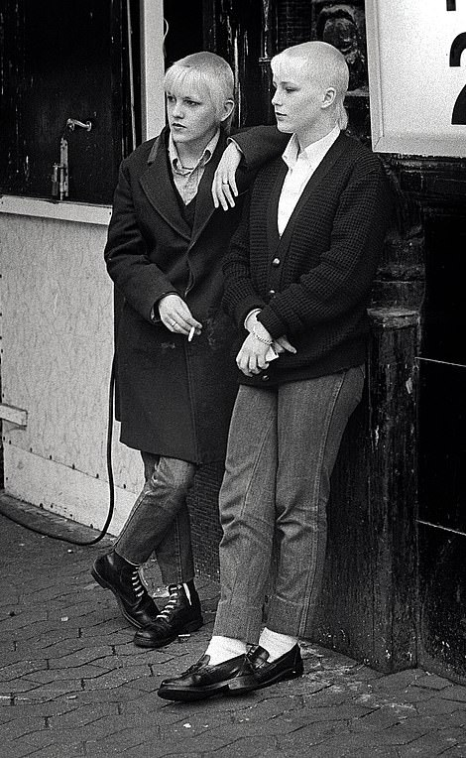
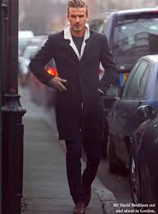
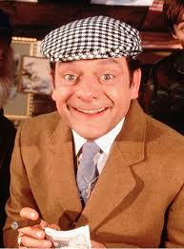
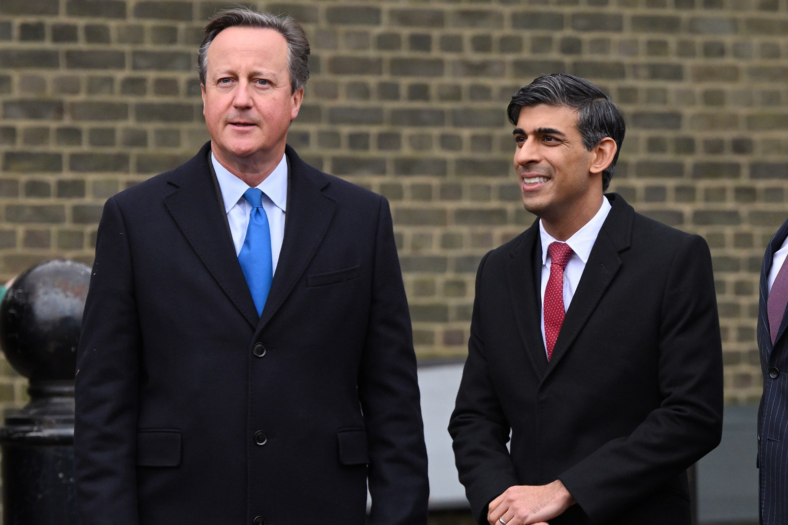
‘Understanding how positioning, movement and exclusion are generated through systems of inscription, exchange and value is central to understanding how differences and inequalities are produced, lived, read’
(Skeggs, 2004:4)

Slide 8
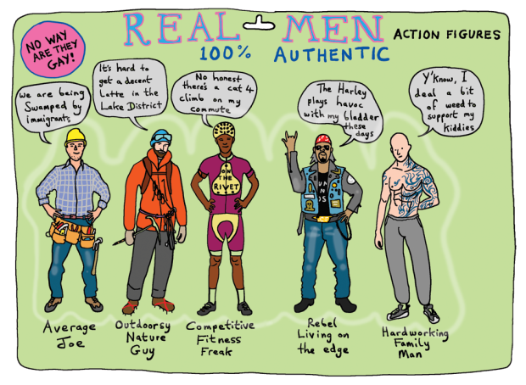
Masculinities
‘differences in identity are produced out of discriminatory processes that establish some identities as more or less valuable than others’
(Lawler, 2014: 13)
Grayson Perry, 2017

Slide 9
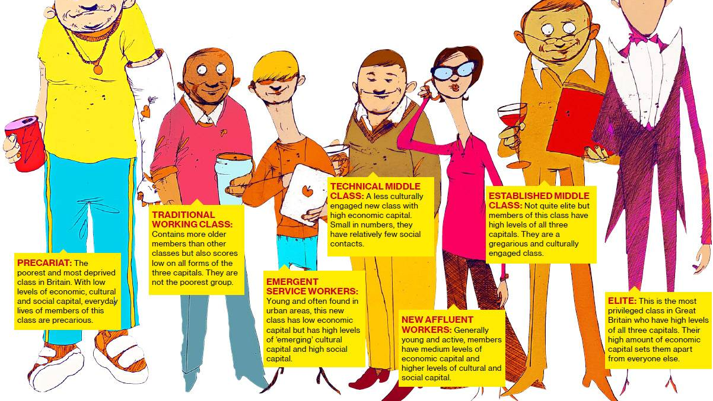
Social Class

Slide 10

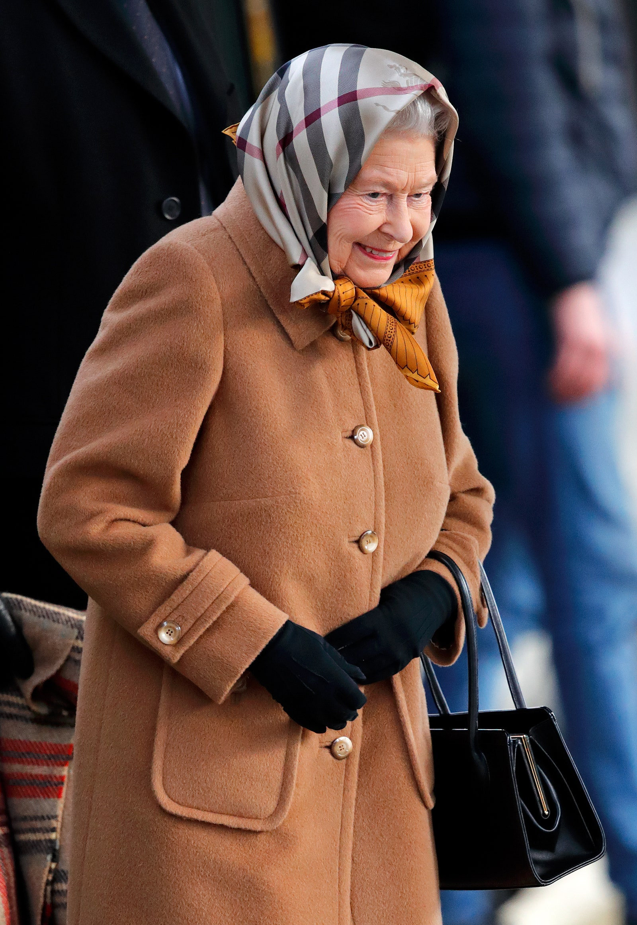
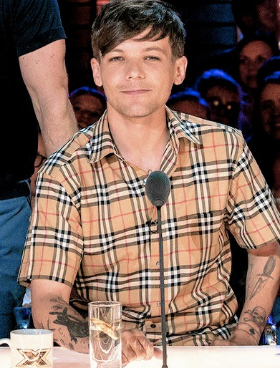
The right to difference
Blondey
Queenie
Louis
‘Different bodies carry unequal values depending on their position in space, their cultural capital or the cultural baggage they embody’ (Skeggs, 2004:17)

Slide 11
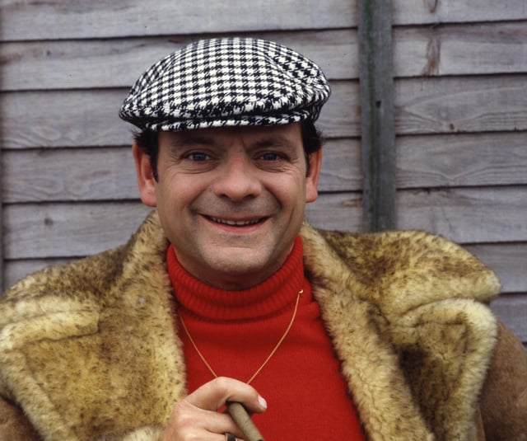
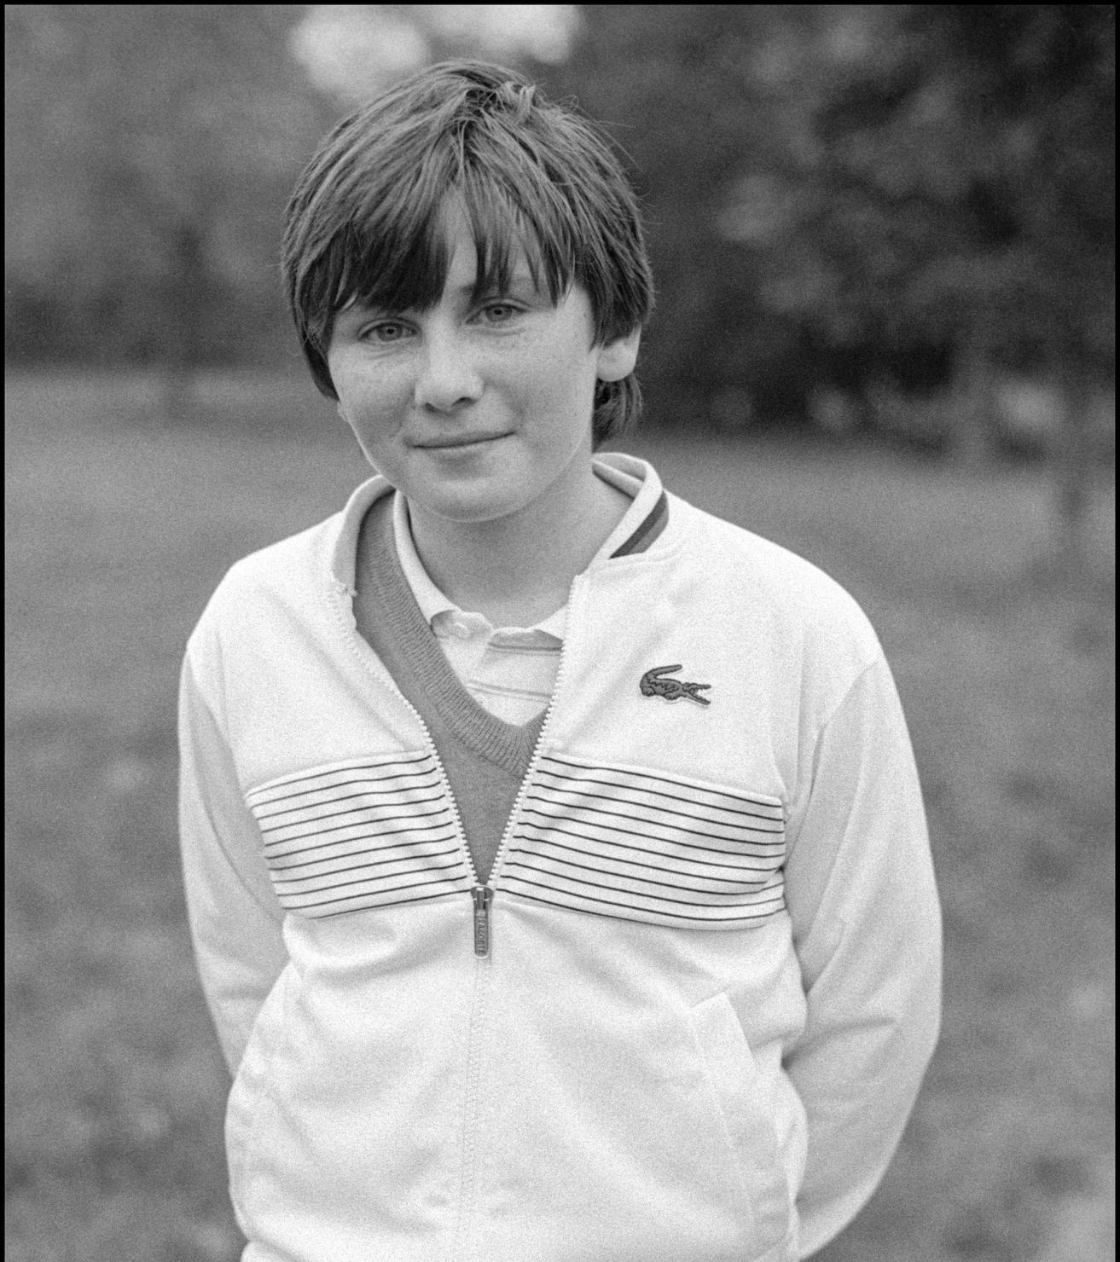
Resistance or Rejection?

Slide 12
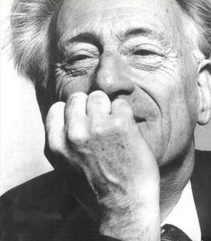
Contestation
‘Something more, something less, something else; lived experience…..’ (Lefebvre, [1981]2005 P5)
Henri Lefebvre

Slide 13
Style is a way of representing in- between spaces (Guy, Green, Banham, 2001)
spaces in between

