Slide 1
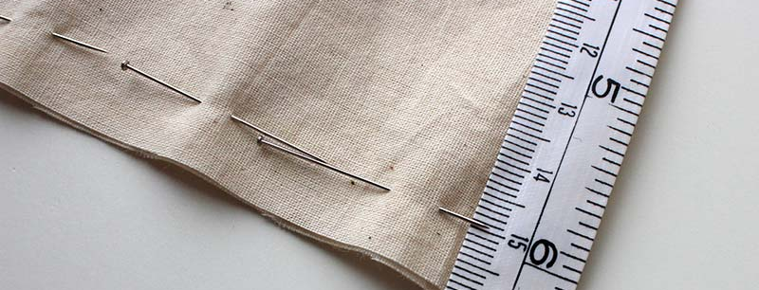
Seam Allowance(s): Legitimised Margins, Identity Politics and Costume
Liza Betts - Critical Costume March 2024
l.betts@fashion.arts.ac.uk

Slide 2
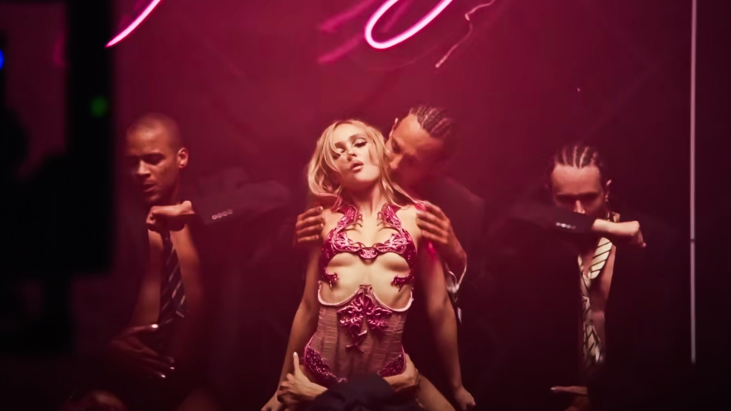
‘I feel like I know her body better than my own..’ (Hitchcock, 2024)
l.betts@fashion.arts.ac.uk

Slide 3
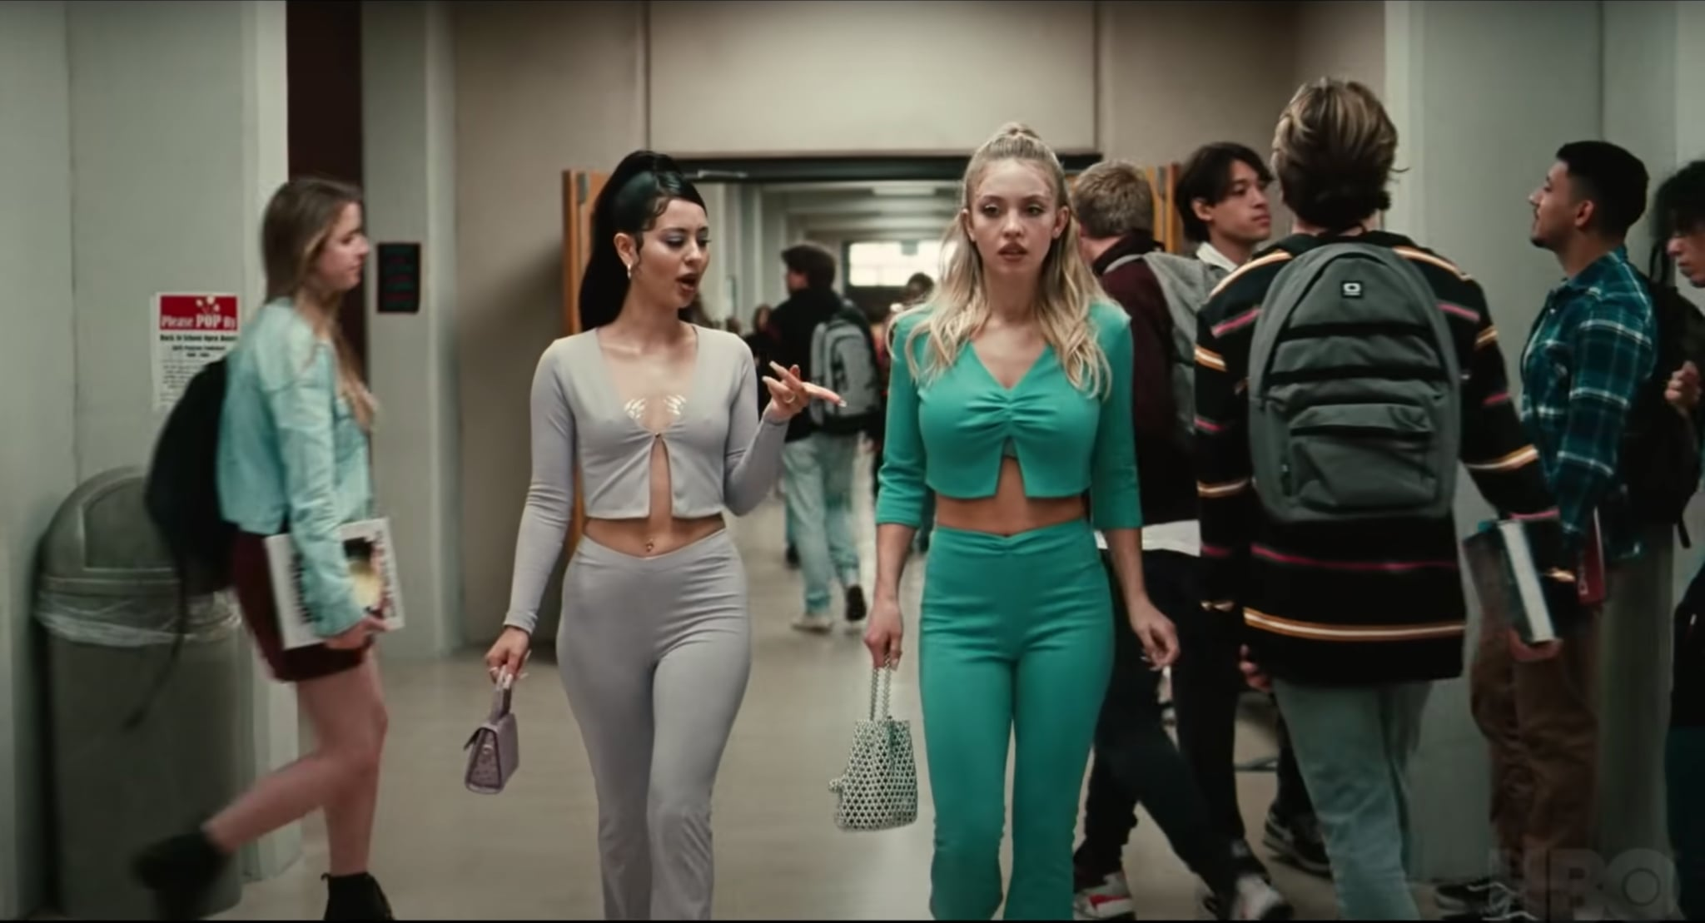
‘I particularly like Bruzzi’s admission that there are some costumes that make such a strong statement that they ‘steal the show’ so to speak’ (Gaines, 2013:159)
l.betts@fashion.arts.ac.uk

Slide 4
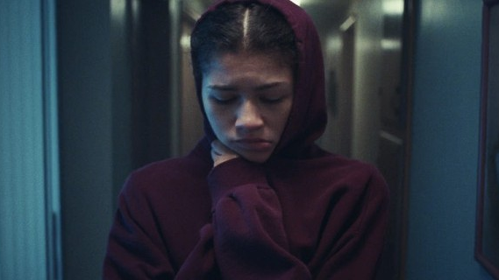
‘Within film, costume is naturalised as clothing but clothing’s role within narrative moves it beyond mere denotation’ (Baert, 1994:355 )
l.betts@fashion.arts.ac.uk

Slide 5
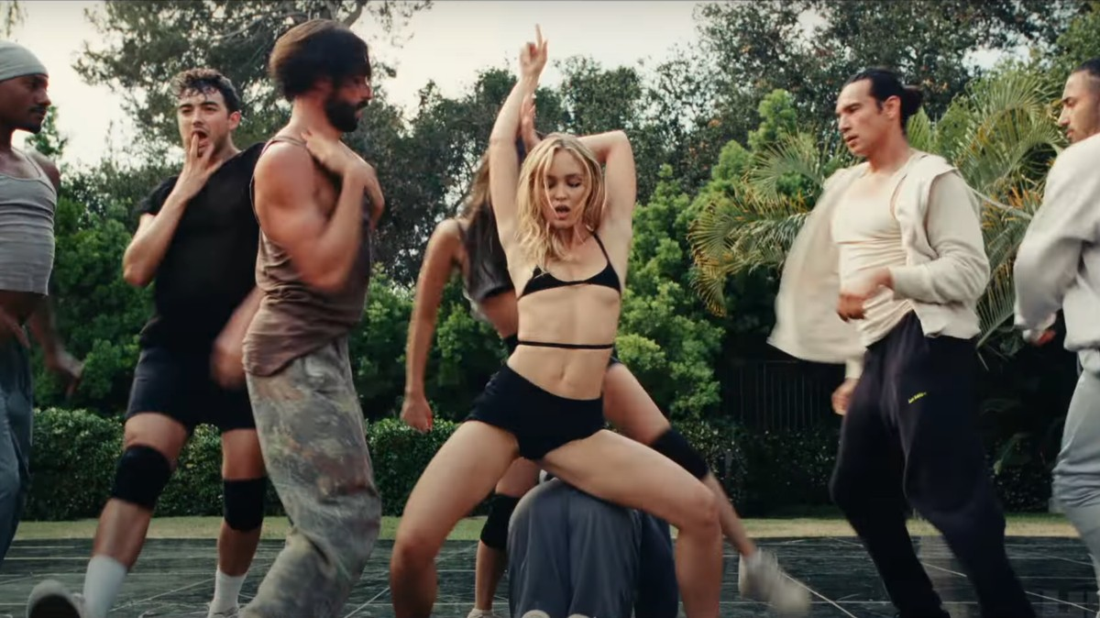
‘Intonation is an important means by which evaluative consciousness is registered’ (Bakhtin in Morris, [1994], 2003:7)
l.betts@fashion.arts.ac.uk

Slide 6
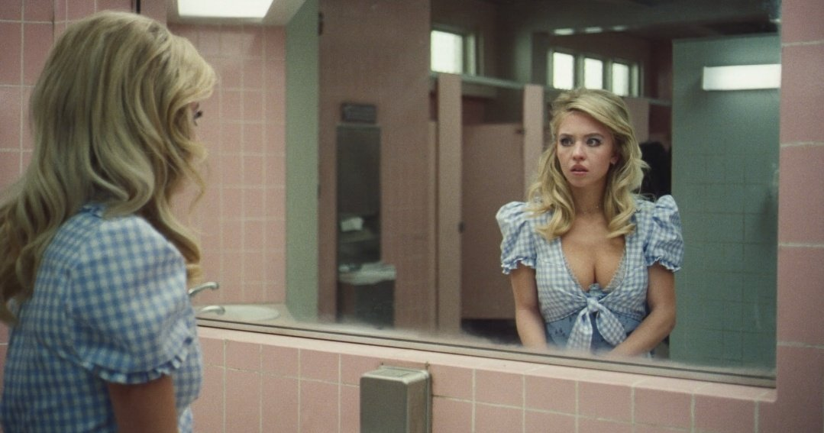
‘Self/other relations are active and productive, something is produced (rather than being revealed) and the construction is an aesthetic one’ (Hirschkop & Shepherd, 2001:155)
l.betts@fashion.arts.ac.uk

Slide 7
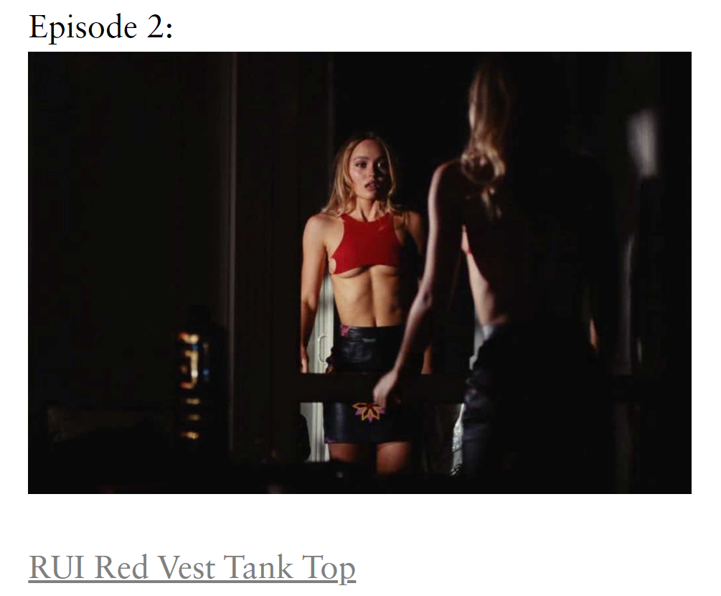
‘Whether you're onscreen or not, your body is a billboard’
Costume Designer Natasha Newman-Thomas quoted by Roby in Harpers Bazaar, 2023
https://www.russh.com/the-idol-fashion-where-to-buy/
l.betts@fashion.arts.ac.uk

Slide 8
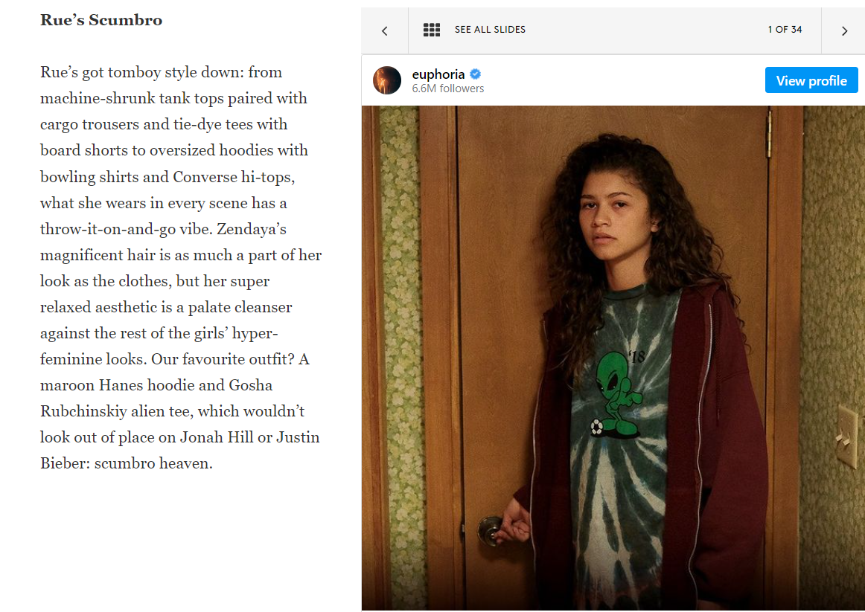
The Carole Lombard in Macey’s Window
(Eckert, 1978)
https://www.refinery29.com/en-gb/euphoria-outfits-fashion#slide-1
l.betts@fashion.arts.ac.uk

Slide 9

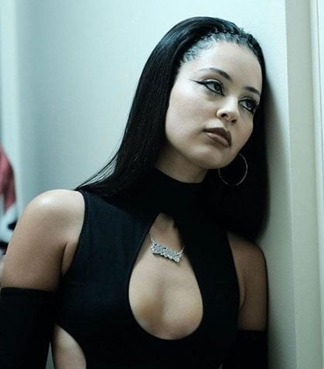
‘It’s crucial to unpack what’s true and what’s not true about female advancement’
Traister quoted by Wiegel, 2016: n.p.)
l.betts@fashion.arts.ac.uk

Slide 10
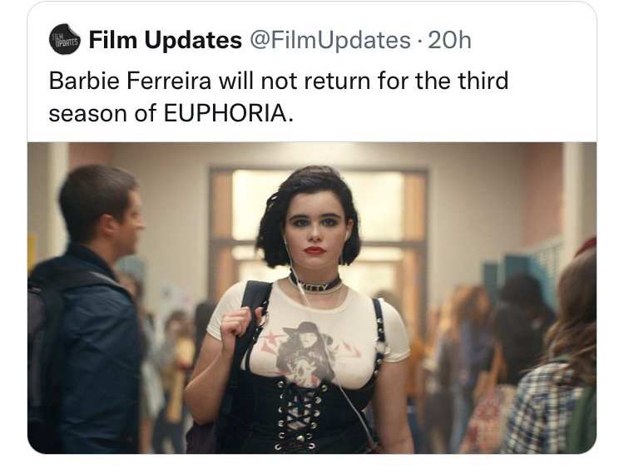
‘In 2022, women comprised 24% of directors, writers, producers, executive producers, editors, and cinematographers working on the top 250 grossing films. This represents a decline of 1 percentage point from 25% in 2021’
(Lauzen, 2023:1)
‘In spite of the righteous noise and well-intentioned initiatives launched by broadcasters, streamers and producers in recent years, two new reports indicate that, not only is the industry still a long way off from gender parity in creative roles, it is moving into reverse.’ (Bennett, 2023:n.p.)
l.betts@fashion.arts.ac.uk

Slide 11
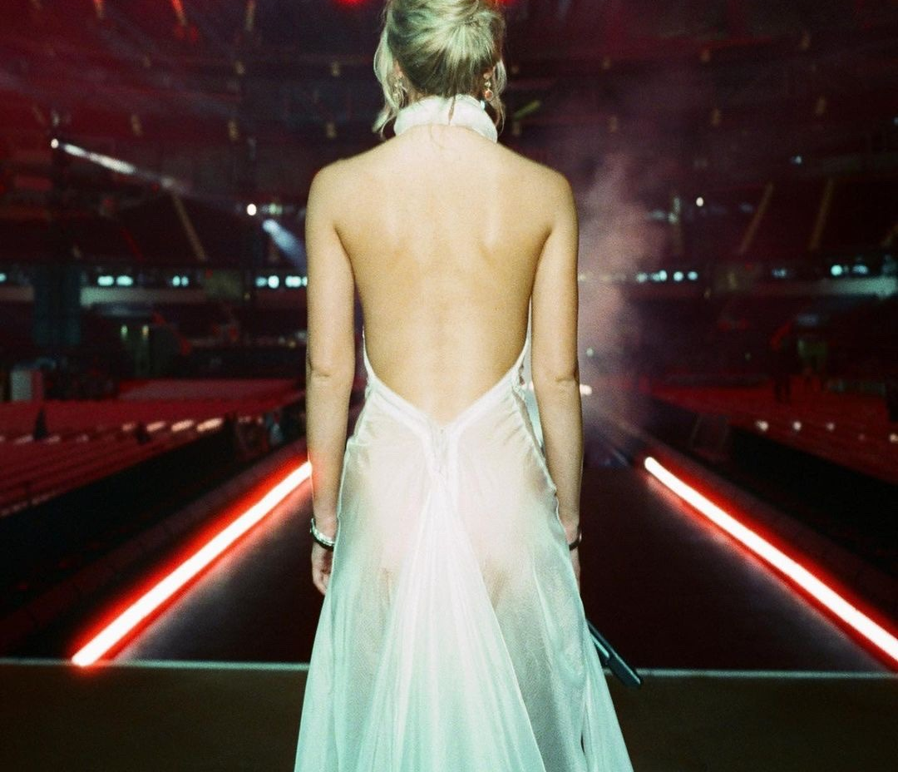
‘Women are deprived of the possibility of defining themselves, that is, their living state deviates from their consciousness and nature, which is a state of female alienation’ (Li, 2022: 3616)
‘Can we be authors of ourselves if we cannot speak or are only heard through the words of others?’ (Skeggs, 2004:130)
l.betts@fashion.arts.ac.uk

Slide 12
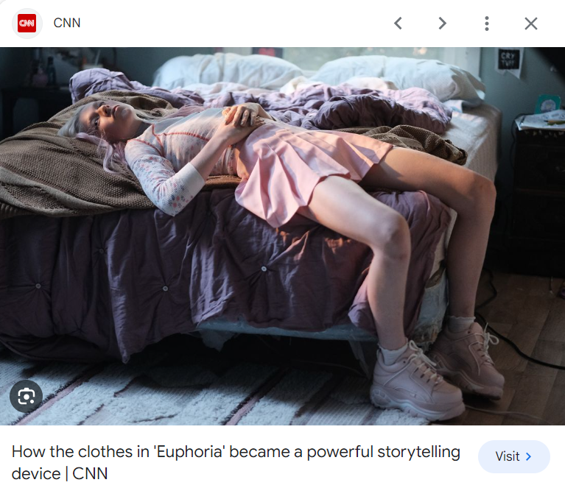
‘even if younger women have not completely rejected feminism, they are extremely ambivalent about it’
(Ortner, 2017:118)

Slide 13
Baert, R. (1994) ‘Skirting the Issue’ in Screen, Vol 35, N4 p 354-373
Baert, R. (1994). Skirting the Issue in Screen, Vol 35, N4 p 354-373
Bennett, H. (2023). Men get cameras, women get clipboards: the gender disparity in factual TV from Royal Television Society see https://rts.org.uk/article/men-get-cameras-women-get-clipboards-gender-disparity-factual-tv#:~:text=Men%20dominate%20the%20next%20three,it's%20clearly%20littered%20with%20barriers.
Eckert, C. (1978). The Carole Lombard in Macy's Window. Quarterly Review of Film & Video, 3(1), pp.1-21.
Hirschkop, A. Shepherd, D. (2001) Bakhtin and Cultural Theory. Manchester: Manchester University Press
Hitchcock, F (2024). Interview Hitchcock to Betts Feb 2024
Lauzen, M. (2023). Boxed In: Women On Screen and Behind the Scenes on Broadcast and Streaming Television in 2022-23. Boxed In: San Diago
Li, Y. (2022) An Analysis of Female Body Alienation in Consumer Society. In 2022 6th International Seminar on Education, Management and Social Sciences (ISEMSS 2022) (pp. 3615-3621). Atlantis Press.
Morris, P. (ed) (1994) The Bakhtin Reader: Selected Writings of Bakhtin, Medevdev & Voloshinov. London: Edward Arnold.
Ortner, S.B. (2017). Too soon for post-feminism: The ongoing life of patriarchy in neoliberal America. In De-Pathologizing Resistance (pp. 116-136). Routledge.
Satan, M., 2013. Jane M. Gaines. Fashion Cultures: Theories, Explorations and Analysis, p.159.
Skeggs, B. (2004). Class, Self, Culture. London: Routledge
Wiegel, M. (2016). Not All The Single Ladies from Dissent see https://www.dissentmagazine.org/article/rebecca-traister-not-all-the-single-ladies-review/

