Slide 1

Fractured Learning Spaces: the emotional impact of ‘damaged’, working class learner identities, and the implications for attainment
Liza Betts, CHS, LcF

Slide 2
Class Inequality, Emotion & Attainment
‘Crossing the Picket Line’ – ‘Billy Elliott’ (Daldry, 2000)
‘there is a powerful dynamic between emotions, the psyche and class inequalities that is as much about the makings of class as it is about its consequences’ (Raey, 2005:911)

Slide 3
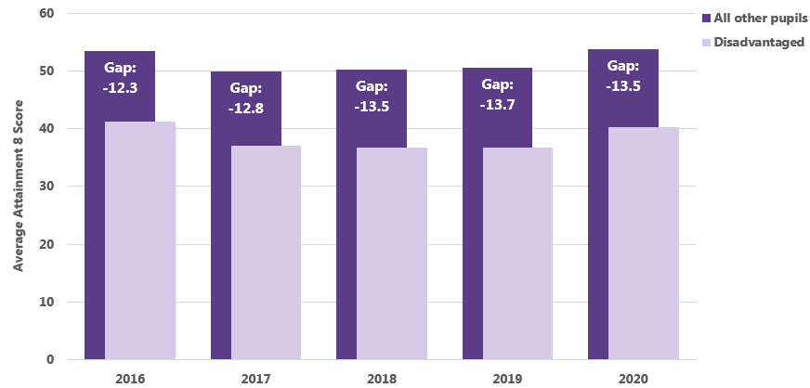
Attainment 8
‘While the salience of social class may rise and fall within policy and academic discourses, surveys have suggested that recent years have witnessed increases in the gap between broad sections of the population who have differential access to money, resources, qualifications, life chances and health’ (Archer, Hutchens & Ross [2003], 2006: 5)
https://www.mimeconsulting.co.uk/dfe-data-release-2020-ks4-attainment/

Slide 4
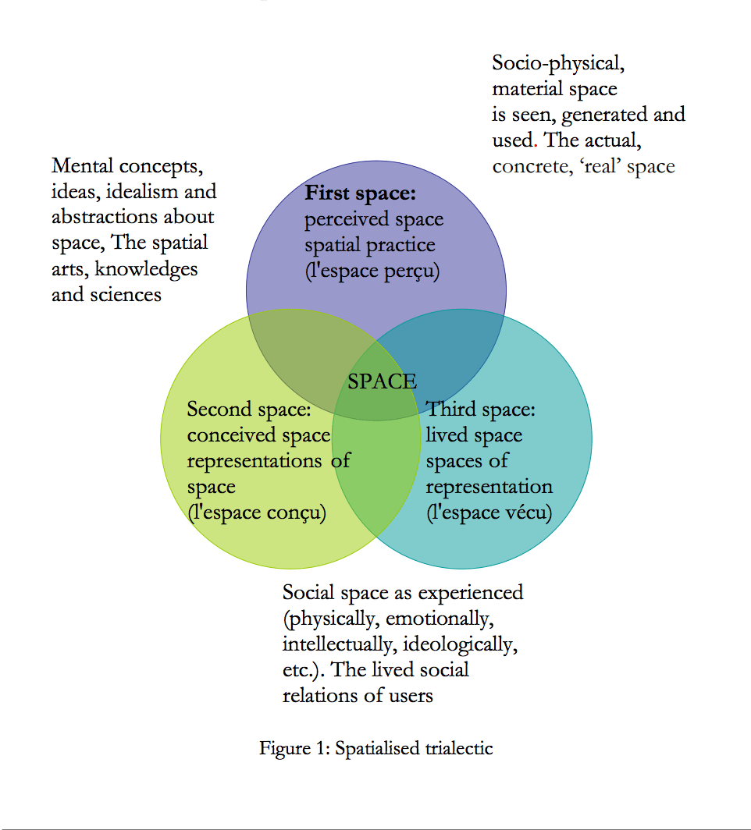
The Abstract Space of Knowledge Production
‘abstract space is that space where the tendency to homogenization exercises its pressure and repression with the means at its disposal’
(Lefebvre, 1991: 307)
https://www.peacebiennale.info/blog/henri-lefebvre-the-spatialised-trialectic/

Slide 5


Valuable Knowledge
‘there is a dissonance, a tension between our experiential realities and our consciousness, and that tension is intricately, sometimes paradoxically bound up in how we think’
(Carpenter & Mojab, 2017: 5)

Slide 6


Slide 7
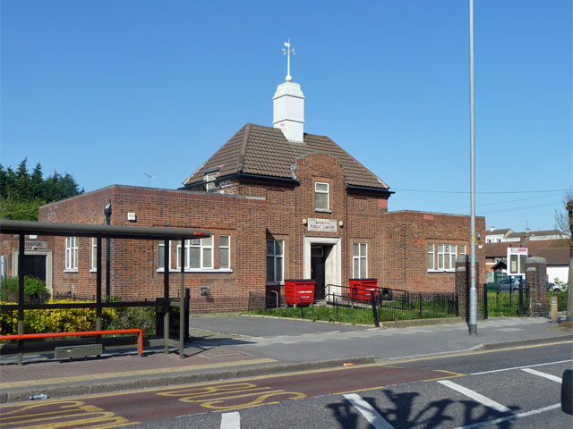
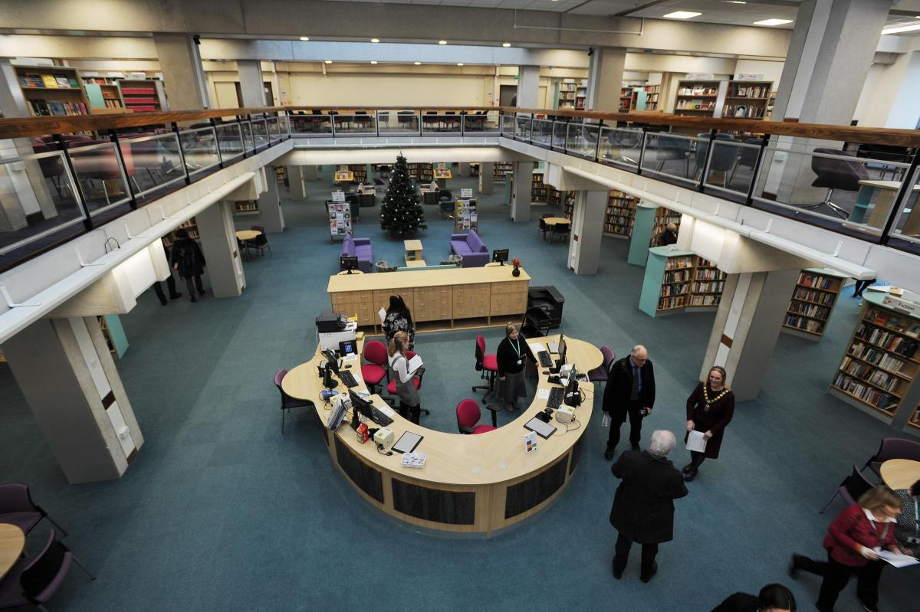
Relational class experience
‘how (does) the working class university student manage the difficulties of reconciling a working class background with the middle class environment of the university when one class culture is seen to have less value than another?’ (Raey, 2017: 102)

Slide 8
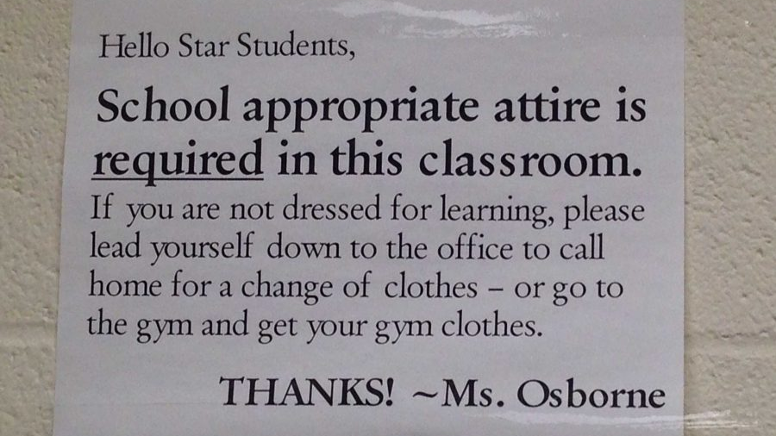
Social and economic conditions
‘The landscapes we inhabit can be regarded as physical and symbolic places, as intersecting and overlapping spaces, with multiple and changing boundaries, that are constituted and maintained by relationships of power, connections and exclusion’
(Thompson, 2000: 1)

Slide 9
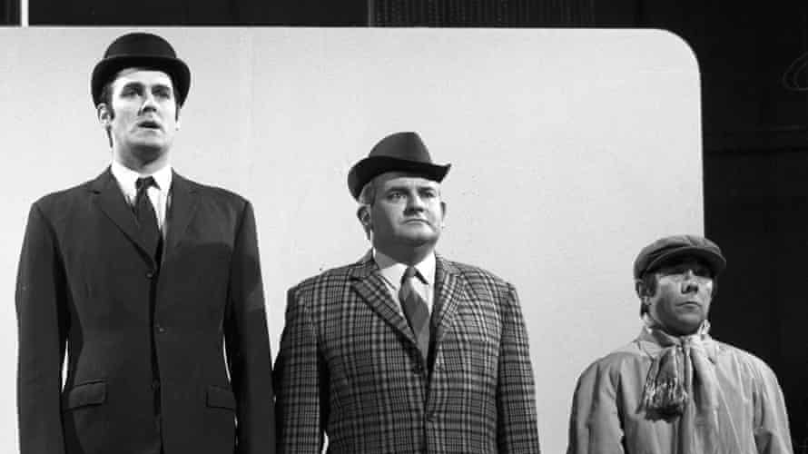
Narratives of escape
‘working-class culture is not point zero of culture; rather, it has a different value system, one not recognized by the dominant symbolic economy’ (Skeggs, 2004: 153).

Slide 10
Key Questions
What are we really doing to make Universities fully inclusive?
Can the conflict that occurs in abstract learning spaces be resolved?
What practical steps can we take to ensure the production of a more equitable production of abstract learning space?

Slide 11
References
Archer, Hutchings & Ross (2003) ‘Higher Education & Social Class’. Oxon: RouteledgeFarmer
Carpenter & Mojab (2017) ‘Revolutionary Learning: Marxism, Feminism & Knowledge’. London: PlutoPress
Lefebvre, H (1991) (Trans) ‘The Production of Space’. Oxford: Blackwell
Reay, D (2017) ‘Miseducation: Inequality, Education & The Working Classes’. Bristol: Policy
Skeggs, (2004) ‘Class, Self, Culture’. London: Routeldge
Thompson, J (2000) ‘Women, Class & Education’. London: Routledge

