Slide 1
Makers, catalogues and representation: some issues at UAL
Georgina Orgill | 6 February 2026
University Archives and Special Collections Centre
Notes:
GO
Welcome to this introductory session for the Collaborative Unit working with the Archives and Special Collections Centre.
[Introduce self and colleague]
We’ll be with you for two sessions over the next couple of weeks, during which we’ll be introducing you to some of the foundational concepts, practices and issues in archival theory and practice, with a particular focus on the archival practice of cataloguing.
Today we’ll be focusing on basic archival theory and introducing you to the collections you’ll be working with over the course of this unit.
NB: We’re going to be introducing you to many concepts from a professional archival context that are likely to be new and unfamiliar to you. All of it is helpful for you to know as researchers and practitioners as you move through this unit, but we don’t expect that by the end of this session you’ll be experts in archival theory. We also include lots of definitions and links on the slides -- these slides are available via your tutor / Moodle so you can feel free to reference them after the session too.
We want to highlight that you’re likely to leave with more questions than answers by the end of today, and we’re happy to think through these questions with you over the course of your unit.

Slide 2
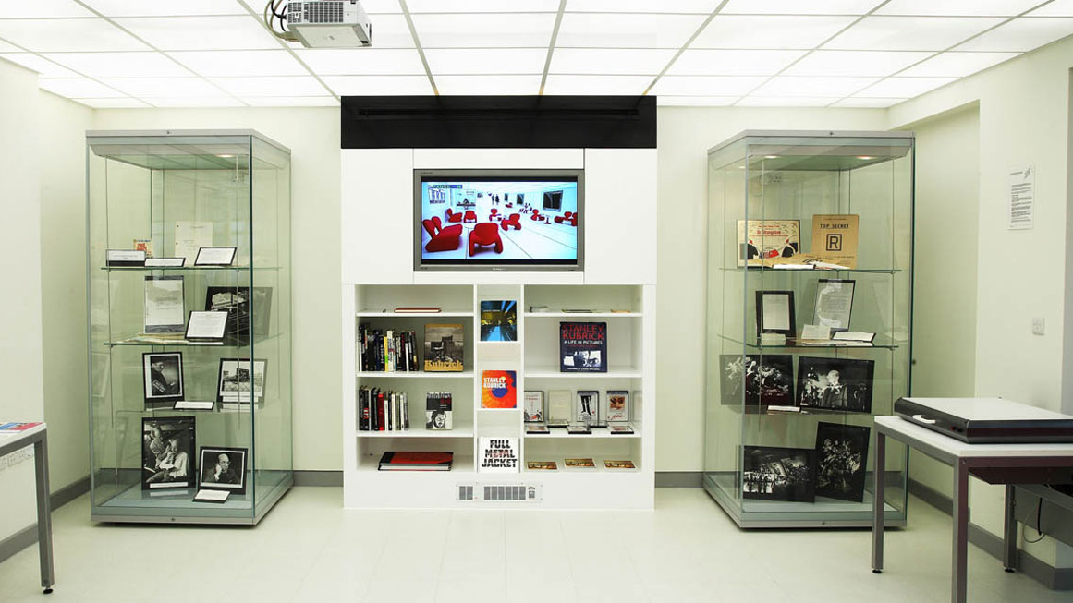

Slide 3
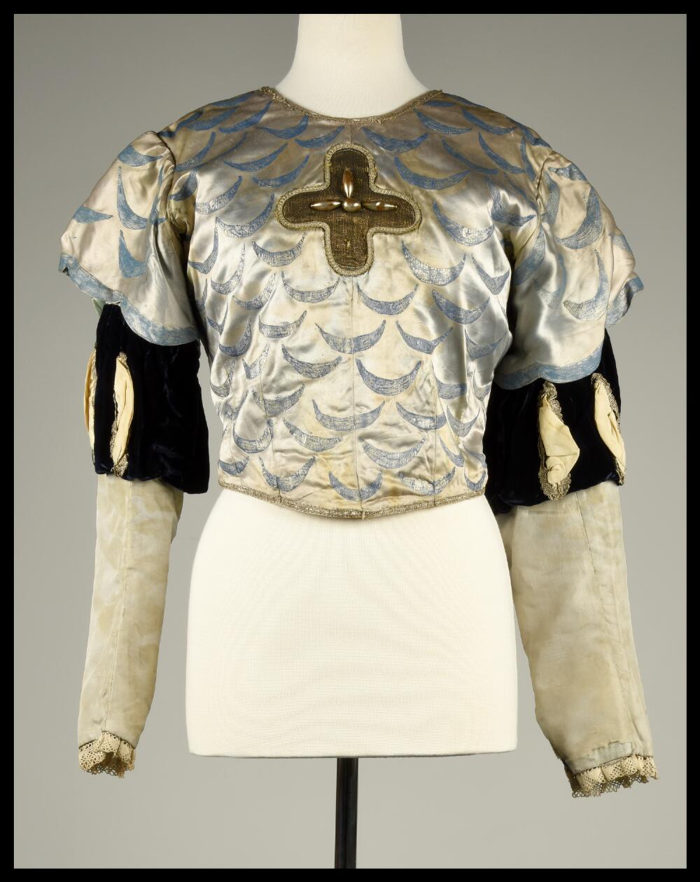
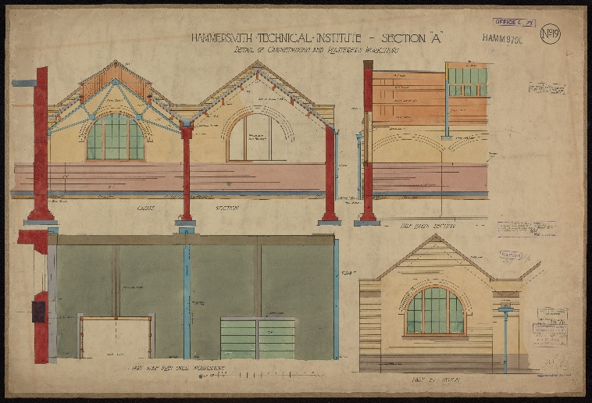
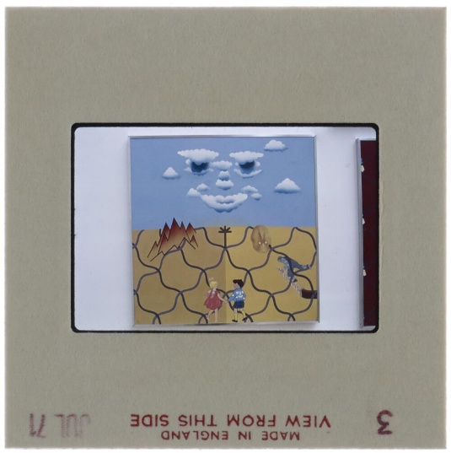
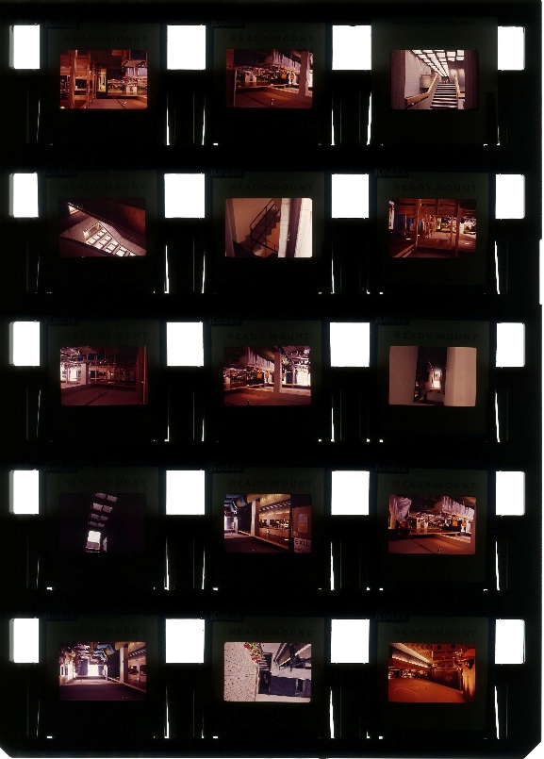
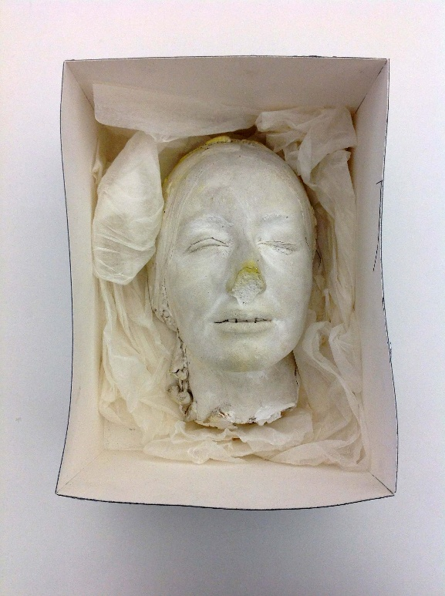
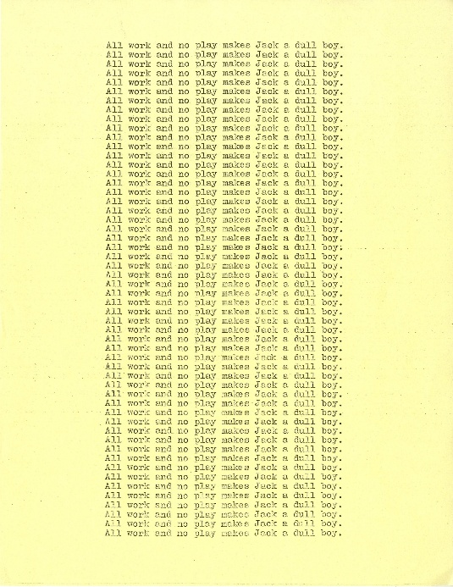
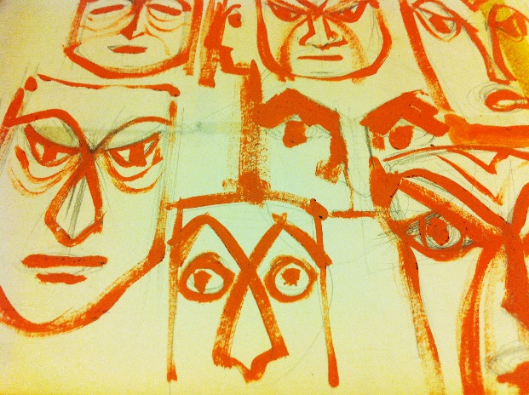
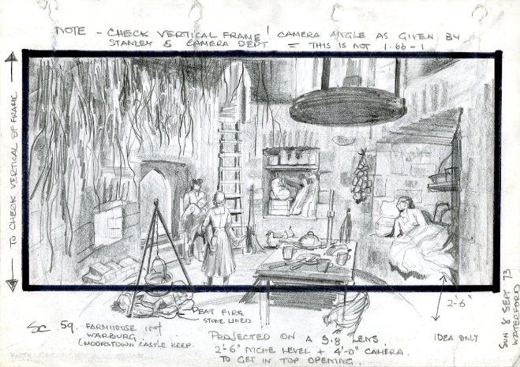
Notes:
GO
Archives are unique material, an ‘authenticity’ (primary vs secondary).​
A lot of material, new information can be found on a topic.​
Archives can act as a stimulus, check/confirm or challenge thinking about ideas and theories.​
Archives can show you the ‘behind-the-scenes’ of a process – for example, textile archives can show you the way a garment is constructed. Many archives will have draft material, which can help you see the decisions which underpin the ‘finished product’. ​
Archive research can contextualise your other research to get the most out of it. ​
Archives and collections offer physical material to which you can create a response – they can be used for inspiration or as a starting point for creative ideas​
​
Clothing and textiles
Building plans, set designs
Photographs, negatives, contact sheets, slides
Development work, e.g. scripts, correspondence
Artworks
Objects
Performance and performance documentation (film)
Digital material – Audiovisual material, websites, photogrammetry, virtual reality

Slide 4
“Archives have never been neutral – they are the creation of human beings, who have politics in their nature.”
Jarrett M. Drake, An NDSA Interview with Jarrett Drake (2017)

Slide 5
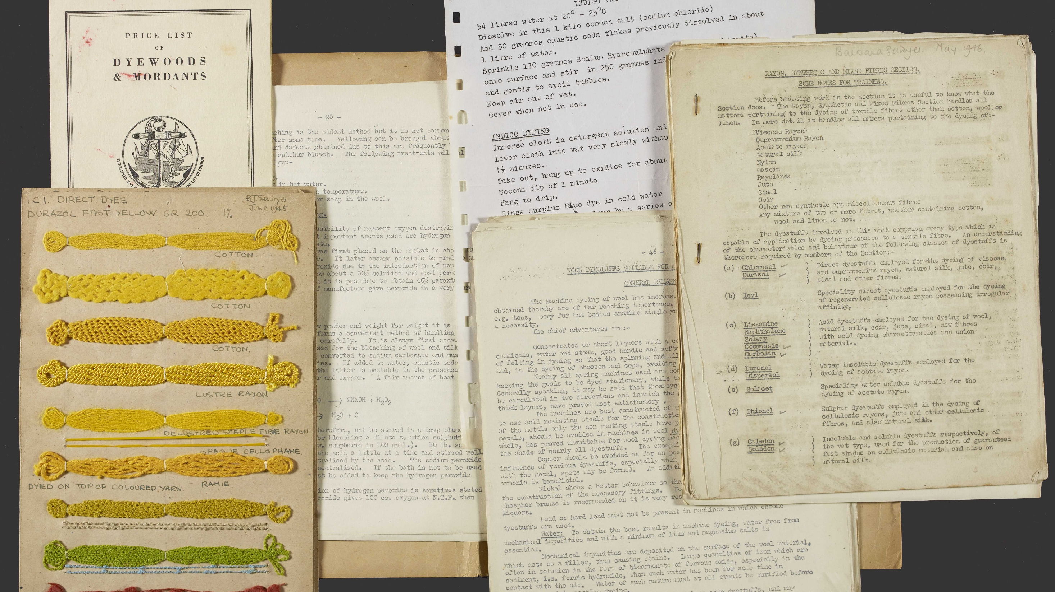

Slide 6
"...the creator...is not the one who made the memories, but the one who commodifies the memories into a collection."
Dorothy Berry, The House Archives Built (2021)

Slide 7
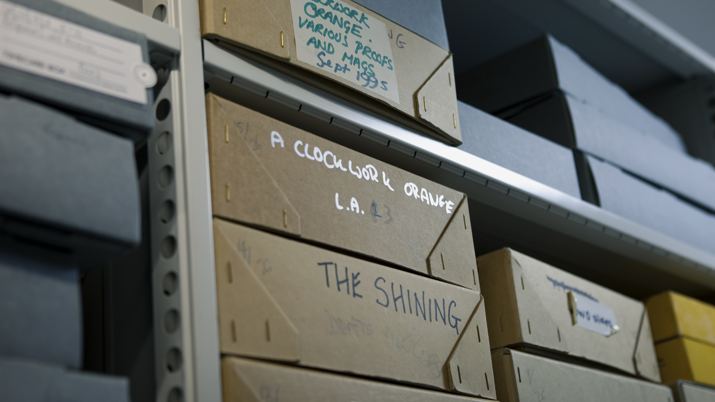

Slide 8
Questions?
Notes:
EL

