Slide 1
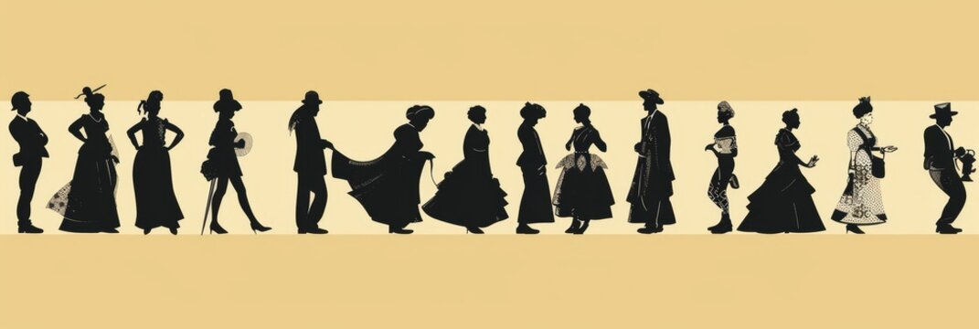
CHARACTER DEFINING a library journaling game about creating characters from the unexpected connections between books
By
David Smith

Slide 2
Action based research development
Can a gaming model utilise aspects of chance to help library users find undiscovered books?
Weeding project – books not being discovered
(2023, O’Farrell)
Sharing research in use of serendipity to discover books
(2024, Mckinnery)
Notes:
Action based research following a personal professional practice model: Marshall, J. (2016) First person action research: Living life as inquiry. London, England: SAGE Publications Ltd.
Running weeding project summer 2024, informed by: O’Farrell, S. (2023)‘Weeding at Westminster -wins, woes, and ways forward’. CPD25 Research Forum . 26 January 2023.
Shared feedback on profession practice from LILAC: Mckinnery, P. (2024) Serendipitous searching: taking art students on a visual research journey. LILAC2024 . 25 March 2024.

Slide 3
Games in the library context
GAME
Curated encounters with the unexpected
Roleplaying as empathy
Decolonising technique
Learning through fun
Fun
Walsh, A. (2018) The librarians’ book on teaching through games and play. Tallinn, Harju Maakond: Innovative Libraries.
Unexpected encounters
Borchgrevink, H. (2024) ‘Finding objects, connecting dots: Exploring serendipity as interruptive artistic strategy for audience interaction in public spaces’, Nordic Journal of Art & Research, 13(2).
Empathy
Karayigit, C. and Ozier, M. (2023) ‘Using character connection journaling to develop cultural empathy’, British Journal of Guidance & Counselling, 51(5), pp. 727–738.
Decolonising
Crilly, J. and Everitt, R. (2022) Narrative expansions: interpreting decolonisation in academic libraries. London: Facet Publishing.
Notes:
Fun principle that fun aids learning and engagement
That allowing an encounter that is unexpected, like the weeded book project, allows information to be rethought or creatively associated with other sources.
Empathy, that seeing things from other perspectives ethically empowering both personally and socially – practical form of social justice.
Decolonising is a practice

Slide 4

Finding an exemplar journaling game: The Last Teashop
Spring Villages (2022) Last Tea Shop Classic. Available at: https://springvillager.itch.io/last-tea-shop
Notes:
A game where you slowly disclose meaning from encounters to make sense from other unexpected contexts. Creativity is used to cohere meaning.
Last Tea Shop is a game about tea and storytelling. Set up your stall and wait for visitors to emerge from the mist. Over cups of tea, talk to visitors about their lives and help them prepare to travel into the Lands of the Dead. Record their thoughts, fears, dreams and hopes in your journal for posterity. Conversations reveal links between visitors

Slide 5
Character Defining – establishing the games principles
Create a central character through the interpersonal relations they have with other important people in their life.
Defining these important characters through the random selection of library books from a curated collection (designed with citational justice and social justice aims).
To allow time for the players to investigate and read the selected books.
For players to have time to share and tell each other about the characters they have created as a conclusion to the game
Notes:
Note the character theme is developed from empathy principle and Amita’s presentation: Nijhawan, A. (2024) 'Storytelling and Identity' [Lecture]. Learning Lounge Talks, UAL, 29 October 2024.

Slide 6
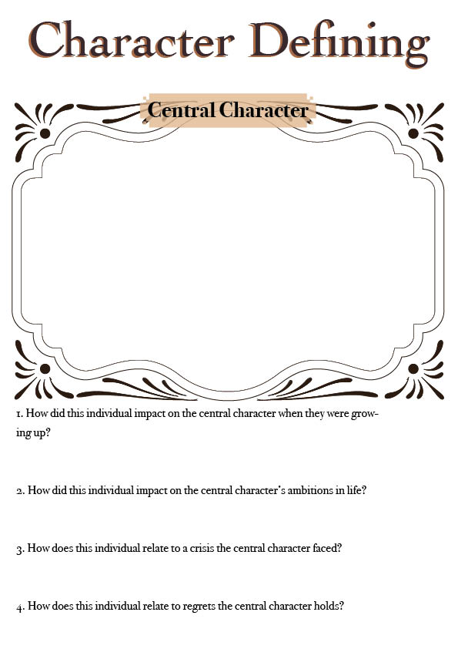
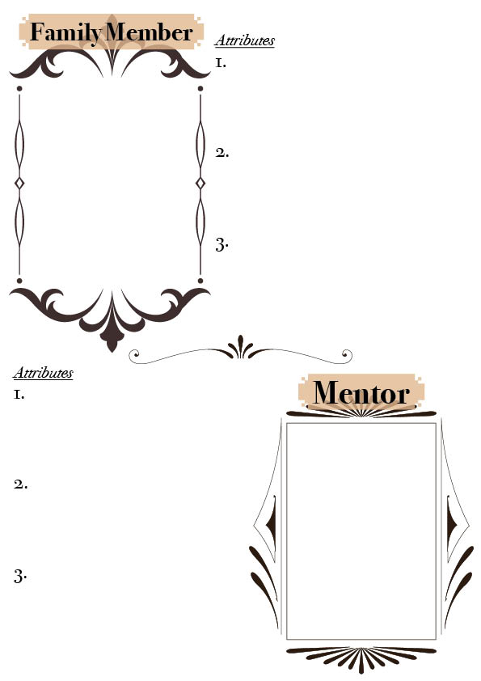
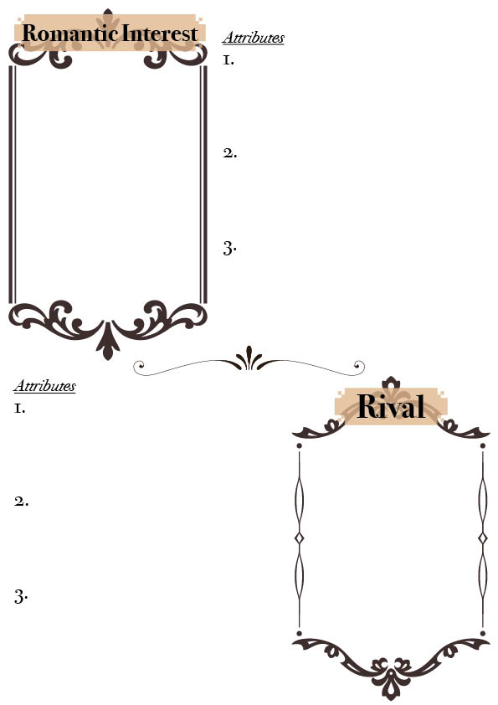
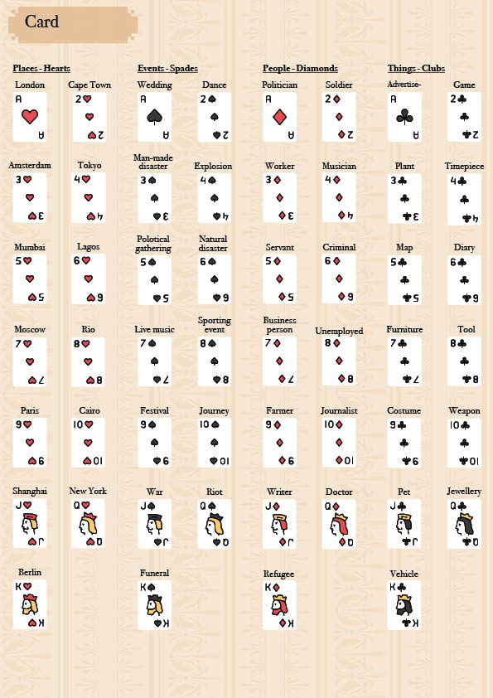
Designing the players’ character sheets
Notes:
Designed by Mara Della Devova

Slide 7
Curating the prompt bibliography – citational justice practice
52 cards x 6 dice rolls = 312 bibliographic references
Suits themed around places, people, objects and events
Each archetype/prompt should follow a process of decentering gravitational citations (Healy, 2015)
Roll a dice | ACE OF HEARTS - London
1 | Routes & remedies: Asian wisdom for living in London. (2006) London: Wellcome Trust.
2 | Bradley, L. (2013) Sounds like London: 100 years of black music in the capital. London: Serpent's Tail.
3 | Cooper, M. and Muir, R. (1999) Michael Cooper: the London sixties. Munich, London: Schirmer/Mosel.
4 | Gentle Author, (2017) East End vernacular: artists who painted London's East End streets in the 20th century. London: Spitalfields Life Books.
5 | Girouard, M. (1984) Victorian pubs. London: Yale University Press.
6 | Kheraj, A. and Boddy, T. (2021) Queer London: a guide to the city's LGBTQ+ past and present. Woodbridge, Suffolk, England: ACC Art Books.
Notes:
Healy, K. (2015) Gender and Citation in Four General-Interest Philosophy Journals, 1993-2013. Available at: https://kieranhealy.org/blog/archives/2015/02/25/gender-and-citation-in-four-general-interest-philosophy-journals-1993-2013/ (Accessed: Jan 8, 2025).

Slide 8
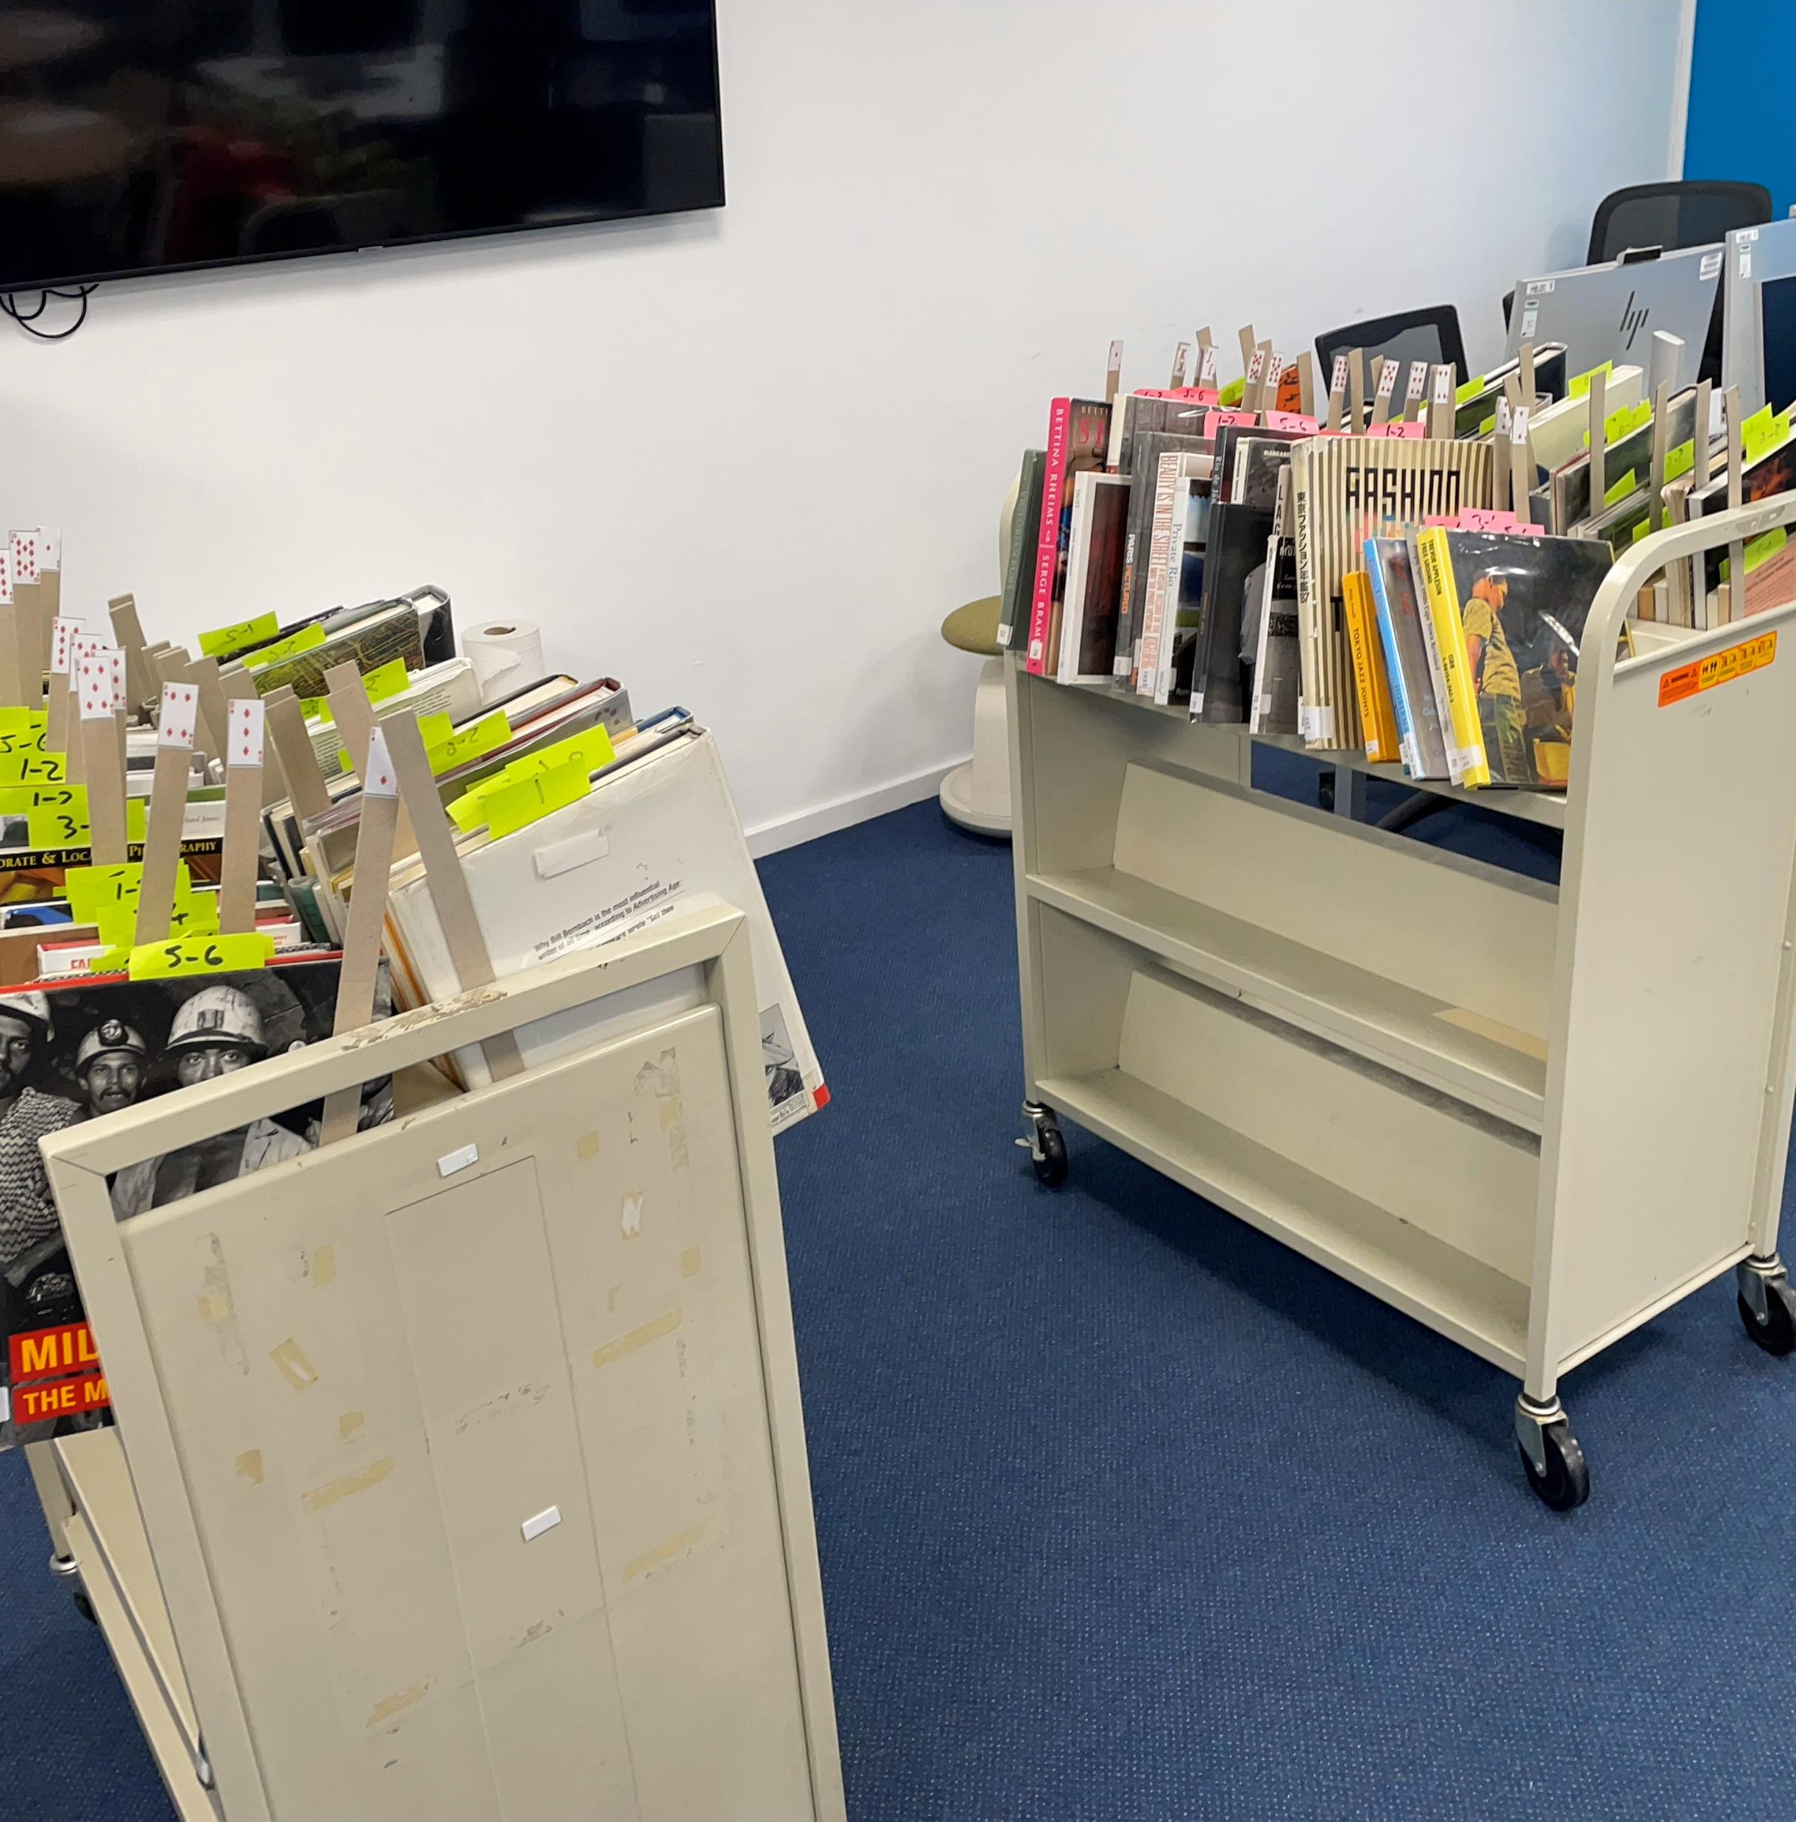
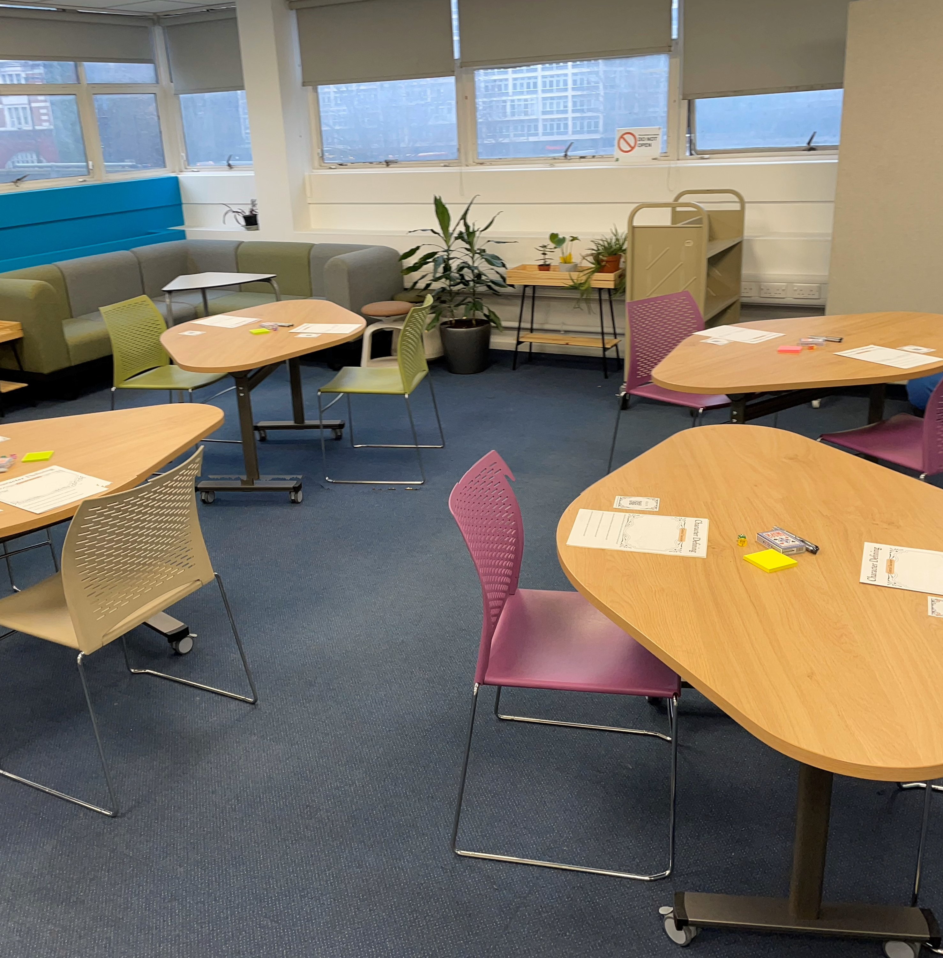
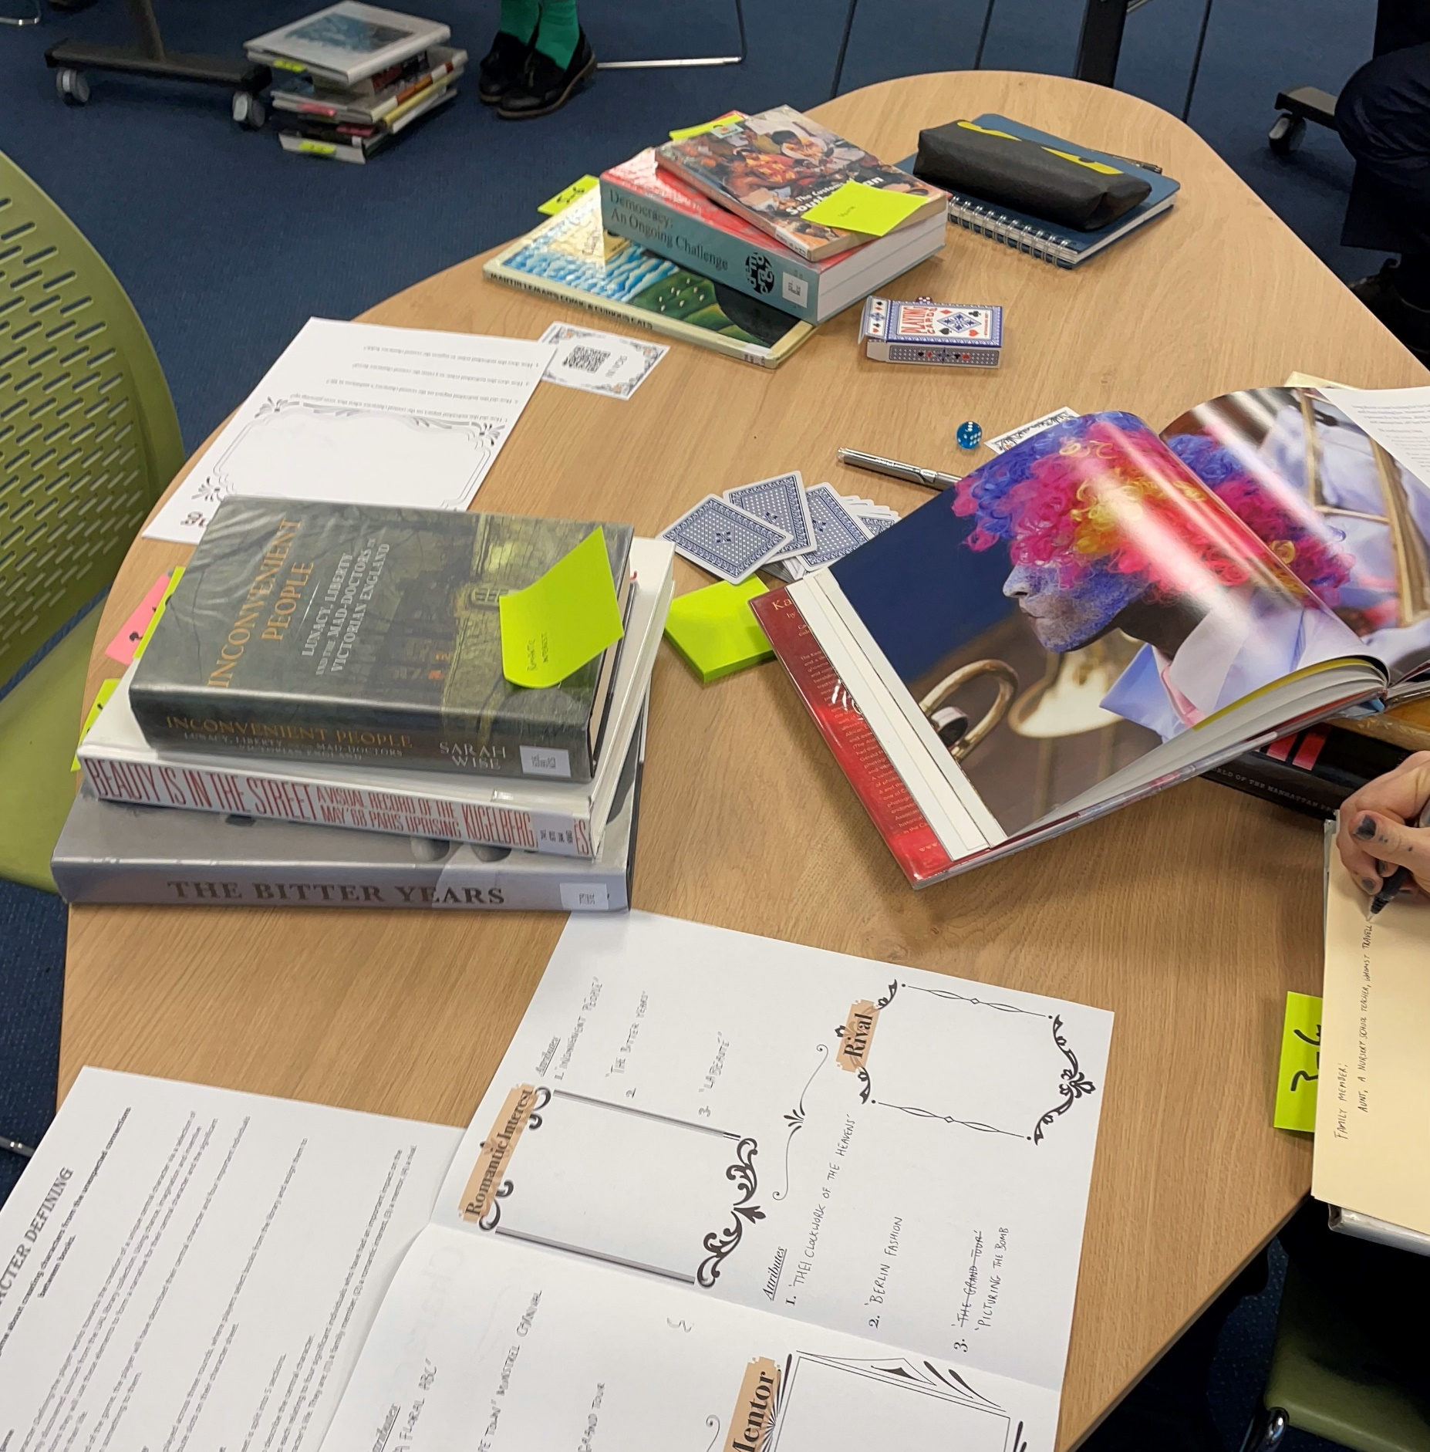
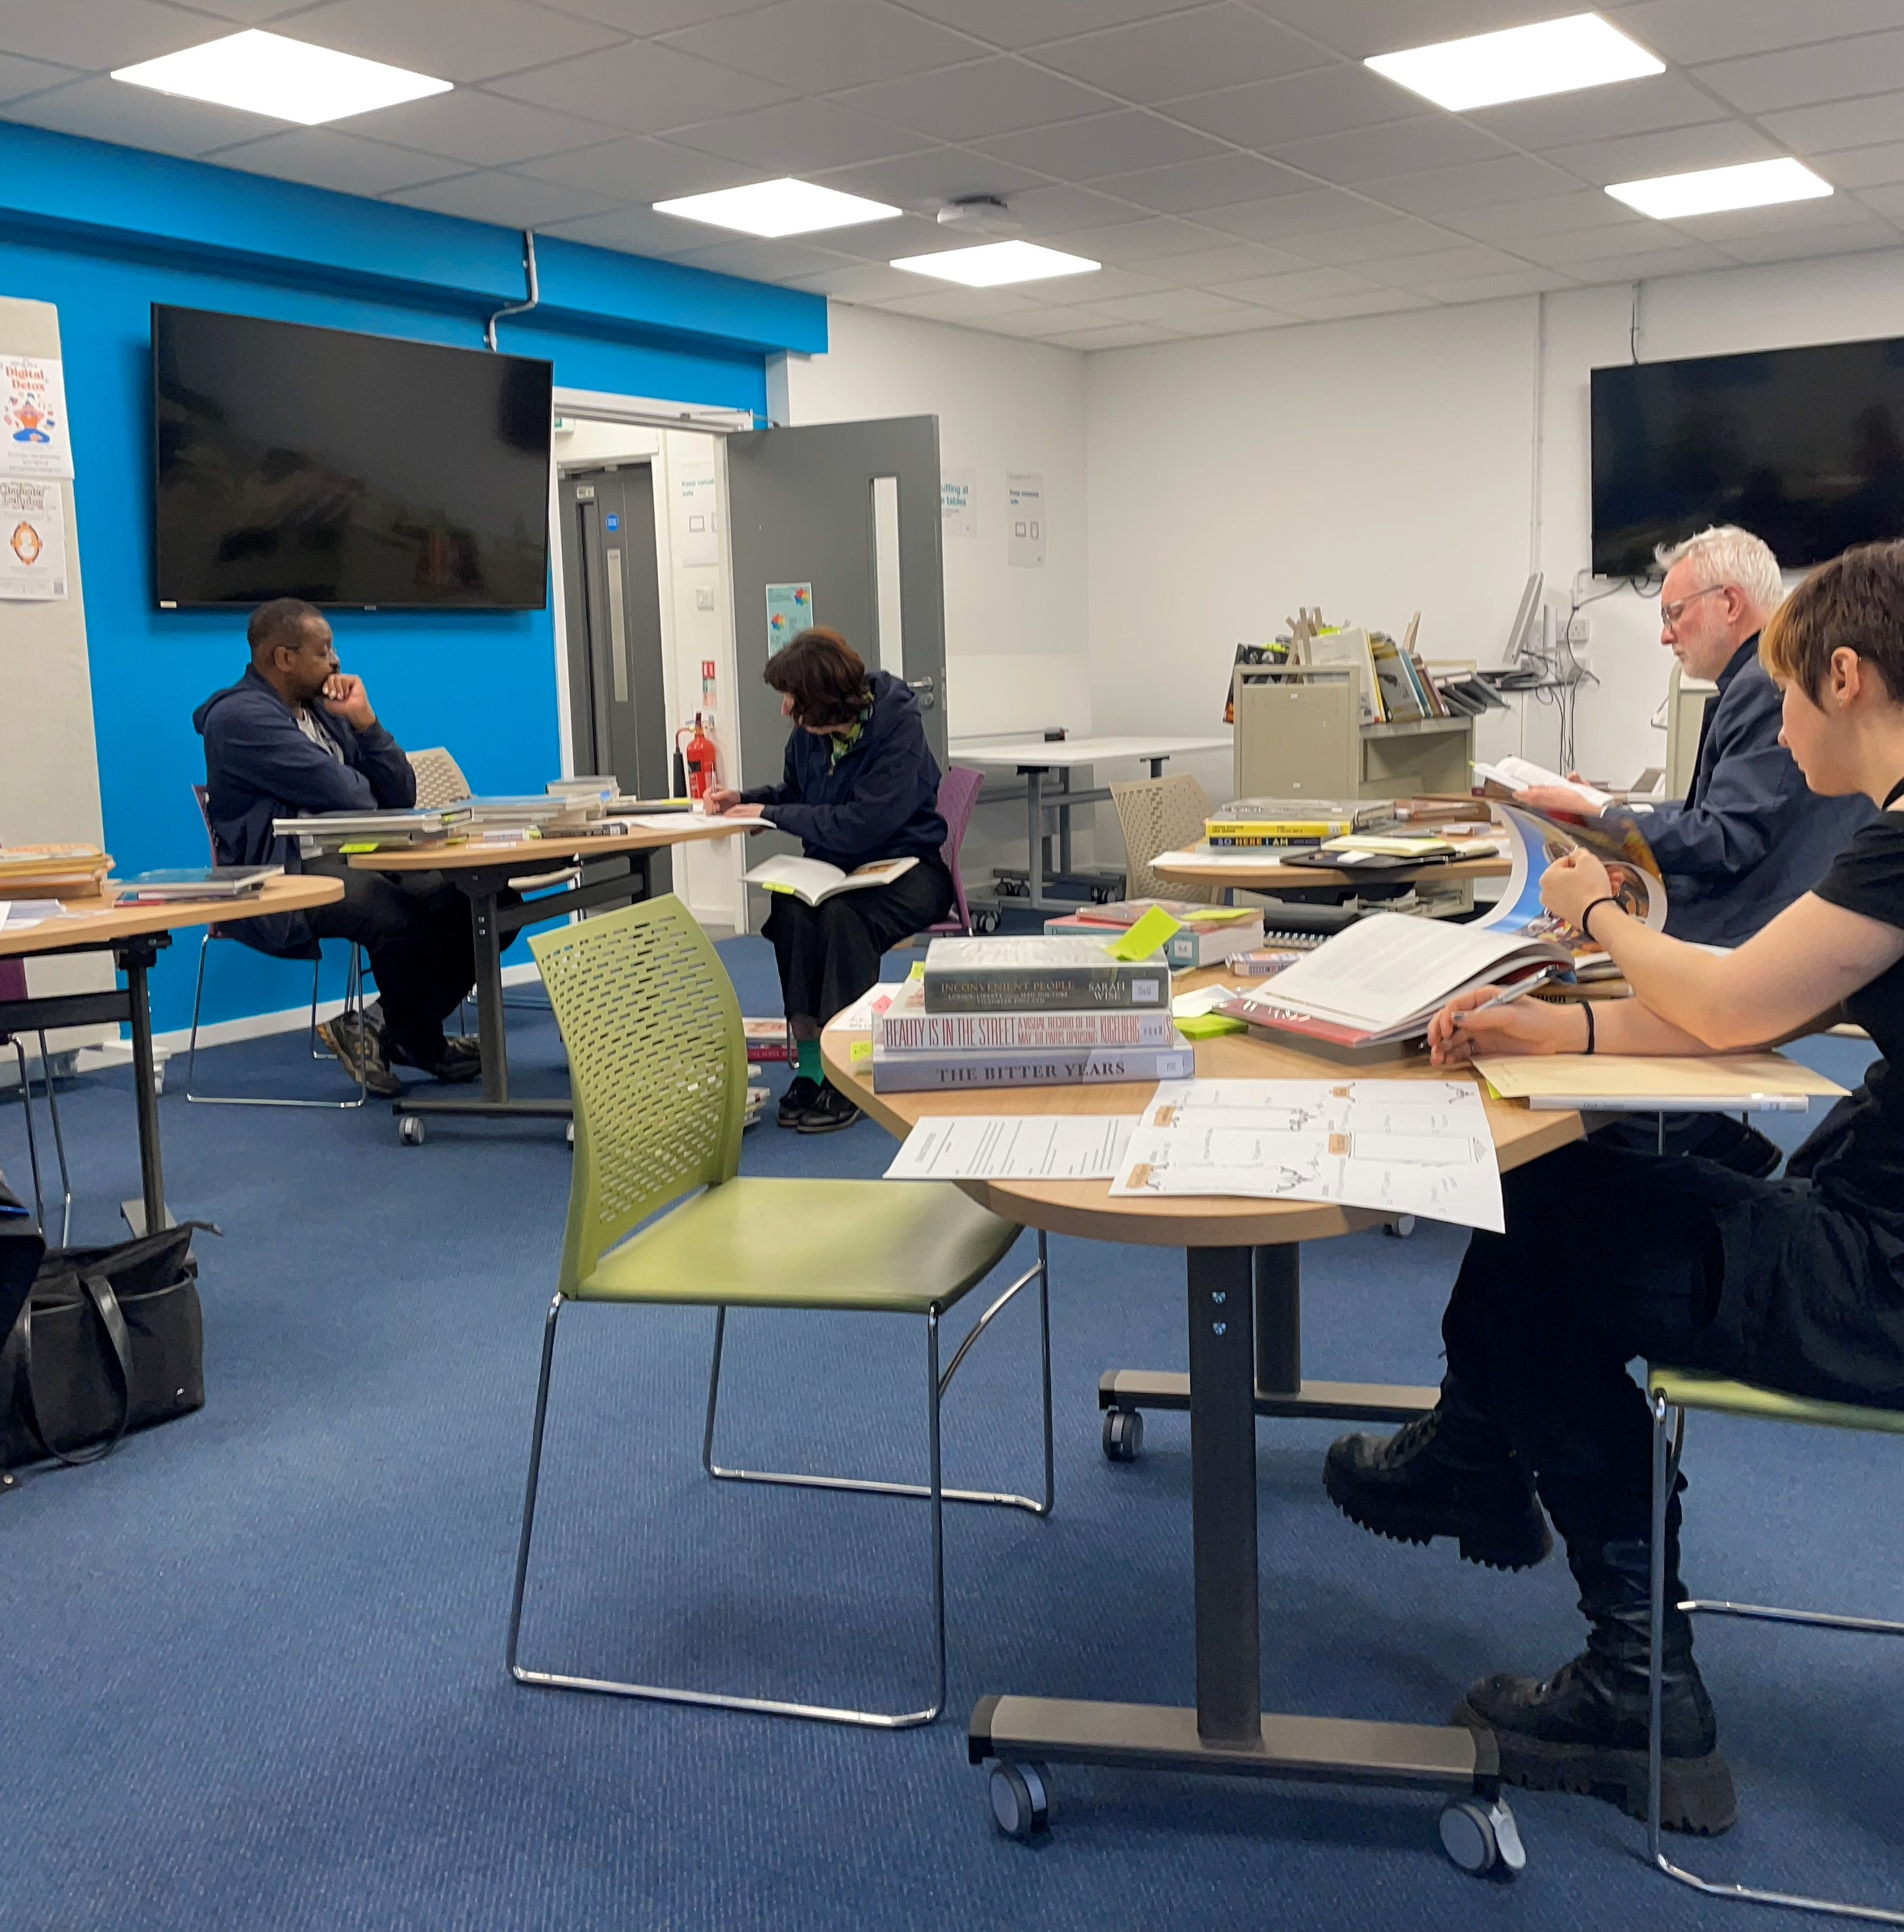
Playing the game
Observations:
Practical – accessing books, rule explanations, “how do I create a character”.
Player sharing – political motifs, wild associations, themes of travel and locations, recurrence of ethics and relationships to others.
Reflection on the game – process of creation, unexpected information, wanting to find out more about new topics (reference requests).
Notes:
Note mixed player demographic.
Study supplemented by an ethnographic approach, taking guidance from (Tjora, 2006) specifically its elucidation of Erlandson’s focus on the documentation and analysis of ‘critical events’. (Erlandson, D.A., Harris, E.L., Skipper, B.L. and Allen, S.D, 1993) As such I would keep a note of critical events that occurred during the session whilst also taking note of direct feedback as it was offered.

Slide 9
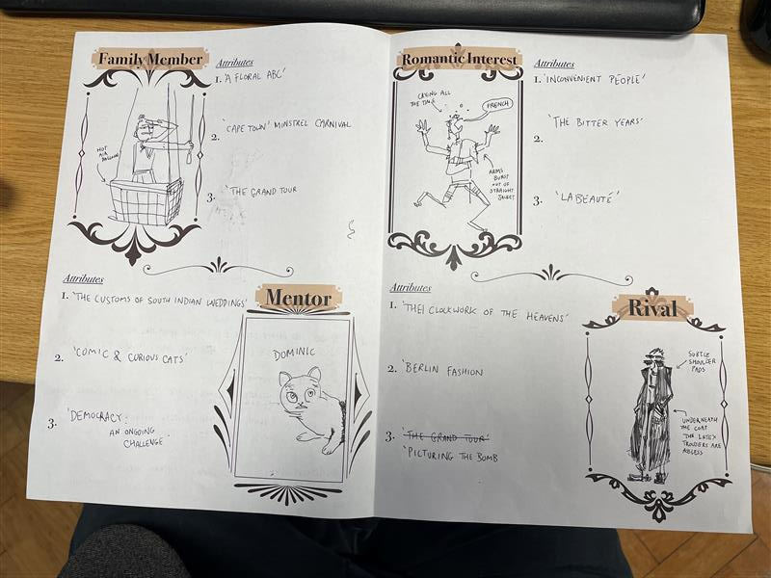
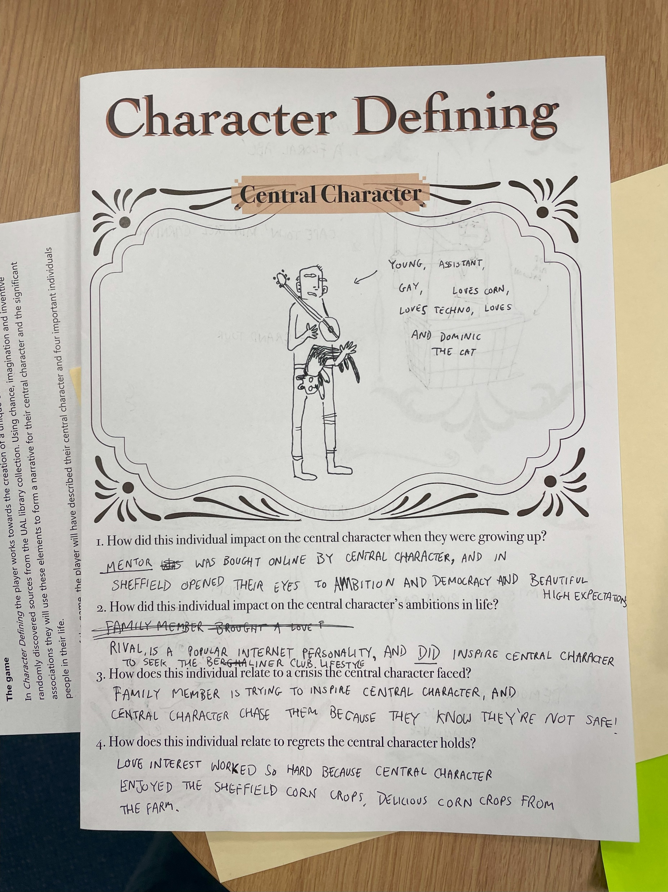
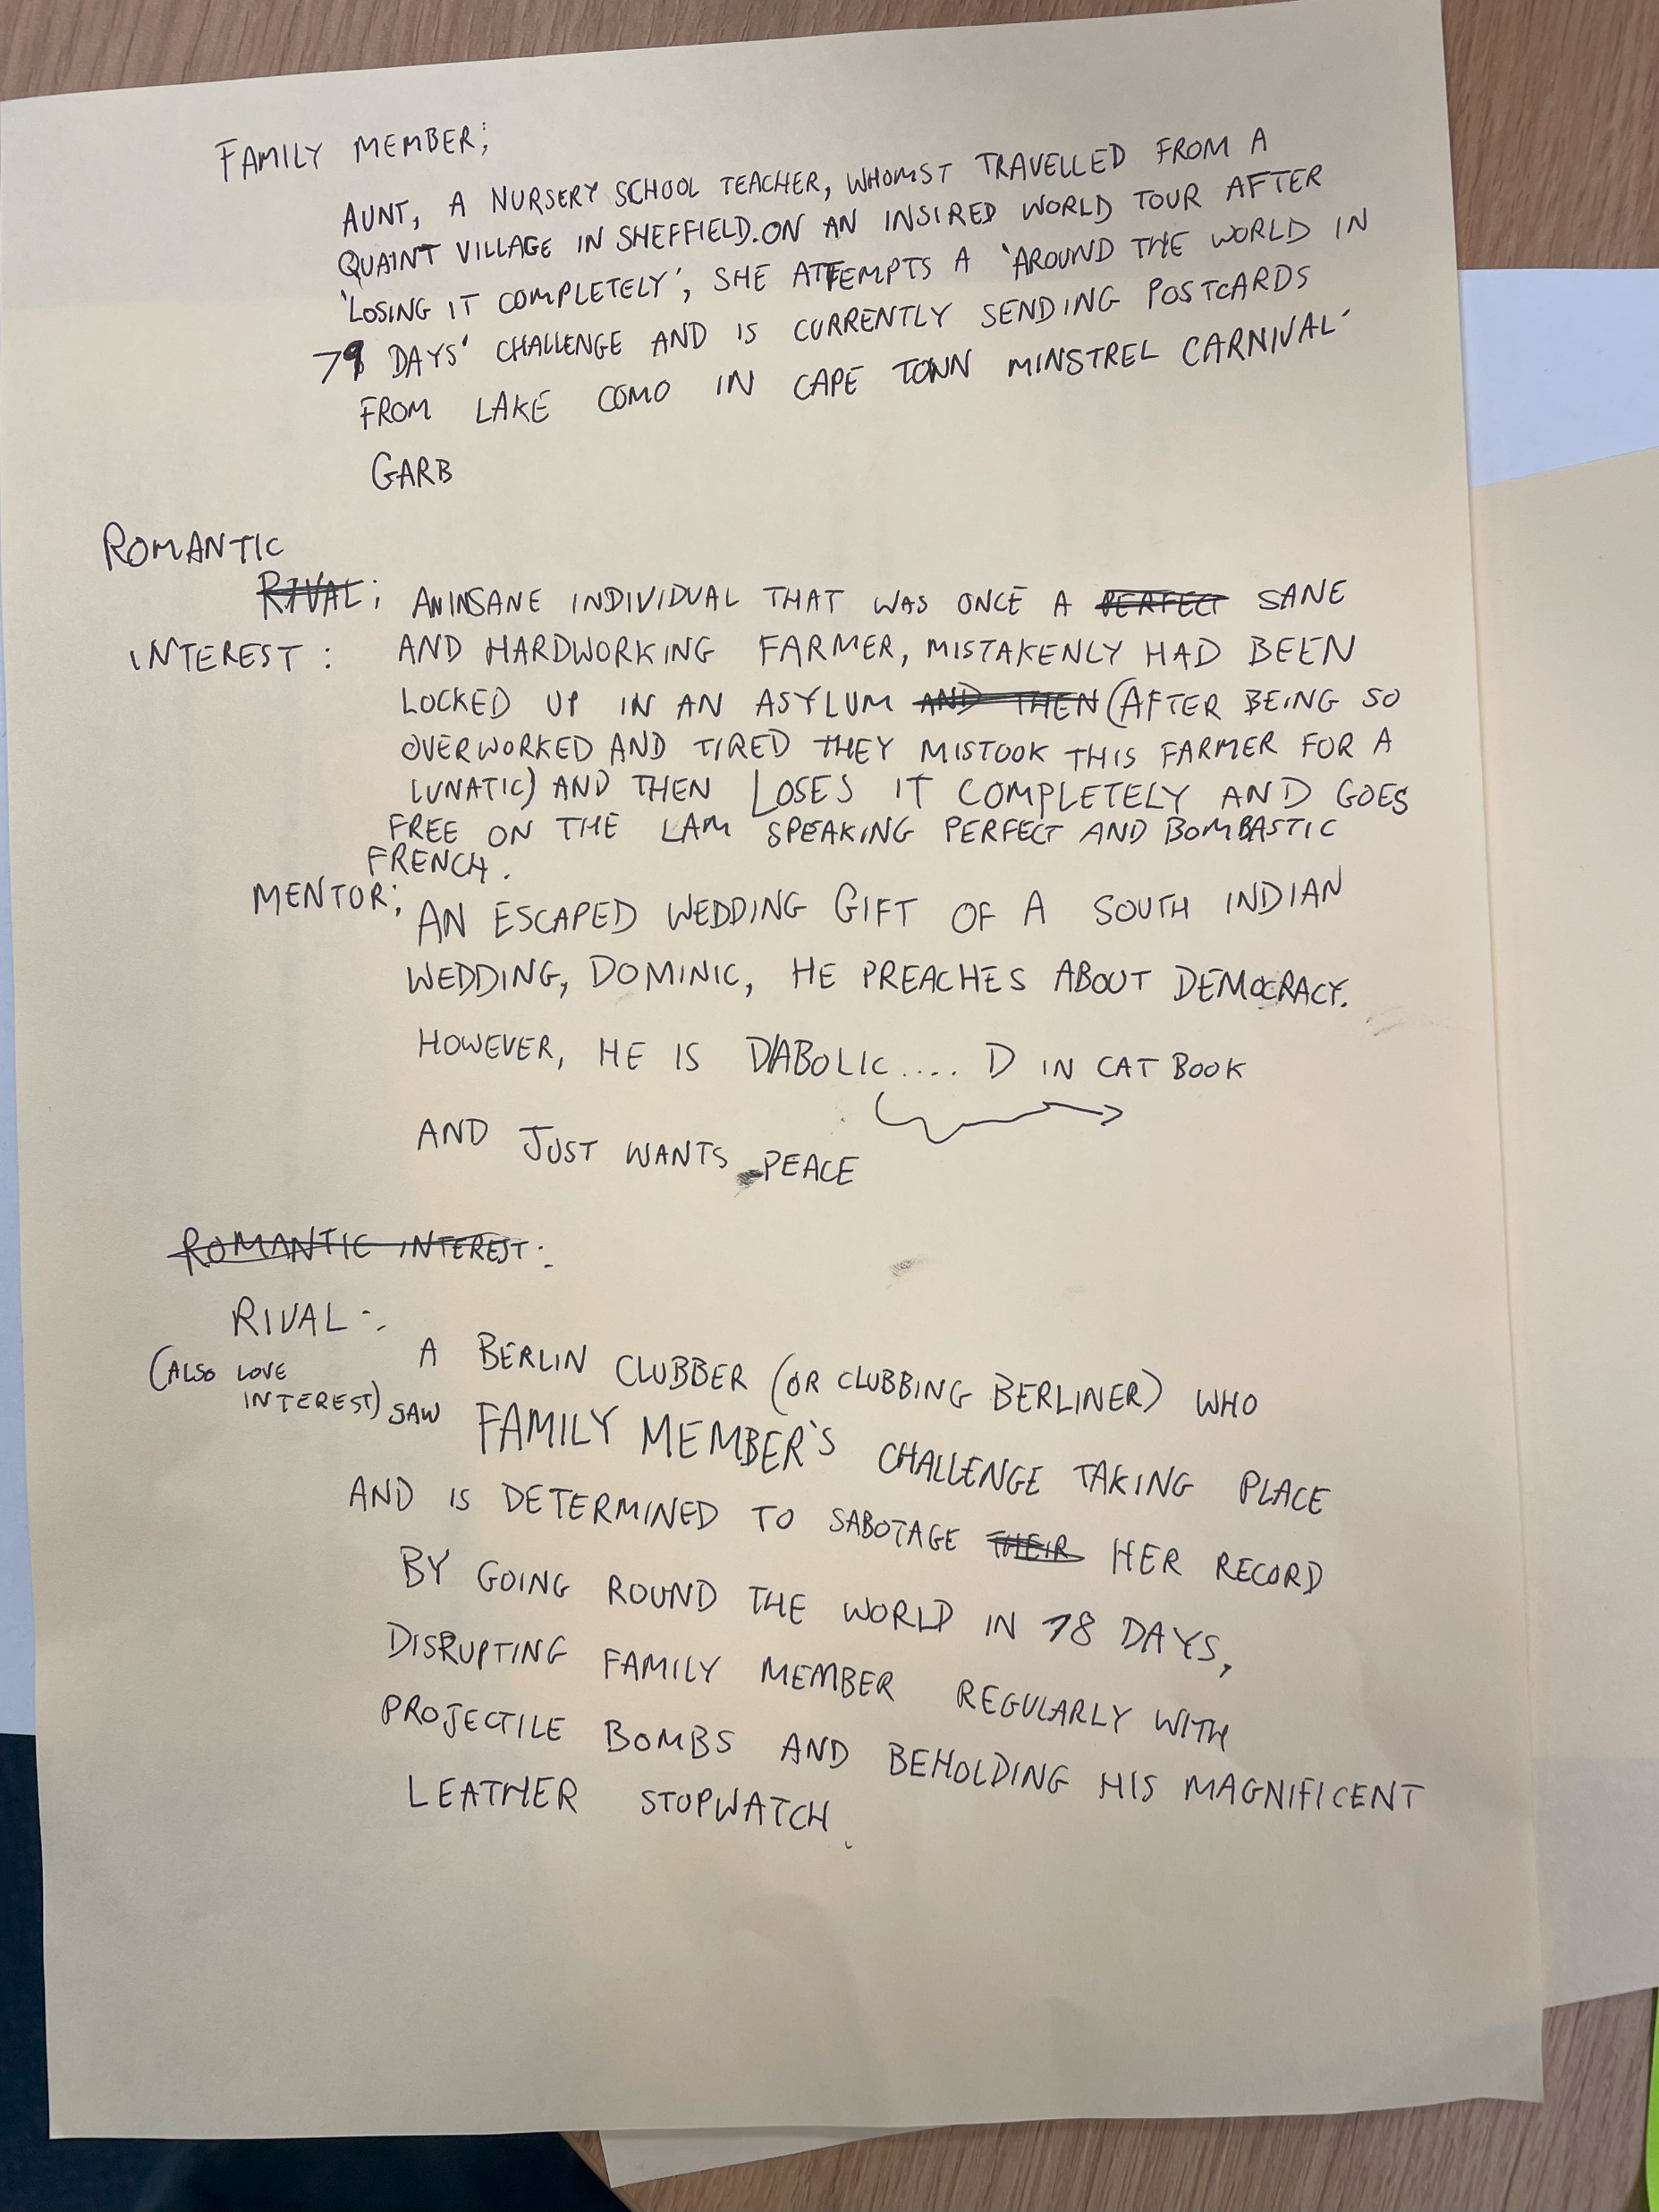
A player’s completed character sheet
Notes:
This student, who was working on the development of graphic novels., included detailed illustrations to accompany the written entries.

Slide 10
Analysing the character sheets
Question: does the creation of narrative forms from randomly selected library sources produce scenarios with more diverse characters and more inventive and critical stories?
Findings
Wide range of locations, and positive descriptions of travel and interaction with others’ cultures.
Expansive and diverse range of professions and ambitions.
3 of the 5 players explicitly raised issues that looked critically at their topics, raised ideals or described social justice scenarios.
Regular incidents of development through character interaction.
The gaming aspect of the session helped to stretch the imaginations of players.
Coding matrix
Geographic locations and places
Disciplines / practices
Presence of critical perspective or social justice
Links to other characters that expands one of the other codings
Innovative or novel connections
Notes:
I investigated storytelling approaches as ways of disclosure that “understand the participants” through their ways of recounting and exploring plots and characters. (Savin-Baden and Wimpenny, 2014 60) This was further nuanced using decolonising practices within the participatory art research context, where it was noted that storytelling can act as a way of processing critical and social issues in a way that shares through empathetic narratives. (Seppälä, Sarantou and Miettinen, 2021 166).
I found a short study looking at the coding and analysis of characters in Conan Doyle’s short stories. (Khalifatunnisa and Iftanty, 2023) The researchers had used coding techniques laid out in the Research methods in education; which I followed up and found very helpful, especially the notes on coding storytelling. (Cohen, Morrison and Manion, 2007 394–395).

Slide 11
Building gaming into future projects
Funded EDI project set up by MA Publishing students and run by Frania Hall and Sonali Misra
Choosing a curated collection of material from the historical printing collection
Adding aspects of role play to encourage empathy and historical context within an object-based learning scenario
Use of books as inspiration for other creative forms – using the photobook collection as prompts for sound art projects
Notes:
The outcome saw the use of gaming techniques in other sessions.

Slide 12
Notes:
Material used for the investigation of the historical print collection, including index cards and study room set up. An example page of the final publication: Details for: Decolonising the archive : eight artefacts from around the world / › UAL homepage catalogue. Student blog: Decolonising the Archive: An MA Publishing project deep-diving into the LCC library special collection | London College of Communication

Slide 13
References
Borchgrevink, H. (2024) ‘Finding objects, connecting dots: Exploring serendipity as interruptive artistic strategy for audience interaction in public spaces’, Nordic Journal of Art & Research, 13(2).
Cohen, L., Morrison, K. and Manion, L. (2007) Research methods in education. Sixth edition. edn. London: Routledge.
Crilly, J. and Everitt, R. (2022) Narrative expansions: interpreting decolonisation in academic libraries. London: Facet Publishing.
Erlandson, D.A., Harris, E.L., Skipper, B.L. and Allen, S.D (1993) Doing Naturalistic Inquiry. A Guide to Methods. Newbury Park, CA: Sage.
Khalifatunnisa, P.R. and Iftanty, E. (2023) Character Values in Sherlock Holmes Short Stories by Sir Arthur Conan Doyle: A Content Analysis.
Karayigit, C. and Ozier, M. (2023) ‘Using character connection journaling to develop cultural empathy’, British Journal of Guidance & Counselling, 51(5), pp. 727–738.
Marshall, J. (2016) First person action research: Living life as inquiry. London, England: SAGE Publications Ltd.
Mckinnery, P. (2024) Serendipitous searching: taking art students on a visual research journey. LILAC2024 . 25 March 2024.
Nijhawan, A. (2024) 'Storytelling and Identity' [Lecture]. Learning Lounge Talks, UAL, 29 October 2024.
O’Farrell, S. (2023) ‘Weeding at Westminster -wins, woes, and ways forward’. CPD25 Research Forum . 26 January 2023.
Savin-Baden, M. and Wimpenny, K. (2014) A Practical Guide to Arts-Related Research. Rotterdam: BRILL.
Seppälä, T., Sarantou, M. and Miettinen, S. (2021) Arts-based methods for decolonising participatory research. Milton: Taylor & Francis Group.
Spring Villages (2022) Last Tea Shop Classic. Available at: https://springvillager.itch.io/last-tea-shop
Tjora, A.H. (2006) ‘Writing small discoveries: an exploration of fresh observers’ observations’, Norwegian University of Science and Technology, Vol.(6(4)), pp. 429–451.
Walsh, A. (2018) The librarians’ book on teaching through games and play. Tallinn, Harju Maakond: Innovative Libraries.

