Slide 1



Presentation at the EURA Conference, Venice, Italy, 17-20 June 2026
Empowering the Silent: Institutional Designs for Translating Latent Political Preferences
Sing Hang Tam
Lecturer in Digital Creative Skills
University of the Arts London
s.tam@fashion.arts.ac.uk
Mengxue Lu
Doctoral Candidate
The Hong Kong Polytechnic University
helena.lu@connect.polyu.hk

Slide 2

2019–2020 Hong Kong Anti-Extradition Bill Movement
2025 Anti-Recall Campaign in Taiwan
Surveys indicated that around 66% of respondents opposed the proposal (Lai and Sing 2020, 46).
Poll results show that 61.4% were against the recall (TPOF 2025).
However, even at the largest rally, protest turnout reached 22% of the population (Lai and Sing 2020, 52).
56.26％ of the people voted for anti-recall campaign (Commonwealth Magazine 2025).

Slide 3
Urban Governance Dynamics—
Modified Framework of Prisoner’s Dilemma
 | Public cooperates (active participation, protest) | Public defects (disengagement, silence)
Government cooperates (responsive, reform-oriented) | Optimal collective outcome: responsive governance, social learning, urban improvement | Inefficient governance: reform without feedback; limited legitimacy gains
Government defects (repression, non-response) | High-risk / low-return outcome for public: legitimacy erosion, latent instability; high cost for public | Stable but suboptimal equilibrium: political stagnation, low trust, predictable control
Mutual defection, which is public disengagement and governmental non-responsiveness, is suboptimal yet risk-averse for both players.
Notes:
I’s unfair game because Gov always has the upper hand and no way for it to lose

Slide 4
Conceptualising the Tipping Point of Risk
“How far would things have to deteriorate for people in Hong Kong to risk their lives? That point has not yet been reached; and people are still far from wanting a revolution. In fact, what was called the ‘Umbrella Revolution’ was not a revolution at all. If you do not take up arms, how could you possibly overthrow a regime?”
Interview conducted with Hong Kong protesters in 2017
“Even if freedom is curtailed; if platforms such as Facebook and Instagram were to be censored; it would still be a far cry from making one revolutionary.”
Interview conducted with Hong Kong protesters in 2019

Slide 5

Hong Kong: Widespread Political Silence
Risk of Inaction
The political situation is deteriorating, the perceived risks of inaction is tolerable for many.
Potential Rewards
Massive but uncertain: The perseverance of political sovereignty.
Risk of Action
Unbearable: Pro-democracy media tycoon Jimmy Lai was arrest and 20 years imprisonment under National Security Law.
Risks of political action outweigh those of inaction, weighted against uncertain potential massive rewards.

Slide 6
Taiwan: Widespread Political Expression
Risk of Action
Minimal: Anonymous vote; no state retaliation.
Potential Rewards
Preservation of democracy and increased political efficacy.
Certain: Determined by referendum results.
Risk of Inaction
The risk of inaction is bearable for many; but it leads to worse political trajectory.
Risks of political action is minimal compared to those of inaction, accompanied with certain potential rewards.

Slide 7
The Paradox of Silence
Violence of
Silence
Compelling people to speak or act politically undermines the very freedoms democracy seeks to protect
Violence against
Silence
Democracy relies on people actively participating in political affairs
Notes:
perfect rights vs defective duties (by Fukuyama), High minimum voter turnout thresholds would only make the city more conservative

Slide 8
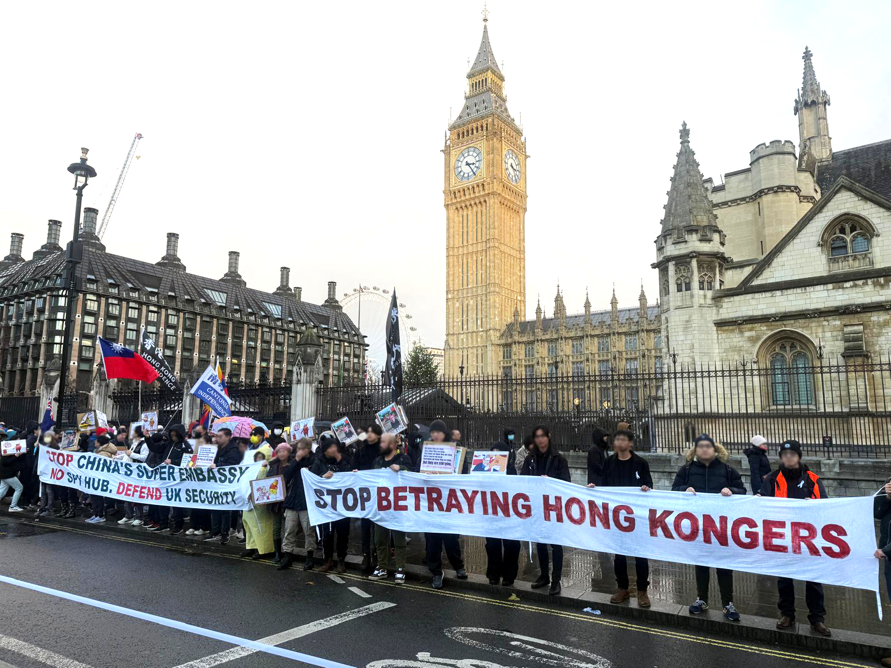
Democracy is the paradoxical power of those who do not count: the count of ‘the unaccounted for’ (Rancière and Panagia 2000, 124).

Slide 9
Question to Ask in Urban Governance
How can a democracy of non-participation be valid?
A more equitable framework that would
recognise and empower those who remain silent?

Slide 10
References
Commonwealth Magazine. 2025. Recall Campaign results. https://www.cw.com.tw/graphics/recall-2025/index.html Accessed on April 10, 2026.
Lai, Y. & Sing, M. 2020. Solidarity and Implications of a Leaderless Movement in Hong Kong: Its Strengths and Limitations. Communist and Post-Communist Studies, 53(4), 41–67.
Rancière, J. & Panagia, D. 2000. Dissenting Words: A Conversation with Jacques Rancière. Diacritics 30, no. 2: 113–26.
Taiwanese Public Opinion Foundation (TPOF). 2025. Political Attitudes and Voting Tendencies of Recall Voters (on August 17, 2025). https://www.tpof.org/wp-content/uploads/2025/08/20250811-%E3%80%8C823%E5%A4%A7%E7%BD%B7%E5%85%8D%E9%81%B8%E6%B0%91%E7%9A%84%E6%8A%95%E7%A5%A8%E9%81%B8%E6%93%87%E3%80%8D%E5%8F%B0%E7%81%A3%E6%B0%91%E6%84%8F%E5%9F%BA%E9%87%91%E6%9C%83%E5%85%AB%E6%9C%88%E5%8D%B3%E6%99%82%E6%B0%91%E8%AA%BF%E4%B9%8B2.pdf Accessed on December 10, 2025.

