Slide 1


From Passion to Withdrawal
A Nine-Year Longitudinal Study on Political Disengagement among Hong Kong Migrants in London
Sing Hang Tam
Lecturer in Digital Creative Skills
University of the Arts London
s.tam@fashion.arts.ac.uk

Slide 2
Emotional Trauma
among diasporic Hong Kong communities

Slide 3
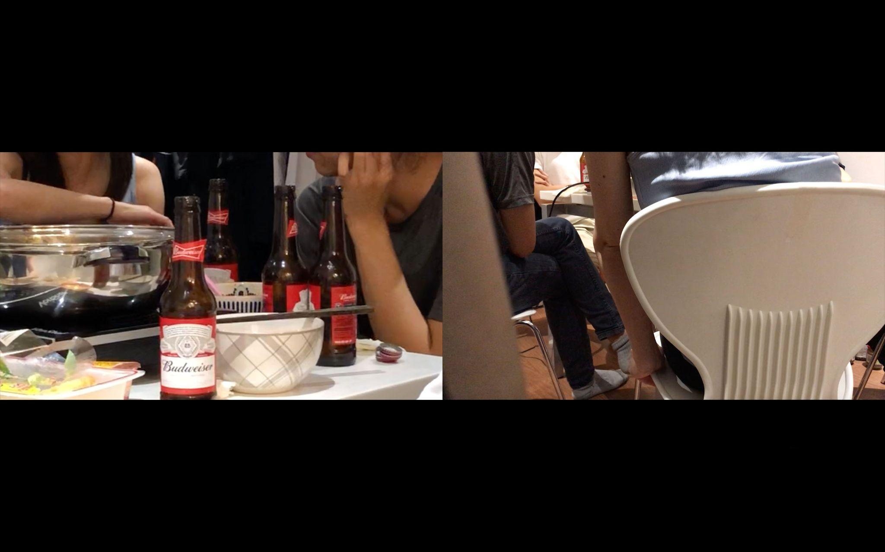
From Passion to Withdrawal: A Nine-Year Longitudinal Study on Political Disengagement among Hong Kong Migrants in London
(2019)
A: You either have the intention to leave, or you are fully committed to staying in Hong Kong.
C: Those who are fully committed to staying are doomed.
A: Both groups are disappointed.
D: But those who stay don’t necessarily agree with the pro-establishment ideology—they just don’t have the option to leave.
(Screenshot of the documentary, taken by the researcher)
Sing Hang Tam

Slide 4

From Passion to Withdrawal: A Nine-Year Longitudinal Study on Political Disengagement among Hong Kong Migrants in London
(2021)
B: People who say “I’ll never go back to Hong Kong” are actually being a bit irresponsible. Many people who can’t go back still want to.
C: That’s true.
A: Yes.
C: Unless you’re “uniquely lucky,” like an orphan whose entire family is dead.
A: But even then, Hong Kong is still where you grew up. Those memories are there; but now you can never go back.
E: Maybe we’re the lucky ones. I can imagine some people feel abandoned by society. Some took part in the protests and now have to escape elsewhere to avoid prosecution.
(Screenshot of the documentary, taken by the researcher)
Sing Hang Tam

Slide 5
Reimagining Nationhood
among diasporic Hong Kong communities

Slide 6
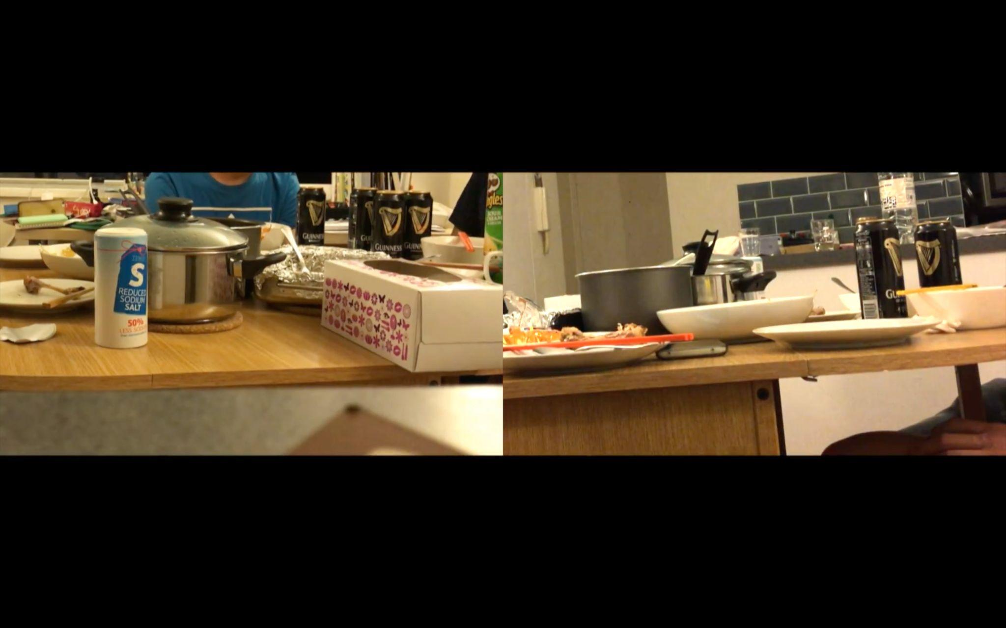
From Passion to Withdrawal: A Nine-Year Longitudinal Study on Political Disengagement among Hong Kong Migrants in London
(2017)
“I feel very homesick, but that doesn’t mean I want to go back. I just feel that I want to become more media literate—to be able to share and discuss these issues with others. I’m not saying I want to return to Hong Kong to develop my career. Right now, I feel homesick, but not to the point of wanting to stay there permanently. I still agree that Hong Kong is my root, but I feel very disappointed.”
(Screenshot of the documentary, taken by the researcher)
Sing Hang Tam

Slide 7
From Passion to Withdrawal: A Nine-Year Longitudinal Study on Political Disengagement among Hong Kong Migrants in London
(2019)
“The most intense feeling I had was the feeling of having a ‘Hong Konger’ identity, rather than a sense of achieve anything. People knew that they wouldn’t achieve much by sleeping on the streets in protest. But I knew that they were the only people with whom I share most of my identity. That was a great feeling. Not just any ‘Hong Konger’, but a specific group of people in Hong Kong. As you know, some Hong Kongers criticised those who slept on the streets. We are all Hong Kongers, but I don’t share my identity with those who verbally attacked the protesters. Only those who slept on the streets made me realise, ‘Wow, I share ninety percent of my identity with them.’”
(Screenshot of the documentary, taken by the researcher)
Sing Hang Tam

Slide 8
From Passion to Withdrawal: A Nine-Year Longitudinal Study on Political Disengagement among Hong Kong Migrants in London
(2021)
“After what happened in Hong Kong, similar social movements emerged elsewhere—such as in Myanmar and Israel [referring to Israeli-Palestinian conflict]. In comparison, Hong Kong’s protests were relatively peaceful when viewed globally. I have tried to pay attention to what is happening in places like Israel and Belarus.”
(Screenshot of the documentary, taken by the researcher)
Sing Hang Tam

Slide 9
From Passion to Withdrawal: A Nine-Year Longitudinal Study on Political Disengagement among Hong Kong Migrants in London
Local
Global
Hong Kong-centric
Comparative
Sing Hang Tam

Slide 10
From Passion to Withdrawal: A Nine-Year Longitudinal Study on Political Disengagement among Hong Kong Migrants in London
If a nation is necessitated by pain,
to what degree is pain shared?
Sing Hang Tam

Slide 11
Reimagining Democracy
among diasporic Hong Kong communities

Slide 12
From Passion to Withdrawal: A Nine-Year Longitudinal Study on Political Disengagement among Hong Kong Migrants in London
(2019)
“The idea is ‘if you say that you won’t throw bricks, then you are not on my side.’ How could that be? I should be able to support the movement without supporting the act of throwing bricks, right? However, even the space [of having discussions] seemed to have narrowed and disappeared.”
(Screenshot of the documentary, taken by the researcher)
Sing Hang Tam

Slide 13

From Passion to Withdrawal: A Nine-Year Longitudinal Study on Political Disengagement among Hong Kong Migrants in London
(2025)
“One must first be free in one’s mind. If you silence others simply because you disagree with them, then you do not deserve freedom, because you are not truly free. … If democracy does not exist within these groups, it cannot exist beyond them.”
“The visible organisations among diasporic Hong Kong people are too homogeneous. I am very privileged—because even when I doubt these organisations, I never doubt my own beliefs. … Some people have already started questioning whether decentralised organisations and collective decision-making are actually possible. Many are trying, but these organisations are still very experimental.”
(Screenshot of the documentary, taken by the researcher)
Sing Hang Tam

Slide 14
From Passion to Withdrawal: A Nine-Year Longitudinal Study on Political Disengagement among Hong Kong Migrants in London
Emotion
Reflection
Triggered by
internal divisions
Critique on
democracy as mentality/
Experimentation
Sing Hang Tam

Slide 15
From Passion to Withdrawal: A Nine-Year Longitudinal Study on Political Disengagement among Hong Kong Migrants in London
Fundamental paradox of democracy:
Democracy is simultaneously liberating and demanding.
Sing Hang Tam

Slide 16
From Passion to Withdrawal
A Nine-Year Longitudinal Study on Political Disengagement among Hong Kong Migrants in London
Sing Hang Tam
Lecturer in Digital Creative Skills
University of the Arts London
s.tam@fashion.arts.ac.uk

