Slide 1
Embedding Evaluation for Educational Excellence
Building staff-student partnerships to develop pedagogical practice
Dr Frania Hall, Media School, LCC, UAL.
ANTF Symposium – Newcastle 13th May 2026

Slide 2


RESOURCE SHOWCASE
https://positiveevaluation.myblog.arts.ac.uk/

Slide 3

ME AND THE MEDIA SCHOOL
Introduction
UNIVERSITY OF THE ARTS LONDON
Course leader Publishing
Teaching and Learning Lead Media School
1470 students
8 undergraduate 9 postgraduate courses
Evaluation project funded for 3 years so far – for staff participation and student engagement

Slide 4
Evaluation for teaching and learning
Introduction
‘Encourage teachers to claim the right to valid, rigorous and creative approaches to the evaluation of their courses and teaching’ Nygaard and Belluigi, 2011:690

Slide 5
THE PROBLEM
The Research
Teaching staff often feel distanced from institutional evaluation.
Evaluation is frequently retrospective, survey-led and disconnected from practice.
Staff innovation often unevidenced​
Staff on teaching pathways can feel work not recognised
Students engaged after learning, not during​ - it is not meaningful for them
Teaching excellence requires evidence of impact, transferable practice and collective leadership.​

Slide 6
Theoretical frameworks = evaluative cultures
The Research
Theory of Change
Student Voice
Staff as Stakeholders
Organisational Learning
Evaluation as practice

Slide 7
Criteria developed for evaluation
The Research
Research with institution case studies, UAL staff and students, building on extensive literature review, suggested the following criteria:
Reflective
Targeted
Iterative
Qualitative
Mixed methods
Inclusive
Ethical
Proportionate
Actions-oriented
Contextual
Embedded

Slide 8
What if
The Research
evaluation could be something staff own — creative, qualitative, embedded in practice, done in genuine partnership with students?

Slide 9
Positive Evaluation is:
The Approach
A process for student engagement
A process that takes account of student journey
A process for acknowledging context
A process for learning
A process for identifying what works and what doesn’t work
A process for experimenting
A process for connecting – staff/students; staff/staff
A process all are responsible for

Slide 10
Staff/Student Evaluation Alignment
The Approach
Students:
Reflect on learning as they progress through unit, identify areas to focus on, develop learning literacies
Staff:
See how learning happens, assess effectiveness, identify what works/doesn’t work based on evidence, adapt ongoing

Slide 11
The Framework
The Approach
Grounded in qualitative research methods​
Designed to be embedded in day-to-day practice​
Staff choose their own research question​, own the data
Students are partners — not just respondents​
Captures what works and why, not just satisfaction scores
Best practice shared, iterative – not reinvention

Slide 12
IMAGINE
The Approach
- You’re planning an innovative session. You want to understand whether it works with the students — and to be able to show it.
But you want to avoid end of unit survey because you want to know how it is going now
And hear from students who may never do surveys
Where do you start?
https://positiveevaluation.myblog.arts.ac.uk/

Slide 13
The resource
The Resource
A framework – ethos of evaluative thinking, evaluative culture, empowered, meaningful
Step by step – easy to adapt and implement 3 stage process
Toolkit – inclusive tools – worksheets, templates, suggested activities to collect student voices
Outputs – project reports, project outlines with data, summarized for top level ideas
Resources – from institutions like QAA and advance HE as well as academic literature

Slide 14











The blog sections
The Resource

Slide 15
3 stage framework
The Resource
Step 1
Design form
Research question
Step 2
Data Collection
Touch points
Step 3
Analysis
Practice sharing
Toolkit
Reflections
Next steps and iteration

Slide 16
Design through a unit/session.
The Resource
Flexible depending on scale of project – unit-long, afternoon workshop, specific intervention etc.
Touchpoints are 10 min max at the start/end of a session
start
touch point 1
touch point 2
end point
Mid-point reflection

Slide 17
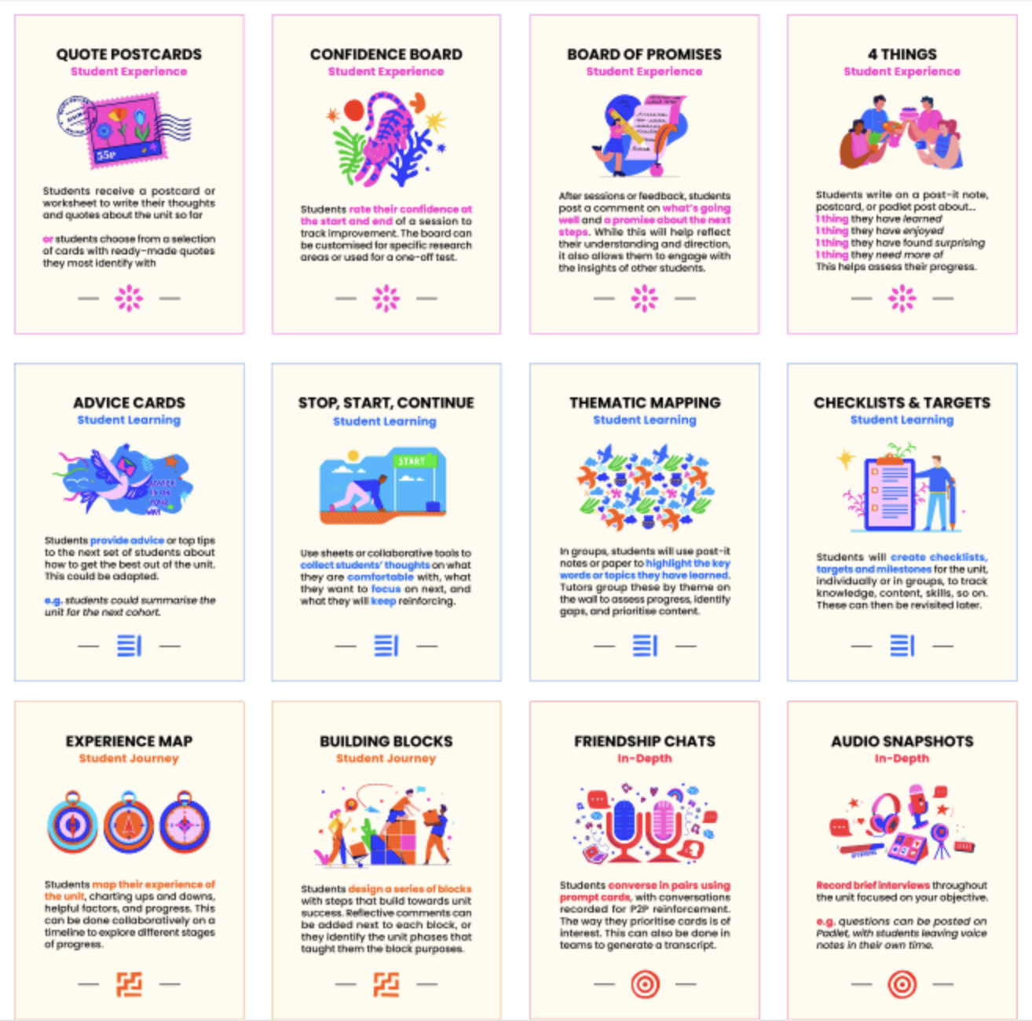
TOOLKIT
- deck of qualitative methods -

Slide 18

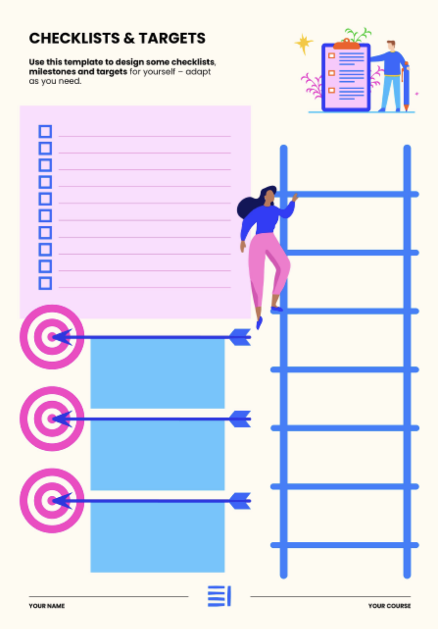
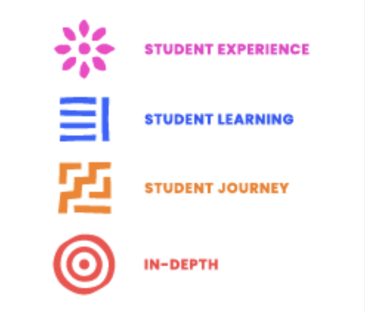
Tools for different purposes
Hear students in their own words
Student plan out targets for themselves

Slide 19

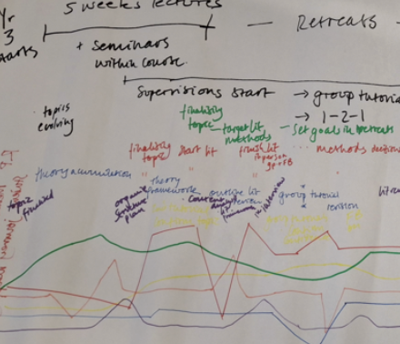
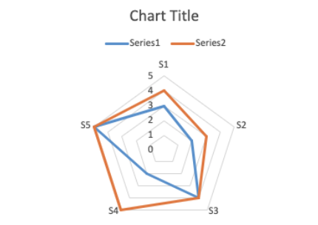
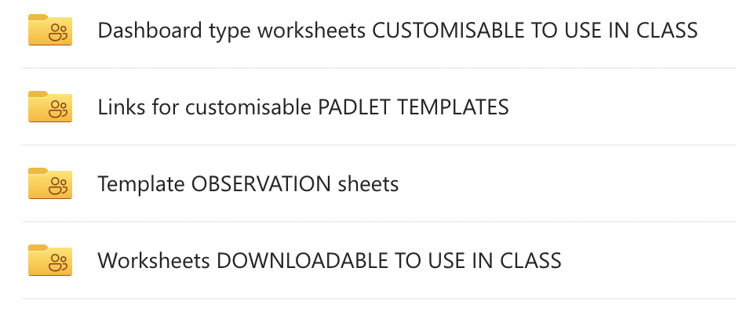
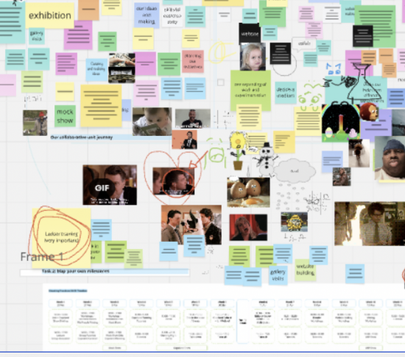
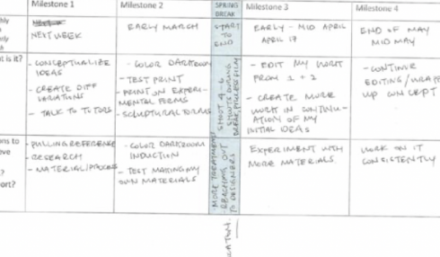
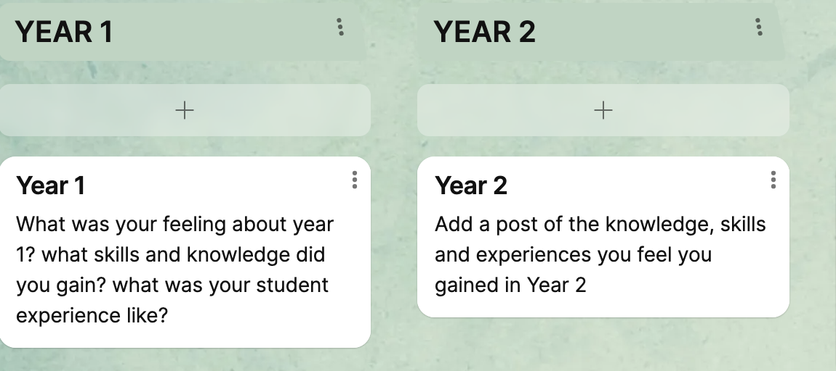
Other methods
Notes:
We also use additional data like tutorial records, attainment data, course- level statistics etc.

Slide 20
How does this look in practice?

Slide 21
1. The Research Project – restructured
In Action
Year 3 Undergraduates, 4 BA Programmes – 185 students - 3 years of data
9+
data collection methods
192
data points
annual increase
In attainment
91%
Draft submission rare
Annual evaluation - tools from the resource used:
Confidence mapping dashboards at writing retreats
Observation sheets (retreat days)
Student focus group & journey mapping
Staff reflection forms
Advice cards,
End-of-unit surveys
Attendance/, tutorial records, VLE usage

Slide 22
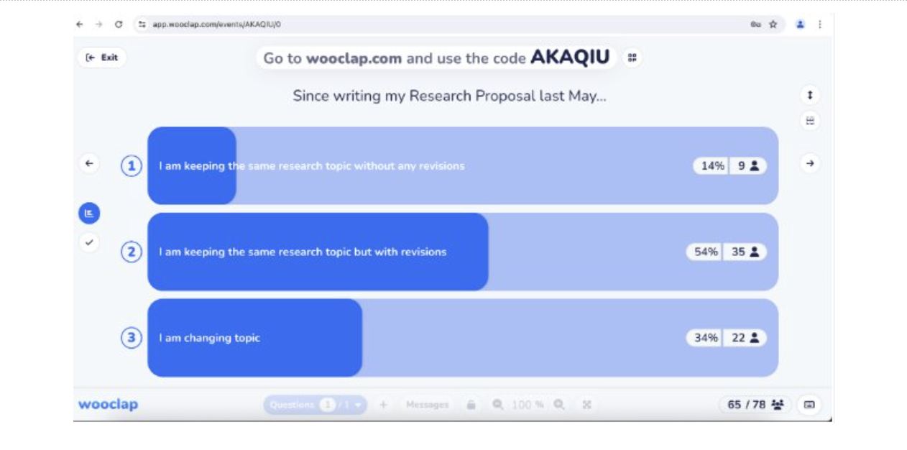
Examples of data sets - polls
In Action
This poll worked well as a very quick test of something specific

Slide 23
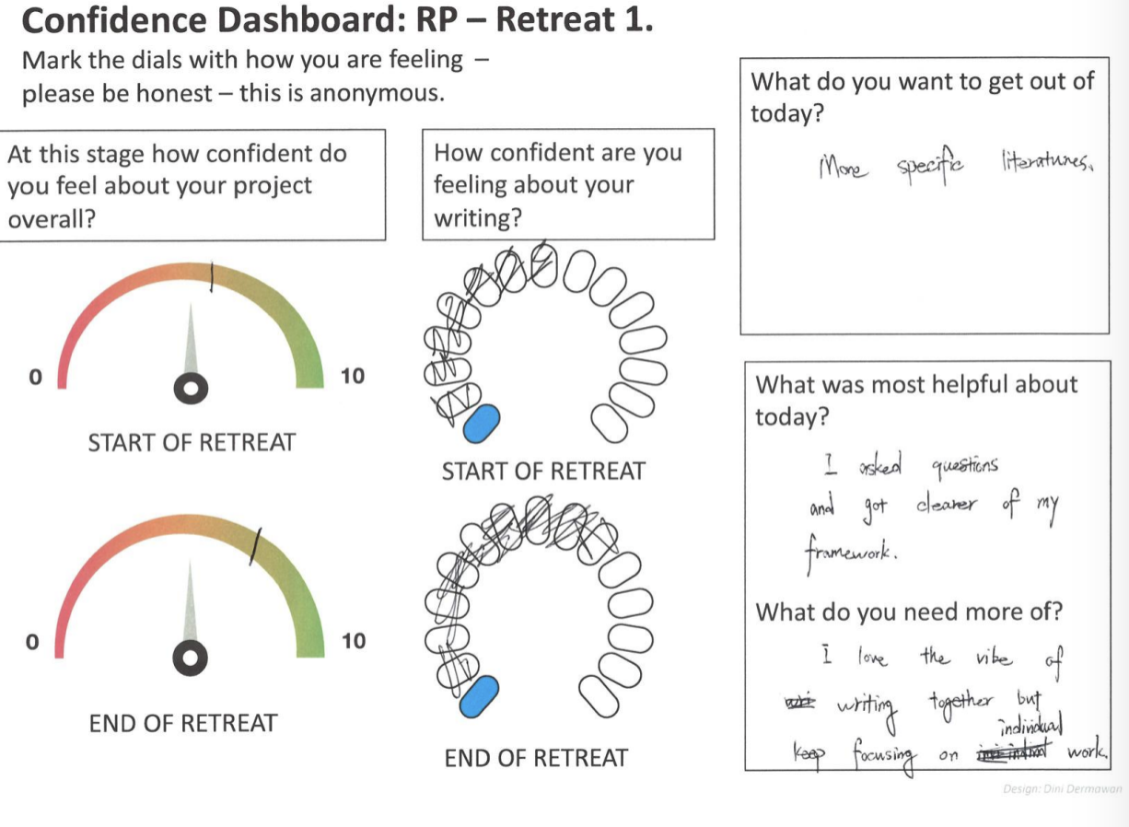
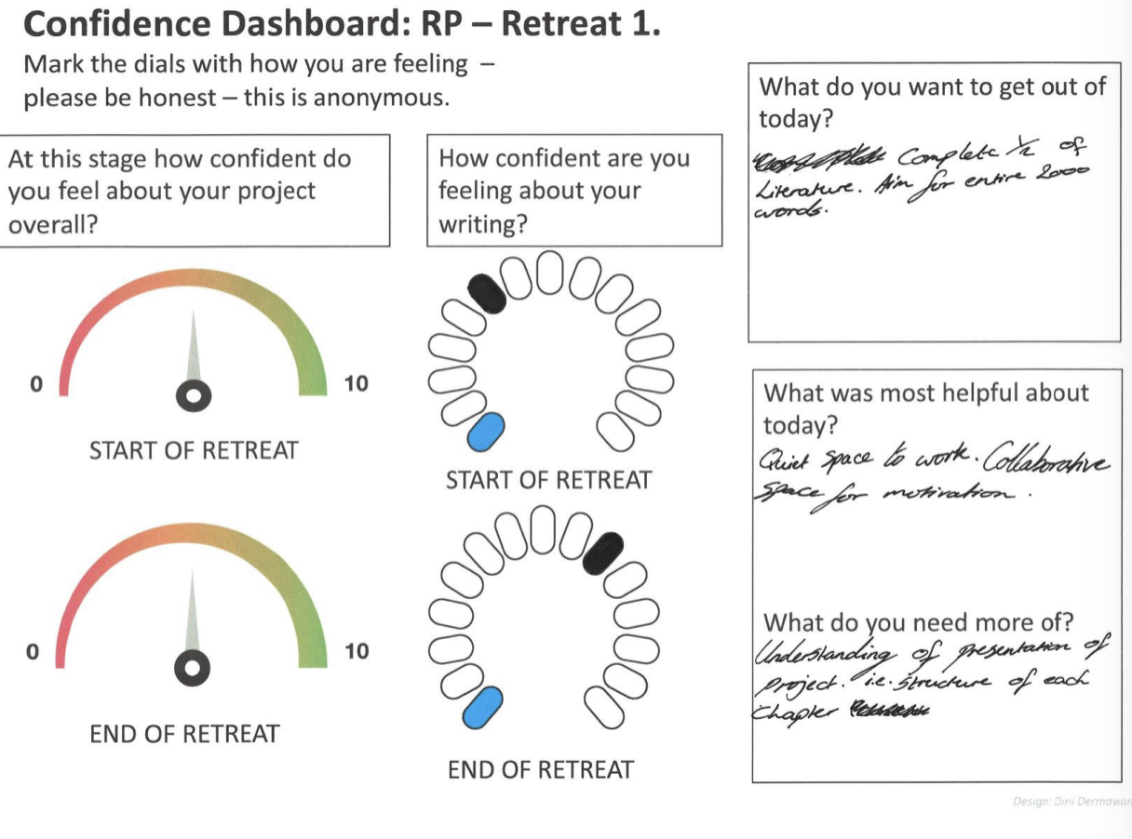
Example of dataset– confidence dashboard
In Action
These help understand how far the retreat itself helps a student build confidence from the start to the finish - Students had chance to reflect on their progress.

Slide 24
Example of dataset - Student advice quotes
In Action
ADVICE - 'Make an excel spreadsheet and add your references on the day you did you research rather than leaving it last minute its better to get them done than stressing it out on the days before the deadline
ADVICE ‘Stick with your supervisor's advice - there's often more than one way and you might receive multiple answers from different tutors.’
These help us understand what sorts of things students have learned and how they reflect on their ways of learning – capturing it in their own voices
ADVICE 'Don’t overcomplicate things!'

Slide 25
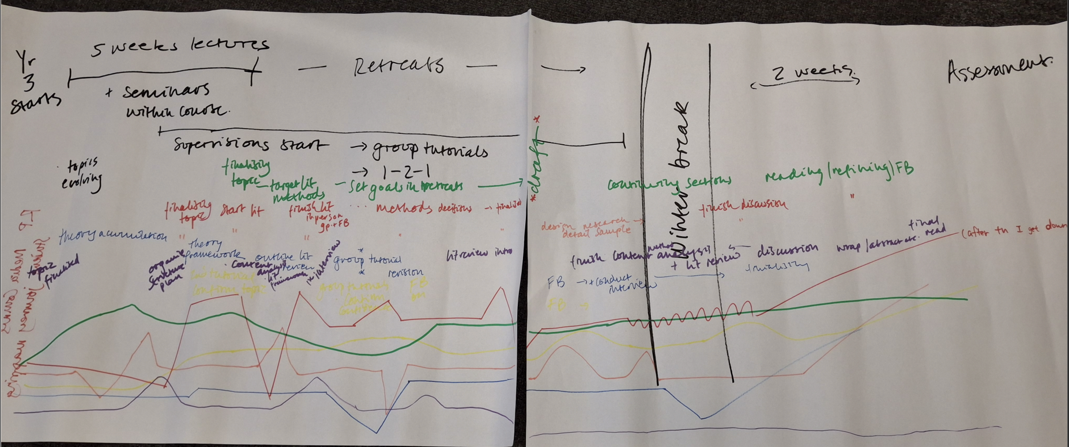
Data set example – mapping exercise image
This helps chart bottlenecks, moments of anxiety etc, and students reflect on their own processes of learning

Slide 26
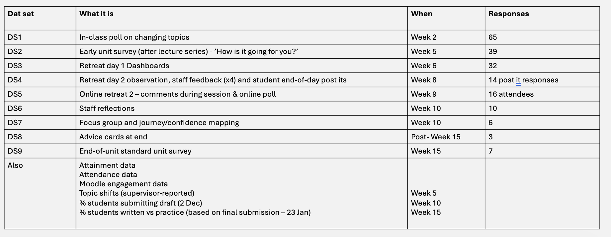
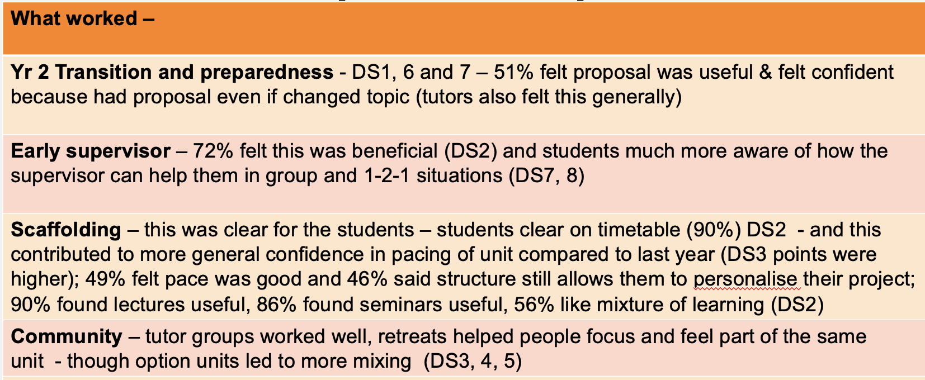
Data linked to findings
In Action

Slide 27
2. Journey mapping and personal milsetones
In Action
Year 2 Undergraduates Photography unit – 80 students
The intervention
Miro board co-creation session — mapping route to assessment
Students set personalised, phased milestones
Mid-term check-in to review progress
Students broke their projects into detailed, personal plans
“I felt supported and heard. A lot of information yet a lot of support
.”
This helped me feel more grounded within the unit, helping me feel more secure with my ideas.”
82% found the session useful

Slide 28
3 Option Units
In Action
The question: what does 'intellectual stimulation' actually mean to students?
Poor NSS scores on 'intellectual stimulation’
First year of specialist optional units rooted in staff research
Evaluation used: focus groups, interviews, Padlets, staff reflections
Lightbulb moments,
Freedom to develop own voice,
Theory meeting real life,
Combines creativity, critical discussions and future thinking
it meant everyone was able to kind of find their own voice with a, with a broader critical lens, I think
I think it's always a bit of a lightbulb moment when you're studying theory and you realise that that explains why you do something in your personal life

Slide 29
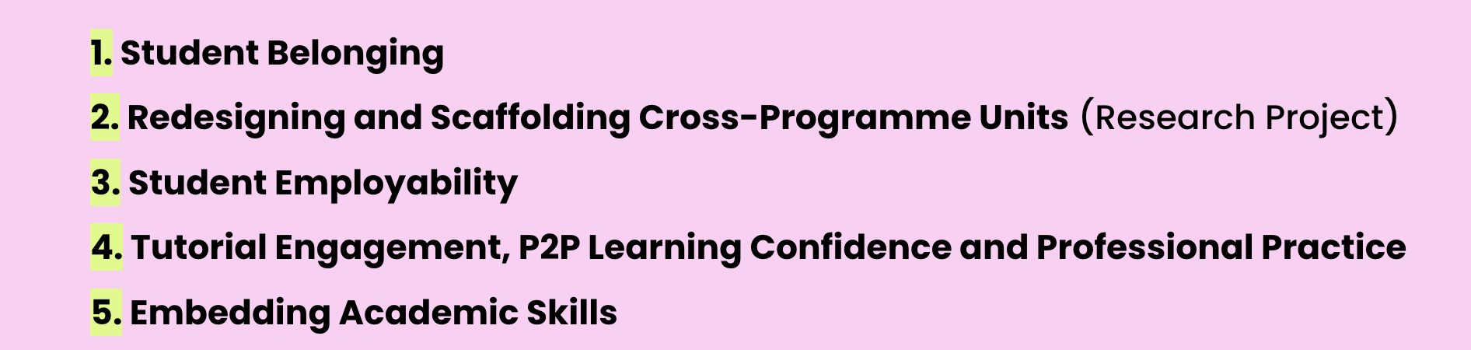
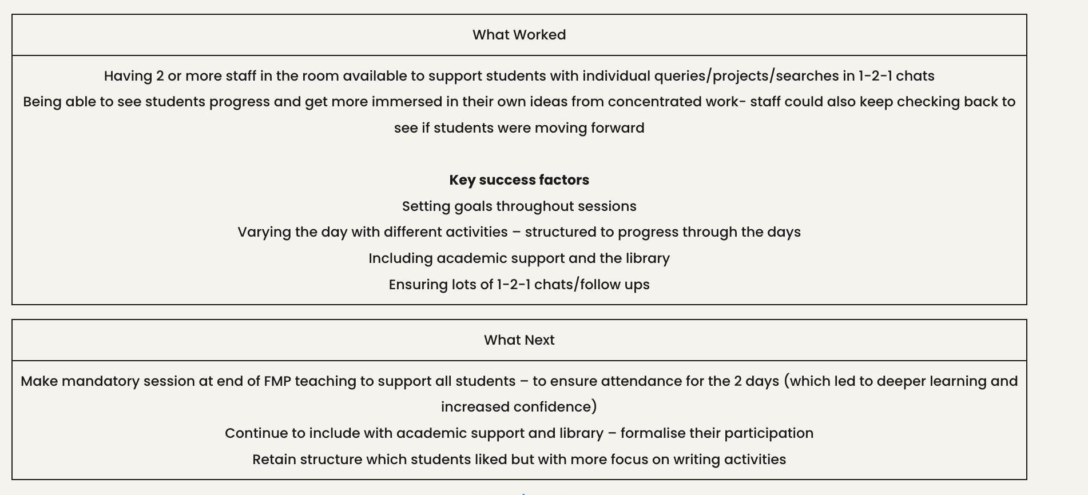
Summaries - finding new ideas
In Action
THEMATIC
SUMMARIES

Slide 30
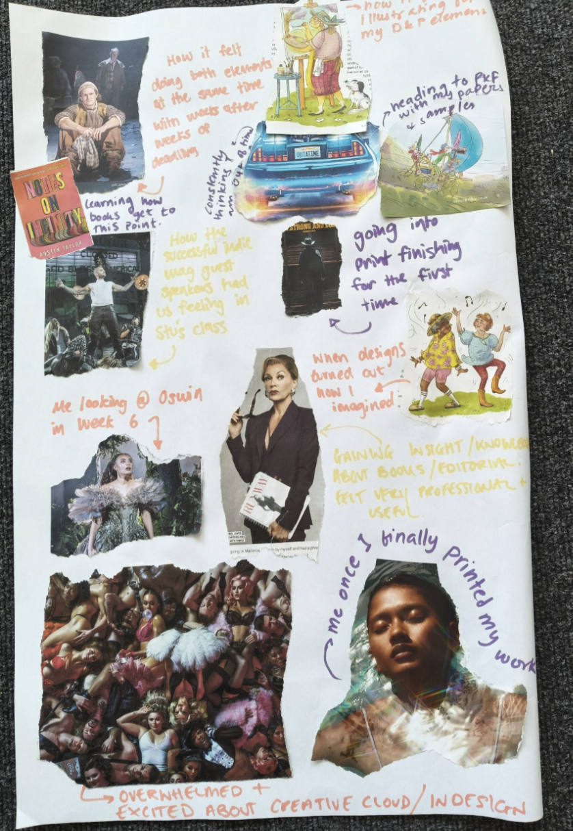
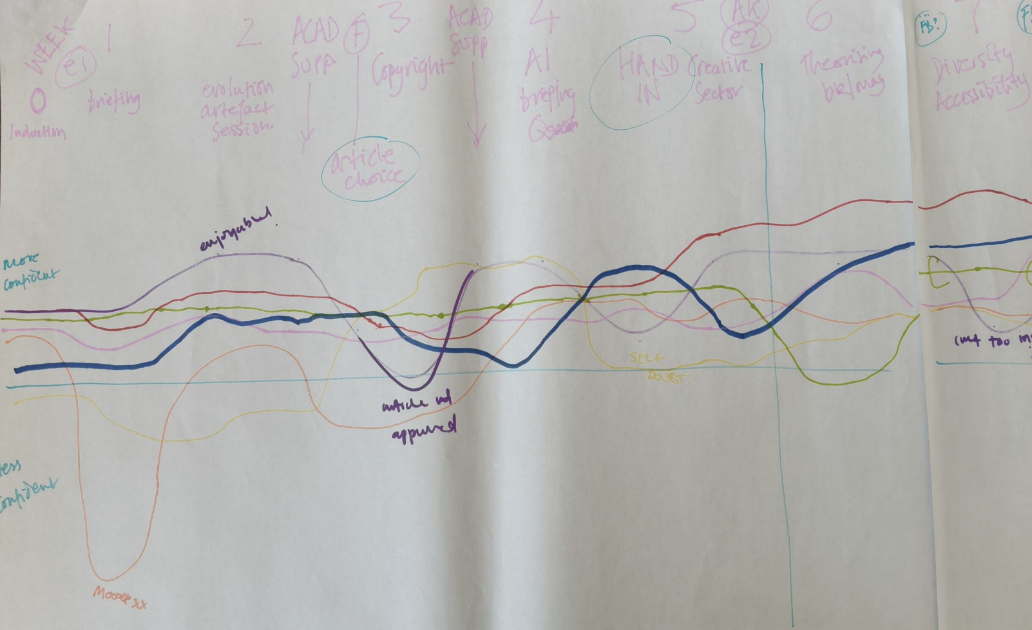
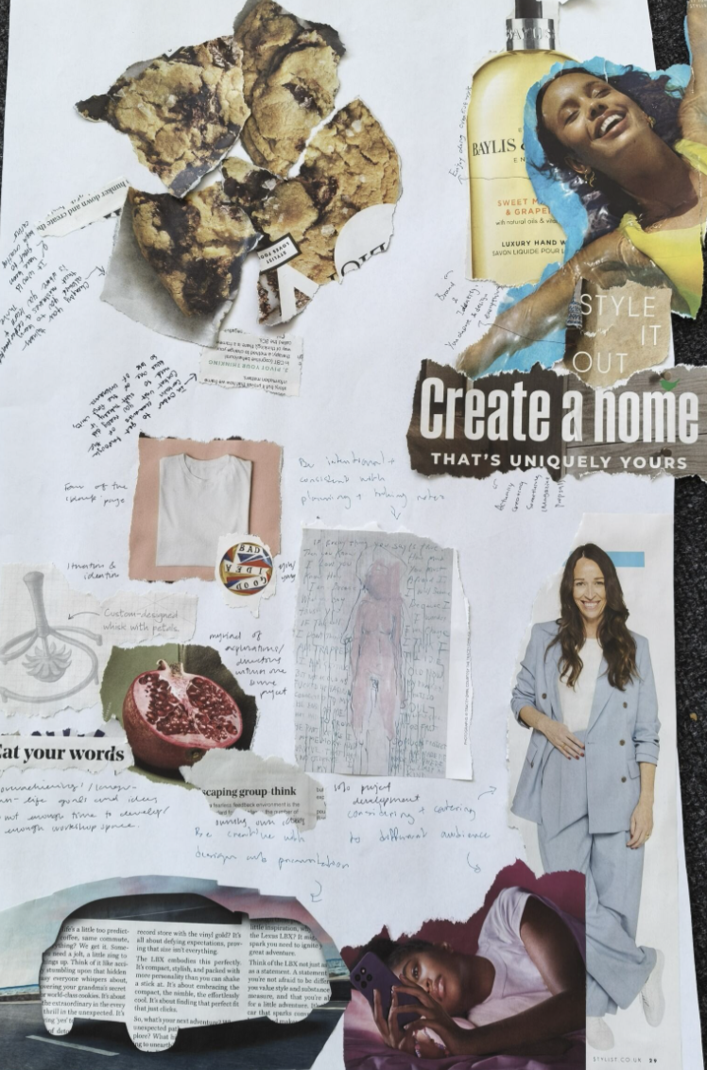
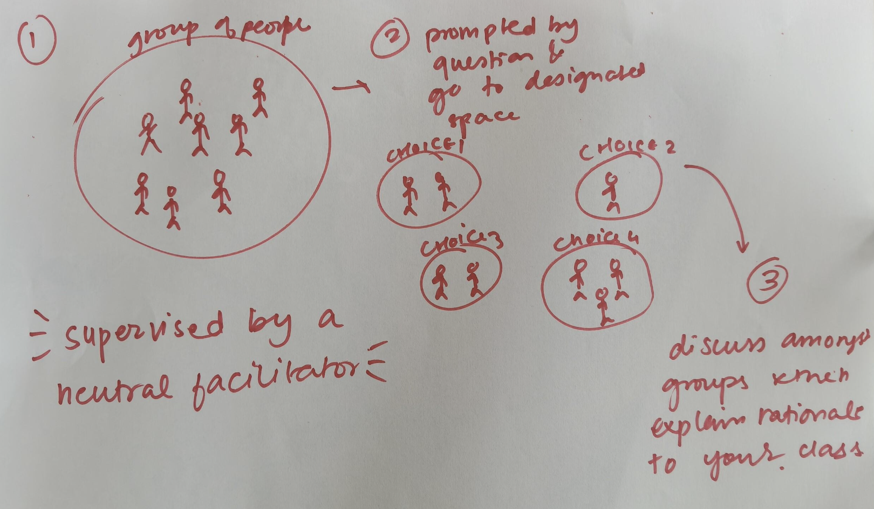
Research into creative, inclusive methods
Current work

Slide 31

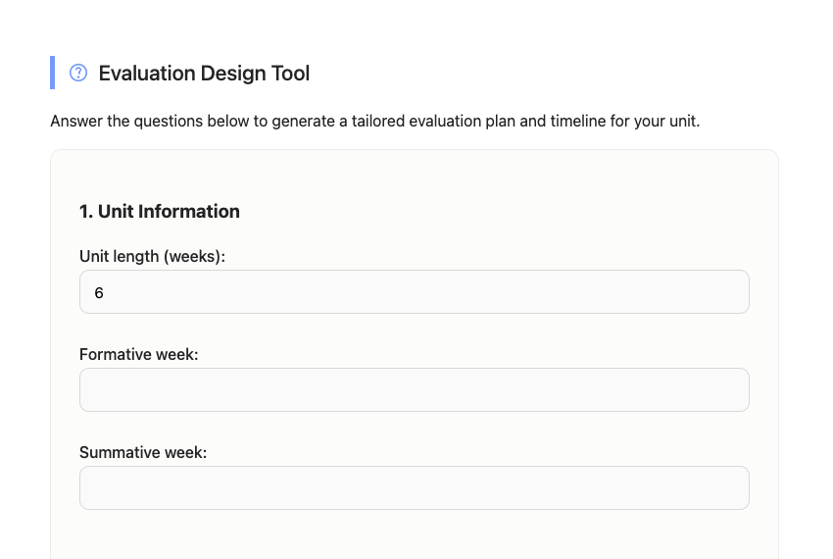
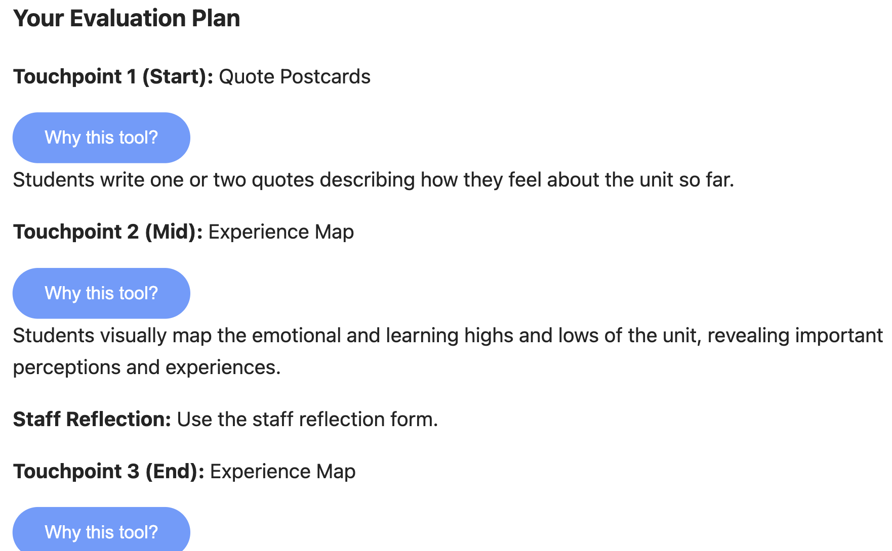
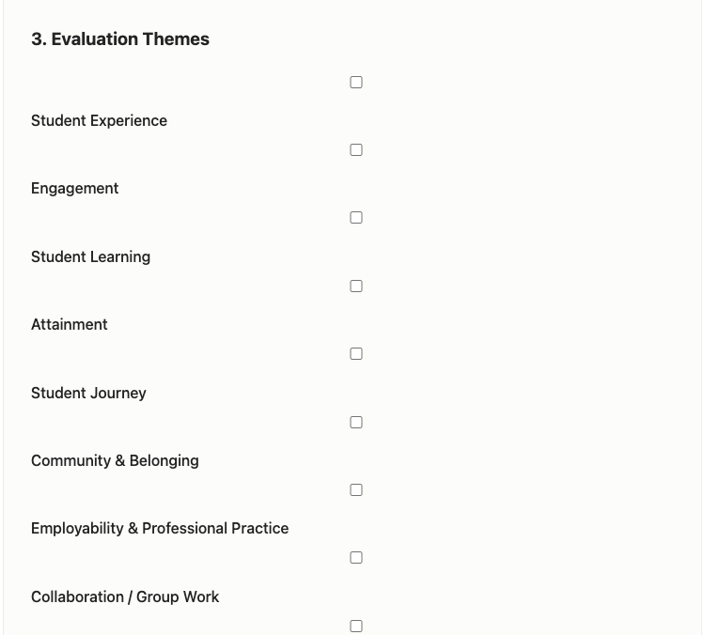
Design form – diagnostic – in development
Current work

Slide 32
Partnership approach
THE BIGGER PICTURE
Co-creating progress of units with students – journey together
Students as reflective partners​
Dialogue replaces surveys​
More inclusive, hearing more diverse voices
Immediate pedagogic benefit​

Slide 33
Impacts
THE BIGGER PICTURE
28 staff involved
Have record on blog of what they did and what it achieved
Helps them evidence work for applications/promotions
More conferences and funding on educational research side
Richer on-going conversations with students
900 students impacted​
Improved engagement and learning​
More awareness of their learning journey
Wider range of voices captured, more data overall
As evaluation progresses can pivot
Developing learning literacy and open conversations with staff, feeling heard

Slide 34
UAL
THE BIGGER PICTURE
Tools more widely across UAL – for variety and to improve responses
Working with central evaluation team acknowledging evaluation as key to the education strategy in development
Part of PG cert and MA Academic practice – embedding into practice

Slide 35
WISER mapping
THE BIGGER PICTURE
W
Well-being
Understanding, dialogue, partnership
I
Innovation
A way to assess effectiveness of innovation, iterate
S
Students, staff, stakeholders
Conversations, engagement to see what works
E
R
Equity and Ethics
Inclusivity, more student voices, transparency, responsibility
Reward and recognition
Collecting evidence of excellence, sharing and celebrating

Slide 36
Culture not compliance
THE BIGGER PICTURE
Staff ownership
Student partnership
Sector relevance
Celebrating innovation
Evaluation as something staff do, not something done to them
Students as genuine collaborators in understanding what works
Staff-led evaluation that speaks back to TEF and NSS with evidence institutional surveys can’t produce
Capturing and sharing best practice — not letting it disappear
The resource doesn't just help you do evaluation — it helps you show what excellent teaching looks like.
ual:

Slide 37
Staff in driving seat
THE BIGGER PICTURE
At its heart effective evaluation is about the quality of choices made in balancing realistic expectations and needs of it with judgements about focus, scope and methods.’ (Parsons, 2017:1)

Slide 38
Thank you – and an invitation
Thank you
Use it • Adapt it • Share it​
https://positiveevaluation.myblog.arts.ac.uk/​
f.hall@lcc.arts.ac.uk
  COLLABORATIONS?
  I would love to hear from you
  F.hall@lcc.arts.ac.uk

Slide 39
References
Nygaard, C., Belluigi, D.Z., 2011. A proposed methodology for contextualised evaluation in higher education. Assessment & Evaluation in Higher Education 36, 657–671. https://doi.org/10.1080/02602931003650037
Parsons, D., 2017. Demystifying evaluation: Practical approaches for researchers and users, 1st ed. Bristol University Press. https://doi.org/10.2307/j.ctt1t89h20

