Slide 1

Empowering Participatory Evaluation
Building an Evaluative Culture at the Media School, University of the Arts London.
Dr Frania Hall
Pecha Kucha - The Evaluation Society 18th May 2026

Slide 2

The Evaluation challenge
Notes:
Across sectors, evaluation is expected – but often experienced as compliance, extraction, or reporting. So it can feel distant.

Slide 3

A familiar problem
Notes:
Even with strong frameworks, evaluation often sits outside practice – done to people, done after, done for others.– and not necessarily as meaningful to those involved in providing the feedback – ie students

Slide 4
A reframing
Local-level –
empowered
Institutional- level
centralised
Notes:
What if evaluation were designed as a participatory, ongoing capability distributed at the local level – not a one‑off activity? Something that everyone could do – with a supportive process of self-evaluation.

Slide 5
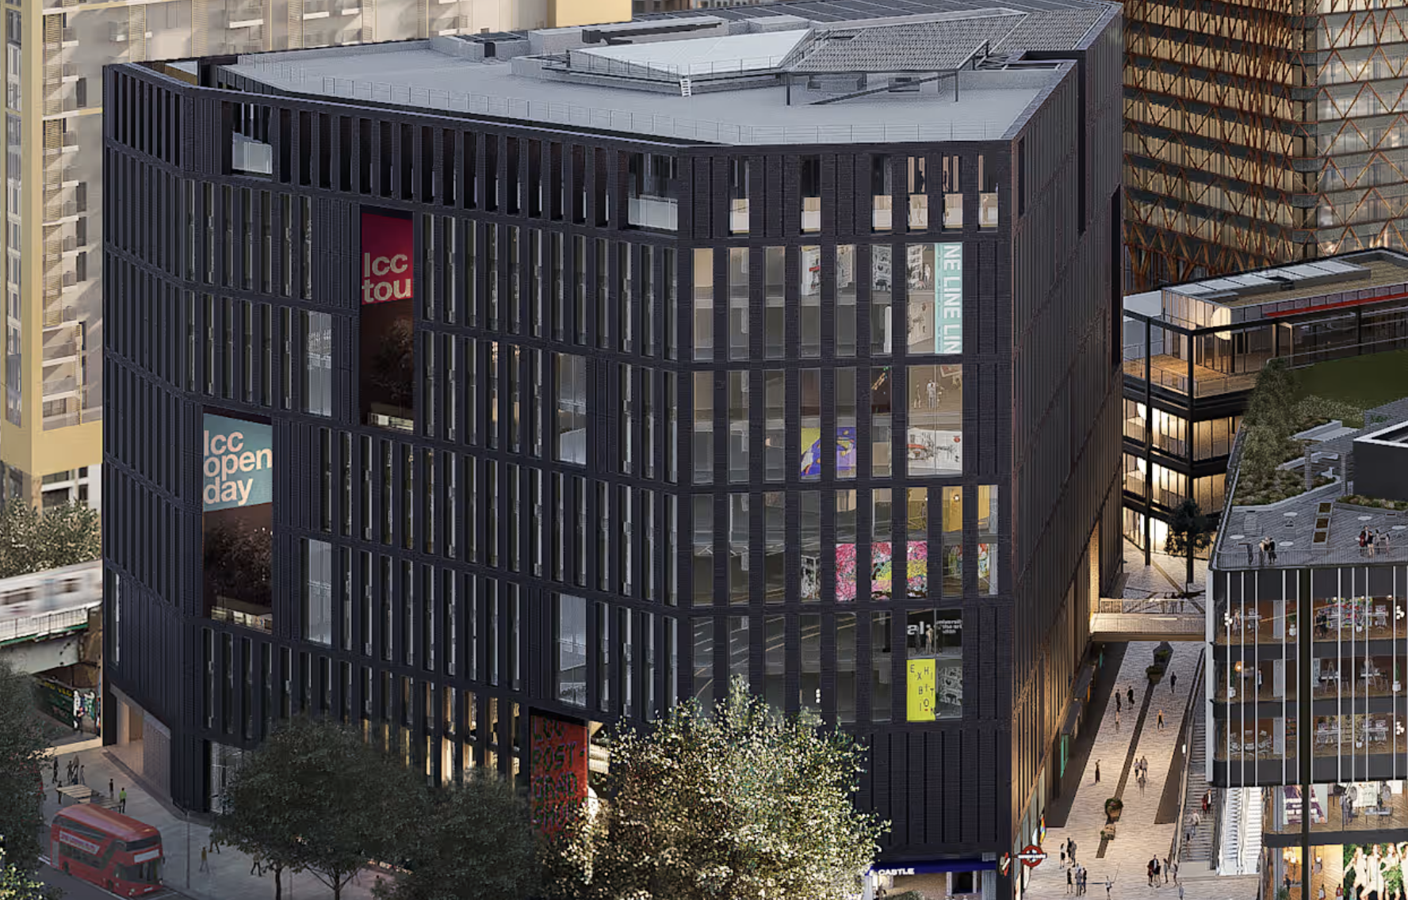
The setting
Notes:
This comes from a three‑year project in a large teaching organisation, UAL – large creative sector university – but the approach is deliberately transferable. Media School at LCC within UAL has c 2500 students.

Slide 6

The research approach
Notes:
The model emerged from my research, case studies, and working directly with practitioners and participants both staff and students – and Built around theory of change approaches

Slide 7
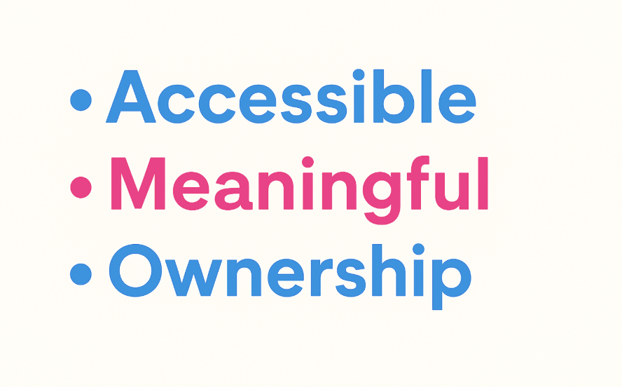
Evaluation imperative
Notes:
OfS imperatives reinforce centrality of evidence-based T&L. Formal evaluation guidance existed, but day‑to‑day evaluative practice was uneven and inaccessible locally. Also students did not feel it particularly related to them.

Slide 8
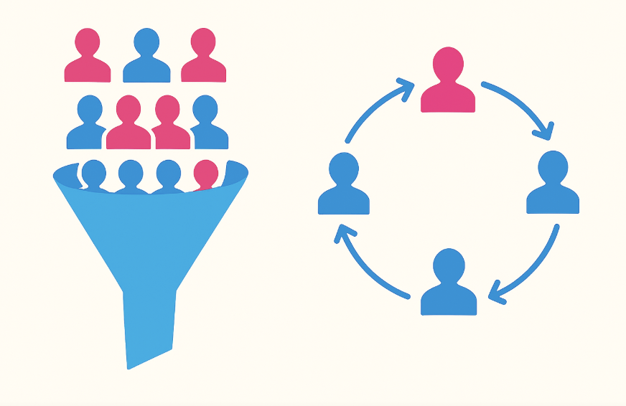
From evaluation activity to evaluation culture
Notes:
I focused on building an evaluative culture within the media school - away from a top down approach to a shared responsibility, shared language, shared learning – with students participating in a way that made it useful/relevant. Meaningful to them

Slide 9

Evaluative mindset
Notes:
I was also interested to develop ways of thinking about teaching and learning = building an evaluative mindset means asking: What are we testing? What evidence will help us learn?

Slide 10

Participation for co-creation
Notes:
Participation wasn’t an add‑on – it shaped the tools, questions, timing, and use of findings. This was with both staff and students – innovating for example to design inclusive tools that could suit a variety of different students and their creative langugages.

Slide 11
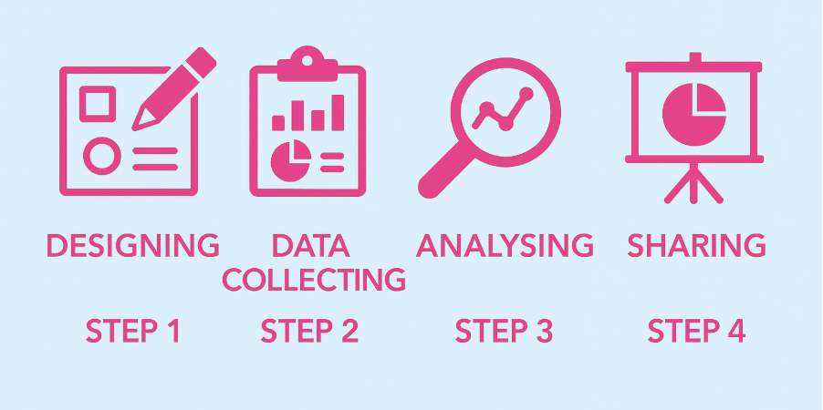
The evaluation process
Notes:
I developed an easy to use framework - step by step – with the data collection stage involving different touch points and stages of reflection - A consistent but flexible framework underpinned every evaluation – large or small.

Slide 12
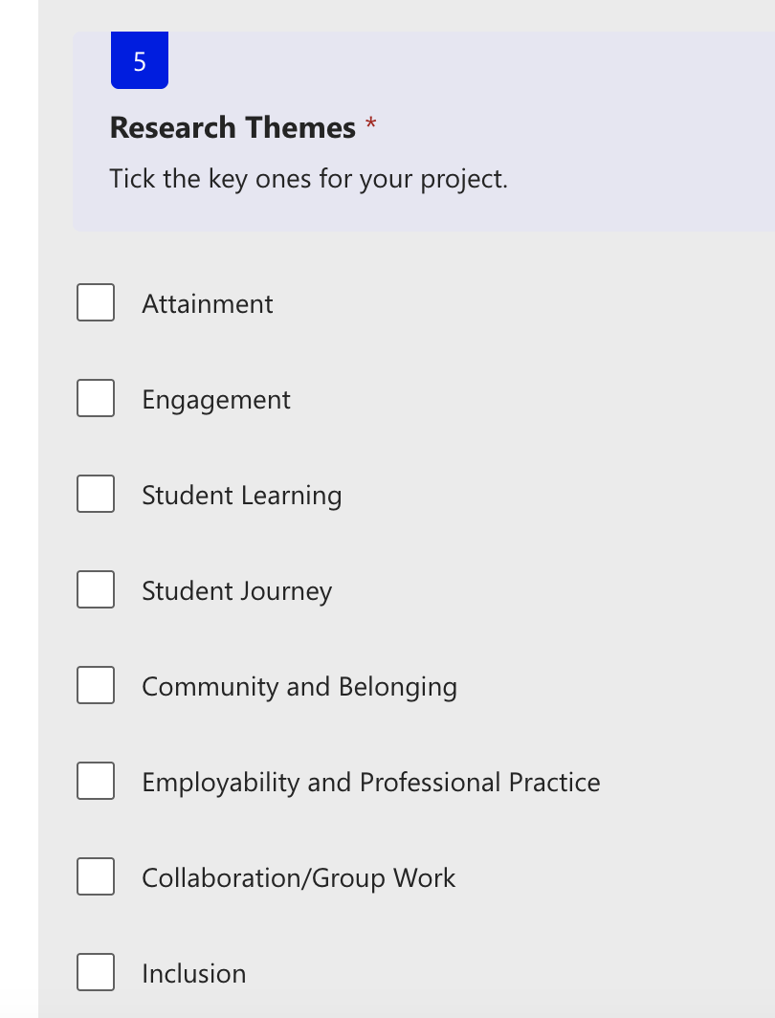

Designing for use
Notes:
Each project begins by clarifying purpose, focus, and intended use – not methods first. Avoiding trying to research everything but focus on a theme and the activity/change/intervention that was directed towards that So ensures it answers specific evaluative questions – with the appropriate data collection tools.

Slide 13
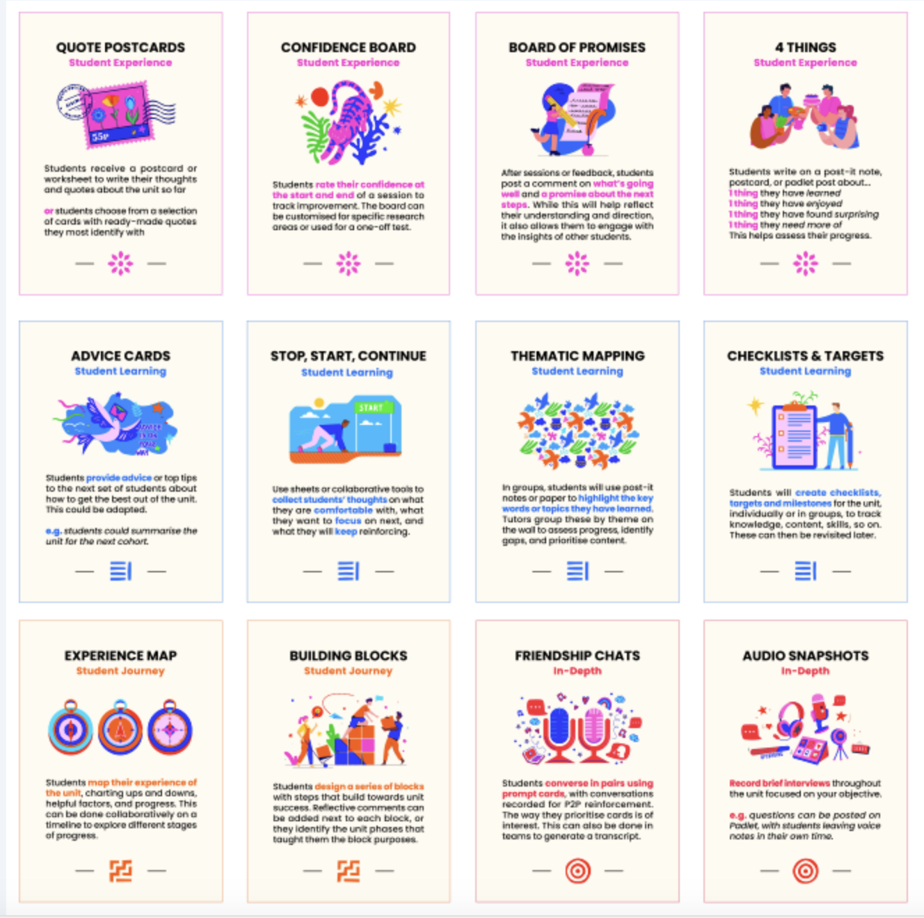
Participatory qualitative tools
Notes:
I designed robust inclusive, qualitative tools to capture student voice, that could be embedded into everyday settings

Slide 14
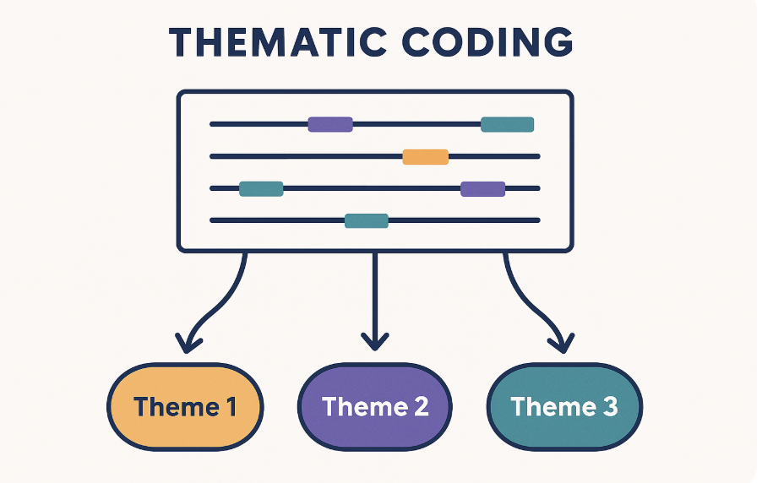
Analysis and sense‑making
Notes:
This stage is very important and can be underestimated in terms of timing – but it is what makes it robust – Analysis focused on collective sense‑making and identifying actionable insights informing next steps

Slide 15
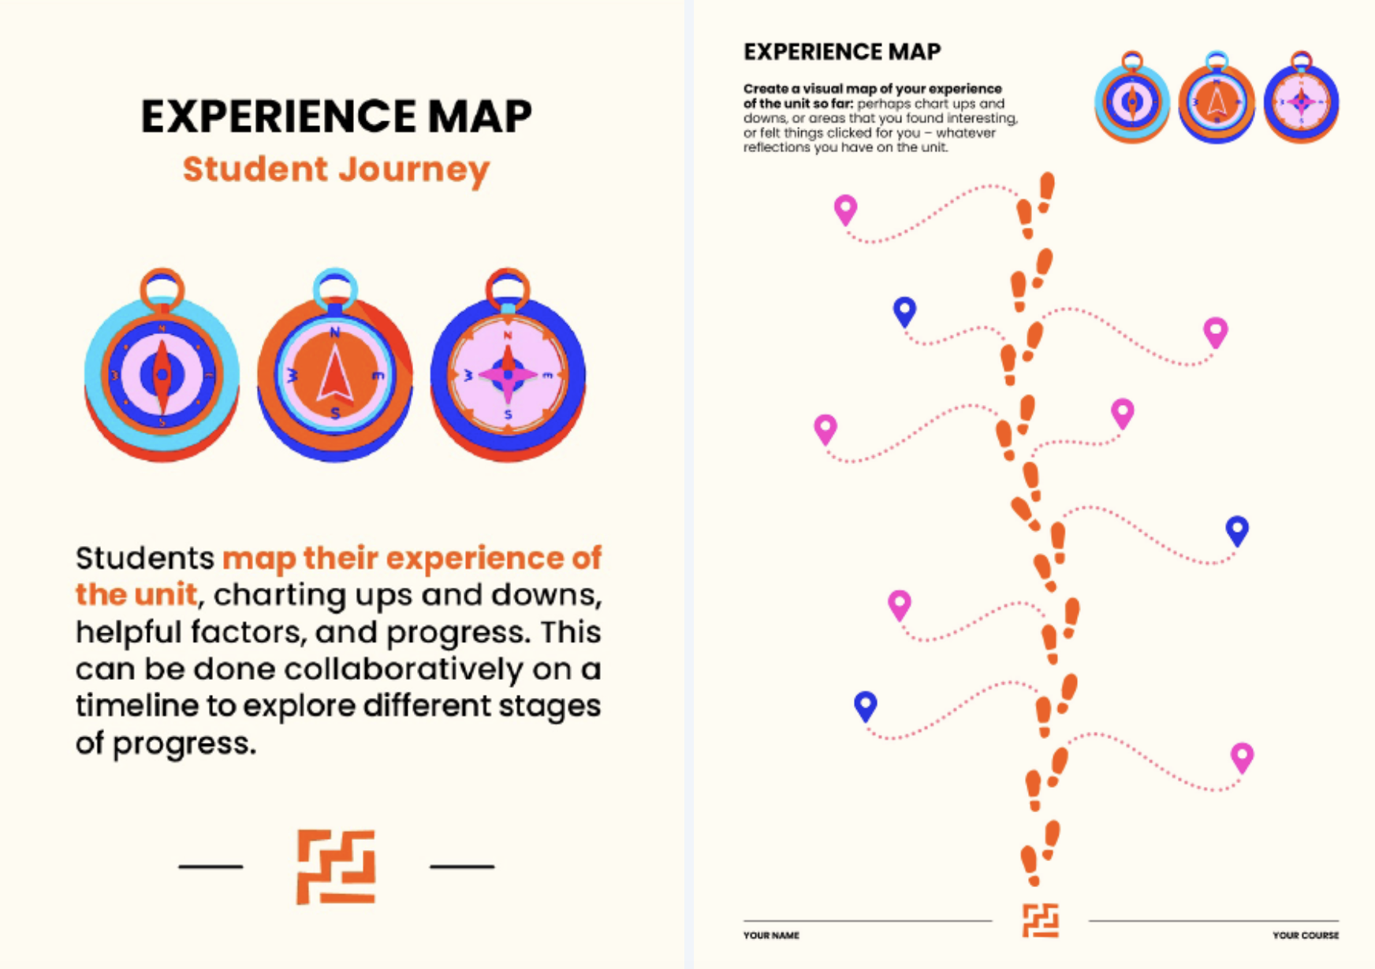
Examples in practice 1 –
Collaborative journey mapping
Notes:
Participants map experiences over time – surfacing pressure points, confidence, change.

Slide 16
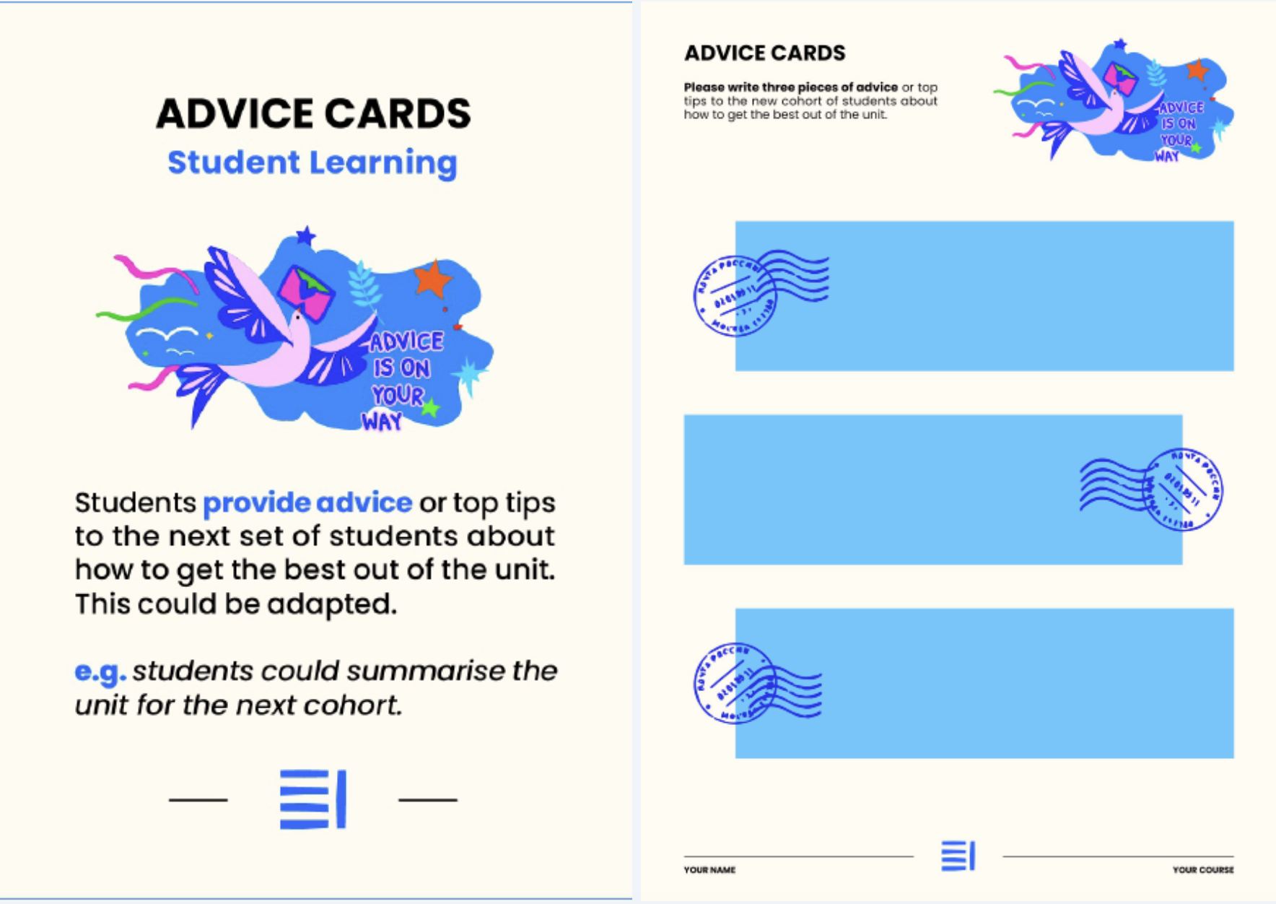
Example 2
Advice cards
Notes:
Participants generate advice for future cohorts – evaluation becomes reflection and knowledge transfer – students talking to other students in their own voice

Slide 17

Building capacity
Notes:
Over the last 3 years, staff developed confidence designing and running their own evaluations so that our body of evaluative research is growing all the time – in itself evidencing a process of self-evaluation – and reflecting shared responsibility.

Slide 18
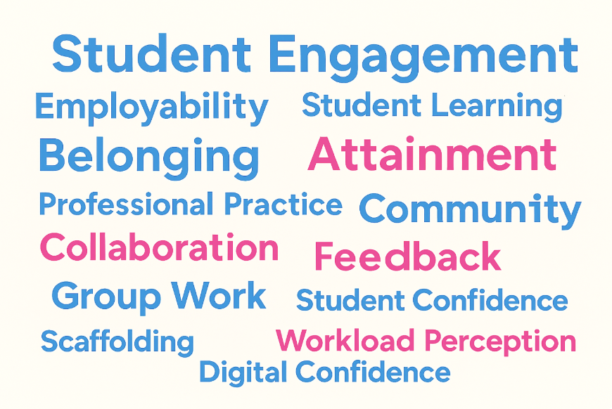
Inclusivity and success
Notes:
18 projects so far have covered around 700 students and 28 staff exploring range of key T&L themes. More inclusive, more responsive, more data.

Slide 19


Organisational learning
Notes:
A thematic evidence base emerged – allowing comparison, iteration, and cumulative learning. All this – including the framework - is available on a blog I have created.

Slide 20

Why this travels
Notes:
Robust flexible action-oriented evaluation process embedded for capacity building – empowering, supporting continuous improvement and practice-sharing, and in particular celebrating staff

Slide 21
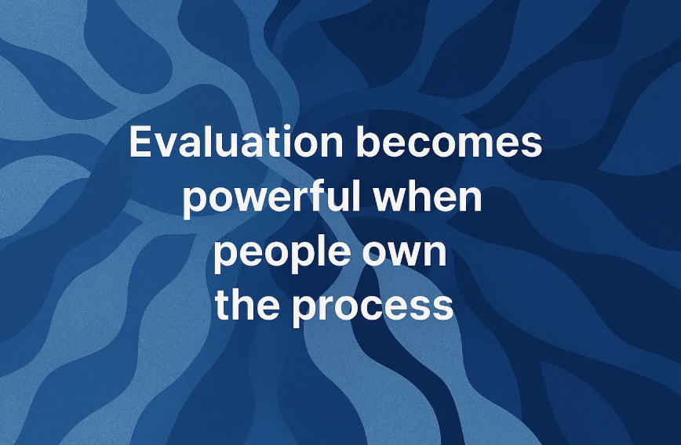
BLOG LINK: https://positiveevaluation.myblog.arts.ac.uk/
Notes:
So that Evaluation becomes powerful and more positive when people own the process, not just the data.

