Slide 1
Co-creating Success through Evaluation Design
The Research Project Unit in the Media School, UAL
Dr Thomas Giagkoglou and Dr Frania Hall, Media School, LCC, UAL
Advance HE Annual Conference 30th June 2026

Slide 2
Outline
Evaluation approach
Research project introduction
Datasets examples
Findings – preparedness, attainment, topic
Summary

Slide 3
THE PROBLEM
Teaching staff often feel distanced from institutional evaluation
Evaluation is frequently retrospective, survey-led and disconnected from practice
Staff innovation often unevidenced​
Staff on teaching pathways can feel work is not recognised
Student evaluation - engaged after learning, not during​ - it is not meaningful for them
Teaching excellence requires evidence of impact, transferable practice and collective leadership

Slide 4
Embedding evaluations
This allows us to:
Develop on going relationships with students – around their learning
See how things are happening in real time – observe what is working
Make it meaningful for students – reflective learning moments, they articulate what success looks like to them, personalize milestones
Utilise Accessible methods – collect voice in the ways they want to communicate
Build an inclusive, equitable learning space
So built into pedagogy and develops capacity

Slide 5
Theoretical frameworks
Evaluation is key for TEF (Advance HE report Moore et al., 2023)​
Evidence for enhancement and impact (Austen et al., 2021) ​
Student engagement for partnership (Healey and Healey, 2019) ​
Building knowledge from an iterative cycle of evaluation (Thomas, 2017)​
Concepts of dynamic evaluation (Mazzucato, 2025). ​
Centrality of student voice (Bovill, C., 2020, Cook-Sather, A., 2020)​
Empowerment and creativity – (Nygaard and Belluigi, 2011)​
Designing Evaluation – judgements, focus and scope – (Parsons, 2017)

Slide 6
Criteria developed for evaluation
Research with institutional case studies, UAL staff and students, building on extensive literature review, suggested the following criteria:
Qualitative
Mixed methods
Reflective
Inclusive
Ethical
Accessible
Targeted
Proportionate
Contextual
Actions-oriented
Iterative
Embedded

Slide 7
3 stage framework
The Resource
Step 1
Design
Design form
Research question
Step 2
Capture
Data Collection
Touch points
Step 3
Act
Analysis
Practice sharing
Toolkit
Reflections
Next steps and iteration

Slide 8
Design through a unit/session.
The Resource
Flexible depending on scale of project – unit-long, afternoon workshop, specific intervention etc.
Touchpoints are 10 min max at the start/end of a session – built into curriculum
start
touch point 1
touch point 2
end point
Mid-point reflection

Slide 9
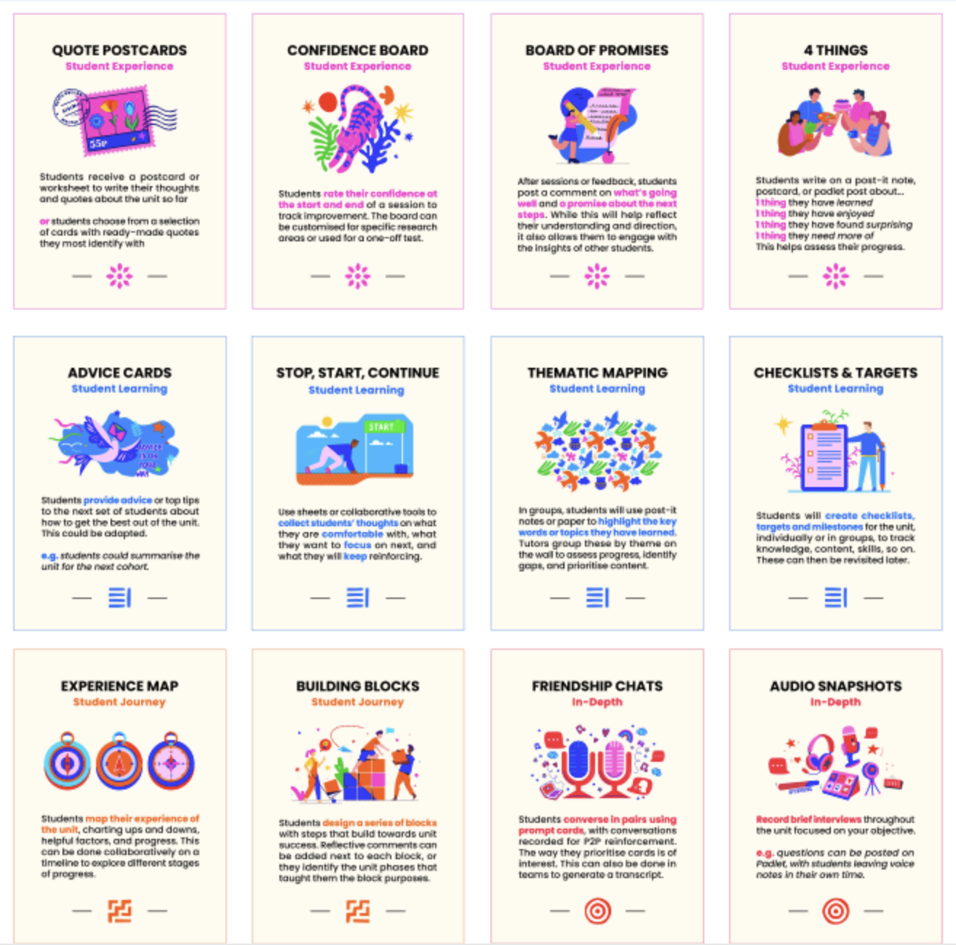
TOOLKIT
Deck of qualitative methods to choose from, depending on theme
The Resource

Slide 10
Co-creation
LEARNING JOURNEY
Students are heard in the process
Their experience shapes teaching
Feedback loops and Feeding forward
EVALUATION DESIGN
Tools designed with students
Inclusivity reinforces belonging and equity
Supports student confidence

Slide 11
The Research Project

Slide 12

Research Project unit background
Research Project (40 credits): the ‘re-envisioned’ dissertation unit – Year 3
Delivered over 13 weeks between September – January
BA Advertising, BA Contemporary Media Cultures, BA Media Communications, BA Public Relations (176 students this year)
SLT includes a boosted number of Tutorial hours (8 hrs) and Workshops hours (20 hrs)
Choice between empirical project and practice-based project
Common lectures; course-localised seminars; methods workshops; 1-1 supervisions; writing retreats
Formative assessment: Weeks 7 & 10 > Winter Break > Final submission: Week 13

Slide 13
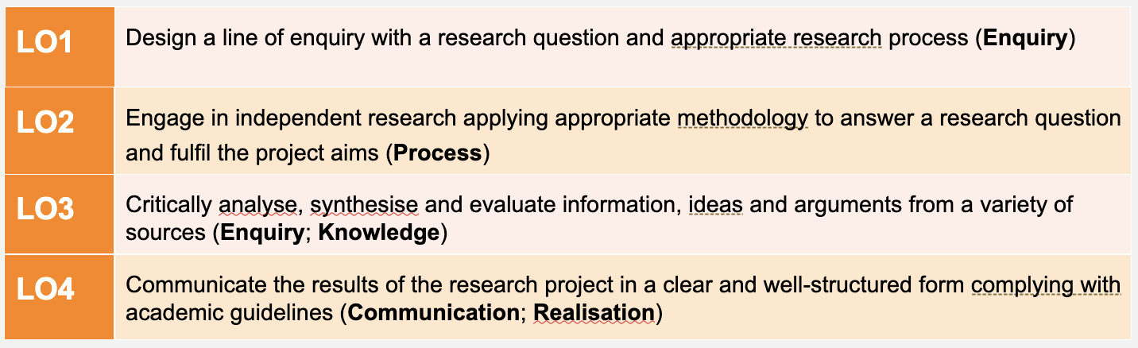
Research Project LOs
“A written research project (6000-8000 words), or a practice-based research project with a written component (4000-5000 words)”

Slide 14
Research focus – year 3 of Research Project
Student engagement – through scaffolding, community building with the writing retreats
Student confidence – through transition from yr 2 unit, having written a research proposal, earlier supervisor allocation, writing confidence through retreats
Student attainment – through further scaffolding, confidence-building as above
Student learning – through understanding of research skills and how they apply skills after the unit ends
Topic choices – through transition from yr 2 unit, having revised the proposal
Drivers for written-only VS practice option – through considering each course’s profile
Student journey – understanding confidence ups and downs through flow of unit

Slide 15
Datasets

Slide 16
Full Datasets
Dataset | What it is | When | Responses
DS1 | In-class poll on changing topics | Week 2 | 53
DS2 | Early unit survey - ’How is it going for you?’ | Week 5 | 29
DS3 | Retreat day 1 Dashboards | Week 6 | 28
DS4 | Online retreats – comments during session & online poll | Week 7-9 | 13 attendees
DS5 | Retreat day 2 observation, and student end-of-day post its | Week 10 | 40 post-it notes
DS6 | Staff reflections | Week 10 | 6
DS7 | Student focus groups (2) | Week 10 | 9 participants
DS8 | Advice cards at end | Week 13 | 9
DS9 | Standard end-of-unit survey | Week 13 | 21
Also | % students submitting drafts % students written vs practice (based on final submission – 22 Jan) Attainment data Attendance data Moodle engagement data | Week 10 Week 13 | TOTAL = 208

Slide 17
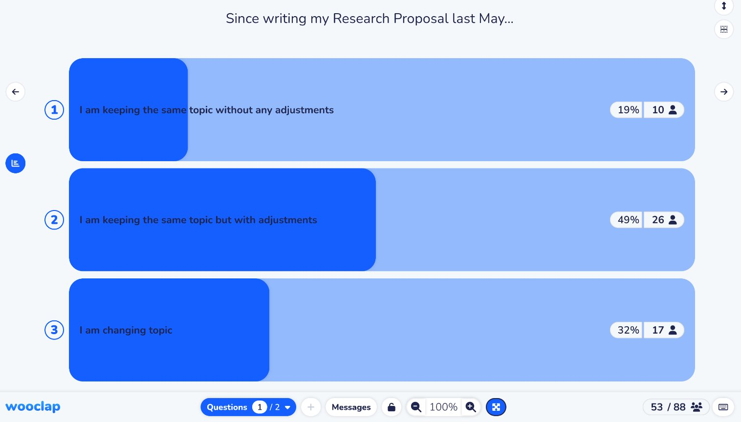
Dataset example – in-class poll (Week 2)

Slide 18
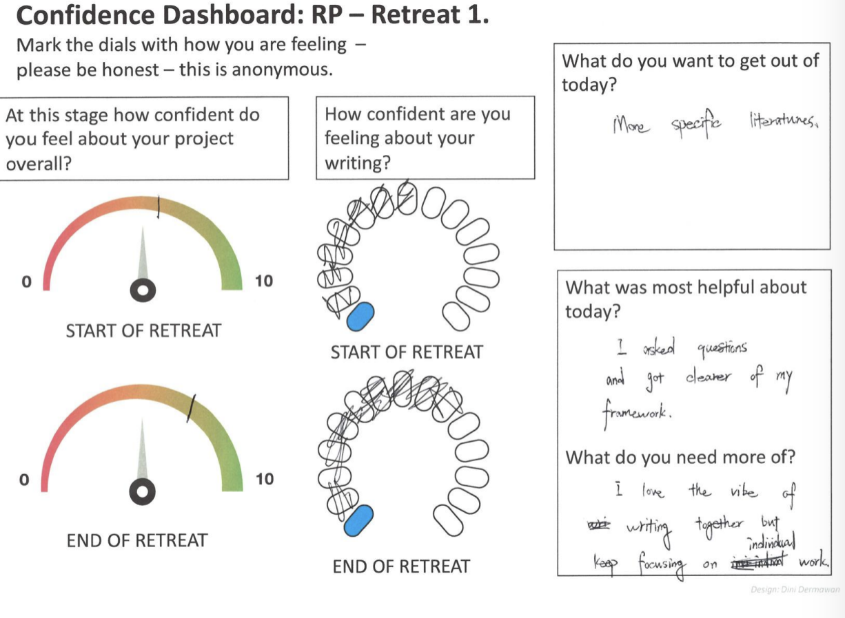
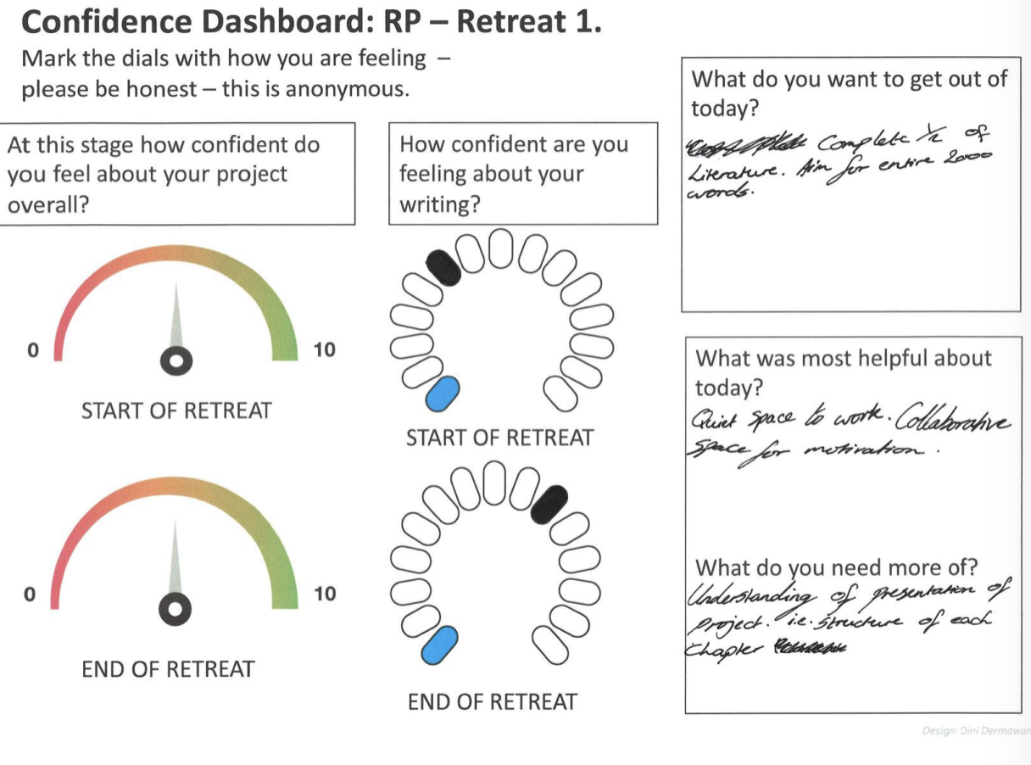
Dataset example – Dashboard (on-site retreat) (Week 6)

Slide 19
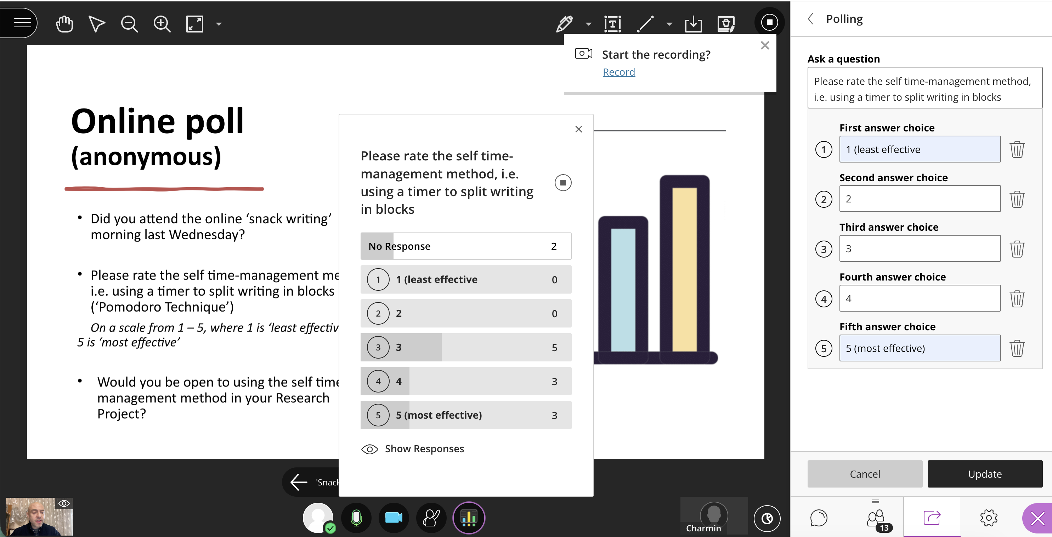
Dataset example – Online poll ('snack writing' morning) (Week 8)

Slide 20
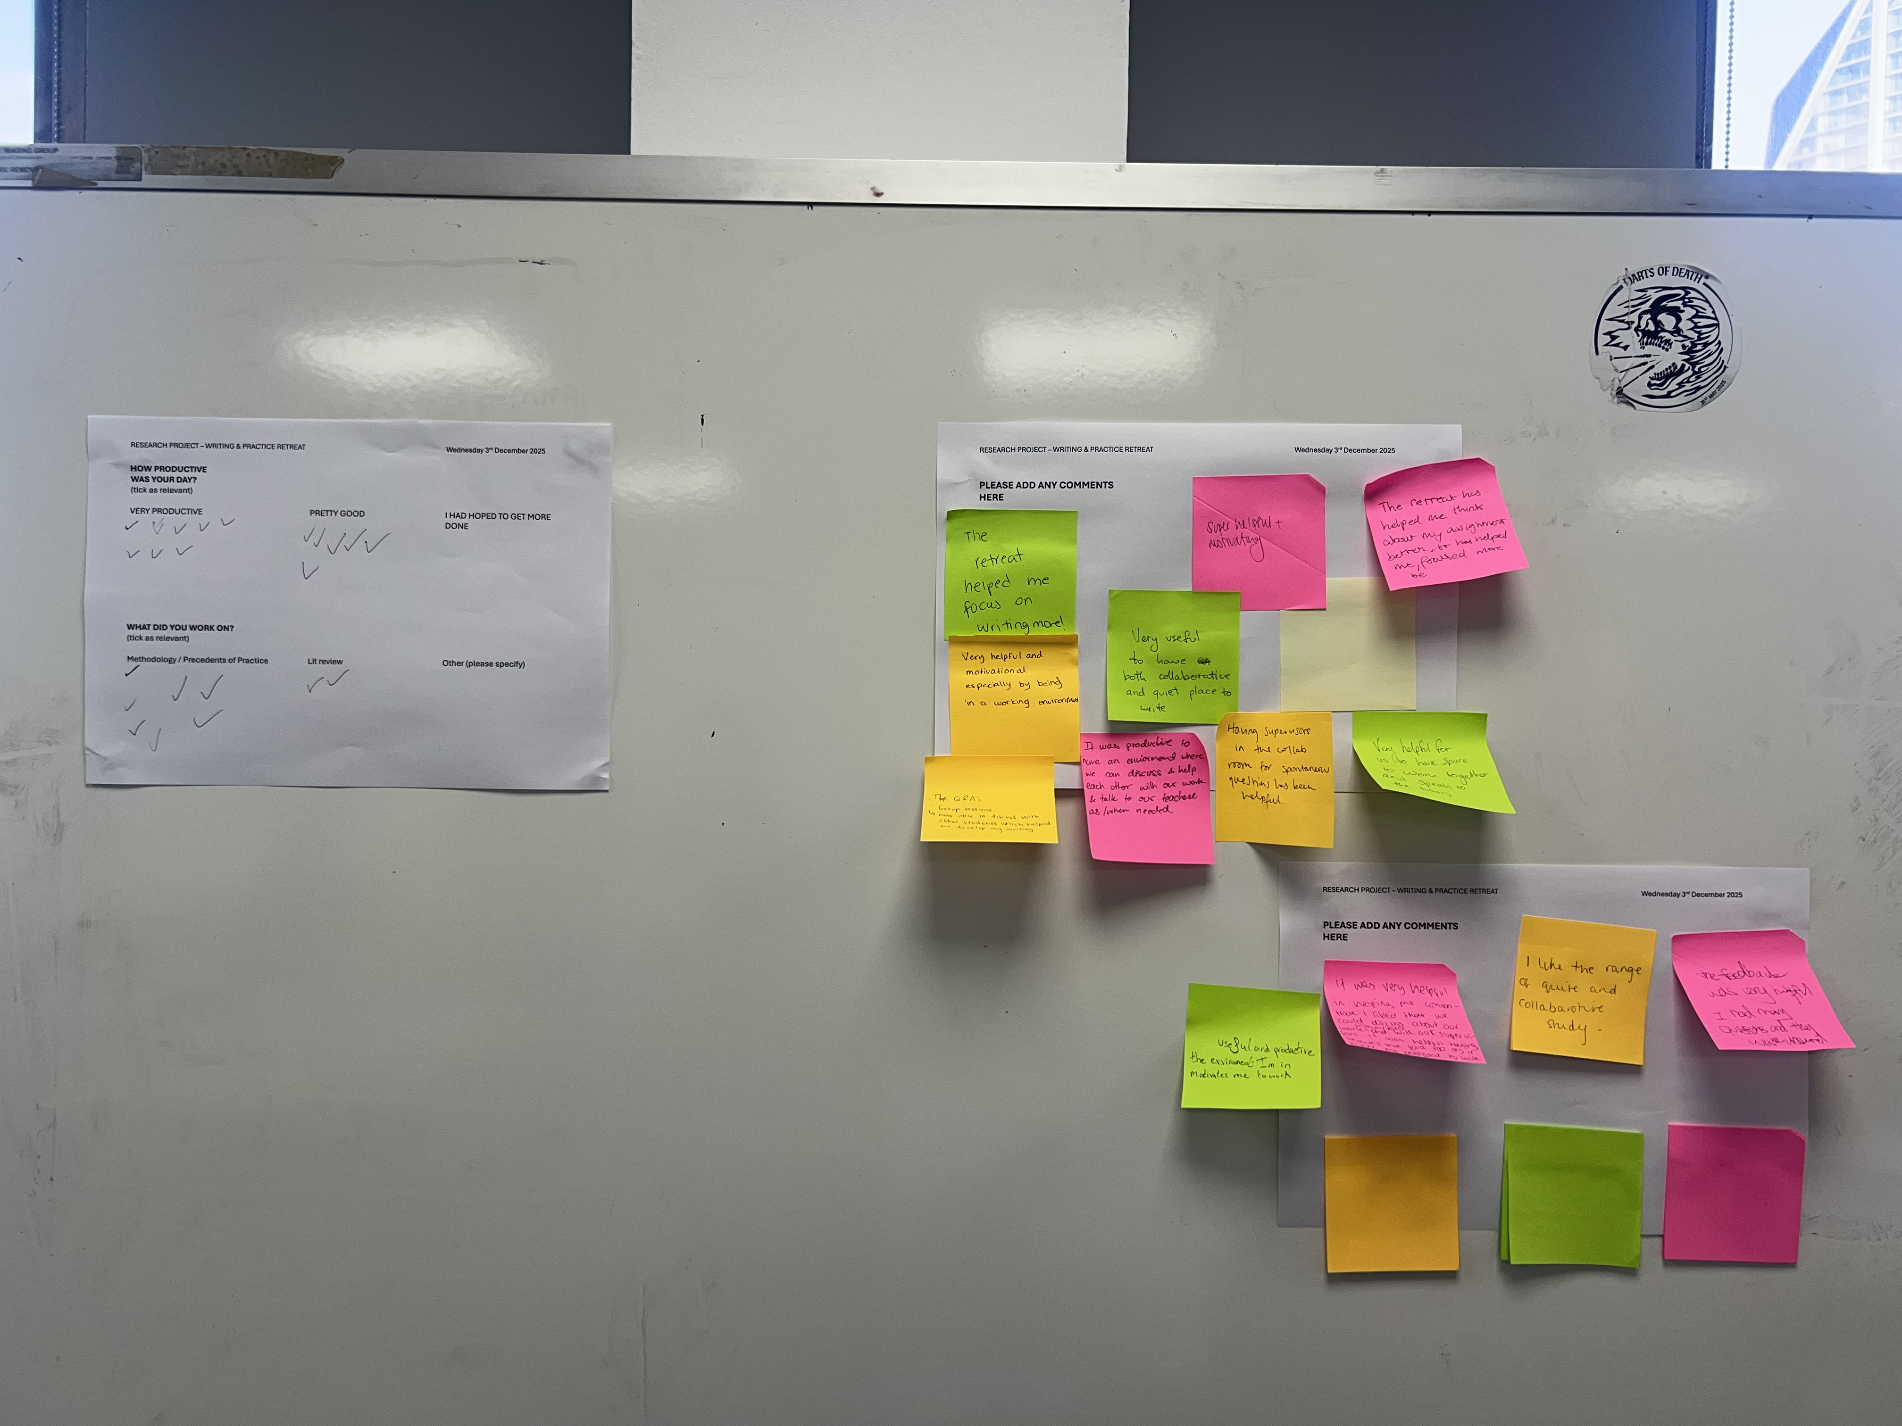
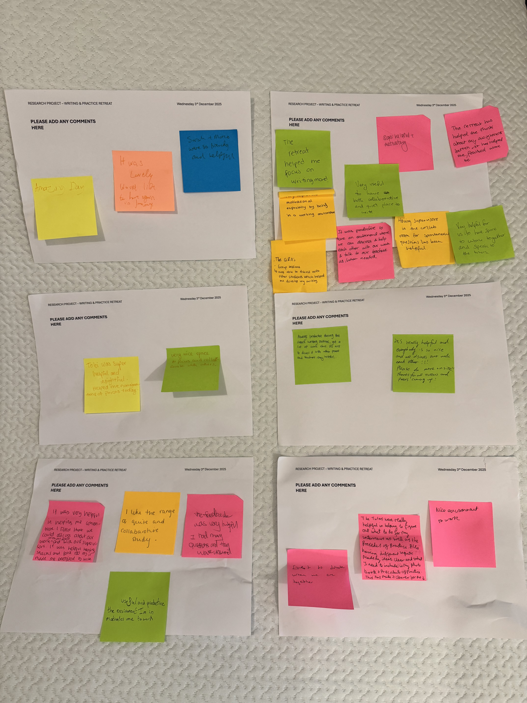
Dataset example - Feedback from on-site retreat (Week 10)

Slide 21


Dataset example – Advice cards (Week 13)

Slide 22
Student preparedness

Slide 23
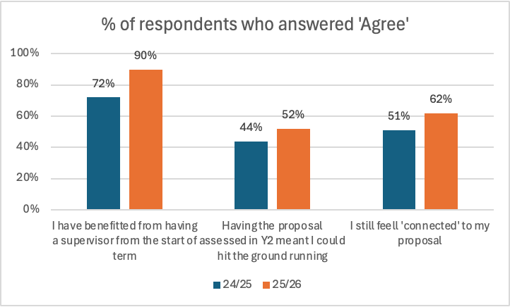
Preparedness and the research proposal
Source: Early unit survey (N= 29, 25/26)

Slide 24
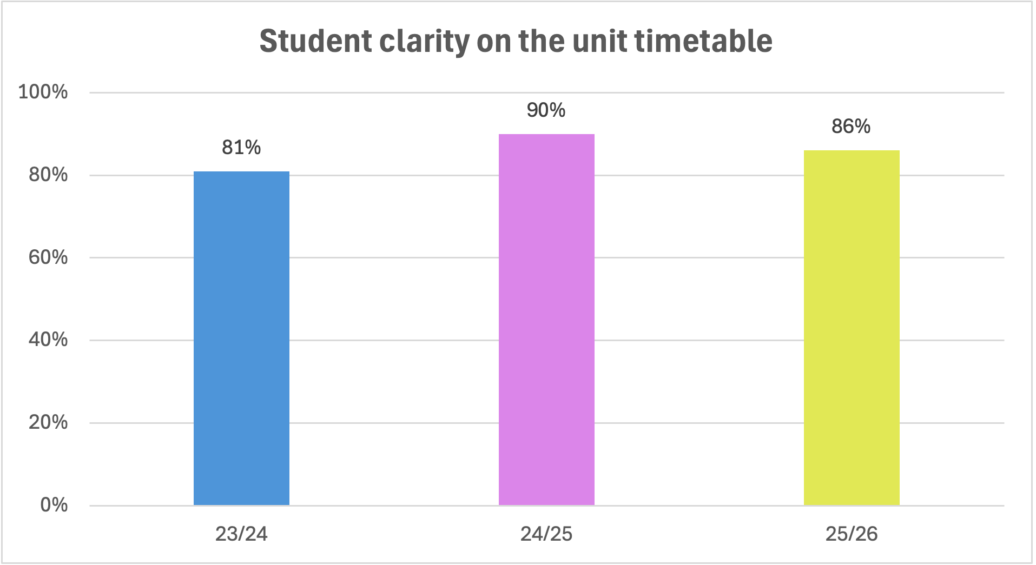
Clarity on the unit timetable
Source: Early unit survey (N=29, 25/26)

Slide 25
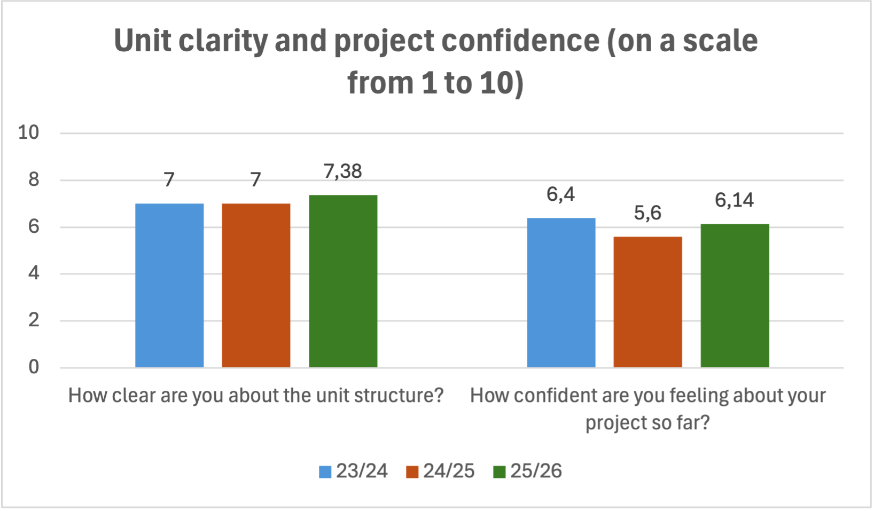
Clarity on the unit structure
Source: Early unit survey (N= 29, 25/26)

Slide 26
Student quotes – transition and preparedness
‘The unit that we did in year 2 was kind of setting up for what we were coming back to. So, it wasn't a surprise for me... I thought like it was a fairly good transition between. Obviously, there was more detail or more things you had to change and be a bit more precise’.
... I feel that there's like a consistency in my experience because I didn't change my topic at all. Tutors gave me much support, like [X tutor] gave me the inspiration for my topic and during my supervision time with [Y tutor] I got insights for my methodologies and the structure for my literature review’.
I like the structure at the beginning with the lecture and seminar. I think transitioning from in the very early stages of discussing early elements of the project and then actioning them in the seminar, it was quite useful [...] I felt like that continuity helped build my confidence and know what point I should be at’.
Source: Student focus group (24/25)

Slide 27
Staff quotes – transition and preparedness
‘Students had better / earlier idea of what is expected from them. They understood the different parts better’
6 out of 10 respondents said the
Year 2 proposal helped student
preparedness
‘I think students do still treat this as a discrete unit rather than a continuation of last year’
‘Proposal allowed them to brew on their ideas over the summer’
‘there is flexibility in when we meet, on their terms, which makes for a tailored approach to fit their working method’
Source: Staff reflection forms (24/25)

Slide 28
Topic changes

Slide 29
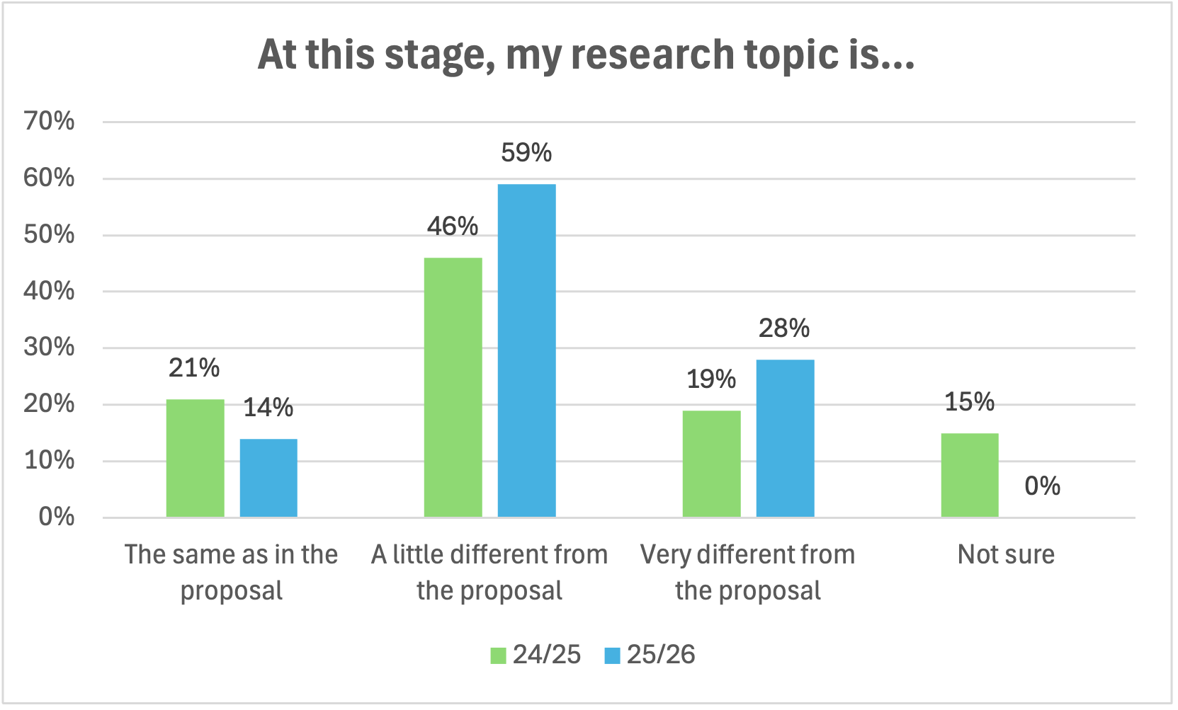
Dr. Thomas Giagkoglou Dr Frania Hall, UAL - https://positiveevaluation.myblog.arts.ac.uk/
Changes in research topic, year-on-year
Source: Early unit survey (N= 29, 25/26)

Slide 30
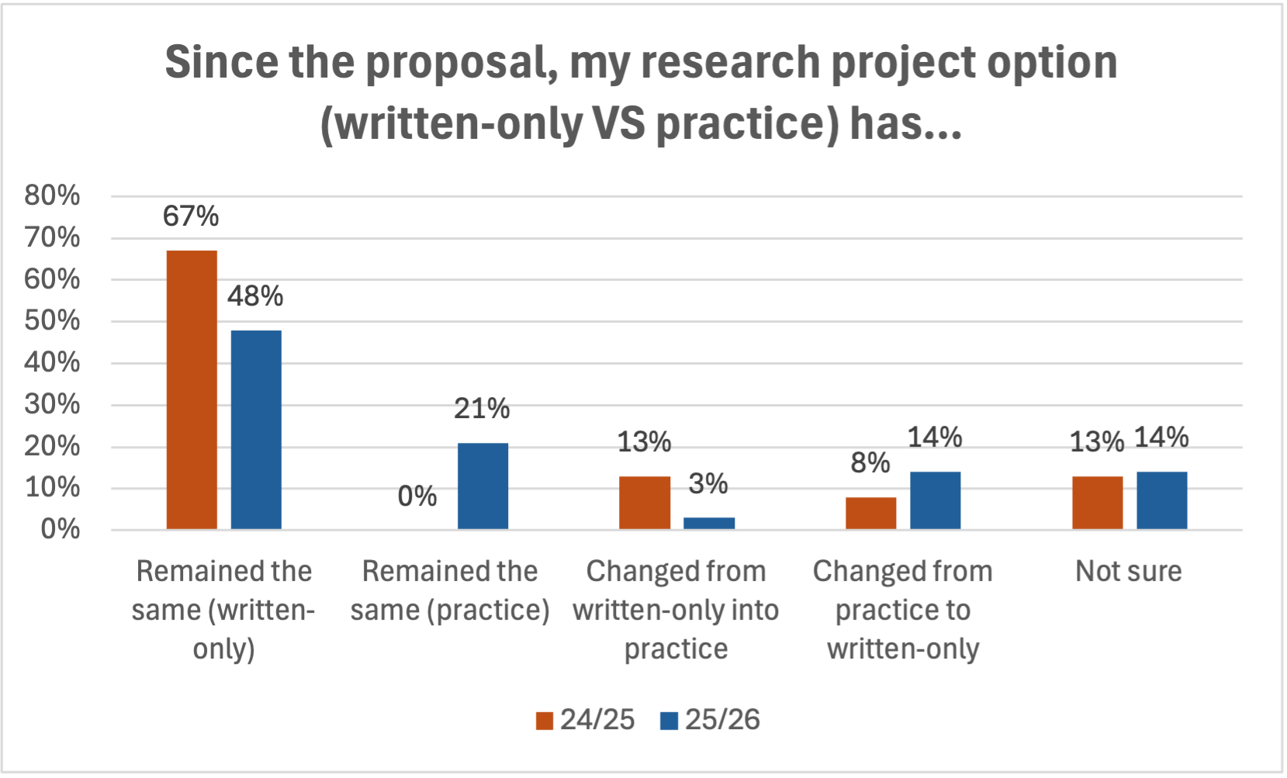
Changes in project option, year-on-year
Source: Early unit survey (N=29, 25/26)

Slide 31
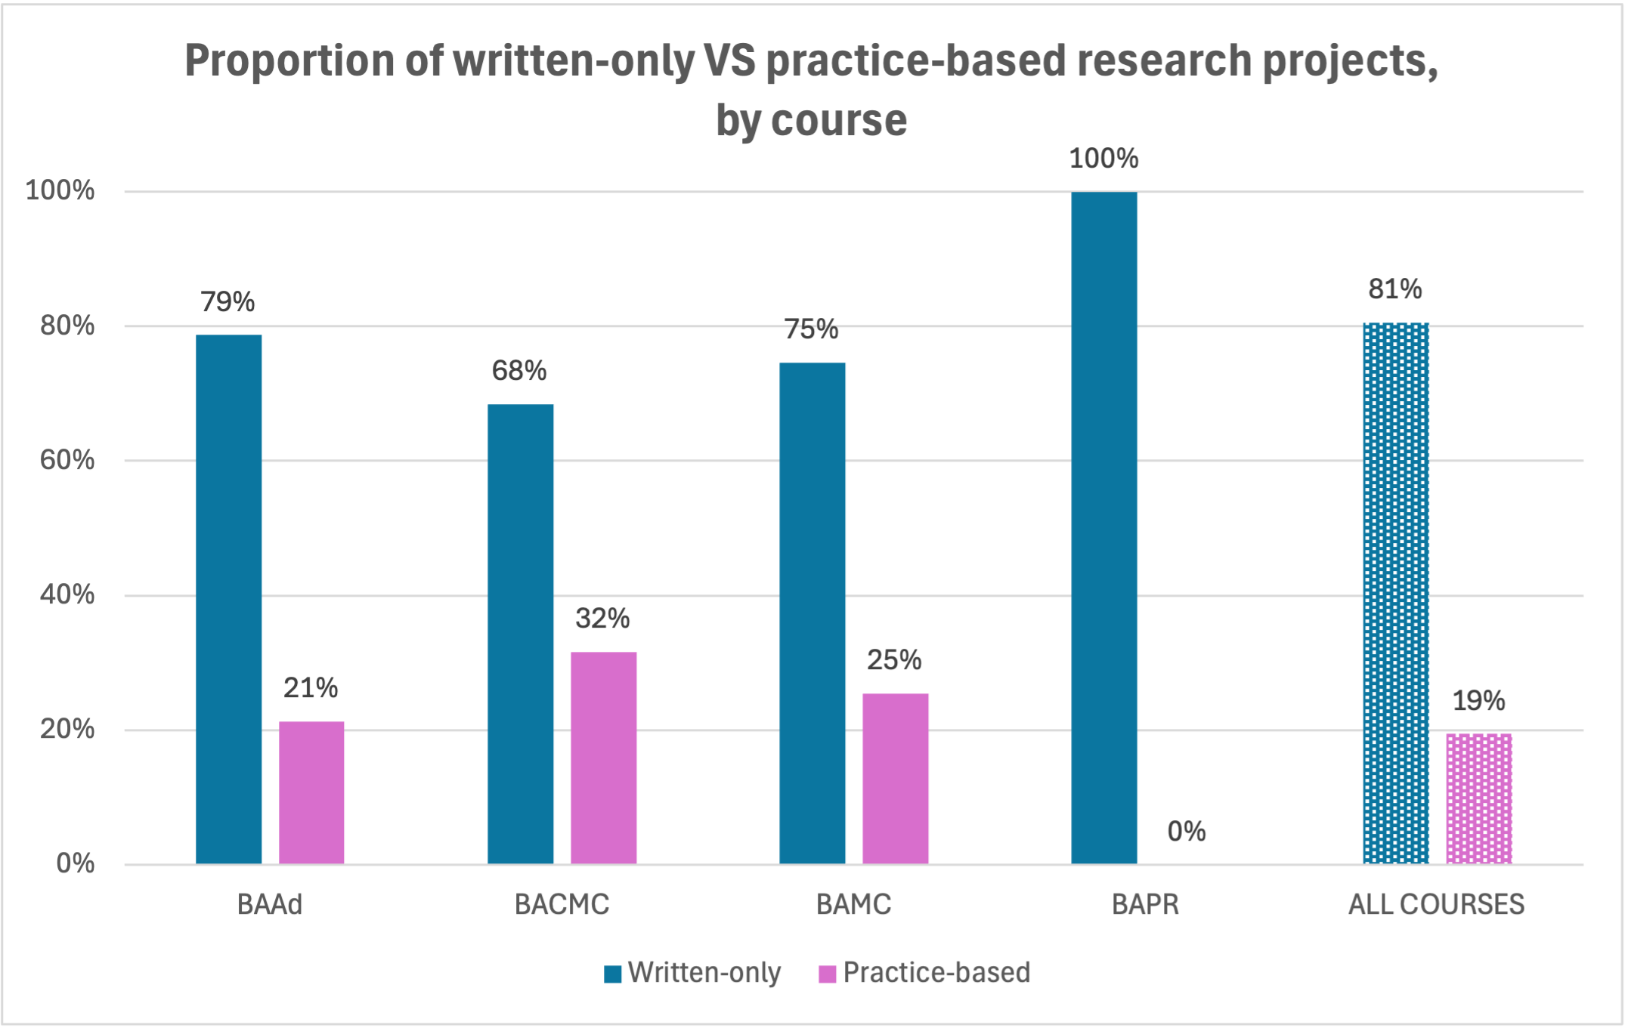
Written-only VS practice-based, by course
Source: UAL Moodle (N=176)

Slide 32
Unit attainment

Slide 33
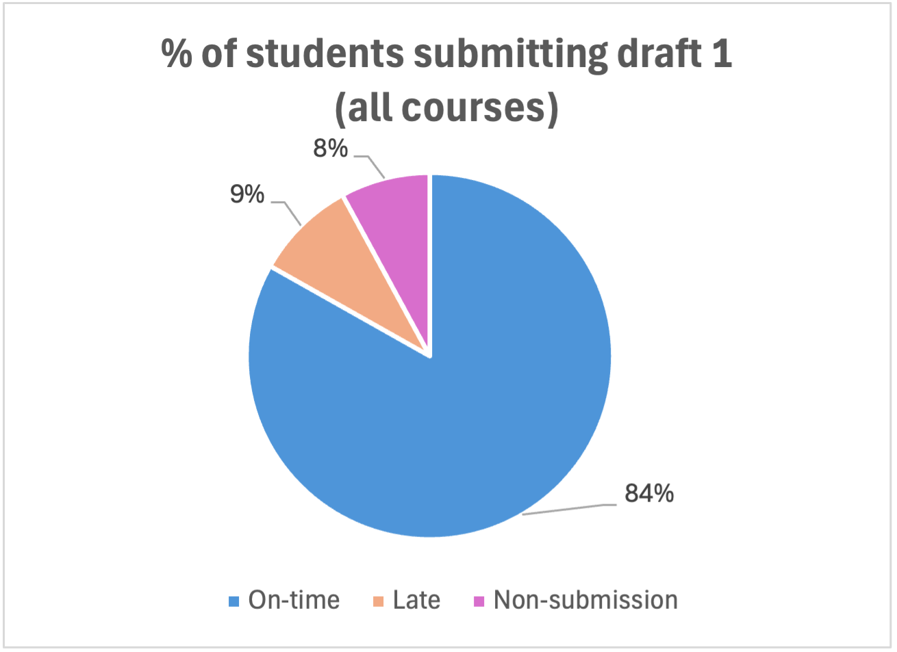
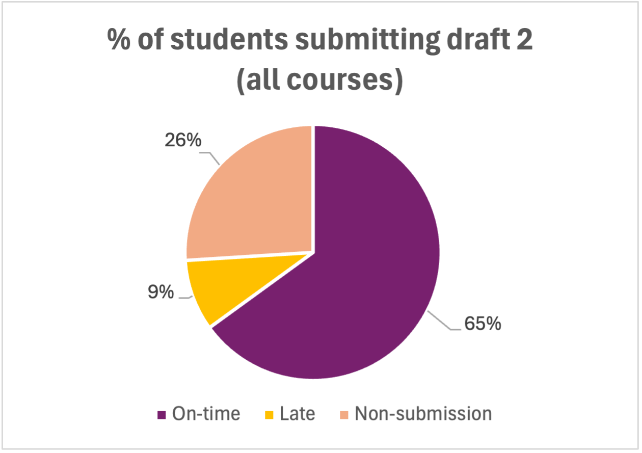
Submission of formative assessment (drafts), all courses
Source: UAL Moodle (N= 176, 25/26)

Slide 34
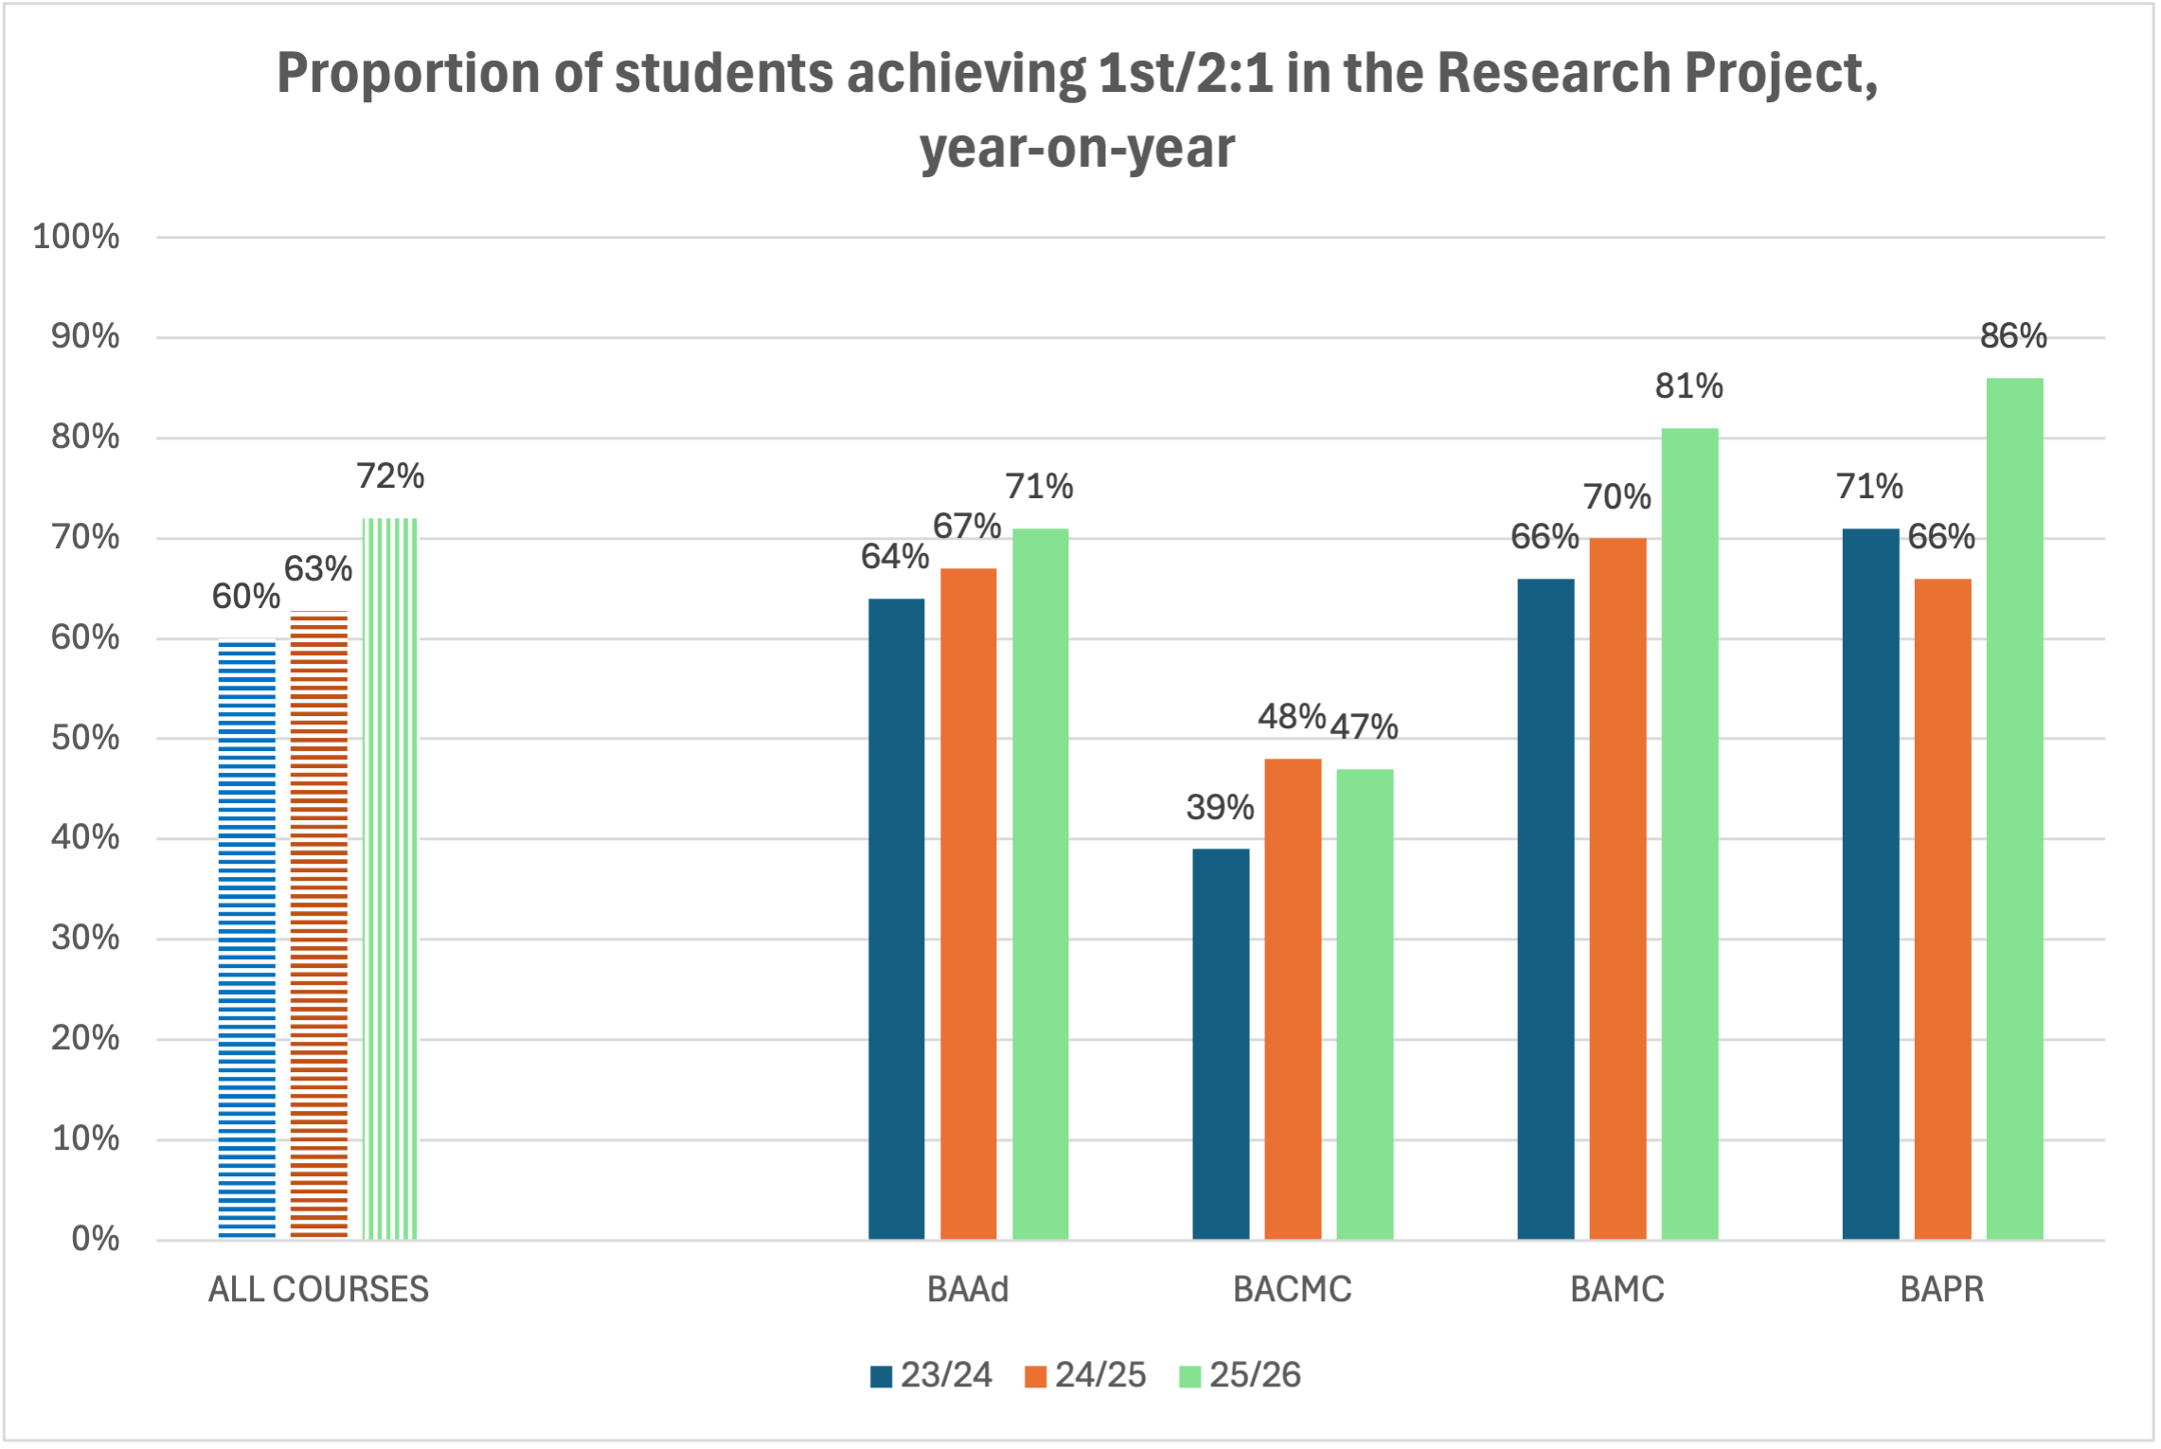
Research Project unit attainment, by course, year-on-year
Source: UAL Assessment Feedback (N= 176, 25/26)

Slide 35
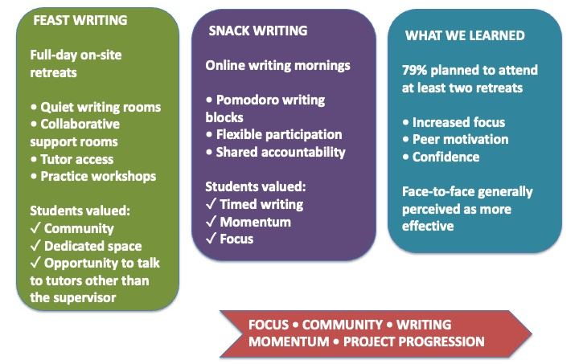
Writing Retreats: Keeping the momentum

Slide 36
The Evaluation project
In-depth understanding of the pedagogy for this unit – iterative, building success
New approach in Media School now three years on, capacity-building - used more widely at UAL (eg MA Academic Practice)
Self-evaluation processes – OfS aligned
Scalable approaches – adaptable from workshop to unit

Slide 37
Co-creating success
Impacts – staff: collaborations, practice-sharing, evidencing and celebrating innovative work, new research
Impacts – students: increased attainment and engagement, improved student confidence, reach and inclusivity – more voices heard

Slide 38
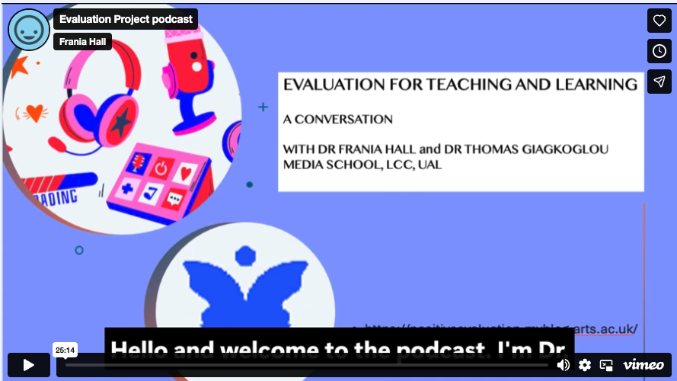
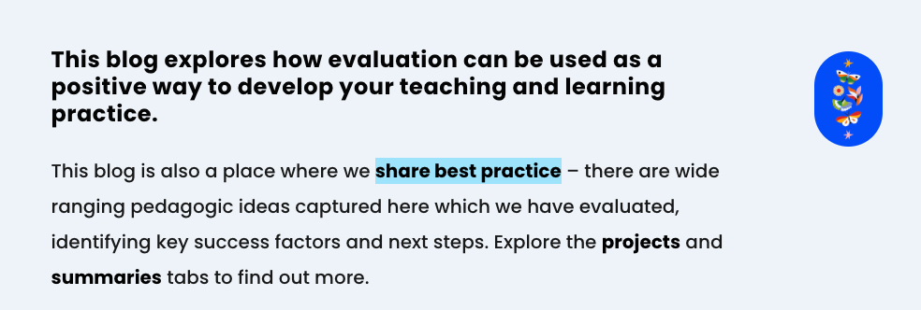
Thank you!
Dr Thomas Giagkoglou - t.giagkoglou@lcc.arts.ac.uk
Dr Frania Hall – f.hall@lcc.arts.ac.uk
https://positiveevaluation.myblog.arts.ac.uk/podcast/

