Slide 1
Playing the AI publishing game:
A case study of one author’s digital publishing model.
Dr Frania Hall, Media School, LCC, UAL.
By the Book – Mainz – 24 June 2026

Slide 2


Slide 3
Theoretical frameworks
Self-publishing models & ecosystems
AI and challenges for publishers/
publishing
Probabilistic systems
Actor network theory
Authorship – human-centred/ machine-centred
Technology as disruptor

Slide 4
Methodology
Observational data from Amazon author pages and book lists, and Good Reads listings
Qualitative interview

Slide 5
Introducing Barrett Williams
Systems engineer, ex-US air force, chief information officer
4478 titles on Amazon (5885 on good reads)
Available as ebooks and as part of Kindle Unlimited
Most books around 130-160 pages – priced between £2.50-£3.80

Slide 6


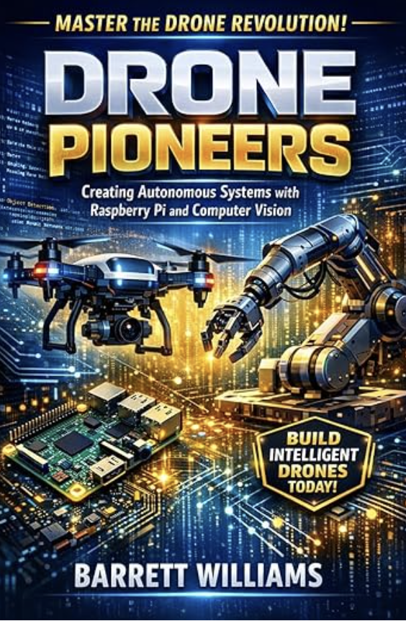



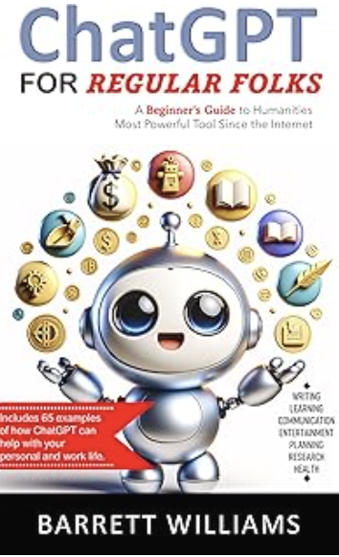


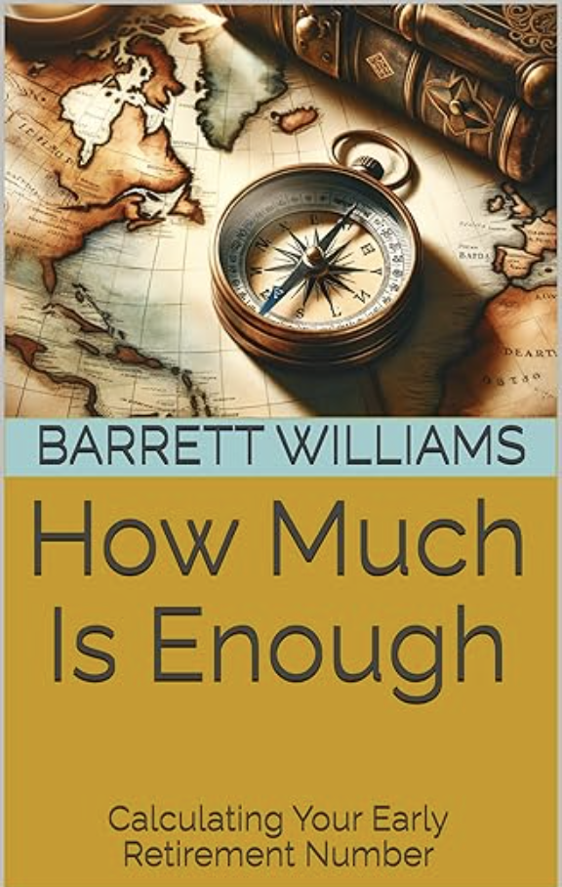
Variety

Slide 7
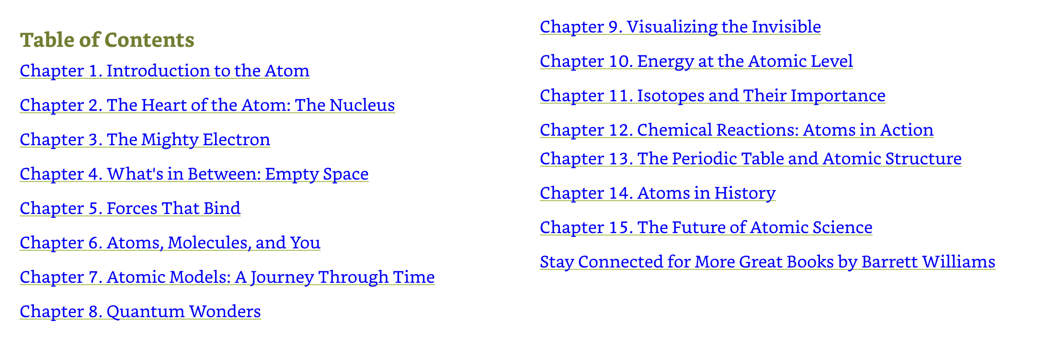
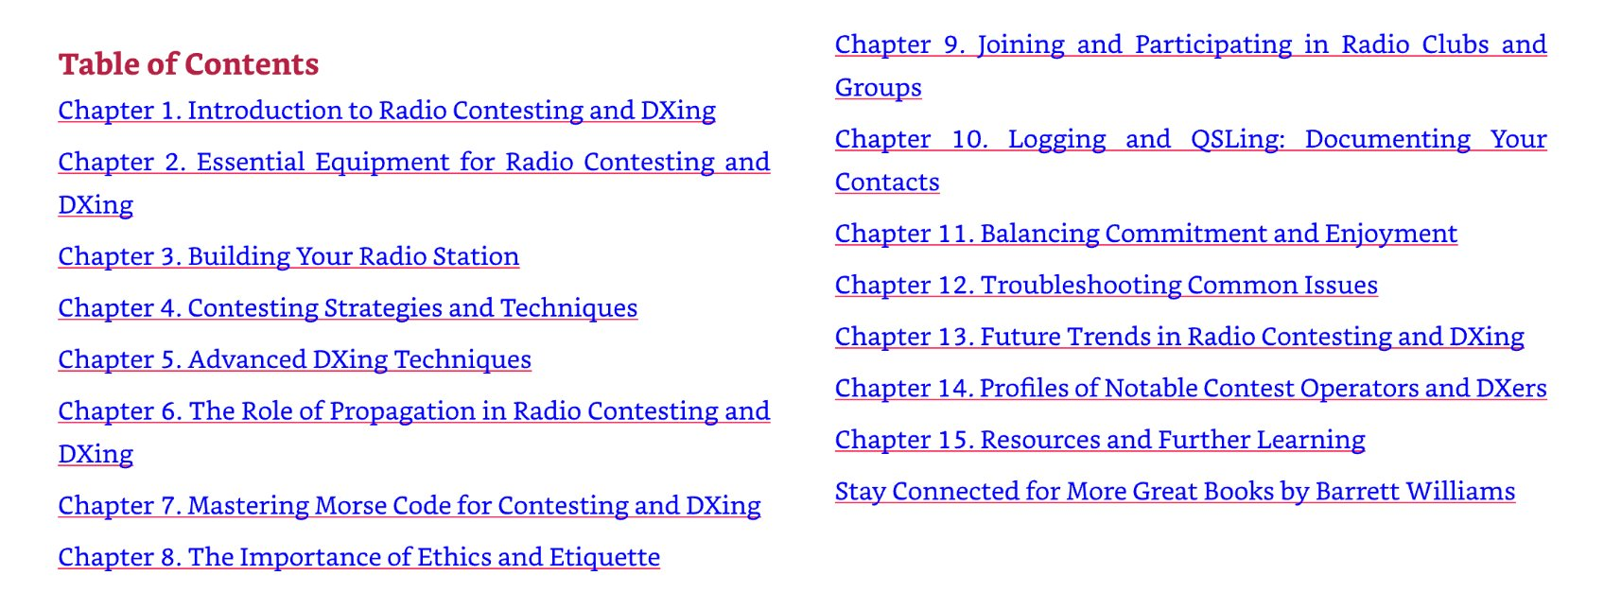
Structure

Slide 8

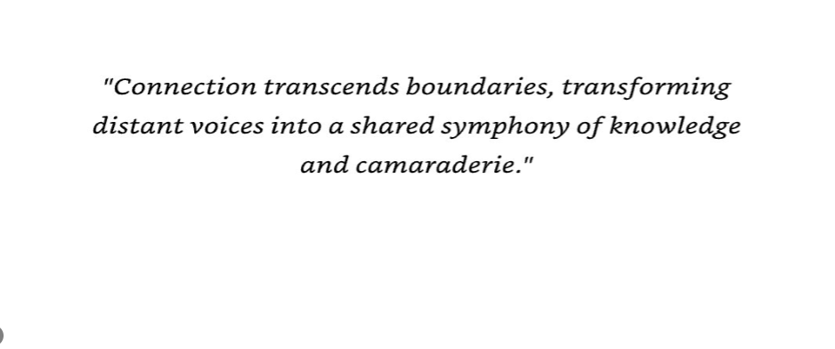
Paratext

Slide 9


Series and clusters - Amazon

Slide 10
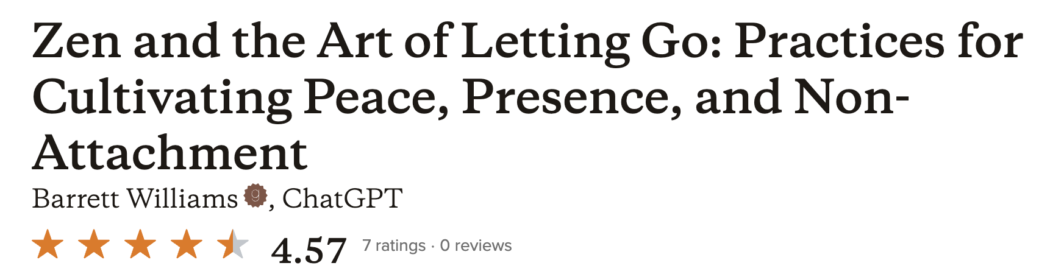
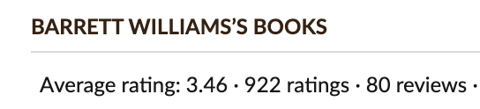
Good Reads ratings

Slide 11


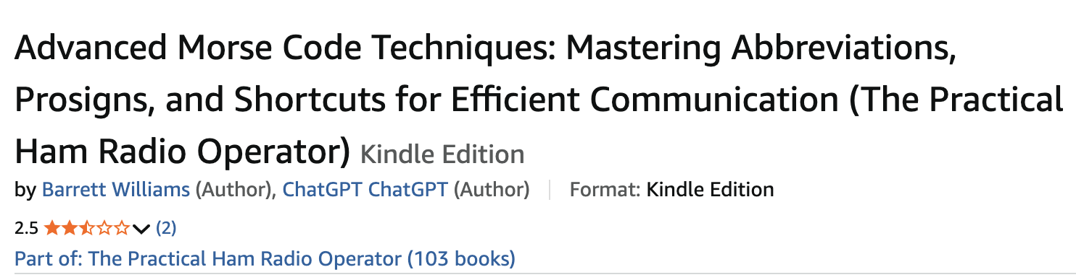
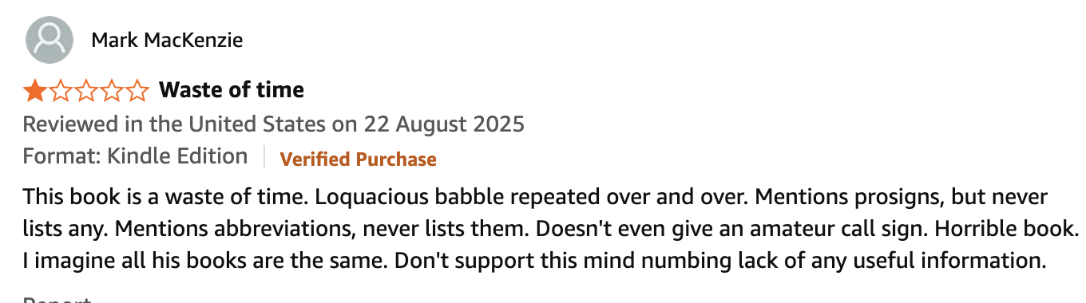
Reviews - good and bad

Slide 12
Publishing workflow
Topic selected
Software interface/ inputs
Software creates metadata and categories
Software automates process to KDP
AI writes book
Audio book run

Slide 13
Frequency
Currently 10 titles a week – restricted by Amazon
Varied topics on weekly launches Popularity rankings – no major pattern
14th april | Behind the action -stunt direction | Designing safety - prop weaponry management | Water independence - mastering off grid
22nd April | Hard-Rock Mining and Ore Processing | Navigating the chaos - nonlinear dynamics | Mastering solo business success

Slide 14
Frequency and Popularity
10 titles a week restricted by Amazon
No major pattern (small numbers)
25th March 2026 | Liquid Soap making 15/5/23 | Molecules in motion 15/3/26 | Cashflow from storage 21/7/23
14th April 2026 | Bokashi composting 4/8/24 | Reach through the stars (radio satellites) 14/5/23 | Time travel in your hands (antique postcards) 2/5/23
14th april | Behind the action -stunt direction | Designing safety - prop weaponry management | Water independence - mastering off grid
22nd April | Hard-Rock Mining and Ore Processing | Navigating the chaos - nonlinear dynamics | Mastering solo business success

Slide 15
Motivation and learning - 'engineering endeavor'
'One of the best ways that I learn is by building and by using. That’s why I did this.'
Curious
Interested in the challenge
Keen to learn
Still learning
At the start 'you'll see that's all stuff Barrett's kind of interested in, because I didn't have anything to start with'

Slide 16
BUSINESS MODEL – sales value percentages
48% e-book
40% subscription Kindle Unlimited.
12% audiobook

Slide 17
Themes

Slide 18
Author – producer - creator
I’m not an author, I’m an engineer. I don’t write books, I manufacture them. I call this whole thing my book factory.
It gave me a respect for people that do this for a living and that actually have these real skills. There is a, I have learned there's a ton that goes into writing a book, nonfiction or fiction, either one. And I didn't want to diminish that in any way.

Slide 19
Author/producer/creator
Creative labour – recognises huge effort of authors and fiction is very difficult – has tried fiction
Admiration for authors
Who wrote it dilemma
'Human-inspiring' titles seem to be being produced by AI

Slide 20
Identity
My gut tells me the computer wrote it. I asked it to write it, and it wrote it. But should it be listed as an author? I don’t know.

Slide 21
Identity as publisher
Self-aware
Tests and questions eg 3 challenges. 3 signals
Honest about AI as author
Amazed by effectiveness of AI
Pleasure in the way it works

Slide 22
Ethics
I didn't want to cheat people.
okay, I'm going to use this technology, but I need to be very upfront and very open and honest about all of this and not try to swindle anybody.

Slide 23
Ethics and transparency and legitimacy
Respect for human authors
Anxiety not to plagiarize
Checks and balances from AI and additional ones
Not claiming to be author but Amazon now says can’t say AI is an author
If don't like it can get refunds via Amazon – readers in control

Slide 24
Publishing sensitivities
The best way to determine if a book is good is to throw it out into the marketplace and see what the response is.
An agentic system is where you spawn different AI instances that specialise. That’s just division of labour, the same principle humans follow.'

Slide 25
Publishing sensitivities
Publishing sensitivities – tone, objective, test in market
Publishing functions recreated, and need depth – editorial, layout, project management
Market place – soak in market – reader responses
Lack of ability to get info from Amazon
What sells - cover design, title, subtitle
Learning as go along – eg marketing, special deals
Tried to get in touch with readers – newsletters – barriers not knowing readers

Slide 26
Human & Machine
Artificial intelligence, even in 2022, could create a nonfiction book that humans found value in, so that was amazing to me.

Slide 27
Human-machine interaction
Software interfaces and emergent connectivity and co-production (Barad)
Construction of parameters is detailed and thought through
Based on human writers
AI is a collaborator - intertwining human/machine (Hayles)
What humans value – a book by AI
Emerges from a network - human prompts, AI model, datasets, platform constraints (ANT – Latour)

Slide 28
Quality
Because when people are actually paying money, they'll be real honest about the quality.
They consistently get about a 3.6‑star rating, which isn’t five stars, but considering the books are written by a computer, I think that’s amazing.

Slide 29
Quality, value and reader responses
Good enough - some value it – probabilistic, adequacy model
Quality is not really good enough to market – but that is not the business model
Meet minimum criteria – optimise for likelihood not originality
Minimum viable product

Slide 30
Amazon
'Amazon puts a huge barrier between me and my readers. There’s no interaction. I don’t know who they are.'

Slide 31
Amazon
Amazon change frequency
Just plays by rules – (possibly established per author)
KU Payment is dynamic any given week – analysis by author and overall KU account – and specific rules per author in that week
Chat GPT is not an author
Amazon author interface not really set up for 5500 books
Clusters not series
Can’t reach readers

Slide 32
Observations

Slide 33
Overall
Very present
Very aware of context
Ethical
Constrained by Amazon
Tests for success 1) works 2) has readers 3) can be automated
Tests of quality 1) has readers 2) consistency in ratings 3) positive hearsay
Reader interest has to be proven in marketplace
Publishing processes even if automated are recognisable

Slide 34
Quality tolerances and probabilistic systems
3.6 is 'good enough' – consistent
Incremental probability-weighted consensus, information stability – wikipedia, AI (Bayes)
Knowledge is contingent, revisable and distributed; collective intelligence (Levy), wisdom of crowds can outperform (Surowiecki)
Algorithmic - probabilistic selection system (Parisi) and discoverability based on probability
Digital systems everything becomes computable and probabilistic (Kittler)

Slide 35
Tensions
Profitable – but not retire-early money – and requires consistent on-going publishing
Probabilistic – Responsive to Amazon
Balance between effort, frequency and spend – remain profitable not too much work, nor expect to market – let readers find
Publisher, not author, identity
Randomness – letting AI make choices - eg chooses title based on data vs controls via the parameters of the software.
Who is the author?

Slide 36
Final thoughts
PRODUCTION - authorship moves from a singular creative act to authorship as iterative probabilistic production
CIRCULATION – algorithm (with AI driven metadata) ensures circulation
GATEKEEPING - not editor, increase in output leaving filtering to post-publication selection (ratings, clicks, shelving)
AUTHOR: distributed authorship with AI, curator of outputs, orchestrates systems through prompts and interfaces = manager of probabilities

Slide 37
Thank you
Frania Hall
f.hall@lcc.arts.ac.uk

Slide 38
References
References
Barad, K. (2007) Meeting the Universe Halfway: Quantum Physics and the Entanglement of Matter and Meaning. Durham, NC: Duke University Press.
Bayes, T. (1763) ‘An essay towards solving a problem in the doctrine of chances’, Philosophical Transactions of the Royal Society of London, 53, pp. 370–418. [royalsocie...ishing.org]
Hayles, N.K. (2017) Unthought: The Power of the Cognitive Nonconscious. Chicago, IL: University of Chicago Press.
Kittler, F.A. (1999) Gramophone, Film, Typewriter. Stanford, CA: Stanford University Press. [sup.org], [books.google.com]
Latour, B. (2005) Reassembling the Social: An Introduction to Actor-Network-Theory. Oxford: Oxford University Press.
Lévy, P. (1997) Collective Intelligence: Mankind’s Emerging World in Cyberspace. New York: Plenum Press.
Parisi, L. (2013) Contagious Architecture: Computation, Aesthetics, and Space. Cambridge, MA: MIT Press.
Shannon, C.E. and Weaver, W. (1949) The Mathematical Theory of Communication. Urbana, IL: University of Illinois Press.
Surowiecki, J. (2004) The Wisdom of Crowds: Why the Many Are Smarter Than the Few and How Collective Wisdom Shapes Business, Economies, Societies and Nations. New York: Doubleday.

