Slide 1
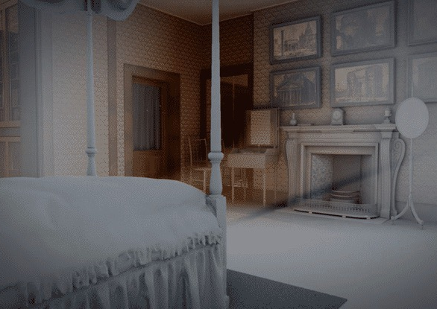
Dear Friend, I can no longer hear your voice…
by artist, Anne-Marie Creamer
Notes:
Intro: Dear Friend, I can no longer hear your voice…
Developed through deep collaboration with museum staff and extensive archival research—including diaries, drawings, models, ephemera, and personal letters—the film engages in situated research, embedding creative inquiry within the museum’s spatial, emotional, and historical contexts.

Slide 2
Introduction to
Dear Friend, I can no longer hear your voice… lamentation and conjuring ghosts as strategies for survival
By artist, Anne-Marie Creamer
Notes:
Intro (title)
following Jeffrey Kripal explores the paradox of the spectral and the impossible: ghosts are not “real” in materialist terms, yet they press on experience, memory, and culture with undeniable force.
Soane’s conjuring of Eliza is precisely this impossibility: she is gone, yet her presence is woven into the very fabric of his professional life.
My work extends this logic—animation and choral sound conjure her without “proving” her. It is an embrace of the impossible, a refusal to reduce mourning to closure.
Haunting here becomes a survival strategy: by conjuring the dead beloved as an impossible but felt presence, one resists annihilation by grief.

Slide 3
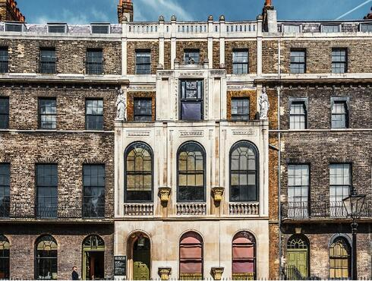
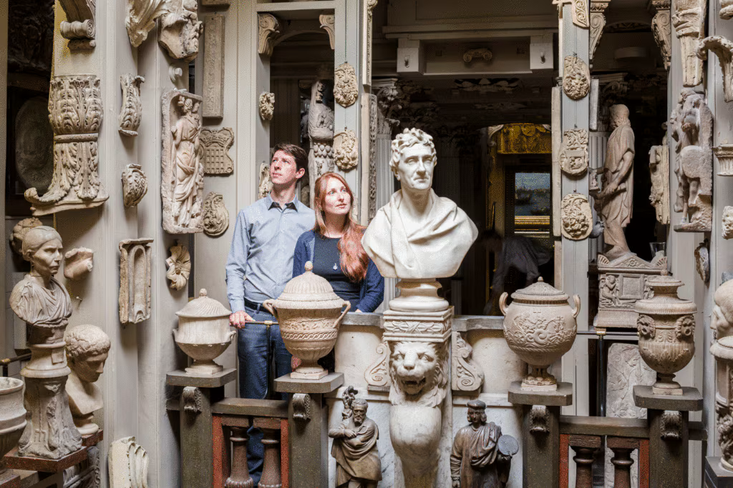
The John Soane Museum, Lincoln’s Inn Fields, London
Museum context (Soane’s house–museum)
Sir John Soane’s Museum is the extraordinary house and museum of the British architect Sir John Soane (1753-1837).
UK’s first formal museum. Sir John Soane was one of the foremost architects of the Regency era, a Professor of Architecture at the Royal Academy, and a dedicated collector of paintings, sculpture, architectural fragments and models, books, drawings and furniture.
Today, Sir John Soane’s Museum occupies three buildings, Nos 12, 13, and 14 Lincoln’s Inn Fields. Sir John Soane acquired and rebuilt each of these buildings during his lifetime.
Notes:
Sir John Soane’s Museum is the extraordinary house and museum of the British architect Sir John Soane (1753-1837).
Today, Sir John Soane’s Museum occupies three buildings, Nos 12, 13, and 14 Lincoln’s Inn Fields. Sir John Soane acquired and rebuilt each of these buildings during his lifetime.
Sir John Soane was one of the foremost architects of the Regency era, a Professor of Architecture at the Royal Academy, and a dedicated collector of paintings, sculpture, architectural fragments and models, books, drawings and furniture.
Born in 1753, the fourth son of a bricklayer, his father’s professional links with architects and his own natural talent for drawing won him the opportunity to train as an architect. A talented and hard-working student, Soane was awarded the Royal Academy’s prestigious Gold Medal for Architecture, as a result receiving a bursary (funded by King George III) to undertake a Grand Tour of Europe. His travels to the ruins of Ancient Rome, Paestum and Pompeii would inspire his lifelong interest in Classical art and architecture.

Slide 4
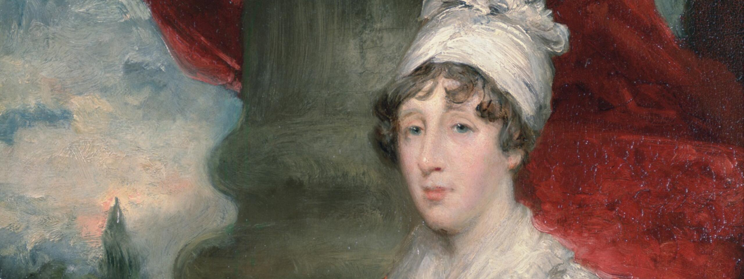
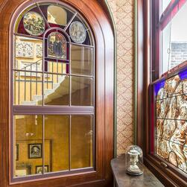
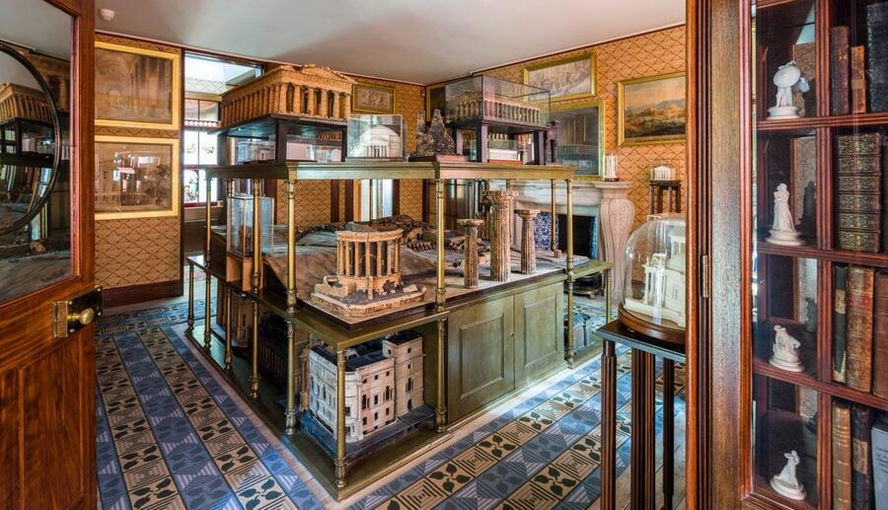
The premise of
Dear Friend…
Notes:
Premise of the film:
Detail Eliza’s sudden death in 1815
And the room which had been her bedchamber, was ‘kept ’for 19 years and then, an elderly Soane, having recently got agreement that an act of parliament would turn his House-Museum into the England’s first formal museum. At this point, Soane emptied his wife’s bedchamber order to make the now famous ‘model room’, with Eliza’s objects hidden away. Some, like the little vase in the bottom left image, were turned into a site of private memorialization.

Slide 5
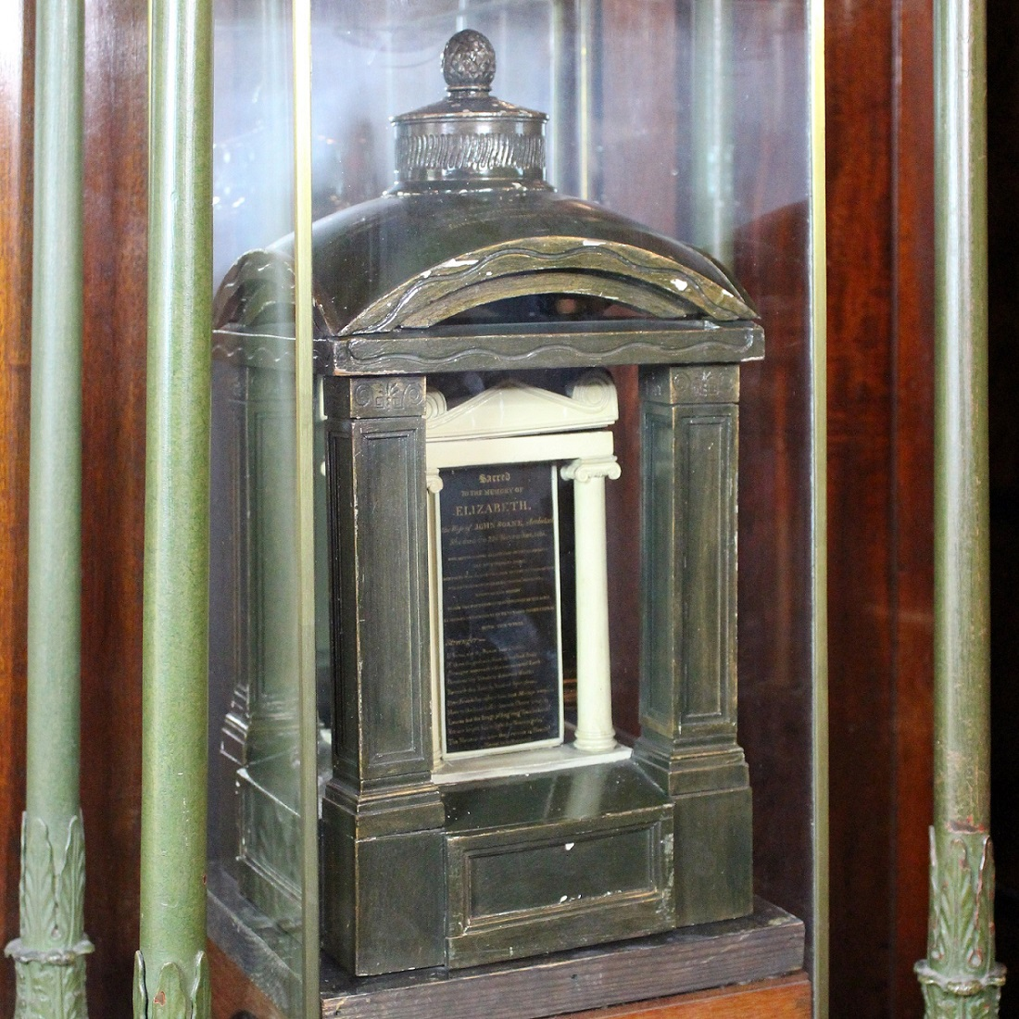
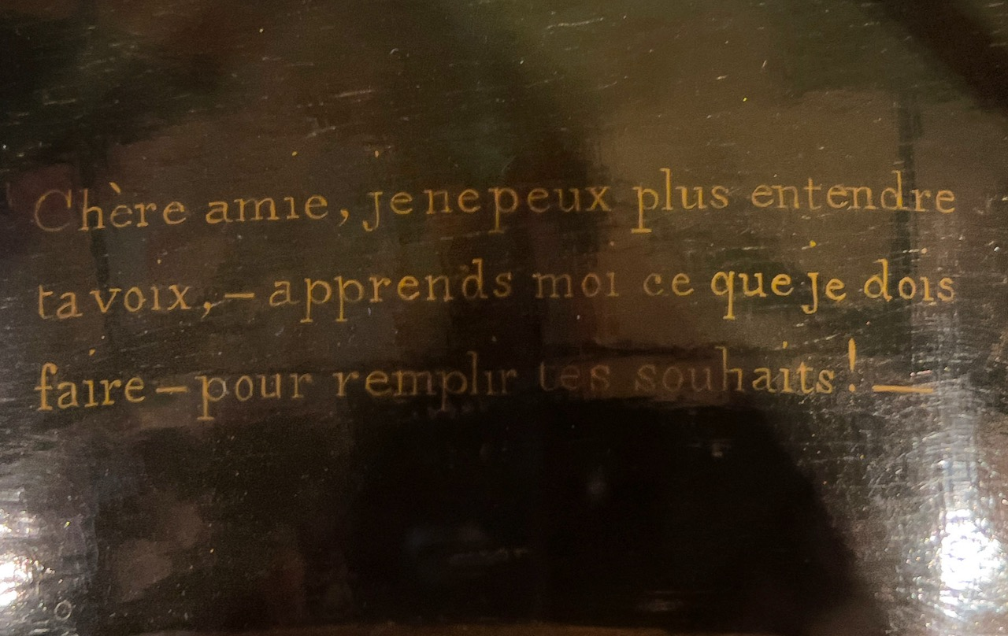
Title source
The source of the title for Dear Friend, I can no longer hear your voice
Notes:
Title source:
*The film and exhibition title refers to an inscription hidden on the canopy of a model of the Soane family tomb, which is in the Library-Dining Room at the Museum. It refers to a passage from a now largely forgotten novel, Corinne, ou l'Italie by Madame de Staël, first published in 1807, where in addressing a portrait of his dead father a young man declares -
“Dear Friend, I can no longer hear your voice, but tell me by your mute gaze, still so powerful to my soul, tell me what I must do to give you in heaven some satisfaction….”

Slide 6
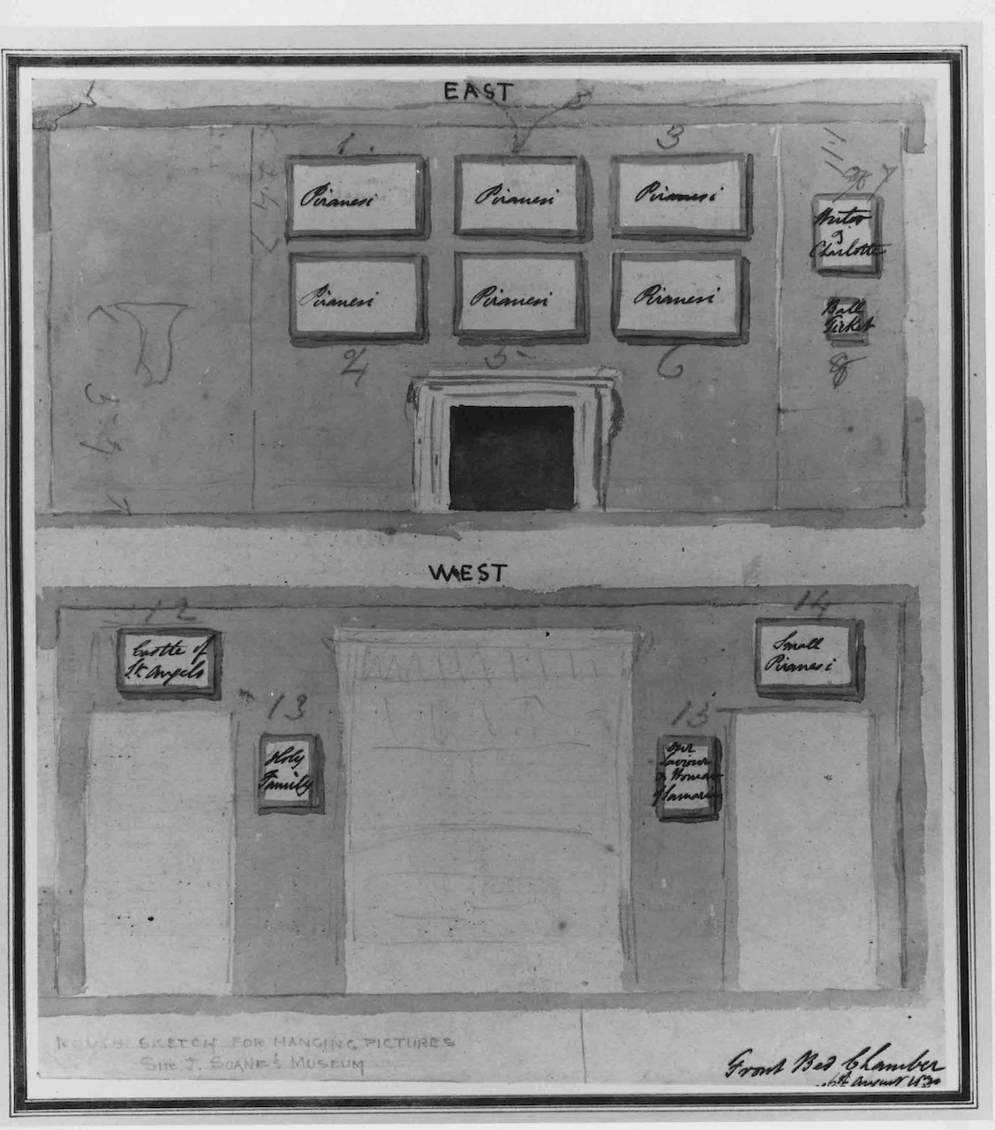
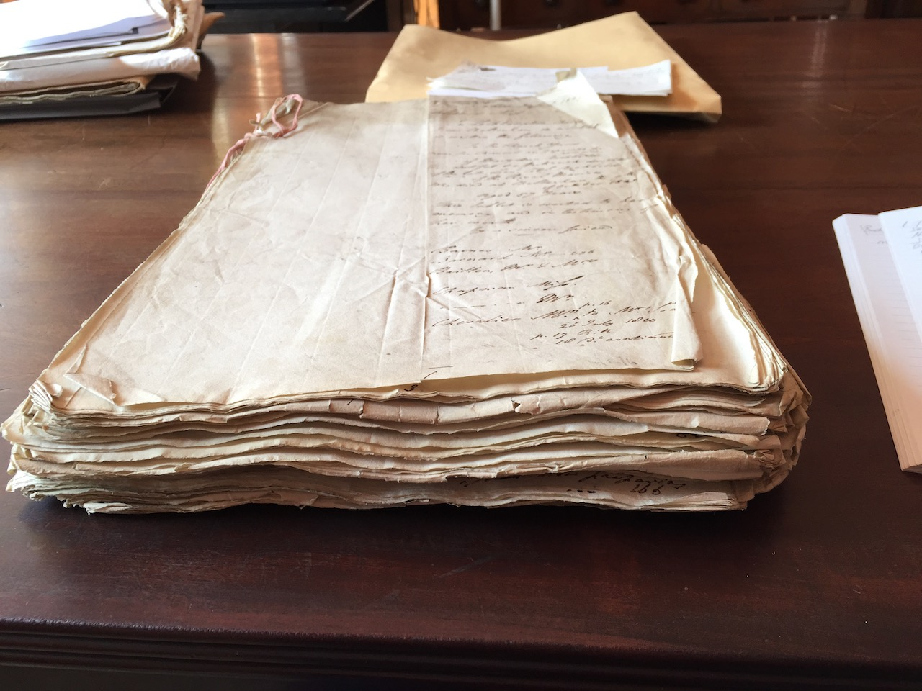
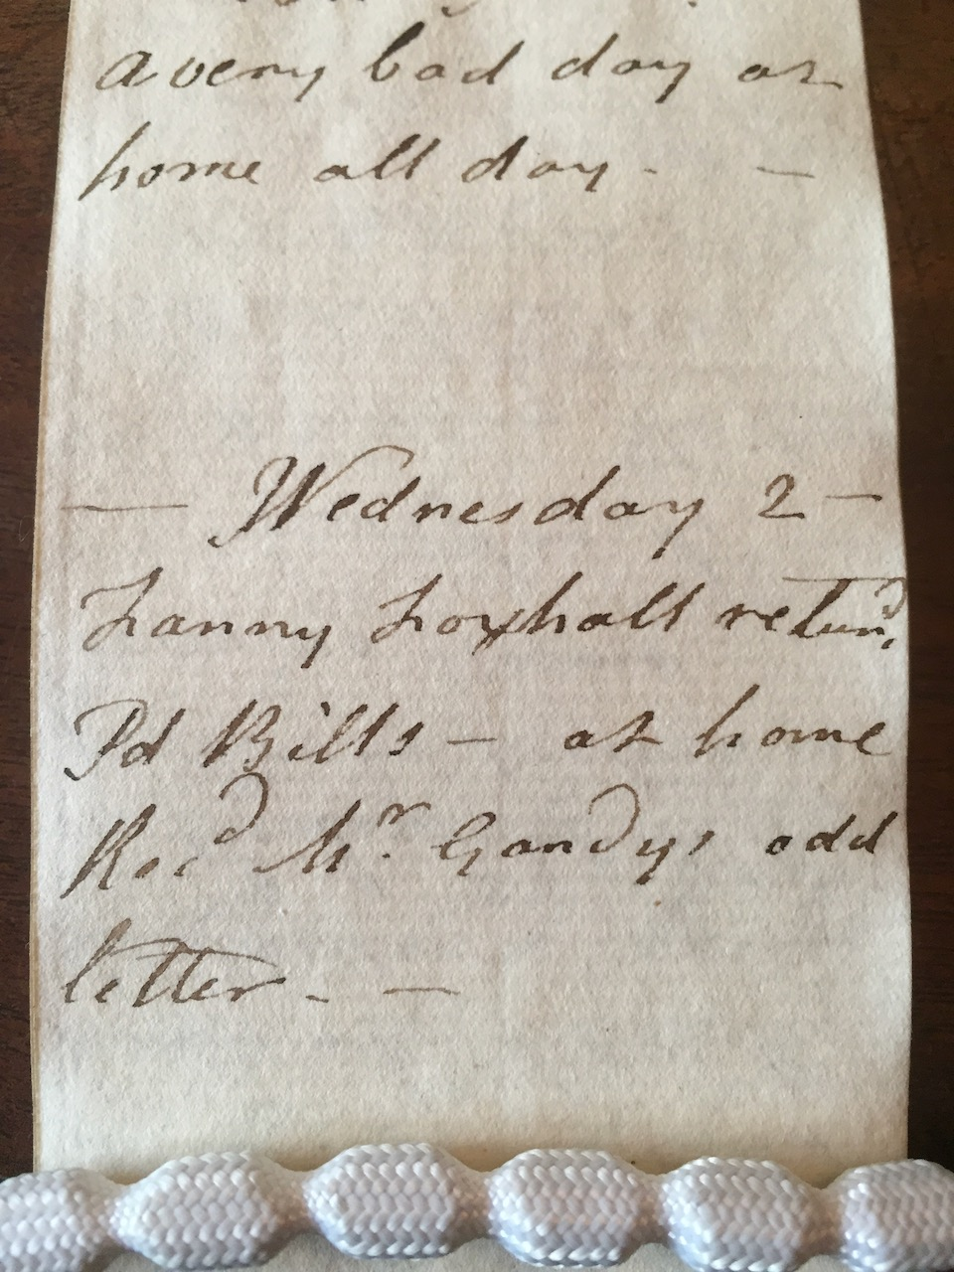
Dear Friend….Process
Archives → Process (research, animation, choral sound)
Dear Friend: beginning in the archives at Soane Museum & what is known
Notes:
Archives → Process (research, animation, choral sound)
Feminist retrieval of Eliza
Working from inside out: Through the archives – first time museum staff worked in this way.
Through examining ephemera, fragments, shopping lists, – through what was left of the fragments of the material cultural of Eliza’s left in the museum archives, and by triangulating these with diaries, dates of the formal history of the museum, my aim was to gradually- and up to a point – ‘conjure’ – Eliza.
I started reading all of Eliza’s diaries and letters. Then John Soane’s, and all letters and diaries the museum had around the time of Eliza’s sudden death, which included 2 close female friends- and to map these events, even small shopping trips, onto the contents of the museum collection and stores.
I was keen to meet Eliza; to animate her presence; understand who she was in the context of her time.
But also, to understand how the loss of Eliza was an important – and creative - aspect of the life of a beloved national museum, in ways that had no been unacknowledged in its’ public history, to date.

Slide 7
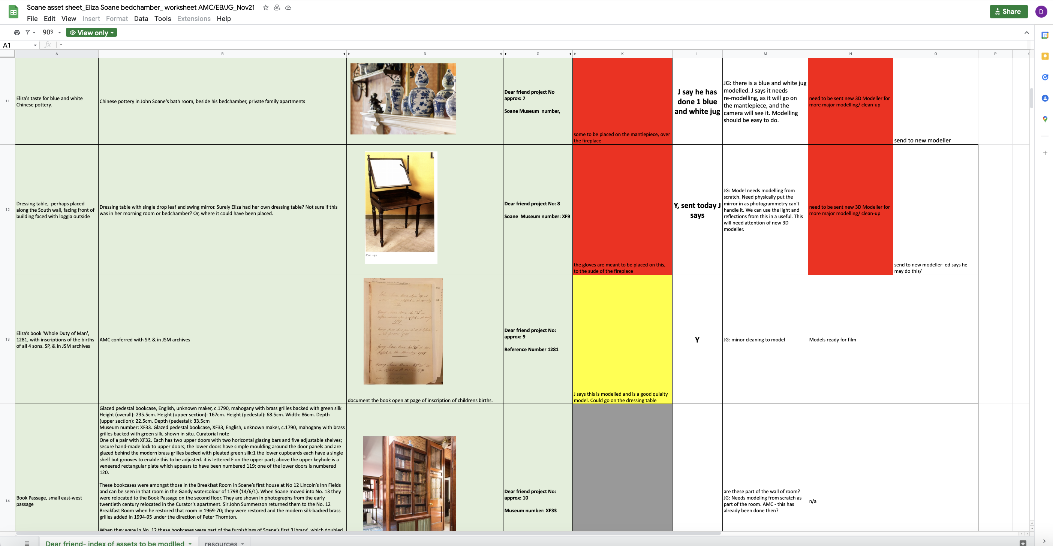
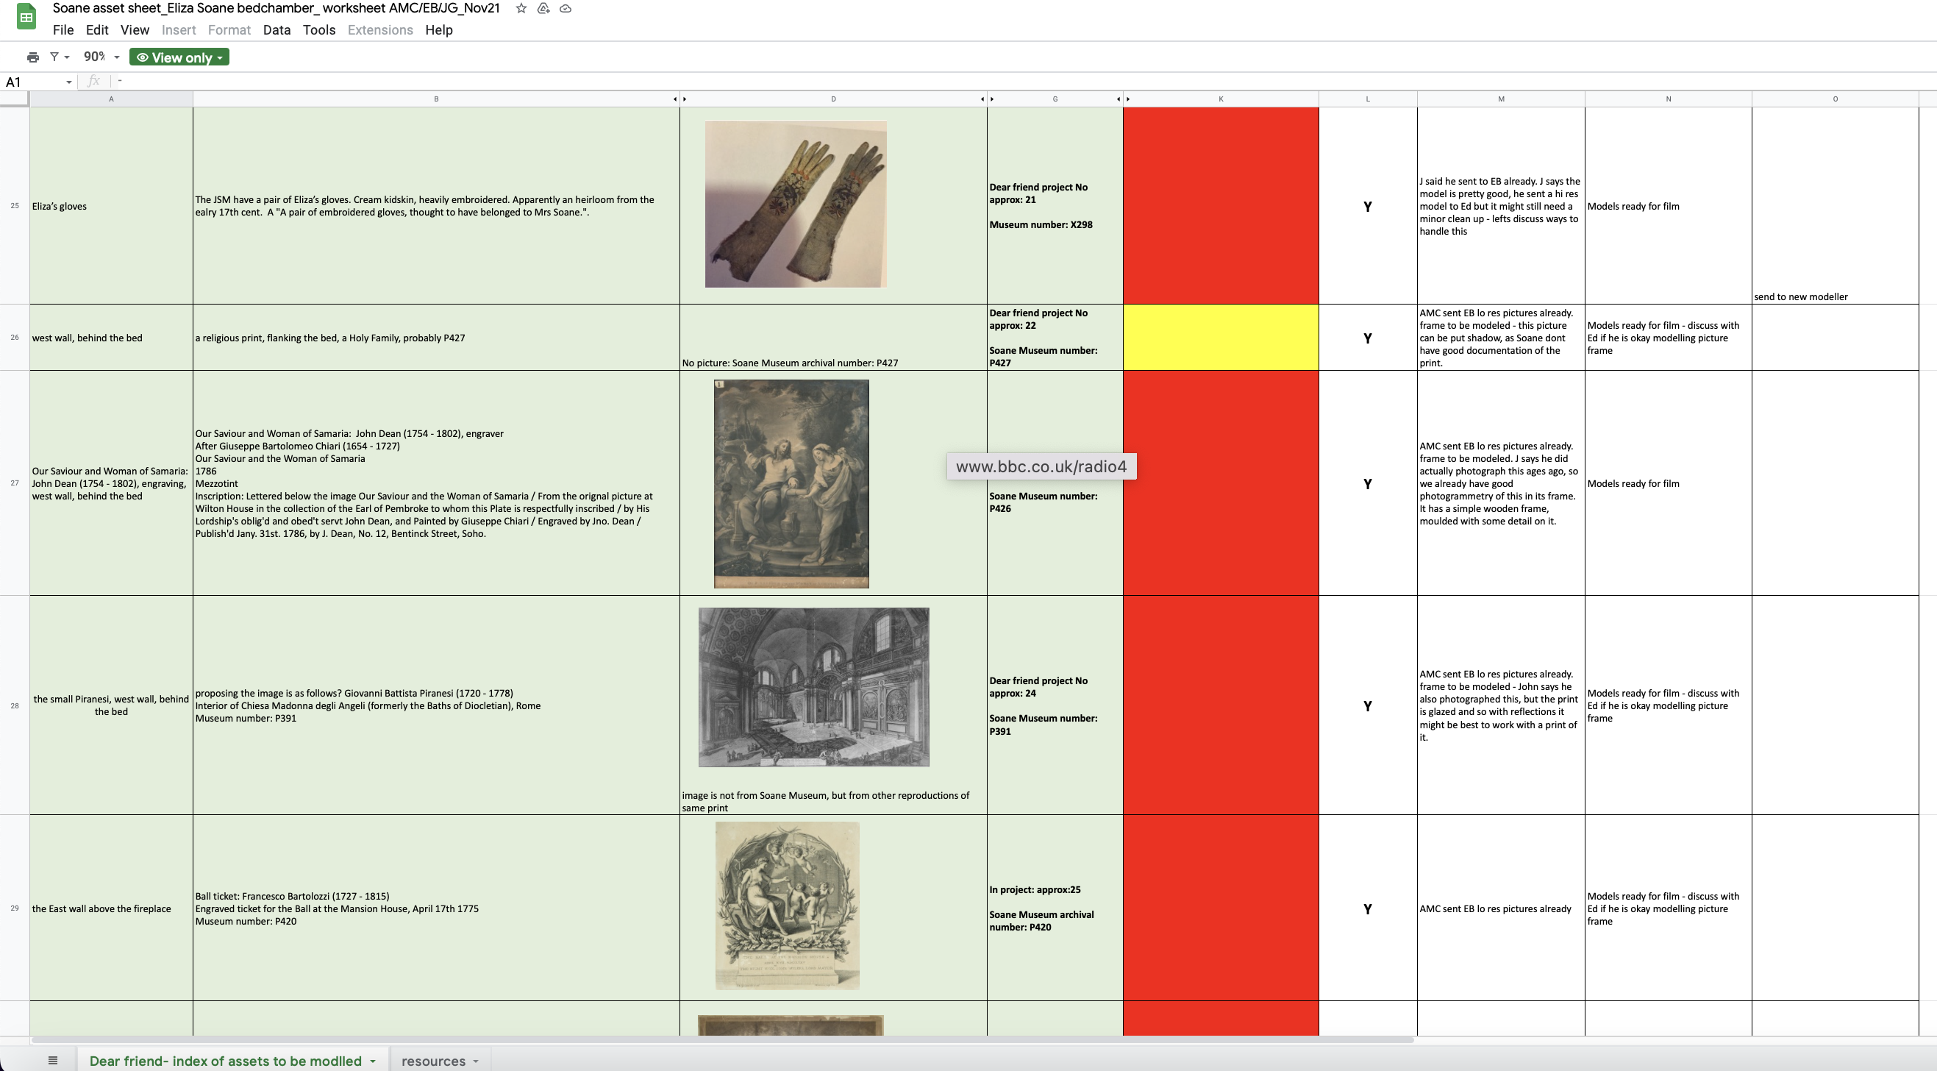
Archives → Process (research, animation, choral sound)
R&D: research in archives are mapped onto Soane Museum Collection
Notes:
Archives → Process (research, animation, choral sound)
Here, as part of that process, one outcome of the early part of the R&D process I developed, with Soane chief archivist and Deputy Director and Inspectoress, a speculative list of about 33 objects within the museum’s collections, some not shown for many years.
This represented new knowledge for the museum…

Slide 8
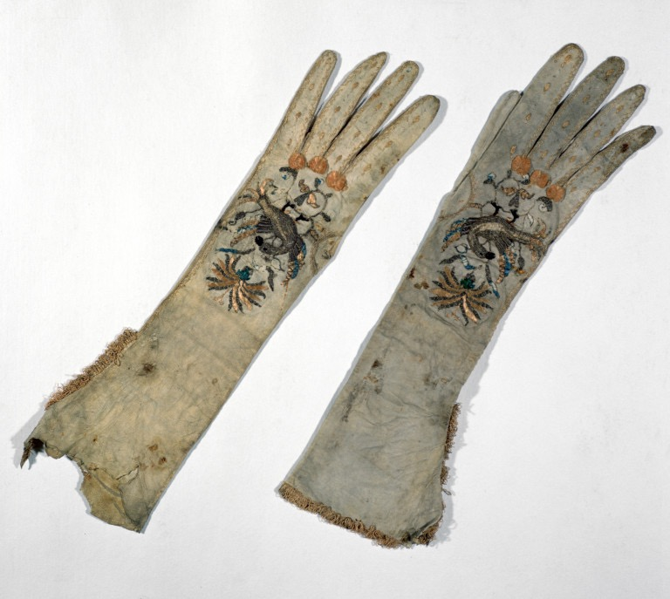
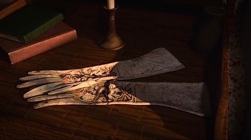
Archives → Process (research, animation, choral sound)
Eliza’s possessions are in Dear Friend
Notes:
Archives → Process (research, animation, choral sound)
Process of photogrammetry – used previously in archeology
Explain – taking each of the objects and with a photographer documenting each object with 200;s of photos in order to make a CAD model of each object, and when this was done to combine them into a new visualization of the room – the first time since 1837 since those objects were ‘seen’ in the room together.

Slide 9
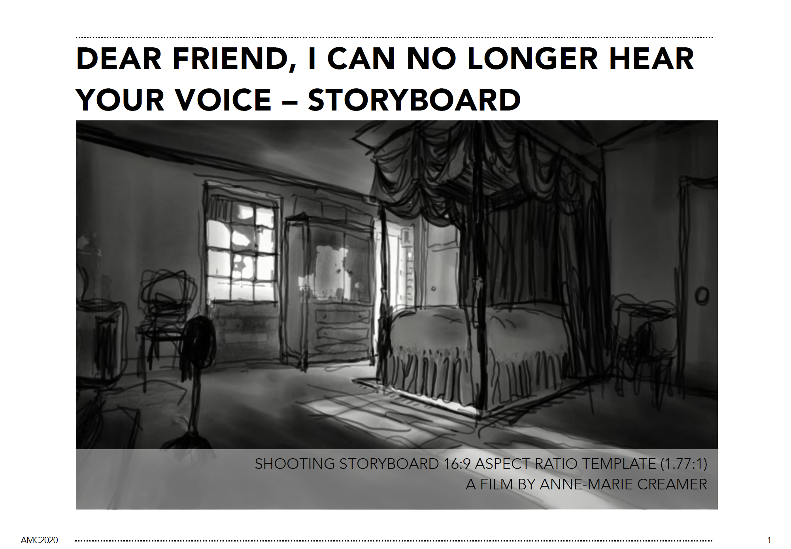
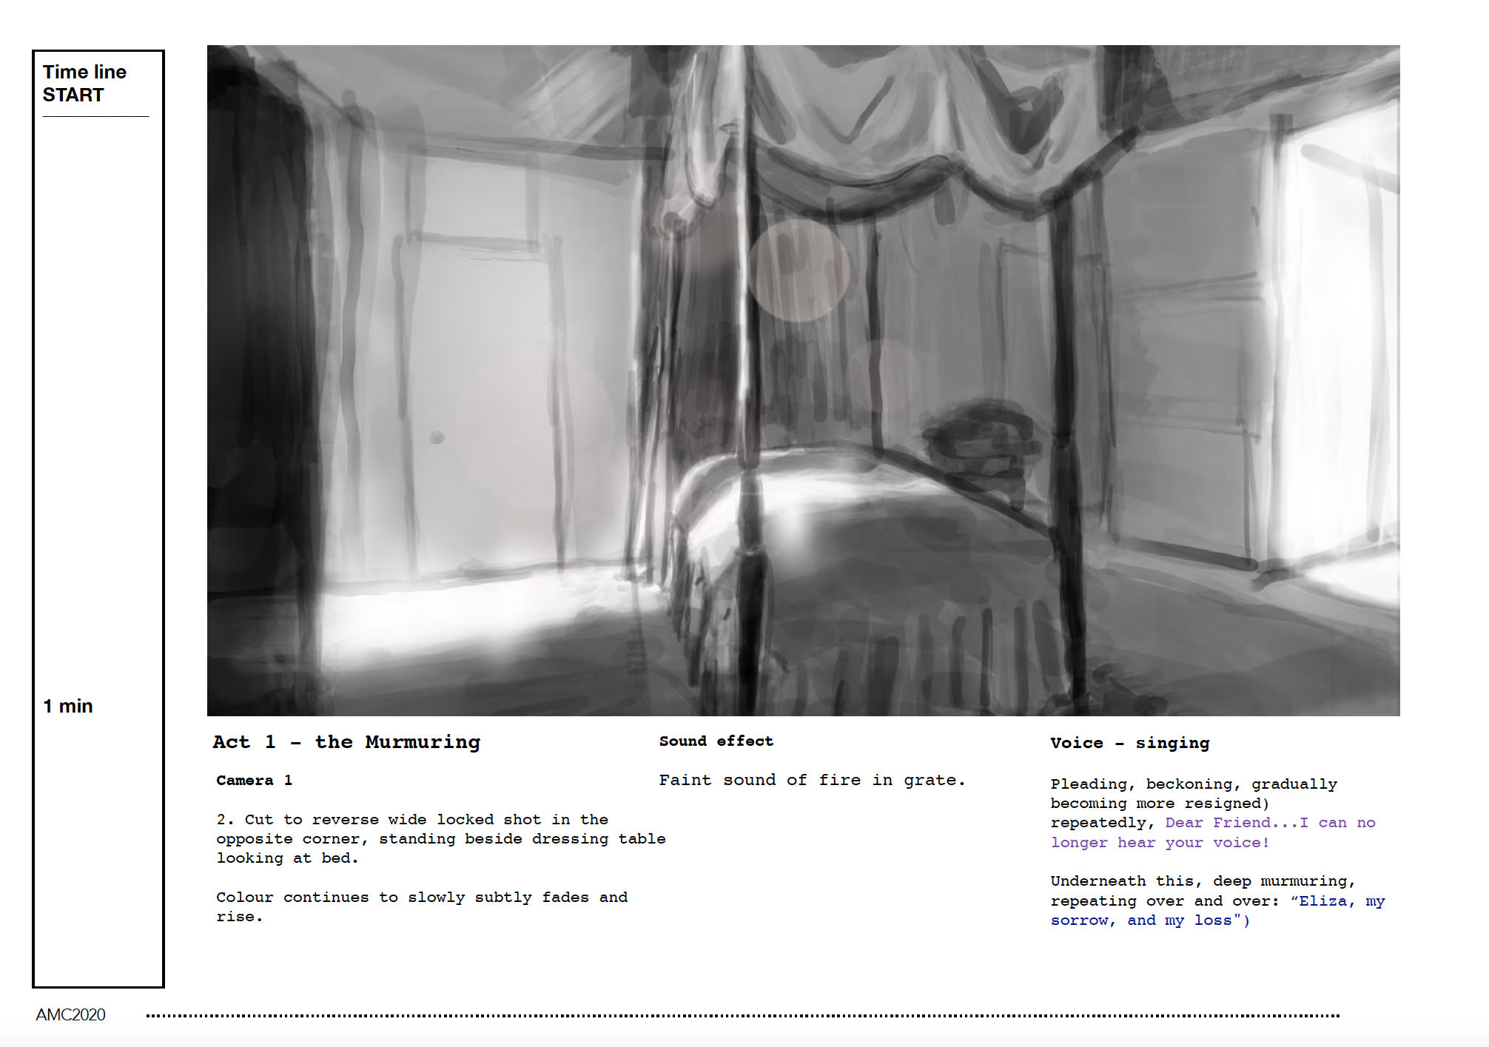
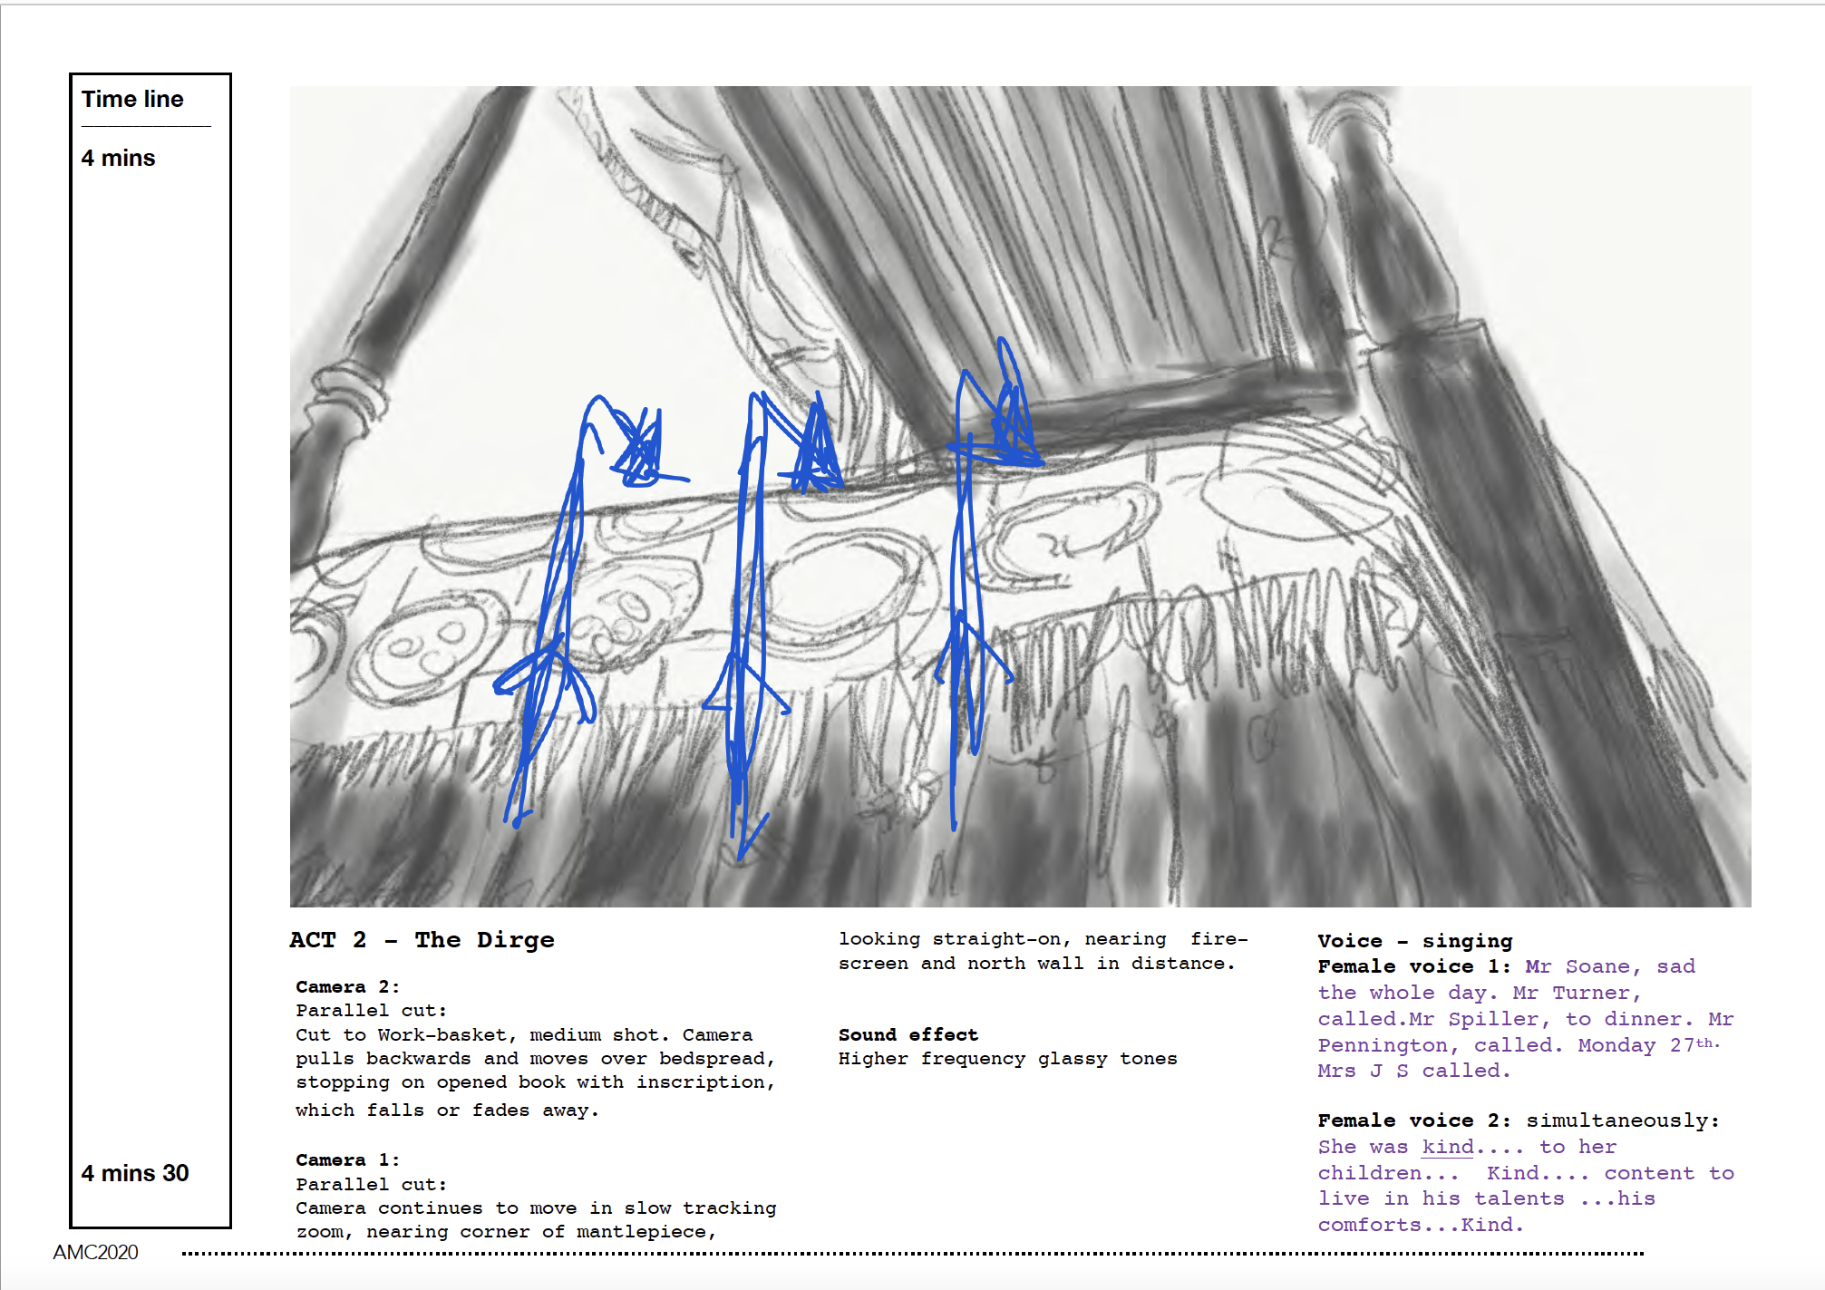
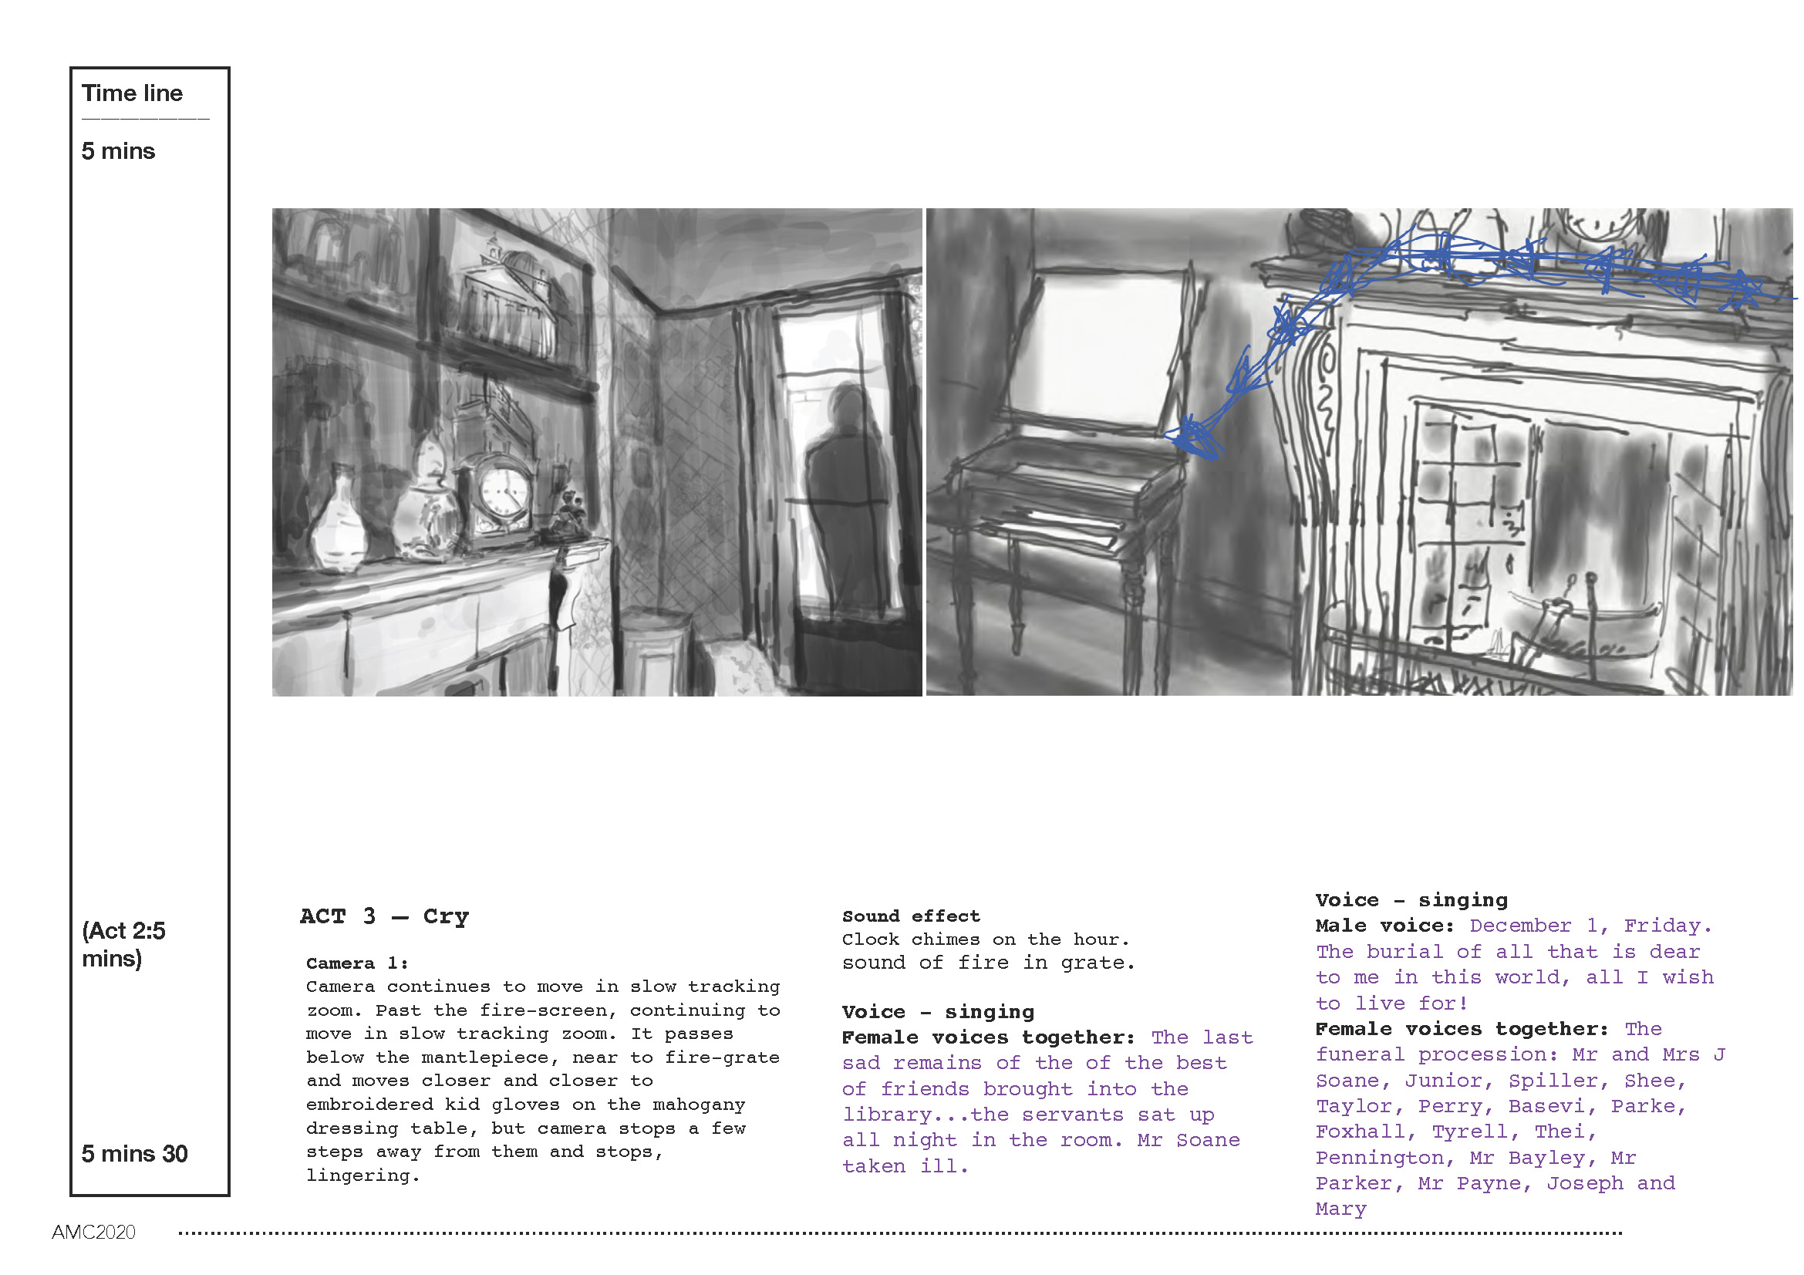
Archives → Process (research, animation, choral sound)
My storyboard for Dear Friend, extracts
Notes:
Archives → Process (research, animation, choral sound)
Had to visualize work before it existed, in order to support collaboration

Slide 10
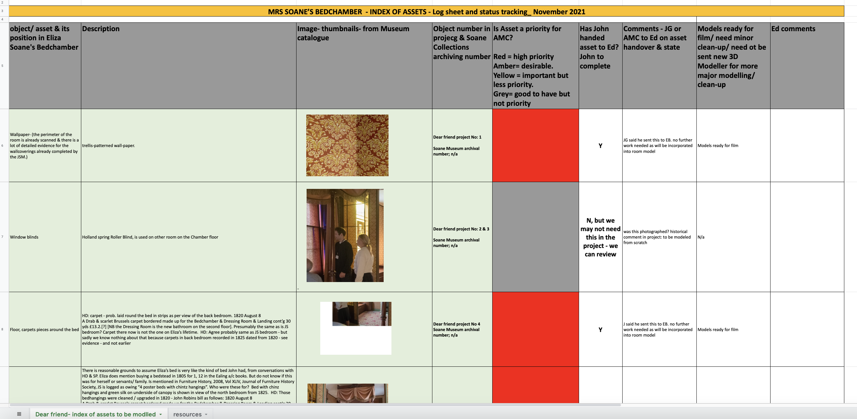
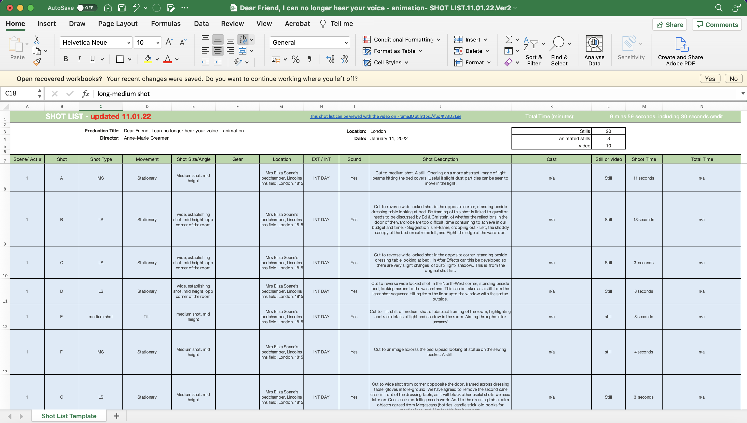
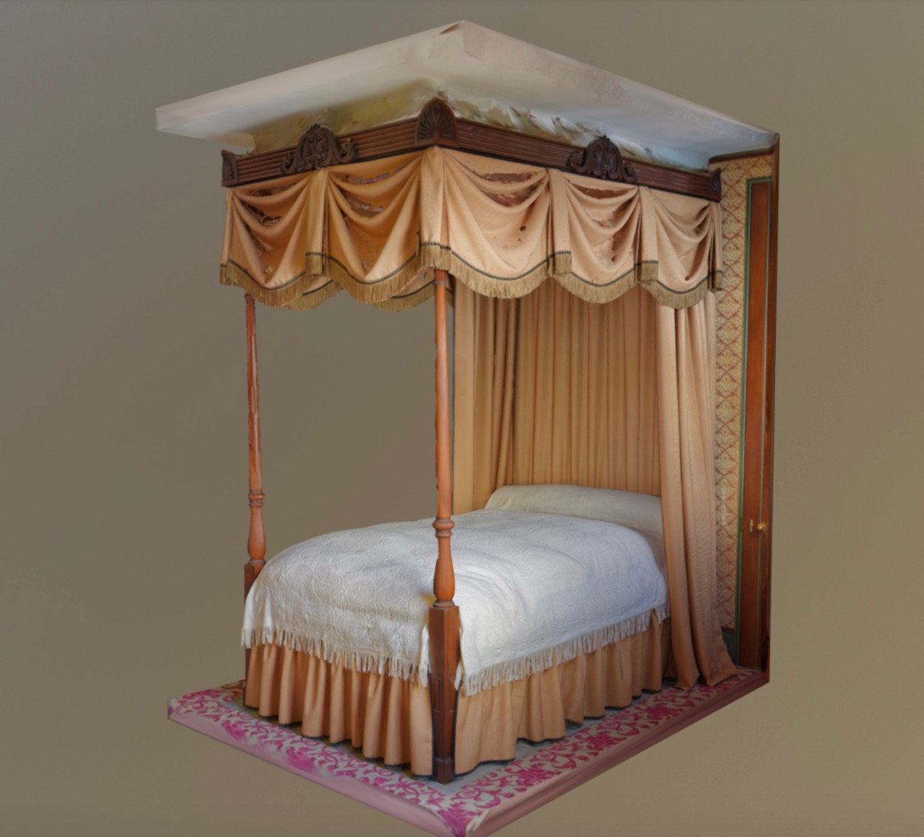
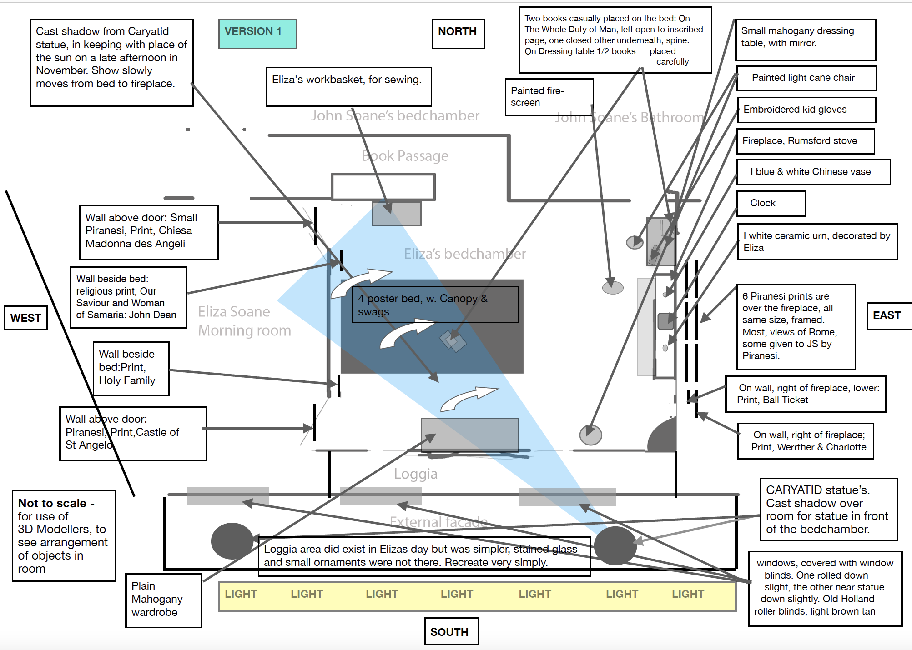
Archives → Process (research, animation, choral sound)
3D: collaboration with Ed Brown & Christian Flores
Notes:
Archives → Process (research, animation, choral sound)
More of the process – which had to be very granular, in order to help the 3D artists – with topographical maps, lists, and a shot list with timings, of how the virtual camera would move through the room – in effect I had to make the film first in my head! So, yes, a kind of conjuring, teasing forth, from a combination of disparate elements, in an exercise that was far fuller of fiction, speculative imagination that it might seems.

Slide 11
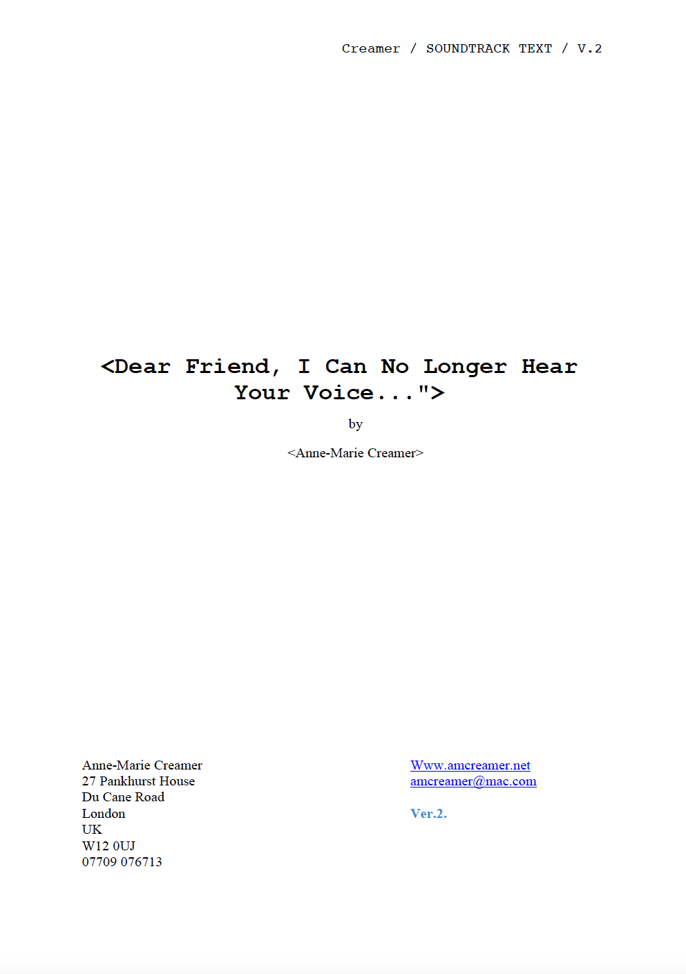
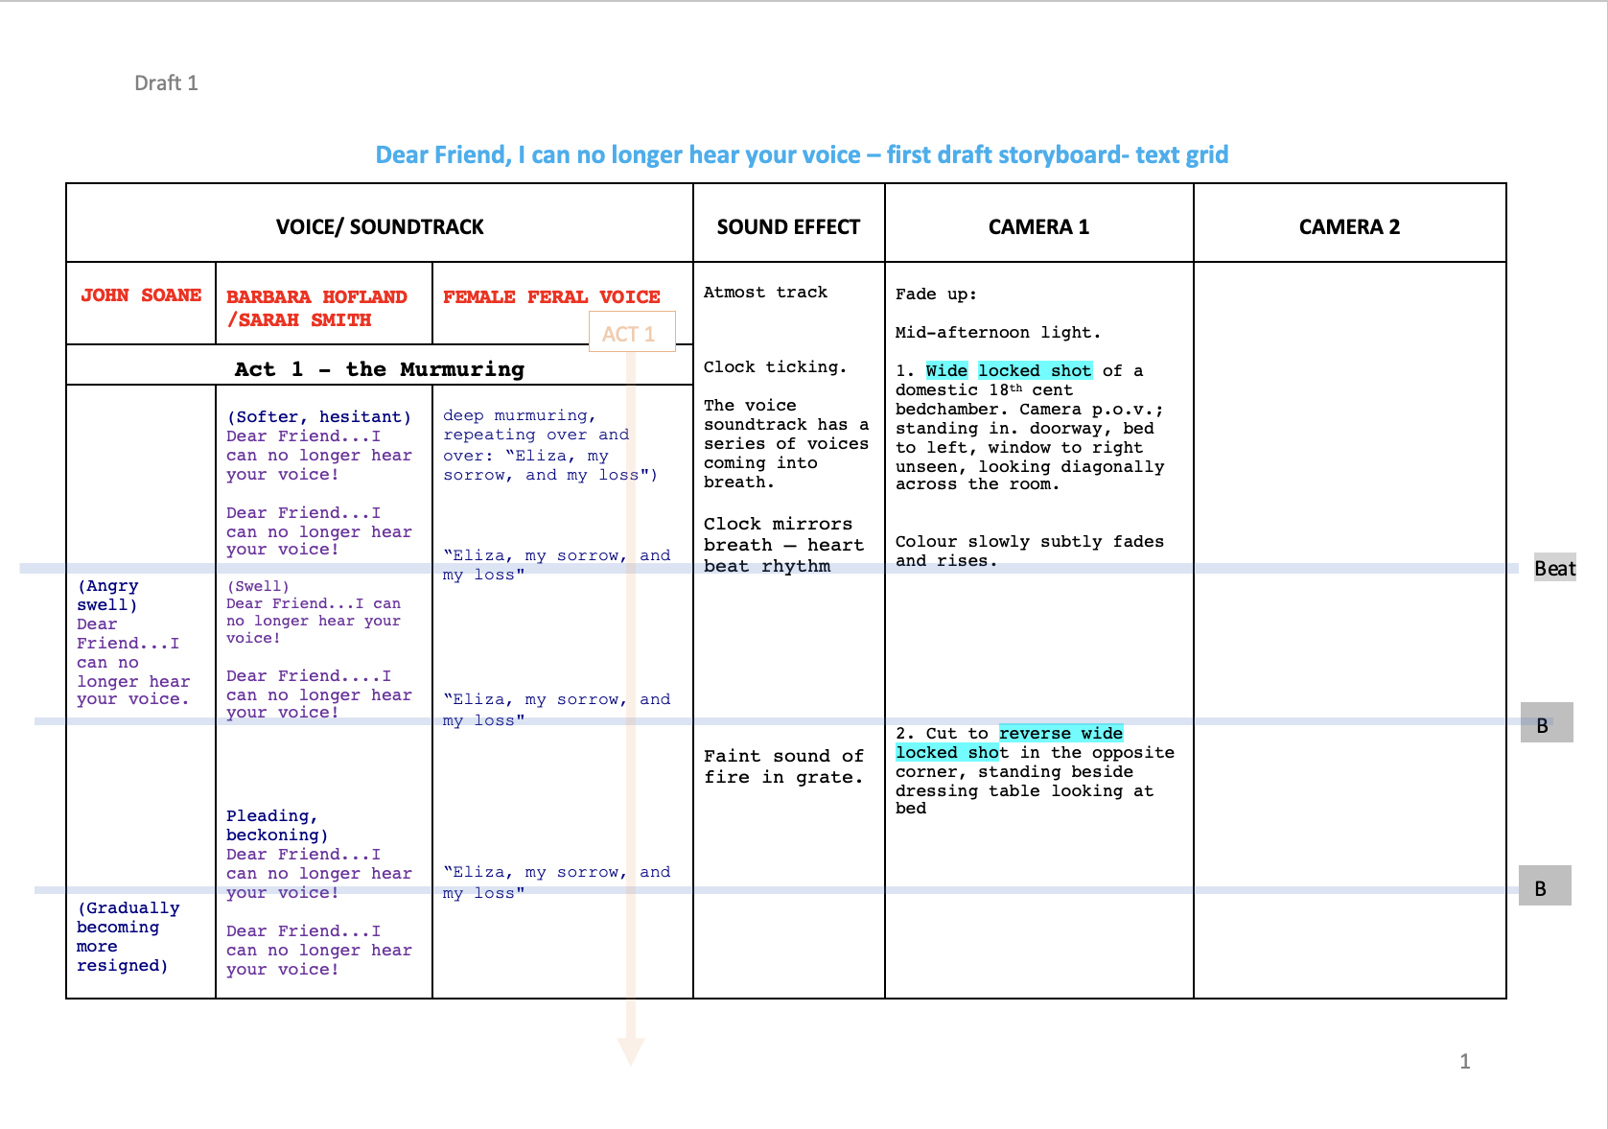
Archives → Process (research, animation, choral sound)
Soundtrack, collaboration with Verity Standen
Notes:
Archives → Process (research, animation, choral sound)
I always knew that the way the visual journey through the room would combine with sound was crucial, as the sound would convey the motional weight and stakes of this act of conjuring – each move of the camera needed to seem searching, full of yearning.
While in the archives, I took elements of John Soane’s diaries in the immediate hours, days, weeks, and months after Eliza’s sudden death, together with elements of diaries and letters form two close family friends of Eliza’s who describe John Soane’s grief, the coming together of her funeral, and the gradual passage of time coming to terms with bereavement. In Soane’s case, refusing to come to terms with it. From this, I wrote a libretto, a text, for composer Verity Standen, who I had chosen for her work with polyphonic sound, especially the human voice, entangled in space and place.
It was Standen’s first time working with a museum in this way and to help her, I also had to draw but also show how the words should be paced and fit into a 3-act structure.

Slide 12
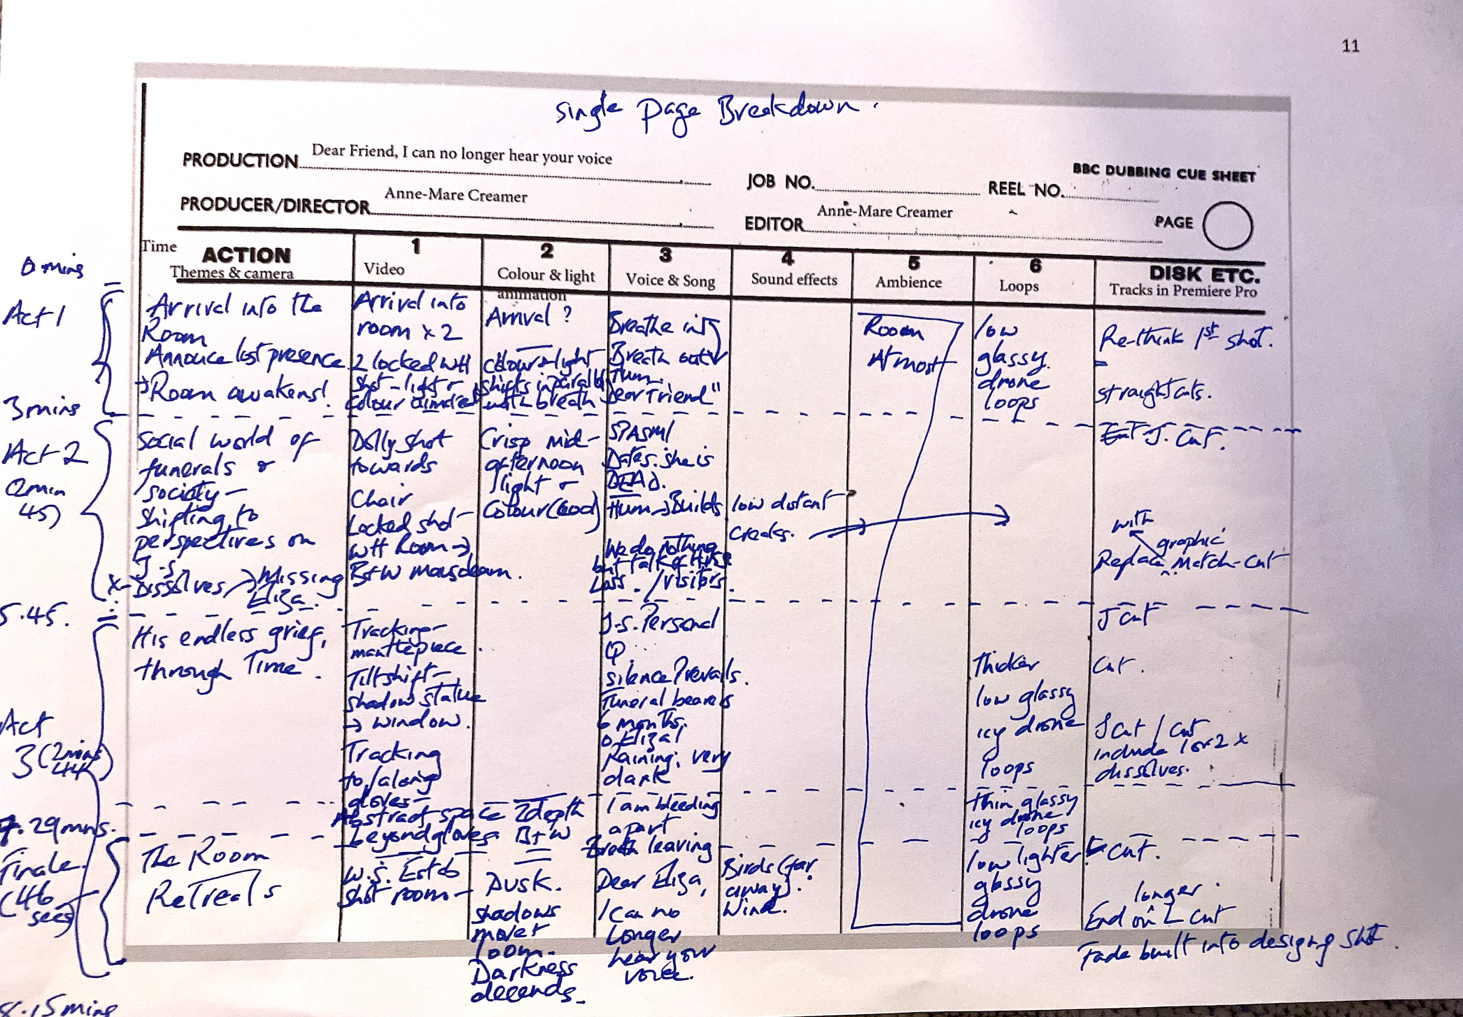
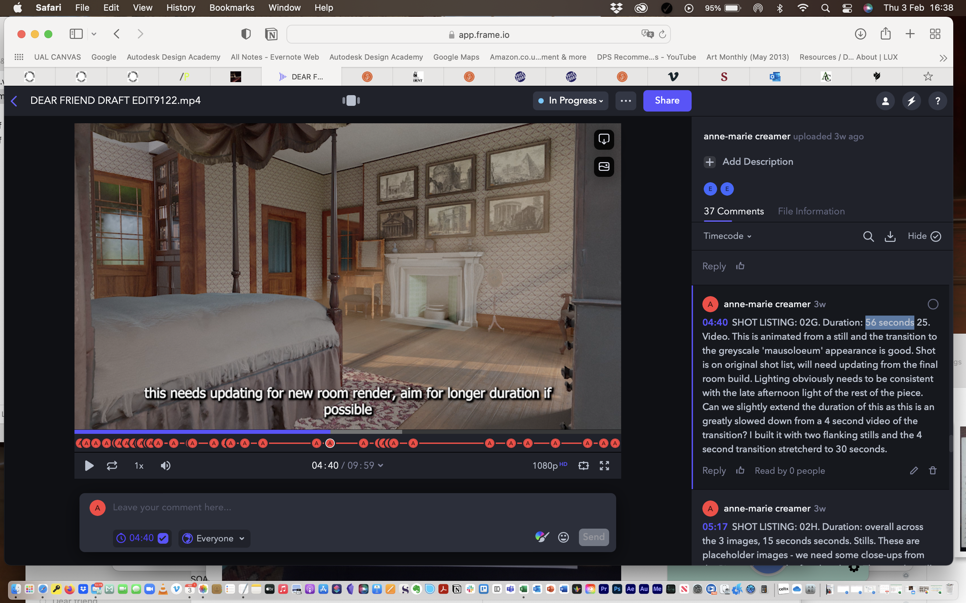
Archives → Process (research, animation, choral sound)
editing & sound-map
Notes:
Archives → Process (research, animation, choral sound)
Sound map:
Diagram of background ambient sounds…and deep structural approach to the soundtrack

Slide 13
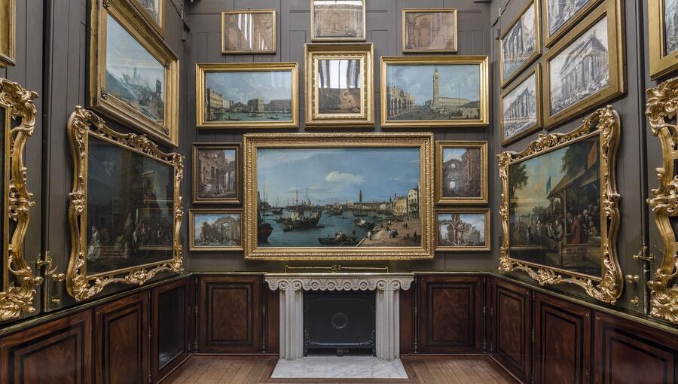
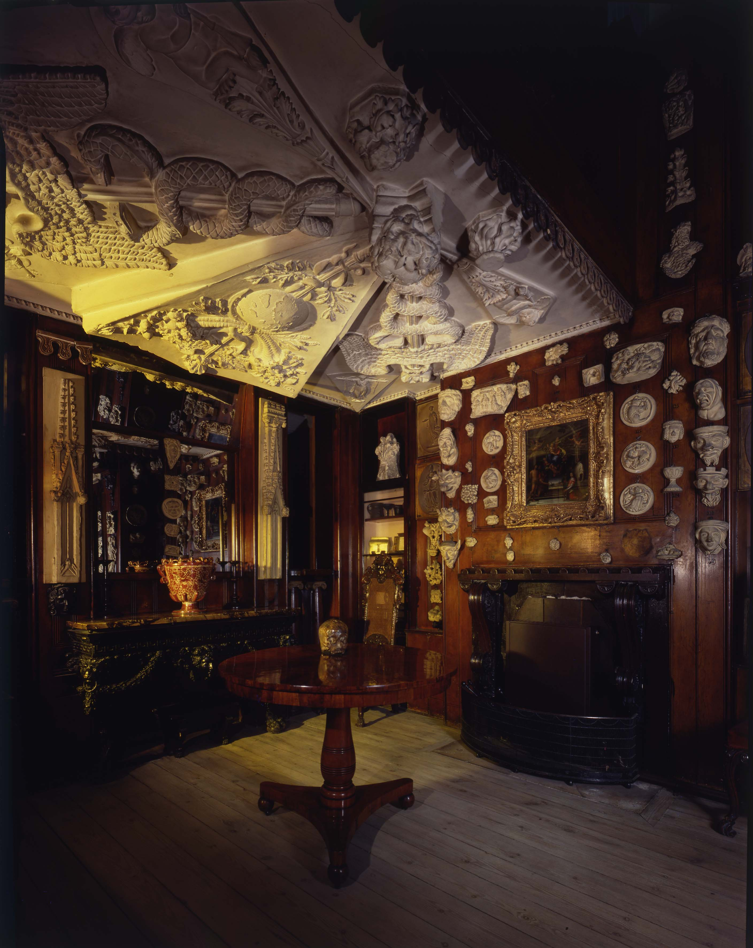
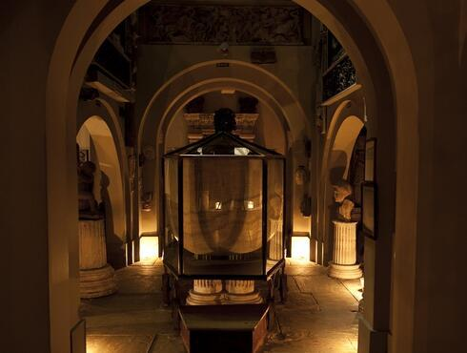
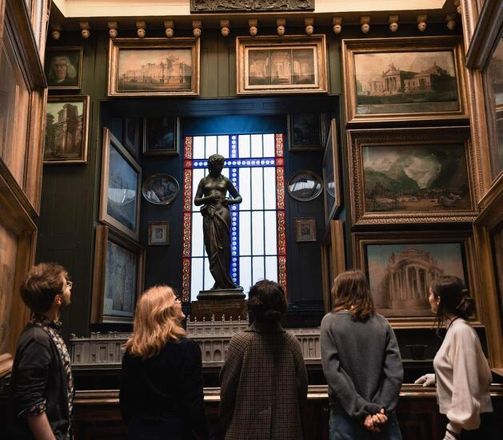
Soane’s use of light, space and experimentation
Notes:
Soane created the Museum as a showcase for his collections of architectural models and fragments, paintings, sculpture and other interesting objects. It was also a teaching resource, allowing his pupils to access these collections, and in particular to study original ancient sculpture as well as casts at a time when the Napoleonic Wars made travel to continental Europe extremely difficult, and as a legacy. Soane had a private act of parliament passed that means his museum is to be kept open to the public, for free, in perpetuity. Today, the Museum is kept, as far as possible in exactly the state it was in at Soane’s death in 1837.
Soane’s inventive use of light, space and his experimentation with the forms of Classical architecture earned him great success as an architect. During his career he won numerous high-profile projects, including the Bank of England (where he was architect for 45 years) and Dulwich Picture Gallery, and created his own extraordinary home and Museum on Lincoln’s Inn Fields.
His successes as an architect and his fascination with the history of architecture led to his appointment as Professor of Architecture at the Royal Academy in 1806. Already an enthusiastic collector, he began to repurpose his home at Lincoln’s Inn Fields as a Museum for students of architecture.

Slide 14
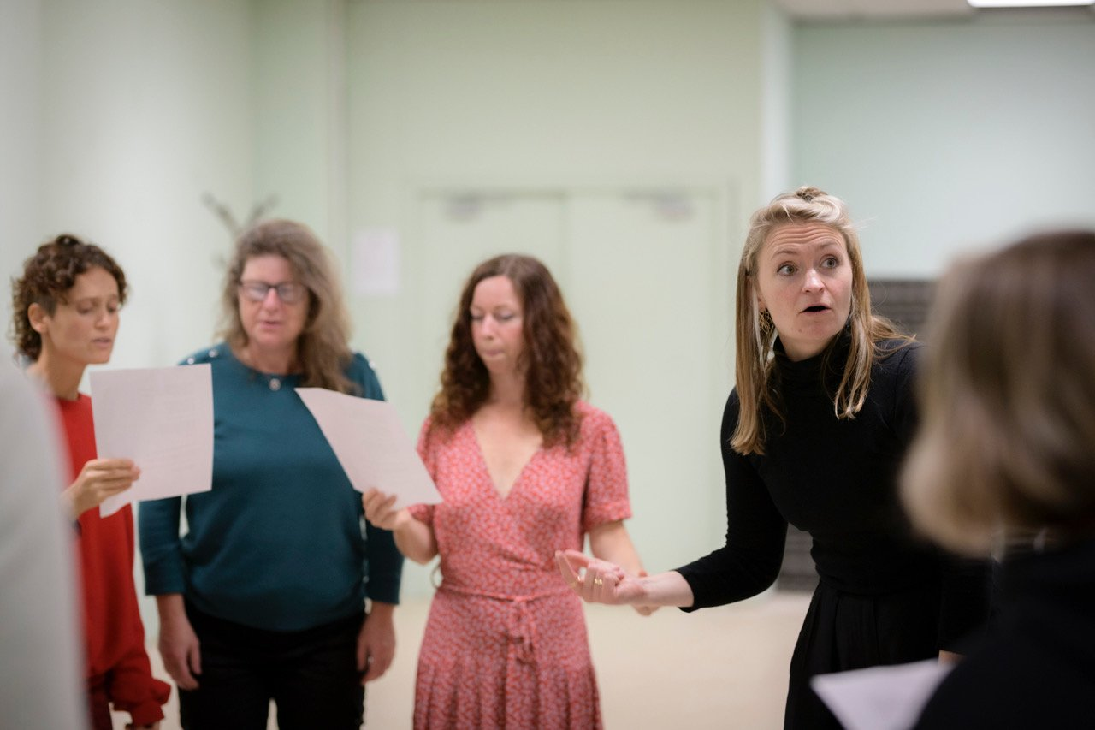
Dear Friend & the form of lamentation
Notes:
Although need to hear voice of the beloved, Dear friend does NOT feature Eliza’s voice, and instead focuses on the tension between silence and personal historical diaries and letters sung by a female choir as a form of collective grieving.
Dear friend… is interested in collective mourning, an animation whose mournful music filled museum.
In my discussions with composer Verity Standen, I played her Irish keening songs, ‘keening’ lamentations and we explored how something of the genteel 18th century could contain something more feral; a physical yearning of grief. It interests me that forms of lamentation are often culturally gendered as female, and the choir takes on this role.
An important context of Dear Friend, is that I started the work years before, it was meant to premier in 2018, when I became seriously ill, faced with my own mortality. We rescheduled, to spring 2020, when the pandemic happened, and then again to Spring of 2022, just as people were coming out of the pandemic, more having faced the loss of loved ones. Obviously, this context affected the resonance of the work, and we staged several events, Reclaiming Eliza, re-activating her presence through working with actors to read her unpublished letters, and in partnership with the Wellcome Collection, to stage a panel on creative forms of memorialization and bereavement.
The counterpoint between the voice and images are intended to beckon us to lament; to express grief or gather to mourn, through rhyme or prayer or polyphonic sound. Lamentation rolls off the tongues of the women singers in Dear Friend like waves—it is guttural, loud, visceral sounding in its sorrow.

Slide 15
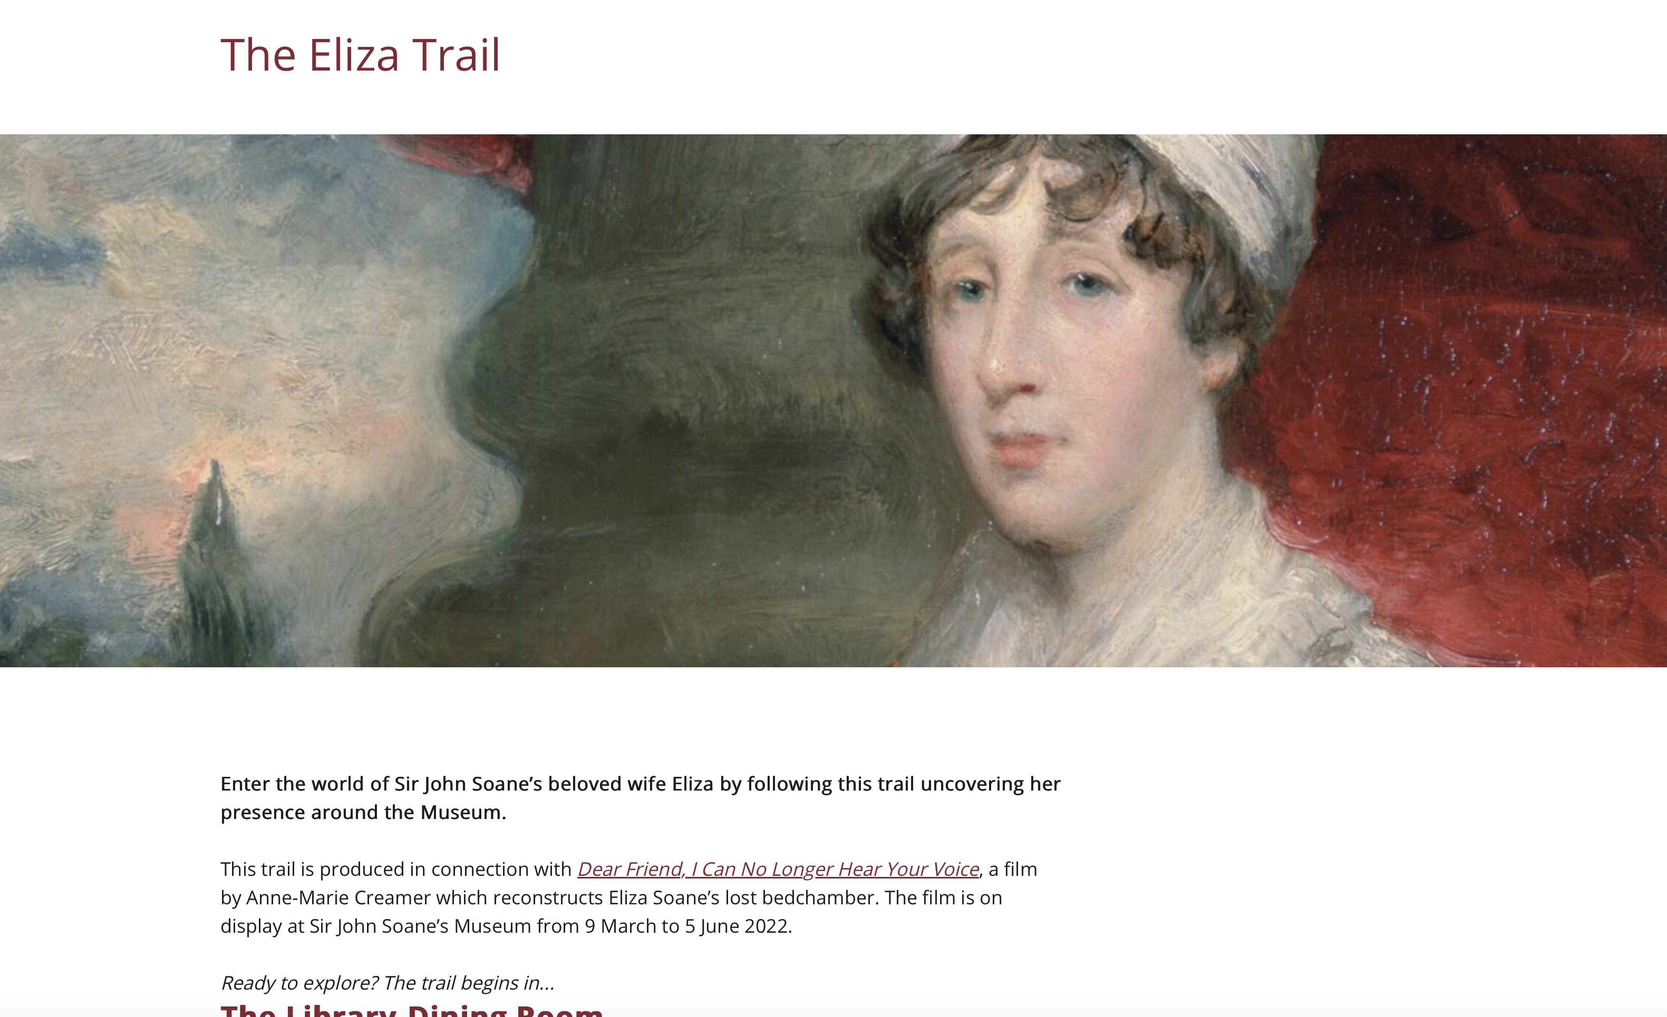
The Soane Museum as a site of Concealed Lamentation…
The Eliza Trail: Via Museum website- https://www.soane.org/eliza-trail
Notes:
Soane’s Concealed Lamentation
https://www.soane.org/eliza-trail
John Soane’s house–museum is often celebrated as Britain’s first formal museum, a triumph of architecture and collecting. But if we read it differently, it is also a work of concealed mourning. After the death of his wife Eliza, Soane embedded veiled references to her absence throughout his home: fragments, light effects, architectural motifs. In doing so, he created a private language of lamentation. Eliza became an undeclared ghost, not in a literal sense, but as a spectral presence woven into the fabric of his daily life and work. This was his way of surviving grief—by ensuring she would accompany him always, even if silently, invisibly.
In making Dear Friend, I respond to this haunting through my own conjuring of Eliza’s voice. Avery Gordon reminds us that ghosts are how the forgotten insist on being acknowledged. Jeffrey Kripal speaks of the spectral as an impossibility that nevertheless presses on us with force. As an artist I am also interested in how haunting can be a feminist strategy of resistance, bringing silenced voices into the present. For me, conjuring Eliza’s ghost is not only a way of retrieving what has slipped from view, but also a way of transforming lamentation into survival: survival of memory, conjuring as a form of consolation, and survival of our capacity to imagine different futures through art.”

Slide 16
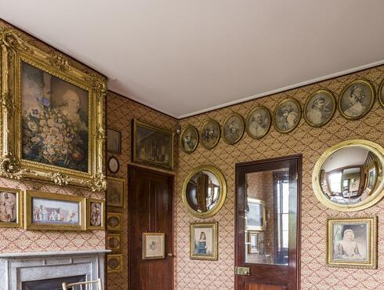
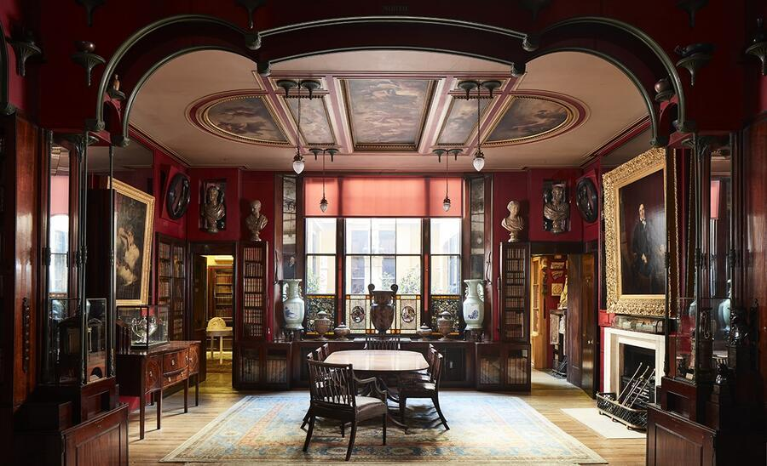
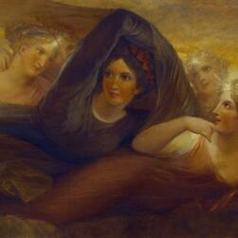
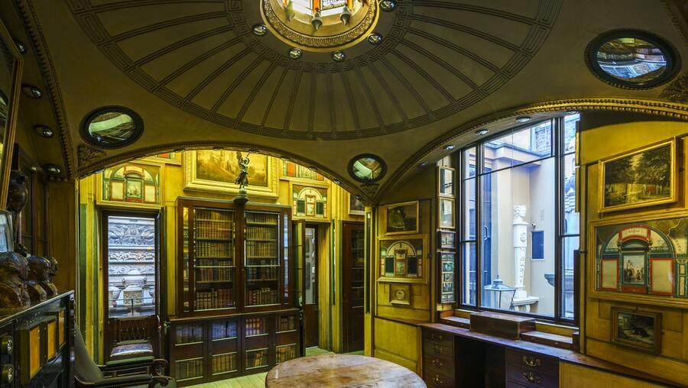
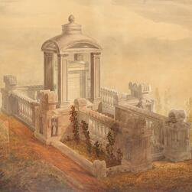
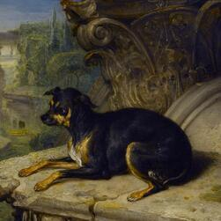
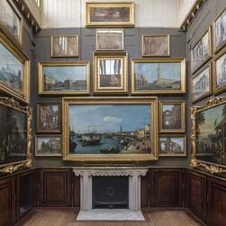
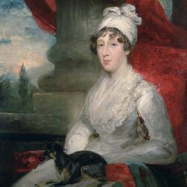
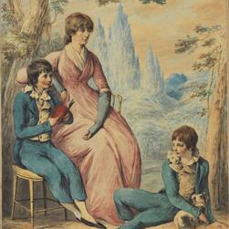
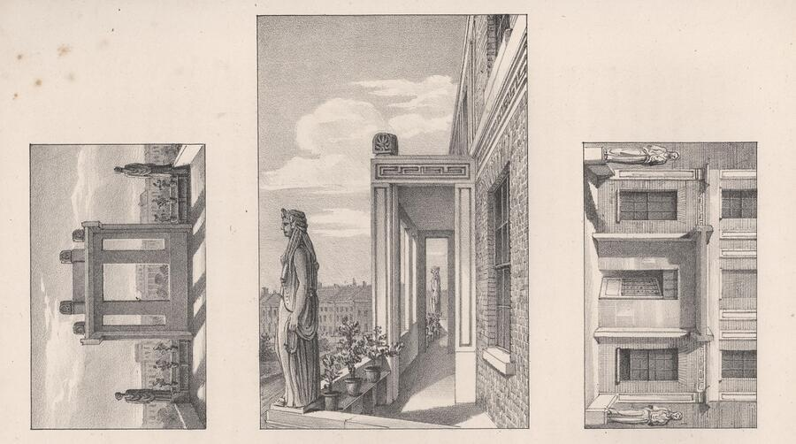
Conjuring ghosts as strategies for survival
Notes:
Insinuating her presence in the museum by the spatial placement of images and objects, so that in every room of the house there are – private – allusions to Eliza everywhere – she is everywhere and nowhere.
Interesting that for such a private man, he kept this private – in effect, she became his own personal ghost.
The museum had not focused so much on Eliza, and the creative uses Soane put his grief to work, so that over time it informed his aesthetic use of light and space, for which he became famous. Many of those visual tropes feature in the animation- uses of shadow, silhouette, re-fracted light, dust, and song.
Soane is an early 18th century figure, so formally well before before Freud – but its not hard to see his House-Museum is in its entirety, can be viewed as a form of self-portrait; with rooms created for fictional characters, with hidden recessive form of light and space everywhere so the journey through the museum of labyrinthine through a psyche. His ‘private’ but knowing approach to his grief of his wife sudden death is a “theory of memory as haunting”, as sociologist Avery Gordon would recognize.
In focusing on Eliza, and the meanings Soane gave to Eliza’s death and her absence in 2022, I have hoped that a nationally known museum became ‘re-balanced’ as also an intimate space of emotion and loss, an exemplar also of creative forms of conjuring of the loved one/ of ‘memory as haunting’, and so through which the living find consolation - So, indeed, a strategy for survival.

Slide 17
Structure & Abstraction of Dear Friend…
Disappearance → Shadow → Fracture
Notes:
Stills on
Disappearance → Shadow → Fracture

Slide 18
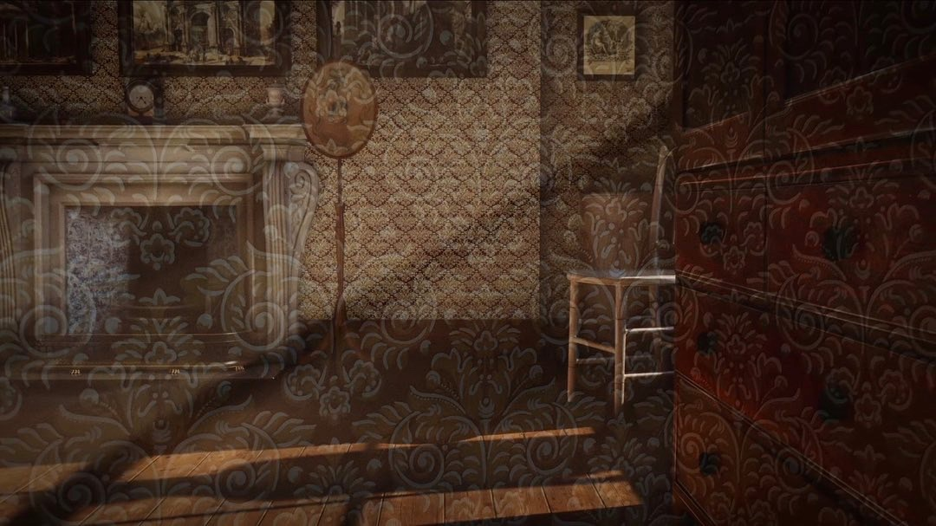
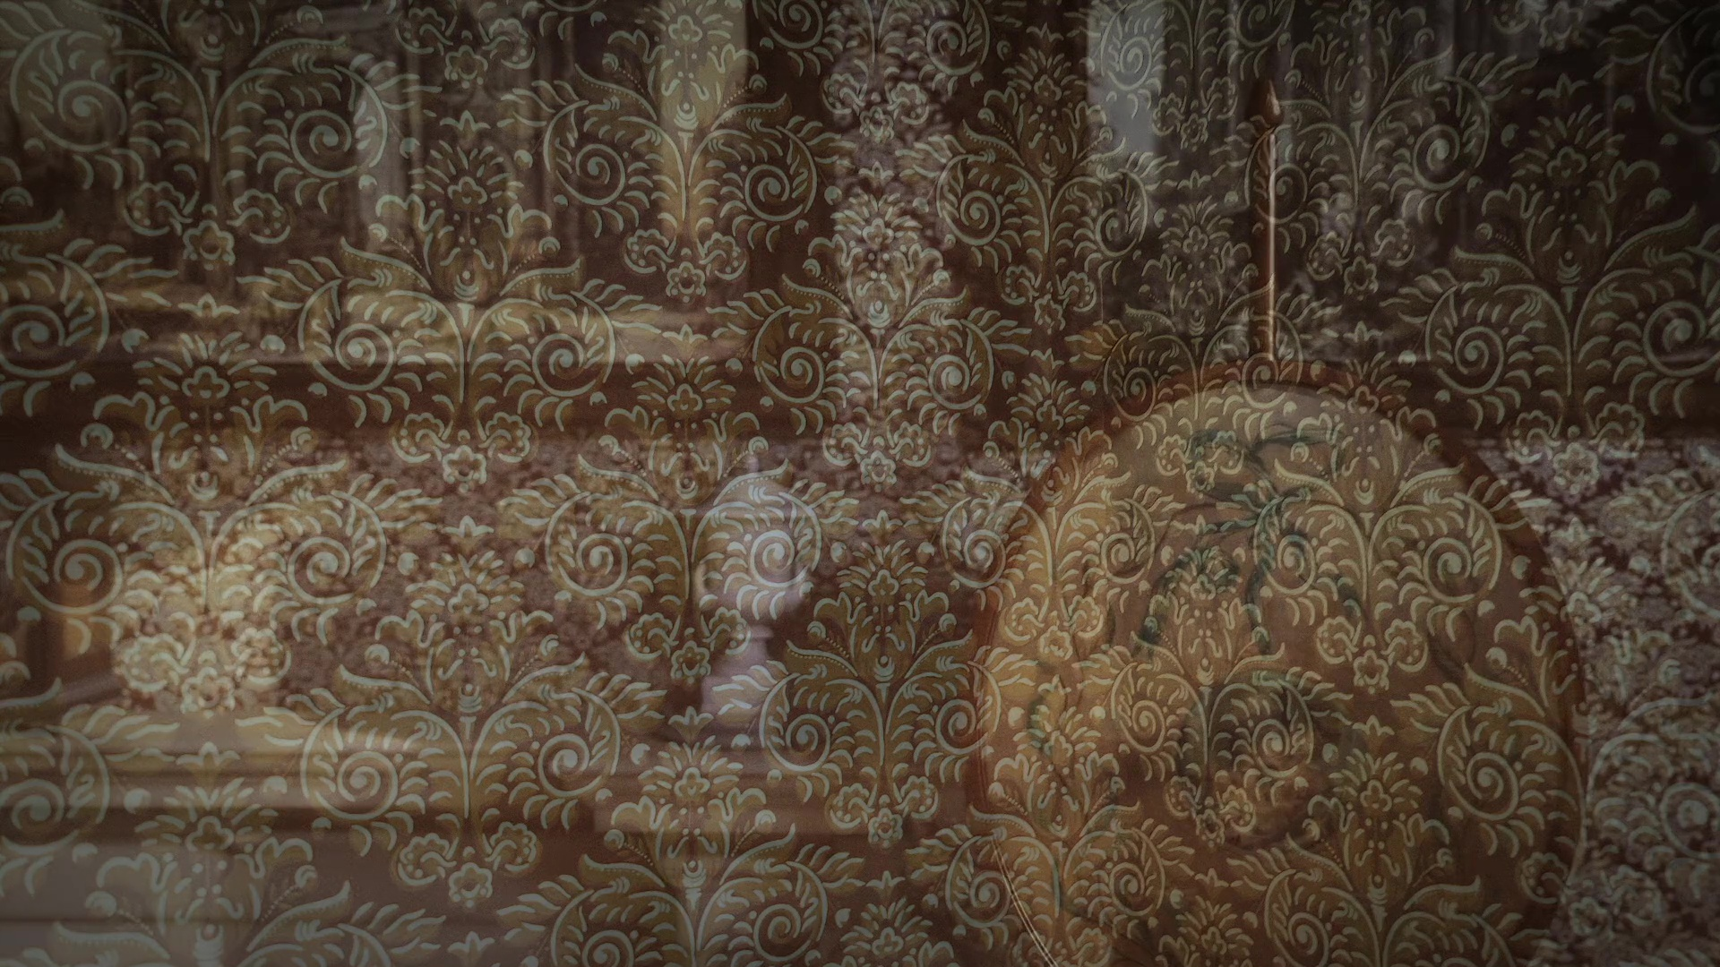
Wallpaper & disappearance, (stills from Dear Friend)
Notes:
Disappearance → Shadow → Fracture

Slide 19
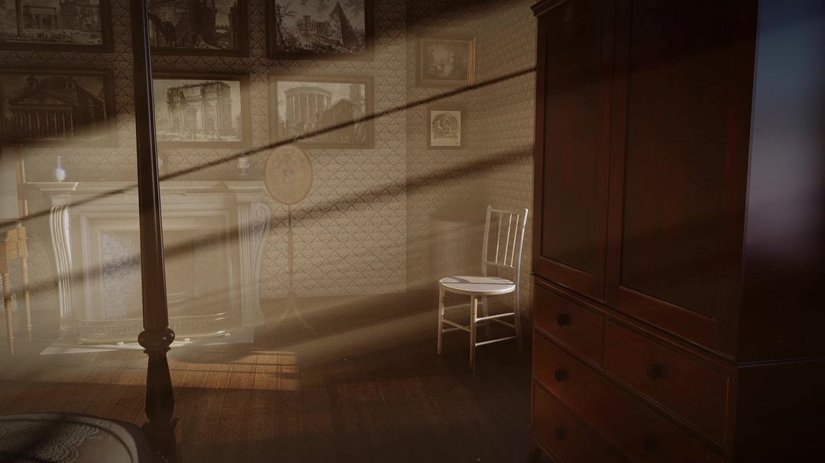
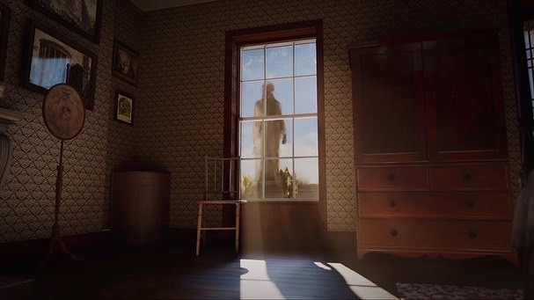
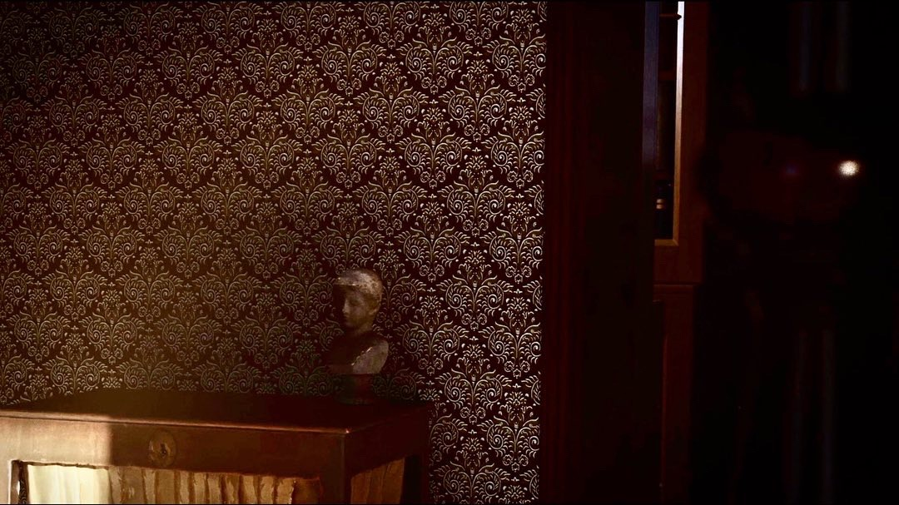
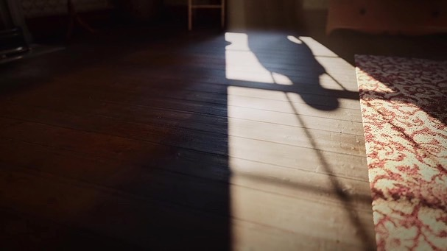
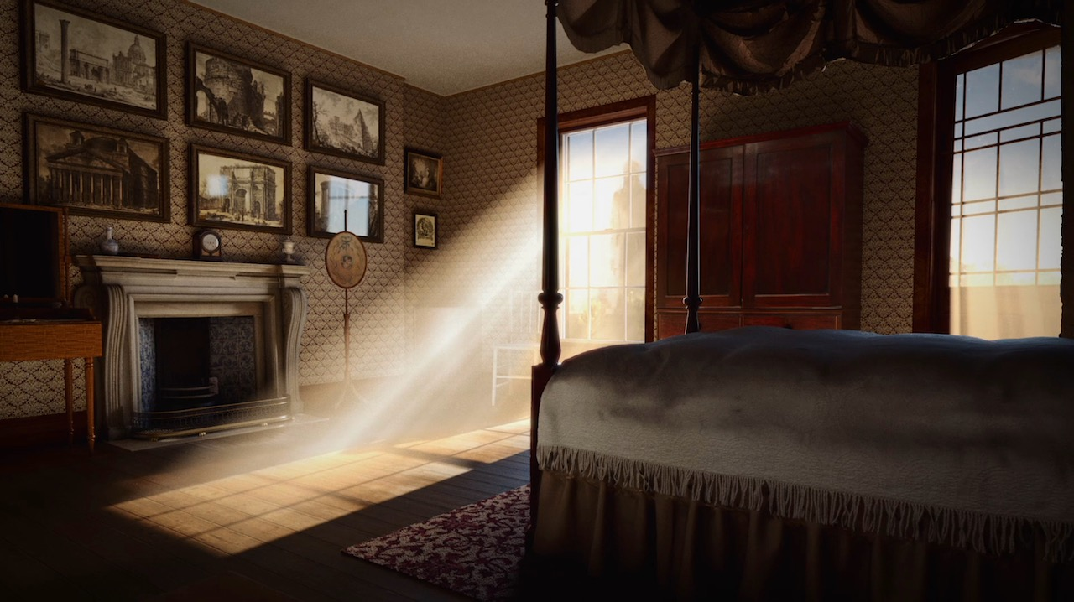

Light & shadow, silhouette, statues, & dust (stills from Dear Friend)
Notes:
Disappearance → Shadow → Fracture

Slide 20



Room as tomb for the absent body, (stills from Dear Friend)
Notes:
Disappearance → Shadow → Fracture

Slide 21




fracturing, splitting, (stills from Dear Friend)
Notes:
Disappearance → Shadow → Fracture

Slide 22


Installation shots (exhibition documentation)
Exhibition installation shots of Dear Friend at Soane Museum
Notes:
Installation shots (exhibition documentation)
Through this, the film undertakes a feminist and ethical retrieval of a near-absent historical figure, Eliza Soane, whose life persists only in fragments.
the private memorialisation of grief, drawing on Soane’s writings to respectfully re-frame and reanimate a famous and beloved museum as also space of profound personal loss.
My positionality as an artist-researcher is central to Dear Friend…. I approached the work as an emotional custodian rather than a neutral observer, exploring how Soane’s hidden architectures of grief intersect with contemporary concerns around gender, memory, and lamentation.
As a form of custodianship, the film preserves both material culture and its emotional residue; to make visible the spectral, the marginal, and the soon-to-slip-away. I think my positionality as an artist-researcher is central, to navigating Soane’s private grief and my own contemporary engagement with feminine forms of collective lamentation, gender and otherness.

Slide 23
Enjoy the film
Thanks for your time…
Contact:
Anne-Marie Creamer
Email: a.creamer@arts.ac.uk
Website: https://amcreamer.net
Notes:
My contact details

Slide 24
Links
Dear Friend… via Sir John Soane Museum website | https://www.soane.org/exhibitions/anne-marie-creamer-dear-friend-i-can-no-longer-hear-your-voice
Soane Museum essay on Dear Friend…by Tom Jeffreys | https://www.soane.org/features/introduction-dear-friend-i-can-no-longer-hear-your-voice
Producers of Animated film, Animate Projects webpage with link to interview: | https://animateprojects.org/portfolio/dearfriend/
Notes:
Links

