Slide 1

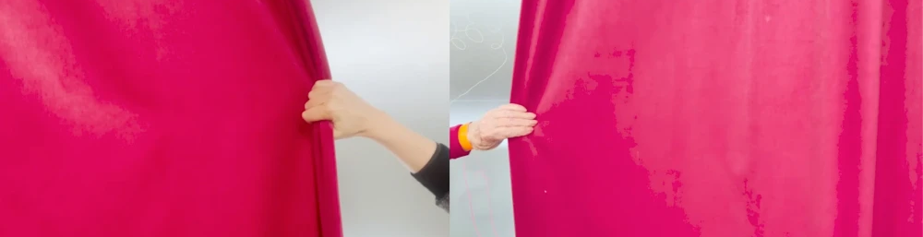
IRL: Working with Lived Experience
Issues of Creativity, Ethics & Emergent Knowledges
Anne-Marie Creamer
Dr Hannah Zeilig &
Dr Rachel Marsden
Better Making workshop scene
with Arts4Dementia

Slide 2
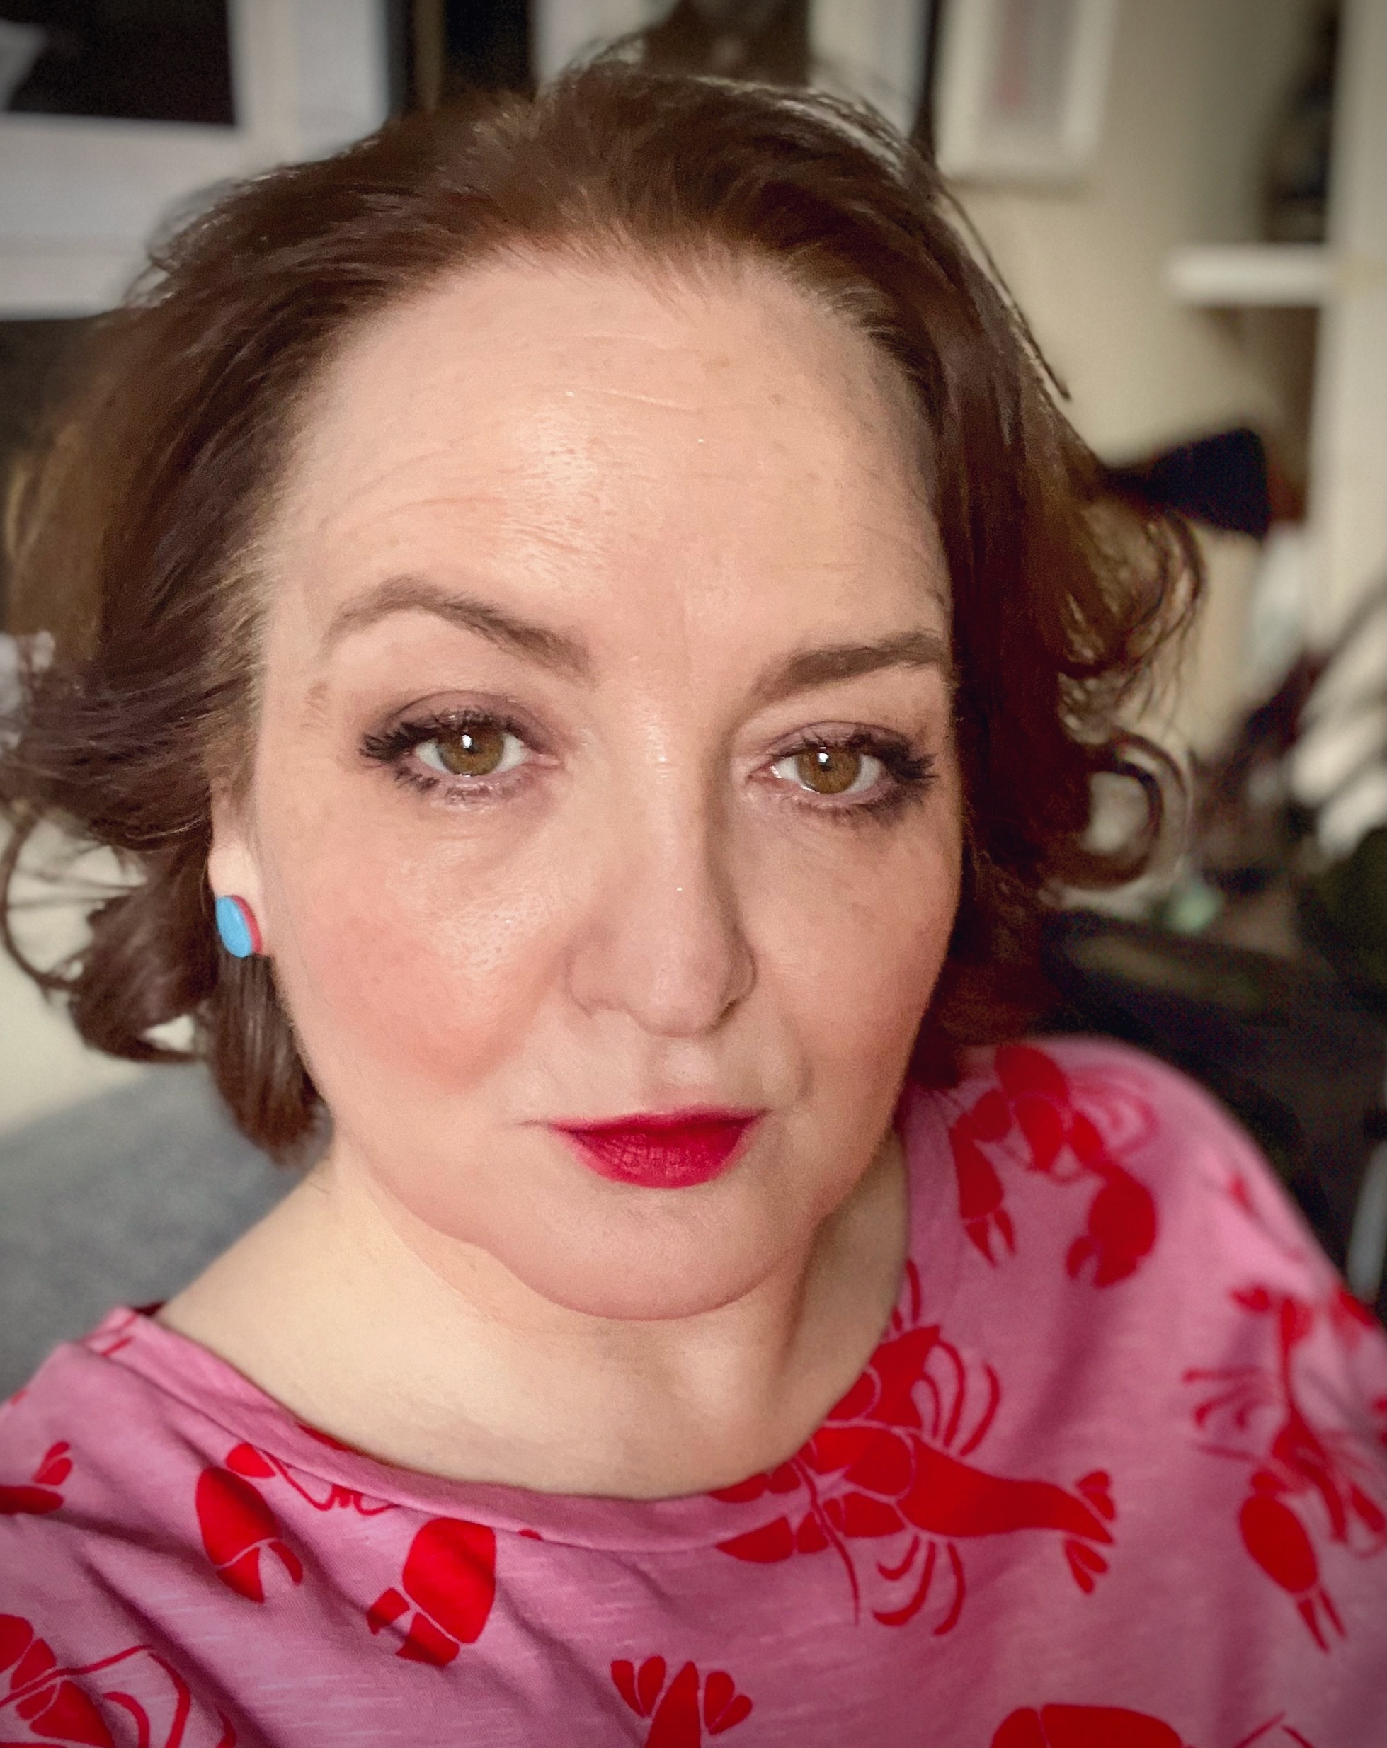
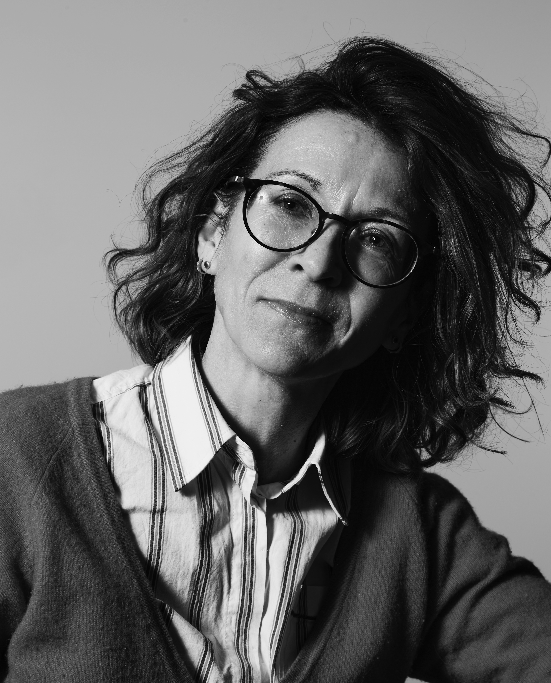
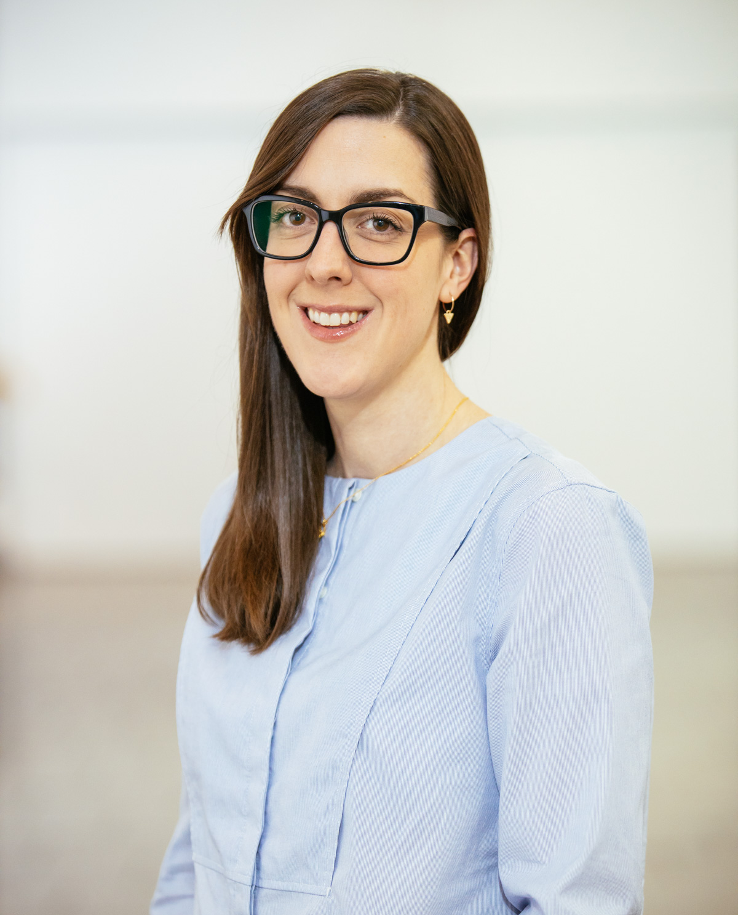
2
What does it mean to be a lived experience collective?
Anne-Marie Creamer
Dr Hannah Zeilig
Dr Rachel Marsden

Slide 3
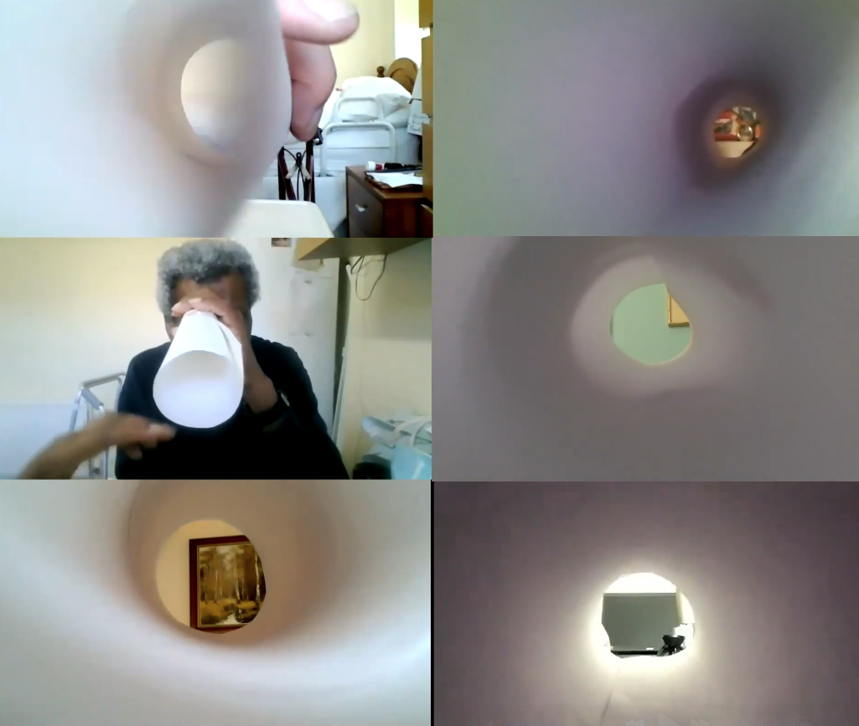
3
How can creative practice
and
methodologies help generate knowledge from / with
lived experience?
‘Better Making’
TUNNEL Film

Slide 4
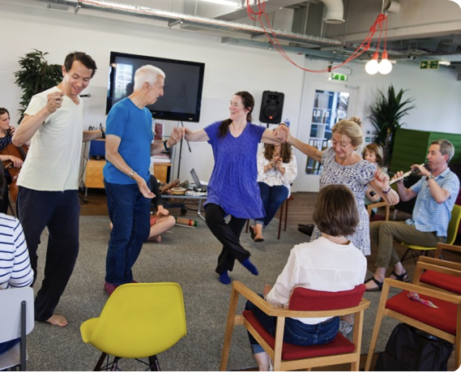
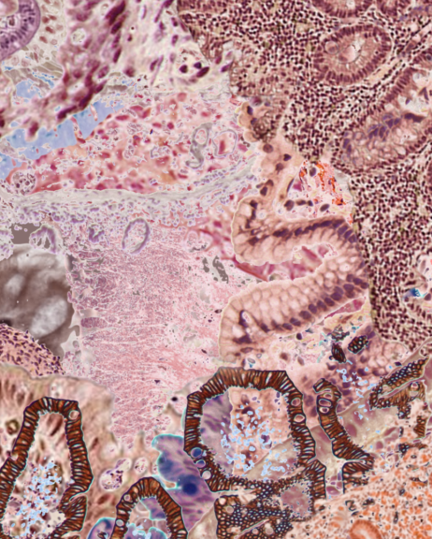
4
‘With All’ project, co-creativity with people with dementia
How do we learn to see into
lived experience?
Still from moving image artwork by Amelia Hine, commissioned for the Stomach Ache website (2022)

Slide 5
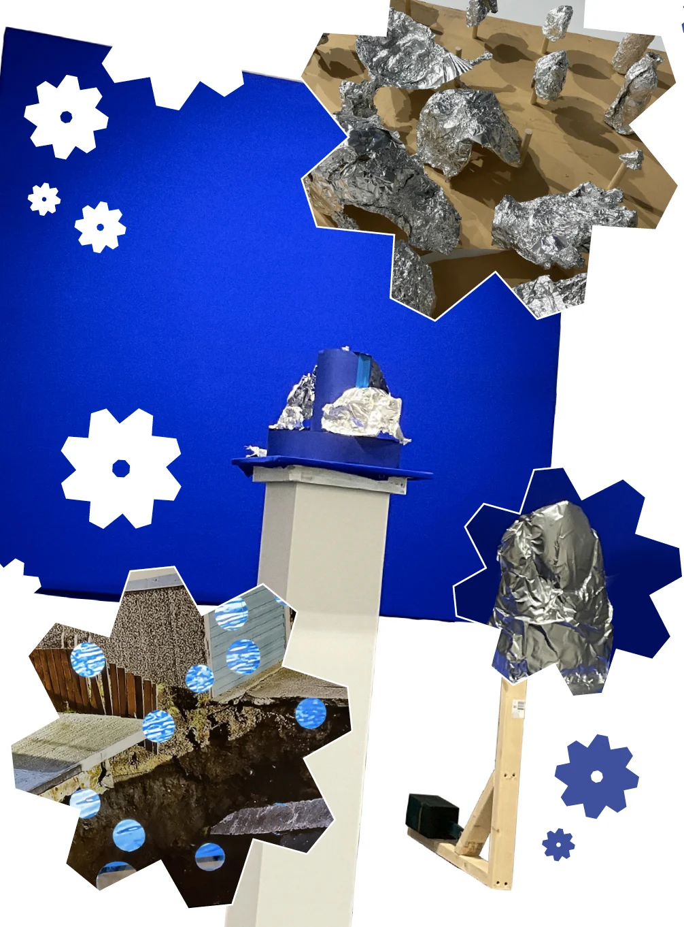
5
How does practice within an art school context (UAL) shape the meaning-making of lived experience?
Work from ‘Better Making’ workshops held at Vane Gallery, Gateshead, design by Alex Whiteley

Slide 6


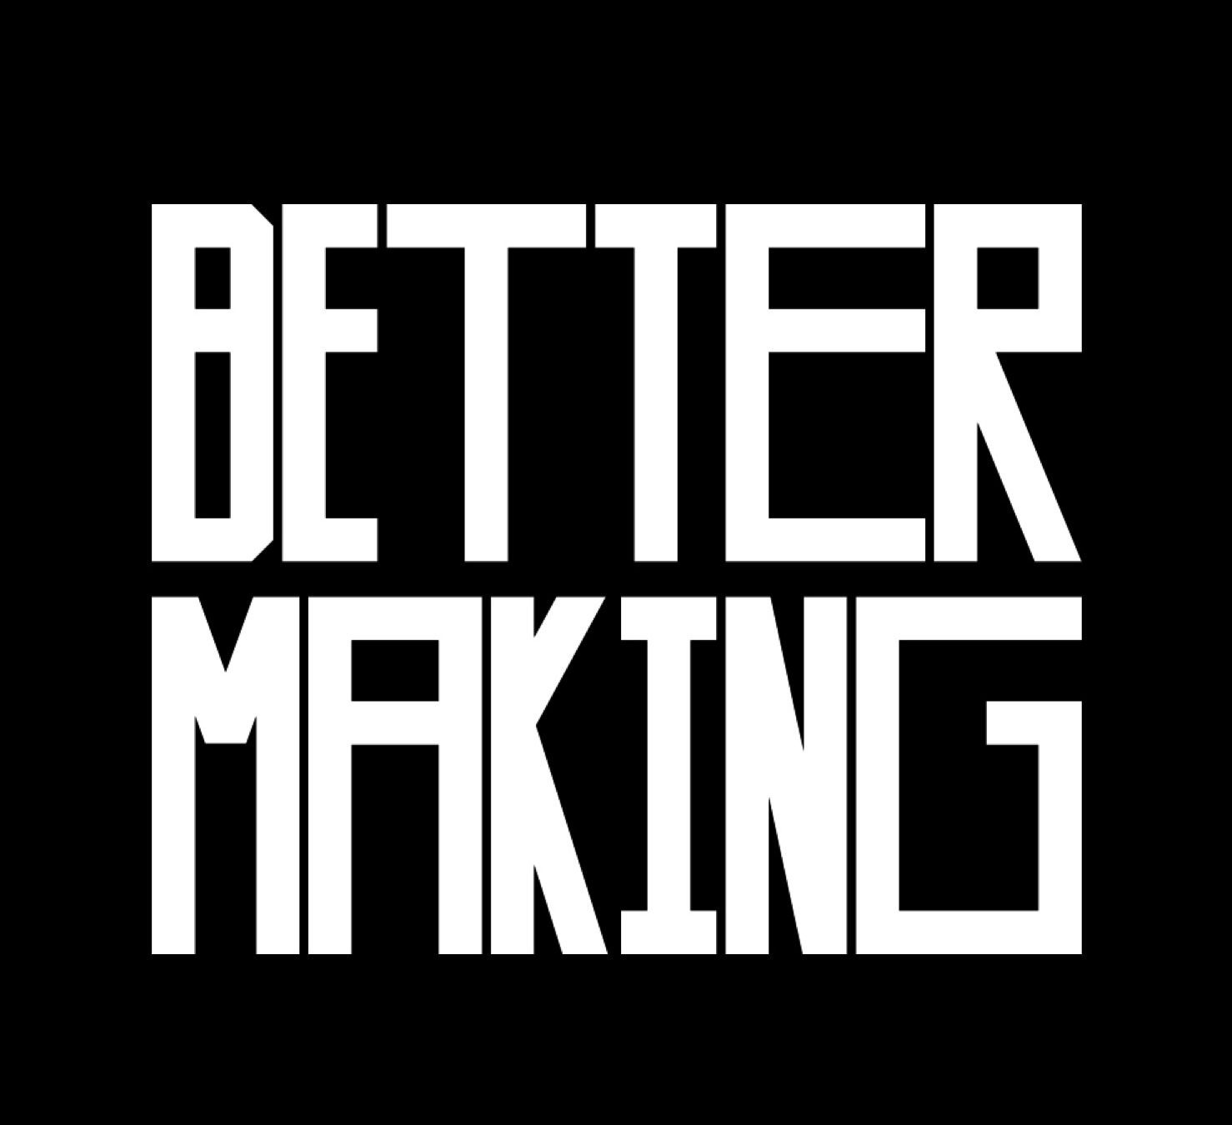
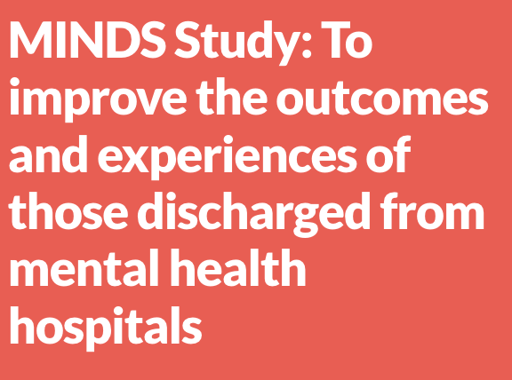
6
Stomach Ache Project
Northern Network for Medical Humanities Research (NNMHR) new network grant from Durham University, Institute for Medical Humanities.
With All: Co-creativity with people with dementia
Better Making
Wellcome Collection, as part of the Created Out of Mind residency.
Creative social prescribing programme, Central Saint Martins (CSM), UAL.
MINDS: To improve the outcomes and experiences of those discharged from mental health hospitals
National Institute for Health and Care Research (NIHR), Applied Research Collaboration (ARC), East of England

Slide 7
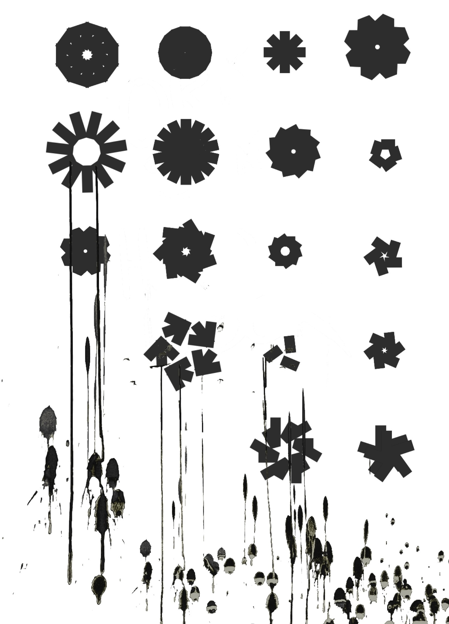
7
What are
your
thorny issues?
Contact us:
r.marsden@arts.ac.uk
h.zeilig@fashion.arts.ac.uk
a.creamer@arts.ac.uk
Work from ‘Better Making’ workshops

