Slide 1
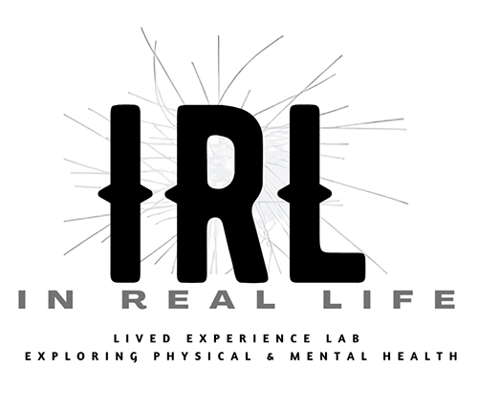

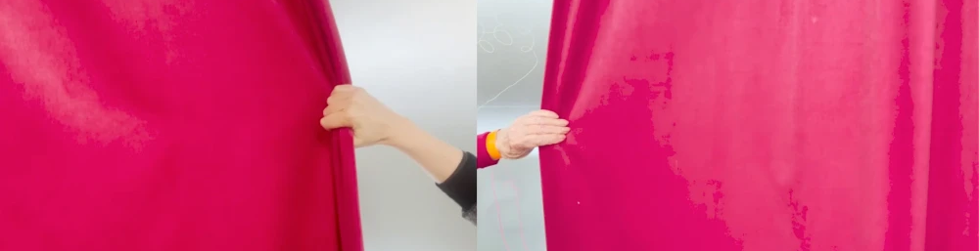
IRL: What it Means to Work with Lived Experience
Creativity, Power and the Ethics of Emergent Knowledges
Anne-Marie Creamer
Dr Hannah Zeilig &
Dr Rachel Marsden
Better Making workshop scene
with Arts4Dementia

Slide 2
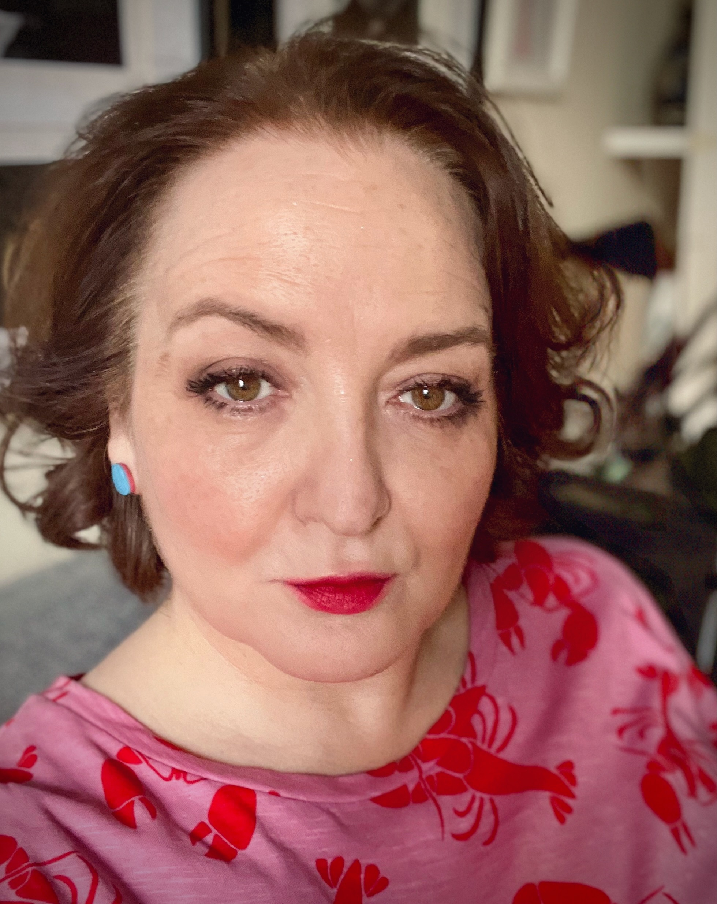
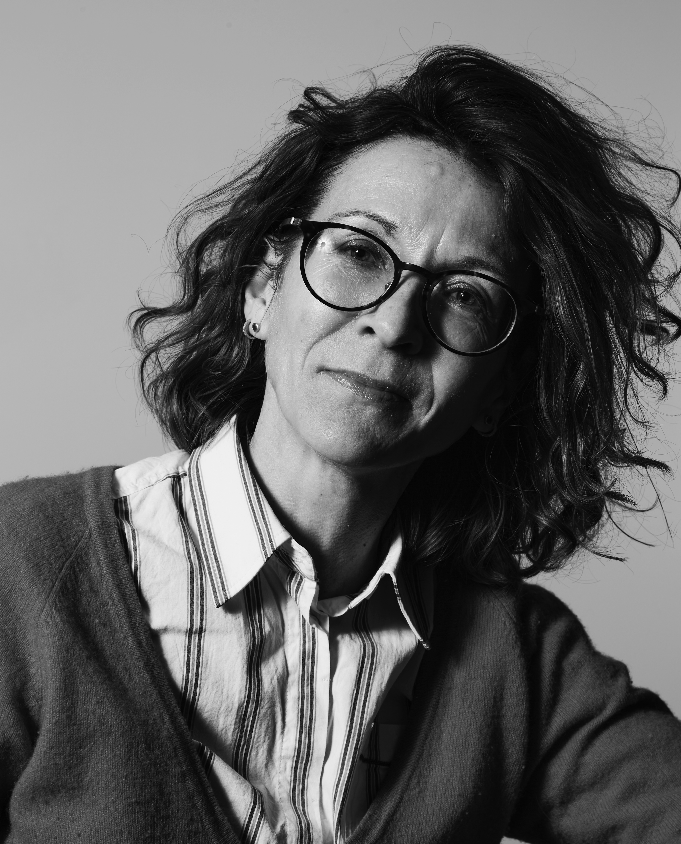
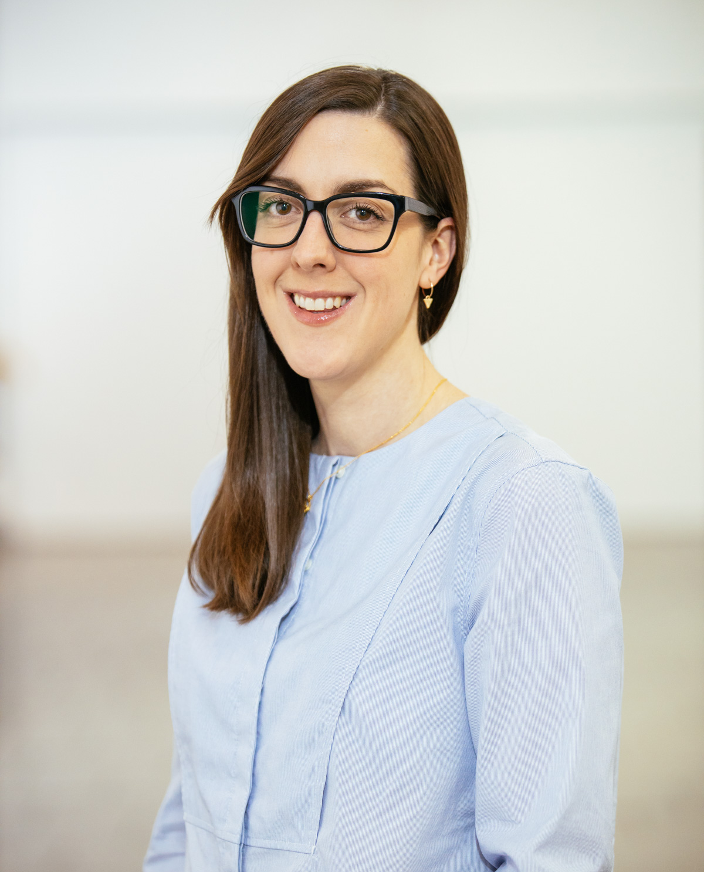
2
What does it mean to be a
lived experience collective?
Anne-Marie Creamer
Dr Hannah Zeilig
Dr Rachel Marsden

Slide 3
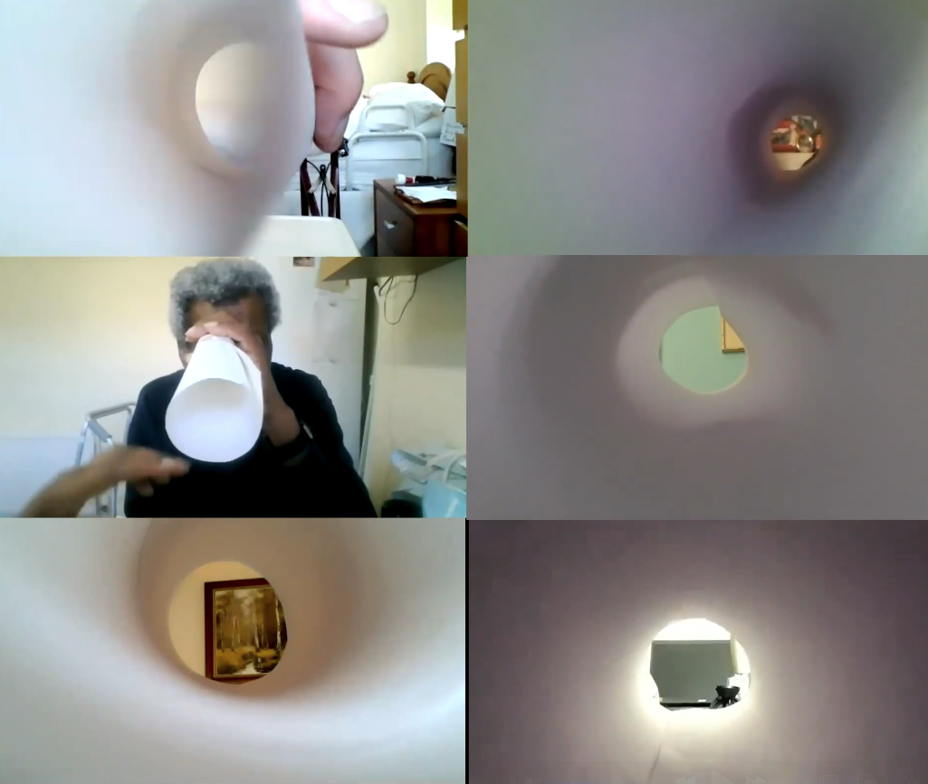
3
How can creative practice
and
methodologies help generate knowledge from / with
lived experience?
‘Better Making’
TUNNEL Film

Slide 4
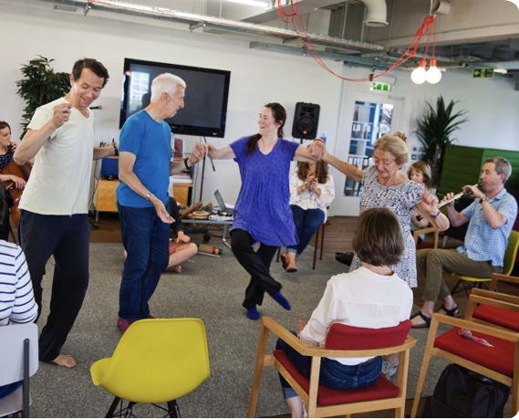
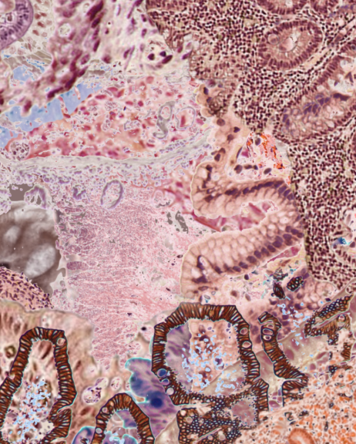
4
‘With All’ project, co-creativity with people with dementia
How do we learn to see
into
lived experience?
Still from moving image artwork by Amelia Hine, commissioned for the Stomach Ache website (2022)

Slide 5
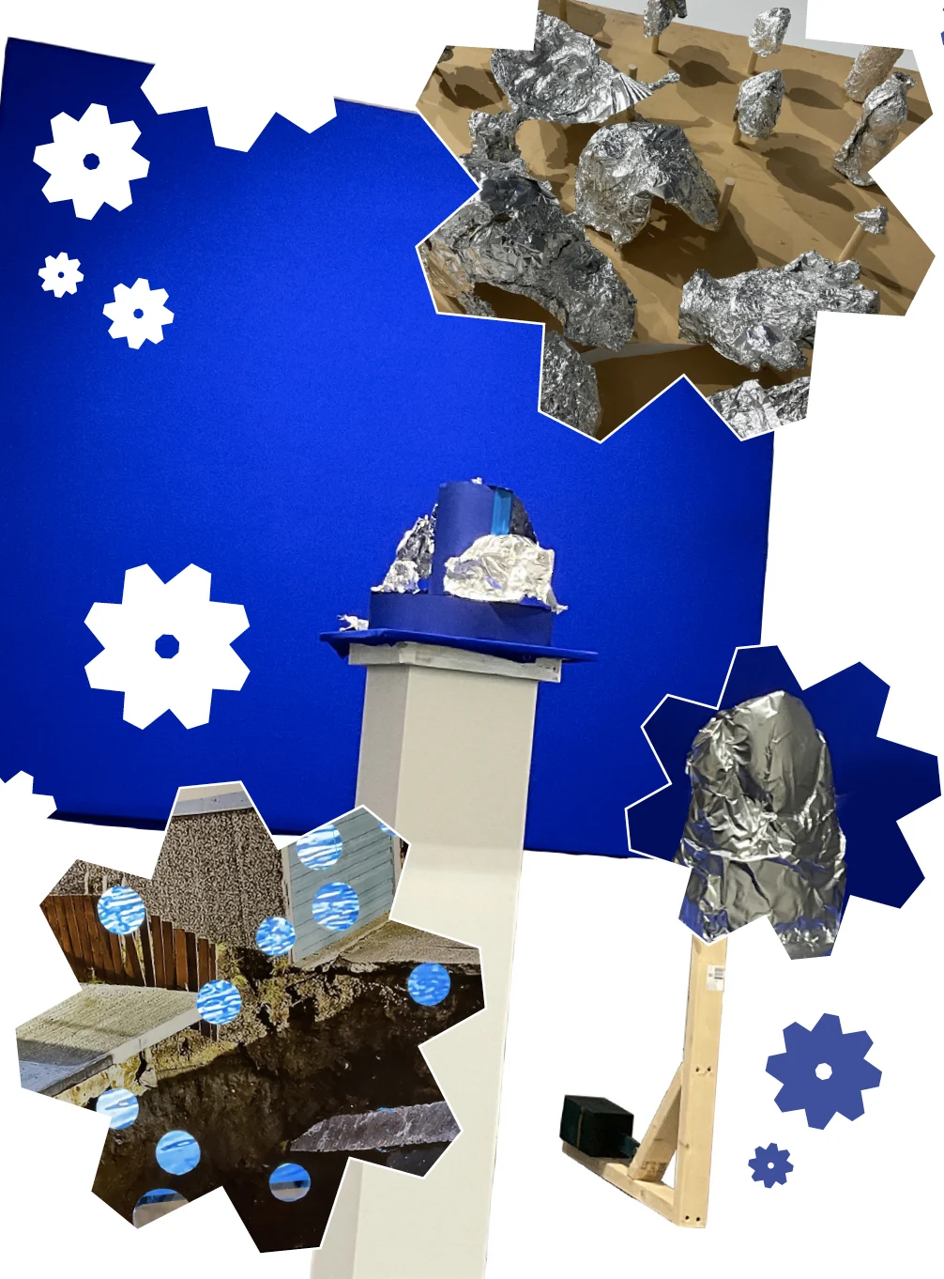
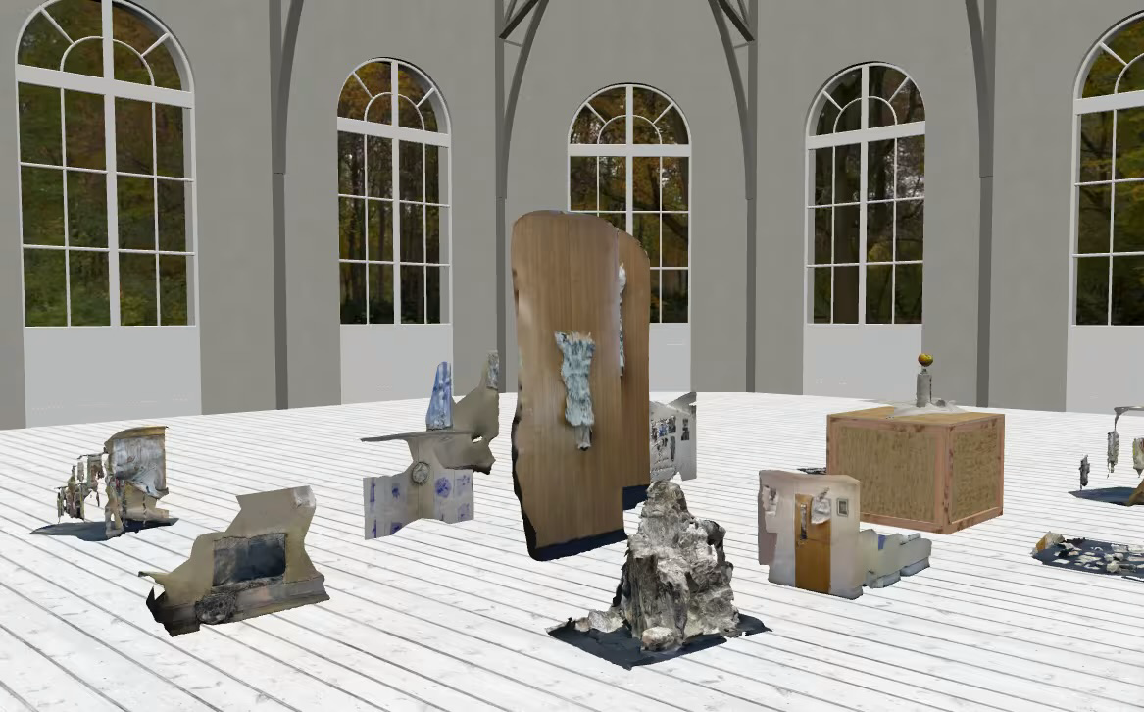
5
How does practice within an art school context (UAL) shape the meaning-making of lived experience?
Work from ‘Better Making’ workshops held at Vane Gallery, Gateshead, design by Alex Whiteley
‘Better Making’ virtual studio, where over time work made during workshops are archived in a virtual Open Studio

Slide 6


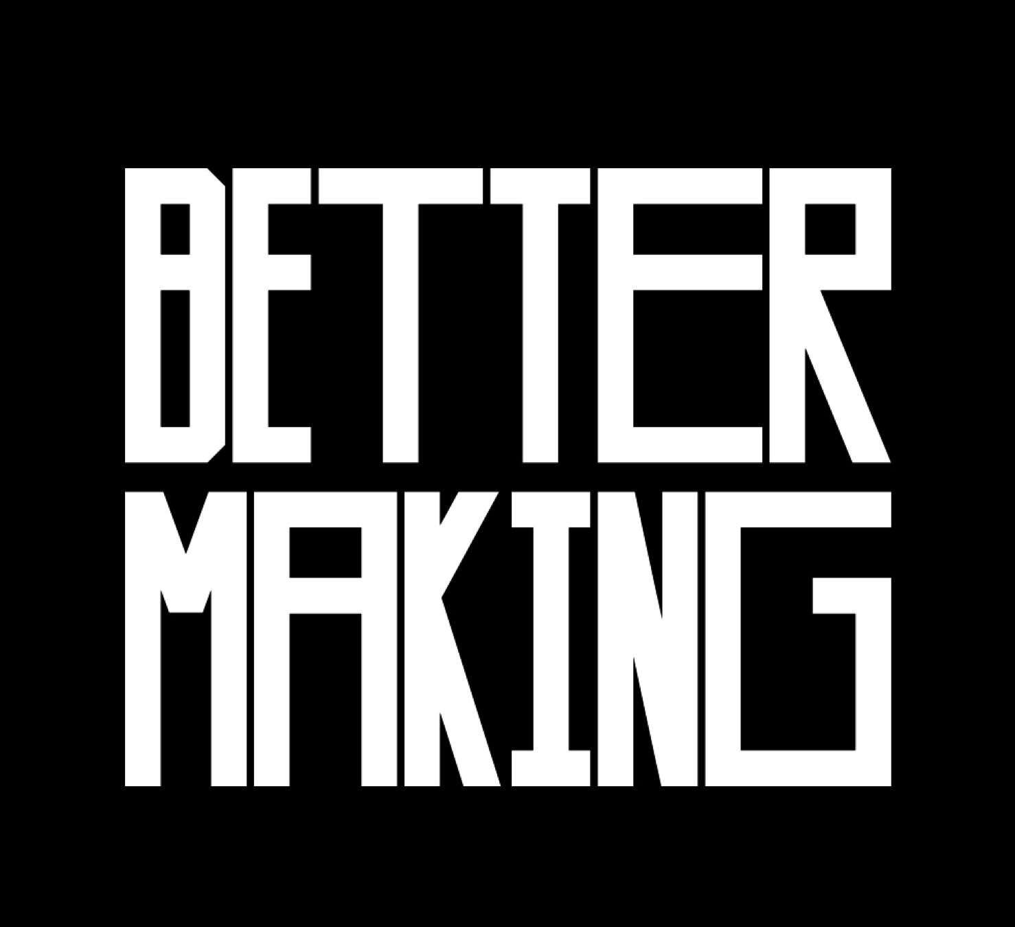
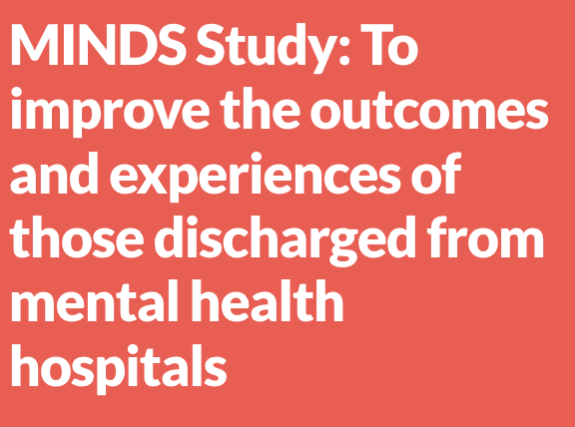
6
Stomach Ache Project
Northern Network for Medical Humanities Research (NNMHR) new network grant from Durham University, Institute for Medical Humanities.
With All: Co-creativity with people with dementia
Wellcome Collection, as part of the Created Out of Mind residency.
Better Making
Creative social prescribing programme, Central Saint Martins (CSM), UAL.
MINDS: To improve the outcomes and experiences of those discharged from mental health hospitals
National Institute for Health and Care Research (NIHR), Applied Research Collaboration (ARC), East of England

Slide 7
Hannah reflects on her experience for the MINDS study:
"I had difficulty communicating my experience in the terms required, especially in meetings that were examining discharge mechanistically. My experience was profoundly emotional. I was marked by the violence of time spent 'inside.' My ears were literally still ringing from clanging doors, the shouts; my body thrumming from enforced medications and restraints.
However, I did not sense this was the sort of 'lived experience' appropriate for a research project. Perhaps it would have been more feasible to capture the experiences of discharge in another medium - Collage? Poetry?
On the other hand, there was positivity to attending study meetings, even if I was mostly silent. I was able to see how severe bipolar disorder, that takes me radically away from the world can also ease me back into it. Participating nudged me toward a hybrid identity as a patient-researcher.
Now, three years later, my patient identity has diminished slightly. Nonetheless, as a 'lived experience' researcher, I often feel like a strangely striped creature whose experiences and expertise don't quite fit anywhere.“

Slide 8
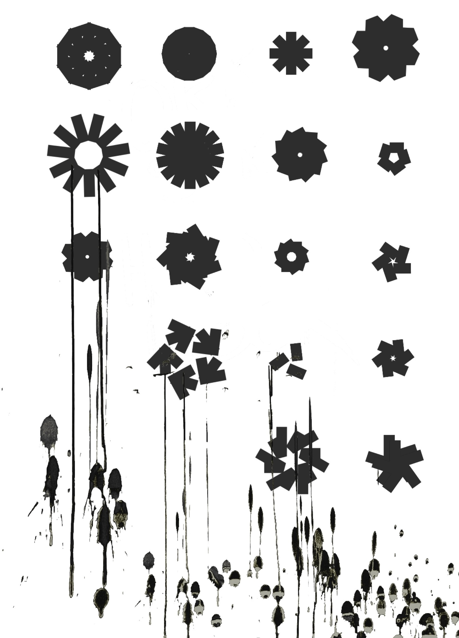
7
What are
your
thorny issues?
IRL: 1st July 2026
Central Saint Martins (CSM), UAL
Contact us: IRL@arts.ac.uk
Work from ‘Better Making’ workshops

