Slide 1
Game Jams as a proof-of-concept entrepreneurial launchpads
Thom Kaczmarek – Senior Lecturer in Games Design at
London College of Communication, University of the Arts London
Global Game Jam Regional Organiser UK & Ireland
Notes:
Wanted to take this occasion and thank Yaraslau Kot for invitation

Slide 2
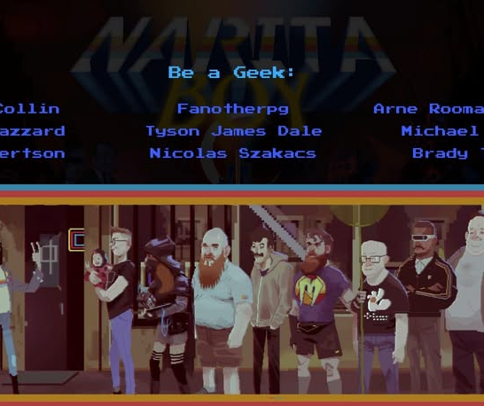

Why what I say may have some value?
1997 – started making games @Fanotherpg
2002 – took part in the first national game-making competition
2006 – Organised the first national game jam, with sponsorship of CD Projekt (which ran for 4 years)
2007 – Founded Zjazd Twórców Gier (now Game Industry Conference) in Poland
  Narita Boy (2021) Credits
  Studio Koba | Screenshot

Slide 3
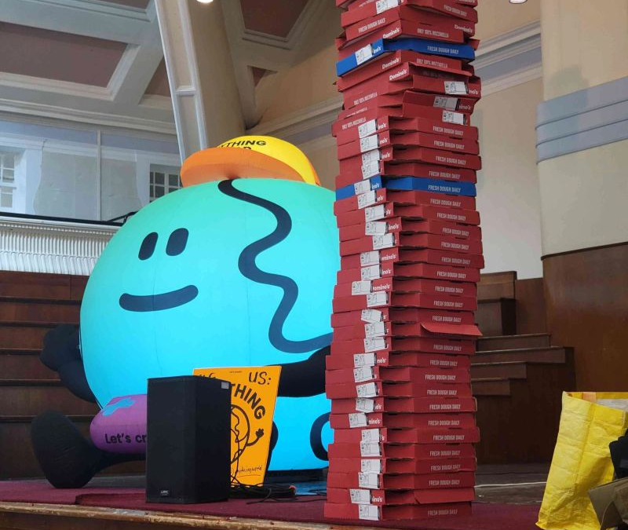
Why what I say may have some value?
2012 – Won the IGDA Accessibility Challenge during the Global Game Jam (which is cited in medical journal)
2018 – Started teaching Game Design FT
2020 – Started running my own GGJ site (since 2024 it’s the largest site nationwide, often in the top 10 globally)
2021 – Became GGJ Regional Organiser for UK & Ireland
  Anything World x UniJam 2024
  Thom Kaczmarek | Photo

Slide 4
So, what is Game Jam?

Slide 5
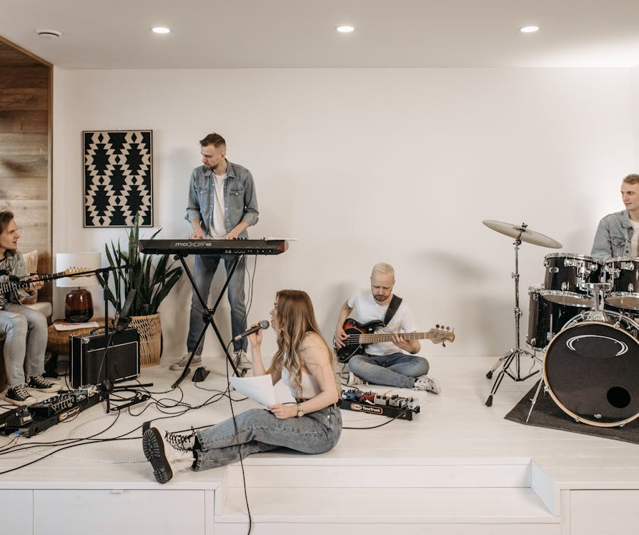
Jam what?
Similar to Music Jams, where people gather to spontaneously create an audio piece, based on an initial tune and direction…
A game jam is a time-constrained event where individuals or teams gather (in-person, hybrid, or virtually) to conceptualise, design, develop, and produce a playable digital or non-digital game based on a specific theme or objective.
  A group of friends performing music with various instruments in a modern home setting
  Pavel Danilyuk | Pexels

Slide 6
What Game Jams are there?

Slide 7

Jams can be in-person, hybrid or online-only
Global Game Jam – the largest worldwide
GMTK Game Jam –Biggest* YouTuber
Ludum Dare – Most jams throughout the year and the oldest* one
Nordic Game Jam – Inspired GGJ, and team-based theme-driven format
7D* Challenge –7 Day format * for genre
  Programming in Kiev, Ukraine
  Alex Kotiliarskyi | Unsplash
Notes:
https://unsplash.com/photos/people-doing-office-works-QBpZGqEMsKg

Slide 8
Educational value of Game Jams?

Slide 9

Value of Jam
No number of degrees or online qualifications will land students a job – employers require evidence of what they know.
Portfolio matters – jams help them increase the quantity of projects and tools they know, as well as the very niche applications of those (quality of expertise).
Networking is how they land a job, and jams force them to engage with others and self-promote.
Experimentation at jams also allows them to delve into other disciplines, gain a better understanding, and even discover a hidden talent.
  Top view of wooden blocks spelling 'Game Jam’
  Ann H | Pexels
Notes:
https://www.pexels.com/photo/arrangement-of-wooden-blocks-spelling-game-jam-34037761/

Slide 10
Jamming Experiential Triangle (JET)
Notes:
This presentation chapter proposes the Jamming Experiential Triangle (JET) as a conceptual framework for understanding why game jams function as powerful launchpads for student creativity, learning, and entrepreneurship.

Slide 11
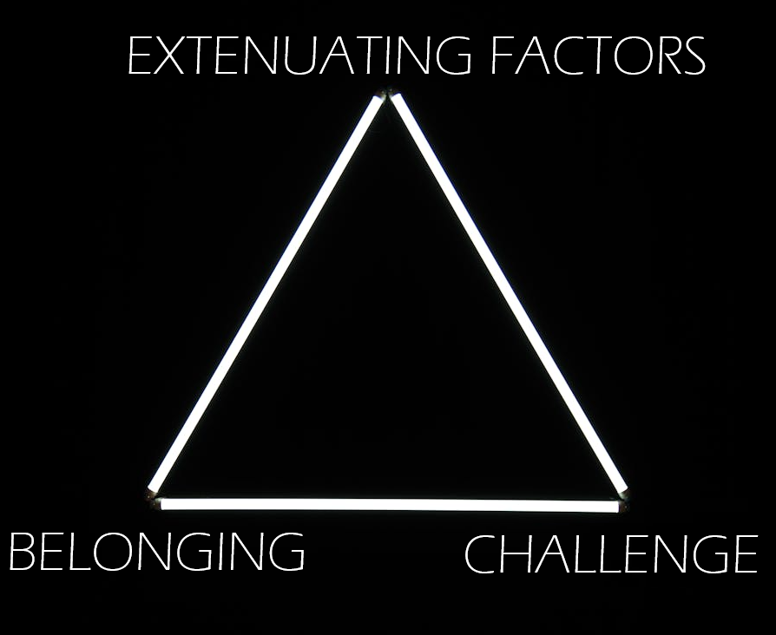
Jamming Experiential Triangle (JET)
Drawing on practice as a Global Game Jam Regional Organiser, I would like to argue that successful jam‑based learning environments emerge from the dynamic interaction of three cornerstones:
- Belonging
- Challenge
-Extenuating Factors
  A glowing triangle made of LED Lights
  Matheus Bertelli | Pexels

Slide 12
Belonging
The first cornerstone, Belonging, situates game jams as temporary but meaningful communities of practice.
Shared identity, peer support, and public participation reduce fear of failure while legitimising experimentation.
This can occur in-person or online, and on its own is sufficient to satisfy participants.
  A glowing triangle made of LED Lights
  Matheus Bertelli | Pexels

Slide 13
The Challenge
The second cornerstone, Challenge, captures both internal and external motivational forces: proving oneself, working with unfamiliar collaborators or technologies, and voluntarily engaging with additional diversifiers that push ideas beyond safe or conventional solutions.
These pressures encourage creative risk‑taking and rapid problem-solving.
  A glowing triangle made of LED Lights
  Matheus Bertelli | Pexels

Slide 14
Extenuating Factors
The third cornerstone, Extenuating factors, encompasses the conditions that distinguish jams from formal curricula: time limits, scope restrictions, themes, industry participants, peer recognition, awards, public showcases, real life limitations.
These factors shape behaviour without grades or institutional assessment, closely mirroring the conditions of early‑stage indie and startup projects.
  A glowing triangle made of LED Lights
  Matheus Bertelli | Pexels
Notes:
https://www.pexels.com/photo/white-triangle-on-black-background-7511011/

Slide 15
Can you jam a success?
Notes:
Together, the JET framework explains how jam environments consistently produce viable proof-of-concept prototypes that serve as foundations for portfolios, studios, and entrepreneurial careers, offering educators an industry-relevant model for experiential game education.
The approach is a legitimate hands-on school of experience, valued by industry, and often takes place internally within companies to prototype the next project, or let the steam off.

Slide 16
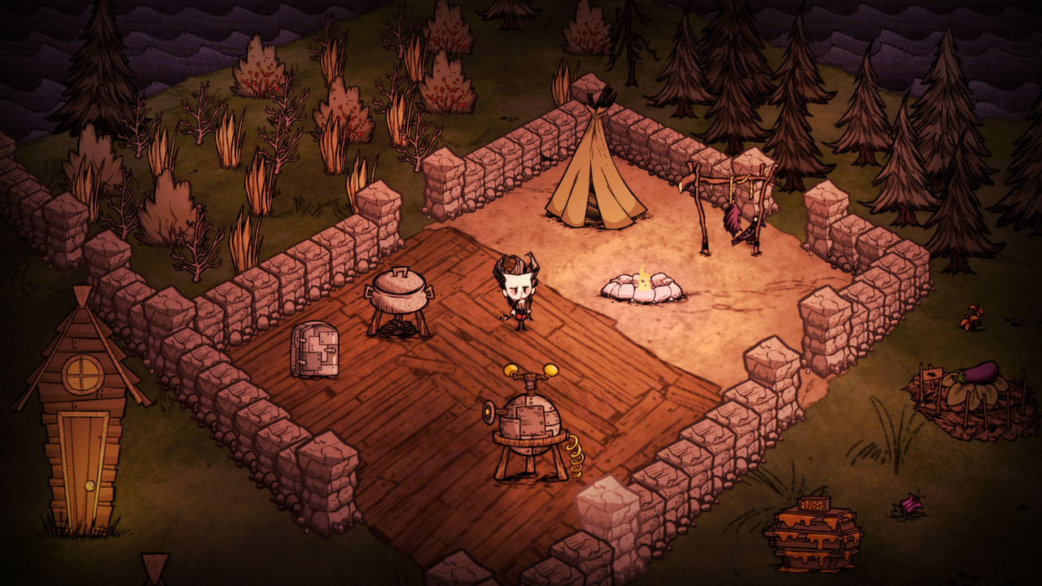
Don’t Starve – Internal 2010
Notes:
One such example of an internal Jam turned success is the survival game Don’t Starve.

Slide 17
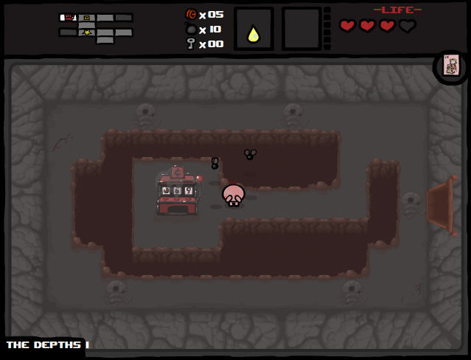
The Binding of Isaac – Internal 2011
Notes:
The Binding of Isaac is another example of internal and reflective game jam, allowing developers deal with their trauma, and initially designed within a single week.

Slide 18
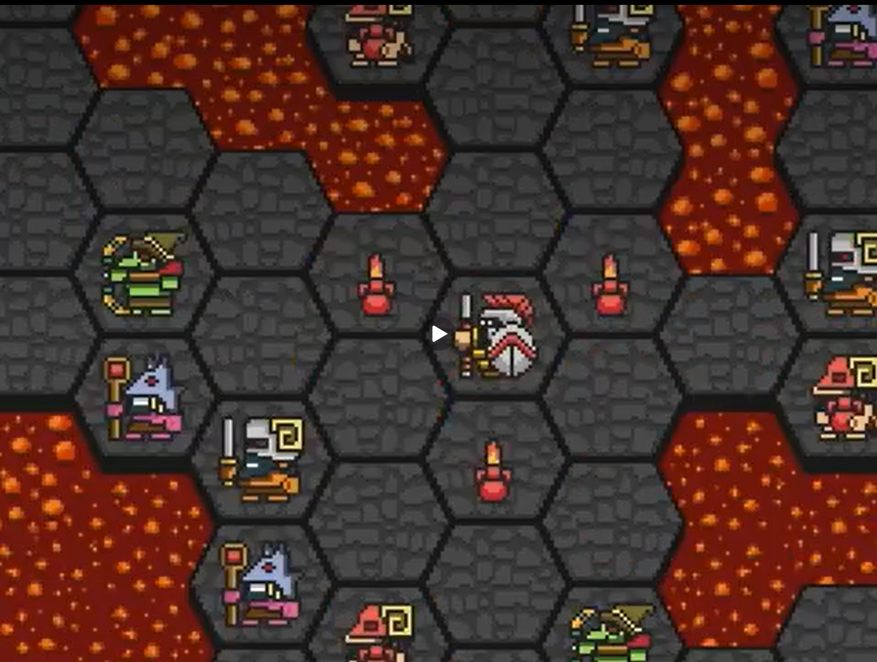
HOPLITE – 7DRL 2013
Notes:
HOPLITE was an early indie mobile hit with over a million downloads, utilising touchscreen, developed as part of a 7-day roguelike challenge.

Slide 19
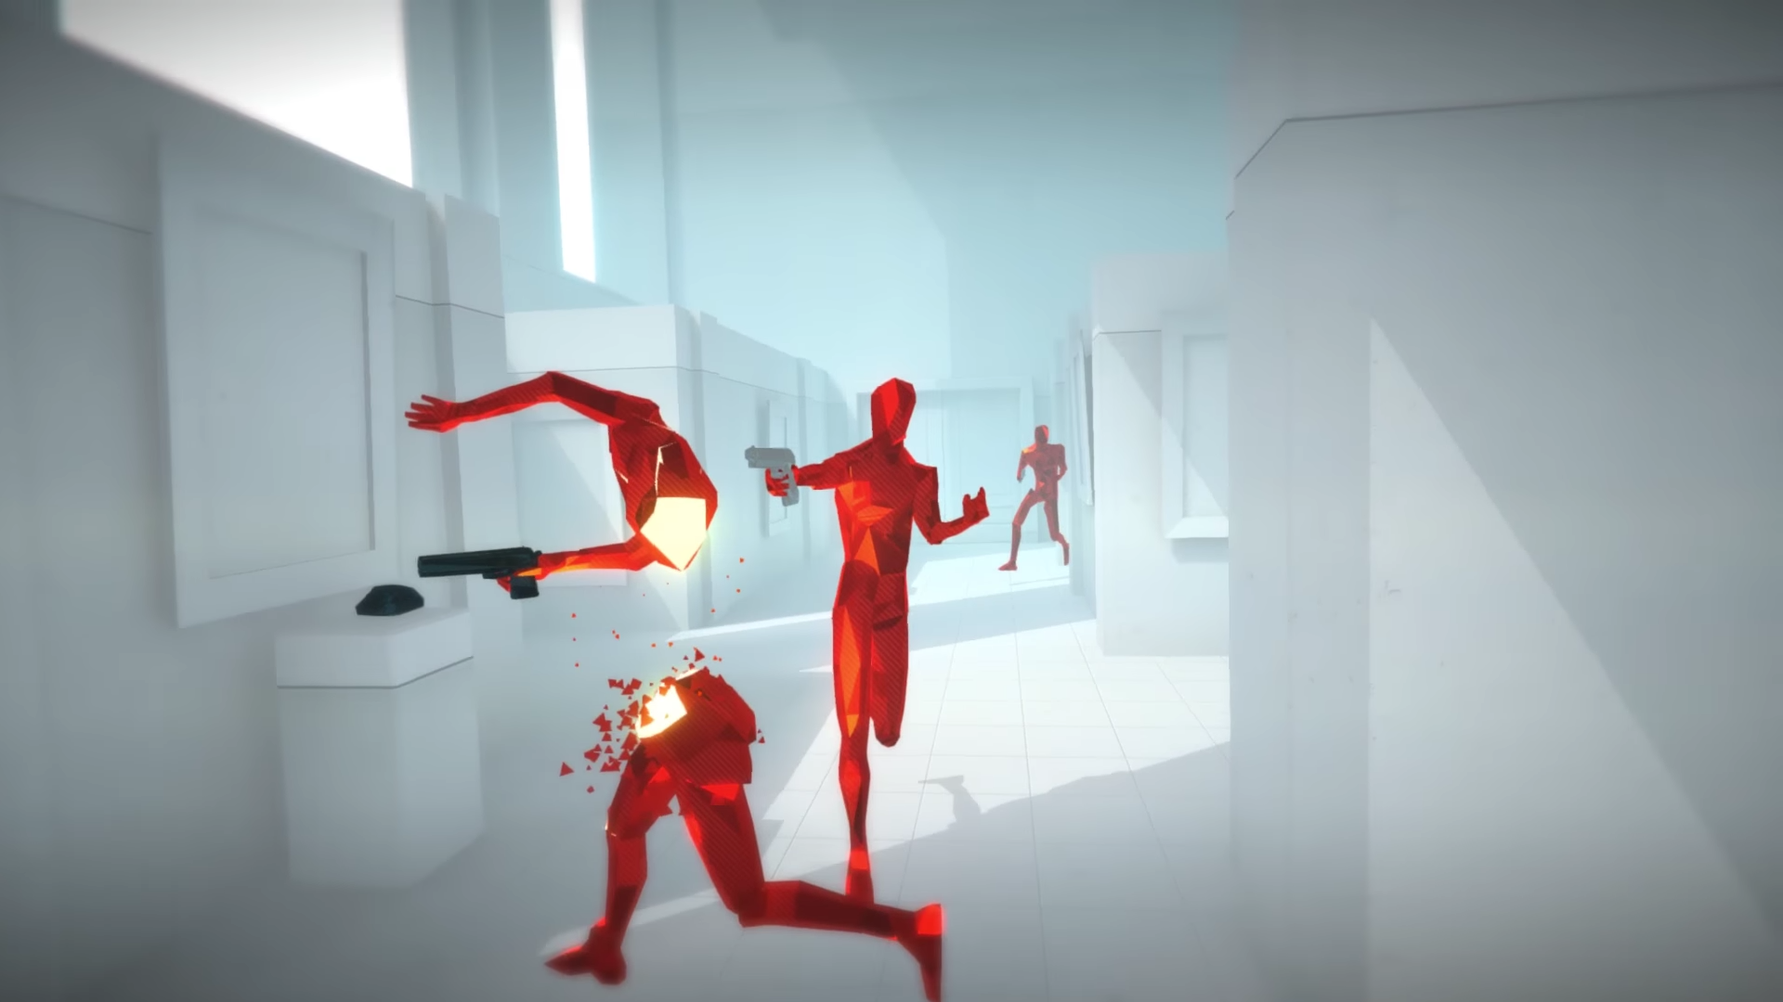
SUPERHOT – 7DFPS 2013
Notes:
SuperHOT – with its unique time moves only when you do mechanics- was originally developed in a week as part of the 7 Day FPS Challenge.

Slide 20
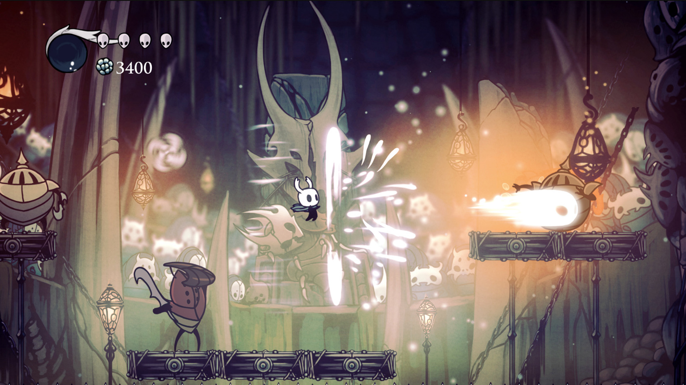
Hollow Knight – Ludum Dare (#27) 2013
Notes:
Hungry Night was original version of the game, focused on exploration.

Slide 21
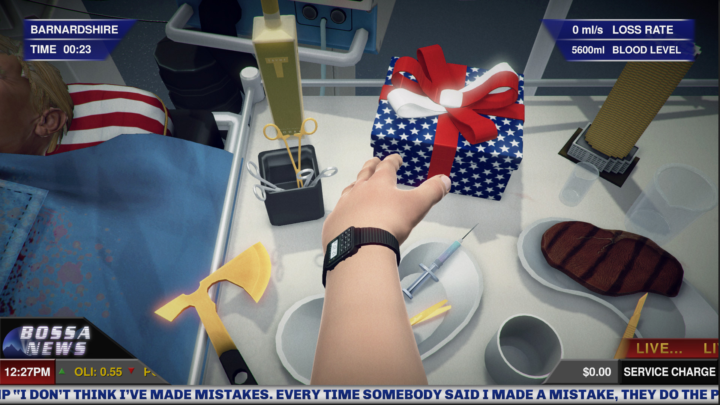
Surgeon Simulator – Global Game Jam 2013
Notes:
Surgeon Simulator was designed around experimentation with physic based human interface and turned so popular it was developed into full game.

Slide 22
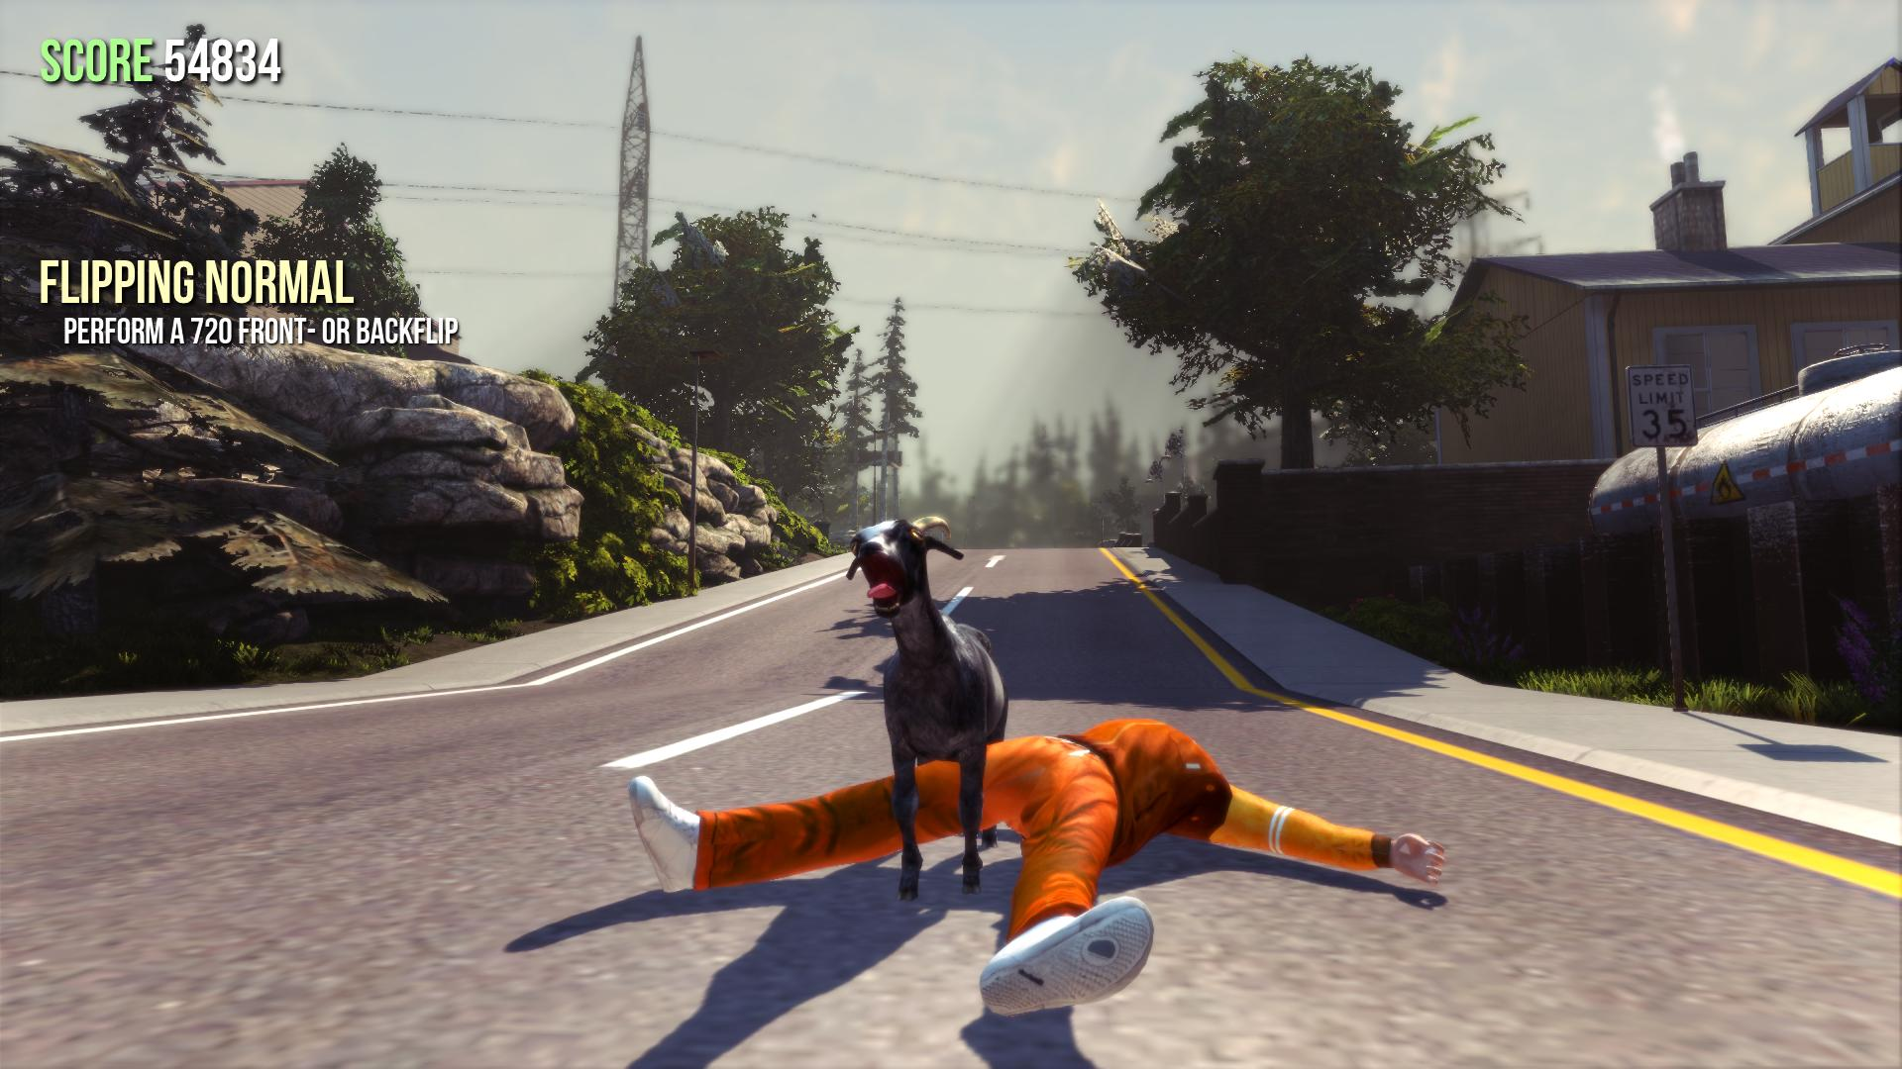
GOAT SIMULATOR – internal 2014
Notes:
Started as a joke to let of steam by developers and shared on YouTube, gained such traction that was turned into series of games that double downed on silliness.

Slide 23
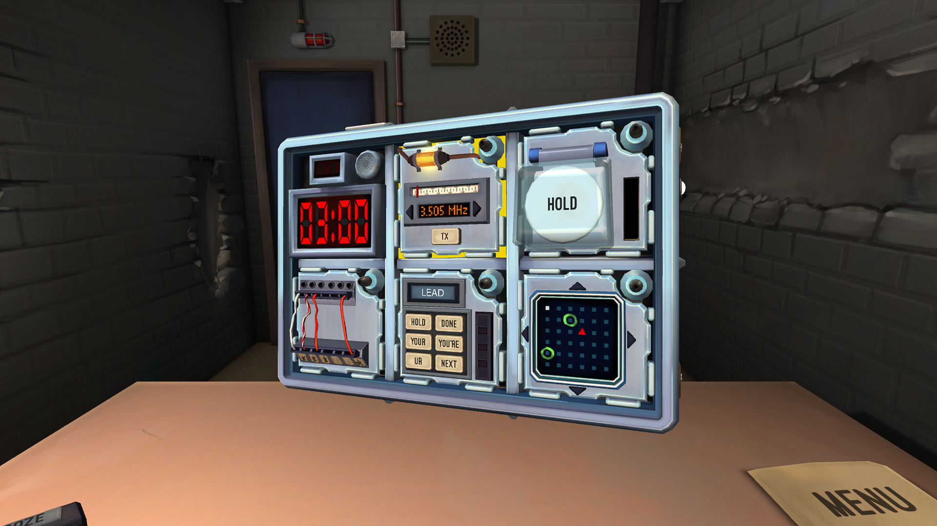
Keep Talking and Nobody Explodes – Global Game Jam 2014
Notes:
Originally collaborative game developed for VR (player defusing the bomb) and guides (reading physical manuals on how the bomb is constructued, and how to defuse it).

Slide 24
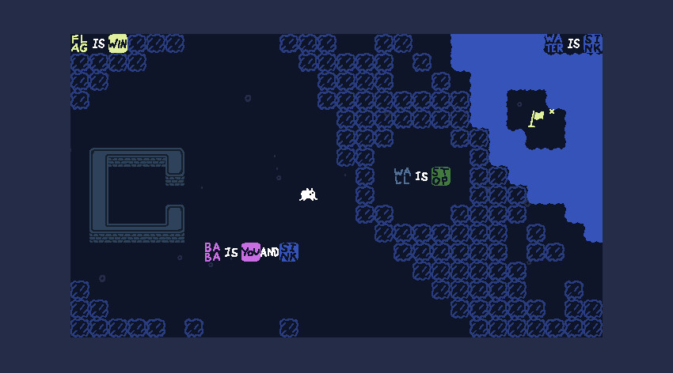
BABA IS YOU – NORDIC GAME JAM 2017
Notes:
Puzzle game that inspired a meta puzzle games, in which you are able to change game rules as you play.

Slide 25
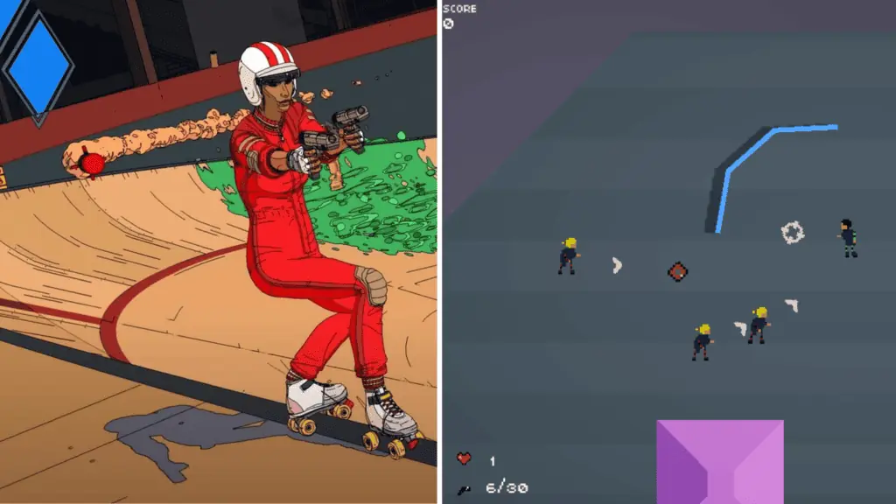
ROLLERDROME – GMTK GAME JAM 2017
Notes:
Rollerdrome started as a top-down 2D shooter (and lost big during GMTK Game Jam), despite that developer saw something and with time evolved the game into an award-winning 3D action-game that we all know and love.

Slide 26
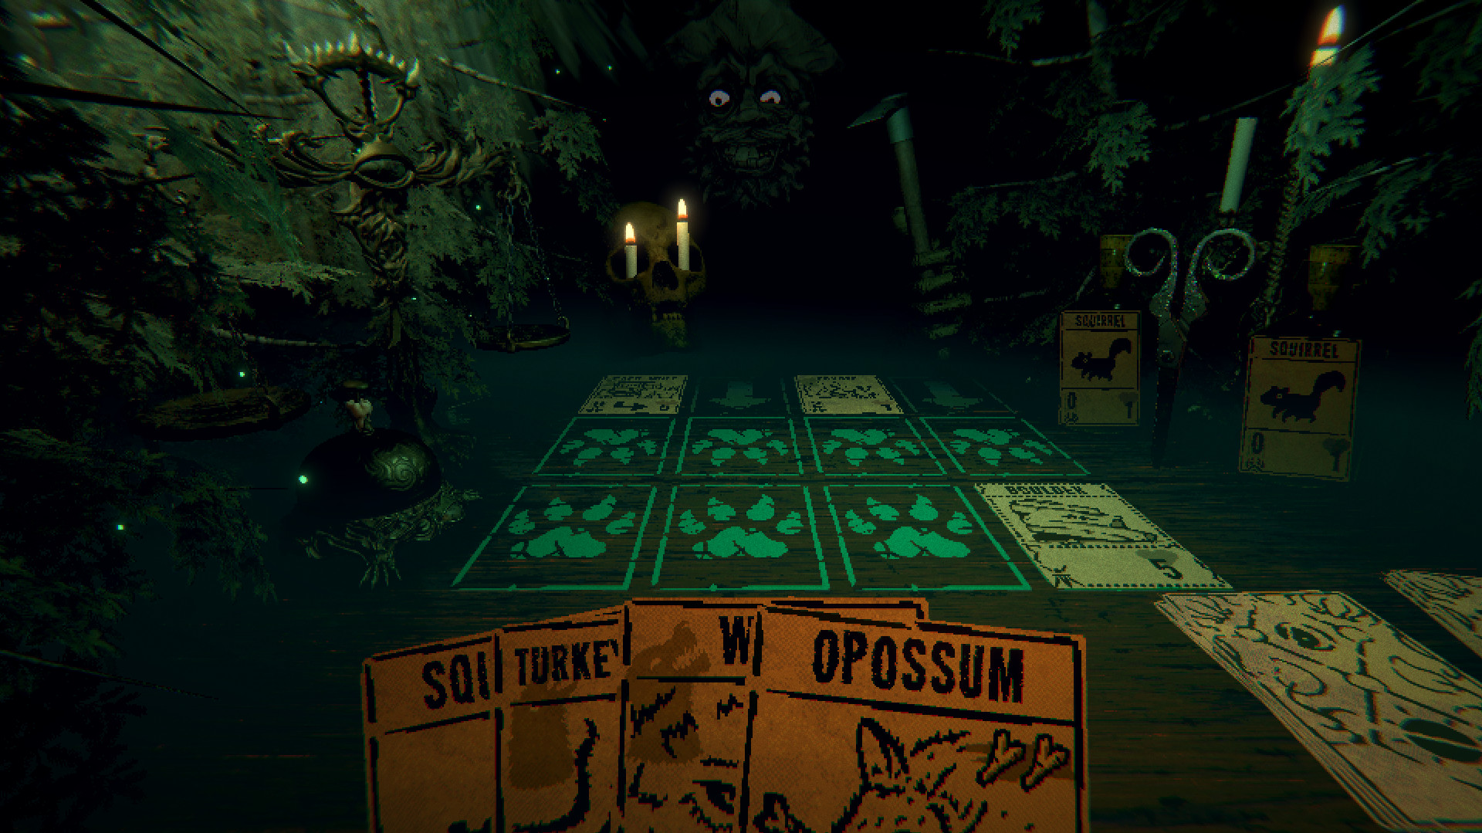
Inscryption – Ludum Dare (#43) 2018
Notes:
Inscryption started with a simple prompt of “Sacrifices must be made” , and due to the popularity of the jam entry, convinced the developer to cancel their other projects and solely focus on developing this title.

Slide 27
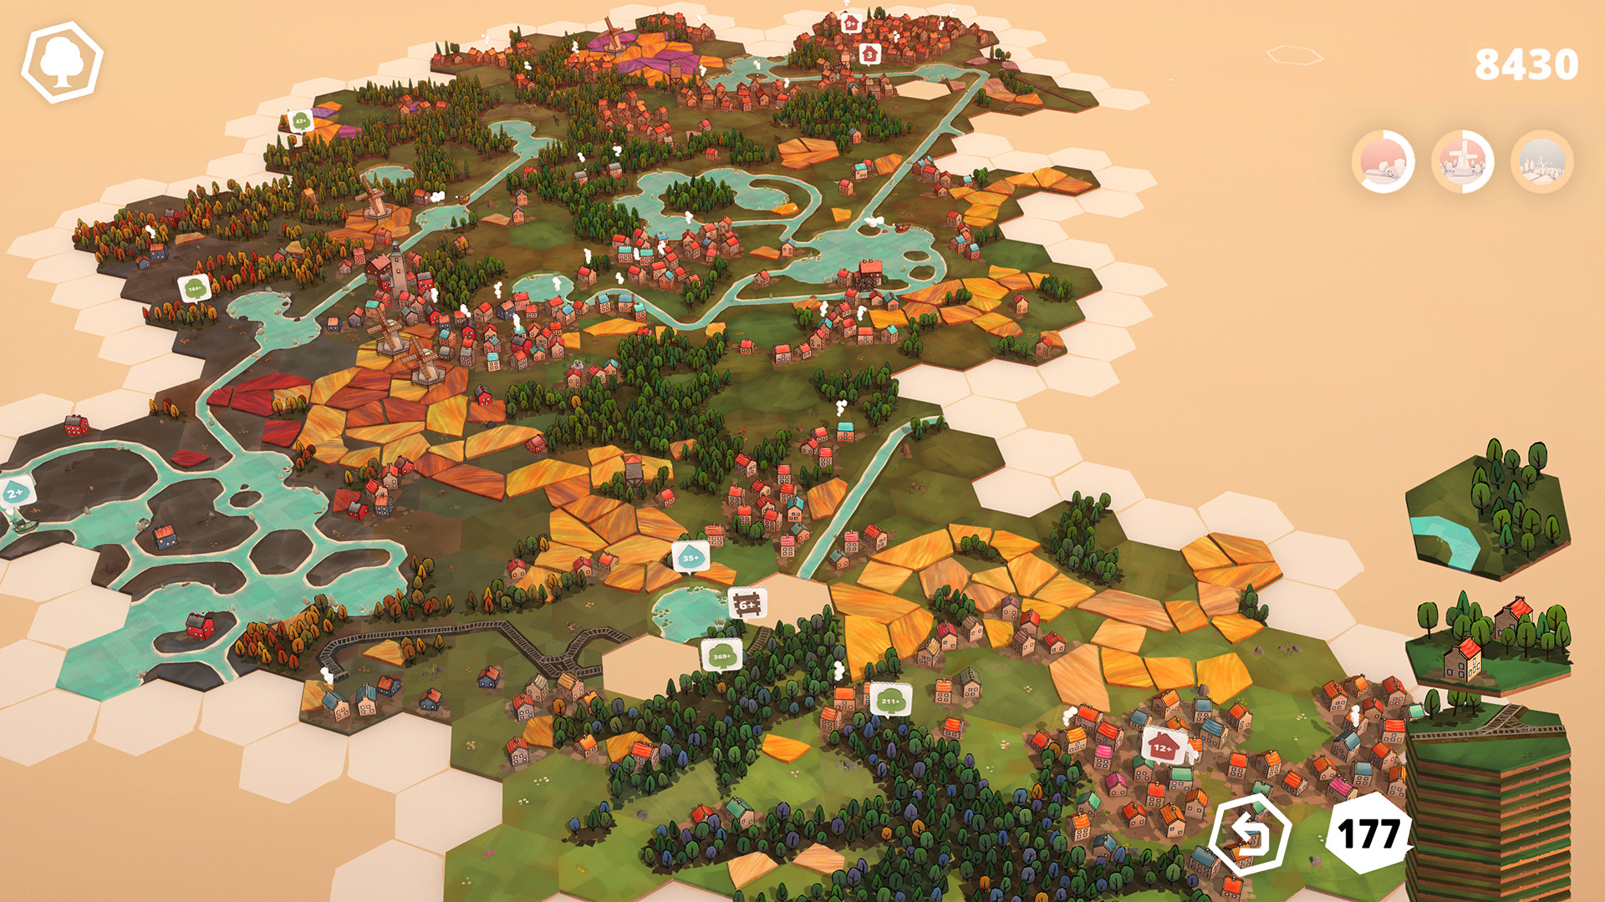
Dorfromantik – Ludum Dare (#46) 2020
Notes:
Pioneered a cozy and peaceful landscape-strategy genre that now is omnipresent especially on mobiles.

Slide 28
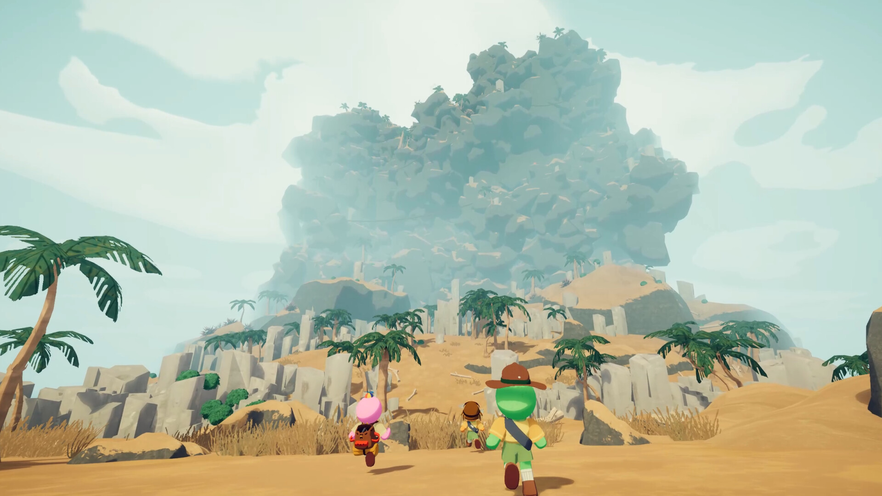
PEAK – Internal 2025
Notes:
Popularised the “Friend-slop” genre of chaotic, high physics multiplayer games designed for streaming due to in-game comedic moments.

Slide 29
Found Guys – UAL Case Study

Slide 30
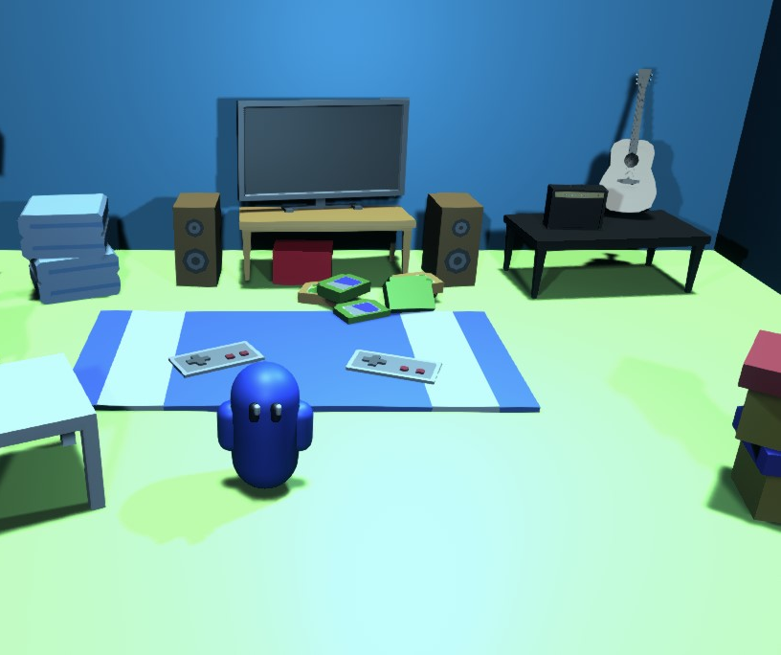
Found Guys (GGJ) > Found Guys VS > Funding
Found Guys Was Developed during the 2021 GGJ by a team of three students.
It was remade with a multiplayer mode and won third place in the Games Innovation Challenge 2021.
This enabled it to be pitched to UK Games Fund Tranzfuser, where it received £5000 of funding for further development.
  Found Guys GGJ
  Luca Cavozzi | Screenshot

Slide 31
Ripple that creates a wave

Slide 32
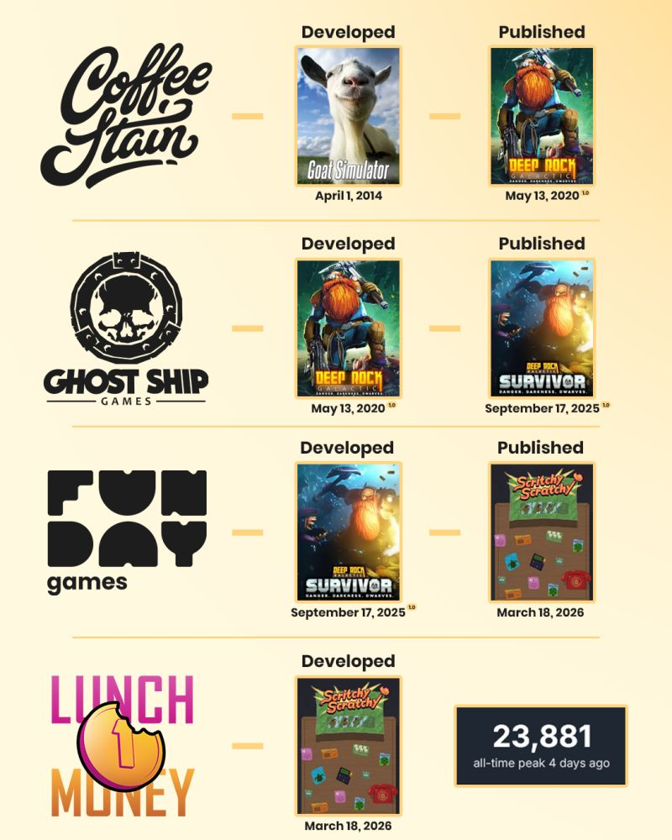
From a Jam Joke to a Generational Goldmine
Goat Simulator allowed Swedish Coffee Stain Studios to expand into publishing in 2017. A year later, they released Ghost Ship’s Games (GSG) Deep Rock Galactic.
Its success allowed GSG to expand into publishing in 2023 and support fellow Danish devs, including Deep Rock Galactic Survivor by Funday Games (FG).
In 2025, FG announced that they would help Lunch Money publish Scritchy Scratchy.
  From Goat Simulator to Scritchy Scratch
  Franz Rier | LinkedIn
Notes:
https://www.linkedin.com/posts/franz-rier-b99053193_its-friday-easter-is-here-lets-end-the-activity-7445773572272340992-bK4U/?utm_source=share&utm_medium=member_desktop&rcm=ACoAAASmpiwBRyNCa5mcmKVJ6za3Cge1TSVIZfk

Slide 33
JET in Practice

Slide 34
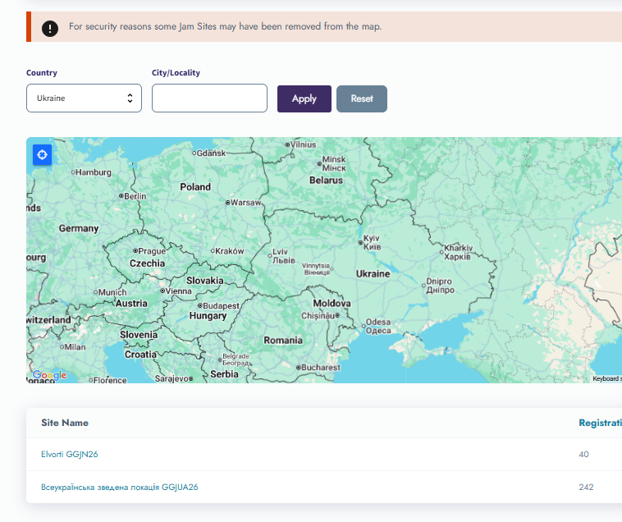
Extenuating Factors
Due to the ongoing full-scale Russian invasion of Ukraine, the GGJ site locations are hidden but active – thanks to Oleksii Izvalov hard work.
However, your gamedev industry still thrives, and its support and mentoring can be invaluable for resilience, teamwork and safe remote engagement.
  GGJ 2026 sites in Ukraine
  Global Game Jam Map | Screenshot

Slide 35

Extenuating Factors
GGJ had sites on all continents (including Antarctica, thanks to the Ukrainian research team!) thus allowing people to feel they are part in something trully global.
GMTK Jam is popular due to YouTuber Mark Brown playing the top 20 highest-ranked games and choosing his favourites.
Other Jams gain popularity with success stories of games that started within their realms.
  The Vernadsky Research Base
  Oksana Savenko | Picture

Slide 36
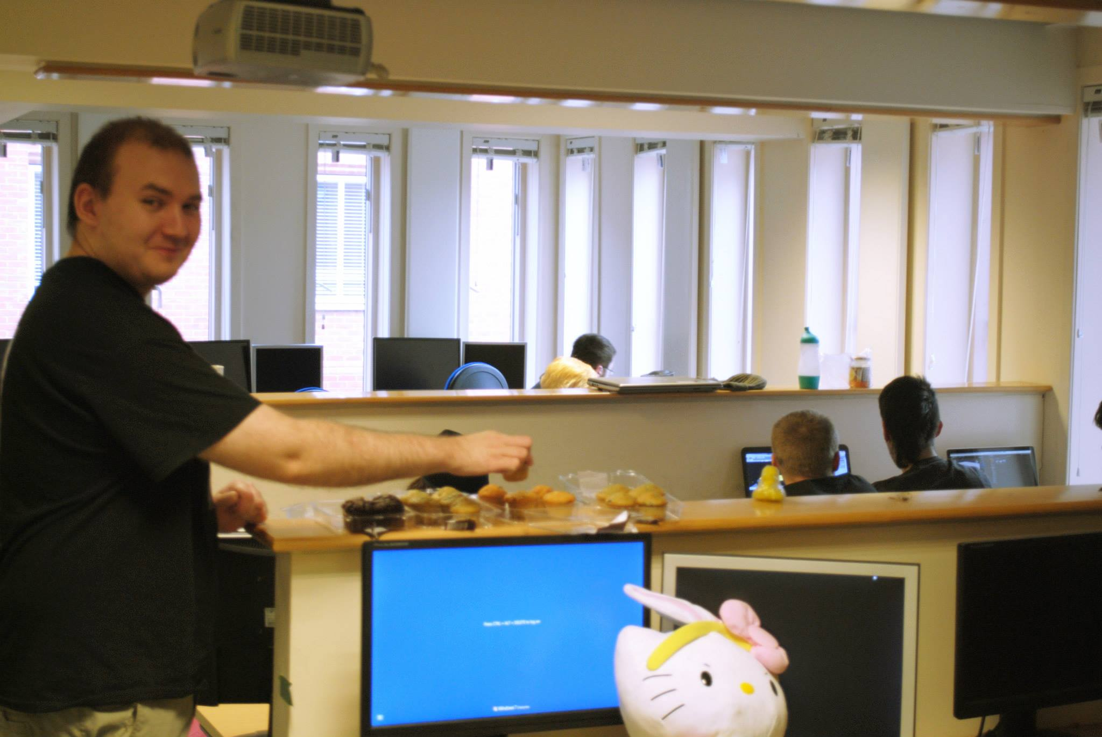
Challenge
Universities and Game Studios are likely locations for Jams, as they address the biggest challenges: access to expensive hardware and software.
Funding is always an issue*, so use free alternatives like Blender, Discord, and Godot.
Do note that GGJ offers Board Game Design & Upload, further lowering the technological barrier to entry.
  GGJ 2014 @ Brunel University
  Chris Cox | Picture
Notes:
*In the UK, we do have the UK Game Fund that helps to sponsor early-stage prototypes and studios' first games. There are also currently talks about a new body that would help industry and academia have a better entry-level and training pipeline.

Slide 37
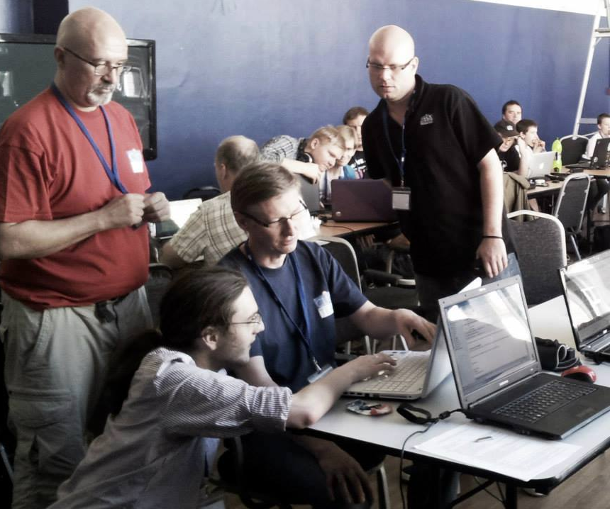
Belonging
Based on the preliminary findings of my research for British DIGRA “Place of Global Game Jam as Identity Infrastructure in UK Cross‑Regional Communities of Practice”, it appears that most Game Jam Participants do not share the game they worked on.
It appears that for many, it’s more about participation and fulfilment from participating in something greater than oneself.
  Clickjam 2013
  Clickteam France | Picture

Slide 38
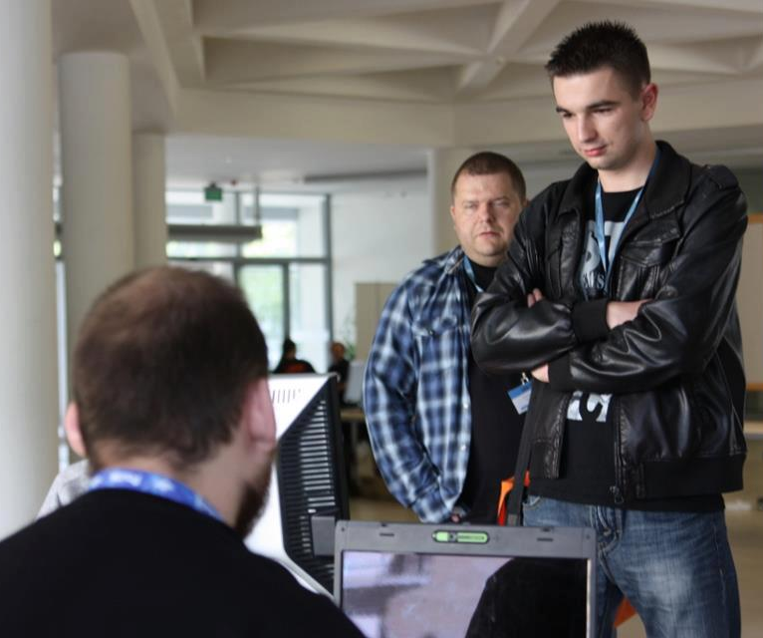
More research is underway
Some of the oldest GGJ sites in the UK & Ireland are held at the best-performing game development courses nationwide.
Research is underway on this relation to establish whether it is causal (the use of jams for promotion, the development of local talent, and relations over an extended period of time, which in turn improves the course) or correlational (as jams tend to be extracurricular, they are run by the staff at high-performing departments) in nature?
  WGK 2013 – SuperHOT first public showcase outside of 7DFPS Challenge
  Thom Kaczmarek | Picture

Slide 39
Thank you
Thom Kaczmarek – Senior Lecturer in Games Design at
London College of Communication, University of the Arts London
Global Game Jam Regional Organiser UK & Ireland t.kaczmarek@lcc.arts.ac.uk

