Slide 1
Place of Global Game Jam as Identity Infrastructure in UK Cross-Regional Communities of Practice
Thom Kaczmarek – Senior Lecturer in Games Design at
London College of Communication, University of the Arts London
Global Game Jam Regional Organiser for UK & Ireland

Slide 2
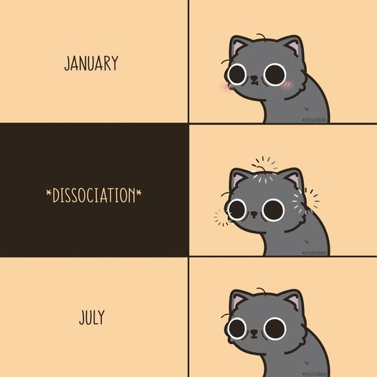

“Well, folks, we all know the story.”
Every year, around the world in January, people commit to participating in the Global Game Jam (GGJ) for 48h and come out forever changed.
Officially recognised game jams now run for a quarter of a century (Lai et al., 2021), and GGJ is, so far, the largest concurrent event (Melo et al., 2023) taking place on all continents (GlobalGameJam, 2024).
  #lifewithbubu
  Bubu | Facebook
Notes:
Every year, around the world in January, people commit to participating in the Global Game Jam (GGJ) for 48h and come out forever changed.
(Click)
Officially recognised game jams now run for a quarter of a century, and GGJ is, so far, the largest concurrent event taking place on all continents.
https://www.facebook.com/lifewithbubu.official/posts/pfbid0zE9D5EW61Huq6g4fN7oGUM4BiKseaPtkfPryUB6N3eMrZAhZYpxa5RUitjAbSv2ul

Slide 3
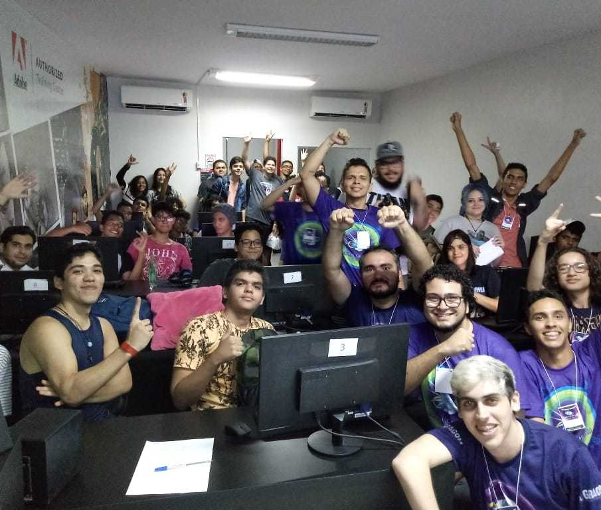
A known quantity…
Game jams are well-researched (Fowler and Khosmood, 2023) methods for knowledge transfer and creation (Laaninen, Hanson and Sauter, 2025) that accelerate design (Falk, 2021) and are seen by the industry as a way to evidence hard and soft skills (Pedercini, 2023; Savage et al., 2026).
  Group shot from São Luís, Brazil
  Global Game Jam Press Kit | Photo
Notes:
Game jams are well-researched methods for knowledge transfer and creation that accelerate design and are seen by the industry as a way to demonstrate both hard and soft skills.
https://globalgamejam.org/global-game-jam-press-kit

Slide 4

…which is inclusive
They are inclusive opportunities for game creation (Centre of Excellence in Game Culture Studies, 2020) that serve as a bridge between consumers and developers (Sampugnaro et al., 2014) by not only giving the opportunity to meet people from the industry and experience their work culture (Kumari, 2022), but to “further the learning of interdisciplinary, epistemic, and procedural knowledge” (Aurava and Sormunen, 2023)
  Meeples from the game Deep Sea Adventure of Oink Games
  Alexander Lyashkov | unsplash
Notes:
They are inclusive opportunities for game creation that serve as a bridge between consumers and developers by not only giving the opportunity to meet people from the industry and experience their work culture, but to “further the learning of interdisciplinary, epistemic, and procedural knowledge”
https://unsplash.com/photos/a-group-of-colorful-plastic-figures-3KUESKOngy8

Slide 5
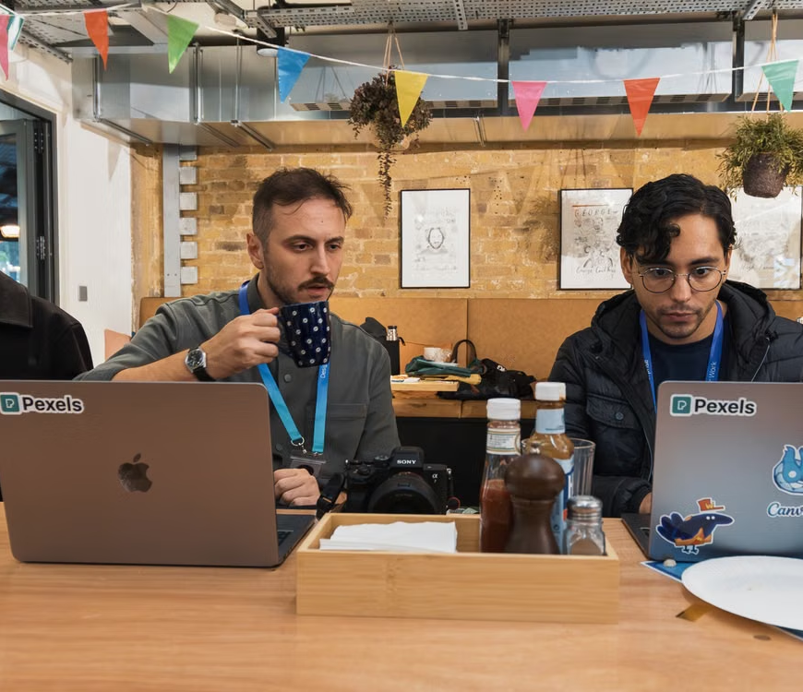
…gives value of being open…
Through the very nature of identity-forming assemblages (Deleuze & Guattari, 1987) and affinity spaces “where people affiliate with others based primarily on shared activities, interests, and goals" (Gee, 2004, p. 67), game jams allow the expertise and resources to be distributed across all participants, flattening hierarchies and fostering informal, decentralised learning.
As mentioned, this shifts their self-perception from hobbyists to developers.
  Young professionals working together in a modern cafe setting, focused on laptops
  Matheus Bertelli | Pexels
Notes:
Through the very nature of identity-forming assemblages and affinity spaces “where people affiliate with others based primarily on shared activities, interests, and goals", game jams allow the expertise and resources to be distributed across all participants, flattening hierarchies and fostering informal, decentralised learning.
(click)
As mentioned, this shifts their self-perception from hobbyists to developers.
https://www.pexels.com/photo/collaborative-work-session-in-trendy-cafe-29284334/

Slide 6

…in an interconnected world…
While GGJ survey data (Global Game Jam, 2026d) highlights that jammers return primarily to improve technical skills, it is the collaborative structure of the event, manifested in high repeat-attendance rates and cross-disciplinary team formation, that fosters an 'identity in practice' (Holland et al., 1998) within a globally shared figured world.
  Artistic composition with wooden mannequins on globes, symbolizing global connection.
  Valentin Ivantsov | Pexels
Notes:
While GGJ survey data highlights that jammers return primarily to improve technical skills, it is the collaborative structure of the event, manifested in high repeat-attendance rates and cross-disciplinary team formation, that fosters an 'identity in practice' within a globally shared figured world.
https://www.pexels.com/photo/creative-conceptual-art-with-mannequins-and-globes-35769880/

Slide 7
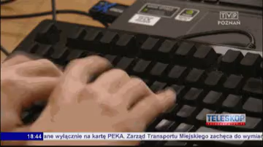
…while having fun researching!
Global Game Jam can be seen as a national knowledge socio-technical infrastructure, as defined by Star and Ruhleder (1996), a relational property that emerges when local practices connect to global standards.
This is especially true in the context of GGJ, where we have globally uniform standards delivered through an installed base of localised sites, during which participants take on the Jammer persona and embrace the creative process of rapid prototyping (Grace, 2016) within given technical and conceptual constraints (Kultima, 2015).
  Sos Sosowski trolling local TV
  TVP Poznan| Teleskop 25/01/2014
Notes:
Global Game Jam can be seen as a national knowledge socio-technical infrastructure, as defined by Star and Ruhleder, a relational property that emerges when local practices connect to global standards.
(click)
This is especially true in the context of GGJ, where we have globally uniform standards delivered through an installed base of localised sites, during which participants take on the Jammer persona and embrace the creative process of rapid prototyping within given technical and conceptual constraints.
https://www.reddit.com/r/gifs/comments/1w862f/they_wanted_to_shoot_me_making_games_on_local_tv/

Slide 8
Politics of access

Slide 9

Politics of access
This work in progress is intended to gather feedback and spark a debate. It is a mix of longitudinal case study and autoethnography, drawing on my roles as jammer, co-creator of UniJam, the UK’s largest GGJ site over the past three years (Global Game Jam, 2024a; Global Game Jam, 2025; Global Game Jam 2026) and the GGJ UK & Ireland Regional Organiser.
I analysed how jam cultures operate as distributed pedagogical systems, to see how they challenge traditional barriers to entry and politics of access, such as:
  Not Getting Through
  Tim Mossholder | Unsplash
Notes:
This work in progress is intended to gather feedback and spark a debate. It is a mix of longitudinal case study and autoethnography, drawing on my roles as a jammer, co-creator of UniJam, the UK’s largest GGJ site over the past three years, and the GGJ UK & Ireland Regional Organiser.
(click)
I analysed how jam cultures operate as distributed pedagogical systems, to see how they challenge traditional barriers to entry and politics of access, such as:
https://unsplash.com/photos/blue-wooden-door-with-white-concrete-wall-GV3bhGqX44g

Slide 10

Jack of all trades, master of none…
- Up to 60% of FE/HE games students come from working-class backgrounds, but only 13% enter the industry (Into Games, 2024)
- Unrealistic student expectations combined with graduate overproduction (Fredericksen, 2024) often do not align with the scarcity of junior roles (Jones, 2023). Only 17% of new hires are graduates, and just 1% are apprentices (TIGA, 2026), with universities’ game graduate employment rates hovering between 5-8% (Into Games, 2024)
  Black and white photograph of students wearing mortarboards at a graduation ceremony
  Safari Consoler | Pexels
Notes:
Up to 60% of FE/HE games students come from working-class backgrounds, but only 13% enter the industry
(click)
Unrealistic student expectations, combined with graduate overproduction, often do not align with the scarcity of junior roles. Only 17% of new hires are graduates, and just 1% are apprentices, with universities’ game graduate employment rates hovering between 5-8%.
https://www.pexels.com/photo/students-in-gowns-and-mortarboards-sitting-at-the-graduation-ceremony-19501573/

Slide 11
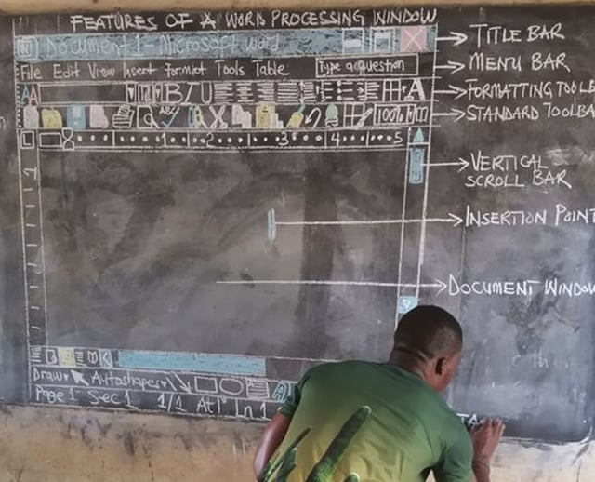
Mind the skills gap
- Despite education being seen as a vital part of the talent pipeline by the industry (TIGA, 2026), instruction in digital skills is inconsistent, exposing structural inequalities in our educational system. This is due to the limited availability of teaching expertise and resources (Ukie, 2025)
- Restricted access to the informal networks (Into Games, 2024) that dominated hiring, since the days of bedroom coders (Ozimek and Rueda, 2022), further limits access to guidance, support and resources for newcomers (Brewer and Romine, 2024)
  Teaching of ICT in Ghana’s schools is very funny.
  Owura Kwadwo Hottish | Photo
Notes:
Despite education being seen as a vital part of the industry’s talent pipeline, instruction in digital skills is inconsistent, exposing structural inequalities in our educational system. This is due to the limited availability of teaching expertise and resources.
(click)
Restricted access to the informal networks that dominated hiring, since the days of bedroom coders, further limits access to guidance, support and resources for newcomers
https://news.microsoft.com/en-xm/2019/03/27/inspiring-change-ghanaian-educator-who-taught-ms-word-on-a-chalkboard-reflects-on-the-year-since-his-story-went-viral/

Slide 12
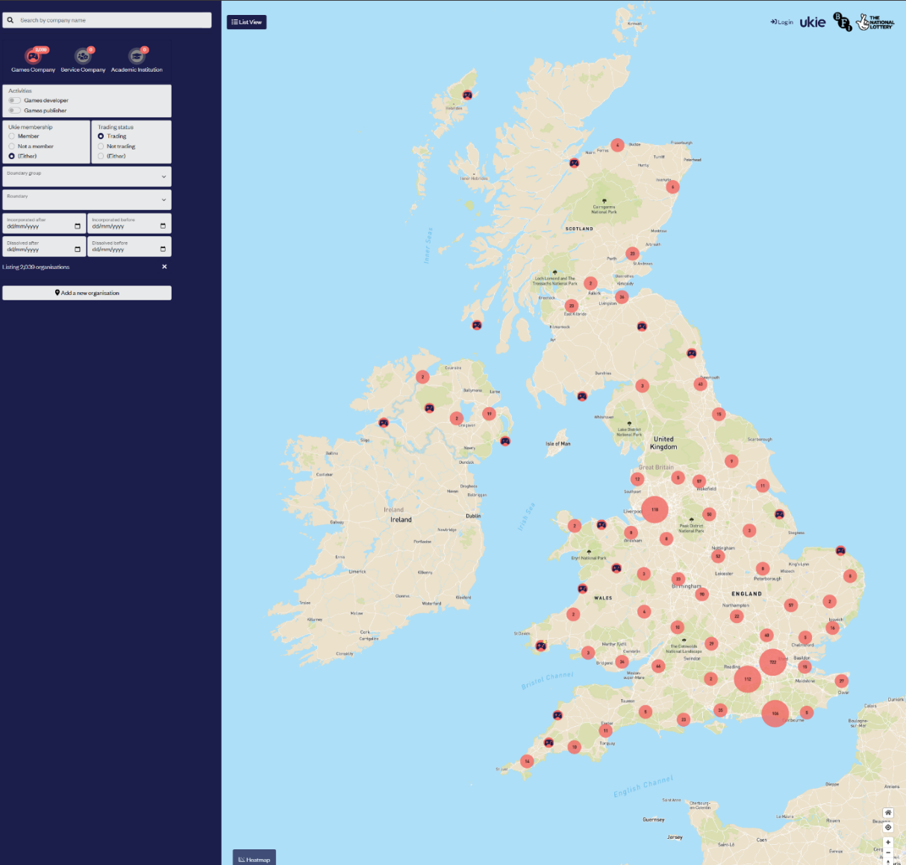
All roads lead to Southeast
- The game industry has “one of the highest barriers to entry in tech” (Berger, 2023), primarily due to its complex interdisciplinary nature (Sun, Chen and Zhang, 2025)
- Despite the majority of NUTS3 regions having at least 1 game development company (Ukie and Nesta, 2016), the largest studios tend to cluster in expensive cities, which requires relocation and significant financial commitment (Thompson and Hebblethwaite, 2020)
  Location of Games Companies in the UK
  Ukie and Nesta | Screenshot
Notes:
The game industry has “one of the highest barriers to entry in tech”, primarily due to its complex interdisciplinary nature
(click)
Despite the majority of NUTS3 regions having at least 1 game development company, the largest studios tend to cluster in expensive cities, which requires relocation and a significant financial commitment.
(click)
For example, over half of the mapped studios are placed in a triangle between London, Southampton and Dover (including Guildford and Brighton).

Slide 13
GGJ Structure

Slide 14

It is mission driven
The Global Game Jam is a non-profit organisation which, as of 2026, has (Global Game Jam, 2026b):
6 hired (paid) staff members
8 volunteer board members
13 volunteer Executive Committee
  1 of which is also hired staff
  1 is also a board member
  further 3 form Global Regional Coordination Team (Global Game Jam, 2026c)
  About
  Global Game Jam | Screenshot
Notes:
The Global Game Jam is a non-profit organisation which, as of 2026, has (Global Game Jam, 2026b):
6 hired (paid) staff members
(click) 8 volunteer board members
13 volunteer Executive Committee
(click) 1 of which is also hired staff
1 is also a board member
Further 3 form Global Regional Coordination Team (Global Game Jam, 2026c)
https://globalgamejam.org/about

Slide 15

Volunteers are GGJ’s bloodstream
Those key members are further supported by 58 volunteer regional organisers (ROs), who are responsible for interviewing, supporting, and mentoring site organisers (SOs).
SOs manage local sites that serve their communities of choice and enable jammers to participate (Global Game Jam, 2026b).
  Tilly saying thank you https://www.instagram.com/sillytillycocker/
  Howie R | Unsplash
Notes:
Those key members are further supported by 58 volunteer regional organisers (ROs), who are responsible for interviewing, supporting, and mentoring site organisers (SOs).
(click)
SOs manage local sites that serve their communities of choice and enable jammers to participate (Global Game Jam, 2026b).
https://unsplash.com/photos/dog-biting-thank-you-mail-paper-CjI_2QX7hvU

Slide 16
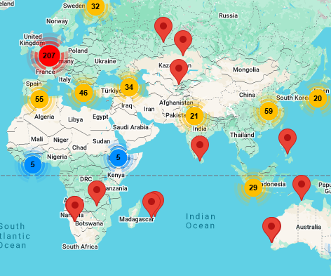
Regions are all over the world
The GGJ regions can range from an area within a country (California), through a whole country (the Philippines), or several countries (the UK & Ireland, including Guernsey, Jersey, and the Isle of Man), to whole geographic regions (North Africa).
The regions are divided by language/number of historic sites (roughly 30 per RO) rather than national boundaries or population.
  Jam Sites For 2026
  Global Game Jam | Screenshot
Notes:
The GGJ regions can range from an area within a country (US California), through a whole country (Philippines), or several countries (UK & Ireland, including Guernsey, Jersey, and the Isle of Man), to whole geographic regions (Africa North).
(click)
The regions are divided by language/number of historic sites (roughly 30 per RO) rather than national boundaries or population.
https://globalgamejam.org/map/2026

Slide 17

Humble beginnings
For the first few years (2009-2012, GGJ operated within International Game Developers Association (IGDA) structures, with prominent academics hosting sites at their institutions. The UK & Ireland were part of it since its inception, with 4 sites in 2009.
In the period 2010-2013, Zuraida Buter (HKU, Netherlands) was GGJ Co-director and European Outreach (Region Organiser).
  Photo
  Zuraida Buter| Linked-in
Notes:
For the first few years (2009-2012, GGJ operated within International Game Developers Association (IGDA) structures, with prominent academics hosting sites at their institutions. The UK & Ireland were part of it since its inception, with 4 sites in 2009.
(click)
In the period 2010-2013, Zuraida Buter (HKU, Netherlands) was GGJ Co-director and European Outreach (Region Organiser).
London MET, University of Wales (Newport), Glasgow Caledonian University, and Tipperary Institute hosted sites in 2009 (GameIndustry.biz, 2009; Unthank, 2021).

Slide 18

Creation and progression of a RO
The role of Regional Organiser for the UK & Ireland was created in 2014 and moved across participating countries, with everyone having prior experience as Jammers and Site Organisers.
RO Role was placed in:
Scotland (2014-2016)
Ireland (2016-2019)
Wales (2019-2025)
England (2020-present)
  Close-up of a European map highlighting the UK with a red pin, perfect for geography themes
  Beate Vogl | Pexels
Notes:
The role of Regional Organiser for the UK & Ireland was created in 2014 and moved across participating countries, with everyone having prior experience as Jammers and Site Organisers.
(click)
RO Role was placed in:
Scotland (2014-2016)
Ireland (2016-2019)
Wales (2019-2024)
England (2021-present)
https://www.pexels.com/photo/pin-on-uk-on-europe-map-19963850/

Slide 19
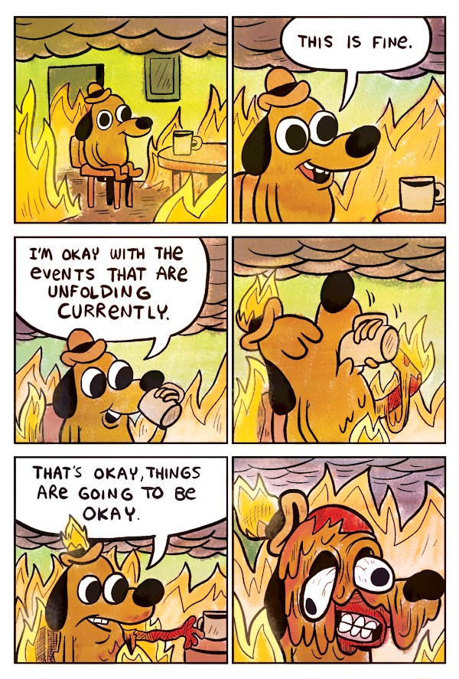
Site Organisers (SO)
Site organisers are the ones who not only choose the community they wish to host the site for but also decide the nature of the jam, making them proverbial gatekeepers.
This is one reason why the jam sites can range from closed communities of practice (Lave and Wenger, 1991) to sites open to anyone, permitting and encouraging novices to work alongside industry veterans, leapfrogging regional inequalities, and allowing for lateral peer-to-peer learning (Fowler et al., 2013).
  This is fine - meme
  KC Greene | Gunshow webcomic series
Notes:
Site organisers are the ones who not only choose the community they wish to host the site for but also decide the nature of the jam (its format, timing and openness), making them proverbial gatekeepers.
(click)
This is one reason why the jam sites can range from closed communities of practice to sites open to anyone, permitting and encouraging novices to work alongside industry veterans, leapfrogging regional inequalities, and allowing for lateral peer-to-peer learning.
https://www.theverge.com/2016/5/5/11592622/this-is-fine-meme-comic

Slide 20
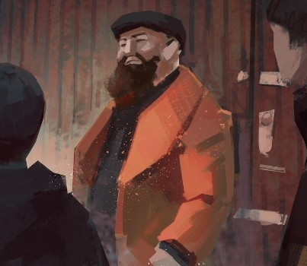
Region organizer
Consequently, the RO not only serves as a single point of contact and interviewer for Site Organisers but also as an enabler of knowledge transfer between institutions with vastly different resources, student demographics, and local industry ecosystems.
And it is the regional organiser's responsibility to ensure that each area hosting a jam has at least one publicly accessible jam site where anyone can participate.
  School Trip
  Anonymous Student | Digital Portrait
Notes:
Consequently, the RO not only serves as a single point of contact and interviewer for Site Organisers but also as an enabler of knowledge transfer between institutions with vastly different resources, student demographics, and local industry ecosystems.
(click)
And it is the regional organiser's responsibility to ensure that each area hosting a jam has at least one publicly accessible jam site where anyone can participate.
https://www.linkedin.com/in/fanotherpg/

Slide 21
Research Performed

Slide 22

Across the isles…
GGJ data is based on user-generated content, which is optional, and, as such, its quality is inconsistent, to put it mildly.
The data collected so far covers the 2014-2023 period, including 572 sites (each with 29 data categories) from 179 organisations (or combinations thereof). This is planned to be expanded to all years.
  Production Item #MP-1.005 | RSDB
  Resource Database | Unsplash
Notes:
GGJ data is based on user-generated content, which is optional, and, as such, its quality is inconsistent, to put it mildly.
(click)
The data collected so far covers the 2014-2023 period, including 572 sites (each with 29 data categories) from 179 organisations (or combinations thereof). This is planned to be expanded to all years.
https://unsplash.com/photos/a-black-and-white-image-of-a-tree-with-many-small-white-lights-TIUyoNGM0no

Slide 23

…down the rabbit hole…
So far, too few of the SO have responded to my questionnaire regarding this study; as such, it is not covered because it is neither representative nor statistically significant.
In the process of collecting data, I found instances of under- and overreporting, at times by as much as 50%; consequently, further research will follow to explore this in greater depth.
If you’re interested, speak to me or my colleague Hanjun Shi afterwards.
  Hanjun Shi
  LinkedIn | Profile picture
Notes:
So far, too few of the SO have responded to my questionnaire regarding this study; as such, it is not covered because it is neither representative nor statistically significant.
(click)
In the process of collecting data, I found instances of under- and overreporting, at times by as much as 50%; consequently, further research will follow to explore this in greater depth.
(click)
If you’re interested, speak to me or my colleague Hanjun Shi afterwards.
https://www.linkedin.com/in/hanjun-shi-5506b3219/

Slide 24
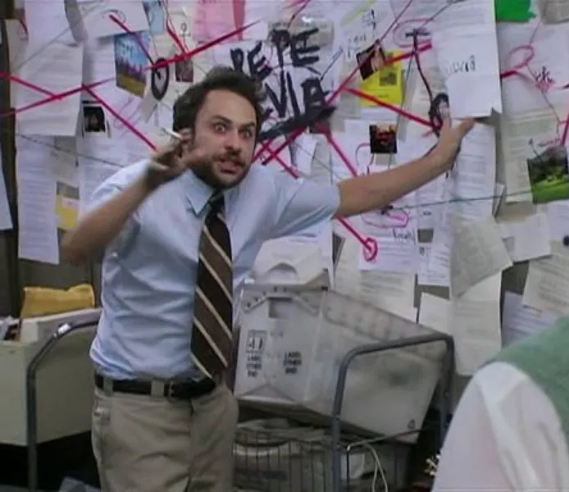
…it will all makes sense, I promise…
As Site Organisers are only responsible for their small community, they often assume that participants “know how it works by now” over time (Shillito, 2022).
As such, it was possible to perform data mode imputation, but only within a single site, based on its history and consistency (location, organiser); however, wherever possible, deeper archival research was conducted to obtain missing information from external sites instead.
  Season 4 episode "Sweet Dee Has a Heart Attack"
  Always Sunny in Philadelphia | October 30, 2008
Notes:
As Site Organisers are only responsible for their small community, they often assume that participants “know how it works by now” over time.
(click)
As such, it was possible to perform data mode imputation, but only within a single site, based on its history and consistency (location, organiser); however, wherever possible, deeper archival research was conducted to obtain missing information from external sites instead.

Slide 25

From jam to career
Global Game Jam allows jammers to share personal details beyond their nicknames.
Consequently, it is possible to track some participants’ trajectories through GGJ itself (jamming/site organising) and cross-reference them with LinkedIn to establish career trajectories.
A few high-profile industry figures for whom game jams were part of their formative years (Rosa Carbó-Mascarell, Adam Clewes-Boyle, and Nida Ahmad) have already been identified, but this is still a far cry from the data required for social mobility research.
  Rosa’s Mention of Global Game Jam
  Linked-in | Screenshot
Notes:
Global Game Jam allows jammers to share personal details beyond their nicknames.
(click)
Consequently, it is possible to track some participants’ trajectories through GGJ itself (jamming/site organising) and cross-reference them with LinkedIn to establish career trajectories.
(click)
A few high-profile industry figures for whom game jams were part of their formative years (Rosa Carbó-Mascarell, Adam Clewes-Boyle, and Nida Ahmad) have already been identified, but this is still a far cry from the data required for social mobility research.

Slide 26
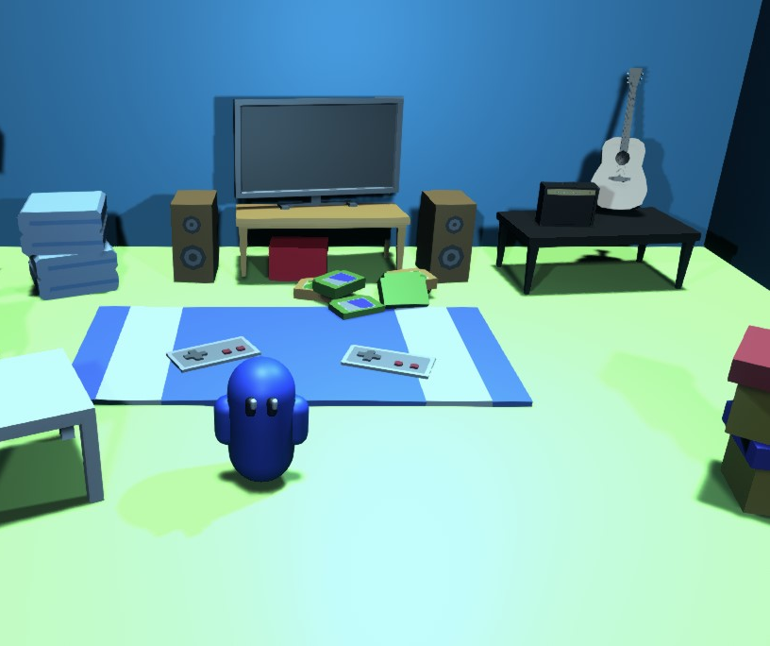
From jam to business
Due to the nature of the jam, it is not only possible to gain an in-depth perspective on all aspects of game development by polishing both soft and hard skills, but also to develop a viral prototype that could serve as a Minimum Viable Product/Vertical Slice/Tech Demo.
This work can lead to setting up an indie studio that offers more realistic opportunities for commercial viability, a route to self-employment, and a way to demonstrate your skill set (Savage et al., 2026).
  Found Guys GGJ, projected that went into Tranzfuser and was on NSE podium for Game Design
  Luca Cavozzi | Screenshot
Notes:
Due to the nature of the jam, it is not only possible to gain an in-depth perspective on all aspects of game development by polishing both soft and hard skills, but also to develop a viral prototype that could serve as a Minimum Viable Product/Vertical Slice/Tech Demo.
(click)
This work can lead to setting up an indie studio that offers more realistic opportunities for commercial viability, a route to self-employment, and a way to demonstrate your skill set (Savage et al., 2026).

Slide 27

SUPERHOT – 7DFPS 2013
Notes:
SuperHOT – with its unique time moves only when you do mechanics- was originally developed in a week as part of the 7 Day FPS Challenge.

Slide 28
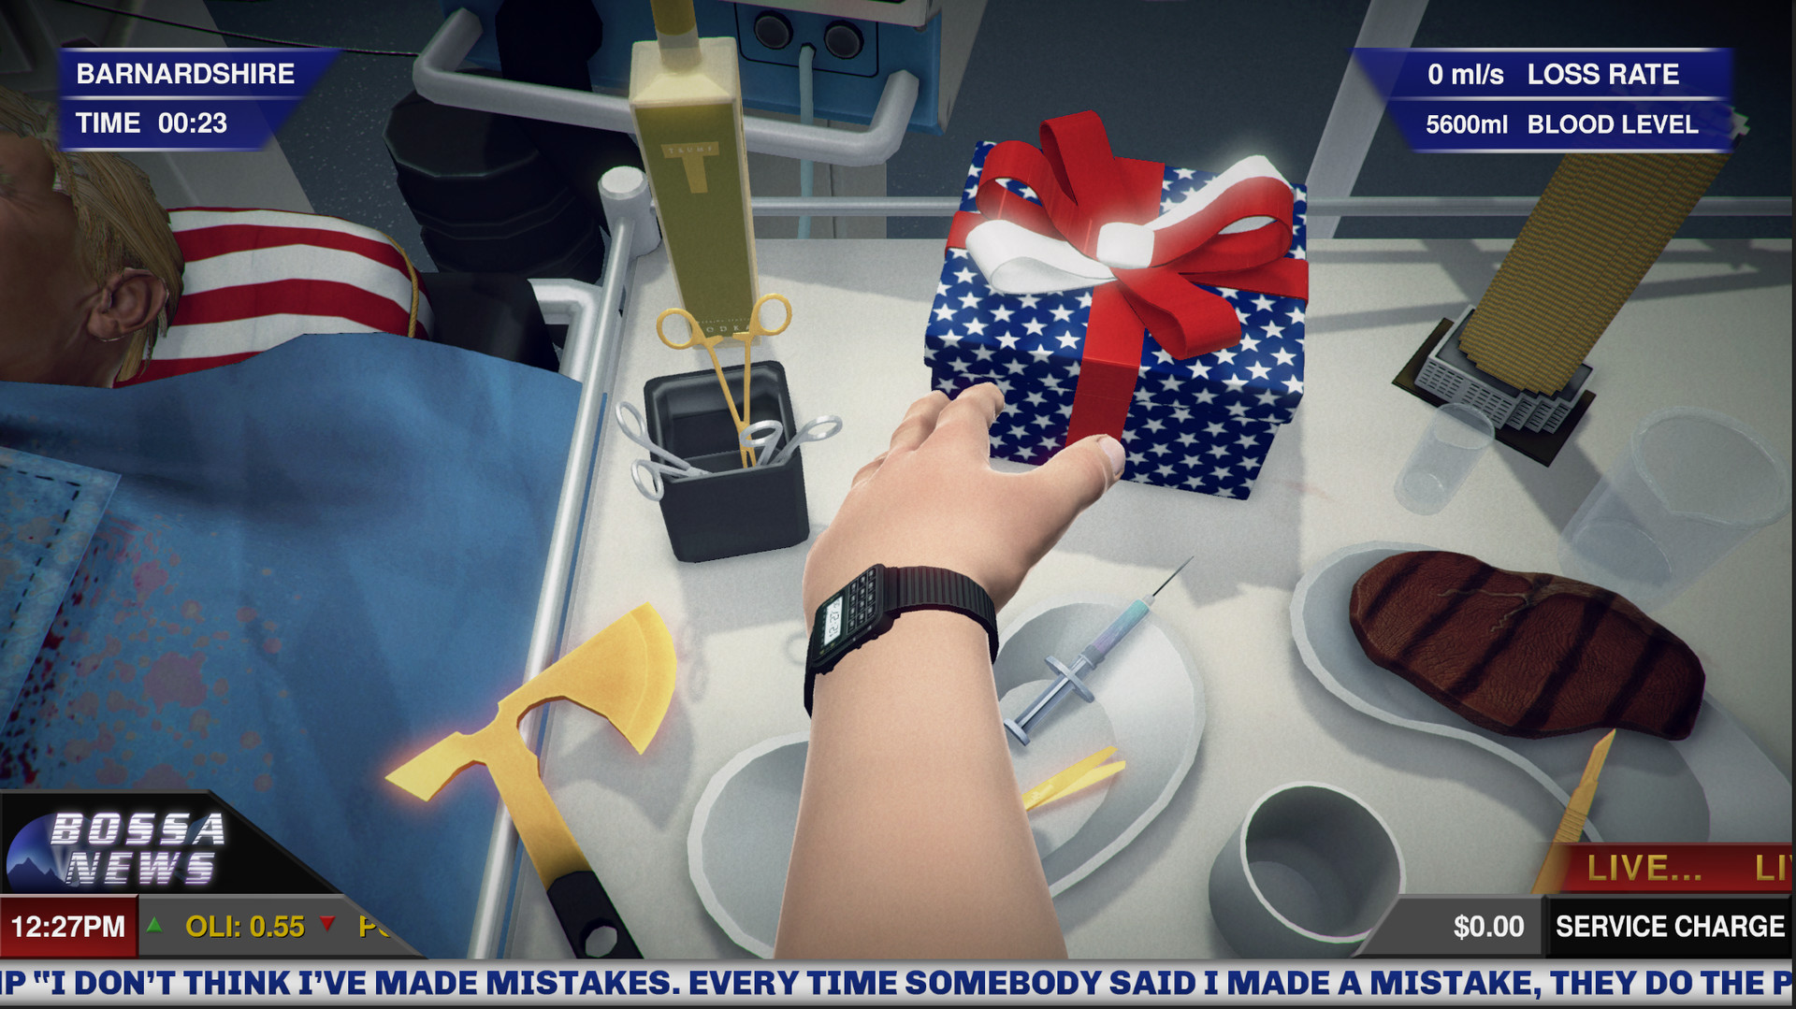
Surgeon Simulator – Global Game Jam 2013
Notes:
Surgeon Simulator was designed around experimentation with physic based human interface and turned so popular it was developed into full game.

Slide 29
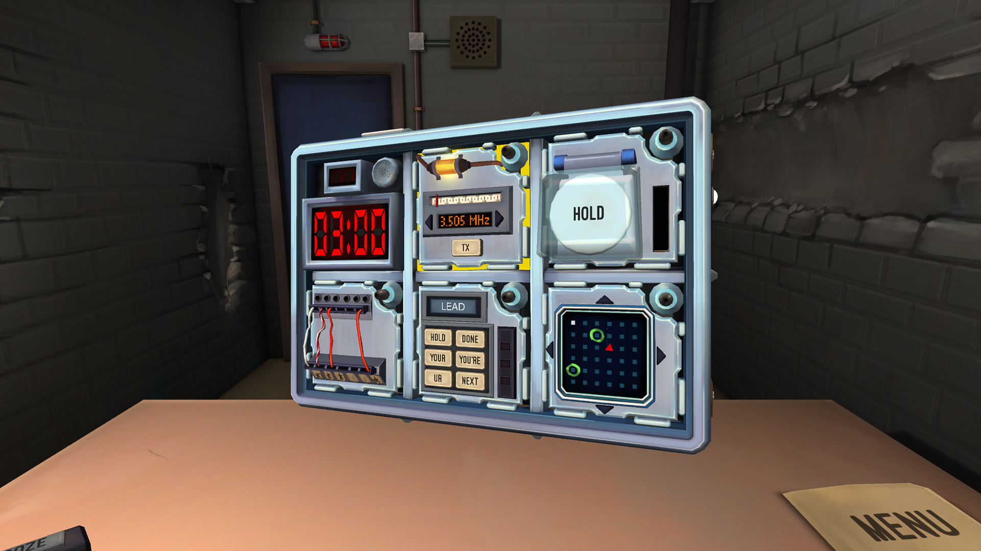
Keep Talking and Nobody Explodes – Global Game Jam 2014
Notes:
Originally collaborative game developed for VR (player defusing the bomb) and guides (reading physical manuals on how the bomb is constructued, and how to defuse it).

Slide 30
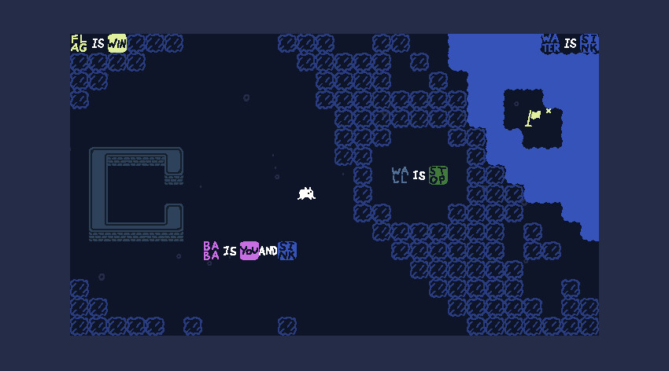
BABA IS YOU – NORDIC GAME JAM 2017
Notes:
Puzzle game that inspired a meta puzzle games, in which you are able to change game rules as you play.

Slide 31
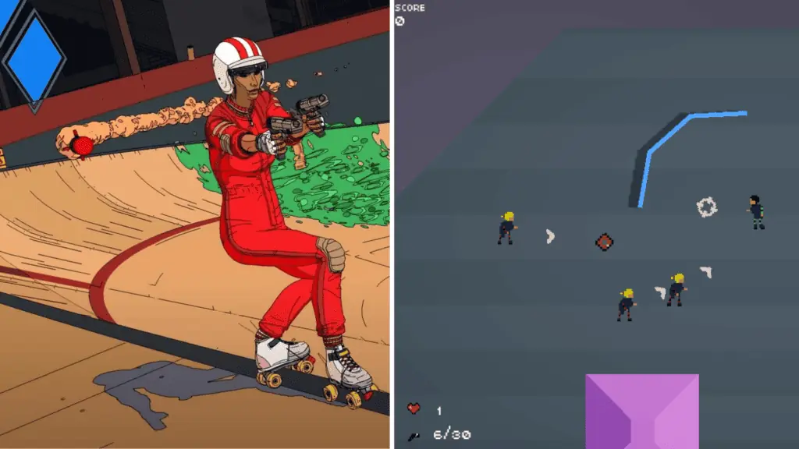
ROLLERDROME – GMTK GAME JAM 2017
Notes:
Rollerdrome started as a top-down 2D shooter (and lost big during GMTK Game Jam), despite that developer saw something and with time evolved the game into an award-winning 3D action-game that we all know and love.

Slide 32
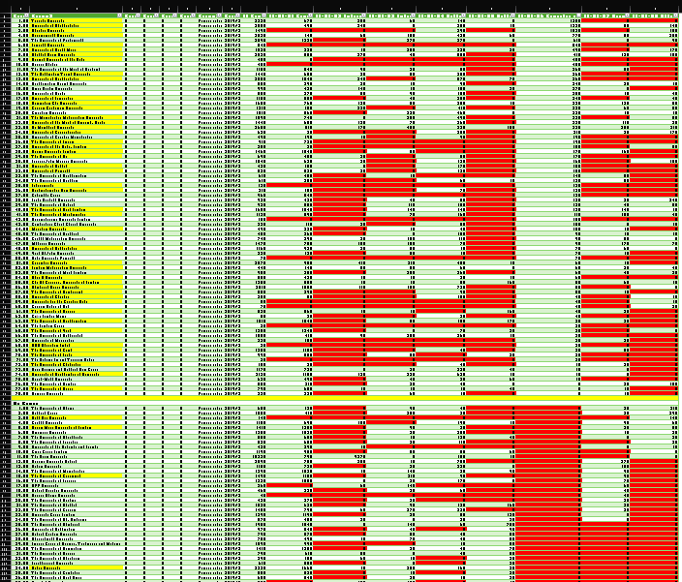
Potential for growth
Several UK institutions, such as Wrexham University and the University of Hertfordshire, have incorporated jams into their curricula and submission requirements. Others, even when participating, struggle to achieve 100% engagement from their target audience (Wearn, Fletcher and Vigurs, 2014).
What is more peculiar is that not all institutions that could participate in the event do (46/78 Game Unis, 7/64 Computing). This might be due to limited availability of teaching expertise and resources (after all, GGJ is volunteer-run); however, at this stage, it is a hypothesis, and institutions will be contacted in due course as part of further research.
  HESA DATA 2019/2020
  Thom Kaczmarek | Screenshot
Notes:
Several UK institutions, such as Wrexham University and the University of Hertfordshire, have incorporated jams into their curricula and submission requirements. Others, even when participating, struggle to achieve 100% engagement from their target audience.
(click)
What is more peculiar is that not all institutions that could participate in the event do (46/78 Game Unis, 7/64 Computing). This might be due to limited availability of teaching expertise and resources (after all, GGJ is volunteer-run); however, at this stage, it is a hypothesis, and institutions will be contacted in due course as part of further research.

Slide 33
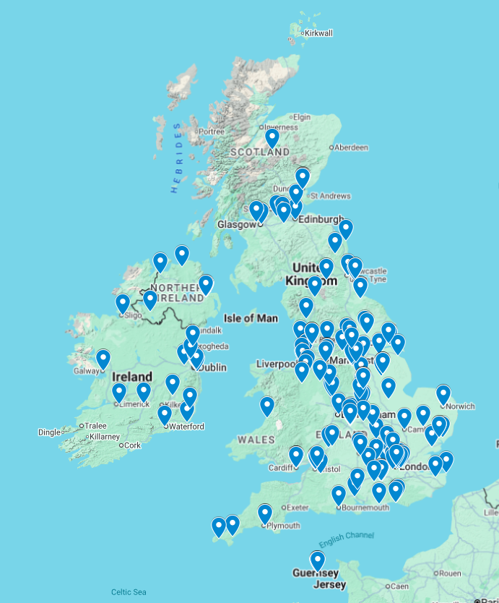
Where jams take place
Game Jams are held across the UK & Ireland region.
Sites demonstrate strong grassroots commitment from educational providers, local communities and maker hubs, as well as tech and game companies, including the most deprived areas such as Grimsby.
https://shorturl.at/fVFDW
Notes:
Game Jams are held across the UK & Ireland region.
(click) Map
(click)
Sites demonstrate strong grassroots commitment from educational providers, local communities and maker hubs, as well as tech and game companies, including the most deprived areas such as Grimsby.
(click) simplified

Slide 34
Hardware and people
Who can access sites and what hardware is available to participants is usually limited not only by the nature of the host organisation and its capacity constraints, but also by internal politics and policies, which add barriers to entry on top of those already in place and shape who can host, attend, and benefit from jams
Many academic institutions do not utilise the power of networking by not inviting their former alumni and local industry practitioners – they limit jam participation to their institution's students, and some even to specific courses.
Notes:
Who can access sites and what hardware is available to participants is usually limited not only by the nature of the host organisation and its capacity constraints, but also by internal politics and policies (safeguarding), which add barriers to entry on top of those already in place and shape who can host, attend, and benefit from jams
(click)
.
(click) simplified
Many academic institutions do not utilise the power of networking by not inviting their former alumni and local industry practitioners – they limit jam participation to their institution's students, and some even to specific courses.

Slide 35
Inclusive access
Historically, game jams are a 48h marathons, minimising friction is necessary; thus, most events were free for participants, with fees covering primarily food or site-specific expenses.
In terms of food, all 2021 incorrectly reported that “Drinks and Snacks will be provided”, it was replaced with “Nothing available/Jammers must sort it out” as it was COVID-Jam and we were at home.
COVID introduced Hybrid and Online/Virtual-only sites.
Since 2017, when GGJ updated their age policies to enforce the age-majority principle, the number of sites requiring participants to be 18+ has increased, but due to UK legal structures, we are more flexible.
Notes:
Historically, game jams are a 48h marathons, so minimising friction is necessary; thus, most events were free for participants, with fees covering primarily food or site-specific expenses.
(click)
In terms of food, all 2021 incorrectly reported that “Drinks and Snacks will be provided”, it was replaced with “Nothing available/Jammers must sort it out” as it was COVID-Jam and we were at home.
(click)
COVID introduced Hybrid and Online/Virtual-only sites.
(click)
Since 2017, when GGJ updated their age policies to enforce the age-majority principle, the number of sites requiring participants to be 18+ has increased, but due to UK legal structures, we are more flexible.

Slide 36
GGJ place and path forward

Slide 37
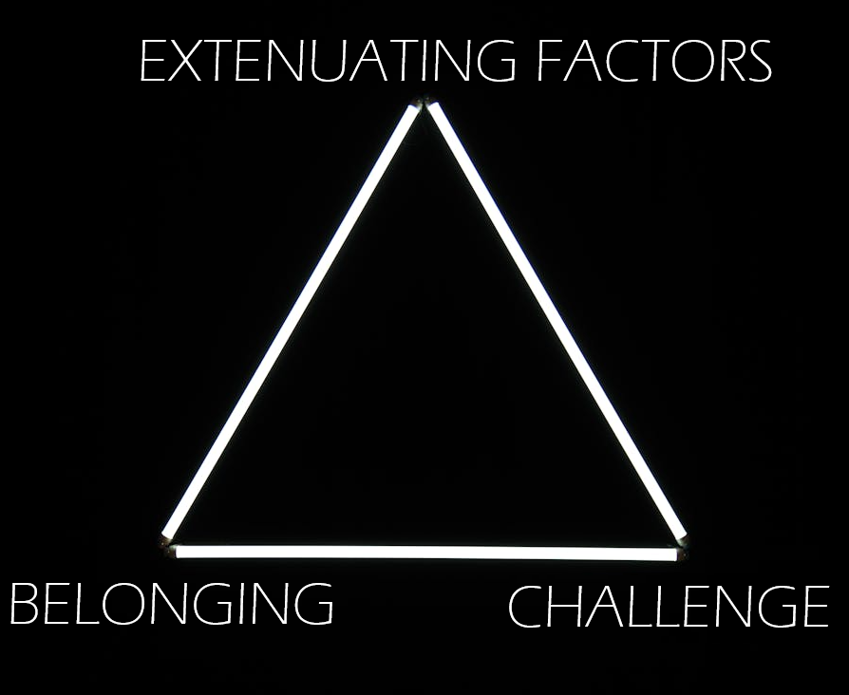
Jamming Experiential Triangle (JET)
Drawing on practice as a GGJ RO, I would like to argue that successful jam‑based learning environments emerge from the dynamic interaction of three cornerstones:
- Belonging (part of something bigger)
- Challenge (how will jammers grow)
- Extenuating Factors (what’s in it for them)
  A glowing triangle made of LED Lights
  Matheus Bertelli | Pexels
Notes:
Drawing on practice as a GGJ RO, I would like to argue that successful jam‑based learning environments emerge from the dynamic interaction of three cornerstones
(click) Belonging (part of something bigger)
(click) Challenge (how will jammers grow)
(click) Extenuating Factors (what’s in it for them)

Slide 38
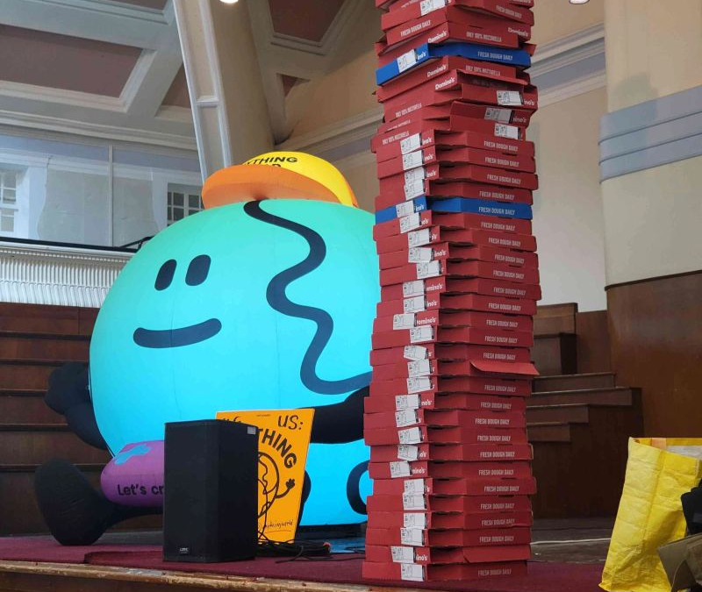
Collaborate more
GGJ evidenced successful ways in which HEIs and industry can collaborate locally (Grey, 2014), regionally (Ilett, 2021), and (inter)nationally (Hebblewhite, quoted in Wrexham.com, 2020), officially (Gow, 2022), and informally (Kaczmarek, 2026).
UniJam emerged as a response to institutional limits and delivered 85% BAME participation and 35% non-male representation, figures that challenge dominant narratives about who participates in game development (Ukie, 2022a, 2022b; Game Developers Conference, 2024)
  Anything World x UniJam 2024
  Thom Kaczmarek | Photo
Notes:
GGJ evidenced successful ways in which HEIs and industry can collaborate locally (Grey, 2014), regionally (Ilett, 2021), and (inter)nationally (Hebblewhite, quoted in Wrexham.com, 2020), officially (Gow, 2022), and informally (Kaczmarek, 2026).
(click)
UniJam emerged as a response to institutional limits and delivered 85% BAME participation and 35% non-male representation, figures that challenge dominant narratives about who participates in game development (Ukie, 2022a, 2022b; Game Industry Conference, 2024)

Slide 39

Conclusion
Unfortunately, “game jams still represent a non-traditional form of education. Larger experimental studies could convince more institutions and participants of game jams’ benefits” (Kolek, Mochocki and Gemrot, 2022), and as such, I welcome your feedback and input.
I started this research to better understand and support my community, and in the process, I realised that…
  S02E04
  Star Trek (1966) | TV series
Notes:
Unfortunately, “game jams still represent a non-traditional form of education. Larger experimental studies could convince more institutions and participants of game jams’ benefits” (Kolek, Mochocki and Gemrot, 2022), and as such, I welcome your feedback and input.
(click)
I started this research to better understand and support my community, and in the process, I realised that…
(click)

Slide 40
Thank you
Thom Kaczmarek – Senior Lecturer in Games Design at
London College of Communication, University of the Arts London
Global Game Jam Regional Organiser UK & Ireland t.kaczmarek@lcc.arts.ac.uk

Slide 41
(Extra) GGJ research problem

Slide 42
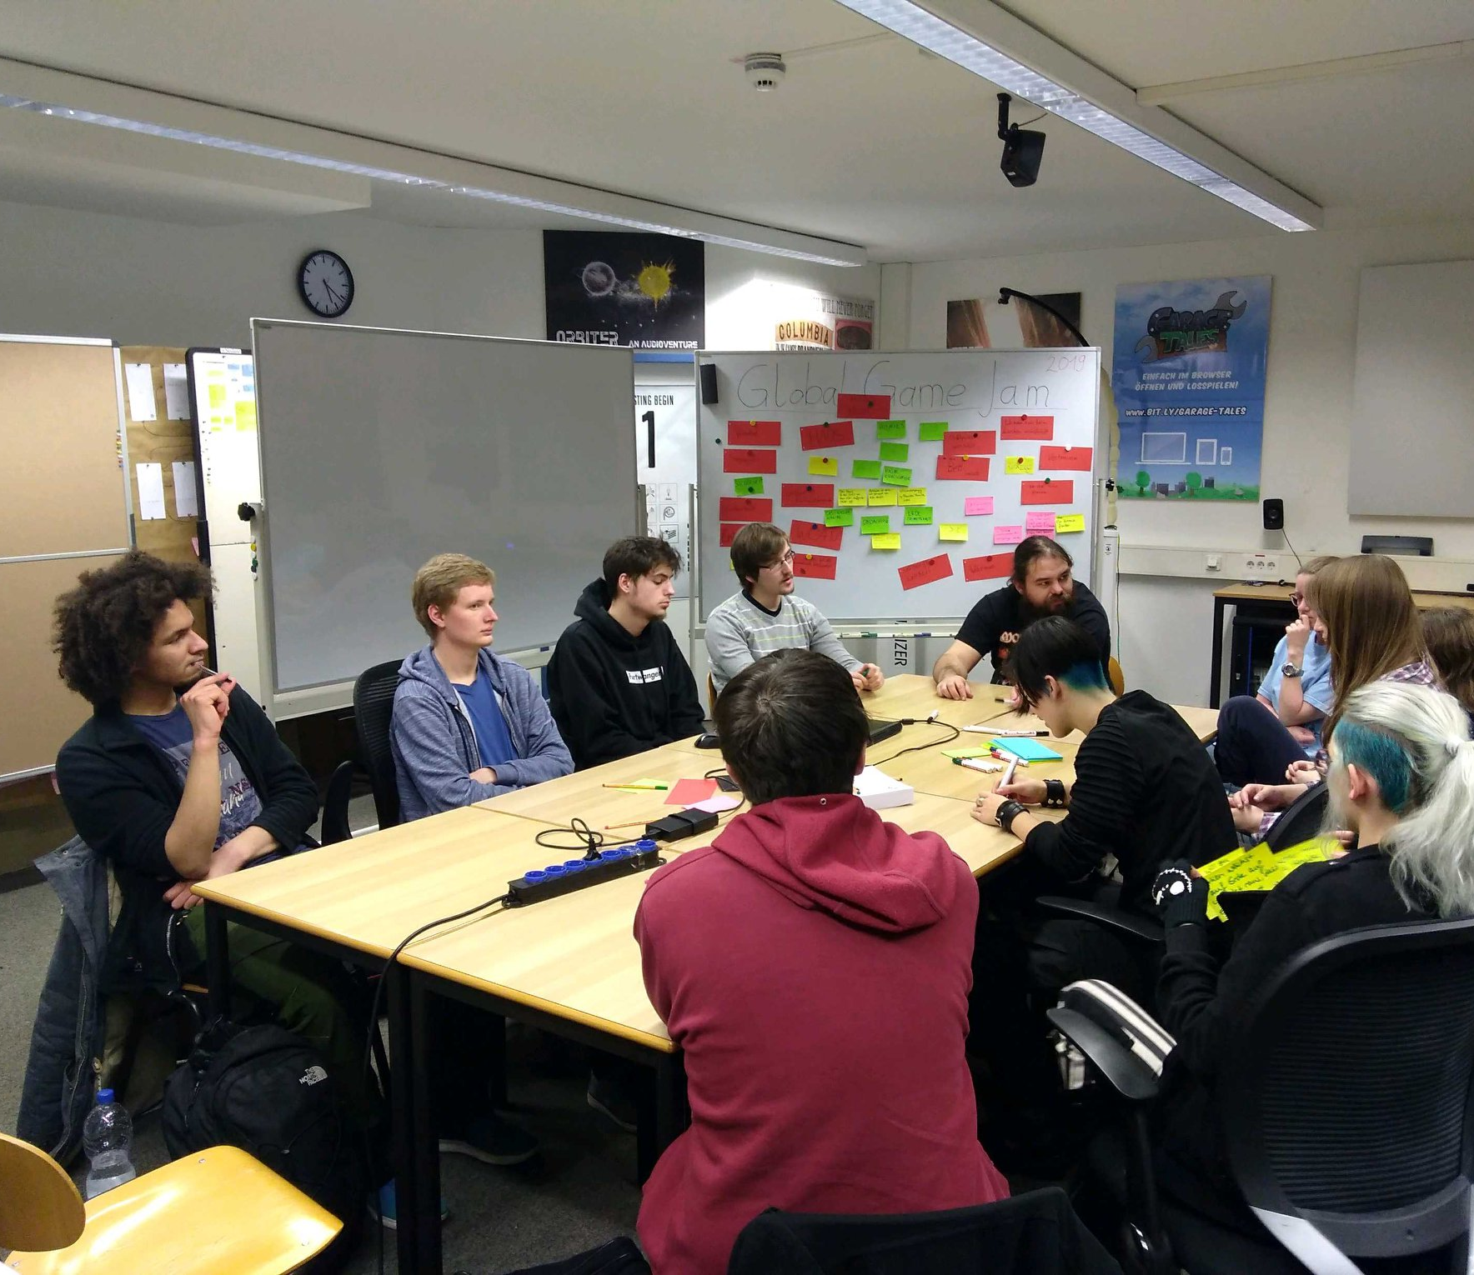
While having head in the clouds…
Due to the “jamming” nature of the events, the research that follows focuses on the process, rather than the product (Grace, 2016). And in turn, many foundational GGJ studies report longitudinal data, such as overall counts of participants, countries and jam sites (Ho, Tomitsch and Bednarz, 2014), at times expanding to the number of games produced (Fowler, Khosmood and Arya, 2013; Global Game Jam, 2024b; Almeida et al., 2026) as factual data points.
  Brainstorming session in Furtwangen, Germany
  Global Game Jam Press Kit | Photo
Notes:
Due to the “jamming” nature of the events, the research that follows focuses on the process, rather than the product. And in turn, many foundational GGJ studies report longitudinal data, such as overall counts of participants, countries and jam sites, at times expanding to the number of games produced as factual data points.
https://globalgamejam.org/global-game-jam-press-kit

Slide 43
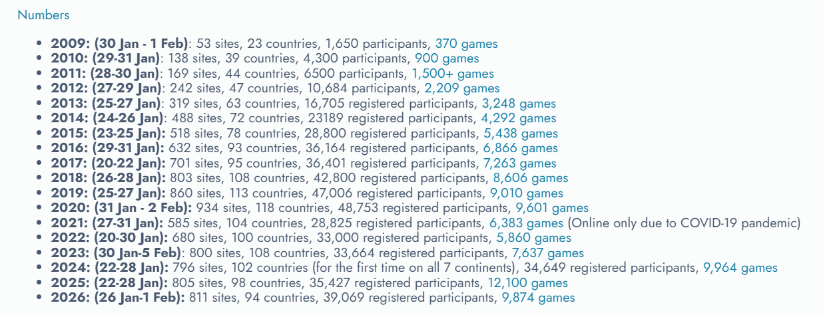
…things may seem fine…
And while the open, global repository offered by Global Game Jam serves as a semi-permanent, open-access archive that turns localised, fleeting game jams into a global pool of regional knowledge (Shin et al., 2012) from all continents, due to recent technical changes, only games from the last 3 years are reliably accessible and trackable (Fronko Games, 2026), thus were skipped temporarily to focus on the disappearing historical data.
  Numbers
  Global Game Jam History| Screenshot
Notes:
And while the open, global repository offered by Global Game Jam serves as a semi-permanent, open-access archive that turns localised, fleeting game jams into a global pool of regional knowledge from all continents, due to recent technical changes, only games from the last 3 years are reliably accessible and trackable thus were skipped temporarily to focus on the disappearing historical data.
https://globalgamejam.org/history

Slide 44

…but laws and logic are here to stay
As the event is, in principle, free of charge and voluntary, it would be normal to expect a drop-off rate of 30-70%, depending on the event's format (Roy, 2026). The insider experience of running and mentoring jams, along with these works’ initial findings, supports this.
In turn, this suggests that official GGJ Surveys (Global Game Jam, 2026d), despite being statistically valid, appear to suffer from self-selection bias (Ingram, 2026) by the most committed community members, which impacts the quality of uploaded data and online responses (Khazaal et al., 2014).
  A single upright pencil stands among scattered pencils on a white surface
  Tara Winstead| Pexels
Notes:
As the event is, in principle, free of charge and voluntary, it would be normal to expect a drop-off rate of 30-70%, depending on the event's format. The insider experience of running and mentoring jams, along with these works’ initial findings, supports this.
(click)
In turn, this suggests that official GGJ Surveys, despite being statistically valid, appear to suffer from self-selection bias by the most committed community members, which impacts the quality of uploaded data and online responses.
https://www.pexels.com/photo/yellow-wooden-pencils-on-white-surface-8386693/

Slide 45
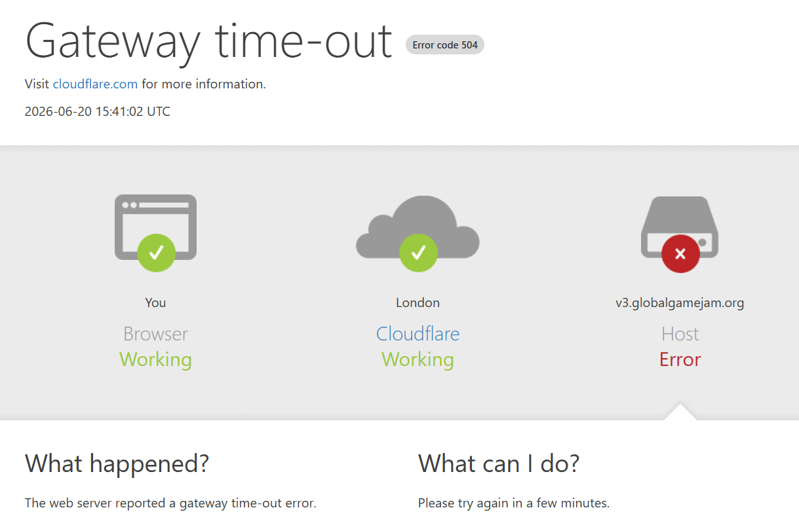
Quick History Class
Over the years, Global Game Jam has evolved both as an organisation and as a service. The current 4th website version began in 2024, and prior data, due to instability, are either hidden (V3, 2014-2023) or inaccessible (V1, 2009-2012; V2, 2013-2014).
Massive thanks to Zain Ul Hassan for his patience and for manually resetting servers during downtime, which enabled data collection.
  Unstable V3 servers
  Thom Kaczmarek | Screenshot
Notes:
Over the years, Global Game Jam has evolved both as an organisation and as a service. The current 4th website version began in 2024, and prior data, due to instability, are either hidden (V3, 2014-2023) or inaccessible (V1, 2009-2012; V2, 2013-2014).
(click)
Massive thanks to Zain Ul Hassan for his patience and for manually resetting servers during downtime, which enabled data collection.

Slide 46
(Extra) RO Profiles

Slide 47
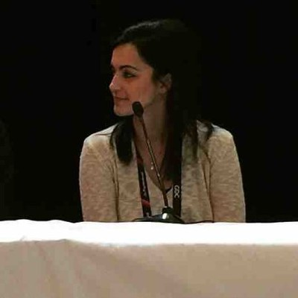
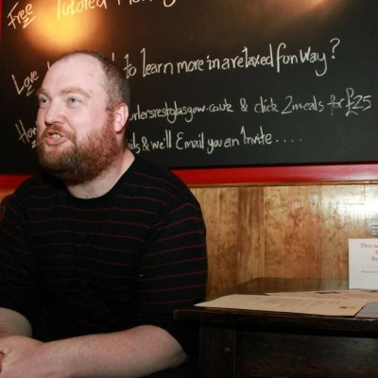

0-1
- (Wales & Scotland) 2009-2012 Dr Mike Reddy (USW) and Dr Romana Khan, now Ramzan (GCU), were important figures in GGJ's earliest years.
- (Scotland) 2014-2016 Brian McDonald from GCU (now Falmouth University) was the first RO for the UK & Ireland (after becoming SO in 2013), before joining the global GGJ Executive Committee for the 2017 cycle.
  Dr Romana Ramzan (Top Left) Dr Mike Reddy (bottom left) Dr Brian McDonald (Right)
  LinkedIn| Photos
Notes:
(Wales & Scotland) 2009-2012 Dr Mike Reddy (USW) and Dr Romana Khan, now Ramzan (GCU), were important figures in GGJ's earliest years.
(Scotland) 2014-2016 Brian McDonald from GCU (now Falmouth University) was the first RO for the UK & Ireland (after becoming SO in 2013), before joining the global GGJ Executive Committee for the 2017 cycle.
https://www.linkedin.com/in/brian-mcdonald-a06110286/
https://www.linkedin.com/in/manak/
https://www.linkedin.com/in/doctormike/

Slide 48



2-4
- (Ireland) 2016-2019 Eoin Carroll, SO at Griffith College Dublin in Ireland since 2011, who, alongside his RO responsibility, became European Coordinator.
- (Wales) 2019-2022 Richard Hebblewhite from Wrexham (Glyndwr) University in Wales, was SO since 2012, progressed to Global Regional Organiser in 2022 and was hired as GGJ Director in 2025
- (England) 2020-2021 Jo Summers, a prominent Site Organiser from Brighton since 2016, became co-Regional Organiser to support Richard
  Eoin Carroll (Left) Richard Hebblewhite (Top Right) Jo Summers (Bottom Right)
  LinkedIn | Photos
Notes:
(Ireland) 2016-2019 Eoin Carroll, SO at Griffith College Dublin in Ireland since 2011, who, alongside his RO responsibility, became European Coordinator.
(Wales) 2019-2022 Richard Hebblewhite from Wrexham (Glyndwr) University in Wales, was SO since 2012, progressed to Global Regional Organiser in 2022 and was hired as GGJ Director in 2025
(England) 2020-2021 Jo Summers, a prominent Site Organiser from Brighton since 2016, became co-Regional Organiser to support Richard
https://www.linkedin.com/in/josum/
https://www.linkedin.com/in/rich-hebblewhite/
https://www.linkedin.com/in/eoinwcarroll/

Slide 49
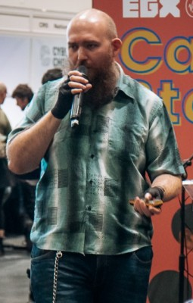

5-6
- (England) 2021- current Thom Kaczmarek, London College of Communication, started as a jammer in 2012, SO in 2020, and as a co-Regional Organiser replacing Jo in 2021, became the lead after Richard's departure in mid-2022
- (Wales) 2022 – 2025 Jack Harker from Wrexham (Glyndwr) University in Wales, worked under Richard at Wrexham Glyndwr and was co-RO with Thom
  Thom Kaczmarek (Left) Jack Harker (Right)
  LinkedIn | Photos
Notes:
(England) 2021- current Thom Kaczmarek, London College of Communication, started as a jammer in 2012, SO in 2020, and as a co-Regional Organiser replacing Jo in 2021, became the lead after Richard's departure in mid-2022
(Wales) 2022 – 2024 Jack Harker from Wrexham (Glyndwr) University in Wales, worked under Richard at Wrexham Glyndwr and was co-RO with Thom
https://www.linkedin.com/in/fanotherpg/
https://www.linkedin.com/in/jack-harker-8888a784/

Slide 50
References

Slide 51
References
1. Almeida, L.A. et al. (2026) 'A taxonomy of participants' difficulties in game jams: a qualitative analysis of experiences', Proceedings of the ACM on Human-Computer Interaction, 10(2), CSCW003, pp. 1–36. doi: 10.1145/3788039.
2. Aurava, R. and Sormunen, K. (2023) 'Future-oriented skills and knowledge in game jams, a systematic literature review', Computers and Education Open, 4, article number 100129. doi: 10.1016/j.caeo.2023.100129
3. Berger, R. (2023) Video games: An industry overwhelming unprepared markets. Available at: https://www.rolandberger.com/en/Insights/Publications/Video-games-An-industry-overwhelming-unprepared-markets.html (Accessed: 26 June 2026)
4. Brewer, J. and Romine, M. (2024) 'Breaking barriers in mobile game development', Proceedings of the ACM on Human-Computer Interaction, 8(CHI PLAY), Article 296. Available at: https://dl.acm.org/doi/10.1145/3677061 (Accessed: 26 June 2026).
5. Centre of Excellence in Game Culture Studies (2020) Impact story: Creating opportunities for inclusive game creation. Available at: https://coe-gamecult.org/2020/12/15/impact-story-creating-opportunities-for-inclusive-game-creation/ (Accessed: 28 June 2026).

Slide 52
References
6. Deleuze, G. and Guattari, F. (1987) A thousand plateaus: capitalism and schizophrenia. Translated by B. Massumi. Minneapolis: University of Minnesota Press.
7. Falk, J. (2021) How Game Jams and Hackathons Accelerate Design Processes. PhD thesis. Aarhus University. Available at: https://arxiv.org/pdf/2205.04966 (Accessed: 27 June 2026)
8. Fowler, A. et al. (2013) 'The Global Game Jam for teaching and learning', in Proceedings of the 4th International Conference on the Foundations of Digital Games (FDG 2013). [Online]. Available at: https://www.researchgate.net/publication/258546541_The_Global_Game_Jam_for_Teaching_and_Learning (Accessed: 26 June 2026).
9. Fowler, A., Khosmood, F. and Arya, A. (2013) 'The evolution and significance of the Global Game Jam', in Proceedings of the First International Workshop on the Global Game Jam (GGJ 2013). Available at: http://www.fdg2013.org/program/workshops/papers/GGJ2013/ggj13_submission_1.pdf (Accessed: 26 June 2026)
10. Fowler, A. and Khosmood, F. (eds) (2023) Game Jams – History, Technology, and Organisation. Cham: Springer.

Slide 53
References
11. Fredericksen, R. (2024) 'Game industry job forecasting: how many people do we have, and how…', Medium, 30 October. Available at: https://medium.com/@refredericksen/game-industry-job-forecasting-7d112acebddf (Accessed: 26 June 2026)
12. Fronkon Games (2026) Global Game Jam Dataset. Available at: https://www.kaggle.com/datasets/fronkongames/global-game-jam-dataset (Accessed: 27 June 2026).
13. GamesIndustry.biz (2009) Global Game Jam 2009: teams across the world compete to create a game in 48 hours. Available at: https://www.gamesindustry.biz/global-game-jam-2009-teams-across-the-world-compete-to-create-a-game-in-48-hours (Accessed: 26 June 2026)
14. Game Developers Conference (2024) GDC 2024 State of the Game Industry Report. Available at: https://reg.gdconf.com/state-of-game-industry-2024 (Accessed: 28 June 2026).
15. Gee, J.P. (2004) Situated language and learning: a critique of traditional schooling. London: Routledge.

Slide 54
References
16. Global Game Jam (2024a) Jam sites for 2024. Available at: https://globalgamejam.org/map/2024?field_address_country_code=All&field_address_locality=&order=id&sort=desc (Accessed: 26 June 2026).
17. Global Game Jam (2024b) Global Game Jam 2024: jammer survey data. Available at: https://globalgamejam.org/news/global-game-jam-2024-jammer-survey-results (Accessed: 26 June 2026).
18. Global Game Jam (2025) Jam sites for 2025. Available at: https://globalgamejam.org/map/2025?field_address_country_code=All&field_address_locality=&order=id&sort=desc (Accessed: 26 June 2026).
19. Global Game Jam (2026a) Jam sites for 2026. Available at: https://globalgamejam.org/map/2026?field_address_country_code=All&field_address_locality=&order=id&sort=desc (Accessed: 26 June 2026).
20. Global Game Jam (2026b) About. Available at: https://globalgamejam.org/about (Accessed: 25 June 2026).

Slide 55
References
21. Global Game Jam (2026c) Global Game Jam 2026 keynote and theme reveal. Available at: https://www.youtube.com/watch?v=ERV-CM6OnRQ (Accessed: 25 June 2026).
22. Global Game Jam (2026d) Global Game Jam 2026: Jammer Survey Data. Available at: https://globalgamejam.org/news/global-game-jam-2026-jammer-survey-data (Accessed: 28 June 2026).
23. GlobalGameJam [@globalgamejam] (2024) 'Did you know that this year #GGJ24 was held in Antarctica - for the first time in the history!'. [X] 19 March. Available at: https://x.com/globalgamejam/status/1770084444843458606 (Accessed: 26 June 2026).
24. Gow, J. (2022) IGGI, Queen Mary University of London [1.4]. Available at: https://v3.globalgamejam.org/2022/jam-sites/iggi-queen-mary-university-london (Accessed: 28 June 2026
25. Grey, S. (2014) Global Game Jam Hull. Available at: https://web.archive.org/web/20140117020450/http://www.globalgamejamhull.com/ (Accessed: 28 June 2026).

Slide 56
References
26. Ho, X., Tomitsch, M. and Bednarz, T. (2014) 'Game design inspiration in Global Game Jam', in Proceedings of DiGRAA 2014: What is game studies in Australia?. Digital Games Research Association DiGRA, pp. 1–4. Available at: https://digraa.org/wp-content/uploads/2014/06/53_ho.pdf (Accessed: 26 June 2026).
27. Ilett, D. (2021) Midlands Games Industry GGJ21. Available at: https://v3.globalgamejam.org/2021/jam-sites/midlands-games-industry (Accessed: 28 June 2026).
28. Ingram, O. (2026) 'Self selection bias: definition, causes & how to avoid it', ResearchProspect. Available at: https://www.researchprospect.com/what-is-self-selection-bias/ (Accessed: 28 June 2026)
29. Into Games (2024) Social Mobility in the UK Games sector 2024. Available at: https://intogames.org/news/report-social-mobility-in-the-uk-games-sector-2024 (Accessed: 26 June 2026).
30. Jones, B. (2023) Employability expectations in the video games industry. York: Screen Industries Growth Network, University of York. Available at: https://screen-network.org.uk/wp-content/uploads/2023/12/58955_Gaming-Industry-Employability_Digital_HR.pdf (Accessed: 26 June 2026).

Slide 57
References
31. Kaczmarek, T. (2026) GDL @ Goldsmiths + UniJam GGJ26. Available at: https://globalgamejam.org/jam-sites/2026/gdl-goldsmiths-unijam-ggj26 (Accessed: 28 June 2026).
32. Khazaal, Y. et al. (2014) 'Does self-selection affect samples' representativeness in online surveys? An investigation in online video game research', Journal of Medical Internet Research, 16(7), p. e164. Available at: https://pmc.ncbi.nlm.nih.gov/articles/PMC4115258/ (Accessed: 28 June 2026).
33. Kolek, L., Mochocki, M. and Gemrot, J. (2022) 'Review of Educational Benefits of Game Jams: Participant and Industry Perspective', Homo Ludens, 1(15), pp. 119–144. doi: 10.14746/HL.2022.15.7.
34. Kultima, A. (2015) 'Defining game jam', in Proceedings of the 10th International Conference on the Foundations of Digital Games (FDG 2015). Pacific Grove, CA, USA, 22–25 June.
35. Kumari, S. (2022) 'Outplay Entertainment GGJ 2022', Global Game Jam. Available at: https://v3.globalgamejam.org/2022/jam-sites/outplay-entertainment-ltd (Accessed: 28 June 2026).

Slide 58
References
36. Laaninen, H., Hanson, H. and Sauter, C. (2025) Jam sessions as knowledge transfer and creation tool: playbook game jams. BSG Go! Scaling-up Baltic Sea Game Support. Available at: https://interreg-baltic.eu/wp-content/uploads/2025/02/Playbook-Game-Jams-for-Competence-Building-1.pdf (Accessed: 26 June 2026).
37. Lai, G. et al. (2021) 'Two decades of game jams', in ICGJ 2021: Proceedings of the Sixth Annual International Conference on Game Jams, Hackathons, and Game Creation Events. Montreal, Canada, 2 August. New York: ACM, pp. 1–11.
38. Lave, J. and Wenger, E. (1991) Situated learning: legitimate peripheral participation. Cambridge: Cambridge University Press.
39. Melo, L. de A. et al. (2023) 'All for one and one for all: Investigating how Global Game Jam participants get and offer help', in 2023 ACM/IEEE International Symposium on Empirical Software Engineering and Measurement (ESEM). New Orleans, LA, USA, 26–27 October. New York: IEEE, pp. 1–12.
40. Ozimek, A. and Rueda, C. (2022) Organising inclusive informal events in the games industry. Available at: https://www.researchgate.net/publication/358299016_Organising_Inclusive_Informal_Events_in_the_Games_Industry (Accessed: 26 June 2026)

Slide 59
References
41. Pedercini, P. (2023) Prototyping. Available at: https://mycours.es/fastcurious/prototyping/ (Accessed: 27 June 2026).
42. Roy, S. (2026) In-person event attendance rate: latest benchmarks (2025–2026). Available at: https://www.nunify.com/blogs/event-attendance-rate (Accessed: 28 June 2026).
43. Sampugnaro, R., Mica, S., Fallica, S., Bonaiuto, A. and Mingrino, M. (2014) 'Participation at the Global Game Jam: a bridge between consumer and producer worlds in digital entertainment', GAME, (3), pp. 35–45. Available at: https://www.gamejournal.it/wp-content/uploads/2014/04/GAME_3_Subcultures_Sampugnaro_et-al.pdf (Accessed: 28 June 2026)
44. Savage, L., Harvey, P., Martin, G., Ross, K. and Filip, C. (2026) 'Industry panel discussion', Gamebridge event, Cambridge, 27 June.
45. Shillito, P. (2022) Very Scary Scenario - Cheshire branch GGJ22. Available at: https://v3.globalgamejam.org/2022/jam-sites/very-scary-scenario-cheshire-branch-ggj22 (Accessed: 27 June 2026).

Slide 60
References
46. Shin, K. et al. (2012) 'Localizing Global Game Jam: designing game development for collaborative learning in the social context', in Nijholt, A. et al. (eds.) Advances in computer entertainment. Berlin: Springer, pp. 117–132. doi: 10.1007/978-3-642-34292-9_9.
47. Star, S.L. and Ruhleder, K. (1996) 'Steps toward an ecology of infrastructure: design and access for large information spaces', Information Systems Research, 7(1), pp. 111–134.
48. Sun, X., Chen, Y. and Zhang, L. (2025) 'Overcoming interdisciplinary communication barriers in the video game industry: an ethnographic and interview study', in Rau, P.-L.P. (ed.) Cross-Cultural Design. Cham: Springer, pp. 238–253. Available at: https://link.springer.com/chapter/10.1007/978-3-031-93739-2_15 (Accessed: 27 June 2026).
49. Thompson, D. and Hebblethwaite, L. (2020) Think global, create local: the regional economic impact of the UK games industry. London: Ukie. Available at: https://cms.ukie.org.uk/wp-content/uploads/2025/04/Resources_Ukie_Think_Global_Create_Local_Jan2020-2.pdf (Accessed: 26 June 2026).
50. TIGA (2026) Skills, training and education in the games industry 2026. Available at: https://tiga.org/news/tiga-report-highlights-ongoing-skills-challenges-in-uk-games-industry-as-studios-invest-in-training-and-adaptation (Accessed: 27 June 2026).

Slide 61
References
51. Ukie (2022a) UK Games Industry Census 2022. Available at: https://ukie.org.uk/news/uk-games-industry-census-2022 (Accessed: 28 June 2026).
52. Ukie (2022b) UK Interactive Entertainment Association (Ukie) – written evidence (CRF0025). Written evidence submitted to the House of Lords Communications and Digital Committee, Inquiry into 'A creative future'. Available at: https://committees.parliament.uk/writtenevidence/111077/pdf/ (Accessed: 28 June 2026)
53. Ukie (2025) Games industry calls for Digital Creativity GCSE. Available at: https://ukie.org.uk/news/uk-video-games-industry-calls-for-digital-creativity-gcse/ (Accessed: 27 June 2026).
54. Ukie and Nesta (2016) The UK games industry, Scale: non-numeric [online map]. Available at: https://map.gamesmap.uk
55. unthank (2021) GGJ 21 - Glasgow Caledonian University. Available at: https://v3.globalgamejam.org/2021/jam-sites/ggj-21-glasgow-caledonian-university (Accessed: 26 June 2026)

Slide 62
References
56. Wearn, N., Fletcher, B. and Vigurs, K. (2014) 'Contextualising nonattendance of eligible students to Global Game Jam locations', in Proceedings of the Foundation of Digital Games (FDG) Global Game Jam Workshop. Stafford: Staffordshire University Repository. Available at: https://eprints.staffs.ac.uk/1886/1/cfp_fdg_ggjworkshop_v2.pdf (Accessed: 28 June 2026).
57. Wrexham.com (2020) Wrexham lecturer to lead UK and Ireland sites in Global Game Jam 2020. Available at: https://wrexham.com/news/wrexham-lecturer-to-lead-uk-and-ireland-sites-in-global-game-jam-2020-180138.html (Accessed: 28 June 2026).

