Slide 1



RGS-IBG Annual International Conference, London, UK, 1-4 Sep 2026
Part of the Panel: Wither Human(ity)?
Muted Voices In Health Literacy:
How Discursive Power Produces Epistemic Injustice In Urban Healthcare
Sing Hang Tam
Lecturer in Emerging Digital Technologies
University of the Arts London
s.tam@arts.ac.uk
Yuet Yam Wong (Anita)
Librarian
Whittington Health Library
yuet.wong1@nhs.net

Slide 2
  “Personal health literacy” is the degree to which individuals have the ability to understand ,find and use information and services to inform health-related decisions and actions for themselves and others.
  “Organisational health literacy” is the degree to which organisations equitably enable individuals to find, understand, and use information and services to inform health-related decisions and actions for themselves and others.
(CDC, 2024)
What is Health Literacy
Notes:
Today’s presentation is about health literacy and power in health communication; I’ll cover the first half on health literacy, and then Sing will take you through a case study and some discourse analysis.
Health literacy can be understood at both an individual and an organisational level.
At the individual level, health literacy refers to a person’s ability to find, understand and use health information and services to make informed health-related decisions.
At the organisational level, it refers to how well healthcare organisations and service providers make it easy for people to find, understand and use health information and services.
This organisational dimension is what we are going to focus on today.
Health literacy is also socially patterned. People experiencing socioeconomic disadvantage, edlery and minority may face greater barriers to accessing and understanding health information and reduce their ability to use healthcare services and make decisions about their care.

Slide 3
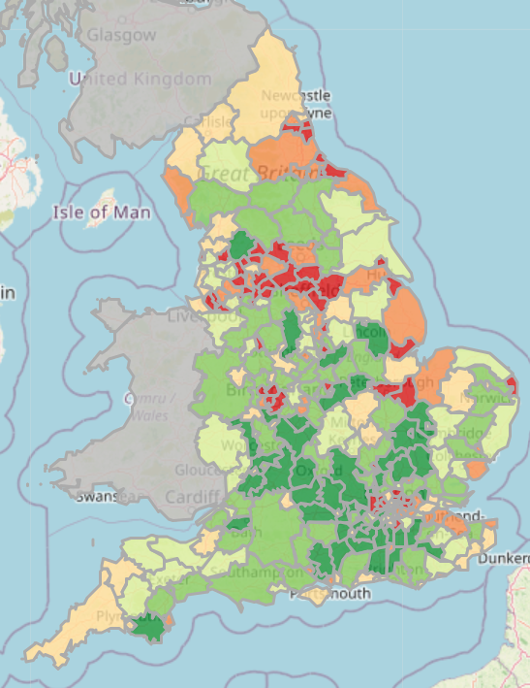
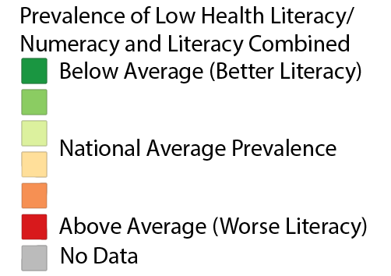
Health Literacy across the UK
Health literacy difference correlates with class difference.
(GeoData Institute, University of Southampton, n.d.)
Notes:
Let’s look at the geographical variation in low health literacy across the UK .
On the map, areas shown in red indicate a higher estimated prevalence of low health literacy, while green indicates a lower estimated prevalence.
Looking across the UK, we can see clear regional differences, with some areas—particularly in parts of northern England—showing a higher estimated prevalence.

Slide 4
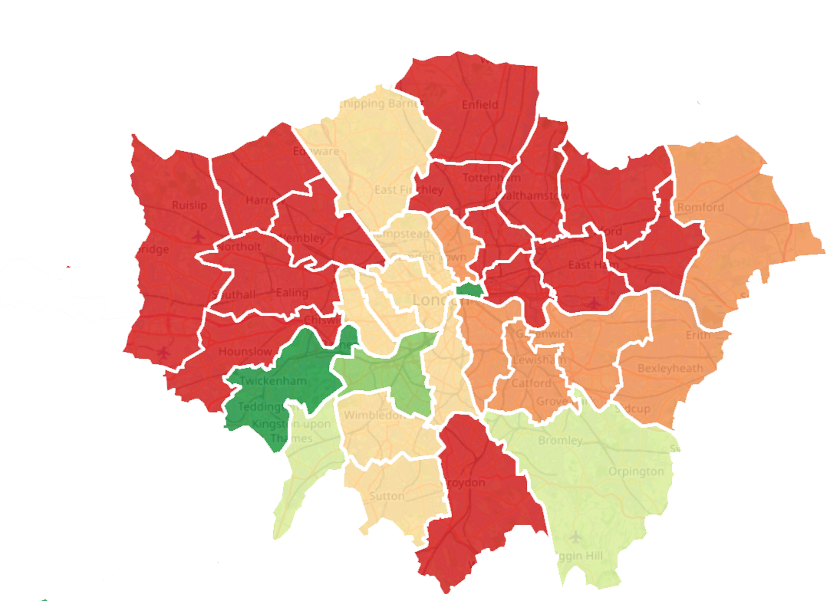
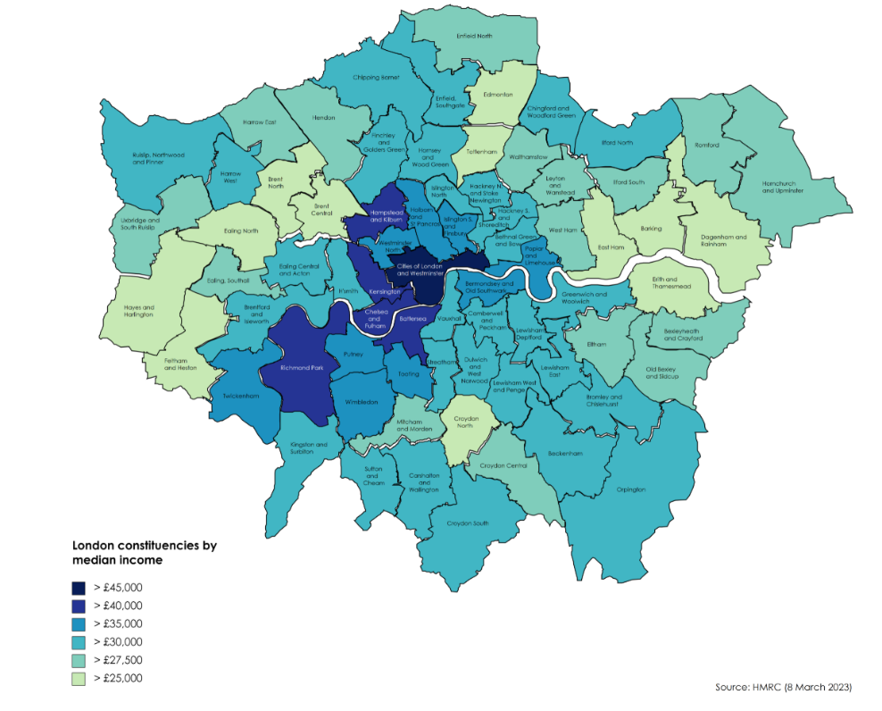
Health Literacy vs Median Income
(GeoData Institute, University of Southampton, n.d.)
(HM Revenue & Customs, 2026)
Notes:
When we zoom in on London, we see some boroughs appear to be affected much more than others. It tends to cluster in particular places, and if we now compare this with income levels across London, we can see that some of the lower-income areas, shown in lighter colours, overlap with areas that had a higher estimated prevalence of low health literacy on the left hand side map.
This suggests that there may be a relationship between socioeconomic disadvantage and health literacy.
However, this does not mean that people on lower incomes are less capable of understanding health information. Rather, people living in more disadvantaged areas may face additional barriers, such as reduced access to education, digital resources, healthcare services or clear and accessible health information.

Slide 5
Health Knowledge is Power
Unequal distribution of Health Knowledge
Power imbalance
Official health communication can reinforce or reduce this imbalance
Epistemic injustice - testimonial injustice
(Fricker, M. (2007)
Serious health Consequences
Notes:
Up to this point, we still place the patient mainly in the position of a recipient of knowledge but I want to take the discussion one step further.
It is not only about can patients understand the information they are given? But also can they produce, define, contribute and interpret their own knowledge and experience
Medical knowledge and terminology are possessed by specialised professional and patients have to depend on professionals to interpret diagnoses, risks and treatment options. This difference in expertise is not automatically a problem. We need medical expertise. But it can become a power imbalance when professional knowledge has much greater authority in defining the problem, presenting treatment options and deciding what counts as offical knowledge.
Patients also possess knowledge—their symptoms, experiences, preferences and understanding of their own bodies. However, when this experiential knowledge is given less credibility, the imbalance can move towards what Fricker describes as epistemic injustice, particularly testimonial injustice.
And in healthcare, this can affect participation in treatment decisions, informed consent, bodily autonomy and ultimately health outcomes.
This is where health communication becomes important.
Official patient information can either reinforce or reduce this hierarchy—depends on whether it posits the institution as the one that knows and instructs, and the patient as someone who receives and follows—or recognises patient experience, encourages questions and supports shared decision-making.
So in the next slides, let’s see does patient information give people the knowledge to participate in decisions, or mainly the recipient of knowledge.

Slide 6
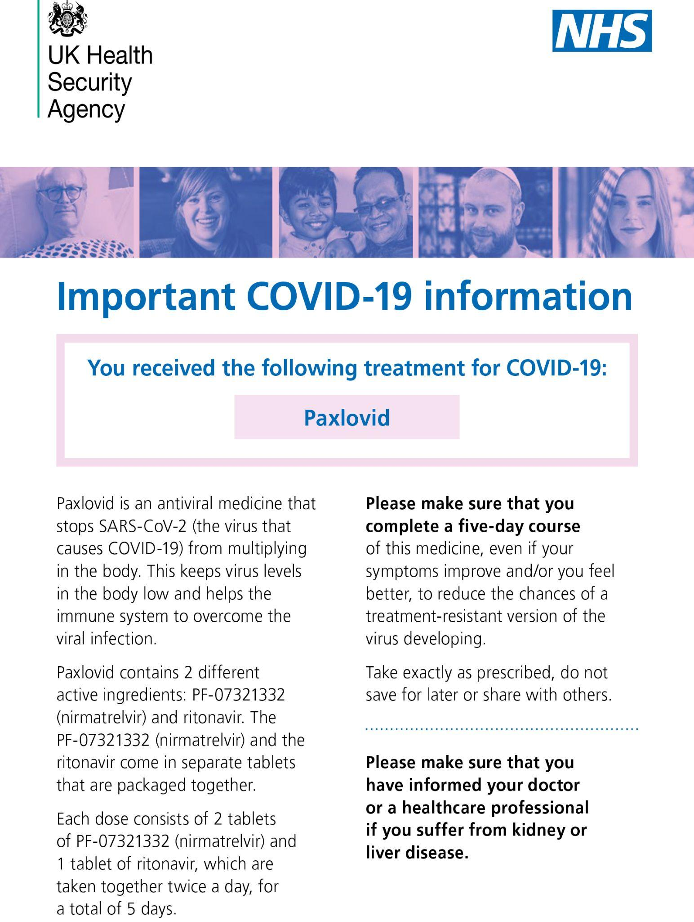
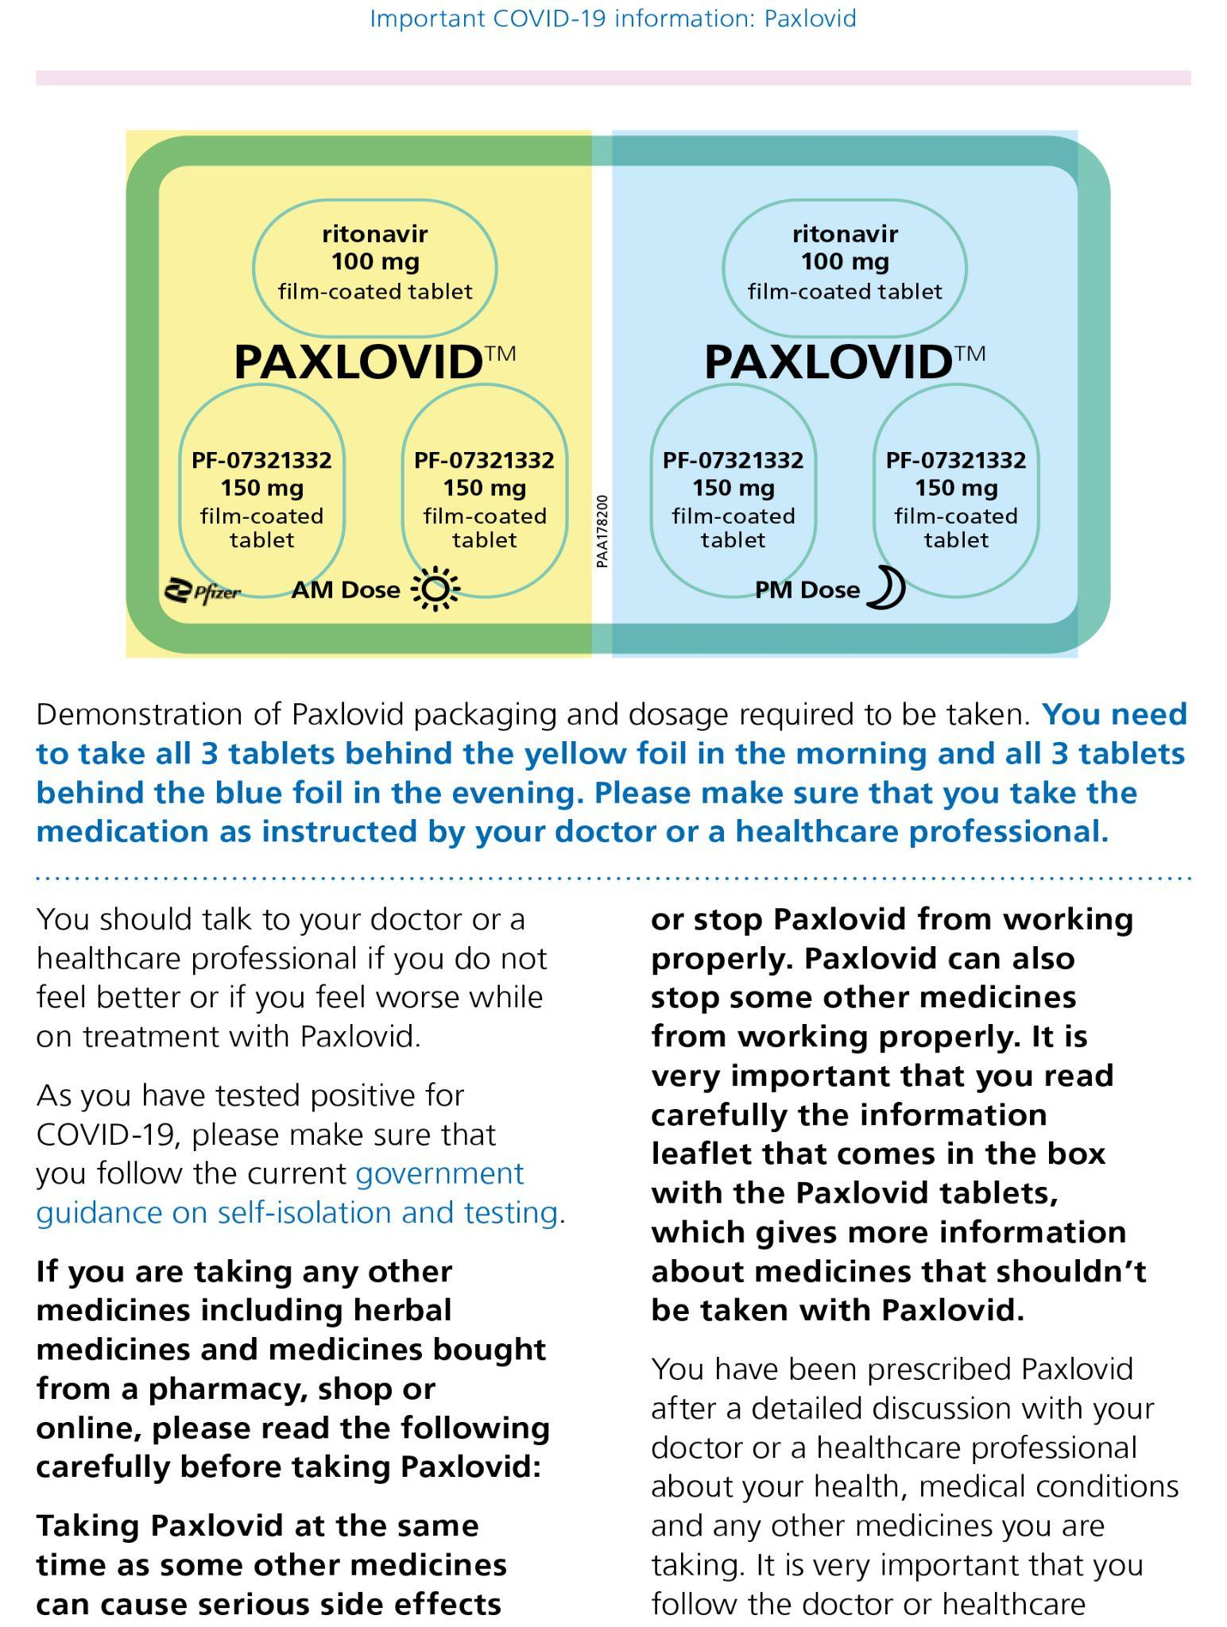
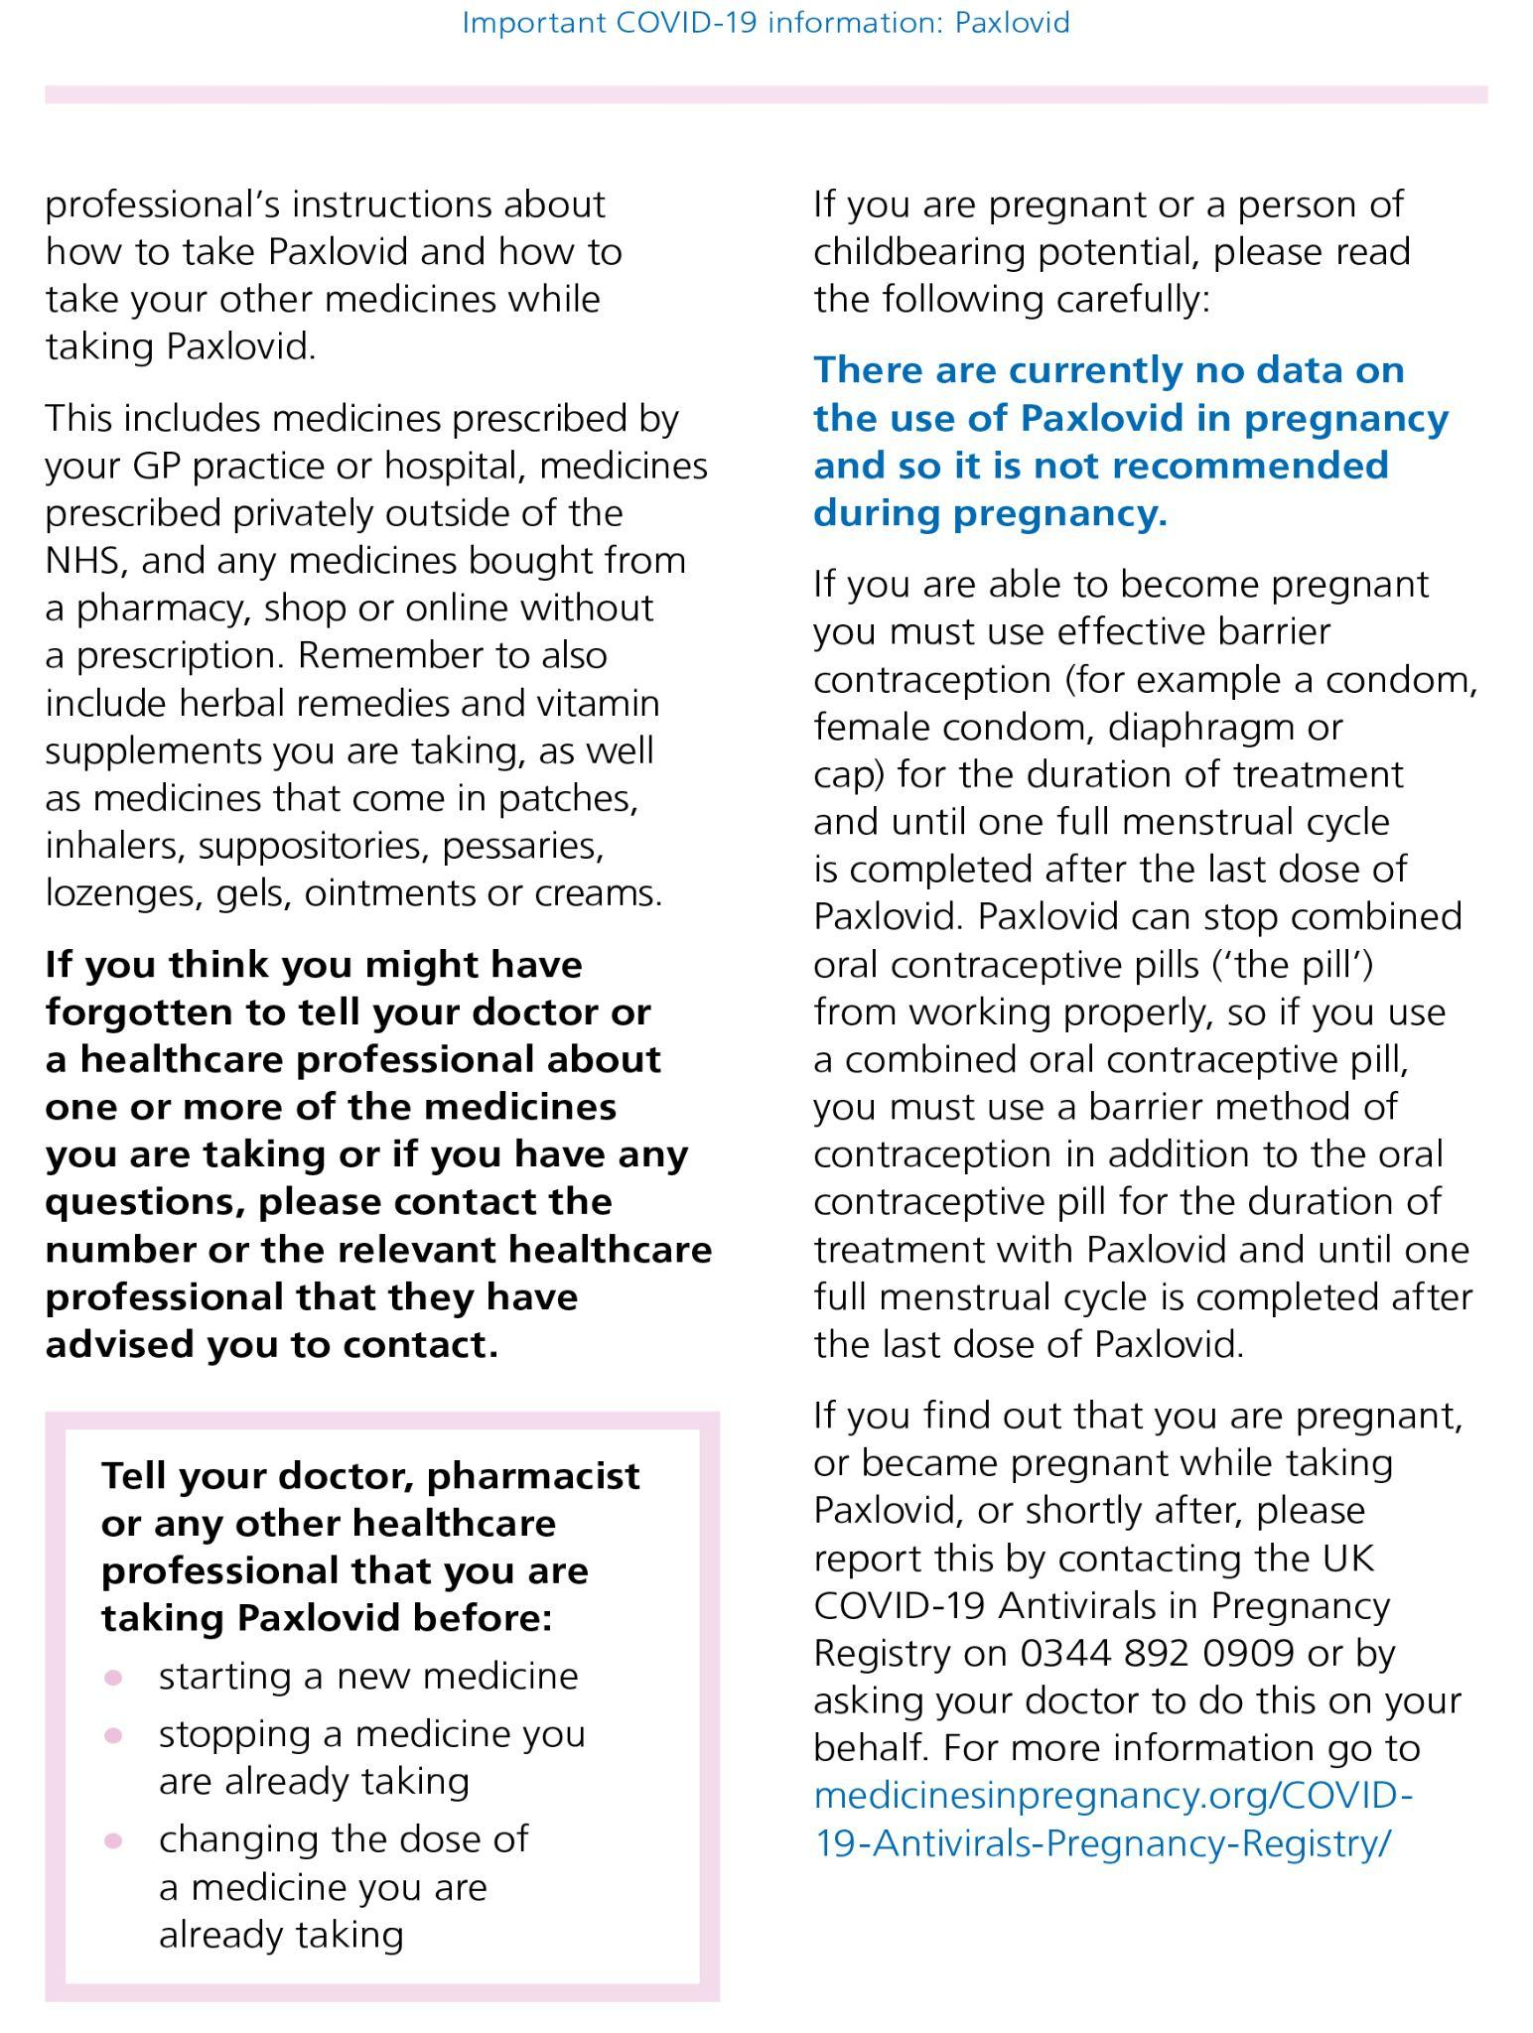
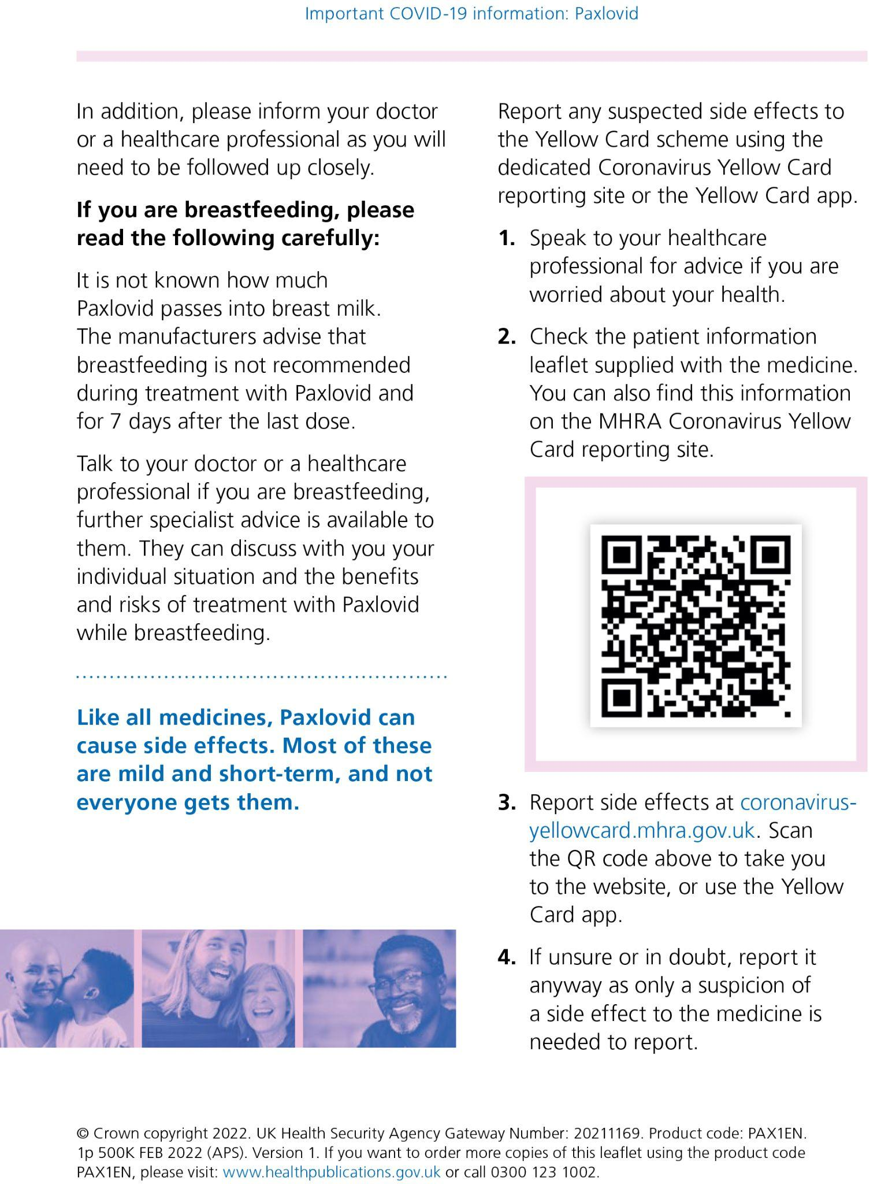
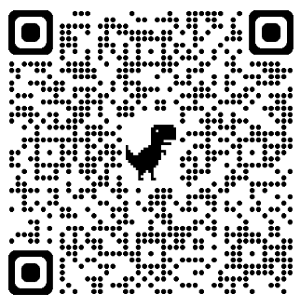
Case Study: Public Facing Important COVID-19 Information
(UK Health Security Agency, 2022)
Notes:
This is a patient information leaflet about a medicine used to treat COVID-19. We have used this leaflet as an example in health literacy training for medical students, particularly to explore how its layout, amount of information and wording could be improved to make the content easier for patients to understand.
Usually, the focus is on whether the leaflet is clear, readable and accessible. But today, I want to look at something slightly different: the power imbalance hidden within the leaflet.

Slide 7

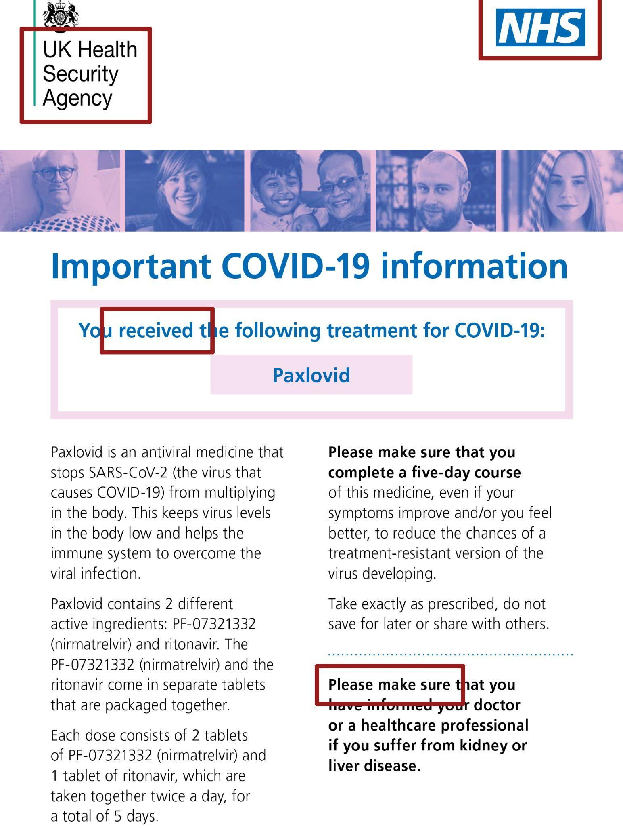
Analysis: How Power is Embedded in the Text
The logos
Visual authority
UK Health Security Agency and NHS logos prominently at the top
Implying a sense of reliable and unquestionable
Strong command and obligation.
“Received”
One-directional relationship
Removes the healthcare professional who made the decision
“You and your healthcare professional have agreed that Paxlovid is an appropriate treatment for you.”
“Please make sure”
No room for negotiation and questions.
Patients are assumed a passive position and barely gets involved in the discussion.
Notes:
The verb “received” positions the patient as the recipient of a treatment selected and delivered by others. The patient is grammatically present as “you,” but their role is passive in relation to the medical decision: they receive the treatment rather than choose, request or agree to it.
The sentence also removes the healthcare professional who made the decision. It does not state who prescribed Paxlovid, how the decision was reached, whether alternatives were discussed or whether the patient gave informed consent. This makes the treatment appear as an already completed and settled decision rather than the outcome of a collaborative process.
The phrase therefore constructs a one-directional relationship:
medical institution decides → treatment is delivered → patient receives
The wording could have been more collaborative, for example:
“You and your healthcare professional have agreed that Paxlovid is an appropriate treatment for you.”

Slide 8
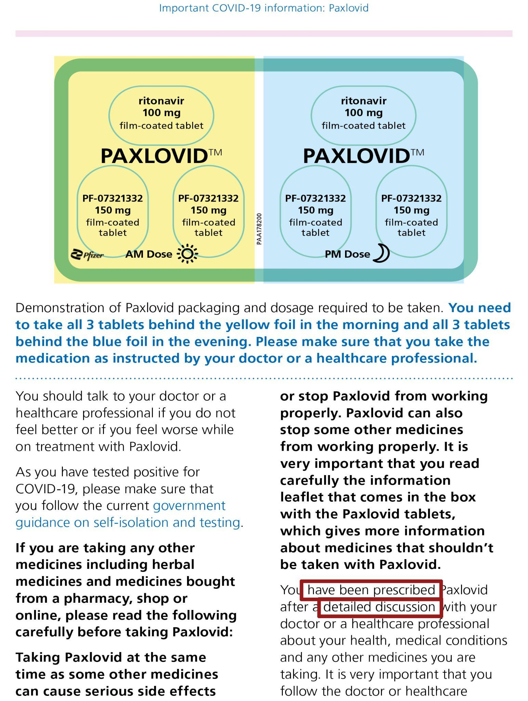
Analysis: How Power is Embedded in the Text
“You have been prescribed…”
Passive voice
Patients as subject
Downplay the accountability of healthcare providers
“After the detailed discussion with your doctors”
Assumption of the a detailed discussion
Unequal and/or rushed decision-making.
Some patients may not have such discussion
“Have the doctors discussed with you?”
Notes:
The patients as the subject, when, in reality, they are being treated. Patients are put to be the subject of treatment to downplay the accountability of the doctors/ service providers.

Slide 9
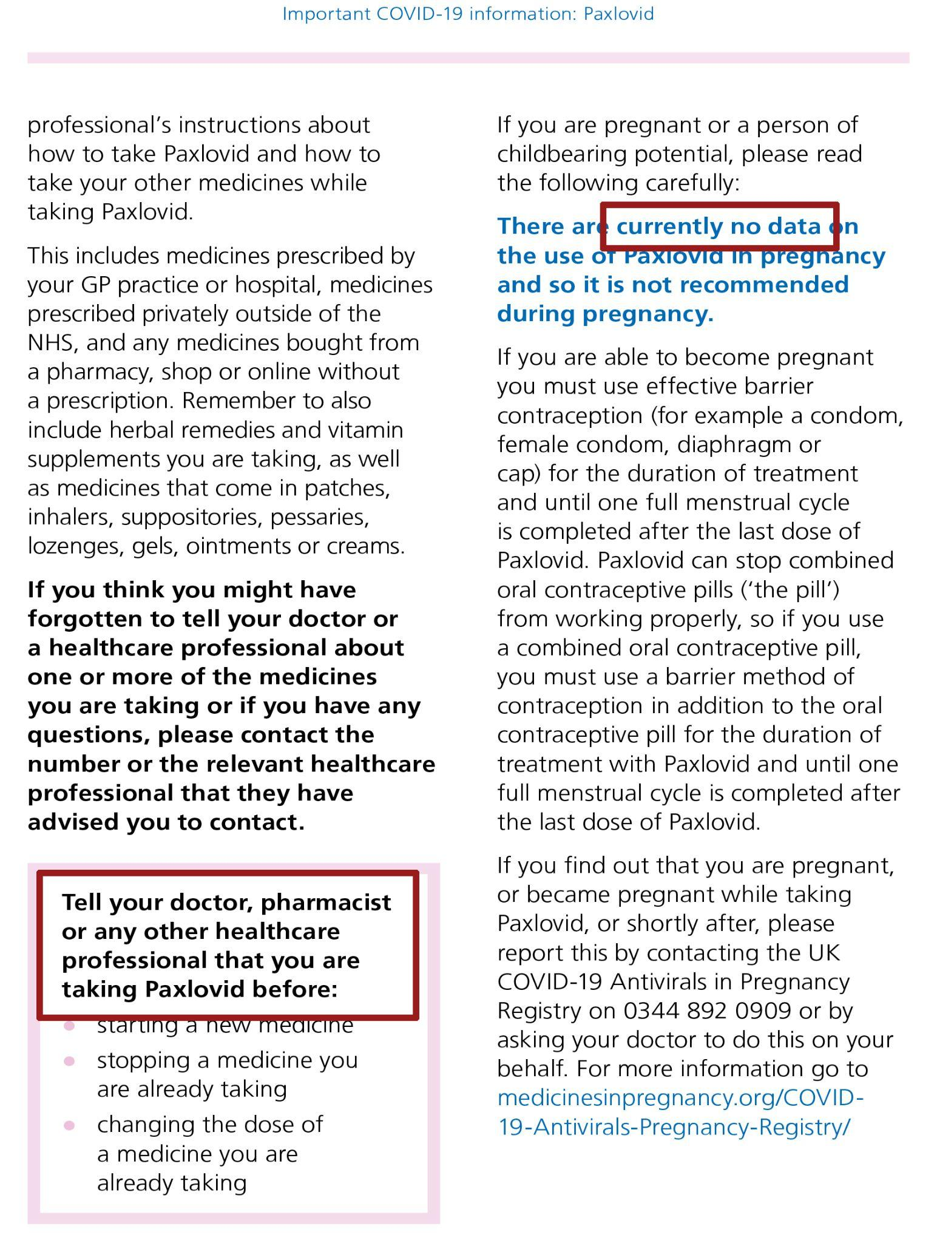
Analysis: How Power is Embedded in the Text
“currently no data…so it is not recommended”
Converts uncertainty into a firm institutional instruction
Epistemic power imbalance - the institution controls both the definition of the uncertainty and the response to it
Not enough information to evaluate the uncertainty independently, consider alternative treatments or understand how individual benefits and risks might be weighed
“Tell your doctor, pharmacist or any other healthcare professional that you are taking Paxlovid before…”
Directly instructs the patient to act
Transfers significant responsibility to the patient
“you may wish to inform”

Slide 10
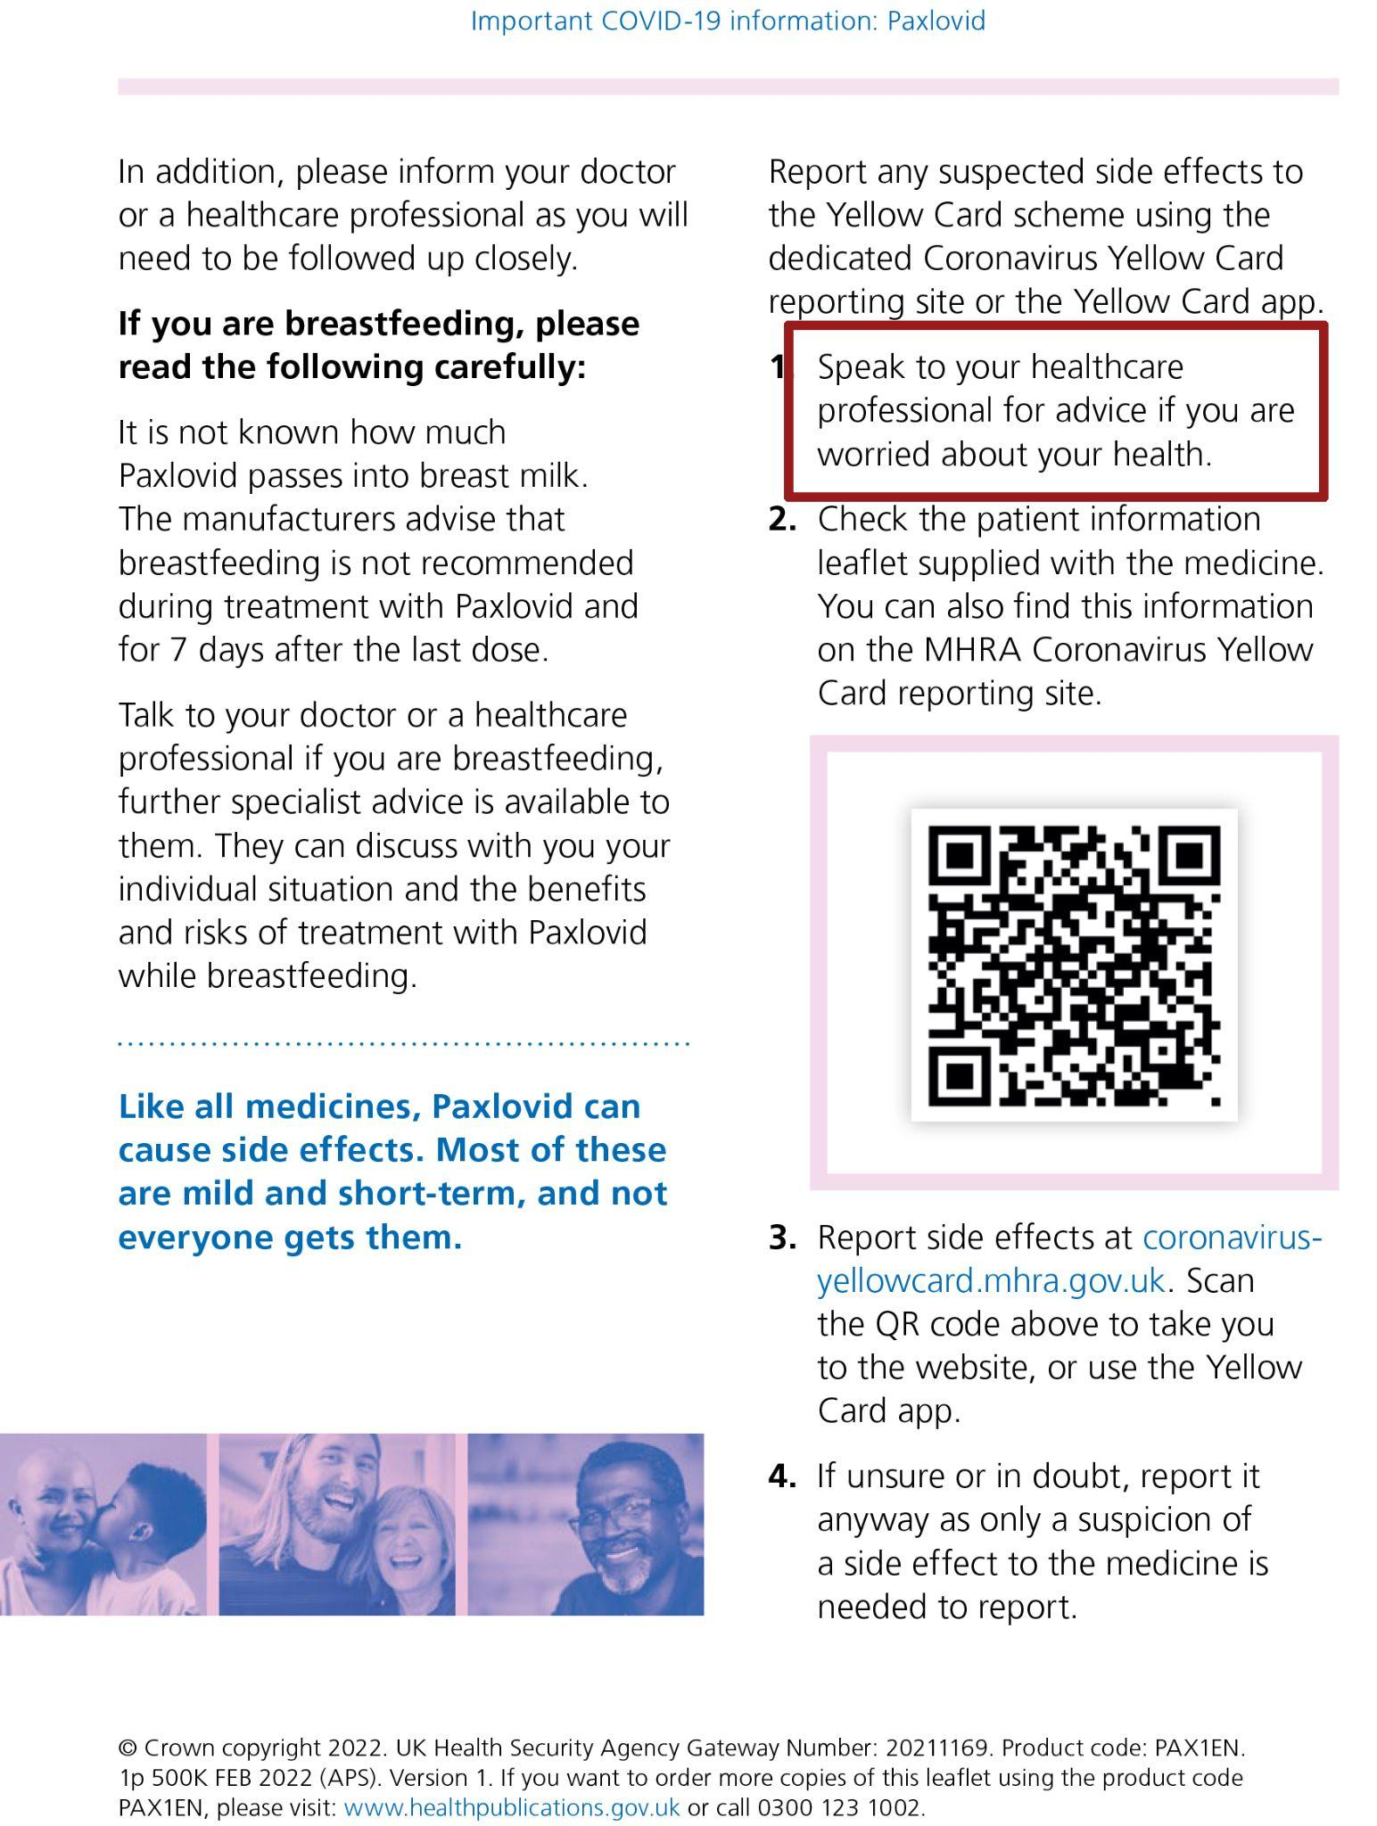
Analysis: How Power is Embedded in the Text
“Speak to your healthcare professional for advice if you are worried about your health.”
The person responsible for recognising a problem, deciding that it is serious enough and initiating contact
Different patients have different levels of “worrying”
Absence of critical health literacy
Promotes functional health literacy
Not encourage patients to evaluate evidence, question recommendations or participate actively in treatment decisions.
Notes:
The leaflet promotes functional health literacy by teaching patients how to take Paxlovid, identify possible risks and report side effects. However, it does not strongly promote critical health literacy. Patients are mainly instructed to read, disclose, comply and seek professional advice, rather than to evaluate evidence, question recommendations or participate actively in treatment decisions.
This reinforces an epistemic hierarchy in which institutions and healthcare professionals interpret medical knowledge, while patients are expected to follow that interpretation. The leaflet could reduce this imbalance by explaining uncertainty more clearly and encouraging patients to ask about evidence, alternatives, risks and how the treatment relates to their individual circumstances.

Slide 11
Street-Level Bureaucracy
(Lipsky 1980)
Street-Level Aristocracy

Slide 12
Analysing the Power
Knowledge within institutional settings is not merely informational but also structural and hierarchical (Foucault 1969). Certain actors are authorised to produce legitimate knowledge, while others are positioned as objects of knowledge rather than subjects capable of contributing to it.
Contemporary medical discourse limits patients’ ability to participate in the discursive processes through which medical priorities, interpretations, and decisions are formed.
As a result, patients frequently report feelings of isolation, confusion, or lack of agency within medical encounters.
Health literacy is a question of who possesses the authority to define what counts as legitimate knowledge in healthcare.

Slide 13
In the school of Radical Democracy, power should circulate among the stakeholders, the question then becomes: how to make discursive power circulate within medical discourse between patients and professionals?
When the public is actively dis-empowered,
and the accountability is manipulated,
is this a form of epistemic violence?

Slide 14
References
Centers for Disease Control and Prevention (CDC) (2024) What is health literacy? Available at: https://www.cdc.gov/health-literacy/php/about/index.html (Accessed: 2 September 2026).
Foucault, M. (2002) The archaeology of knowledge. 2nd edn. Translated by A.M. Sheridan Smith. London: Routledge.
Fricker, M. (2007) Epistemic injustice: Power and the ethics of knowing. Oxford: Oxford University Press.
GeoData Institute, University of Southampton (n.d.) Health literacy: Prevalence estimates for local authorities. Available at: https://healthliteracy.geodata.uk/ (Accessed: 2 September 2026).
HM Revenue & Customs (2026) Table 3.15a: Income and tax by Parliamentary constituency, confidence intervals. Available at: https://www.gov.uk/government/statistics/income-and-tax-by-parliamentary-constituency-confidence-intervals (Accessed: 2 September 2026).
Lipsky, M. (1980) Street-level bureaucracy: Dilemmas of the individual in public service. New York: Russell Sage Foundation.
UK Health Security Agency (2022) COVID-19 antiviral treatment: Paxlovid. Available at: https://www.gov.uk/government/publications/covid-19-antiviral-treatment-paxlovid (Accessed: 2 September 2026)

Slide 15
RGS-IBG Annual International Conference, London, UK, 1-4 Sep 2026
Muted Voices In Health Literacy:
How Discursive Power Produces Epistemic Injustice In Urban Healthcare
Sing Hang Tam
Lecturer in Emerging Digital Technologies
University of the Arts London
s.tam@arts.ac.uk
Yuet Yam Wong (Anita)
Librarian
Whittington Health Library
yuet.wong1@nhs.net

