Slide 1
Co-creating evaluation for future pedagogies
Track - Partnering with Students as Co-Creators of a Future Higher Education
Dr. Frania Hall, University of the Arts London.
RAISE conference, 9th September 2026

Slide 2

Introducing me
Course leader Publishing
Teaching and Learning Lead Media School
1470 students
8 undergraduate 9 postgraduate courses
Evaluation project funded for 4 years so far – for staff participation and student engagement

Slide 3
Presentation
Setting the scene and theoretical context
The workshops
The initiative
Implementation and impacts

Slide 4
Setting up the challenge
WHAT DOES EVALUATION MEAN FOR YOU AND YOUR STUDENTS?
In the context of teaching and learning

Slide 5
Evaluation is important for
Understanding what works
Evidencing effective pedagogical approaches for future decision making and resourcing
Assessing effectiveness of teaching innovation
Supporting continuous improvement
Reporting robustly on teaching and learning activities – inc. formal reporting
Enhancing Educational Excellence
AND Celebrating staff achievements and innovations

Slide 6
But
To students and staff it can look:
Performative
Does not necessarily yield information that is very useful
Is often a snapshot of a particular moment in time
Does not reflect learning as it is happening
Is often not inclusive

Slide 7
Beyond the survey
Moving towards creative, context-specific and rigorous course evaluations to cultivate evaluative mindsets and an evaluative culture
‘Encourage teachers to claim the right to valid, rigorous and creative approaches to the evaluation of their courses and teaching’
Nygaard and Belluigi, 2011:690

Slide 8
Partnership approach
Partnership in undertaking evaluation
2. Partnership to design evaluation tools
Students and staff connect through dialogic, qualitative approaches to evaluations
Use varied, context-appropriate tools for feedback and discussion
To ensure tools are inclusive and meaningful to students
co-creation sessions bring new tools and ensure connectivity

Slide 9
Co-creation workshop with students
2 workshops run
  one on evaluation process and how to embed it
  one on developing new tools to capture feedback
Students seek timeliness, regularity, relevance to learning, qualitative depth and relationship-building
There is fluidity between students evaluating their own learning and evaluating the progress of the unit itself

Slide 10
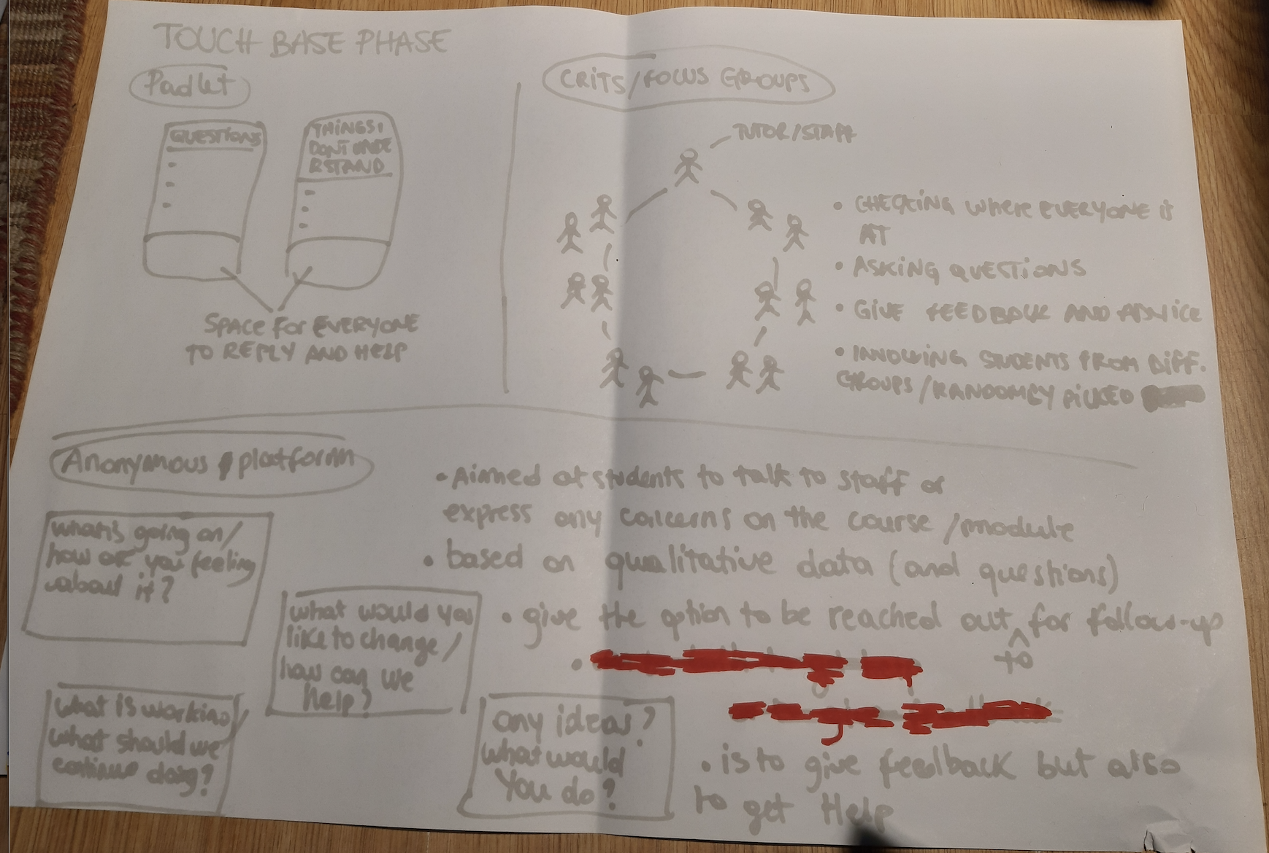
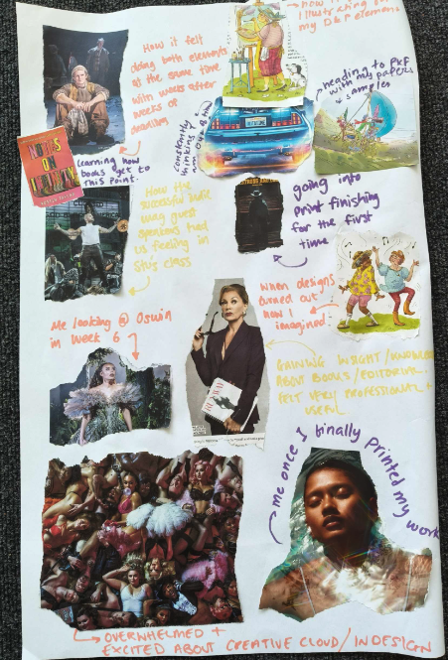
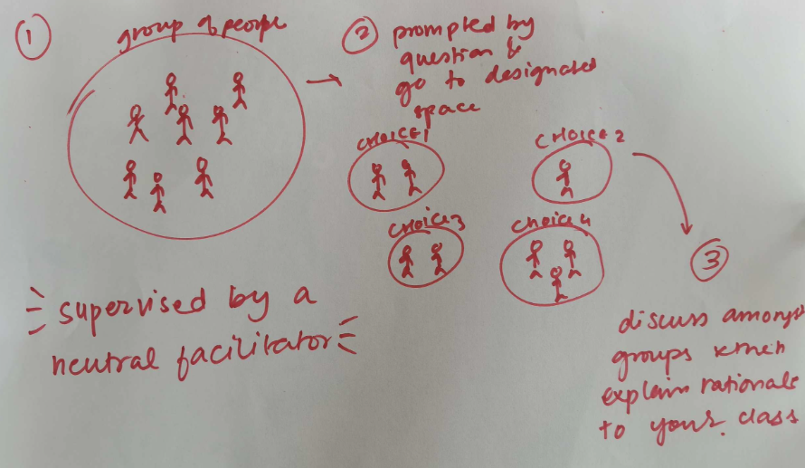
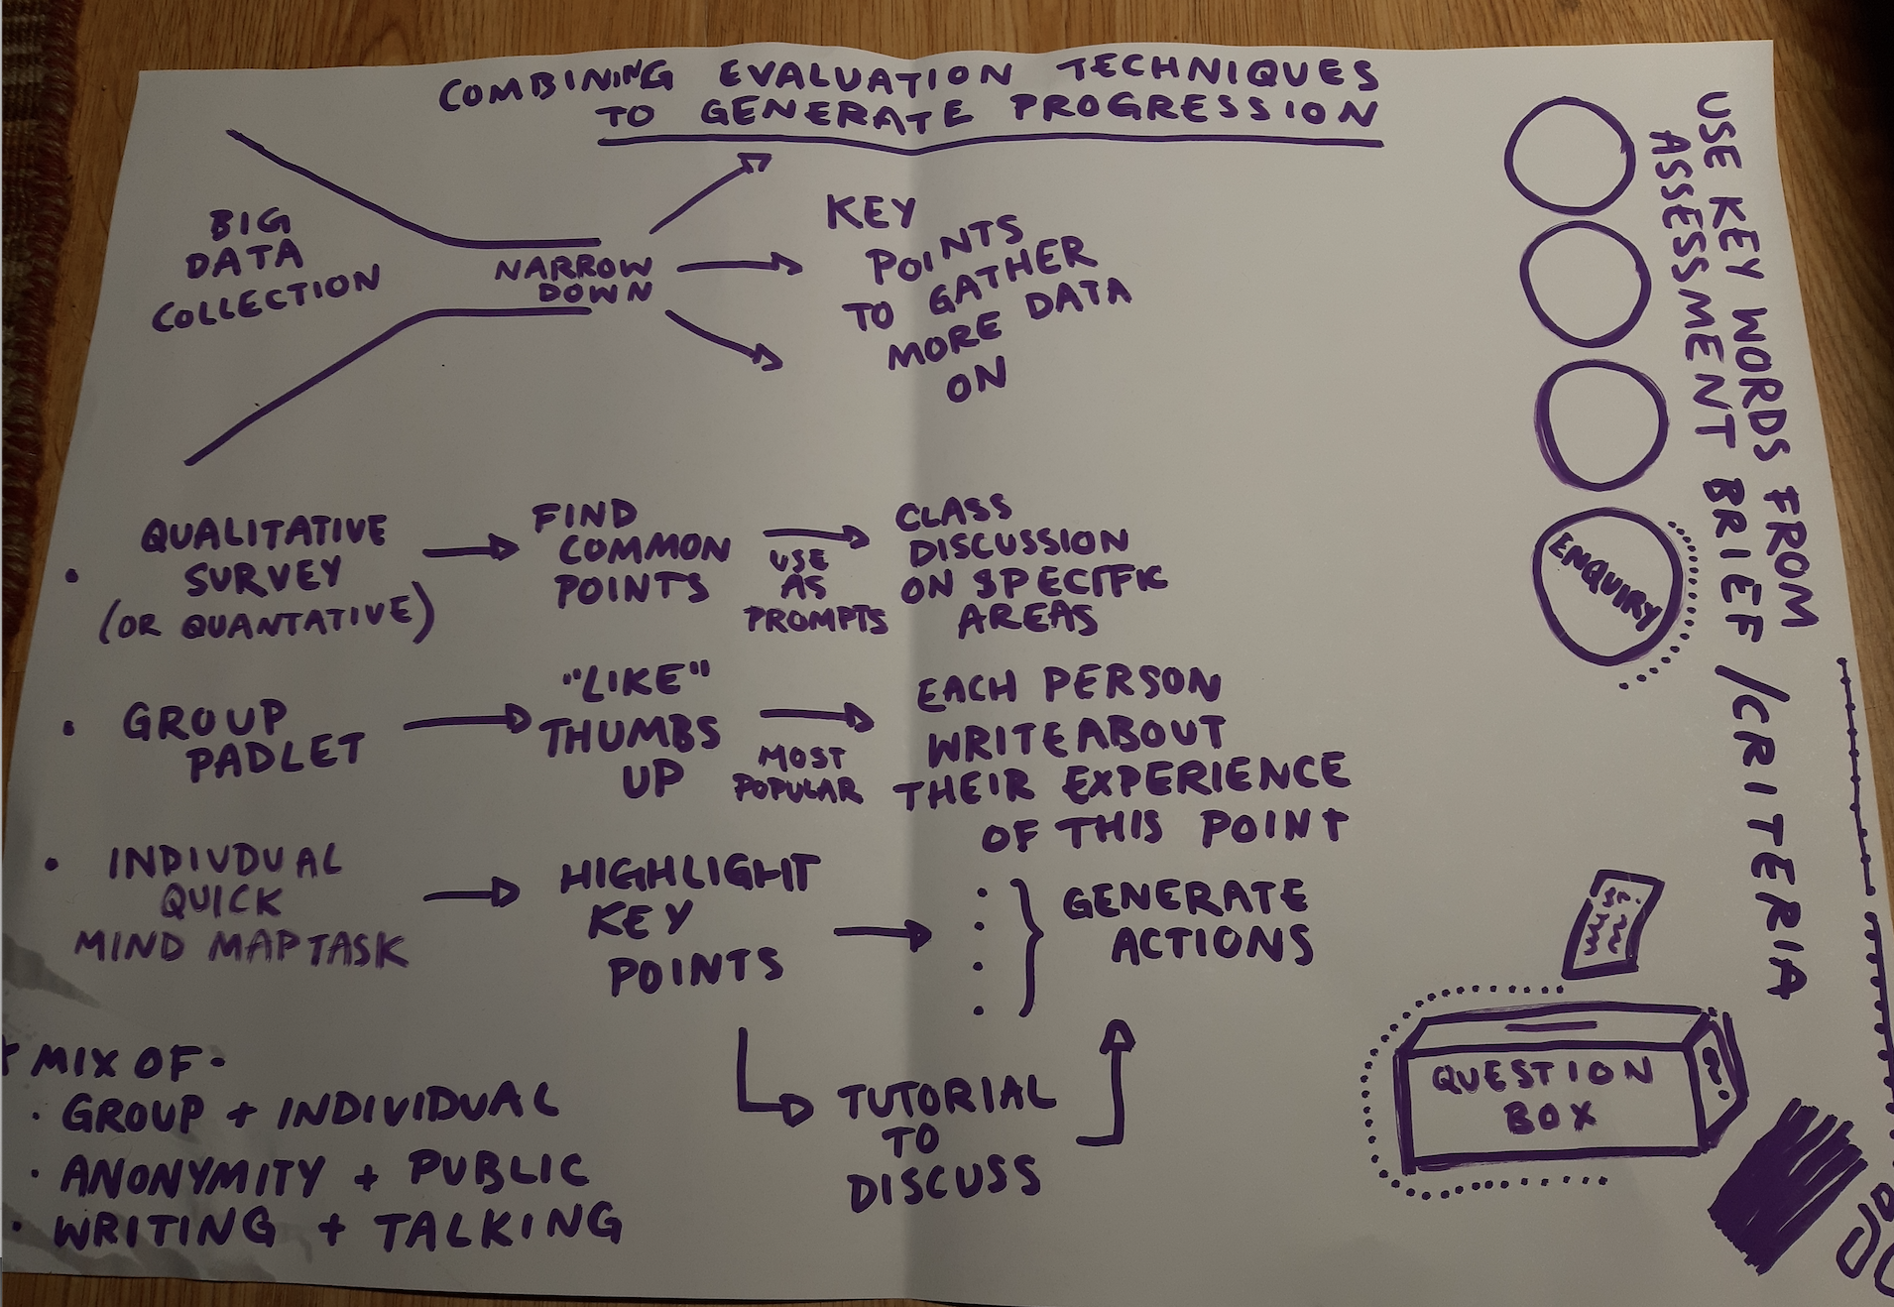
Workshopping activities
Embedding the process
Creative tools for gathering feedback

Slide 11
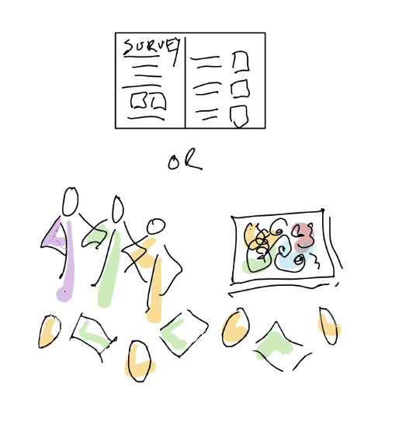
What students want
Inclusive – capture more responses from wider range of students
Varied – avoid surveys – it is difficult to articulate what want to say
Making it meaningful – a reflective moment on own journey
Timeliness and value – happening at moments where adjustments can be made in real time and feed forward
Embedded – easy to integrate into a teaching session
Developing learning literacies

Slide 12
Staff/Student evaluation alignment
Students:
Reflect on learning as they progress through unit, identify areas to focus on, develop learning literacies
Staff:
See how learning happens, assess effectiveness, identify what works/doesn’t work based on evidence, adapt ongoing

Slide 13
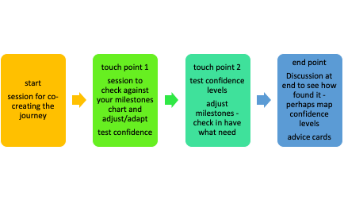
The initiative – designing evaluations
Design: Designing bespoke evaluations using the self-directed design form sensitive to context
Execute: Deploying interactive qualitative touchpoints embedded in normal class sessions.
Analyse & Reflect: Analysing qualitative findings systematically to make immediate, responsive changes and share best practice

Slide 14

https://positiveevaluation.myblog.arts.ac.uk/
Open Educational Resource – including tools, projects and resources
Positive because it makes evaluation a positive, meaningful and productive experience for staff and students

Slide 15
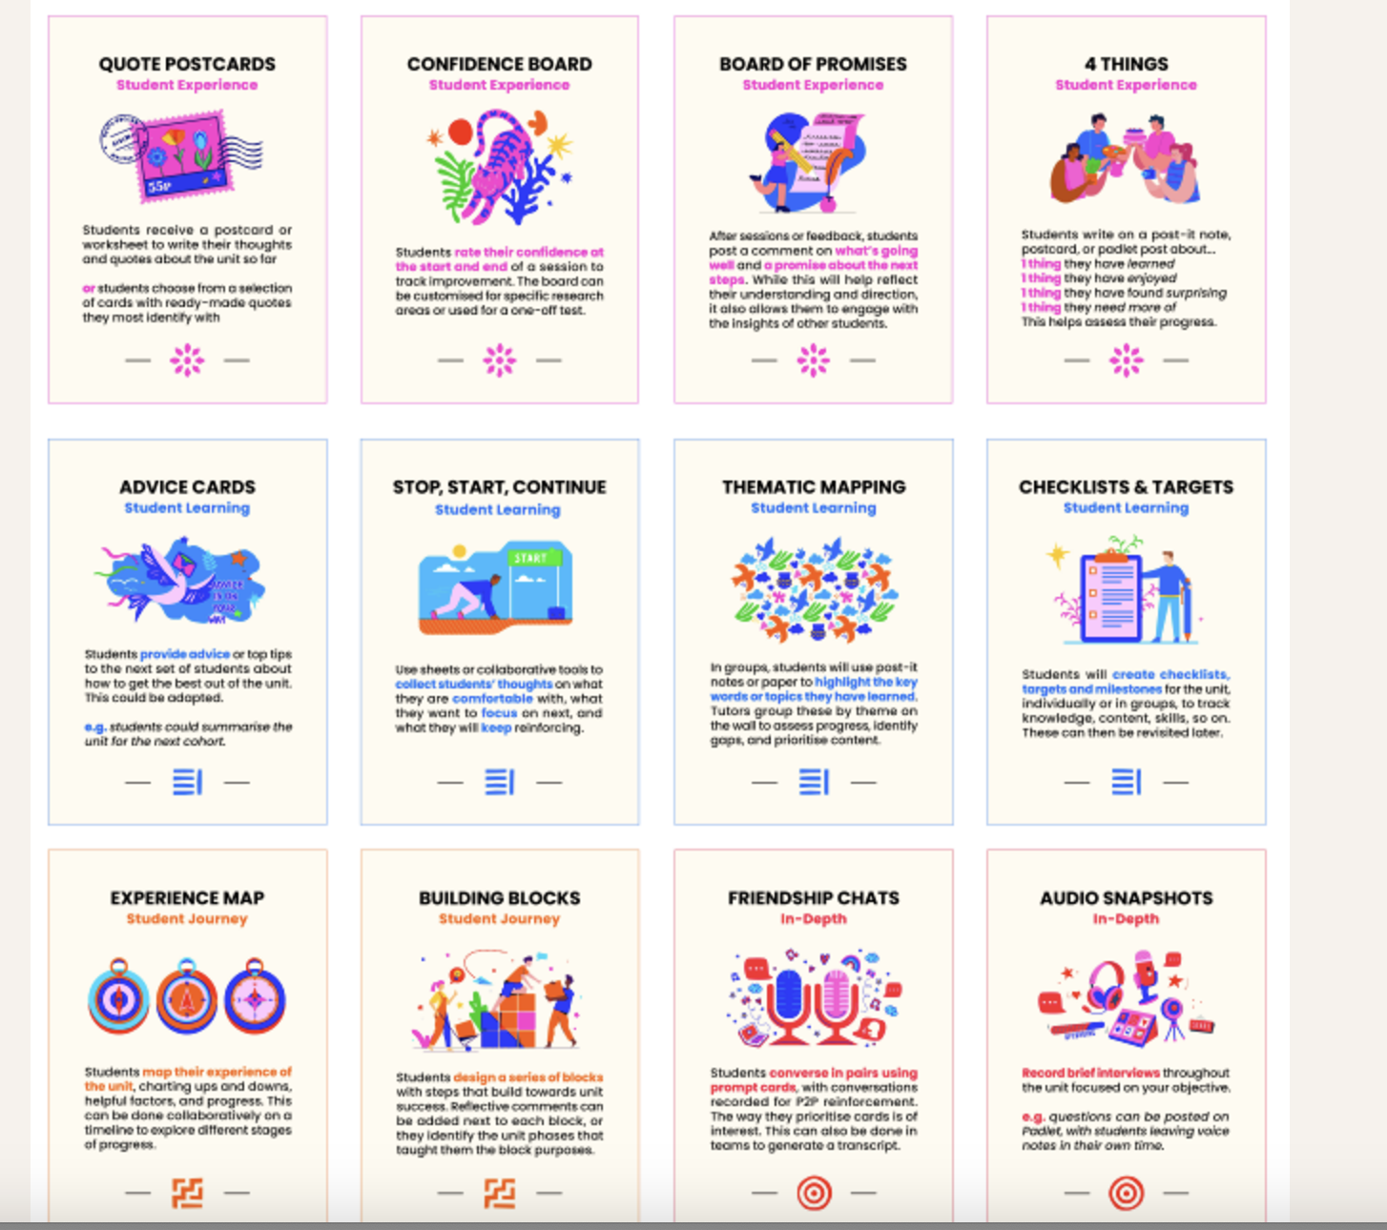
Evaluation toolkit
Deck of 12 activities to capture student voice

Slide 16
The partnership approach
Co-creating progress of units with students
Engaging students in reflection and conversation
Making evaluation helpful now
Embedded into student journey of unit/session
More inclusive data gathering
Developing learning literacies
*Above all - avoiding surveys*

Slide 17
Evaluation projects
Projects are chosen for a number of reasons:
  Significant redesign
  Year on year development
  Specific initiatives – big and small that need testing
  Developing a theme – eg teaching through co-creation
All include a research question to test specific aspects (eg learning journey, student engagement, community and belonging

Slide 18
How has this been used?
OPERATIONAL SCALE
20+ Projects
Embedded fully funded evaluation projects across the Media School.
28 Academic Staff
Directly engaged in developing, running, and analysing touchpoints for curriculum enhancement.
700+ Students
Impacted directly via active, contextualized feedback channels that have improvements in curriculum.
INCLUSIVE VOICE
800+ Data Points
Rich, qualitative and quantitative feedback points collected across diverse cohorts
400+ Students
Participating actively in dialogue, avoiding 'survey fatigue' and capturing representative student views.
Evaluative Mindsets
Shifted institutional culture from retrospective administrative tick-boxing to active, real-time learning partnerships.
3. MEASURABLE OUTCOMES
Example Research Project initiatives
91% Draft Rate
unit following timetabled writing retreats and structured milestone checking.
72% Confidence
Reported by students as they navigated assessments.
60% ➔ 72% attainment
Significant increase in average student attainment in the Research Project unit achieved over a sustained 3-year period.

Slide 19
Longer term impacts
Empowerment and capacity building
Empowers staff to design and run evaluations that work for them
They know the context and can draw it into their evaluations
Student partnership
Opens up on-going discussions with students about their learning progress
Transparent and dialogic
Close the Loop
Data is quickly aggregated, analysed and discussed.
Reported to students with real-time adjustments
Building a collective evidence base of what works.

Slide 20

Next steps
Reinforcing – this is evaluation – not just a feedback session – data collated and systematically analysed
Getting specific – co-creating with students an evaluation strategy for a specific unit
Continuing to develop more inclusive approaches – using the creative languages of the students – eg Collaging, Physical five, Emoji mapping, Collaborative drawing
Experimenting with presentation of data –
For stakeholders

Slide 21
So -
With students as co-creators on the educational journey, evaluation is not a passive space for them but a place to mould and develop educational futures.

Slide 22
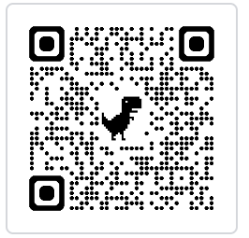
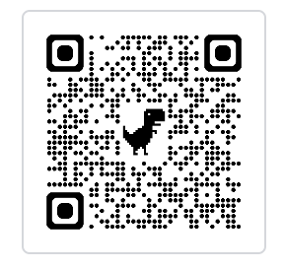
Thank you
blog
I am very interested in collaborating and am building a network – exploring creative inclusive evaluation
We are currently conceptualizing the ‘anti-survey’ and running workshops on alternative methods built on student collaboration
Resource: https://positiveevaluation.myblog.arts.ac.uk/wp-admin/
Podcast case study: https://positiveevaluation.myblog.arts.ac.uk/podcast/
Do get in touch: F.hall@lcc.arts.ac.uk
podcast

